Slide 1
Culturally responsive Tier 1 classroom management
Presented by Betty White, Med., LPC-S, CSC
www.bettywhitelpc@gmail.com
www.kidtools.net

Slide 2
Where are you?
What assumptions do you find yourself making about others?
What are your conscious biases?
What are your unconscious biases?
Do you sometimes form opinions about others before you really know them?
What pre-determined feelings and expectations do you have about a particular culture or class?

Slide 3
Where is your school?
Name 3-5 different cultures in your school. List them on a piece of paper
Write a couple of characteristics that come to mind when you think about that culture.
Where did you develop these ideas about that culture?
In what ways might you alter how you treat people based on these impressions?
Think about a time when someone made an assumption about you. It may have been based on age, ethnicity, religion, profession, gender, socio-economic status, etc. How did that make you feel?

Slide 4
Before embarking
Before embarking on changing the way your school approaches TIER 1, you need data. Look at ODR’s (office disciplinary referrals), ISS (in school suspension), DAEP placements, Detentions, and Out of School suspensions in view of your school’s cultural makeup. Are students in various cultural groups being disciplined at similar rates? If you find that children in certain groups are more likely to have disciplinary consequences, then changes are necessary. Children out of class are not learning, and they get further and further behind and are more likely to suffer even more disciplinary consequences.

Slide 5
Before embarking
While it is necessary to honor and respect our student’s cultural heritage, it is also important to help our students to become “culturally bilingual”. It is possible to recognize and respect cultural heritage while simultaneously helping students to learn about other cultures and how they can honor and respect them, as well as how to conduct themselves in different settings. For example, in certain families, talking loudly and responding to dialogue while watching movies may be the norm, but in order to participate in formal movie settings, these individuals must learn to respect others and be quiet.

Slide 6
Remember…
TIER 1 is the baseline. These are the interventions offered to ALL students. TIER 1 is about providing an atmosphere that allows teachers to teach and students to learn. This includes students with various cultural backgrounds and identities, different ability levels, and so on. Providing a culturally responsive environment allows more students to be successful at this level.

Slide 7
What is culture?
Culture is the customs, arts, social institutions, and achievements of a particular nation, people, or social group. It is a large and mostly diverse set of mostly intangible aspects of social life. It consists of the values, beliefs, systems of language, communication, and practices that people share in common.

Slide 8
What is culturally responsive classroom management?
An approach that guides the decisions teachers make as to classroom management
Teachers who recognize their biases and values and reflect on how these influence them
Teachers who recognize that the goal of classroom management is not just compliance or control, but to provide all students with equitable opportunities for learning
This Photo by Unknown Author is licensed under CC BY

Slide 9
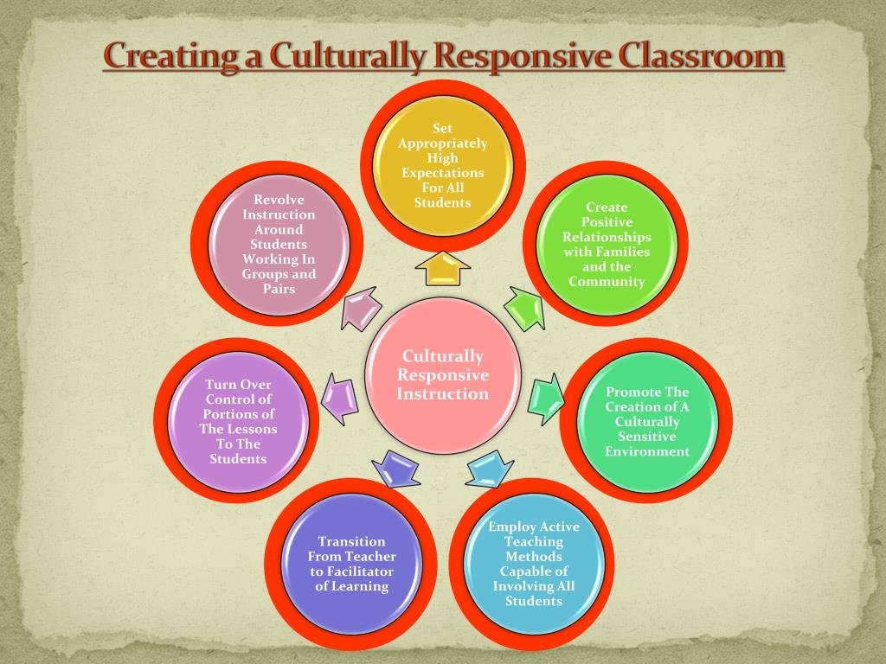

Slide 10
Cultural Differences in the Classroom
Cultural differences are particularly important to understand as the U.S. student population becomes more and more racially, ethnically, and linguistically diverse. In the 2017–2018 school year, 53 percent of elementary and secondary students identified as a race or ethnicity other than white. On the other hand, during that same period 79 percent of public school teachers were white and non-Hispanic. Even in schools where the majority of the student population was from diverse racial or ethnic populations, the majority of teachers were white. This disparity in cultural and racial backgrounds and experiences can lead to unique challenges and potential misunderstandings.
Source: National Center for Educational Statistics (NCES)

Slide 11
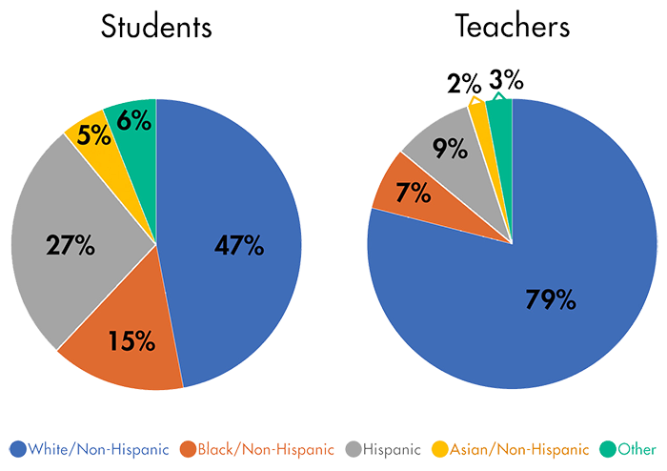

Slide 12
Another look at culture
While we tend to look at culture from the standpoint of ethnicities, there are many other cultures to be considered as well. Ruby Payne made famous the “culture of poverty” and highlighted differences in language, beliefs, and skills between those who lived in poverty, in middle class, and in upper class. LGBTQIA or LGBTQ+ culture is a culture shared by lesbian, gay, bisexual, transgender, and queer individuals. While they come from a variety of backgrounds, they share certain commonalities. Not all individuals in this group are immersed in the culture for a variety of reasons, but the culture exists.
What are some of the other cultural groups in your school or community?

Slide 13
Cultural Gaps
In the United States, the educational system “appropriate behavior” typically reflects middle class, white cultural norms. These norms are demonstrated in school district policies and practices, as well as expectations for classroom behavior, communication, classroom dynamics, and family engagement. As student populations becomes more diverse, differences in these factors produce what are known as cultural gaps.

Slide 14
Identifying these gaps
Respect for authority figures
Teachers are automatically regarded as an authority figure (based on role/position or age). | As a new member of the community, teachers must earn respect.
Relationships with community
Teachers are expected to collaborate with family members or community elders. | Students and families expect teachers to act independently.
Interpersonal space
Standing very close to someone when speaking is seen as violating personal space. | Standing very close to someone when speaking indicates a close relationship.

Slide 15
Identifying these gaps
Eye contact
Eye contact conveys listening. | A lack of eye contact indicates deference or respect.
Verbal interactions
Verbally conveying information in a direct and assertive manner is valued. | Verbally conveying information in an indirect and passive manner is valued.
Providing directions
Providing directions in the form of a question (e.g., “Can you join us for group time?”) implies an expectation to comply. | Providing directions in the form of a question implies an expectation of choice or an option to decline.

Slide 16
Identifying these gaps
Student engagement
Students who listen and remain quiet are respectfully engaged. | Students who actively participate are engaged.
Family engagement
Families who participate in school events are considered to be interested and involved in their child’s education. | There is a clear distinction between the role of the teacher and that of the family: Academics is the sole responsibility of the teachers while families provide instruction on skills and knowledge needed at home and in the community.

Slide 17
Learning About your student’s culture
Classroom meetings (circle times) allows you to get to know your students and their family traditions, interests, and behavioral expectations.
Ask questions-respectfully. If there appears to be a cultural gap, or there has been a misunderstanding, talk to the student (in private) to learn about the situation and give some sense of control back to the student.
Find out as much you can about their families. Meet their parents. Ask questions about what the families educational expectations are. Home visits??
Interact with the students in non-teaching settings and in the community.
Bring student’s culture into the classroom when possible.

Slide 18
Essential Elements or Culturally Responsive Classroom Management
Weinstein, Tomlinson-Clarke, and Curran (2004) developed a 5 part concept of CRCM
Recognition of one’s cultural lenses and biases
Knowledge of students’ cultural backgrounds
Awareness of the broader social, economic, and political context
Willingness to use culturally appropriate strategies
Commitment to building caring classroom communities

Slide 19
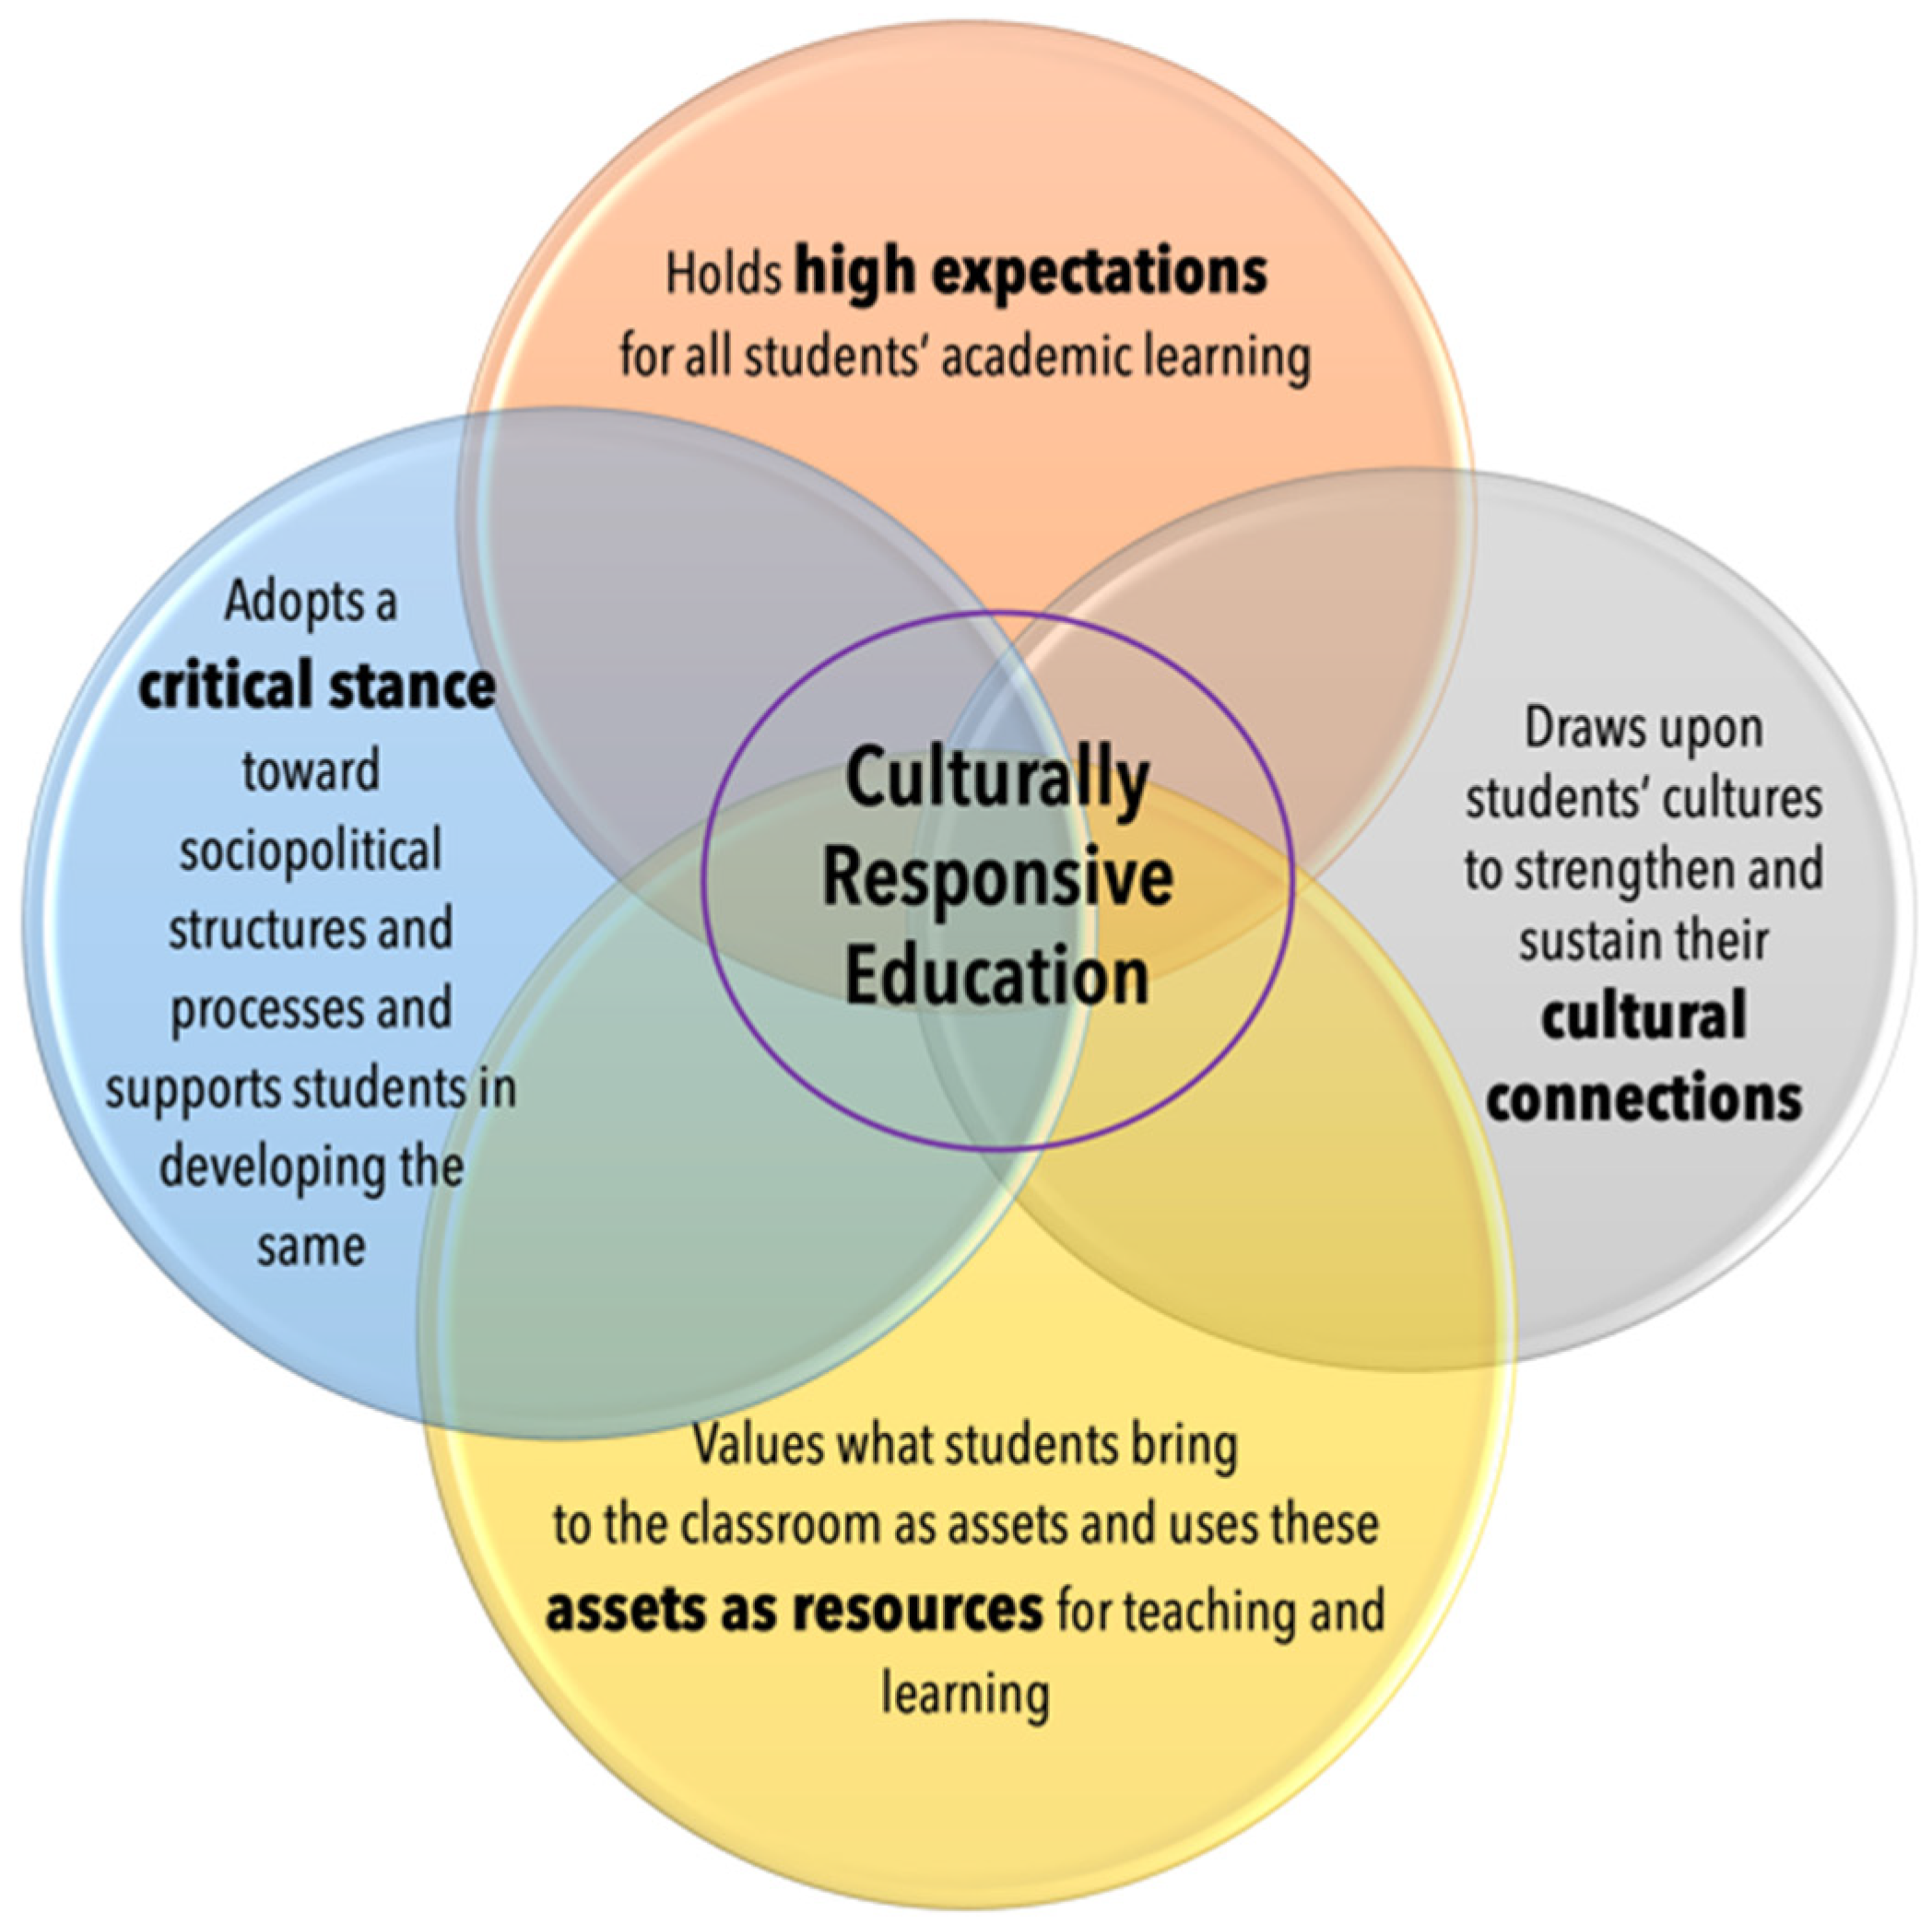

Slide 20
Culturally inclusive language
Using respectful and preferred language when talking to and about our students and stakeholders
This includes using and correctly pronouncing preferred names and pronouns
Checking with individuals as to how they wish to identify with their nation or group: Guatemalan vs Latinx vs Hispanic vs Latina(o) Dine’ vs American Indian vs Navaho vs First Nation

Slide 21
Culturally inclusive language
Person first language: a student with autism, a person with a disability
Preferred language regarding gender. Some students may use genderqueer rather than transgender. Most have a preference and will let you know what it is.
Place of worship instead of church, parents or guardians or adults who love you instead of mom and dad, everyone instead of ladies and gentlemen
What if I get it wrong? Just apologize and move on. Do not make a big deal out of it.

Slide 22
Without connection, there is no cooperation:
Interview your students orally or on paper
Give assignments that allow students to share their experiences and interests
Provide opportunities for students to be the center of attention in classroom discussions.
Attend extracurricular events and community gatherings where your students and families gather as much as possible.
Ask questions about their families and culture in respectful ways. Query them about their educational and behavioral expectations.
Highlight culture in various ways on the campus.

Slide 23
Creating empathy, Responsibility, and sensitivity in the classroom
Create a culture of communication. Talk with students, not just to them. Allow time for sharing on a daily basis.
Provide sharing times for the class to share as a group.
Intentionally engage with students about their lives, and remember and reference what they tell you.
Engage with parents at every opportunity, not just when there is a problem.
Use mediations to help students solve conflicts in appropriate ways.

Slide 24
Creating empathy, Responsibility, and sensitivity in the classroom
Restorative Mediation
Facilitate the mediation. Set a positive tone. Use open ended questions to guide the discussion.
The usual pattern is: One party shares what happened while you and the other party listen. Then the second party shares. After both have shared, they each have a chance to respond to the other, using assertive, not accusatory language.
Next, the parties, with guidance, decide upon a plan of action. As the facilitator, you will summarize and record the plan of action. Check in with students to see that the actions are carried out.

Slide 25
Creating empathy, Responsibility, and sensitivity in the classroom
Classroom Expectations Instead of Rules
Use a class meeting format to establish expectations for the class. These can be called expectations, guidelines, or a social contract.
Rules are usually narrow and establish what not to do
Expectations are broader and establish what to do
Examples:
Engage in productive work. (Do your work.)
Maintain a safe and clean environment. (Keep things neat and safe.)
Share space and materials.
Allow me to teach and others to learn.

Slide 26
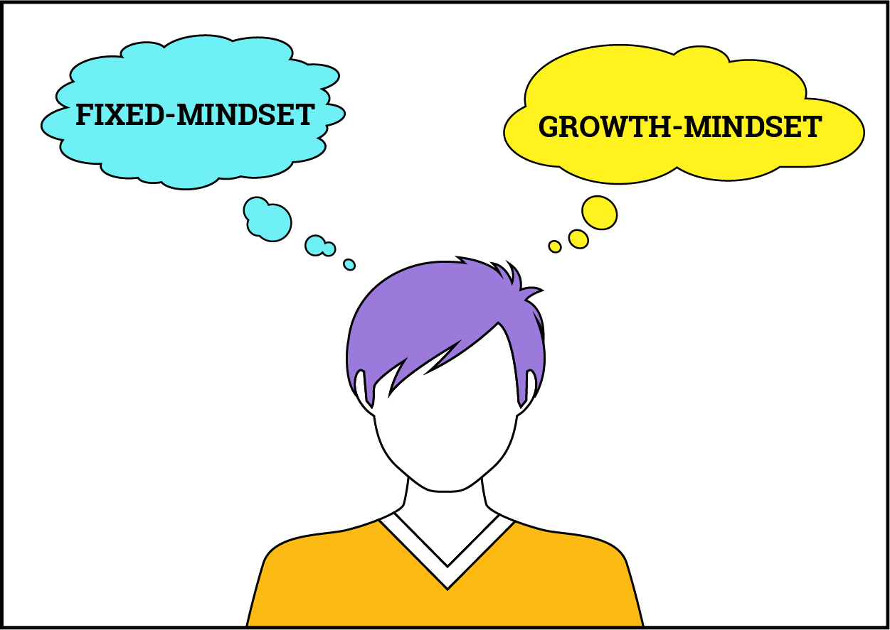
Creating empathy, Responsibility, and sensitivity in the classroom
Growth Mindset-Help students to develop a growth mindset by using the following techniques:
Have them recall something they could not do in the past but now find easy.
Have them draw or write some of the things they did in order to get better
Explain to them that they were displaying a “growth mindset” and that is why they were able to get better over time.
Model the growth mindset on a regular basis.

Slide 27
Creating empathy, Responsibility, and sensitivity in the classroom
Help students learn to recognize and manage their own emotions. This involves a constant dialogue with students to help them recognize emotions, label them, and manage them. There are lots of commercial programs that facilitate this, but is can also be done without a program. This is not just a counselor issue.
To help students manage emotions, they need to understand and practice mindfulness. This involves slowing down, feeling the feeling, taking time to calm and manage the feeling. Teaching students how to do body scans and relaxation and breathing techniques are essential.

Slide 28
Creating empathy, Responsibility, and sensitivity in the classroom
Cultivate empathy with your students.
Help students learn how to read body language and facial expressions
Teach students assertive language techniques such as “I statements”
Teach students reflective listening
Actively reject stereotypes and explain why you reject them
Humanize the curriculum and bring in examples students can relate to
Encourage students and provide opportunities for them to bring their culture into the classroom
Teach what empathy isn’t: overidentification, unsolicited advice or help, pity, fixing

Slide 29
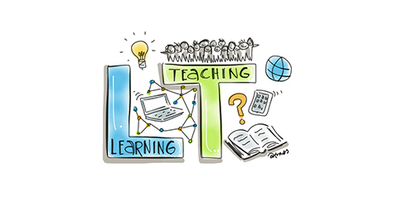
Inappropriate behaviors
When a behavior is noted that is not up to the classroom expectations, ask yourself 2 questions:
Can I teach?
Can the other students learn?
IF the answer to these two questions is YES, then there is no reason to call out the behavior.

Slide 30
Inappropriate or unexpected behaviors
First ask yourself, “Is this behavior one that would be considered culturally appropriate in this child’s family or cultural group?” If so, consider how to address it with understanding and compromise, through individual counseling about the issue, and possibly by addressing it with the whole class.

Slide 31
Inappropriate or unexpected behaviors and understanding
Mrs. Jones requests that a student look her in the eye when he is being disciplined. He continues to look down.
A Hmong boy is very anxious about going into his classroom with non-Hmong (white) peers.
A preschool girl’s mother is upset when her daughter is barefoot and demands that she keep her shoes on at all times.
A parent of a 4th grade student will not allow her to go on a field trip that requires an overnight stay.
A student, while quite compliant and hardworking at school, never returns any homework.

Slide 32
Questioning as an intervention
Capturing Kid’s Hearts uses a specific questions method to help students examine their behavior. Those questions are: What are you doing? What should you be doing? Are you doing it? What are you going to do about it?
Time to Teach is a culturally sensitive program that also uses questioning. While it varies by level, the questions are: What did you do? (What was your behavior?) What did you want? What will you do next time? These questions are answered privately and the student returns to class when they have a plan to change their behavior.
Utilizing individual questions about behaviors give students agency over their behavior.

Slide 33
Creating empathy, Responsibility, and sensitivity in the classroom
Develop and use circle processes

Slide 34
Circle Processes
One way to incorporate culturally sensitive practices into the schools is through circle processes. Circles can range from simple classroom “meeting” circles used as a way to both get to know students and allow students to get to know each other, to more complex restorative justice circles. Circles are an important part of culturally sensitive behavior management practices in schools.

Slide 35
Why Circles?
Schools who have incorporated circle processes, up to and including restorative justice circles, see a decrease in student misbehavior. Talking circles promote school safety at all levels. To find resources and data to support these practices, go to:
https://www.edutopia.org/school/glenview-elementary
(videos and information about dialogue or talking circles in elementary)
https://www.tolerance.org/magazine/talking-circles-for-restorative-justice-and-beyond (information about restorative justice at middle school)
https://www.kipp.org/news/giving-kids-say-schools-switch-suspensions-restorative-justice/ (information about restorative justice practices at HS level)

Slide 36
Philosophy of Circles
The underlying philosophy of circles is build around the idea that we are all in need of help as we navigate life events and that helping others helps us at the same time. Participants are simultaneously both givers and receivers. Circles arise from ancient traditions all over the world. They are also called peacemaking, restorative, and healing circles.

Slide 37
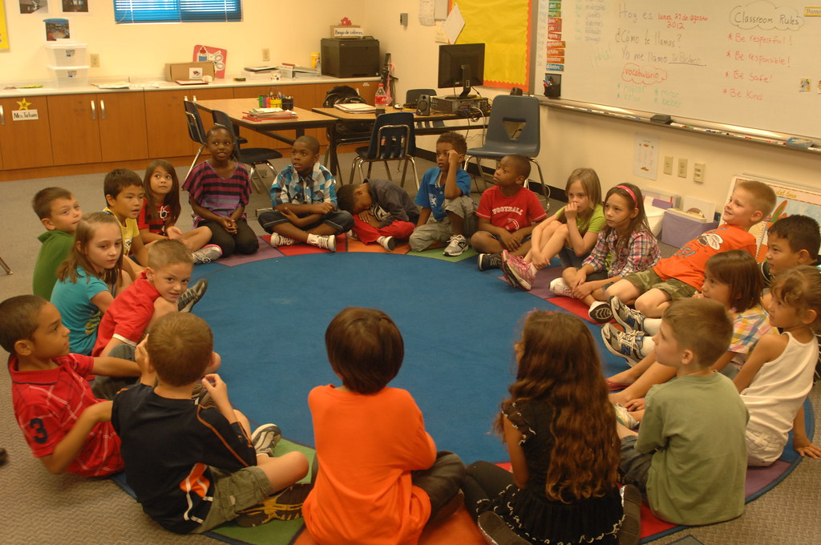
Characteristics of Circles
Circles are a way of bringing people together. In a circle, everyone is:
Equal
Respected
Allowed to talk without interruption
Allowed to tell their stories
Allowed to share various aspects of their experience without judgement

Slide 38
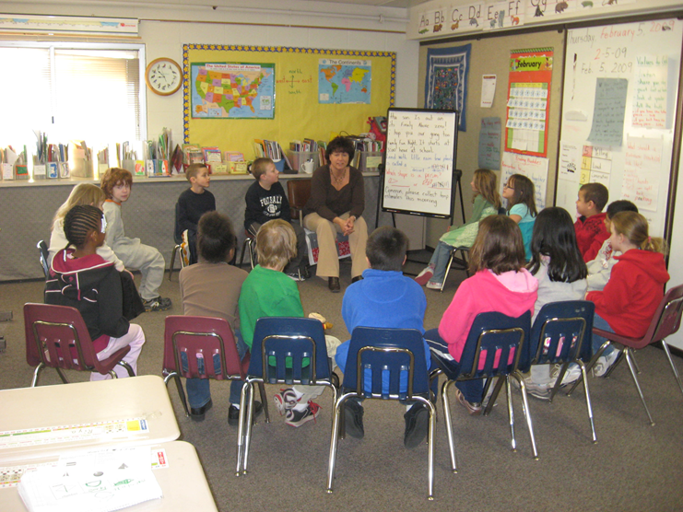
Philosophy of Circles
Circles, whatever their purpose, have certain underlying philosophies:
Every participant deserves honor and dignity
Every participant has something valuable to contribute
Within our universe, everything is connected in some way
Every participant deserves an equal voice
Emotional and spiritual expression are supported

Slide 39
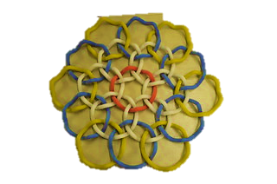
Functions of Circles
Circle processes are used when two or more people need to:
Work out a disagreement
Make decisions together
Address an adverse experience or injustice
Work together as a team
Celebrate
Share experiences, both positive and negative
Address restitution
Reinstate someone who has been excluded
Learn from and better understand each other

Slide 40
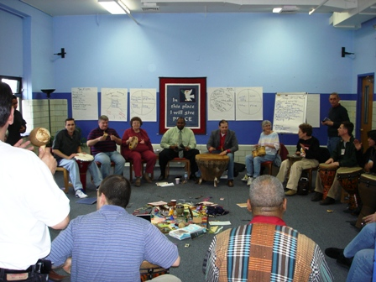
Beginning Circles
If your campus plans to begin utilizing circles for restorative justice or peacemaking, it is important the circles be introduced in all classrooms. A circle is a way to build relationships and to allow all members of the class to be heard. They can be simple check-in circles at the beginning of the day, launch of check-out circles at the end of the day, sharing circles as a way for students to get to know one another better, class meeting circles, re-integration circles for students who have been suspended, in ISS, or out with illness for a time, and problem solving circles. All circle processes have certain elements in common.

Slide 41
Requirements for Circles
There are certain requirements for circle processes. These include:
Shared values that are known to all members of the group
Ceremony-used in beginning and ending the circle
A talking piece
A facilitator or keeper
Guidelines known to all members
Consensus decision making

Slide 42
The Facilitator or Keeper
Most circles need a facilitator or keeper. The school counselor or classroom teacher is a logical choice. However, being a keeper is not like leading a group for any other purpose. Circle keepers must have:
Patience
Empathy
Humility
Deep listening
Acceptance of everyone as worthy of respect
Willingness to sit with uncertainty
The ability to share responsibility
The ability to move the group away from disrespectful or chaotic communication and back into the safe space of the circle without being authoritarian
The strength to communicate the safe, sacred nature of the circle through the beginning and ending ceremonies and through the communication of shared values
A circle keeper serves as a thermostat-not a thermometer

Slide 43
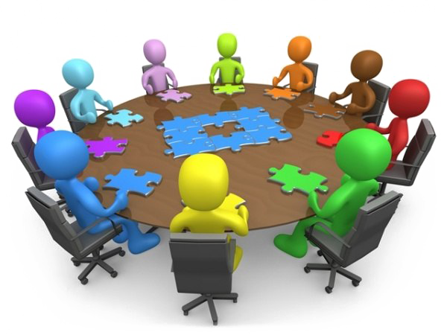
Circle Facilitators
Keep the group within a respectful space
Monitor quality and adjust as needed
Help the group to monitor quality issues and resolve them
Manage time in the circle

Slide 44
Circle Types
Sequential Circles
Real Justice Circles
Fishbowl Circles

Slide 45
Sequential Circles
Sequential Circles-In sequential circles, one person speaks at a time. The talking piece moves around the circle in one direction, and each person has a chance either to speak to the topic or to pass.
Sequential circles are structured around topics or questions raised by the circle facilitator. This format gives both quiet and louder voices an opportunity to be heard. Selecting topics and questions that are important to the group allows you to guide your circle, and give your participants a structured way of voicing their concerns.
Your job as a circle facilitator is to help guide your circle, but not lead it. Facilitators help keep the circle on track and insure that everyone has an opportunity to be heard, but do not pass judgement or steer the discussion.
Once students understand the circle process, you can permit them to initiate and carry out groups on their own. Often you can simply trust your students to go around as many times as necessary to deal with their issues.

Slide 46
Real (restorative) Justice Circles
Real Justice Circles are used when there is a victim (target, survivor, offended) and an offender.
When using real justice circles, the order of speaking is more structured. This circle usually consists of fewer people-the offender, the victim, a supporter for the victim, and a supporter for the offender. Additional supporters may be used.
Your participants still sit in a circle, and discussion is still lead by a circle facilitator. However, your order of speaking is not sequential. Instead, follow a specific speaking order. The general format most commonly used is: offender, victim, victim’s supporter, and offender’s supporter. The circle facilitator asks each person a set of restorative questions and listens to their response.
Once everyone has responded to the restorative questions, the circle transitions into a more open model of discussion. During this time, the circle discusses what the victim needs and how those needs can be met. Once you’re at this point, the previous order is broken down. Everyone is allowed to talk in a non-ordered discussion, adhering to the original guidelines.

Slide 47
Fishbowl Circles
Fishbowl circles are quite different than other circles. First, an inner circle of active participants is created using either a sequential approach or a non-sequential activity. Outside the inner circle are observers, arranged in as many concentric circles as are needed to accommodate the group.
Fishbowl circles are used when there are many active participants but it is impractical to have them all involved. Observers watch the circle activity and may comment on it, but aren’t active members of the circle.
To create a slight variation on this, place an empty chair in the middle of the room. Have your outside observers sit in the chair, one at a time, say something, and then return to the outer circle. This maintains a limited amount of participation by observers.

Slide 48
Initiating Circle Practices
Circles require training and preparation for all who are involved. Those who will participate in a circle, especially in a restorative or peacemaking circle, need to be fully prepared for the process to be effective.
The circle keeper(s) need to meet with all participants in advance. These pre-circle meetings are essential to determine if the circle process is appropriate for all concerned and if all concerned are willing to fully participate in the process.

Slide 49
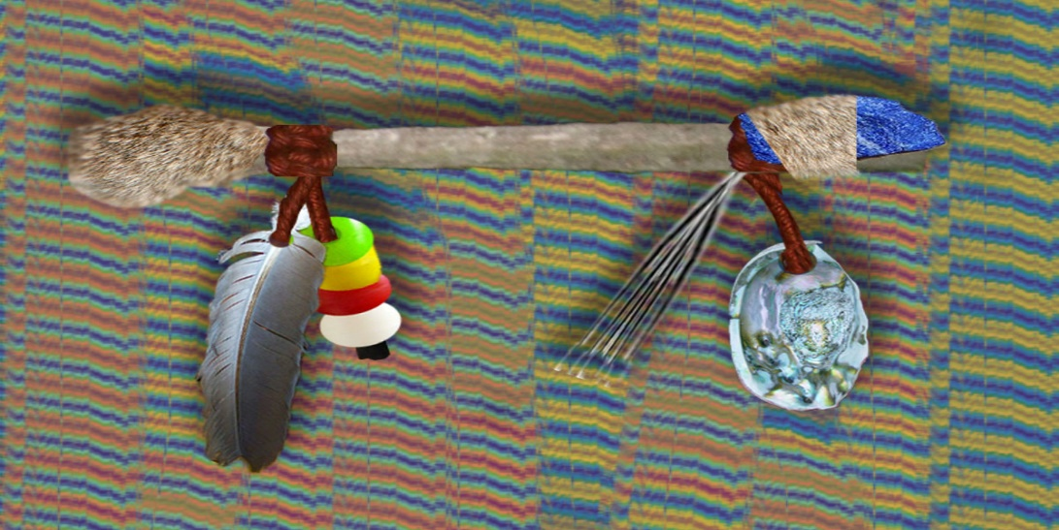
Preparing Participants
If you are planning circle practices as whole group or classroom processes designed to provide bonding and opportunities to discuss group concerns, it is necessary to introduce the idea to the whole group. In this meeting, it is appropriate to go over the general format of a circle, the importance of the talking piece, the purposes of the circle, and so on. It is not critical to set up the values for the circle at this time-that will evolve from the first circle meeting. However, it is important that you discuss confidentiality and the need for respecting the circle as a safe space. Remember, circle processes are not a secret, but we respect other’s sharing by not sharing outside the circle.

Slide 50
Specific Preparations
Determine logistics: when, where, what time?
Consider the talking piece and what might be in the center as a focus.
Decide upon an opening ceremony and how you will establish values.
Choose questions for the check-in round and further relationship building, if needed.
Consider questions for dialog about key issues and further probing questions
Select a closing ceremony.

Slide 51
Circle Essentials
Seating-the circle emphasizes the equality of all-with no barriers between participants
Opening and closing ceremonies-clear beginnings and endings allow participants to see the circle as a safe, special place that allows them to be themselves
Values-deciding upon circle guidelines/values bonds the circle in consensus on behavioral expectations and creates a safe space
Talking piece-helps to regulate interaction and insures that all have opportunity to speak. Allowing a group to construct a talking piece is also meaningful and bonding.
Center piece-the center piece, if used, can reinforce the values of the group or can be representative of the diversity of members of the group
Guiding Questions-help the group to go beyond the surface and engage meaningfully

Slide 52
Effective Questioning
Have participants speak from their own experiences; “How has this impacted you? How have you changed as a result of…? What has been hardest for you? What do you need in this situation? What help can you offer others?”
Have participants share life stories; “Tell about a time when you…”
Focus on feelings and impacts rather than just facts
Help participants recognize their strengths not just negatives
Help participants move from discussion of negative events to “how can things be improved going forward”

Slide 53
More Circle Essentials
Remember that many issues will not be solved in one circle. If you need to reconvene, reiterate the values from the first circle and do an opening ceremony and check in round before taking up where you left off
Allow the group to take responsibility “I don’t know where we go from here” than pass the talking piece.
Use breaks wisely-check in with members who seem to be struggling on breaks
Use questions to help guide the group back to the original issues, by encouraging participants to raise those issues
Suspend the talking piece if the group needs to brainstorm, problem solve, or dialogue informally. Be careful about why and how long you suspend the piece, as it is a part of the safety of the group that allows all voices to be heard

Slide 54
Circle Agreements
If the circle is making agreements, they are made by consensus.
Consensus means, “We can all live with it.” Rarely will you reach a consensus that all group members are enthusiastic about.
Group agreements need to be recorded in detail. Nothing causes failure more quickly than a lack of clarity about everyone’s responsibilities.
If agreements fail, reconvening the circle is the logical plan for addressing the failure.

Slide 55
Resources
http://fromdiaperstodiamonds.com/wp-content/uploads/2015/09/CIRCLE-KEEPER-HANDBOOK-REVISED-PRANIS.pdf Kay Pranis’s Guide to Circles
https://www.foresee.hu/uploads/tx_abdownloads/files/peacemaking_circle_handbook.pdf Guide to Peacemaking Circles
https://www.healthiersf.org/RestorativePractices/Resources/documents/RP%20Curriculum%20and%20Scripts%20and%20PowePoints/Classroom%20Curriculum/Teaching%20Restorative%20Practices%20in%20the%20Classroom%207%20lesson%20Curriculum.pdf Restorative practices from san Francisco Schools
The Little Book of Circle Practices (available from Amazon)

Slide 56
Bal, A. (2018). Culturally responsive positive behavioral interventions and supports: A process- oriented framework for systemic transformation. Review of Education, Pedagogy, and Cultural Studies, 40, 144-174.
Berliner, R., & T.L. Masterson. 2015. “Review of the Research: Promoting Empathy Development in the Early Childhood and Elementary Classroom.” Childhood Education 91 (1): 57–64.
Cressey, J. (2019). Developing culturally responsive social, emotional, and behavioral supports. Journal of Research in Innovative Teaching & Learning, 12, 53-67.
Leverson, M., Smith, K., McIntosh, K., Rose, J., & Pinkelman, S. (2016). PBIS cultural responsiveness field guide: Resources for trainers and coaches. Retrieved from http://www.pbiscaltac.org/resources/culturally%20responsive/PBIS%20Cultural%20Res ponsiveness%20Field%20Guide.pdf

