Slide 1
Supporting Student Mental Health and Wellness in the Classroom
Presented by: Betty White, MEd., LPC-S,CSC
bettywhitelpc@gmail.com
www.kidtools.net

Slide 2
Objectives for Today
Evaluate the challenges present in today’s schools that impact student mental health
Discuss the benefits of regular classroom guidance on student mental health
Evaluate your classroom guidance delivery and plan for improvement
Review trainings necessary for teachers and staff to be aware of student mental health
Consider whole school systems that help to improve staff and student mental health
Examine systems currently in place in your school that help improve student mental health
Develop a tentative plan for improving the mental health climate at your school

Slide 4
Your School
Find someone in the room who is not in your school. Take a few minutes to discuss the following:
The best thing my campus has as far as student mental health is………
The biggest weakness on my campus as far as student mental health is ……..

Slide 5
Student Mental Health
1 in 4 children and adolescents across 11 countries, including the US, experienced strong distress during the pandemic, with depression and anxiety being most common, but including behavior and attention problems in younger students
As many as 1 in 5 children ages 9-17 and 1 in 7 ages 2-8 have a diagnosable mental health condition
Diagnoses of depression and anxiety in children ages 6-17 rose from 5.4 % in 2003 to 8.4 % in 2012
In a survey of over 1000 U.S. parents, 20% said their child seemed more anxious, 19% said they were more irritable, and 14% said they seemed sadder than before the pandemic-71 % stated that the pandemic took a toll on their child’s mental health

Slide 6
Student Mental Health
The pandemic deprived students of connection with peers and educators and impacted social skills and feelings of connection
Over 140,000 (175,000) children lost a primary caregiver due to Covid
Non-white teens reported greater concerns about returning to school, including coping with grief or loss, food insecurity, economic insecurity, and mental health challenges
Schools note that students are acting younger than their age and are morel likely to manifest aggression and violence
There has been an increase in non-suicidal self injury among students
70 % of US public schools reported an increase in students seeking mental health services at school and 76 % reported an increase in staff reporting concerns about students exhibiting signs of depression, anxiety, and trauma at school

Slide 7
Your School
What changes have you noticed in student mental health since COVID disrupted our school system? Share popcorn style!

Slide 8
Teacher Mental Health
A survey of 4,665 pre-K through grade 12 teachers at public, private, and charter schools revealed the following:
81 % said overall workload has increased
80% said they spend more time dealing with students’ mental health
69 % said they were spending more time remediating student learning losses
58% said they had an increase in classroom interruptions during instruction
55% said they had less planning time due to staff shortages and other factors
Another assessment conducted by Miami University in Ohio showed almost 2/3 of teachers reporting emotional exhaustion, and 3 out of 5 reporting concerns with anxiety.

Slide 9
Teacher Mental Health
"I'm feeling at a zero, but I walk into the class and I have to pretend I'm at 100%," Quennie G., an elementary school teacher in Toronto, Canada who is currently on stress leave from her job, told Verywell. "I have to just do my thing, teach my lesson, be engaging, be supportive, be patient with them, but I myself feel like I'm pouring from an empty cup."

Slide 10
Your School
What changes have you noted in teacher mental health since our schools were disrupted with COVID? Follow the directions to get into groups, then choose one person to share as instructed.

Slide 12
Ideal World
In your ideal world, what are the things you would like to see on your campus to support student mental health in TIER 1? Write down your top 4. Share as directed.

Slide 14
General Strategies for Schools
1) Create mental health programming based on data-driven decisions.
2) Collaborate to address the mental health needs of students.
3) Provide a tiered system of mental health support.
4) Evaluate mental health services to ensure they are addressing the academic achievement gaps.
5) Communicate the outcomes to key stakeholders.
From the article, Five Strategies to Develop Mental Health Models in Schools, Dakota L. King-White, March 12, 2018
https://ct.counseling.org/2018/03/five-strategies-develop-mental-health-models-schools/

Slide 15
What is Needed: TIER 1
Frequent classroom guidance presented or facilitated by school counselor
School wide approaches and buy-in for student and staff mental health
Education for staff about potential signs of student mental health difficulties (mental health first-aid)
Training for staff about trauma sensitive approaches in the classroom
Campus wide activities that incorporate wellness for students and staff
Social emotional learning-including self-regulation for all students
Non-stigmatized opportunities for students to express mental health needs to staff and counselors
Opportunities for adult mentors to connect with students
Open communication and education for parents regarding mental health and wellness

Slide 16
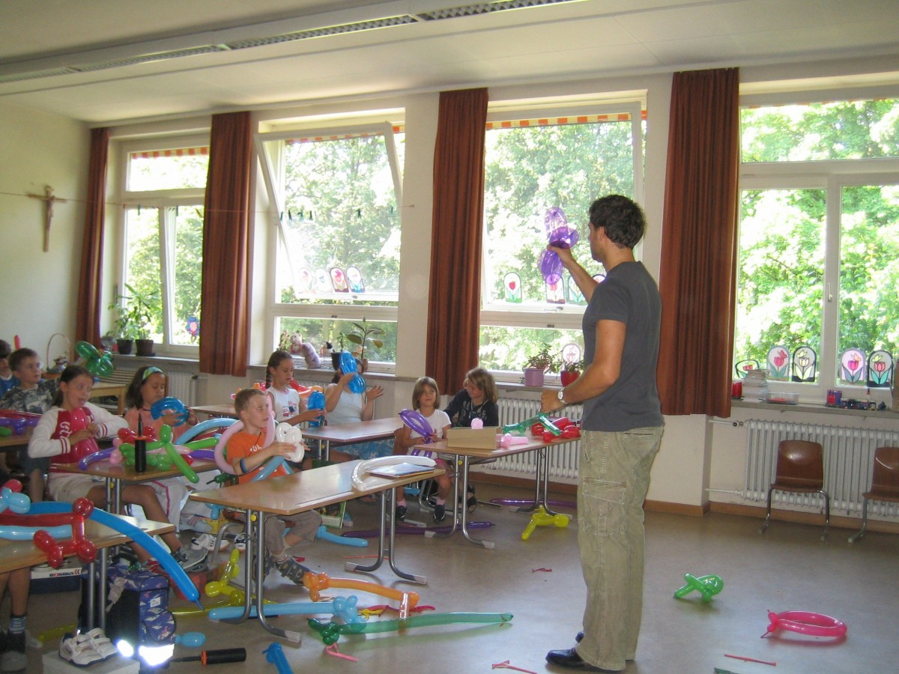
Classroom Guidance
Classroom Guidance lessons, delivered by the school counselor, are the most effective way to both monitor student mental health and to teach students the mindsets and behaviors that lead to student success
Delivering the lessons in the presence of classroom teachers helps them to reinforce your teaching
Student issues often surface during classroom guidance lessons and can then be addressed through individual sessions or small groups
Trends surface during classroom guidance that can be used to further develop your program

Slide 17
Classroom Guidance
A campus needs assessment based on the ASCA Model Standards is a good beginning step towards developing your plan
Convening your Advisory Council to review the data from the needs assessment as well as other campus data is an essential first step in determining what the scope and sequence of the lessons will be based on the ASCA framework
Maintaining flexibility to meet specific needs throughout the school year is important in the plan-individual teachers or grades may have needs based on classroom dynamics or specific incidents

Slide 18
Classroom Guidance
While there are many aspects to classroom guidance as covered in the ASCA national model and the mindsets and behaviors for students outlined in the national model, there are certain topics that are critical to developing a campus that supports the mental health of students and provides an environment that minimizes student mental health difficulties, supports students with mental health difficulties, promotes overall mental health and wellness for students and staff, and provides a means of surfacing students who need further mental health interventions.
Some of the things that must be provided are: emotional intelligence, self-regulation, conflict resolution, anti-bullying strategies, coping and calm-down strategies, self-care strategies, and social skills and communication strategies.

Slide 19
Classroom Guidance Must-Haves
Students must have lessons on expressing feelings, beginning at lower grades with the basics: mad, sad, glad, afraid and progressing to more nuanced emotions as they become older. Having a broad feelings vocabulary and the knowledge that school is a safe place to express these emotions is critical for the mental health of students. IT is also important that staff be versed in expressing emotions appropriately and accepting the appropriate expression of emotions from others.

Slide 20
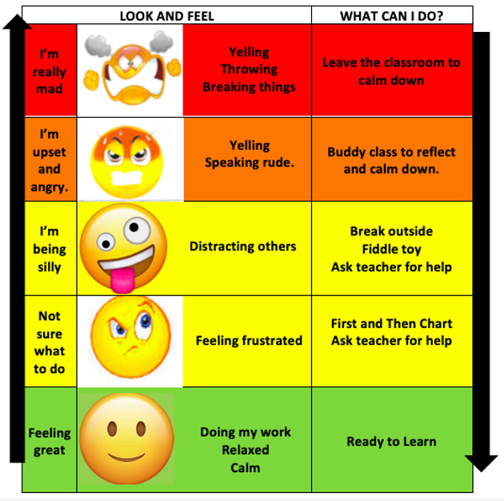
Classroom Guidance Must-Haves
Students must be explicitly taught self regulation as well. Research shows that the ability to self-regulate is more important that IQ in determining school success. Very young children (pre-pre K) require that we regulate FOR them. By pre-school age, we can regulate with them, by demonstrating and helping them through the strategies.. Finally, children can learn to self-regulate by using tools taught during classroom sessions. In order to have a campus full of students who (mostly) successfully self-regulate, in addition to classroom guidance lessons, there must be integrated systems that reinforce and provide tools for students in all areas.

Slide 21
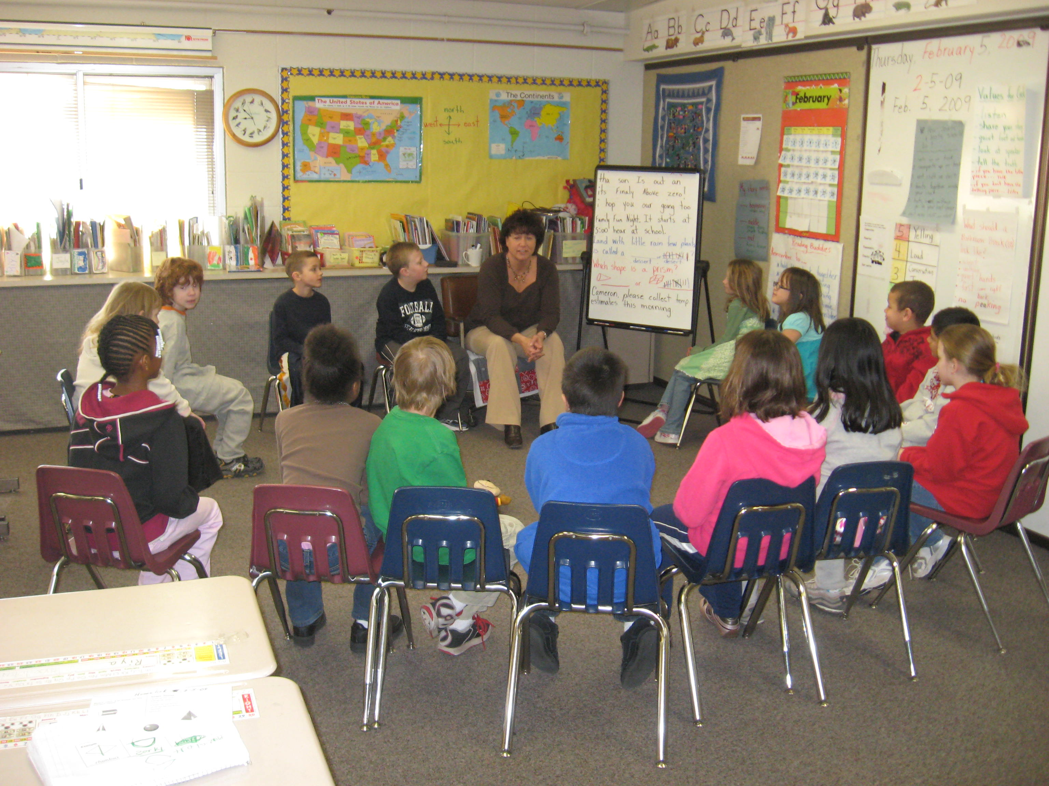
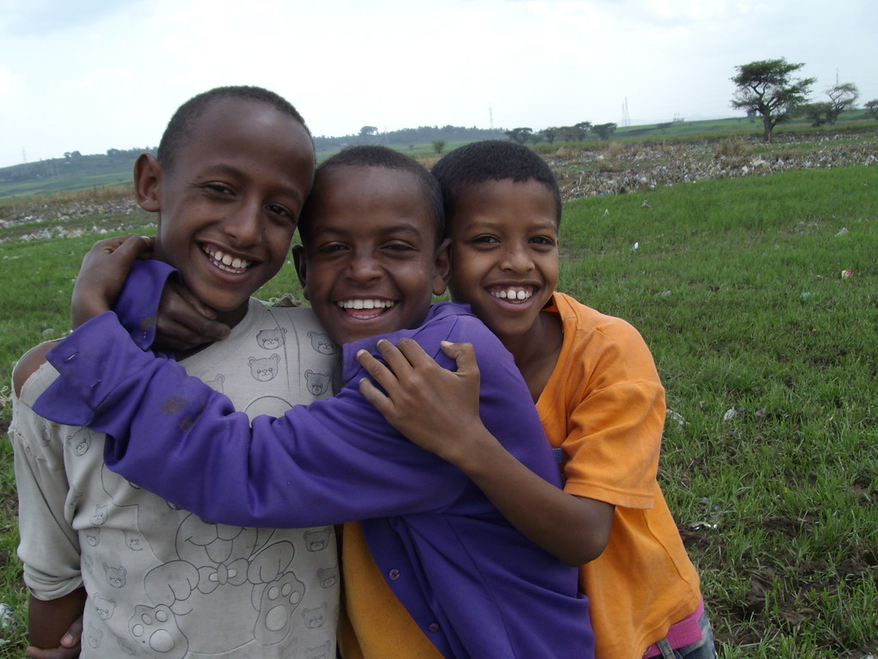
Classroom Guidance Must-Haves
Students must be taught acceptable strategies for conflict resolution and also be provided with the resources and locations where they can practice conflict resolution. Just as with self-regulation, the basic skills can be taught in classroom guidance sessions, but must be reinforced throughout the campus.

Slide 22
Classroom Guidance Must-Haves
Anti-bullying must be a component of classroom guidance, as well as a part of the overall campus plan. In addition to explicit lessons delivered through the classroom guidance program, every campus needs a robust plan for allowing the reporting of bullying, the regular analysis of where bullying might be occurring, plans for the protection of those being bullies and rehabilitation plans for those bullying.

Slide 23
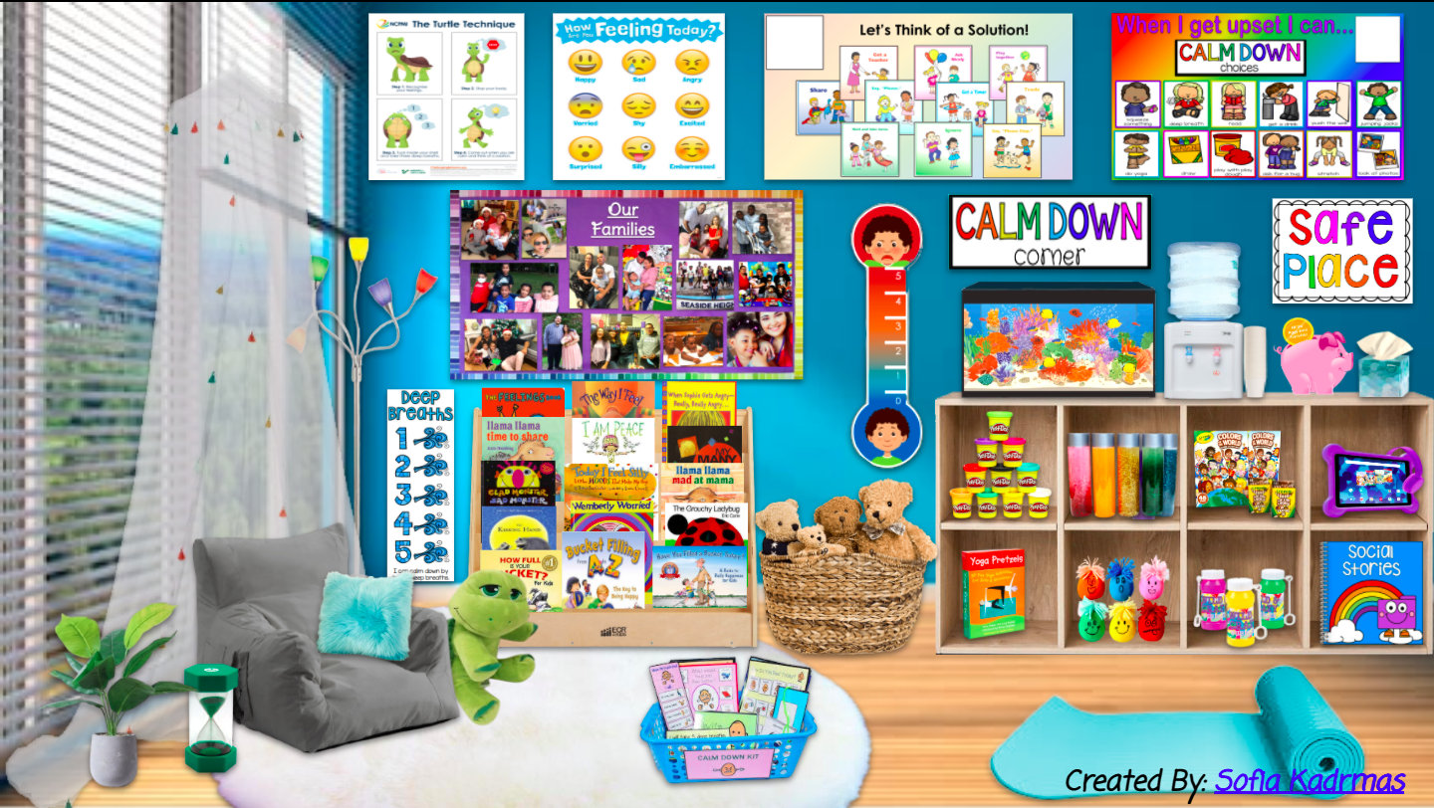
Classroom Guidance Must-Haves
While calming and anti-anxiety strategies are covered in self-regulation, the issue of anxiety had increased since COVID to the extent that it warrants a separate mention. Students need instruction in recognizing the effects of anxiety on their bodies and employing coping strategies to address that anxiety, both in and out of the school setting. To this end, general classroom guidance lessons accompanied by reinforcement in the classroom setting and tools in the classroom setting help students to learn to cope with anxiety in a productive way.

Slide 24
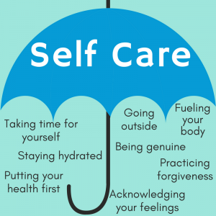
Classroom Guidance Must-Haves
Self-care is an essential part of mental health for both students and staff. Staff who practice self-care within the sight of students reinforce the concepts of self-care. While self-care can be addressed in many areas, it should be reinforced through classroom guidance. One area of self-care that dovetails nicely into classroom guidance is the idea of automatic negative thoughts (ANTS) and irrational thoughts or thinking errors. Teachers who encourage movement and breathing breaks, a campus that promotes nutrition and hydration, and adults who demonstrate mindfulness and wellness practices help students to incorporate these into their everyday lives.

Slide 25
Classroom Guidance Must-Haves
Social skills and communication skills are also a critical part of the puzzle in helping to prevent mental health difficulties in students. The ability to communicate effectively and to understand and follow the basic rules of social interaction help to promotes feelings of inclusion and belonging among students. Again, this can begin in classroom guidance and be reinforced throughout the campus in all areas.

Slide 26
Whole School Approaches
TIER 1 at the campus level must include the following:
A campus wide system that supports student mental health including:
Providing an atmosphere of safety and acceptance for all students
The recognition and expression of emotions in acceptable ways
Teaching and practicing social skills in all areas
Training and reinforcement of self-care strategies for teachers and students
Training and demonstration of assertive communication skills
Training and demonstration of conflict resolution skills
Teaching and encouraging students to utilize self-regulation skills with and without support
Including discussion about mental health topics as appropriate

Slide 27
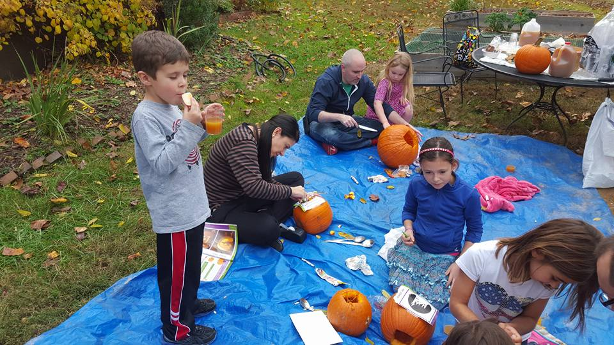
Whole School Approaches
Integrating mental health and wellness activities into the school day outside of class time, during advisory time, specials time, lunch time, and before school time
Ideas such as Wellness Wednesdays, Mindfulness Mondays, Screen-Free Fridays, and so on can help integrate mental health and wellness into the campus culture
Promote belonging with a variety of opportunities for students to interact with others in smaller groups- clubs, service groups, interest groups, etc.
Provide opportunities for students to be recognized-compliments, affirmations, recognition of character traits, work habits, and so on-not just academically focused
Involve parents in non-threatening ways-make the school a place where parents are welcome and feel a sense of belonging

Slide 28
Supporting Staff
TIER 1 Interventions for staff include:
Meaningful engagement in the process of developing whole school systems
Training for staff on the warning signs for mental health problems
Training for staff on how to effectively refer students who are suspected of having mental health issues
Training for staff on trauma informed strategies
Support for staff to implement their own wellness and self-care strategies
Meaningful opportunities for staff to participate in supporting mental health across the campus
Training on how to access crisis support and other mental health services

Slide 29
Supporting Staff
Classroom WISE is a program developed by the Mental Health Technology Transfer Center (MHTTC) Network in partnership with the National Center for School Mental Health
This FREE resource, accessible at www.classroomwise.org , has free training modules as well as resources for implementing the system within classrooms.
MHTTC also has a resource on various resources, both free and for pay, to support student mental health. It is available at https://mhttcnetwork.org/sites/mhttc/files/2021-07/MHTTC%20Educator%20Mental%20Health%20Literacy%20Resource_Final.pdf

Slide 30
Compassion Fatigue and Secondary Trauma n School Staff
Signs of compassion fatigue include:
Isolation
Depression
Difficulty focusing or brain fog
Insomnia
Excessive drinking/drug use
Appetite changes
Irritability
Anger/sadness
Denial
Negativity

Slide 31
Supporting Staff
Offer professional development about mindfulness or self-care
Provide a safe space to talk about the trauma, along with training on healthy coping skills
Provide self-care breaks-cover a class to allow a teacher to get off campus
Share mindfulness strategies with teachers
Providing writing exercises can help teachers process trauma
Continuously remind teachers to note when “good enough” is good enough
ASK teachers what they feel will help them to deal with trauma and burnout
Be generous in reinforcing teachers for their work and allowing them agency in school decisions and processes

Slide 32
Supporting Staff
https://resilienteducator.com/classroom-resources/self-care-for-teachers/
This resource offers lots of free resources for teachers to help them deal with secondary trauma. The wellness resources on this sight also help with “garden variety” wellness practices.
https://safesupportivelearning.ed.gov/sites/default/files/Building_TSS_Handout_3secondary_trauma.pdf
This handout provides both tools to evaluate school and staff needs and suggestions for dealing with secondary trauma
https://www.nctsn.org/
This website requires registration, but has many resources related to trauma and secondary trauma, as well as many other topics.

Slide 33
Supporting Students in the Classroom
Promote healthy social and emotional development of all students in the classroom by:
Promoting social and emotional competencies
Building resilience and growth mindsets
Promoting and allowing open communication with and between students
Teaching, demonstrating, and reinforcing positive behaviors
Teaching, demonstrating, and reinforcing decision making
Encouraging helping and supporting others
Providing space within the classroom for calming
Demonstrating and encouraging wellness and physical health
Ensuring that students have access to school based mental health resources without judgement or recrimination

Slide 34
Supporting Students in the Classroom
Promote relationships with students by:
Establishing daily routines and structure so students feel safe and secure
Create a safe space in both your classroom and the school
Asking questions and engage with students
Allowing students agency and a voice
Being fully present when listening to student concerns
Remember what students tell you about families, relationships, hobbies, etc.
Allowing for some individual time with students as possible
Allowing times for students to engage with and reinforce each other
Modeling good coping and problem-solving behaviors and talking through them
Focus on well-being by providing opportunities for mindfulness activities, breathing exercises, meditation and relaxation, self-regulations, and physical activity

Slide 35
Helping Students with Anxiety in the Classroom
Meet individually with the student and discuss the signs that you are seeing that indicate anxiety. Students are often able to describe things that trigger their anxiety and things that help them to calm down
Create a “coping” toolbox. These will be strategies the student can use independently or with support in the classroom to calm down. T=It might include a pass for a short hall walk, a fidget, breathing exercise reminders, a plan for check-ins while working, a break in the calm down center, and so on
Validate student feelings. No one intentionally chooses to have an uncomfortable feeling.
Use mindfulness strategies to keep students grounded in the present
Help students gain skills in doing the things or being in the situations that cause them anxiety. This might include self-talk, rewarding independent management, changing automatic negative thoughts to more positive ones, encouraging them to “sit” with uncomfortable feelings for a time, and so on.

Slide 36
Helping Students With Depression in the Classroom
Develop a collaborative relationship with the student that includes asking them how they feel, asking them what they need, and allowing a safe space for them.
Remember that they do not want to feel this way and cannot just “Cheer up”. Encourage them and recognize how difficult effort may be for them.
Make adjustments in tasks to help the to be successful, such as additional time, chunking, flexibility in scheduling, location of activities, and so on.
Pair the child with successful children who are sensitive enough to encourage them to participate in activities and “pull” them along gently.
Engineer opportunities for success for the student. This might mean meeting with them to set up a situation where they can demonstrate knowledge to the class, etc.

Slide 37
Mindfulness Activities
Have student shake up a glitter jar and watch and breathe until the glitter settles
Ask students to sit at their desks, close their eyes, then ring a resonant chime. Ask student to raise their hands when they hear the chime stop.
Practice mindful breathing. Have student lie on the floor with a book or a stuffed animal on her stomach. Have the student breath in deeply to make the object rise, then breathe out slowly and watch it fall.
Blow bubbles.
Do finger tracing. Have students sit quietly and put one hand out in front of them, palm facing in. Starting at the base of the thumb, show them how to trace the outline of their hand up around their thumb and around each finger. As they trace upward, ask them to breathe in. As they trace downward, breathe out.
Have students do “push, pull, drop” to feel how they feel when relaxed. They grip the sides of their desk seat and push down hard for a count of 5, then pull up hard for a count of 5, then drop their hands and shoulders.

Slide 38
Mindfulness Activities
Focus on the 5 senses. Name 5 things you can see, 4 things you can feel, 3 things you can hear, 2 things you can smell, and 1 thing you can taste.
Us as a fidget a sensory ball filled with rice, sand, cornstarch, popcorn, or kinetic sand.
Practice yoga poses.
Do color breathing. Have students think of a relaxing color and another that reminds them of stress. Have them breathe in and imagine the relaxing color, then breathe out and see the other color leaving their bodies.
Do a daily gratitude activity, having students share aloud something they are grateful for, or write down something they are grateful for, or simply think about something they are grateful for.
Have students carefully observe the room for a couple of minutes, then close their eyes and remember everything they saw that was….

Slide 39
Signs for Teachers to Consult
Consult with a counselor, nurse, social worker, or administrator if you observe:
Being sad or withdrawn for more than 2 weeks
Self-harm, or planning to self harm
Involvement in physical altercations or an expressed desire to hurt others
Overwhelming fear or panic without an obvious reason
Severe out-of-control behavior
Abnormal eating patterns
Intense worries or fears that interfere with everyday activities
Severe mood swings that cause problems with relationships
Drastic behavioral or personality changes
Repeated use of drugs or alcohol
Risky sexual behaviors

Slide 40
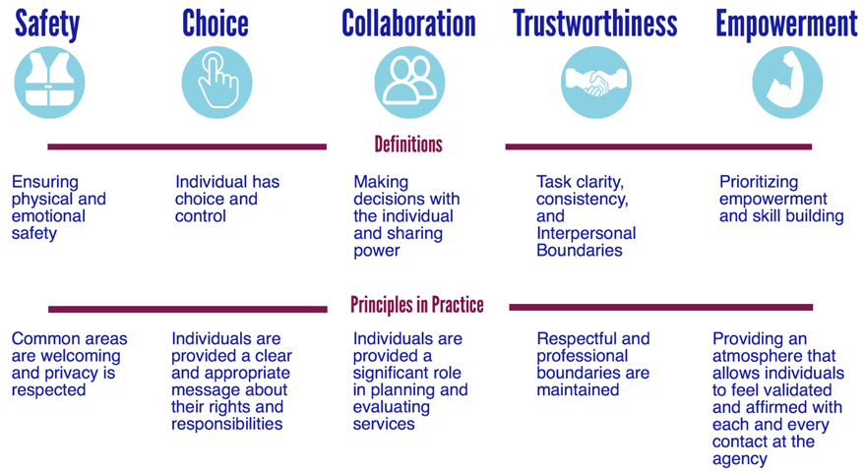
Trauma Informed Schools
Five Essential Components of a Trauma-Informed Approach

Slide 41
Trauma Informed Schools
Four Essentials of Trauma Sensitive Schools
Students must:
Feel Safe (in all areas of the school)
Be Connected (to the school in meaningful ways)
Get Regulated (be provided with support and tools for self-regulation)
Learn

Slide 42
Trauma Informed Classrooms
Essential Elements of a Trauma-Informed School System
Identifying and assessing traumatic stress.
Addressing and treating traumatic stress.
Teaching trauma education and awareness.
Having partnerships with students and families.
Creating a trauma-informed learning environment (social/emotional skills and wellness).
Being culturally responsive.
Integrating emergency management & crisis response.
Understanding and addressing staff self-care and secondary traumatic stress.
Evaluating and revising school discipline policies and practices.
Collaborating across systems and establishing community partnerships.
https://www.nctsn.org/trauma-informed-care
This website also has a child trauma toolkit for educators.

Slide 43
Trauma Informed Classrooms
https://traumasensitiveschools.org/tlpi-publications/
The website listed above provides access to two books about creating trauma informed schools that can be downloaded free, as well as a several videos that highlight the effects of trauma on learning and behavior.
https://www.childtrauma.org/
A free resource with lots of information about trauma and interventions for trauma.
https://www.weareteachers.com/video-every-teacher-needs-know-childhood-trauma/
This is a less than 2 minute video to introduce teachers to the idea of how to help traumatized students

Slide 44
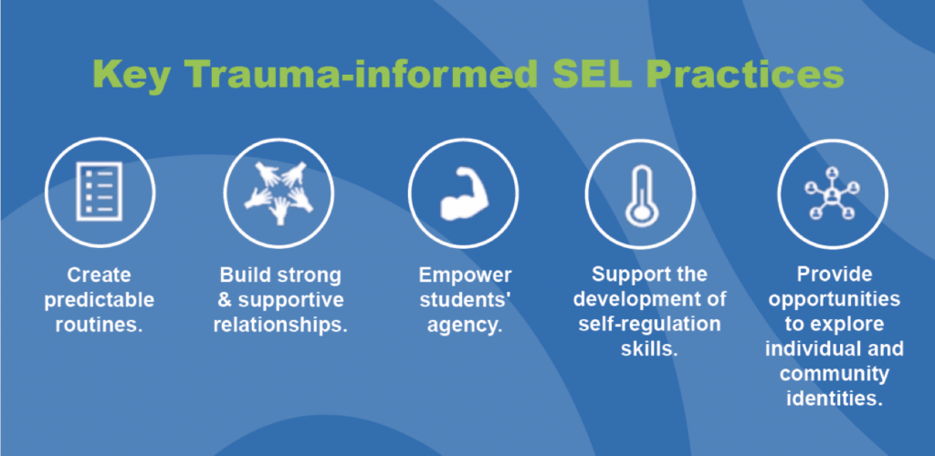
Trauma Informed Classrooms
The National Center on Safe Supportive Learning Environments is a GREAT resource for creating trauma sensitive schools. All resources are free, and include online modules as well as print resources. In addition, there is information on building community involvement and on many gender and equity issues. There are webinars, both current and archived, that address a variety of topics.
https://safesupportivelearning.ed.gov/trauma-sensitive-schools-training-package

Slide 45
Trauma/Mental Health Informed Classrooms
Essentials in the Classroom
1. A way for children to check in each day with their emotional “temperature” and to share any specific concerns
2. A method for students to participate in classroom decisions and to have agency in the classroom. Often these are referred to as “circle” processes
3. An area within the class set up as an area where individual students can access materials to help with emotional self-regulation and procedures for accessing the area
4. Classroom structure and orderly routines that are taught explicitly and reinforced
5. An emergency response plan that it is place and that is practiced BEFORE it is needed
6. Embedded SEL activities that reinforce the social and emotional skills needed to be successful in school
7. The sense of the classroom as family

Slide 46
What’s Next?
Take a minute and think about what we have covered today. Write down three ways you can use this information to benefit your campus. Share as directed.

Slide 47
Resources-Self Regulation
www.eiyale.edu Yale Center for Emotional Intelligence
www.csefel.vanderbilt.edu/ Center for Social and Emotional Effects on Early Learning
www.casel.org/ Collaborative for Academic, Social, and Emotional Learning.
www.edutopia.org Good information on social emotional learning
Preparing Children for Success in School and in Life Marsha Tate
Super Hero Social Skills Kit- Pacific Northwest Publishing
Skillstreaming the Elementary School Child-McGinnis
Teaching Social Skills to Youth-Boys Town Press
Stop and Think Social Skills-Project Achieve
Creating the School Family-Becky Bailey (and Conscious Discipline materials)
Books by Julia Cook
Materials by Brad Chapin
Materials by Michelle Garcia-Winner

Slide 48
Resources-Mental Health and Trauma
www.classroomwise.org
https://mhttcnetwork.org/sites/mhttc/files/2021-07/MHTTC%20Educator%20Mental%20Health%20Literacy%20Resource_Final.pdf
https://resilienteducator.com/classroom-resources/self-care-for-teachers/
https://www.nctsn.org/
https://www.nctsn.org/trauma-informed-care
https://traumasensitiveschools.org/tlpi-publications/
https://www.childtrauma.org/
https://www.weareteachers.com/video-every-teacher-needs-know-childhood-trauma/

Slide 49
Resources, website
Go to www.kidtools.net to access the following resources
Alphabet lessons-a set of over 125 classroom guidance lessons over a variety of topics. (Caution-they will print as a group, because they are linked)
A power-point on teaching self-regulation skills to children
A power-point on circle processes
Information on wellness and resources for wellness
A power-point on the changes in the ASCA ethical code

