Slide 1
Strengthening Local Democracy through Community Councils
Oliver Escobar, University of Edinburgh
Andrew Paterson and Paul Nelis, Scottish Community Development Centre
Joint Forum of Community Councils in West Lothian
November 2019

Slide 2

the big picture: a global democratic recession?
Notes:
Globally:
Democracy Index, down
Authoritarian values amongst young people, up

Slide 3
Democratic Recession
Last 10 years: reduction in the number of democratic systems > democracies are under increasing pressure due to social, political, environmental and economic factors (Wike & Fetterolf 2018)
The Democracy Index (2016, 2018)
  72 countries dropped in the index and just 38 moved up
  number of ‘full democracies’ dropped from 20 to 19 (USA now classed as ‘flawed’)
  49% of the world's population live in a democracy of some kind. But only 4.5% of people live in a ‘full democracy’
People love the idea/principles of democracy, but despair at how it is practiced
Global Attitudes Survey shows increased indifference, frustration and authoritarian attitudes particularly in the youngest populations around the world (Foa & Mounk, 2016)
Growing participation gap between the ‘politically rich’ and ‘politically poor’ (Dalton 2018)

Slide 4
Participation in local decision-making in Scotland: deficits and aspirations
(Scottish Social Attitudes Survey 2015 + Ipsos Mori 2014)
35% of Scottish citizens said they feel part of how decisions affecting their community are made
96% said that people should be involved in making decisions about how local services are planned and run
80% said that people should be involved in deciding how money is spent on local services
77% said would get more involved in their community if it was easier to participate in decisions that affect it

Slide 5
What do we mean when we say ‘local’?
Scotland has the largest average population per basic unit of local government of any developed country (Keating 2005)
Average population per LAA:
  Finland=15,960; France= 1770; Germany= 7,080; Spain= 5.680; EU average= 5,630
  Scotland= 163,200
Alongside England, Scotland has some of the lowest voter turnout at local elections in the EU
Ratio Elected Members/ Citizens represented:
  Finland= 1/500; France 1/125; Germany:1/400; Spain 1/700; UK= 1/2860
  Scotland = 1/4270
A ‘silent crisis’ of local democracy? (Bort et al 2012)

Slide 6
Policy and research context for public participation and democratic innovation
Local Governance Review (> Local Democracy Bill?)
Review of Community Councils (2017-2018)
Places, people and planning – Position Statement 2017
Re-launch of the National Standards for Community Engagement (2016)
Community Empowerment (Scotland) Act 2015
Participatory Budgeting national programme (2014-2019)
COSLA Commission on Strengthening Local Democracy (2014)
Parliamentary Local Government Committee (2013, 2014)
National Planning Framework 3
Christie Commission on Future Delivery of Public Services 2011
Community Councils Short-Life Working Group (2011)
Audits and reviews of Community Planning (2011, 2012, 2013, 2016, 2018)

Slide 7

2014 COSLA Commission on Strengthening Local Democracy
“50 years of centralisation has not tackled the biggest problems that Scotland faces
For a country with Scotland’s wealth and strength, the level of inequality is intolerable, and has huge social and financial costs
There is a link between the absence of strong local democracy and the prevalence of inequalities
It is communities that empower governments at all levels, not governments that empower people”

Slide 8



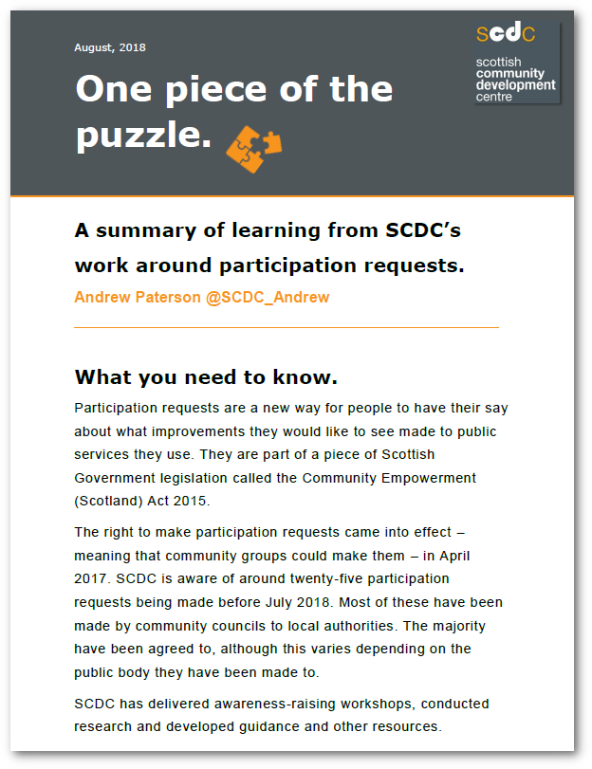



Background to our research
Community Empowerment
Democratic renewal
Building on what’s there

Slide 9
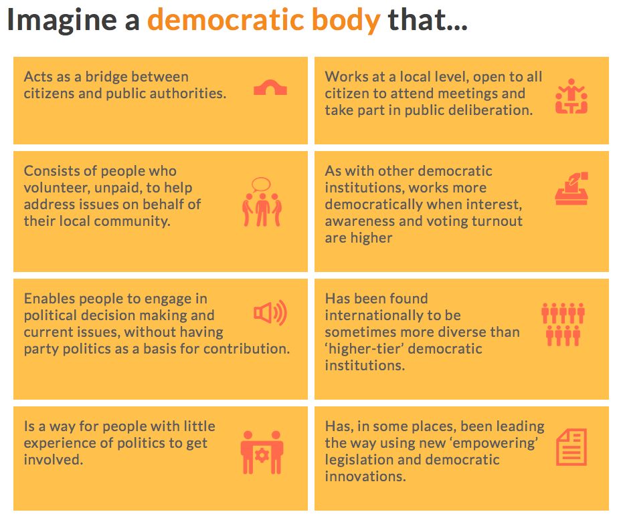

Slide 10

Methods
Self-funded research by What Works Scotland and Scottish Community Development Centre
Research Reference group (RRG)
Literature review
5 regional workshops
Online survey with 600+ responses
(mainly community councillors)

Slide 11
Findings - Participation
CCs are involved in a myriad of aspects of community life
Challenges around recruitment, competitive elections and diversity
Calls for better promotion
Relationship with other community organisations

Slide 12
Findings - Power and influence
Which powers?
Stronger representation in decision making structures
Being consulted earlier in the planning system
Spending powers
Role of elected members
Oversight and accountability

Slide 13
Example – Money for Moray
The Joint Community Councils of Moray (JCC) set up, then helped to run, the community-led participatory budgeting (PB) initiative, Money for Moray.
The project has organised five voting events that have enabled people in Moray to decide how to allocate £275,000 of funding to local projects
M4M say this has “generated more interest in the work of Community Councils and has increased membership in some”. Also “helps the credibility of Community Councils with agencies”

Slide 14
Findings - Support
Information
Training and capacity building in a range of areas
Resources
Association

Slide 15
Example – Midlothian’s Federation of CCs
Consists of representatives from the 16 community councils in Midlothian.
Meets to address issues of shared concern.
Provides a collective voice when engaging with agencies.
Has representatives on community planning groups to ensure information is shared and community councils have a voice in local decision-making structures.

Slide 16
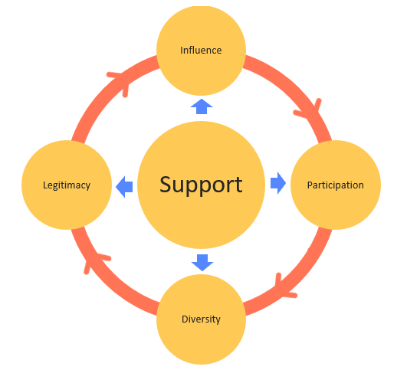

Slide 17
Key recommendations
The Local Governance Review should consider strengthening CCs to improve local democracy.
CCs should be given more power and resources at the same time as being better supported to better represent local diversity.
Required support includes training, capacity building, CC associations and compensation schemes to address barriers to participation.
Options for making CC membership more representative of local diversity should be considered.
The Scottish Government, and local authorities, should conduct a publicity campaign for CCs
Reforms should be flexible and take account of local need.

Slide 18
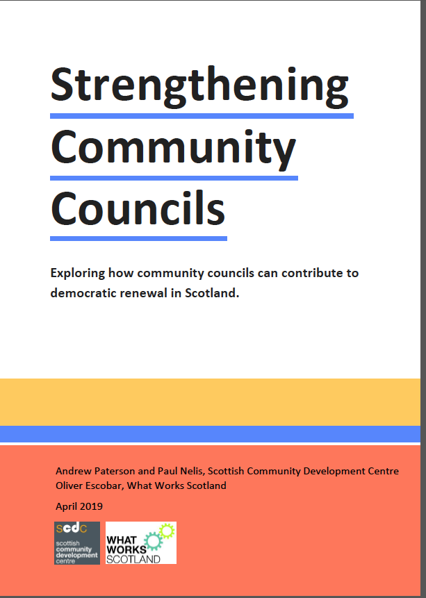
Thank you
Full report:
https://www.scdc.org.uk/what/strengthening-community-councils
Contact:
Andrew Paterson, SCDC andrew@scdc.org.uk
Paul Nelis, SCDC paul@scdc.org.uk
Oliver Escobar, UoE Oliver.Escobar@ed.ac.uk

