Slide 1


Slide 2


COMPANY PROFILE OF
Factory Address:
Baktier Complex (3^{rd - 6th} Floor)
2112, Hazi para, Wazedia, Bayzid, Chittagong

Slide 3
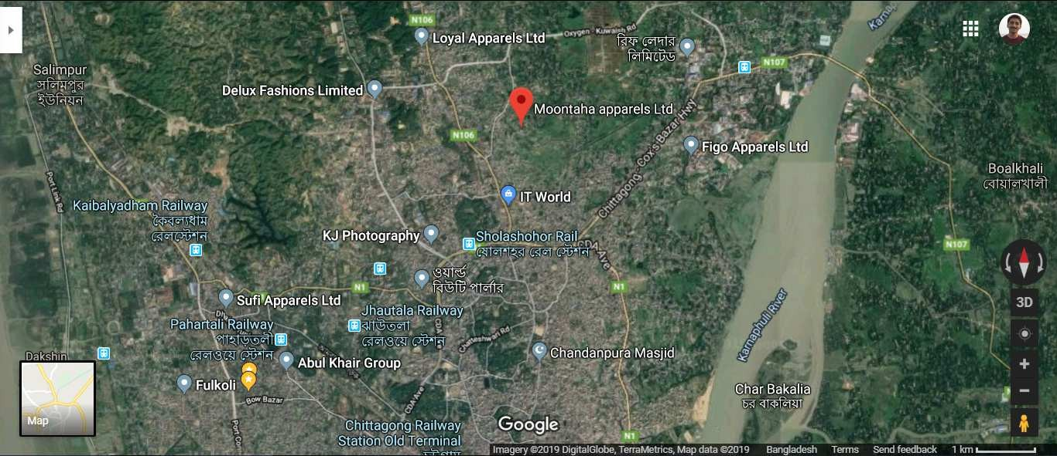
LOCATION ON THE MAP

Slide 4

Summary of the Company
We Have 5 Factory 1.Moontaha Apparels Ltd, 2.Monntaha Fashion Ltd .3. Vestment Tune Style .4. Anita Apparels Ltd. 5. Kujess Apparels Ltd.
Moontaha Apparels:The company is a six storied building having total floor space of 19,000 sft. The building is equipped with all sorts of production facilities. Here total 7 line are running with 240 machine are running. Production Capacity 70,0000Dzn (if under Garments) 45,000 Dzn (If T-shirt, POLO Shirt Or semi critical Item)
Moontaha Fashion Ltd-The company is a six storied building having total floor space of 14,000 sft (4th 5th 6th Floor) with cutting & Finisshing. Here total 5 line are running with 200 machine are running. Production Capacity 50,0000Dzn (if under Garments) 30,000 Dzn (If T-shirt, POLO Shirt Or semi critical Item)
Vestment Tune Style Ltd-The company is a six storied building having total floor space of 12,000 sft (5th 6th Floor) with cutting & Finisshing. Here total 4 line are running with 160 machine are running. Production Capacity 40,000Dzn (if under Garments) 25,000 Dzn (If T-shirt, POLO Shirt Or semi critical Item)
Anita Apparels Ltd-The company is a four storied building having total floor space of 37,000 sft (4th Floor) with cutting & Finisshing. Here total 5 line are running with 200 machine are running. Production Capacity 50,0000Dzn (if under Garments) 30,000 Dzn (If T-shirt, POLO Shirt Or semi critical Item)
Kujess Apparels Ltd-The company is a six storied building having total floor space of 12,000 sft (5th 6th Floor) with cutting & Finisshing. Here total 4 line are running with 160 machine are running. Production Capacity 40,000Dzn (if under Garments) 25,000 Dzn (If T-shirt, POLO Shirt Or semi critical Item)

Slide 5

About Us
Moontaha Apparels Ltd has been established in 2015 by Mr. Md. Abdul Barek with a vision to introduce a state-of–art garments knit factory in Bangladesh. We believe that making garments is not a process of cutting and sewing but involves lot of critical issues from very beginning to end like selection of factory sit, construction of compliant factory building, selection of modern machinery, recruitment policy for recruiting the right people health, security and social aspect of employees, quality assurance, buyers satisfaction, environment issue and lot more.
Considering the present global socio-economic situation we have established a very balanced factory catering to the need of our buyers in terms of providing quality products and addressing health, security and social aspect of labor which is one of the paramount concerns of our buyers. Our working force especially the workers is our assets and we have invested lot of money and time to develop a skilled labor force.

Slide 6

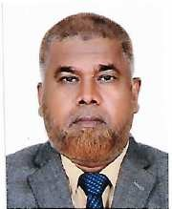

Mr. Abdul Barek has experienced in garments field last 30 years successfully. Mr. Barek is very much conversant with the needs and concern of all buyers and under his leadership the company is prepared to serve our valuable buyers catering to their requirement. Mr.
Barek has developed his skilled on production and quality control of garments. In this successive period of garments sector he has established other industries, which is below:
Moontaha Apparels Ltd (Managing Director), Moontaha Fashion Ltd. (Managing Director), Stitch Tone Apparels Ltd (Director), Vestment Tune Style Ltd (Chairman)
Mr. Barek has introduced a very strict quality assurance policy for Moontaha Apparels, Which will be back bone of the factory

Slide 7


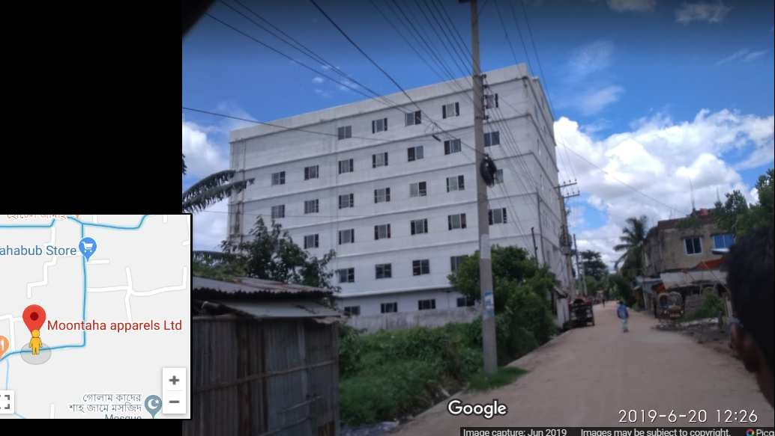
Floor Plan For Moonataha Apparels Ltd
Floor No. | Use
3rd Floor | Sewing
4th Floor | Sewing / Store
5th Floor | Finishing /Packing / Office / Sample Room
6th Floor | Cutting / Conference room

Slide 8

List Of Machinery’s
S.L | Name of Machine | Qty (Pcs)
01. | Plain Machine | 70
02. | Over Lock 4 Thread | 90
03. | Over Lock 5 Thread | 20
04. | Flat Lock (Knife Set) | 40
05. | Flat Lock CYLENDERBED | 15
06. | Rib Cutting | 03
07. | Thread sucker | 02
08. | Bar tack | 15
09. | Zigzag Three Step | 16
10. | Zigzag One Step | 15
11. | Cutting Machine | 03
12 | Heat Transfer machine | 06
13 | Needle Detector | 01
14 | Button Attach | 02
TOTAL |  | 298

Slide 9

GIRLS & LADIES BRIEF / BIKINI / HICUT / HIPSTER / THONG
BOYS & MEN'S BRIEF / BOXER
BOYS GIRLS MEN'S LADIES TEE SHIRT / A-SHIRT / CAMY/ POLO
GIRLS & LADIES LEGGINGS / LONG PANTS/ SHORT PANTS
GIRLS & LADIES SPORTS BRA/ BLOUSE
BOYS & GIRLS TOP BOTTOM SET
T/C BOXERS AND SHORTS
POPLIN SHIRTS AND BLOUSE
TROUSERS

Slide 10



Numbers Of Sewing Lines: 08
Panties:
BRIEF / BOXER:
TEE SHIRT / A-SHIRT / CAMY:
LEGGINGS / LONG PANTS:
SPORTS BRA/ BLOUSE:
TOP BOTTOM SET:
T/C BOXERS AND SHORTS:
POPLIN SHIRTS AND BLOUSE:
TROUSERS :
80,000Dz
50,000Dz
30,000Dz
30,000Dz
25,000Dz
15,000Dz
10,000DZ
10,000Dz
10,000Dz

Slide 11
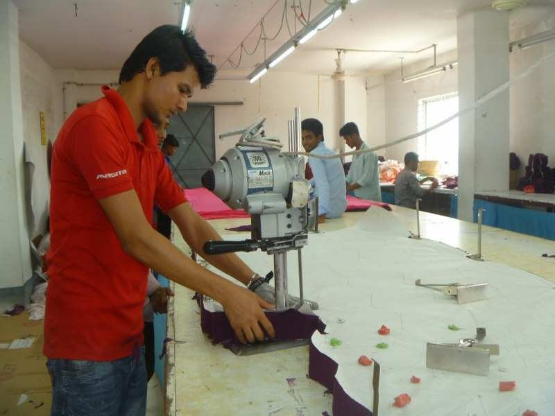
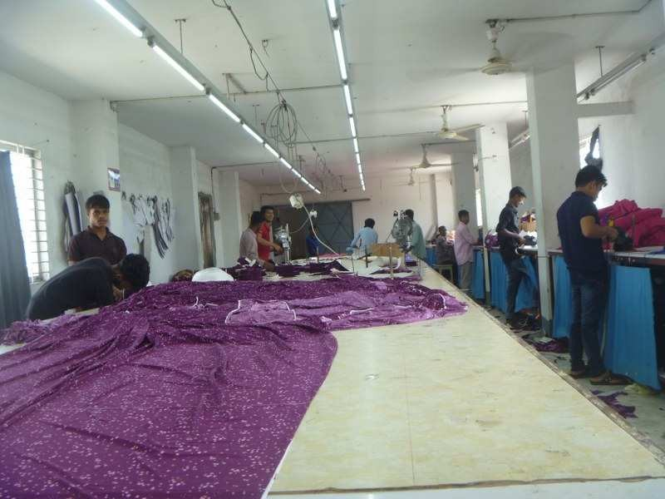
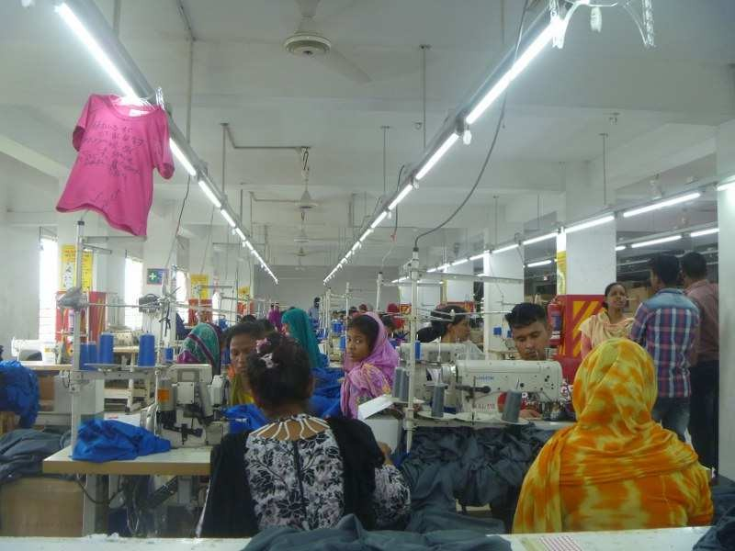
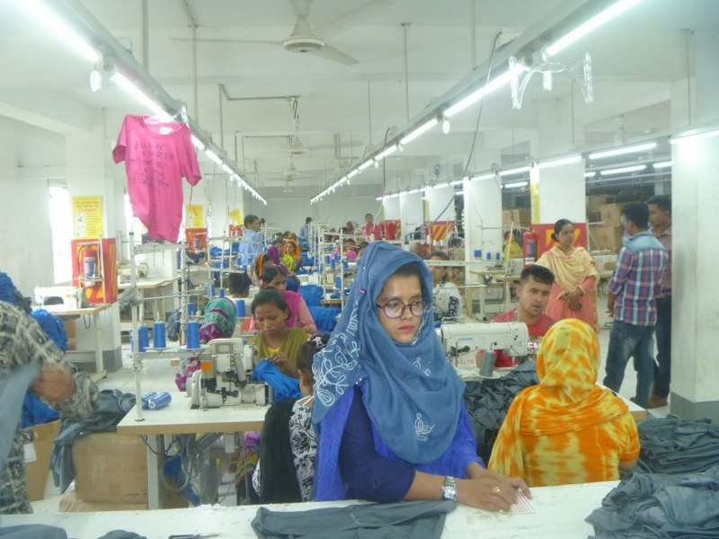
AT-A-GLANCE

Slide 12
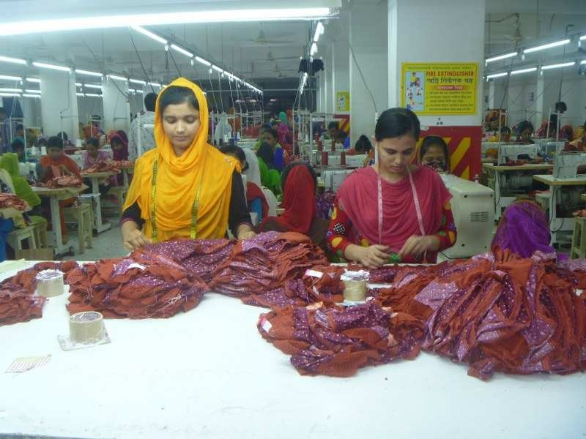
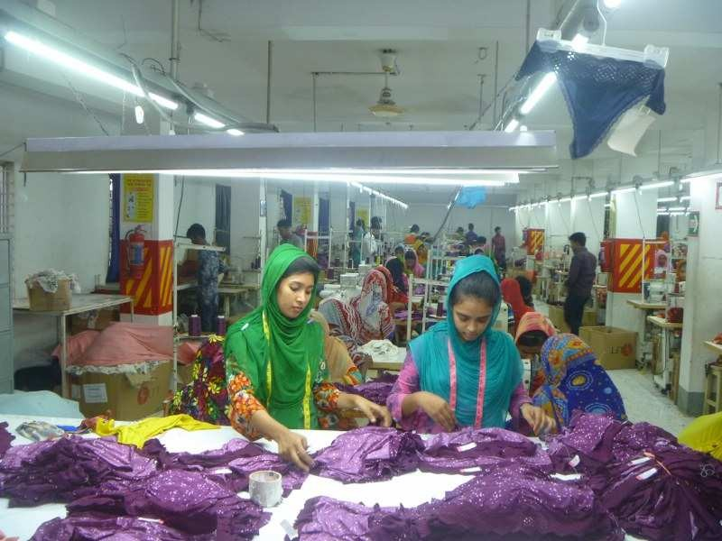
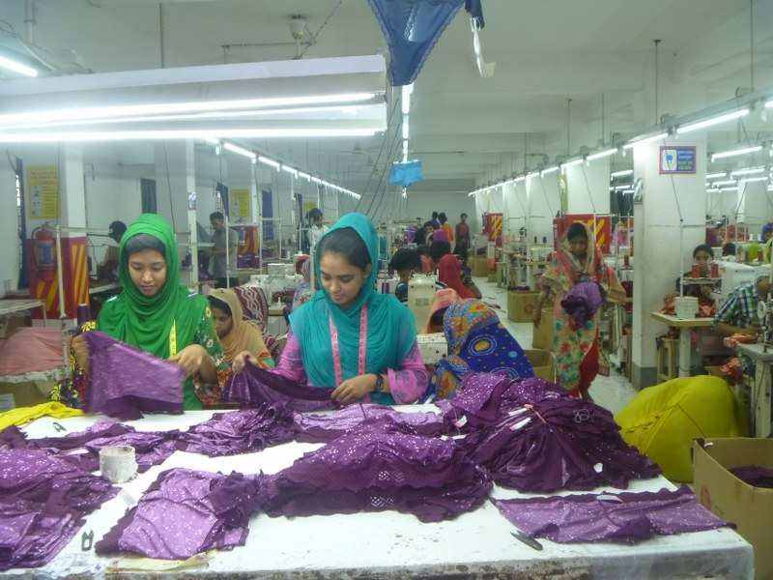
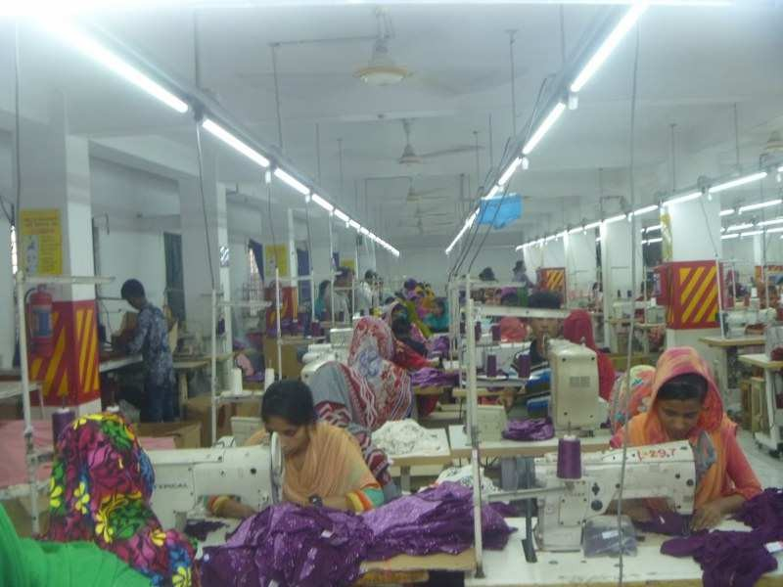
AT-A-GLANCE

Slide 13
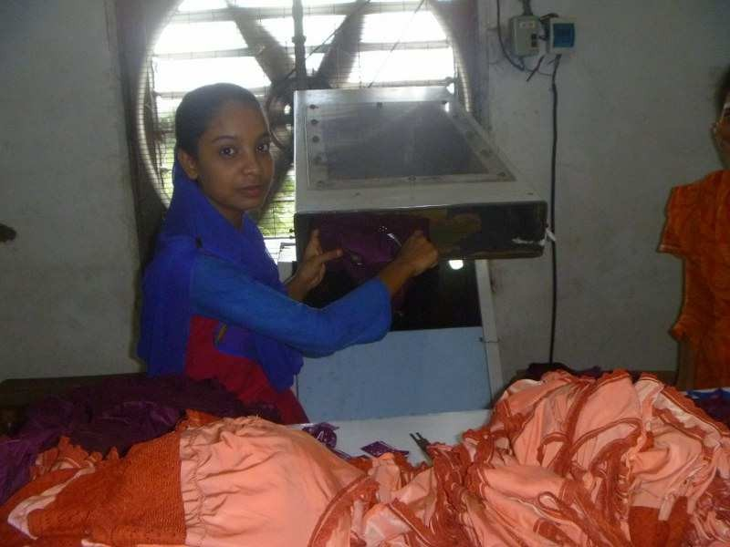
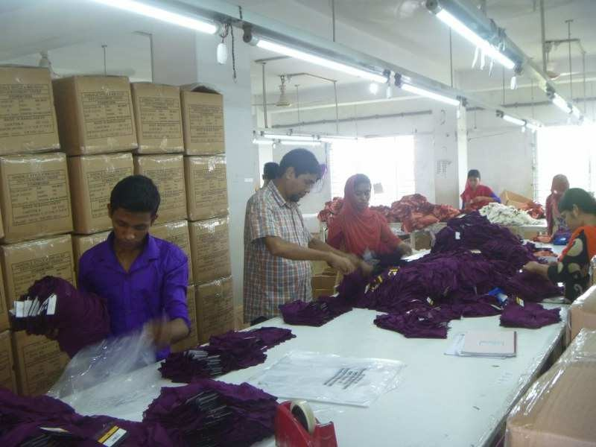
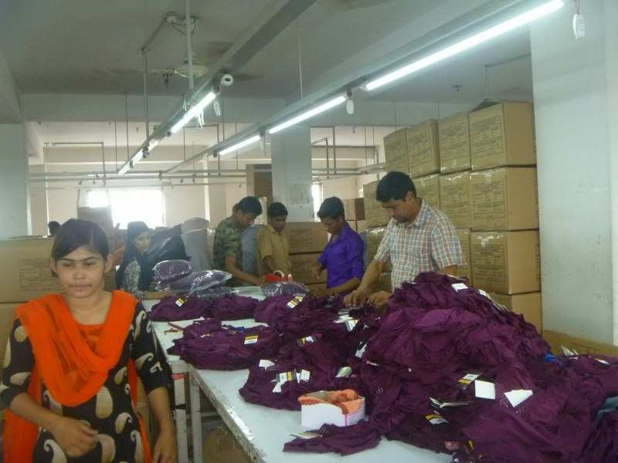
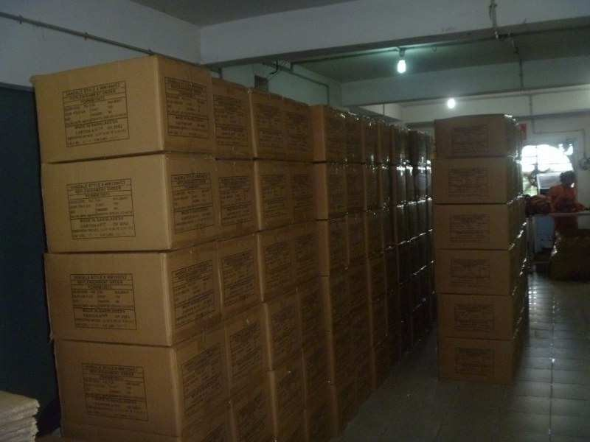
AT-A-GLANCE

Slide 14

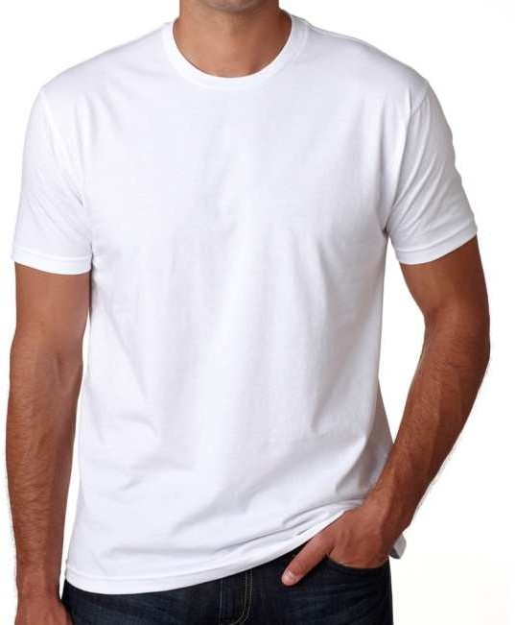
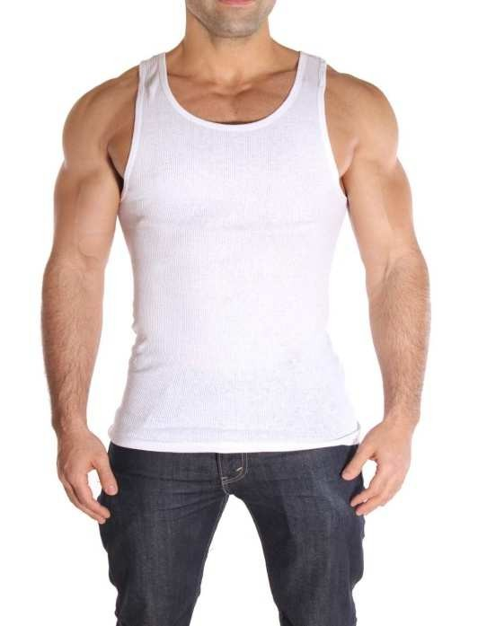
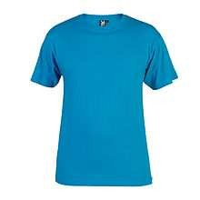
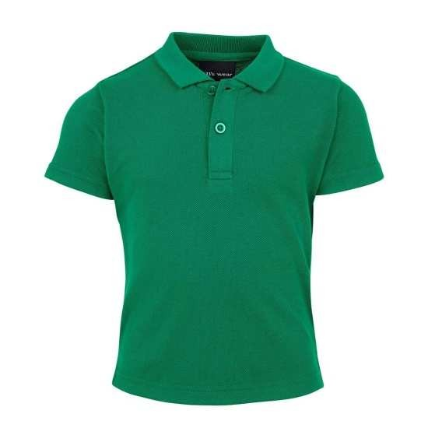
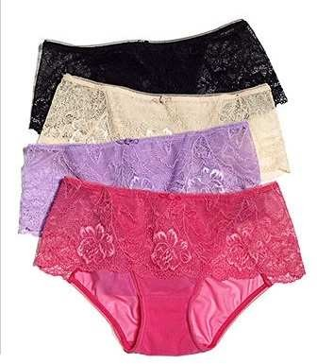
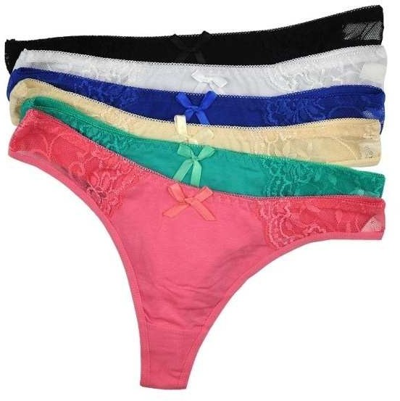
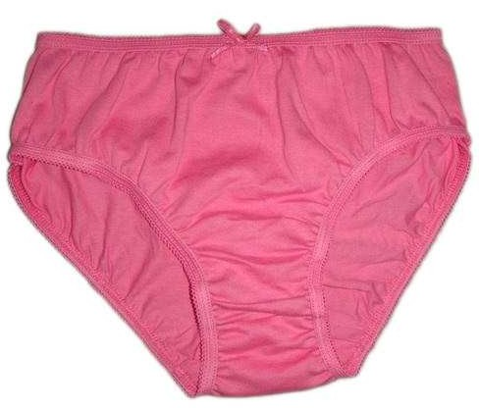
Product Pictures

Slide 15
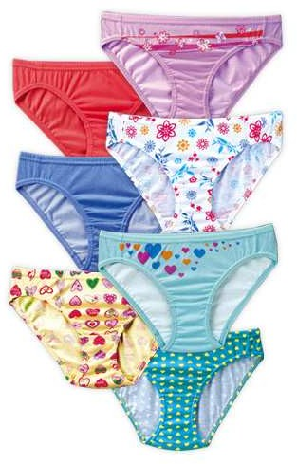
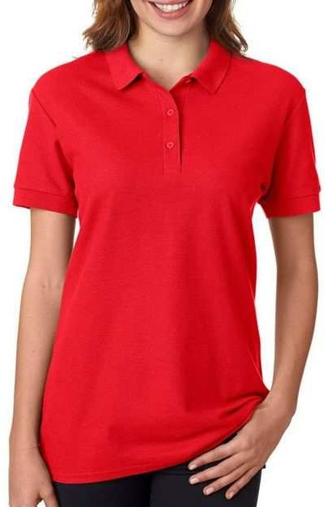
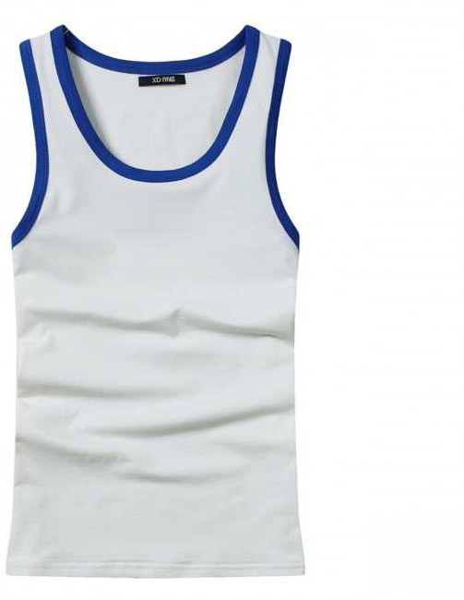
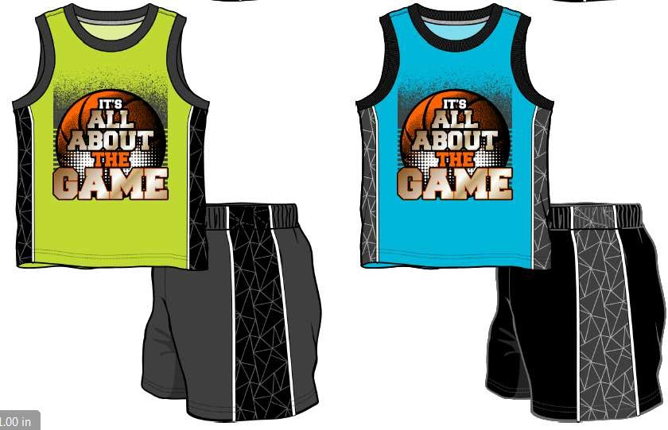
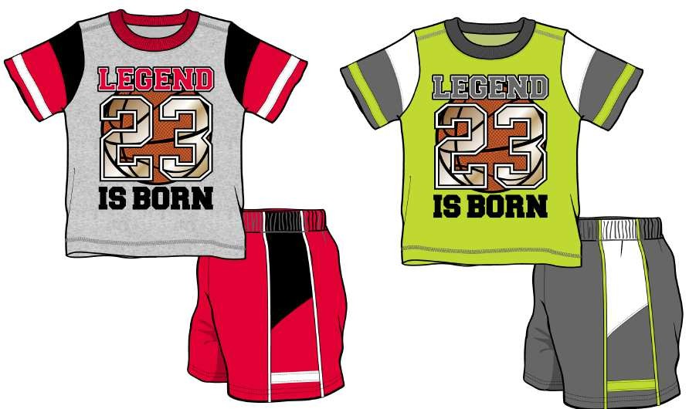
Product Pictures

Slide 16
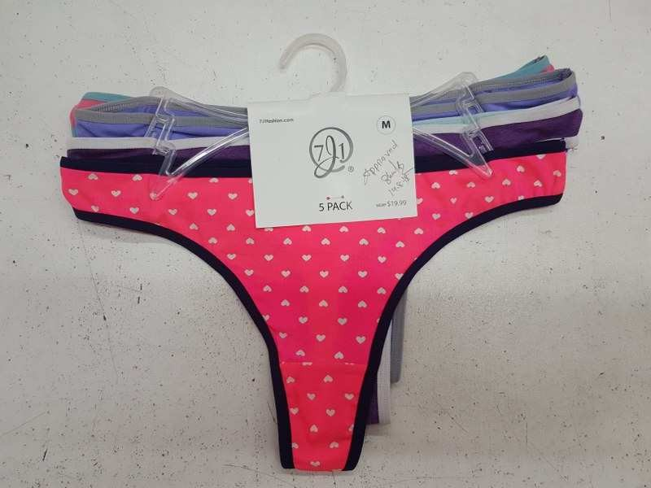
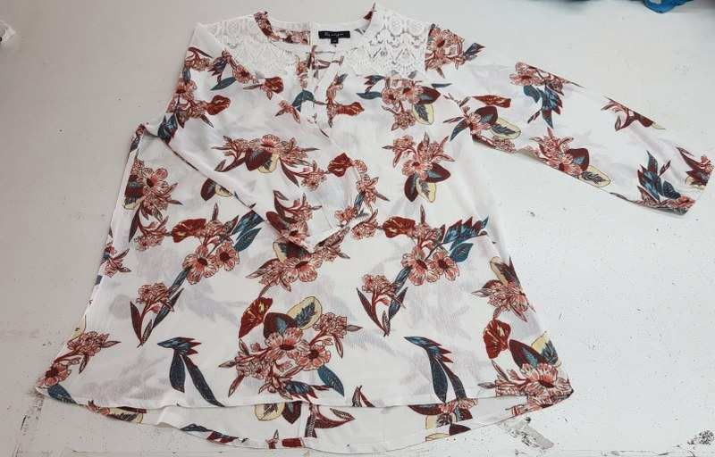
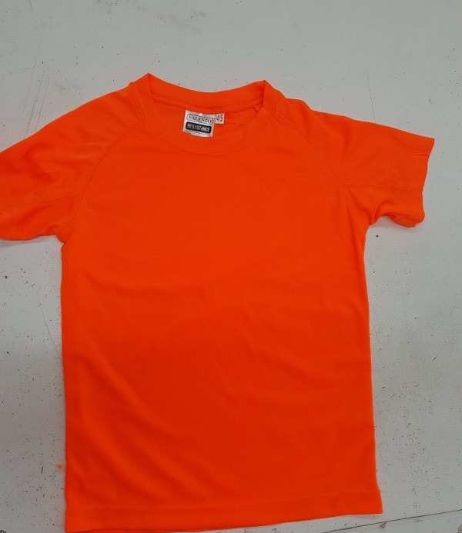
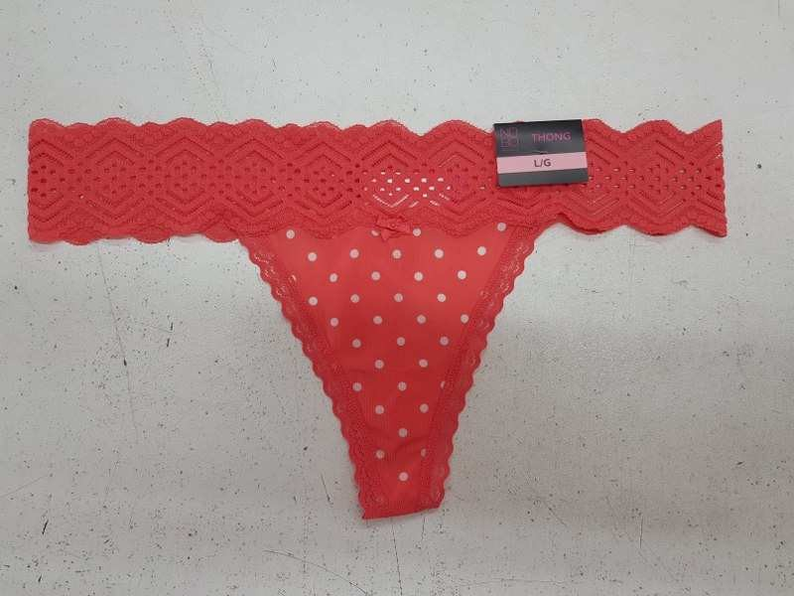
Product Pictures

Slide 17


License Details Others
Bond License No: 5(13)CUS:BOND:/ Chatta/BOND(PO)LI/18/2016
Bin/Vat: 001078524-0504
Tin: 775517600451
IRC NO: 200315120000719
ERC NO: 260315213405419
Trade License : TRAD/CHTG/028904/2021
EPB Enrolment Certificate : BD 06197
BKMEA Registration Certificate : 2079-B/2016
Fire License : Catto-9318/2015-16
Factory License: 4801/Ctg
BSCI CERTIFICATE
SEDEX
Bank Details: Agrani Bank Limited. Strand Road Corporate Branch Chittagong, Bangladesh SWIFT-AGBKBDDH041

Slide 18

Contact Details
MD. ABDUL BAREK
Managing Director
Mob# +8801714-306729
Yasir Arafat.
Executive director
Mob#+1(631)9779241
Firoz Mahmud
Merchandiser
Mob# +8801733262744

