Slide 1
Aviemore Primary School/ELC
Parent/Carer Presentation
Our Curriculum

Slide 2
Curriculum for Excellence

Slide 3
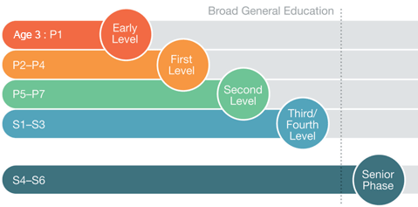
A 3-18 curriculum

Slide 4
What is the curriculum?

Slide 5
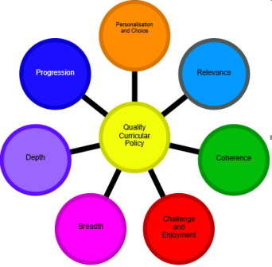
Principles of curriculum design

Slide 6
Four capacities

Slide 7
Curricular Areas

Slide 8
How do we plan and track progress?
Experiences and outcomes (often called Es+Os) are a set of clear and concise statements about children's learning and progression in each curriculum area. They are used to help plan learning and to assess progress.
Benchmarks – The Curriculum for Excellence Benchmarks set out clear statements about what learners need to know and be able to do to achieve a level across all curriculum areas.

Slide 10
What is different about Curriculum for Excellence?
Skills based curriculum
Child centred
Developmental approach e.g Play-based pedagogy
Outdoor Learning
Active Learning
Co-operative Learning
Interdisciplinary Learning

Slide 11
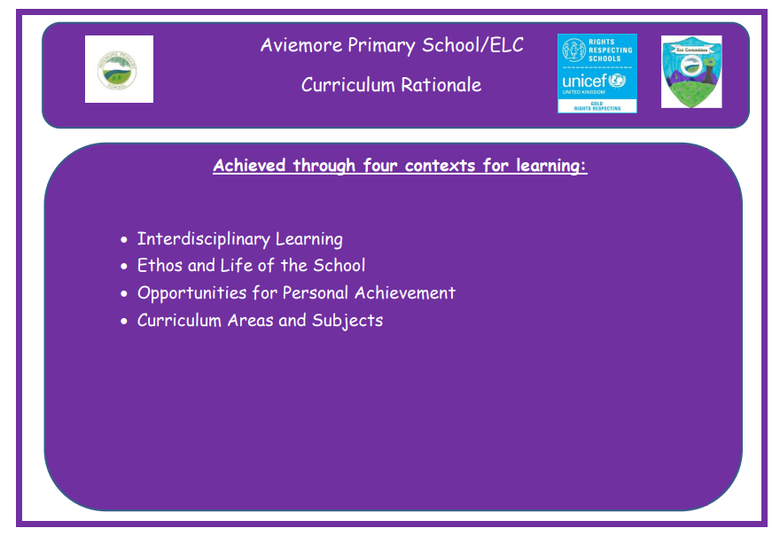
What is our curriculum at Aviemore? Curriculum Rationale

Slide 12
Progression Pathways

Slide 13
Contexts for Learning

Slide 14
Skills

Slide 15
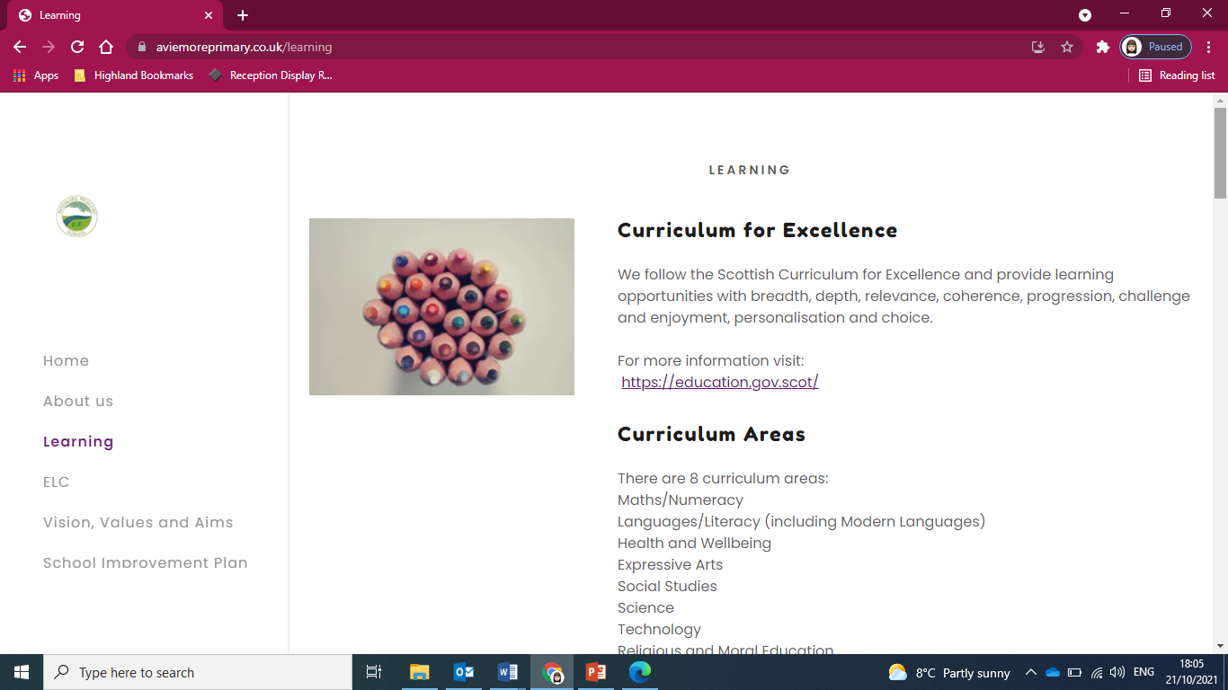
How can I find out more?
https://education.gov.scot/parentzone/learning-in-scotland/about-the-3-18-curriculum/
www.Aviemore.primary.couk/learning

