Slide 1

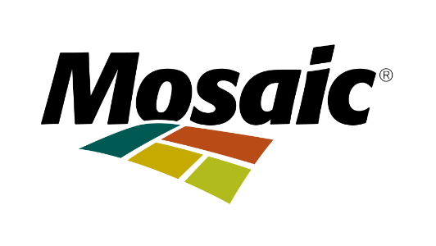
Cintas Safety Proposal
Elizabeth, Ava, Maria, Martin
Notes:
Maria - In an industry where one small gap can have major consequences, safety and compliance aren’t just priorities, they’re critical. Mosaic has clearly built a strong internal safety program which is convenient and impressive but today, we’re here to show how Cintas can help strengthen it even further.
My name is Maria, and alongside Martin, Elizabeth, and Ava, we’re here to present a customized safety proposal built specifically around the challenges you shared with us during our discovery meeting

Slide 2
Sales Agenda
04
01
02
05
03
06
Customer Situation Overview
Investment and Value
Value Summary
Product and Service Recommendation
Next Steps
Rational (Why Cintas?)
Notes:
Today, we’ll briefly recap your current situation, present our recommended solutions, outline the proposed investment, and most importantly, demonstrate the measurable value this partnership can deliver to Mosaic

Slide 3
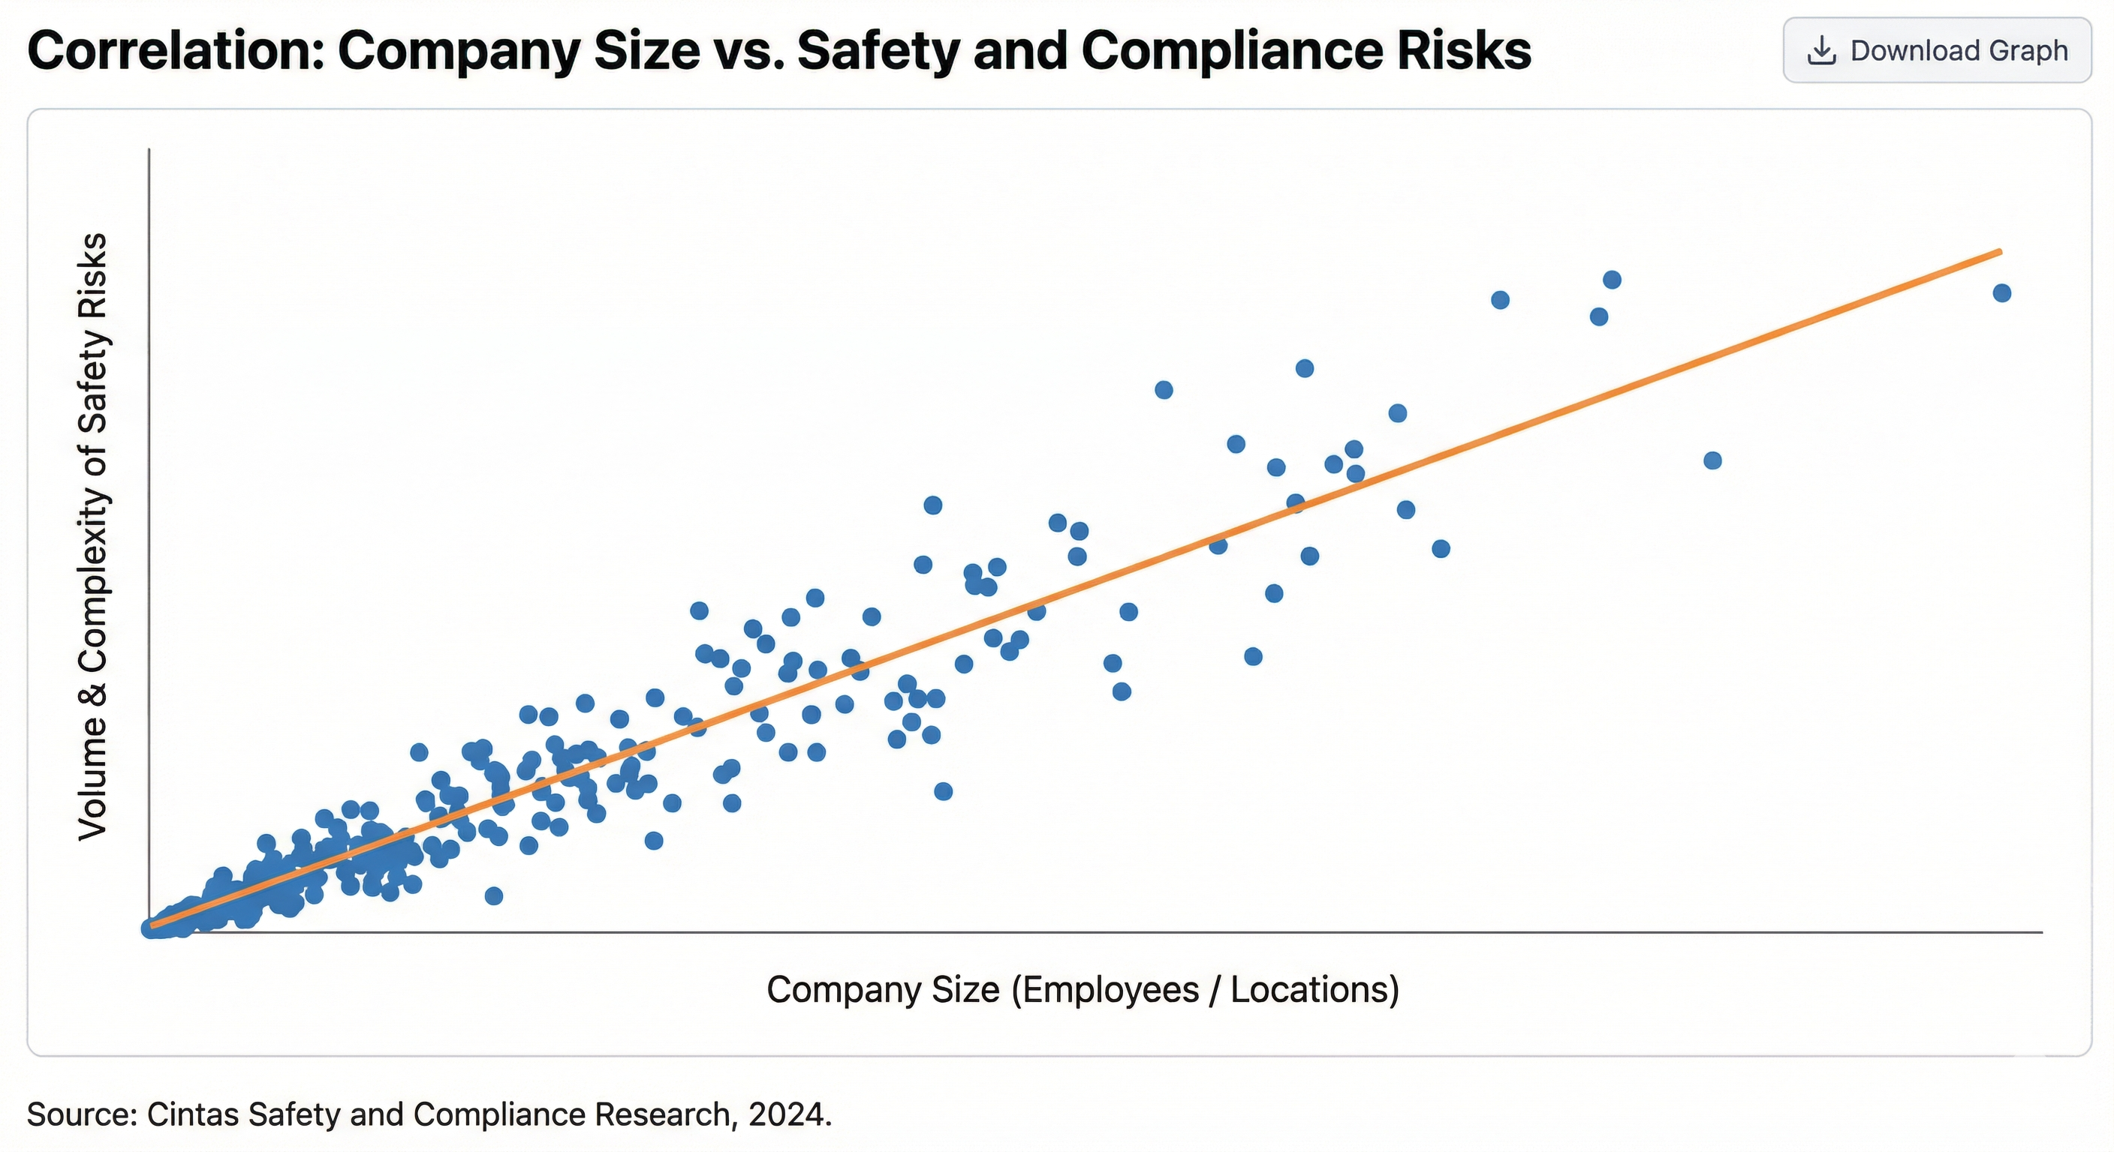
Customer Situation Overview
Mosaic needs support
Large companies = compliance risks
Challenges:
OSHA compliance
Managing safety across locations
Reducing injuries
Objective:
Improve safety efficiency
Support internal control
Notes:
Internal EHS team manages OSHA compliance
Uses multiple vendors (5–20 per region) for safety supplies
EHS team spends significant time managing vendors and supplies
Balances vendor coordination, compliance oversight, and training

Slide 4
Why Cintas?
Company goals match Cintas’
Reduces operational burden
Greater consistency for Mosaic
Efficiency in everyday business
Notes:
Ability to bundle multiple services in ONE SINGLE PROVIDER

Slide 5
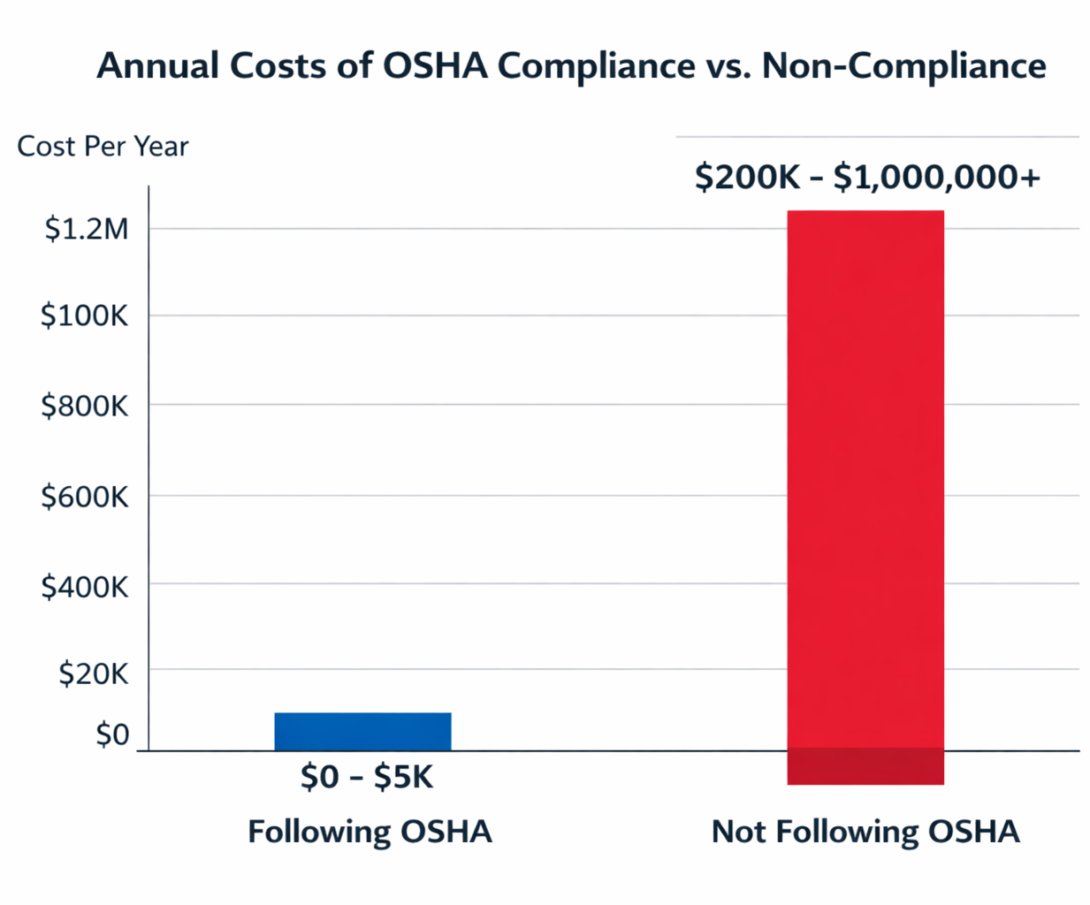
Product and Service Recommendation
✔ First Aid & Safety Supply Management
✔ PPE Vendor Consolidation
✔ Compliance Support Tools
Notes:
“We recommend the Cintas Integrated Safety Support Program for Mosaic:
First Aid & Safety Supply Management – keeps all sites fully stocked and compliant.
PPE Program with Vendor Consolidation – standardizes protective gear and improves worker safety.
Compliance Support Services – optional, helps Mosaic stay OSHA-ready and reduce risk.
This package is simple, focused, and strategic, protecting your people, operations, and bottom line.”
How Each Service Connects to Mosaic’s Needs
First Aid & Safety Supply Management: Ensures fully stocked, compliant safety supplies across operations
PPE Management: Standardizes protective equipment and improves worker safety consistency
Safety Training Programs: Strengthens safety culture and reduces workplace incidents
Uniform Services: Enhances professionalism, safety visibility, and operational efficiency
Compliance Support: Helps Mosaic stay OSHA-ready and reduce regulatory risk
Recommend a package that includes:
First Aid & Safety Supply Management Program (MAIN PRODUCT)
PPE Program with Vendor Consolidation (Second)
Compliance Support Services (Optional but Strong Add-On).
“Cintas Integrated Safety Support Program”
Includes:
✔ First Aid & Safety Supply Management
✔ PPE Vendor Consolidation
✔ Compliance Support Tools
Simple. Focused. Strategic.
Product and/or Service Recommendations
Present a summary of the specific products and/or services the team is recommending, from your company,
Provide a clear rationale for each recommendation, supported by data or insights.
Rationale:
Provide the reasons why the recommended products and/or services are being recommended to the prospective customer.

Slide 6
Proposed Investment & Expected Value
Integrated Safety Support Program
$165 per employee annually
  First Aid Safety Supply ($55)
  PPE Management Program ($65)
  Service Visits & On-Site Support ($45)
Total Annual Investment: $495,000 per year (Florida Only)
Estimated Annual Value
$80,000 – Administrative labor savings
$50,000 – Vendor consolidation efficiency
$75,000+ – Compliance risk mitigation
Total Measurable Annual Value: $200,000+
Notes:
Our proposed investment would be structured as a recurring service agreement, billed monthly based on the number of employees in Florida. At $165 per employee annually that cost includes
Mosaic has 3,000 Florida employee so these expense would total approximately $495,000 annually. Based on reduced administrative coordination, improved vendor efficiency, and lowered compliance risk exposure, we estimate over $200,000 in measurable annual value in addition to strengthening safety oversight and operational consistency = 41% ROI

Slide 7
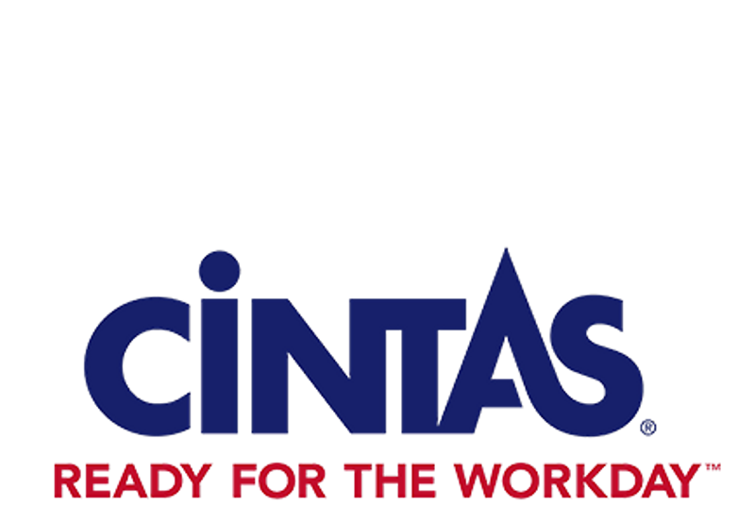
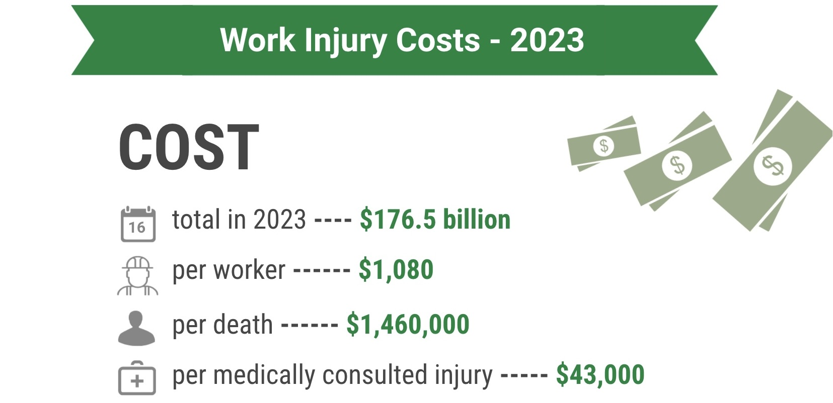
Value Summary
Notes:
Looking at the estimated cost for a work place injury according to the national safety council (NSC)
we can see how expensive it is for a company to deal with work injuries with medically consulted injury costing around $43,000 and in worst cases death costing around $1,460,000 which really puts into perspective the financial impact of safety gaps and reinforces why investing in proactive safety management is far more cost-effective than reacting to incidents after they occur.

Slide 8
Next Steps
Mosaic Commitment
Follow Up Meetings
Mosaic Concerns
02
04
01
03
05
Pilot/Prototype Implementation
Production measures

Slide 9
Thank you!
Notes:
Thank you and I hope you give us the chance to help you get ready for the workday!

Slide 10
Resources
2024 Cintas Safety and Compliance Research
OSHA penalties. Occupational Safety and Health Administration. (n.d.). https://www.osha.gov/penalties
Top OSHA violations of 2024 and higher penalties for 2025. NAHB. (2025, January 9). https://www.nahb.org/blog/2025/01/osha-violations-2024?utm_source=chatgpt.com
National Safety Council. (n.d.). Work injury costs. Injury Facts. Retrieved February 23, 2026, from https://injuryfacts.nsc.org/work/costs/work-injury-costs/

