Slide 1

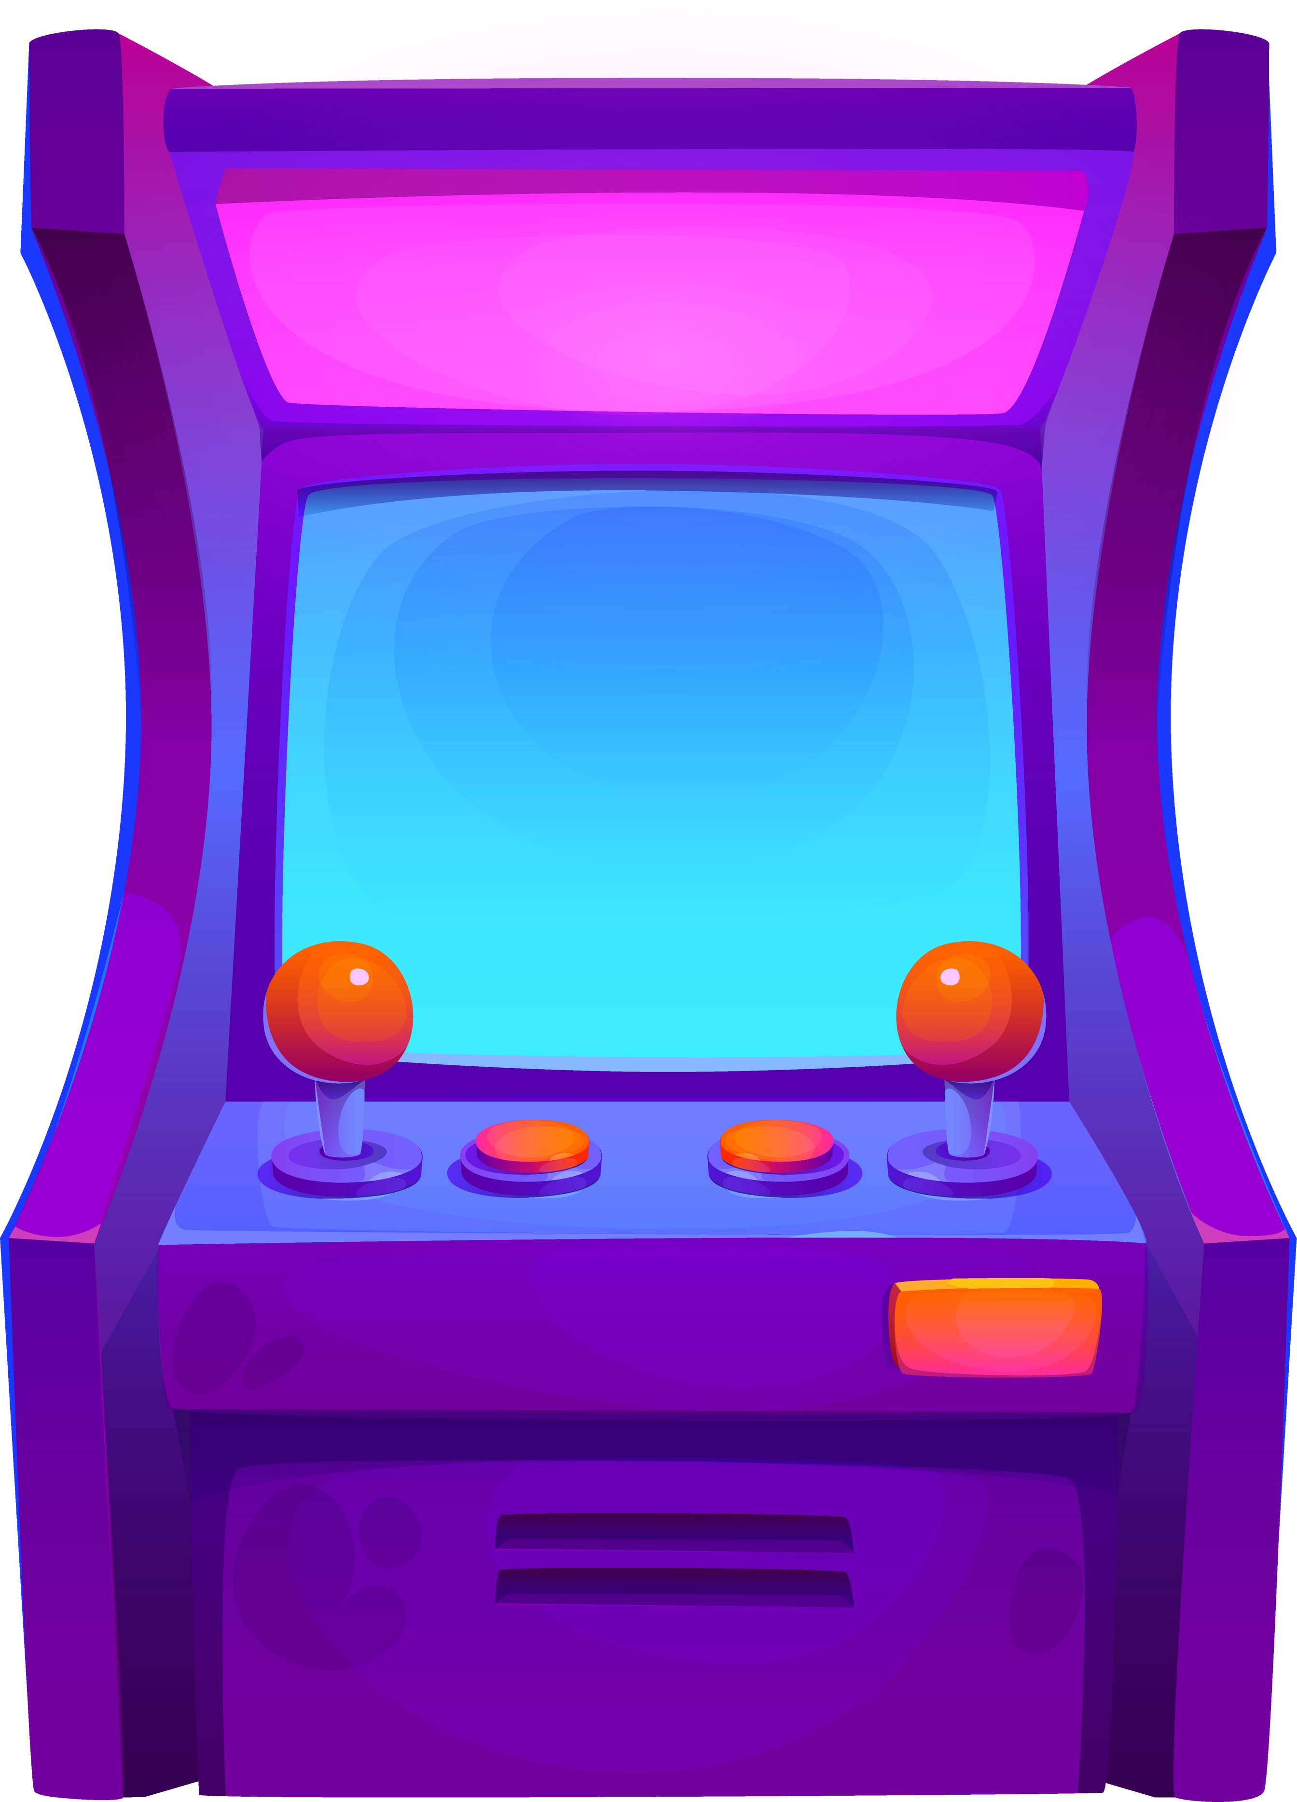



ARCADE
Monsters
Florida Expansion Location Analysis
Team 7: Maria L. Angelina D. , Murphy B. , Isabella A., Tracy P.

Slide 2







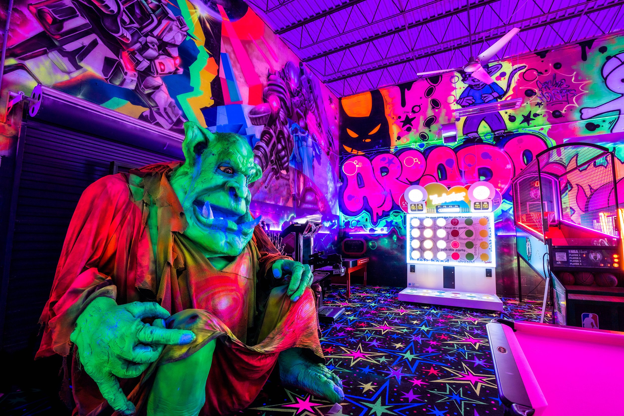

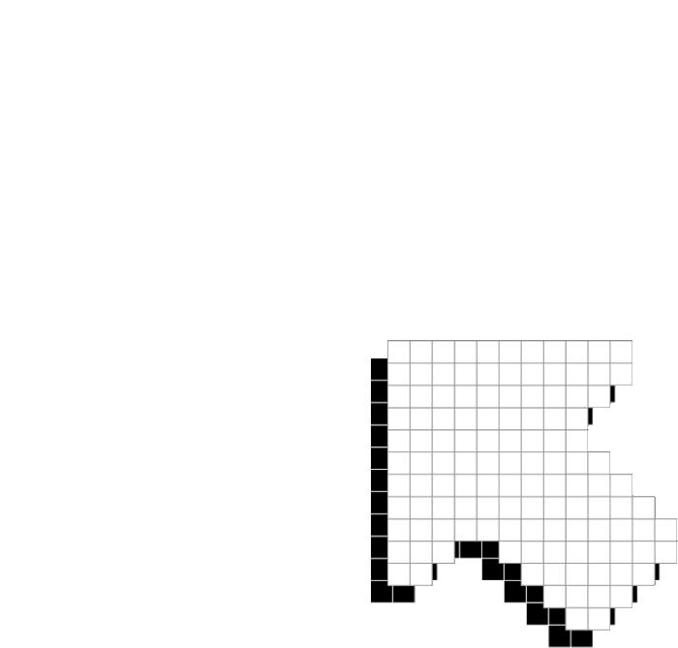
01
07
12
Company Overview
Modern Arcade Entertainment brand that offers:
Unlimited Play, Immersive Experience & Food / Beverages
Current Locations: Concentrated In Orlando Area
Notes:
Arcade monsters is a modern entertainment brand whose goal is to create a safe, fun environment for all ages. They are a cashless company that offers unlimited play passes along with food and beverages. From small hangouts to big social events their goal is to (and I quote) "become the world leader in arcades, recreational gaming, and amusements." The company currently has 5 locations in central Florida and 2 in California.

Slide 3


HIGHSCORE 2500
PLAYER 1
Target Market
Teens and Adults (13-30+)
Retro Games + Alcoholic Drinks
Nostalgic
Notes:
https://my.ibisworld.com/us/en/industry-state/fl71312/state-industry-report
https://my.ibisworld.com/us/en/industry/71312/at-a-glance
Although arcade monsters is marketed for all ages it's main focus is teens and adults. Arcade Monsters offers a fun hangout spot that is budget friendly for teens. Arcade Monsters also has classic, retro arcade games from the 70s-90s, like pinball, pac-man and space invaders for adults looking for a nostalgic experience. To further support their target towards adults, they also have a bar that sells alcoholic drinks . Industry trends show 18-34 is the key audience. This chart compares the age market for all arcades in the US compared to Arcade Monsters which is very similar.

Slide 4
Key Variables Selected
A.
Age 18–44
B.
Entertainment Spending
C.
PRIZM Psychographic Segments
- Young Digerati
- Urban Achievers
Notes:
So for our analysis, we focused on three key variables: age, entertainment spending, and PRIZM psychographic segments. Young Digerati and Urban Achievers are lifestyle-based segments that reflect how consumers spend their discretionary income. Young Digerati includes college students and young professionals who prioritize social activities, while Urban Achievers represent higher-income professionals willing to spend more on premium experiences.

Slide 5
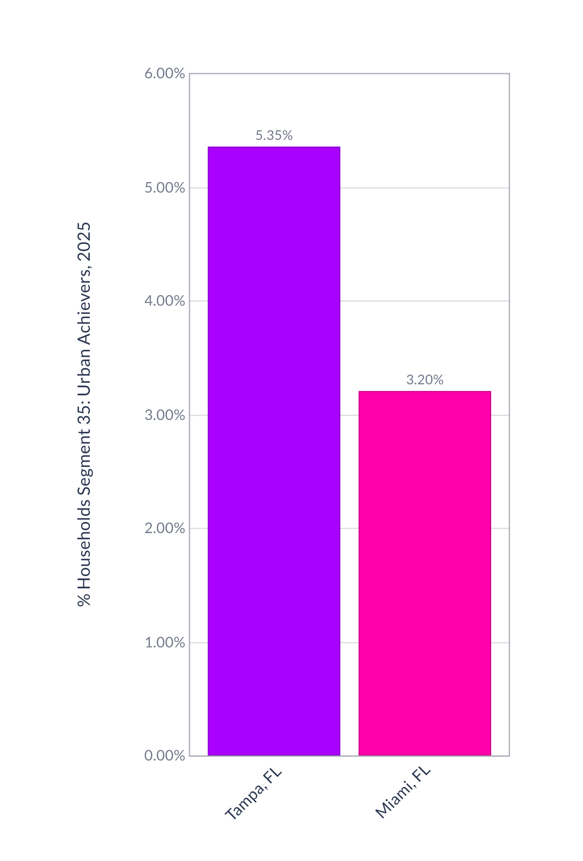
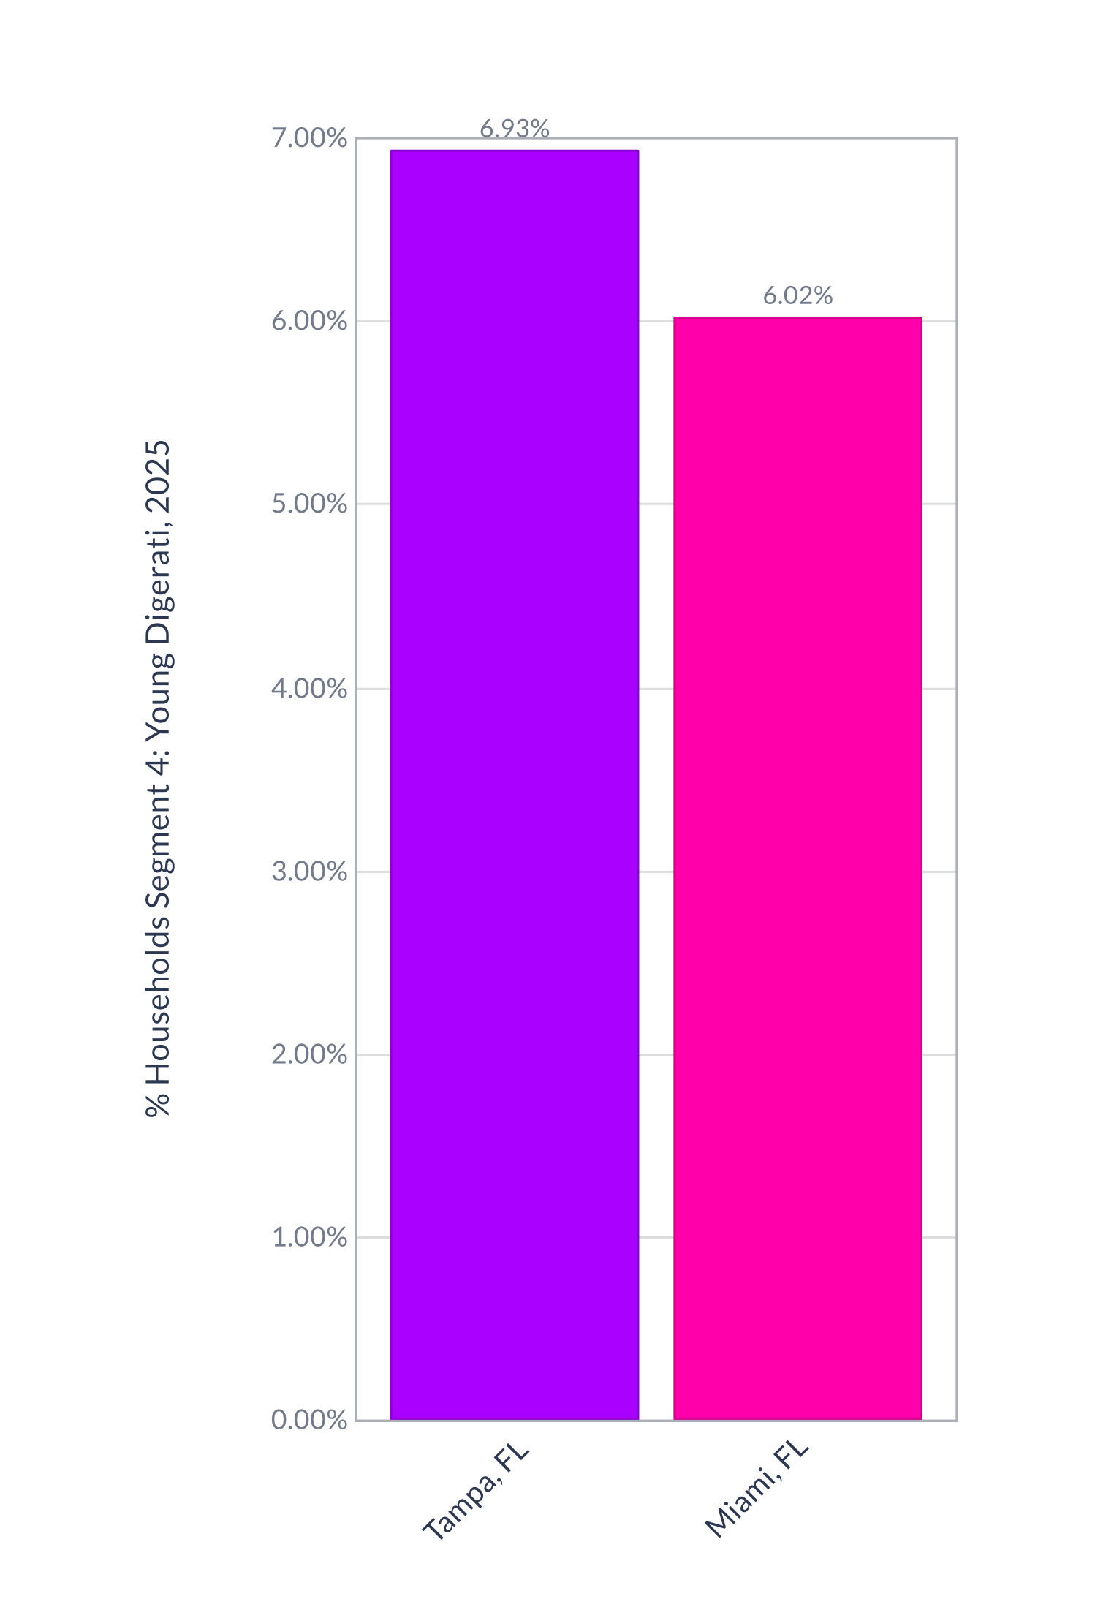
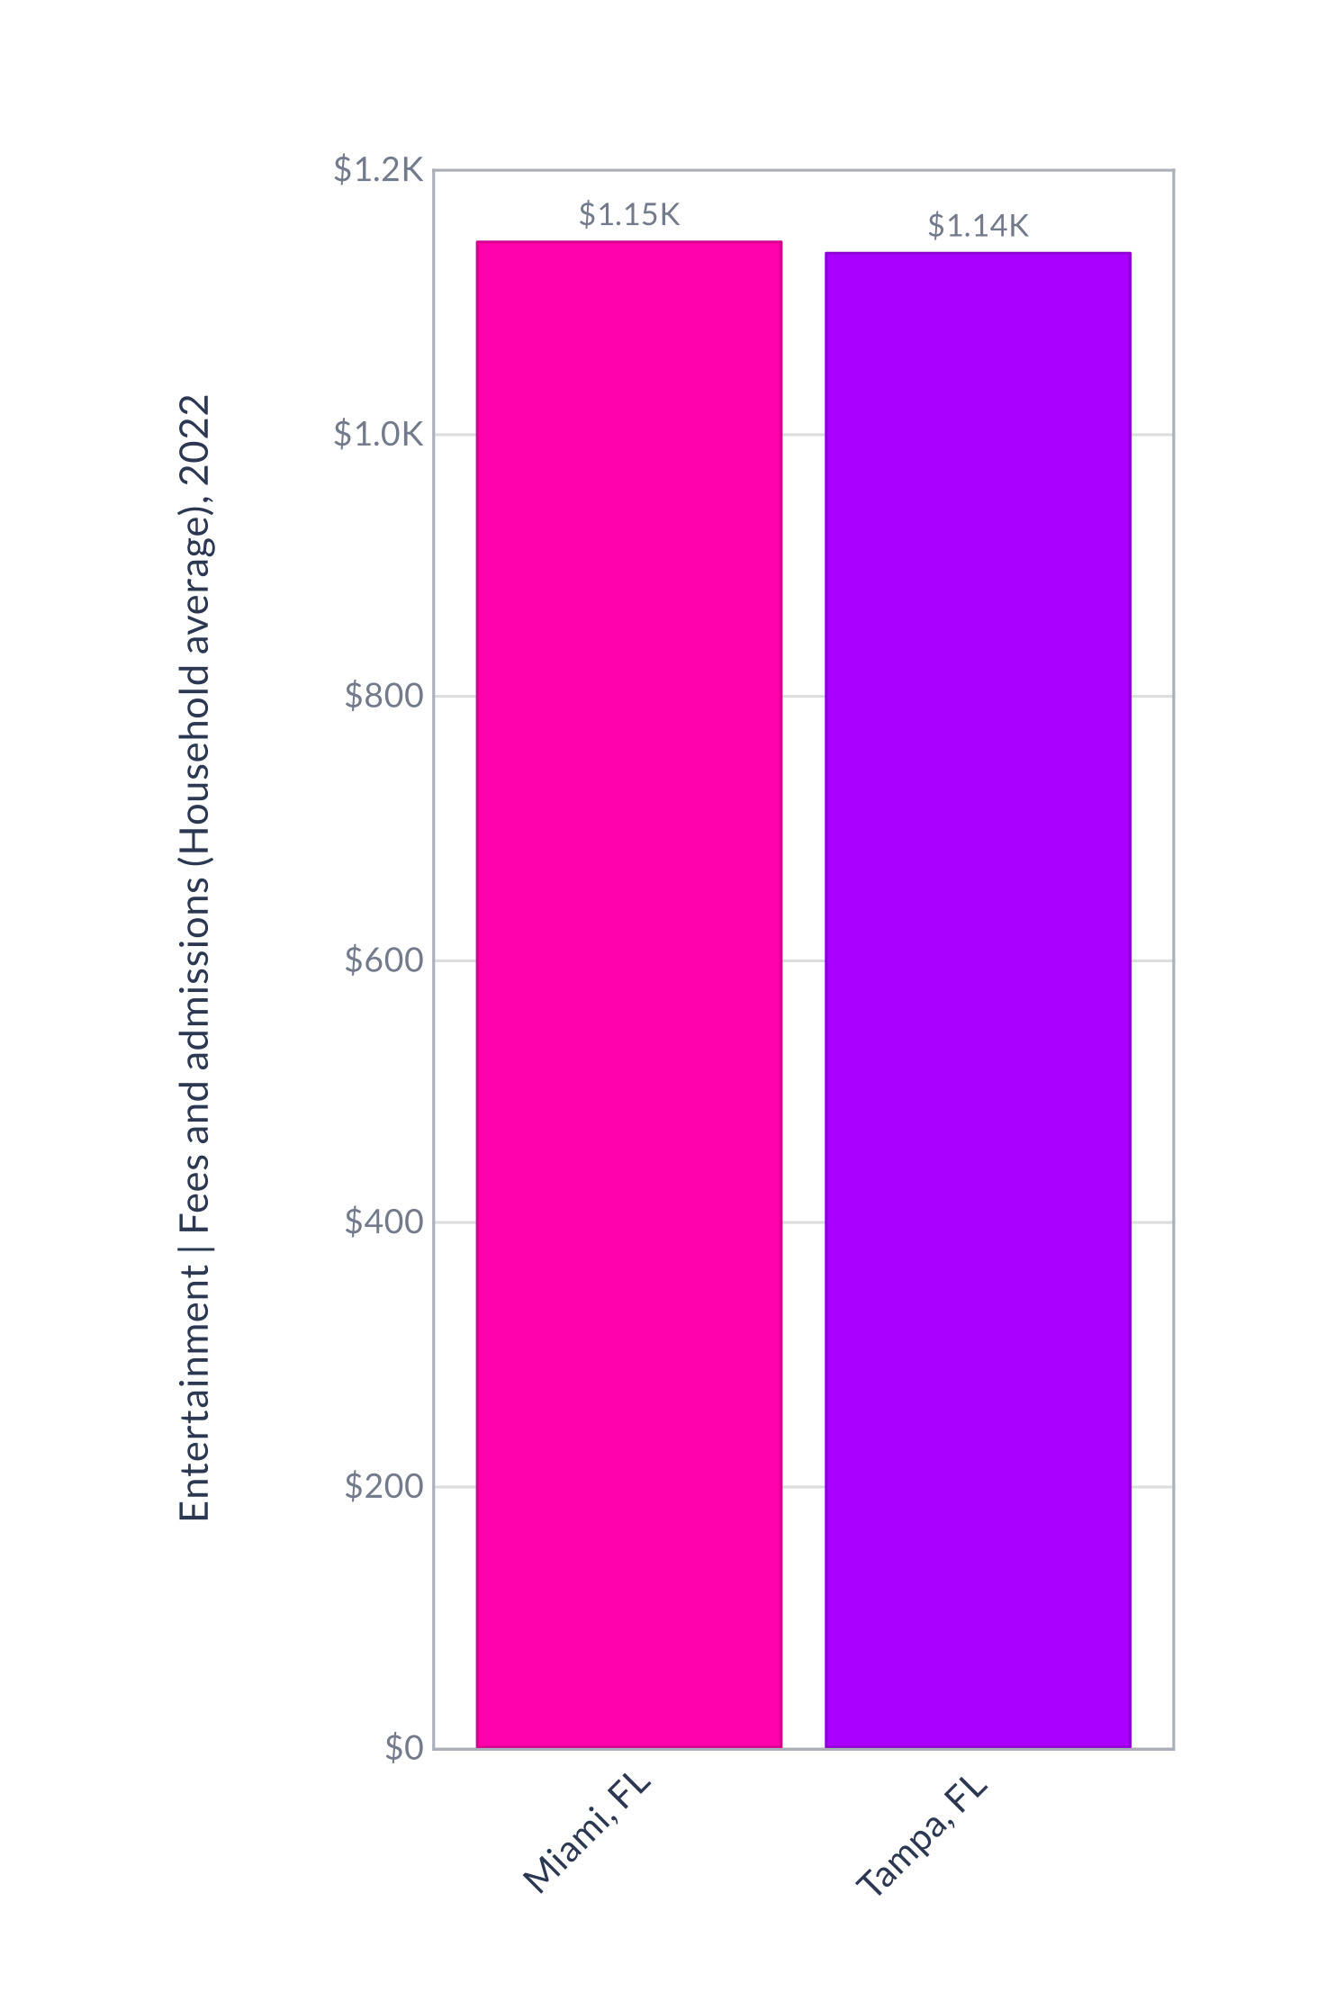
HIGHSCORE 2500
PLAYER 2
Target Customer Lifestyle Comparison
Notes:
We focused our expansion analysis on two major metro markets: Tampa and Miami. Using SimplyAnalytics, we compared key lifestyle variables including Young Digerati, Urban Achievers, and entertainment spending. As shown here, Tampa demonstrates a higher concentration of both Young Digerati and Urban Achievers, indicating stronger alignment with experience-driven consumers. While both cities show strong entertainment spending, Tampa’s lifestyle segment concentration gives it a strategic advantage.

Slide 6








701 S Miami Ave, Miami, Forida
COMPARING Locations
Where do u think the best location would be for Arcade monster
A. Tampa
B. Miami
1602 W Swann Ave,
Tampa, FL 33606
701 S Miami Ave, Miami, Florida

Slide 7
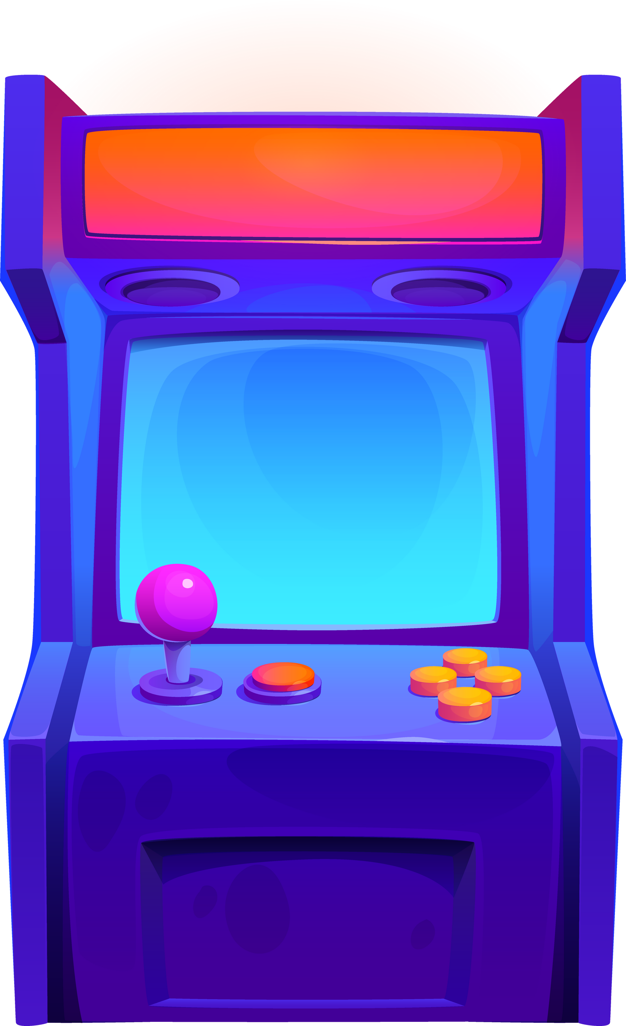
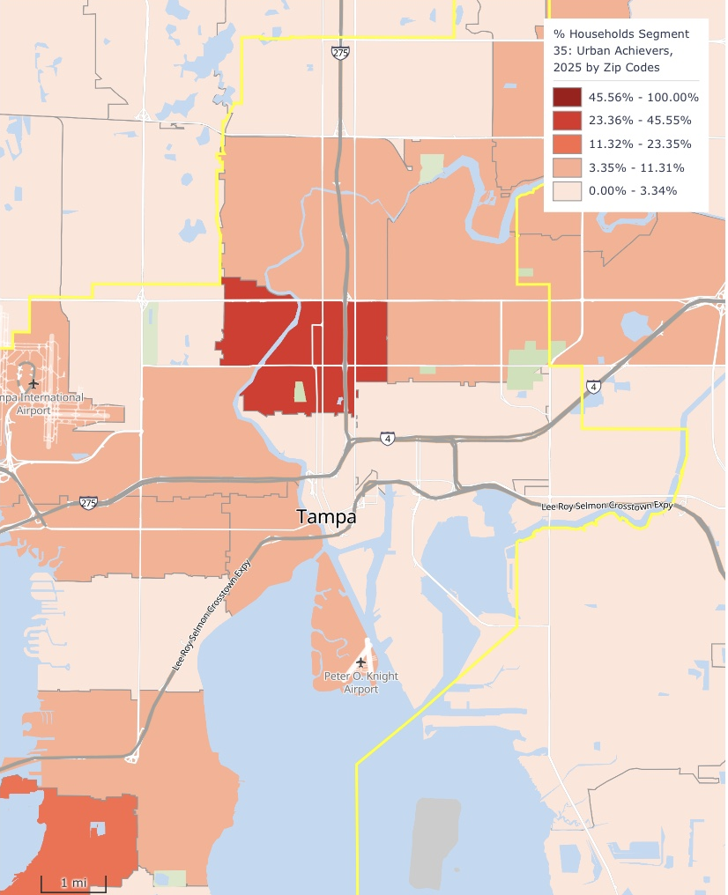
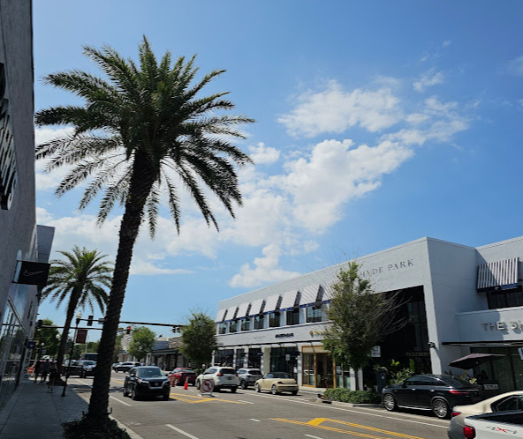
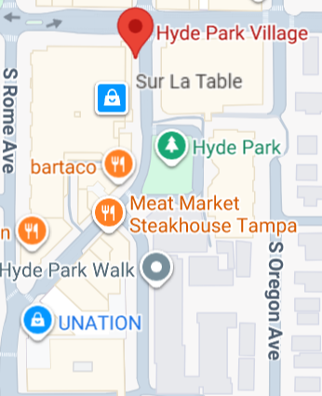
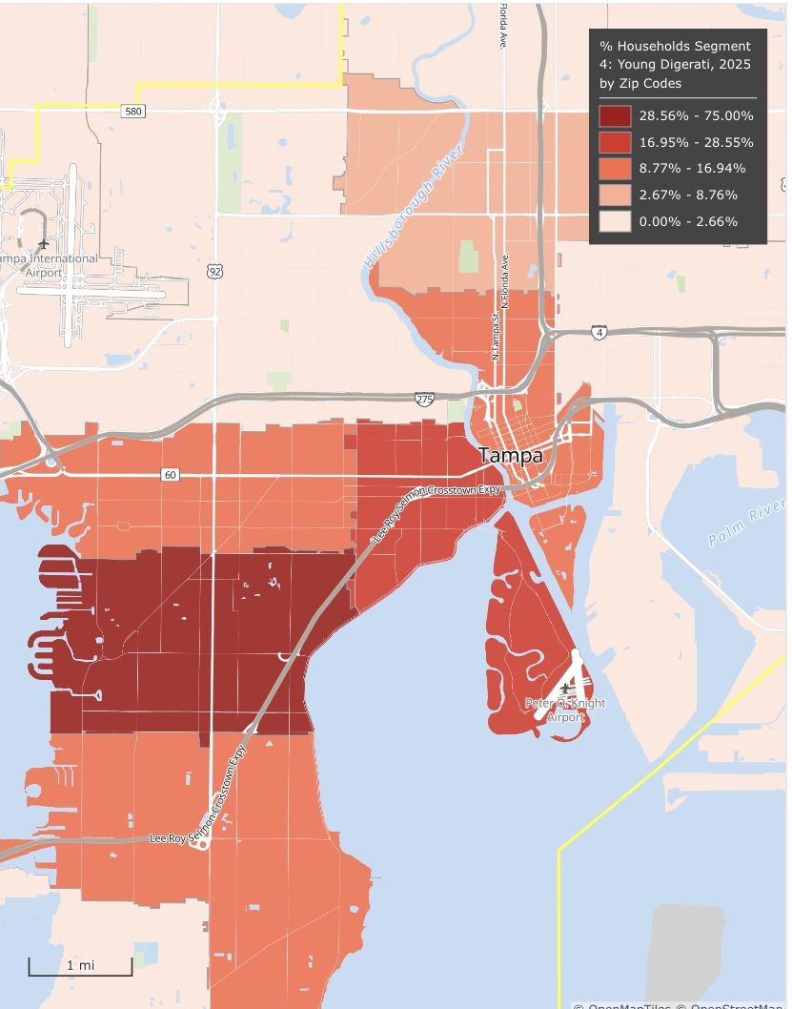


RECOMMENDATION
Hyde Park Village, FL
1602 W Swann Ave, Tampa, FL 33606
Notes:
Our final recommendation is HYDE PARK located in Tampa, Fl. This map shows the concentration of Young Digerati and Urban Achievers across Tampa, with Hyde Park displaying one of the strongest overlaps of these high-value segments. Combined with consistently high foot traffic from its established dining and nightlife environment, Hyde Park offers both strong spending power and natural customer flow, making it the most strategically aligned location for Arcade Monsters’ expansion

Slide 8


Competitive Advantage
01
02
03
Re-entries included with day passes
Accessibility &
Visibility
Minimal Competition
Notes:
Our competitive advantage starts with minimal competition from other entertainment spaces — meaning we stand out as a go-to destination. Plus, re-entry is included with every day pass, so guests can come and go freely. And with strong accessibility and visibility, we’re easy to find and even easier to enjoy. Less hassle, more fun.

Slide 9
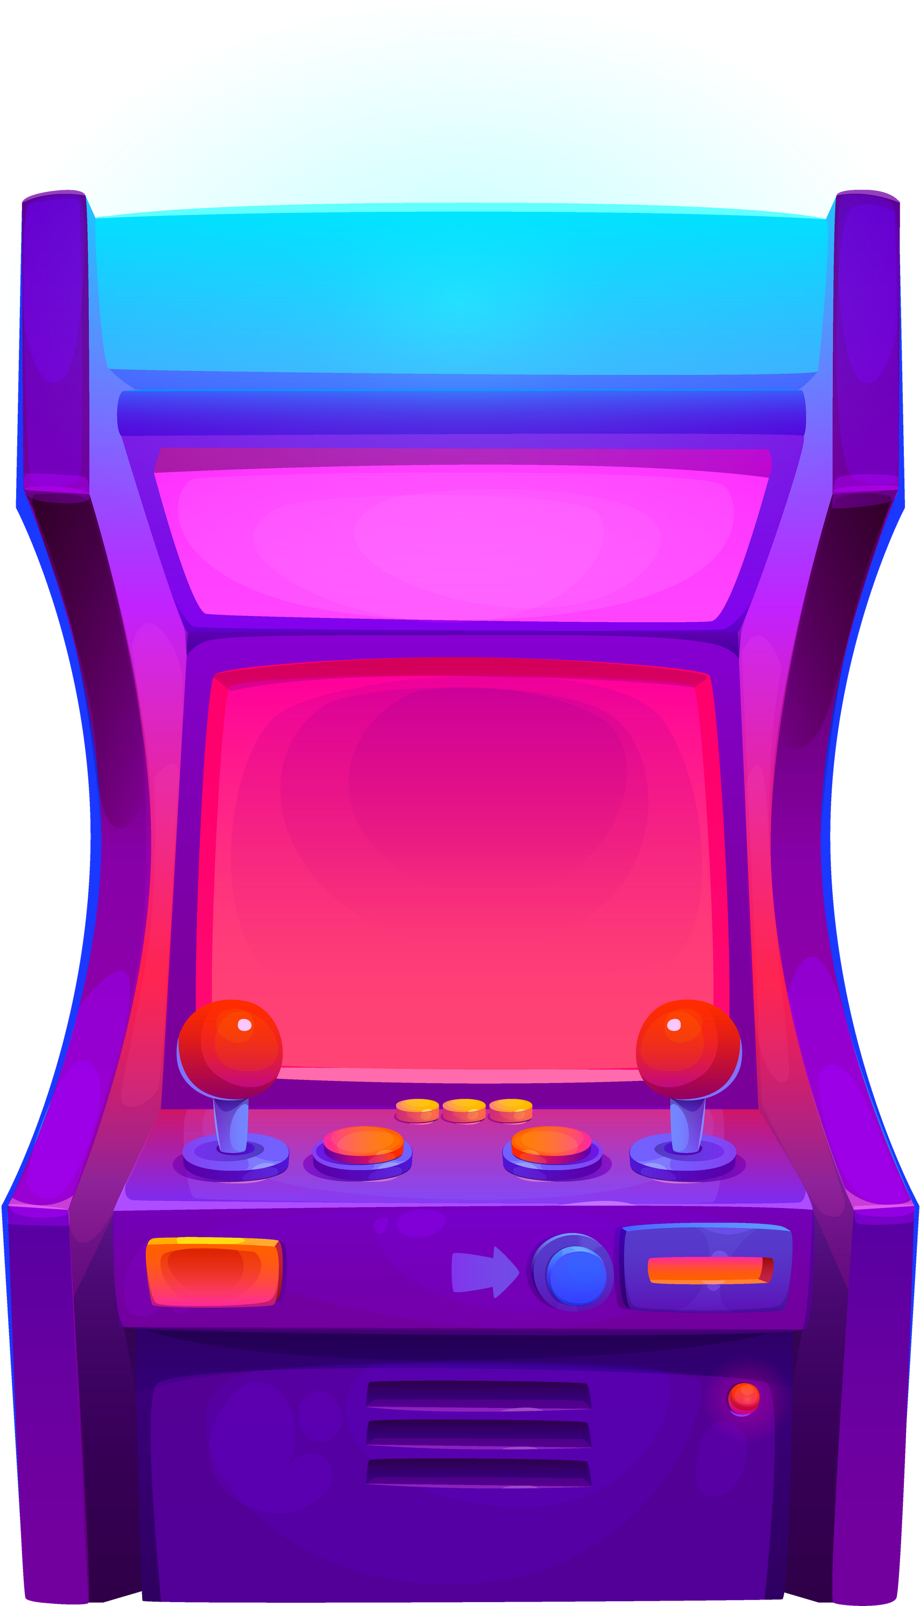
Objections and Risks
A.
Higher rent & operating costs
B.
Strong competition for leisure spending
Notes:
While Hyde Park has higher operating costs and slightly lower visit frequency than a campus location, these risks are offset by stronger discretionary spending, year-round demand, and a customer base that aligns with premium entertainment experiences.
Despite higher operating costs—including elevated rent—and slightly lower visit frequency compared to a campus location, Hyde Park benefits from stronger leisure spending, steady year-round demand, and a customer base that naturally aligns with premium entertainment experiences.

Slide 10
GAME OVER
Thank You For Playing!
"It's simple, we're just a couple of guys who grew up in the 80s playing video games. Our goal is to re-create all the fun from the golden era of gaming in a safe and loving environment for all to enjoy. "

Slide 11
References
WS Development. “Tampa’s Hyde Park Village Finesses Its Mix.” WS Development, www.wsdevelopment.com/news/tampas-hyde-park-village-finesses-its-mix/?utm_source=chatgpt.com. Accessed 11 Feb. 2026.
Amusement Arcade Industry. ZipDo Education Reports, 2026, https://zipdo.co/amusement-arcade-industry-statistics/ Accessed 11 Feb. 2026
SimplyAnalytics (2026). Claritas PRIZM Premier Data 2025. Retrieved February 8, 2026, from SimplyAnalytics database.
SimplyAnalytics (2026). SimplyAnalytics Consumer Expenditure Estimates Data 2022. Retrieved February 8, 2026, from SimplyAnalytics database
SimplyAnalytics (2026). Map with Claritas PRIZM Premier Data 2025. Retrieved February 8, 2026, from SimplyAnalytics database.
Arcade Monsters. About Us. Arcade Monsters, www.arcademonsters.com/about-us. Accessed 6 Feb. 2026.
AI Disclaimer: ChatGPT Open AI was used to find sources that had information in regards to the industry it's the target market.

