Slide 1

“This Lesson + Summary Worldview of a 2nd Temple Jew”
www.blues2joy.com/resources
Notes:
If you want a copy of this presentation and also a bonus document which is a more an in depth study into the powers behind this studt called “Summary Worldview of a 2nd Temple Jew” you can find it on my website at this address: www.blues2joy.com/resources . It’s right at the top of the page for you to download. So check it out if you want a copy…
So here we go, buckle up because I think your cognitive dissonance may get tested a bit today.

Slide 2
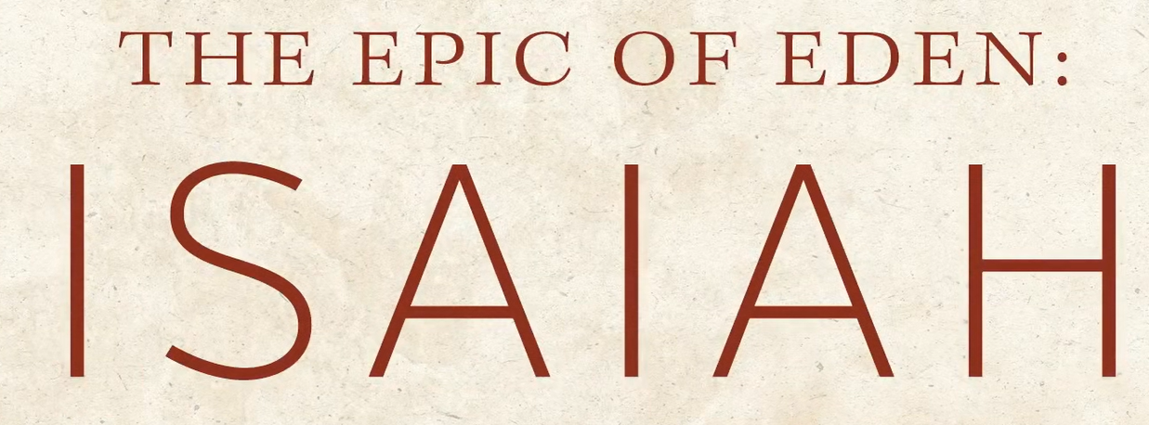
Our Lesson Today: The Book of Isaiah & The Idol
Isaiah 44:6-20
Notes:
Introductory Summary: Setting the Stage for Understanding Idols and the Powers Behind Them
There is a crucial distinction that lies at the heart of Isaiah’s message and the wider biblical worldview. The ancient nations surrounding Israel did not treat idols as mere symbols or religious artwork. They believed the idol was the physical body of a god — a crafted incarnation that could see, hear, eat, and act once it underwent the ritual called “opening the mouth.” The craftsmanship, the precious materials, and the elaborate ceremonies were all designed to make the statue appear alive. I saw on the Discovery channel once where the Greeks actually developed what we call today “Animatronics” or “Anthropomorphism” into developing idols that actually move. It’s easy to find this on YouTube and my doing an internet search.
But Scripture here is unambiguous (leaving no room for doubt or misunderstanding):
the idol itself is lifeless. It cannot breathe, move, speak, or save.
Exodus 20:3, the very first commandment of the Ten Commandments.
The Ten Commandments
…2“I am the LORD your God, who brought you out of the land of Egypt, out of the house of slavery. 3 You shall have no other gods before Me. 4 You shall not make for yourself an idol in the form of anything in the heavens above, on the earth below, or in the waters beneath.…
This is the first of the Ten Commandments, where God tells Israel that He alone is to be worshiped. The phrase “before Me” literally means “in My presence” or “in addition to Me.” In other words, God is saying:
“Do not place any other god, loyalty, or object of devotion alongside Me or above Me.”
It’s a command about exclusive allegiance — God must be first, without rivals.
What “gods” was God concerned about in Exodus 20:3?
Short answer: the real spiritual beings the nations worshiped, not imaginary statues.
In the ancient Near East, every nation believed in a pantheon of divine beings. The Bible acknowledges these beings exist — but insists they are created, lesser, and not to be worshiped.
Here are the main categories of “gods” God was warning Israel about:
1. The gods of Egypt
Israel had just come out of a world filled with:
Ra (sun god)
Osiris
Isis
Horus
Hapi (Nile god)
Heqet (fertility goddess)
The plagues were direct attacks on these gods.
2. The gods of Canaan
Israel was about to enter a land dominated by:
Baal (storm/fertility god)
Asherah (mother goddess)
Astarte/Ishtar (sex/war goddess)
Dagon (grain god)
These were the biggest threats because Israel would live among these people.
3. The “sons of God” / divine council beings
The Bible also refers to real spiritual beings who rebelled and became the gods of the nations:
Deuteronomy 32:8–9 says God allotted the nations to lesser divine beings.
Psalm 82 shows God rebuking these beings for injustice.
1 Corinthians 10:20 says pagan sacrifices are offered to demons.
So God wasn’t warning Israel about fictional gods — but about real spiritual powers that wanted Israel’s loyalty.
4. Human-made idols that represented these beings
Even though the idols were physical objects, the spiritual beings behind them were real (Deut. 32:17; Ps. 106:37).
Why this mattered
God was forming a covenant family, and the first commandment is basically:
“Do not give your loyalty to any other spiritual power — only to Me.”
It’s about exclusive allegiance, not denying the existence of other spiritual beings.
The Bible treats these “gods” as real, living spiritual beings, not imaginary characters or lifeless statues.
Not gods in the sense of rivals to Yahweh’s power — but created spiritual beings who rebelled and became the corrupt powers behind the nations.
Here’s the clearest way to understand it.
🟦 1. The Bible never says other gods are fake — it says they are inferior
Scripture repeatedly acknowledges that the nations worship real spiritual beings, but insists they are:
created
limited
corrupt
not worthy of worship
Examples:
Deuteronomy 32:17 — “They sacrificed to demons, not God… to gods they had not known.”
Psalm 82 — God stands in the divine council and judges these beings.
1 Corinthians 10:20 — “What pagans sacrifice, they sacrifice to demons.”
The Bible’s position is:
These beings exist, but they are not gods in the way Yahweh is God.
🟦 2. These beings were assigned to the nations
After Babel, God disinherited the nations and assigned them to lesser divine beings:
Deuteronomy 32:8–9 — God “fixed the borders of the peoples according to the number of the sons of God… but the LORD’s portion is His people.”
These beings later became corrupt, demanding worship and leading nations astray.
🟦 3. The idols were physical, but the beings behind them were spiritual
The Bible distinguishes between:
the carved statue (lifeless)
the spiritual entity behind it (real)
Paul makes this exact point:
The idol is nothing.
The spiritual power behind it is real.
🟦 4. These beings show up throughout Scripture
They appear as:
“sons of God” (bene elohim)
“princes” over nations (Daniel 10)
“gods of the nations” (Psalm 96:5)
“demons” (New Testament)
They are part of the divine council worldview — a major biblical theme.
🟦 So were they real?
Yes — real spiritual entities.
No — not gods equal to Yahweh.
They were created spiritual beings who rebelled and became the corrupt powers behind pagan religion.
This is why the First Commandment is not about imaginary threats.
It’s about exclusive loyalty in a world full of competing spiritual powers.

Slide 3
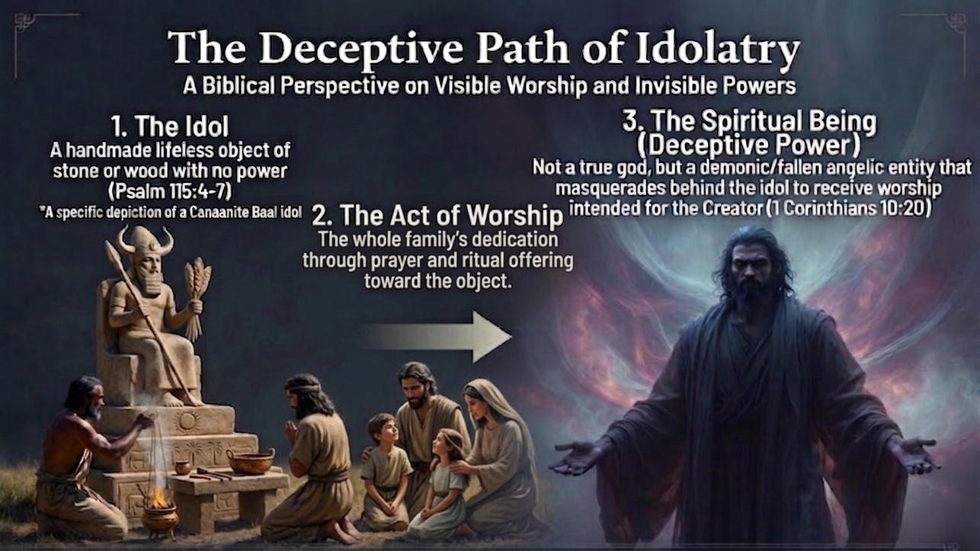
Notes:
This is why Isaiah (Active 740-700 BC) can mock the idol as a powerless block of wood while God simultaneously pronounces judgment on the corrupt spiritual rulers of the nations. The ritual never animated the statue. The god never entered the object. But the worship was still spiritually directed — not to Yahweh, but to the fallen powers described in Deuteronomy 32 and Psalm 82.
In this lesson, we will look at:
How ancient people crafted idols to appear alive
Why they believed the gods inhabited these statues
How Isaiah exposes the emptiness of the idol itself
What Scripture reveals about the real spiritual beings behind pagan worship
How this contrast prepares the way for the true Servant of the Lord
By understanding both the illusion of the idol and the reality of the powers behind it, we can appreciate Isaiah’s message with fresh clarity. We will see why the prophets insist that idols are nothing — and yet idolatry is spiritually dangerous. And we will see how the living God calls His people to reject every false source of power and trust in Him alone.

Slide 4
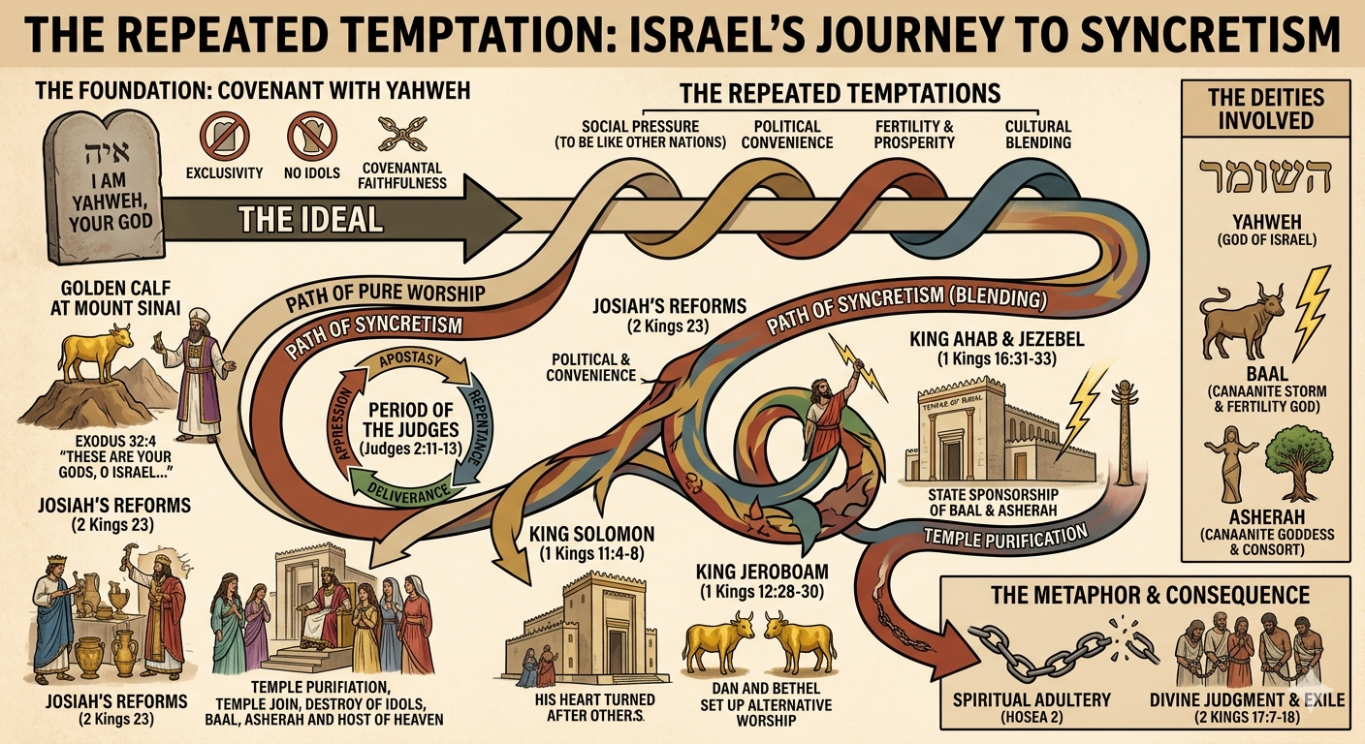
Notes:
In the video Ms, Richter will discuss…
•Israel’s repeated temptation to blend (Syncretism) Yahweh with Baal, Asherah, and other gods.
•Isaiah’s relentless exposure of idols as powerless, man made, deceptive, and yet spiritually destructive.
•Yahweh’s claim that He alone is God, He alone foretells the future, and He alone saves.

Slide 5
Core Message…
Isaiah presents a dramatic contrast between Yahweh, the true Servant-King, and the idol, the false hero Israel trusted. Idolatry is not merely bowing to statues—it is trusting anything other than Yahweh for identity, security, fertility, prosperity, or salvation.
Notes:
SHOW VIDEO NOW

Slide 6
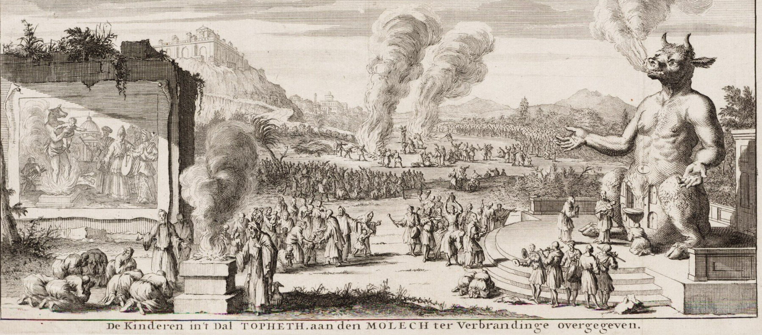
WHAT IDOLATRY LOOKED LIKE: The Tophet
Notes:
Let’s learn a new word. The word is “tophet” and it originated from the Aramaic and meant “hearth, fireplace or roaster.” It is used 10 times in the Hebrew Bible. In every scripture in which it is used, it is clearly being condemned. It is even used as a warning: “Thus will I do unto this place, saith the Lord, and to the inhabitants thereof, even making this city as Tophet; And the houses of Jerusalem, and the houses of the kings of Judah, shall be defiled as the place of Tophet, because of all the houses upon whose roofs they have burned incense unto all the “host of heaven”, <VERY KEY PHRASE> and have poured out drink offerings unto “other gods”” <ELOHIM- ANOTHER KEY PHRASE. (Jeremiah 19:12-13; kjv). For Jeremiah, the tophet was the epitome of horror and evil.
It was not an obscure place. In fact, it is alluded to around 25 times in the Bible. University of Pisa professor Paolo Xella wrote: “[I]f we collect all the relevant passages and analyze them thoroughly and synoptically, we will discover that no less than about 25 passages in the Old Testament testify more or less directly that Israelites and Canaanites (i.e. Phoenicians) sacrificed (and burned) their children … in tophet near Jerusalem” (‘Tophet’: An Overall Interpretation).
2 Kings 23:10 says the tophet was “in the valley of the children of Hinnom” (see also Jeremiah 7:31). The Valley of Hinnom
I read somewhere that archeologists discovered thousands of urns with the ashes and bones of children.
Y’know, JUST A THOUGHT BUT…I truly don’t believe that these people were stupid and at least educated to some degree. Forget the Hellywood version of these people. For them to make sacrifices, especially of their children to an ugly goat-man, I think one has to realize that there is a very powerful force and influence behind that act of worship.

Slide 7
Deuteronomy 32:8-9, perhaps more than meets the eye when it is first read..
Dead Sea Scrolls: “When Elyon gave the nations as an inheritance, when he separated the sons of man, he set the boundaries of the peoples according to the number of the sons of God (bene elohim). For Yahweh’s portion was his people; Jacob was the lot of his inheritance”.
Septuagint (LXX): “When the Most High divided the nations, when he separated the sons of Adam, he set the boundaries of the nations according to the number of the angels of God (aggelón theou). And his people Jacob became the portion of the Lord, Israel was the line of his inheritance”.
Masoretic Text (MT): “When Elyon gave the nations their inheritance, when he divided all the sons of man, he set the boundaries of the peoples according to the number of the sons of Israel (bene yisrael). For Yahweh’s portion was his people, Jacob was the lot of his inheritance”.
At Babel…

Slide 8
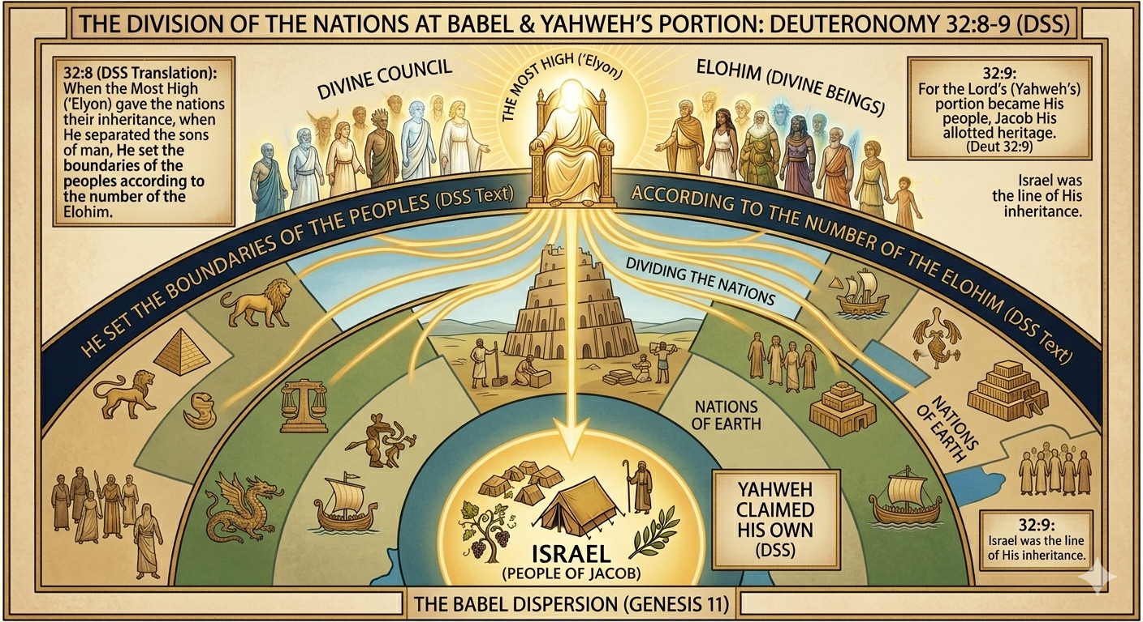
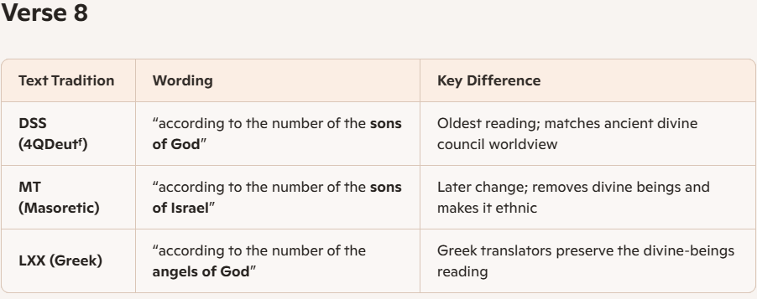
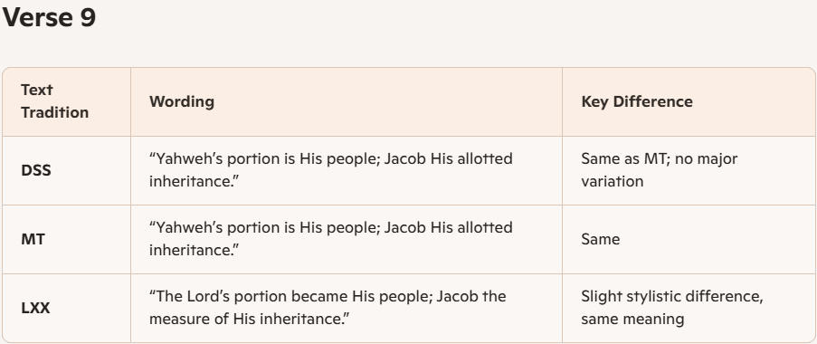
Deuteronomy 32:8-9
Notes:
This is where our conversation presses deeper — the Bible also teaches that the worship offered to these idols was not directed toward empty air. Behind the idols stood real spiritual beings, the rebellious elohim of Deuteronomy 32:8-9 (bene ha-elohim) & Psalm 82:1-8. (That designation is also found in Job and Genesis 6) These beings were assigned to the nations, became corrupt, accepted worship, and ruled unjustly. The nations believed their idols housed the gods; Scripture reveals that the statues were dead, but the spiritual powers behind the worship were tragically real. This can easily be documented with Scripture.
Your Bible probably reads of the Masoretic Text (MT) manuscript.

Slide 9
. Isaiah himself acknowledges the spiritual powers behind the nations
Isaiah 24:21 is the smoking gun:
“The LORD will punish the host of heaven in heaven, and the kings of the earth on the earth.”
Isaiah sees:
earthly rulers
heavenly rulers
Both being judged.
That is the Deut. 32 worldview in Isaiah’s own words.
Interpretation
These passages are often interpreted as a divine council scene where God, as the Most High, delegates authority over other nations, yet maintains personal control over “Not Yet” Israel. It is used to explain the biblical view that other nations were under the influence of lesser divine beings, while Israel was under the direct guidance of Yahweh.
Notes:
By the way—I go into great detail about this subject in my bonus material you can download from my website).

Slide 10
YOU CAN’T HAVE IT BOTH WAYS: You have to believe which translation to accept…
Key Details of Deuteronomy 32:8-9 (written apx.1400-1200 BC)
The Division (v. 8): When "the Most High" divided the nations after the flood/Babel (apx.2200-2000 BC), he set boundaries for humanity ("sons of Adam").
"Sons of God" vs. "Sons of Israel":
  "Sons of God" (bene ha-elohim):
Found in the Dead Sea Scrolls and the Septuagint, this reading suggests God assigned other nations to lesser divine beings or angels.
  "Sons of Israel" (bene yisrael): Found in the traditional Masoretic Text (MT 600-1000 AD), this reading is used in the KJV & other Bibles, suggesting boundaries were set based on the number of the tribes of Israel.
The LORD's Portion (v. 9): Regardless of the "sons" debate, both versions highlight that the Lord (Yahweh) retained Israel as his own direct "allotted heritage" or "portion".
Context: This passage is part of the "Song of Moses" (Deuteronomy 32) and serves to highlight Israel's unique, direct relationship with God, distinguishing them from other nations.

Slide 11
My belief is that these boundaries or territories were assigned by Yahweh to lesser Elohim. Here’s why: (RE: Deuteronomy 32)
>Masoretic Text (MT) (600-1000 AD)
בְּנֵי יִשְׂרָאֵל
“sons of Israel”
This is the reading in most modern Jewish Bibles and many Christian translations. PROBABLY YOUR BIBLE…
An Analysis per many theologians:
This reading cannot be original.
Israel did not exist when the nations were divided at Babel (Genesis 10–11).
It breaks the logic of the passage.
It appears to be a later scribal change to avoid the idea of “other gods.”
Notes:
Modern scholarship overwhelmingly agrees that Deuteronomy 32:8 originally referred to divine beings (elohim), not human beings As Well as Psalms 82.
And this is not fringe. It’s not Heiser’s idea. It’s not a supernaturalist bias. It’s the consensus of:
textual critics
Hebrew linguists
Dead Sea Scrolls scholars
ancient Near Eastern scholars
mainstream evangelical scholars
Jewish scholars
secular scholars
Scholars Who Support “Sons of God / Divine Council” in Deuteronomy 32:8–9
Textual Critics & Hebrew Linguists
Frank Moore Cross
David Noel Freedman
W. F. Albright
Paul Sanders
D. A. Robertson
John William Wevers
Emanuel Tov
Peter Flint
Ancient Near Eastern & OT Scholars
Mark S. Smith
Patrick D. Miller
John Day
Jeffrey Tigay
Moshe Weinfeld
Evangelical / Conservative Scholars
Michael S. Heiser
Daniel Porter
John Walton
Tremper Longman III
Richard Hess
Jewish Scholars
Nahum Sarna
Jacob Milgrom

Slide 12
My Analogy of the situation: Kinda dumb but I think it works ☺
MAFIA/COSA NOSTRA:
Godfather (Head of the Families) – Crime Bosses – The Wise Guys
THE FALLEN SPRITURAL REALM:
Satan (Head of the Rebellious Ones) – Fallen Elohim of Deut.32/Ps.82 –Demons
(The powers behind Idolatry and Chaos) Then & Now…

Slide 13
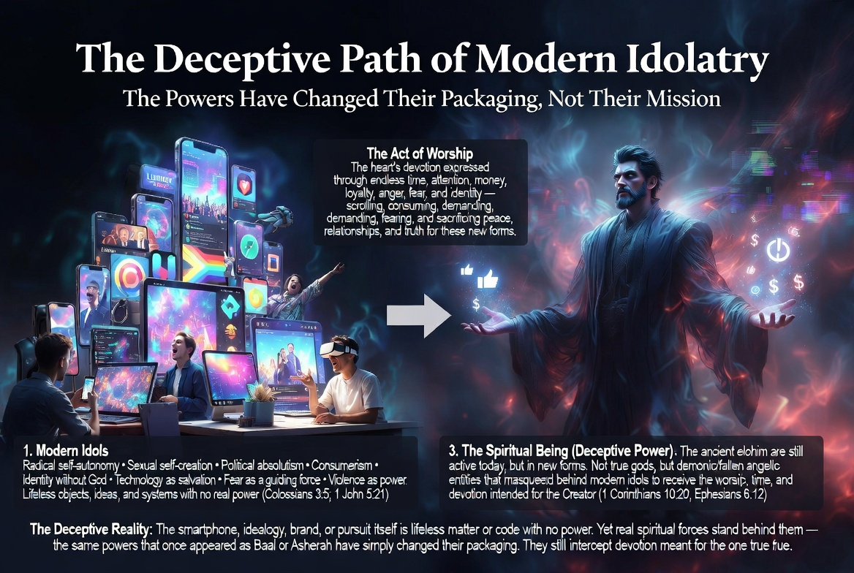
Notes:
WHAT IDOLATRY LOOKS LIKE TODAY
We no longer bow to Baal statues, but the spiritual dynamics are identical.

Slide 14
The Idol of Self
“The great crime of humanity… is that we move ourselves into the center of our own universe.”
Modern idolatry is:
self‑rule,
self‑definition,
self‑worship,
self‑sovereignty.

Slide 15
The Idol of Blended Faith
Just as Israel blended Yahweh with Baal and Asherah, today people blend:
Christianity + New Age
Christianity + Islam (“same God” confusion)
Christianity + secular moralism
Christianity + political identity
Christianity + prosperity gospel
This creates a god who is no longer the God of Scripture.

Slide 16
The Idol of Cultural Pressure
Ancient Israel compromised to “fit in” with Canaan.
Today Christians compromise to fit in with:
sexual ethics,
materialism,
expressive individualism,
political tribalism,
entertainment-driven spirituality.

Slide 17
The Idol of Security
Ancient people trusted Baal for rain and crops.
Today people trust:
money,
career,
government,
relationships,
technology,
personal autonomy.
Idolatry is anything we trust more than God.

Slide 18
SCRIPTURAL WAYS CHRISTIANS CAN FIGHT THIS SPIRITUAL WARFARE
1. Remember Who God Is (Isaiah 44:6–8)
2. Destroy the Idols (Deut. 12:1–5)
3. Love God With All Your Heart (Deut. 6:4–5)
The Shema is the antidote to idolatry:
“Hear, O Israel… You shall love the LORD your God with all your heart…”
Idolatry thrives where love for God grows cold.
Practice:
Worship, prayer, Scripture meditation, and obedience.
4. Expose the Lies (Isaiah 41:21–24)
5. Remember the Gospel (Acts 4:12)
“There is salvation in no one else…”
Jesus is the true Servant Isaiah promised.
He rescues us from the idols that enslave us.
Practice:
Preach the gospel to yourself daily.
6. Walk in the Spirit (Gal. 5:16–17)
Idolatry is a work of the flesh.
Victory comes through the Spirit’s power.
Practice:
Ask the Spirit to reveal hidden idols and empower obedience.
7.Engage in Community (Heb. 3:12–13)
Idolatry grows in isolation.
Community exposes deception.

Slide 19
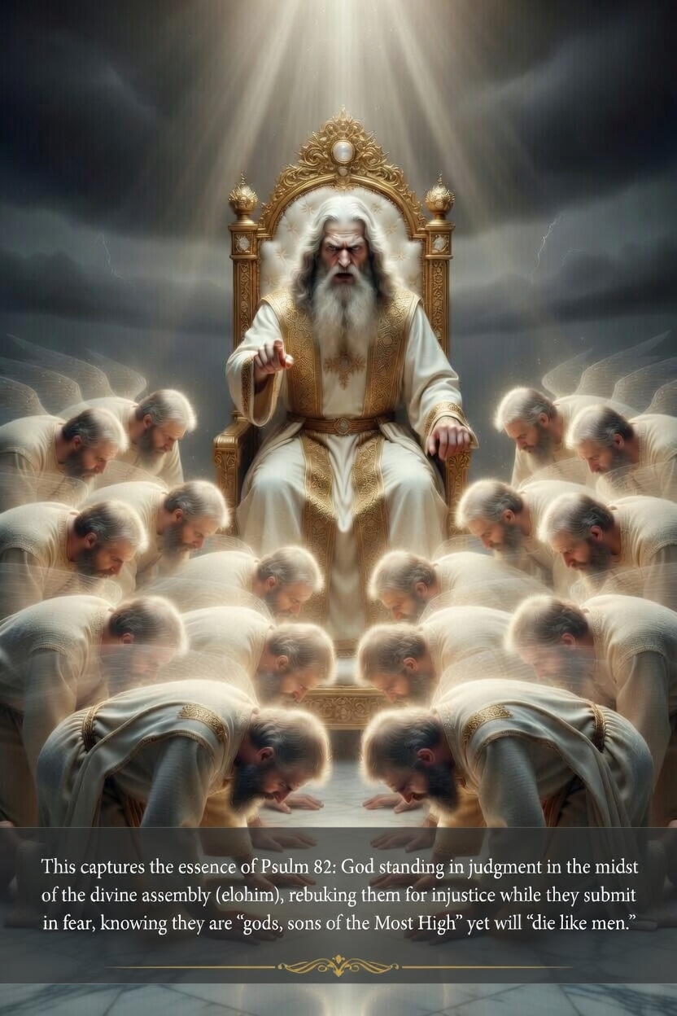
So What is to Become of These “Elohim” ? Psalm 82:1-7
5 “The ‘gods’ know nothing, they understand nothing.^{v}
They walk about in darkness;^{w}
all the foundations^{x} of the earth are shaken.
6 “I said, ‘You are “gods”;^{y}
you are all sons of the Most High.’
7 But you will die^{z} like mere mortals;
you will fall like every other ruler.”
1 God presides in the great assembly;
he renders judgment^{p} among the “gods”:^{q}
2 “How long will youª defend the unjust
and show partiality^{r} to the wicked?^{b} ^{s}
3 Defend the weak and the fatherless;^{t}
uphold the cause of the poor^{u} and the oppressed.
4 Rescue the weak and the needy;
deliver them from the hand of the wicked.
Notes:
These gods are still inflicting chaos on the world even today. But by Jesus sacrifice, He has broken their power. And their future is grim…

