Slide 1
Menu
Full breakfast £8.90……..with coffee £10.90
Bacon, Link sausage, Potato scone, Haggis, Black pudding,
Eggs (scrambled, poached, fried), mushroom, grilled tomato, baked beans
served with sourdough toast
Full veggie breakfast £8.00 ……..with coffee £10.00
Vegan sausage, avocado, potato scone, veggie haggis,
Eggs (scrambled, poached, fried), mushroom, grilled tomato, baked beans
served with sourdough toast
Avocado
Smashed Avocado on sourdough toast with toppings
[Eggs £7.50] [Salmon £7.90] [Pancetta £7.50] [Mushrooms £7.50]
Eggs
Eggs (scrambled, poached, fried) on sourdough toast
[Just Eggs £6.50] [Salmon £7.50] [Pancetta £6.90] [Mushrooms £6.90]
[Baked Beans £6.90]
Pancakes £6.90
5 American style pancakes with maple syrup & toppings
Blueberries, Bongou cream cheese, Banana, Granola
Kids
3 pancakes with maple syrup & choice of toppings £4.50
Blueberries, Bongou cream cheese, Banana, Granola
Baked beans on toast £3.50
Mini full breakfast £5.00
Toast with bacon, link sausage, egg, baked beans
Babycino – FREE
Cawston kids juice 80p
Drinks
Black coffee £2.20 Cloudy Apple juice:
Milk coffee £2.80 full glass £2.50
Hot chocolate £3.00 half glass £1.30
Extras: Oat milk 50p; Syrup 50p
Feel free to ask about ingredients and allergens

Slide 2
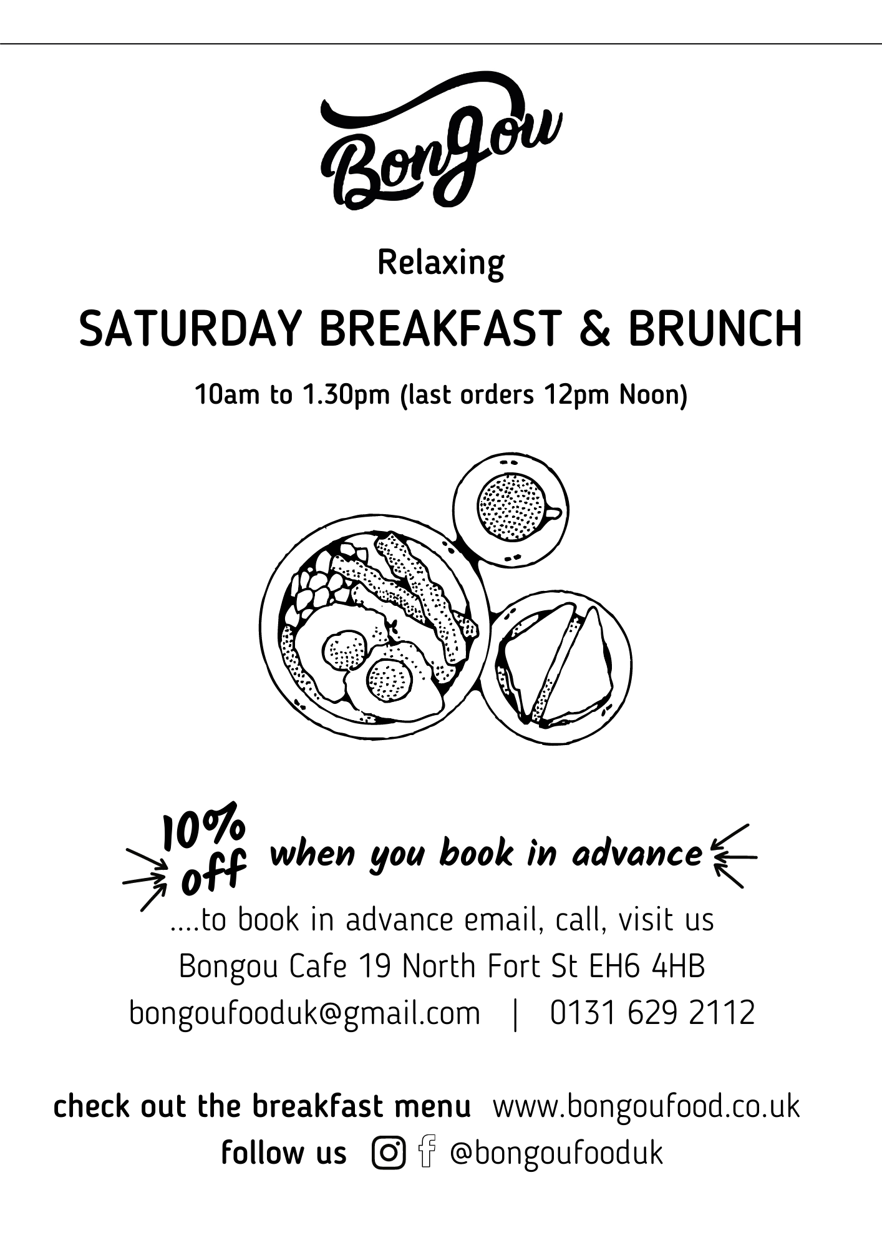
Menu
Full breakfast £8.90……..with coffee £10.90
Bacon, Link sausage, Potato scone, Haggis, Black pudding,
Eggs (scrambled, poached, fried), mushroom, grilled tomato, baked beans
served with sourdough toast
Full veggie breakfast £8.00 ……..with coffee £10.00
Vegan sausage, avocado, potato scone, veggie haggis,
Eggs (scrambled, poached, fried), mushroom, grilled tomato, baked beans
served with sourdough toast
Avocado
Smashed Avocado on sourdough toast with toppings
[Eggs £7.50] [Salmon £7.90] [Pancetta £7.50] [Mushrooms £7.50]
Eggs
Eggs (scrambled, poached, fried) on sourdough toast
[Just Eggs £6.50] [Salmon £7.50] [Pancetta £6.90] [Mushrooms £6.90]
[Baked Beans £6.90]
Pancakes £6.90
5 American style pancakes with maple syrup & toppings
Blueberries, Bongou cream cheese, Banana, Granola
Kids
3 pancakes with maple syrup & choice of toppings £4.50
Blueberries, Bongou cream cheese, Banana, Granola
Baked beans on toast £3.50
Mini full breakfast £5.00
Toast with bacon, link sausage, egg, baked beans
Babycino – FREE
Cawston kids juice 80p
Drinks
Black coffee £2.20 Cloudy Apple juice:
Milk coffee £2.80 full glass £2.50
Hot chocolate £3.00 half glass £1.30
Extras: Oat milk 50p; Syrup 50p
Feel free to ask about ingredients and allergens Menu updated on 10/09/21

