Slide 1
Mayor Robert Sullivan
Brockton: Where Progress Meets Possibility

Slide 2
Major Development and Infrastructure Projects

Slide 3
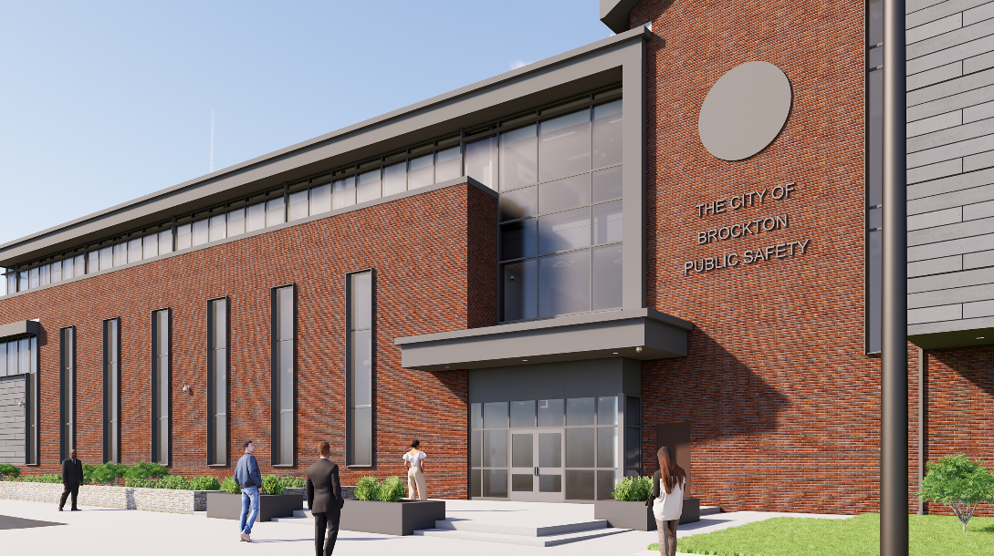
Brockton Public Safety Building
135 Warren Avenue
MAJOR DEVELOPMENT AND INFRASTRUCTURE
Public Safety Investments
Scheduled to open September 2025
Four departments in one state-of-the-art building
Police
Fire
IT
Brockton Emergency Management (BEMA)
Two-way traffic conversion on Warren Avenue (from Spring Street to Belmont Street)

Slide 4
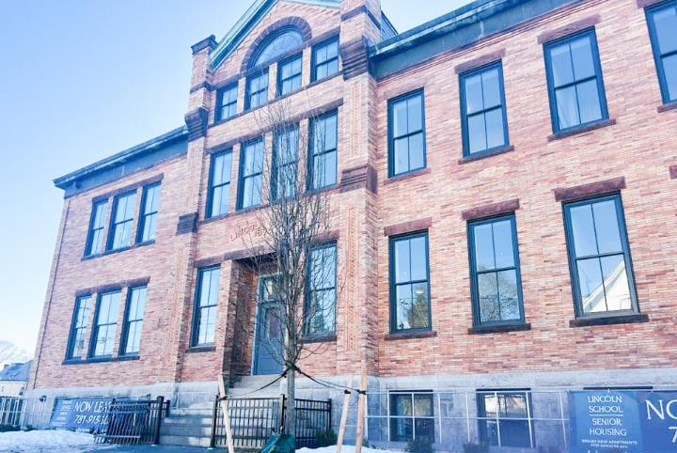
MAJOR DEVELOPMENT AND INFRASTRUCTURE
Redevelopment of Key Properties
Lincoln School Senior Housing
NeighborWorks Housing Solutions
Ribbon-cutting February 26, 2025

Slide 5
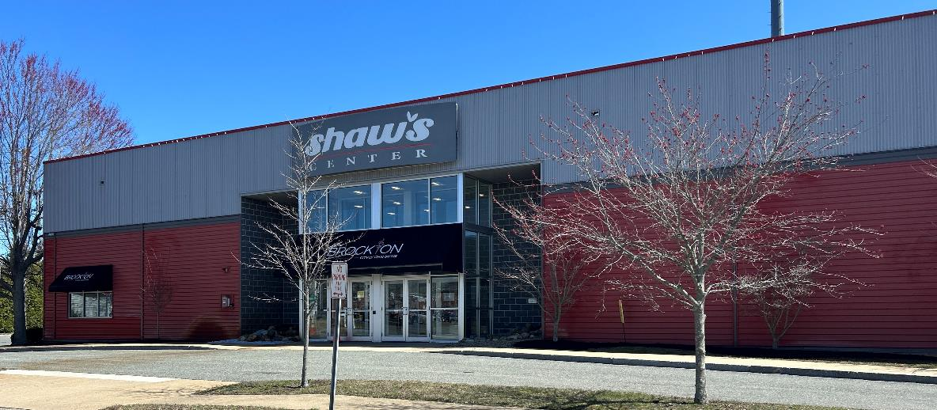
MAJOR DEVELOPMENT AND INFRASTRUCTURE
Redevelopment of Key Properties
Shaw’s Center/
Campanelli Stadium
CARES Act and ARPA funds
Approximately $4,000,000
Energy improvements
New scoreboard
LED lighting
Concession improvements
Locker room improvements
Originally a public meeting space for City and Community use, this building was converted to serve as the COVID response center/clinic, temporary home for the Brockton Council on Aging and as a City Hall Annex.

Slide 6
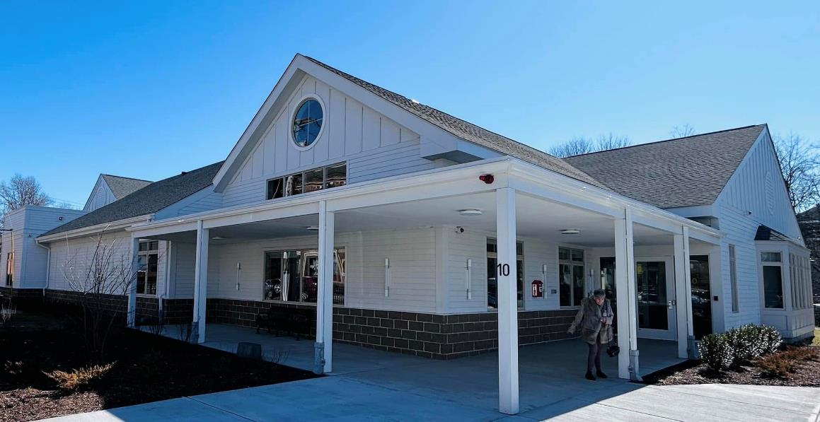
MAJOR DEVELOPMENT AND INFRASTRUCTURE
Redevelopment of Key Properties
Mary Cruise Kennedy
Senior Center
Opened on March 3, 2025
Total: $7,669,400* ARPA funding
*Includes state earmark of $1 million

Slide 7
Housing Growth and Urban Revitalization

Slide 8
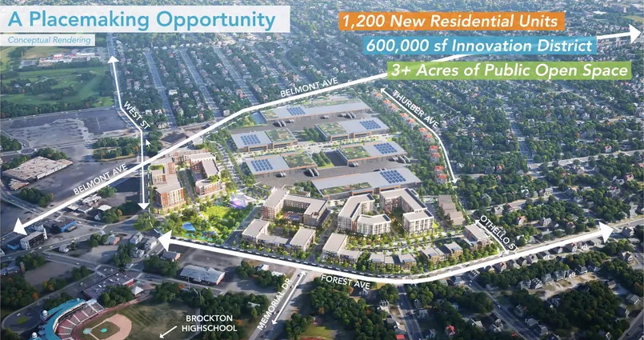
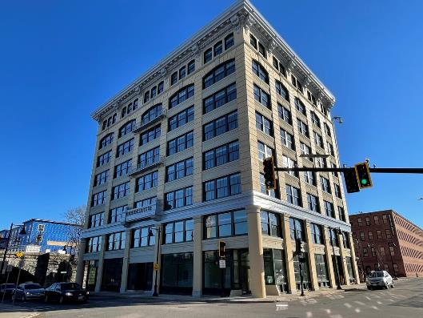
HOUSING GROWTH AND URBAN REVITALIZATION
Hundreds of new downtown housing units Increasing foot traffic, supporting small businesses, and modernizing our city.
Fairgrounds Development A multi-use site encouraging housing, business growth, and recreation while increasing tax revenue.

Slide 9
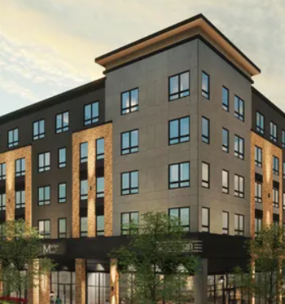
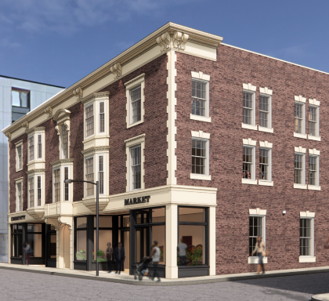
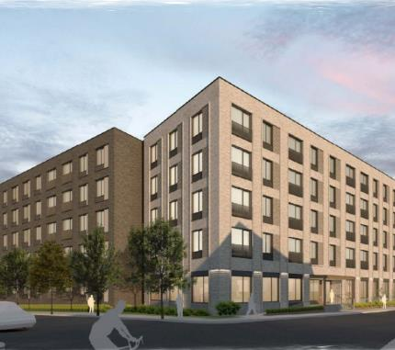
Residential Projects Currently Under Construction
HOUSING GROWTH AND URBAN REVITALIZATION
43-69 Montello Street
26 School Street
132 Main Street
46 Montello Street
69 North Montello Street
Merian on Main (rendering)
Dakota Properties
Hotel Grayson (rendering)
NeighborWorks Housing Solutions
Brockton South
Transit-Oriented-Development
(rendering)
NeighborWorks Housing Solutions

Slide 10
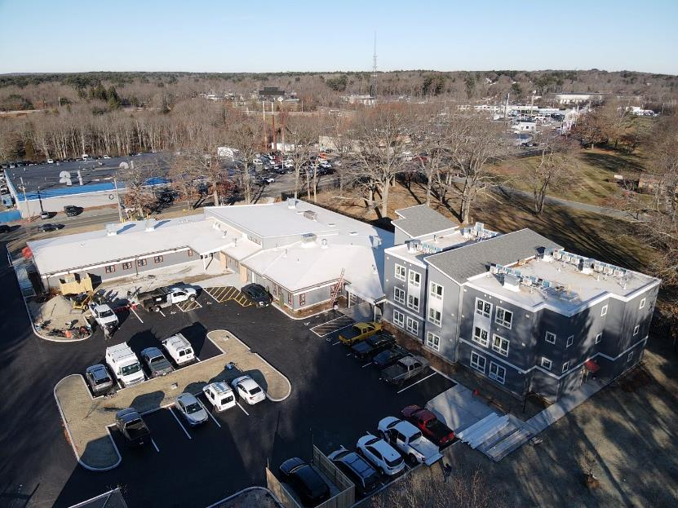
HOUSING GROWTH AND URBAN REVITALIZATION
Father Bill’s & MainSpring
Smith Family Housing Resource Center (HRC)
and Yawkey Hall, Manley Street
ARPA contribution of $650,000
from the City of Brockton

Slide 11
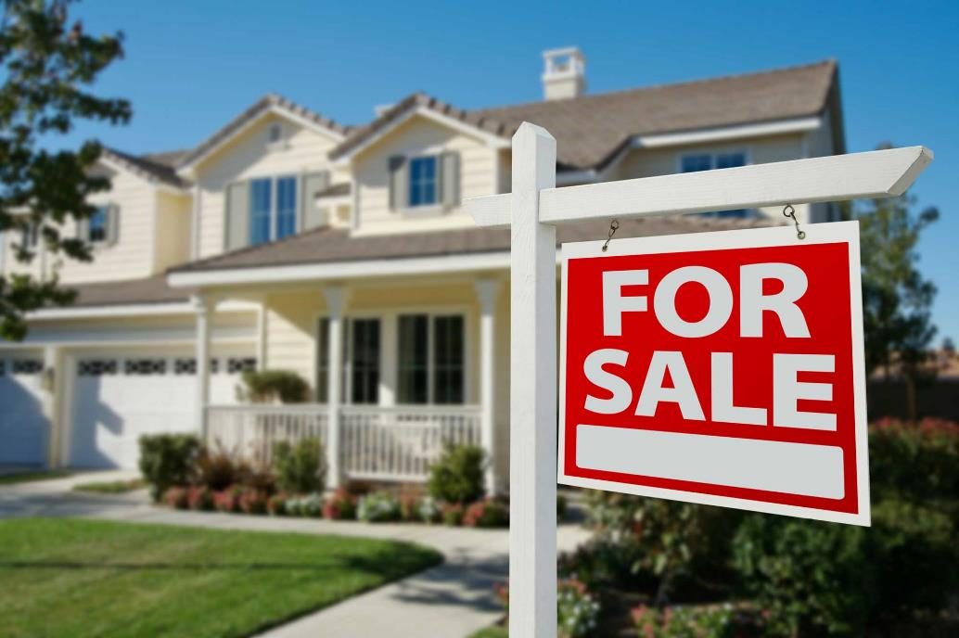
HOUSING GROWTH AND URBAN REVITALIZATION
Housing Market Boom
Home prices in Brockton have surged from the high $200,000s to the low $400,000s since 2017, reflecting the City's growing economic appeal and vitality.
Source: Boston Magazine

Slide 12
Economic Growth and Business Investments

Slide 13










ECONOMIC GROWTH AND BUSINESS INVESTMENTS
New Businesses In Brockton

Slide 14
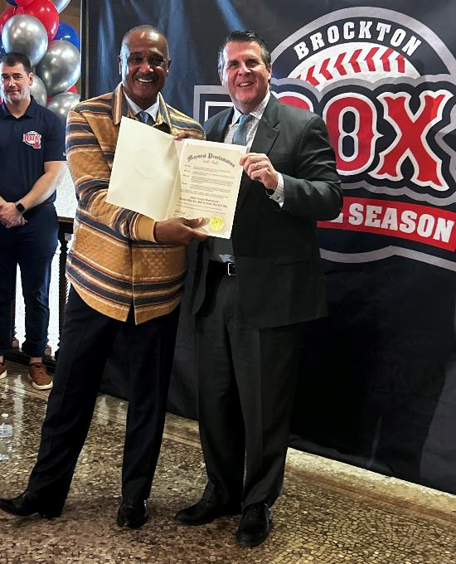

ECONOMIC GROWTH AND BUSINESS INVESTMENTS
Brockton Rox Revival Season
Bringing excitement, community engagement, and economic benefits.
New ownership group:
Shawn Reilly
Bill Janetschek
Rob Janetschek
Major League and Red Sox Hall of Famer Jim Rice
Opening Day May 16th!

Slide 15
Transportation, Infrastructure, and Connectivity

Slide 16
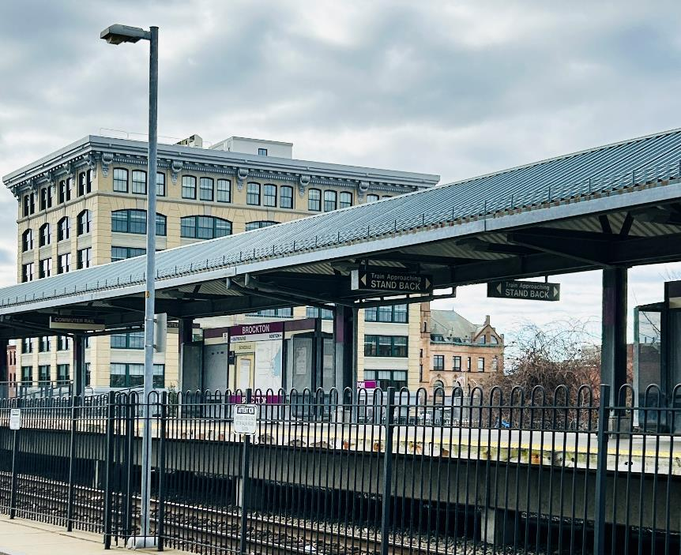
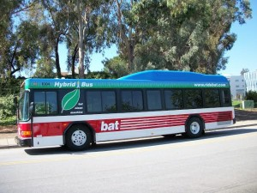
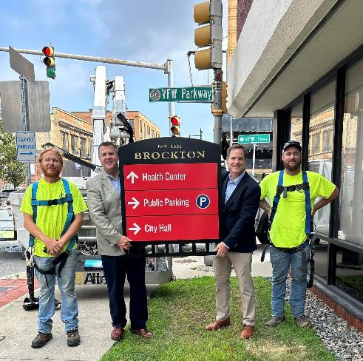
TRANSPORTATION, INFRASTRUCTURE, AND CONNECTIVITY
5 Electric Busses
South Coast Railway Ribbon-cutting March 24th
Wayfinding Signage

Slide 17
TRANSPORTATION, INFRASTRUCTURE, AND CONNECTIVITY
CSX Rail Yard Initiative plans to unlock 30 acres of centrally located land for business and community development.
Developer: Charter Development
Inter-Municipal Sewerage Agreements will strengthen the City’s finances by expanding partnerships with East Bridgewater and Easton, fostering responsible regional growth in commercial development and job creation.

Slide 18
Historic and Cultural Investments

Slide 19
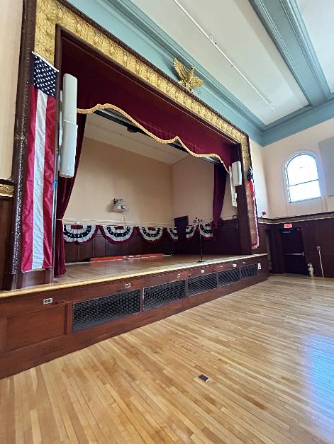
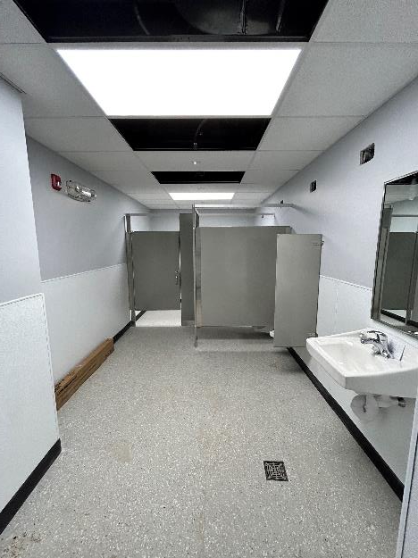
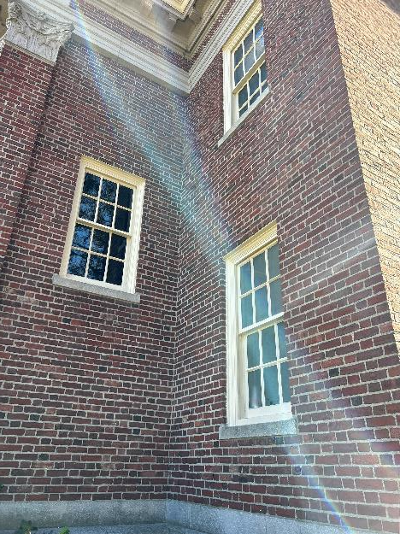
HISTORIC AND CULTURAL INVESTMENTS
War Memorial Building
Re-opened
September 12, 2024
$4.8 million ARPA funds

Slide 20
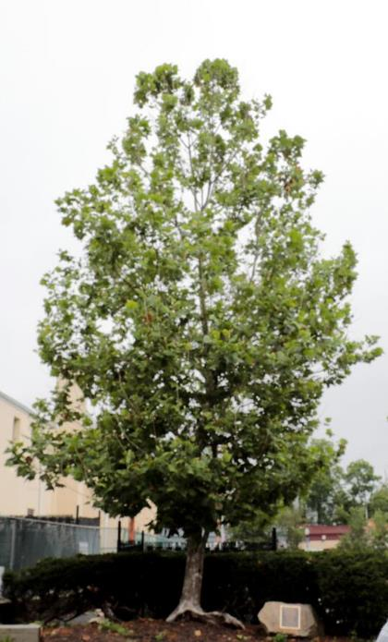
HISTORIC AND CULTURAL INVESTMENTS
The Historic Liberty Tree
Property acquired by City
Historic landmark
Stop on the Underground Railroad and significant location for suffragist movement

Slide 21
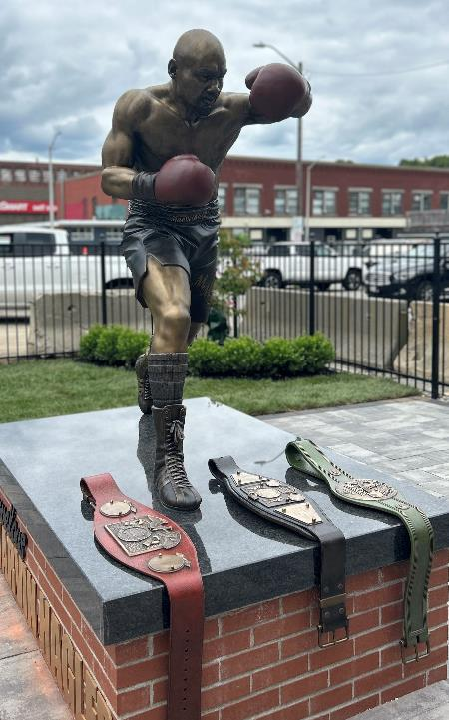
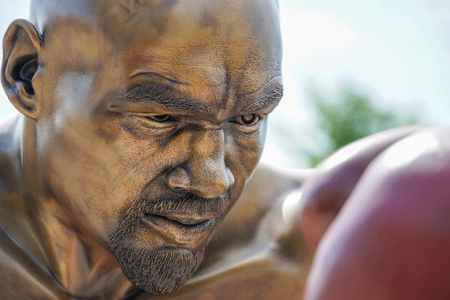
HISTORIC AND CULTURAL INVESTMENTS
Marvelous Marvin Hagler Park
Marvelous Marvin Hagler Statue
June 13, 2024
$150,000 state funding*
*Thank you former State Representative Gerry Cassidy

Slide 22
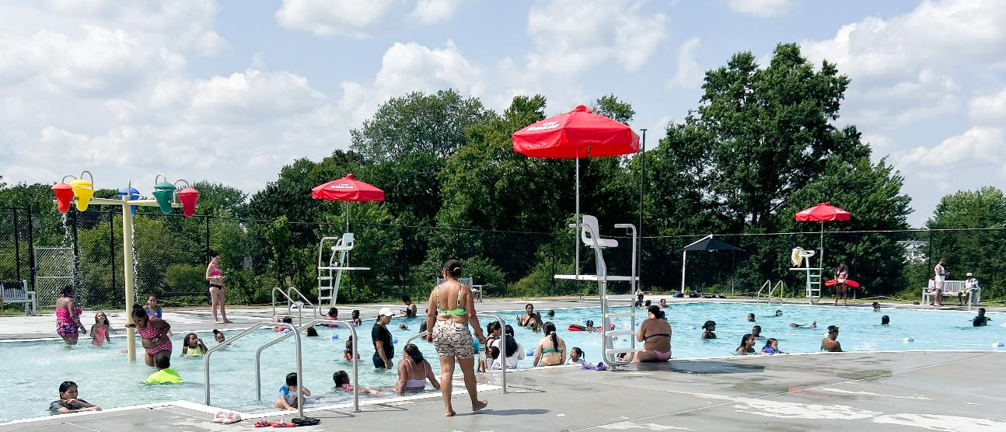
HISTORIC AND CULTURAL INVESTMENTS
Lawrence R. Cosgrove Memorial Pool
Re-Opened July 15, 2025
Funded by ARPA and
President Biden’s Omnibus Bill
Total: $6,004,533

Slide 23
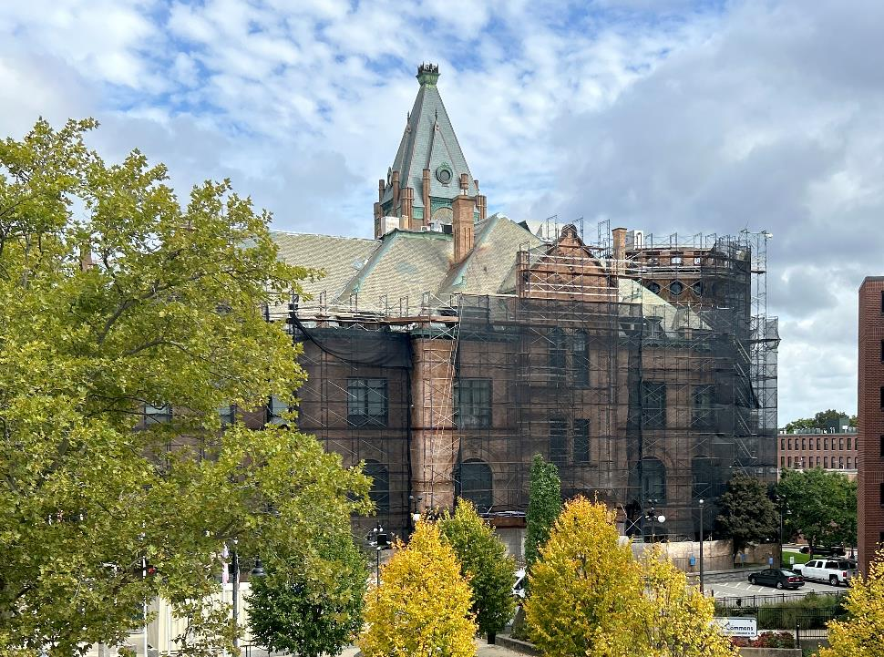
HISTORIC AND CULTURAL INVESTMENTS
Brockton City Hall
Restoring the People’s House for improved accessibility and aesthetics.
ARPA funding: $8,600,000

Slide 24
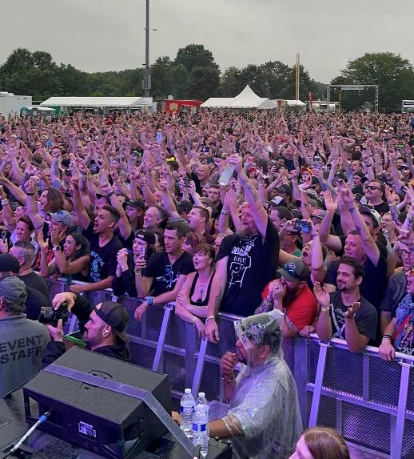
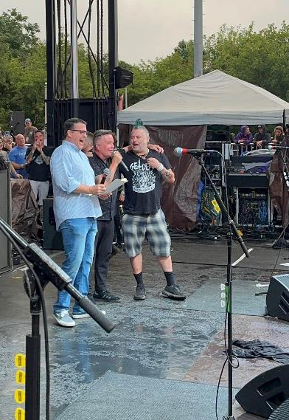
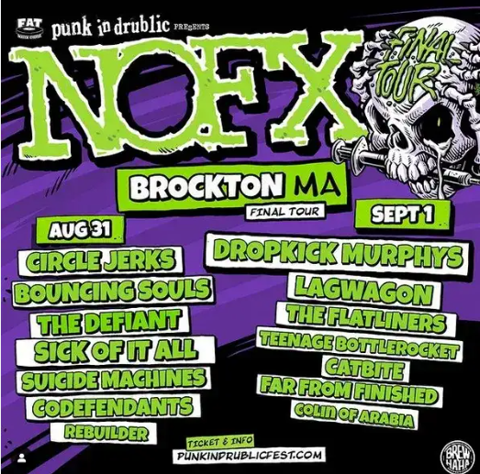
HISTORIC AND CULTURAL INVESTMENTS
Major Music Festival: Punk In Drublic
August 31 and September 1, 2024

Slide 25
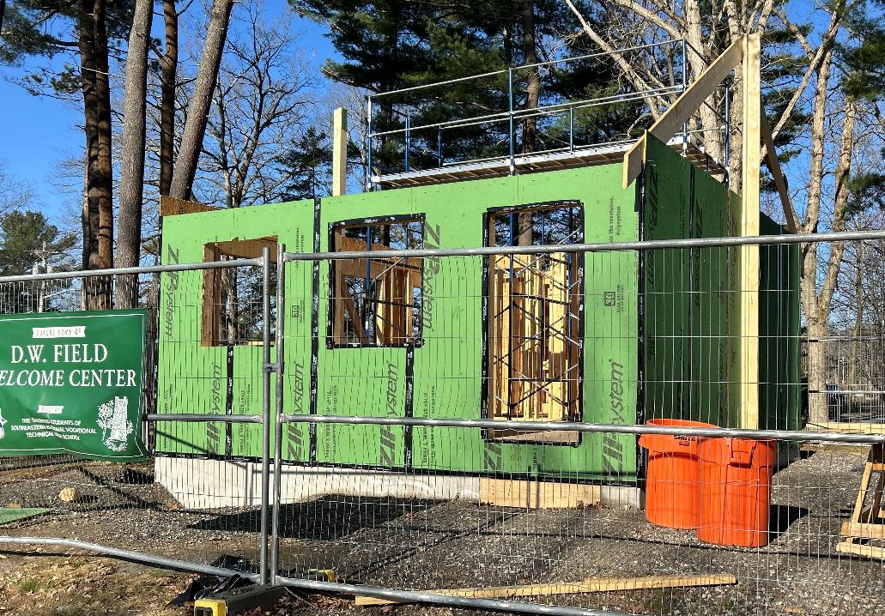
HISTORIC AND CULTURAL INVESTMENTS
DW Field Park Welcome Center
Southeastern Regional Vocational Technical High School student project

Slide 26
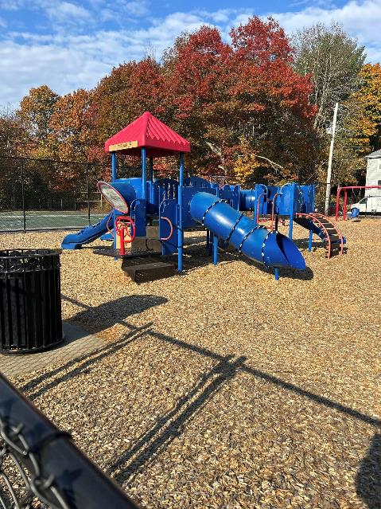
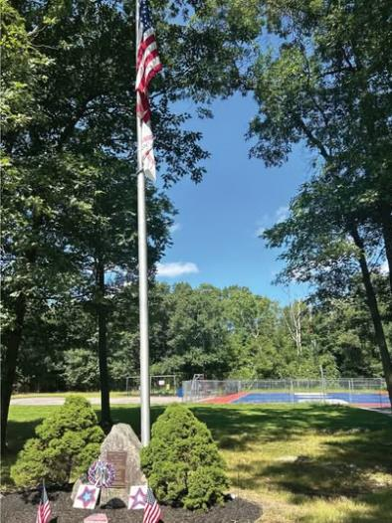
HISTORIC AND CULTURAL INVESTMENTS
ARPA-funded Playground and Recreational Space Renovations
Walker’s Playground
Edgar’s Playground
Hilstrom Farm Park
Justin DeMello Playground
Buckley Playground
Bent Playground
Tukis Playground
Timothy Holster Playground
Parmenter Playground
DW Field Golf Course window replacement
$3,300,000

Slide 27
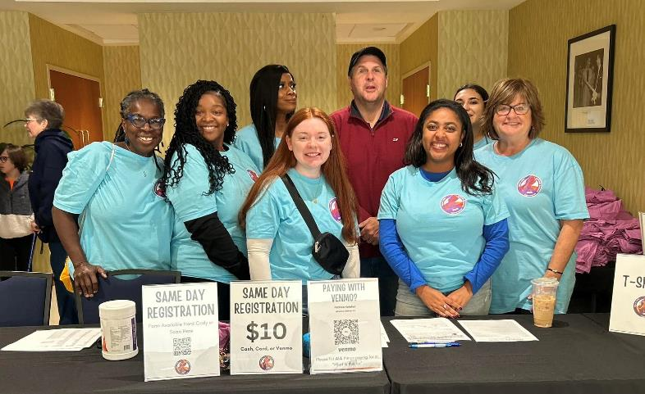
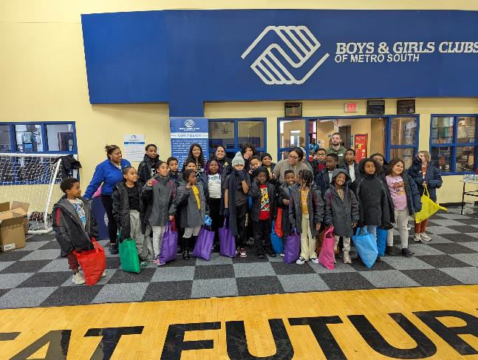
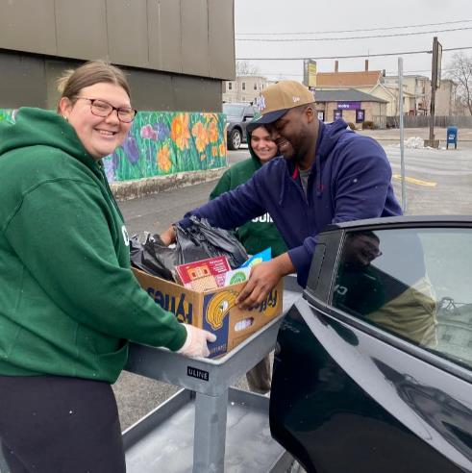
HISTORIC AND CULTURAL INVESTMENTS
ARPA investment in Brockton non-profits
$2 million to 42 non-profits
Family and Community Resources
Boys & Girls Club of Metro South
The Charity Guild

Slide 28
Looking Ahead: Future Priorities

Slide 29
LOOKING AHEAD: FUTURE PRIORITIES
Desalination Supply Contract Ensuring Brockton secures long-term, cost-effective water resources.
CSX Rail Yard Redevelopment Maximizing the site’s potential for economic growth and job creation.
State-Mandated Accessory Dwelling Units (ADUs) Thousands of new housing units expected due to new state laws.
Brockton Fairgrounds Housing, business, green space, restaurant/retail space
K Mart Plaza
VA Medical Center Housing
Lovett Brook (Good Samaritan) Life science development
Christo’s Housing and social services

Slide 30
LOOKING AHEAD: FUTURE PRIORITIES
The business community is essential to our continued growth.
Together, let’s keep building a stronger, more vibrant Brockton, focused on fostering and supporting businesses that drive job creation, stabilize families, and enhance our housing stock.

Slide 31
Thank You

