Slide 1

GROUND FLOOR Deputy Collector Finance Office Tax Office FIRST FLOOR City Solicitor’s Office Elections Commission Mayor’s Office SECOND FLOOR Auditing/Payroll City Council Chambers City Council Committee Room G.A.R. Room Procurement Treasurer’s Office | THIRD FLOOR * Assessor’s Office City Clerk DPW Engineering Department Human Resources Licensing Commission Parking Authority Weights and Measures SHAWS CENTER * Board of Health Building Department 39 MONTAUK ROAD * Public Works 50 SCHOOL STREET* Planning Department *New / temporary locations
WELCOME TO BROCKTON CITY HALL
Robert F. Sullivan, Mayor
Robert F. Sullivan, Mayor

Slide 2
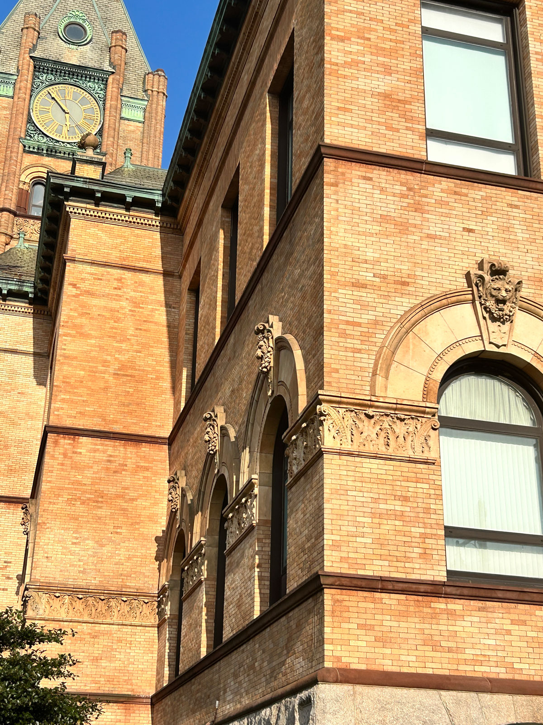
GROUND FLOOR Deputy Collector Finance Office Tax Office FIRST FLOOR City Solicitor’s Office Elections Commission Mayor’s Office SECOND FLOOR Auditing/Payroll City Council Chambers City Council Committee Room G.A.R. Room Procurement Treasurer’s Office | THIRD FLOOR * Assessor’s Office City Clerk DPW Engineering Department Human Resources Licensing Commission Parking Authority Weights and Measures SHAWS CENTER * Board of Health Building Department 39 MONTAUK ROAD * Public Works 50 SCHOOL STREET* Planning Department *New / temporary locations
Robert F. Sullivan, Mayor

Slide 3
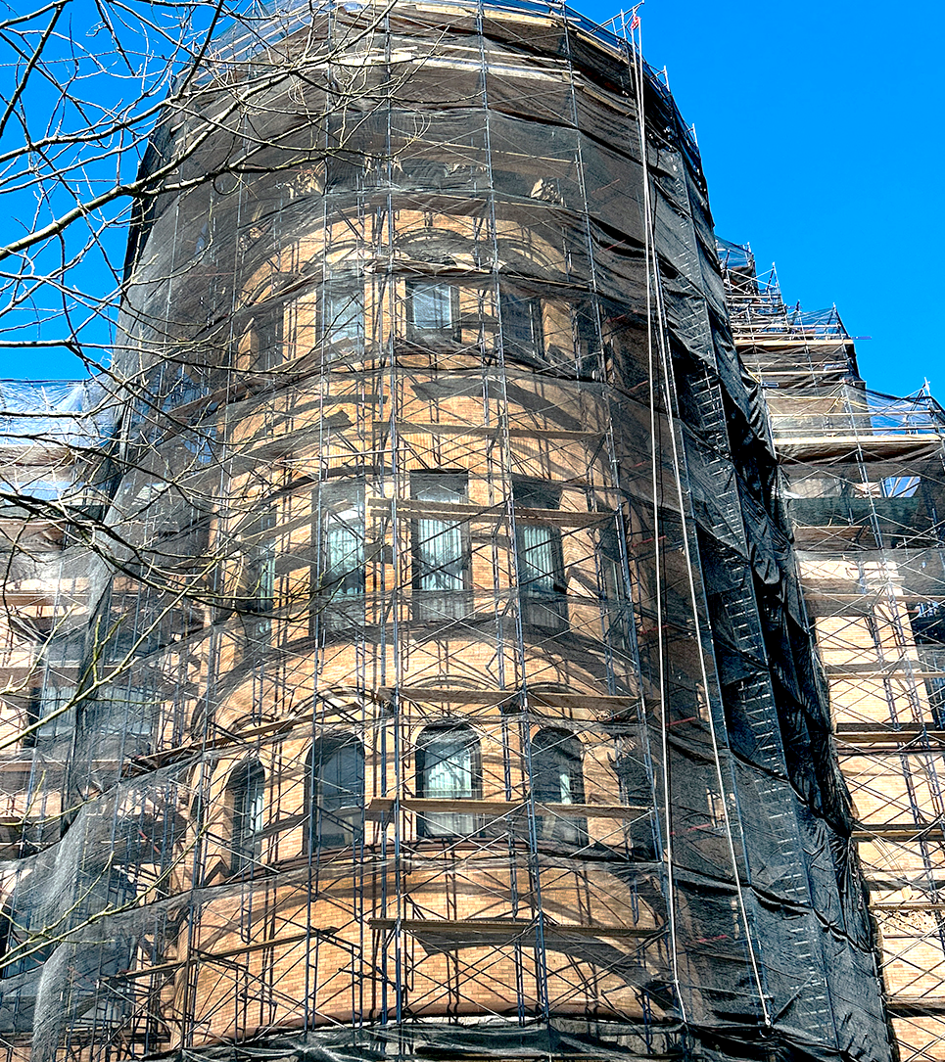
GROUND FLOOR Deputy Collector Finance Office Tax Office FIRST FLOOR City Solicitor’s Office Elections Commission Mayor’s Office SECOND FLOOR Auditing/Payroll City Council Chambers City Council Committee Room G.A.R. Room Procurement Treasurer’s Office | THIRD FLOOR * Assessor’s Office City Clerk DPW Engineering Department Human Resources Licensing Commission Parking Authority Weights and Measures SHAWS CENTER * Board of Health Building Department 39 MONTAUK ROAD * Public Works 50 SCHOOL STREET* Planning Department *New / temporary locations
Robert F. Sullivan, Mayor

Slide 4
GROUND FLOOR Deputy Collector Finance Office Tax Office FIRST FLOOR City Solicitor’s Office Elections Commission Mayor’s Office SECOND FLOOR Auditing/Payroll City Council Chambers City Council Committee Room G.A.R. Room Procurement Treasurer’s Office | THIRD FLOOR * Assessor’s Office City Clerk DPW Engineering Department Human Resources Licensing Commission Parking Authority Weights and Measures SHAWS CENTER * Board of Health Building Department 39 MONTAUK ROAD * Public Works 50 SCHOOL STREET* Planning Department *New / temporary locations
Robert F. Sullivan, Mayor

Slide 5
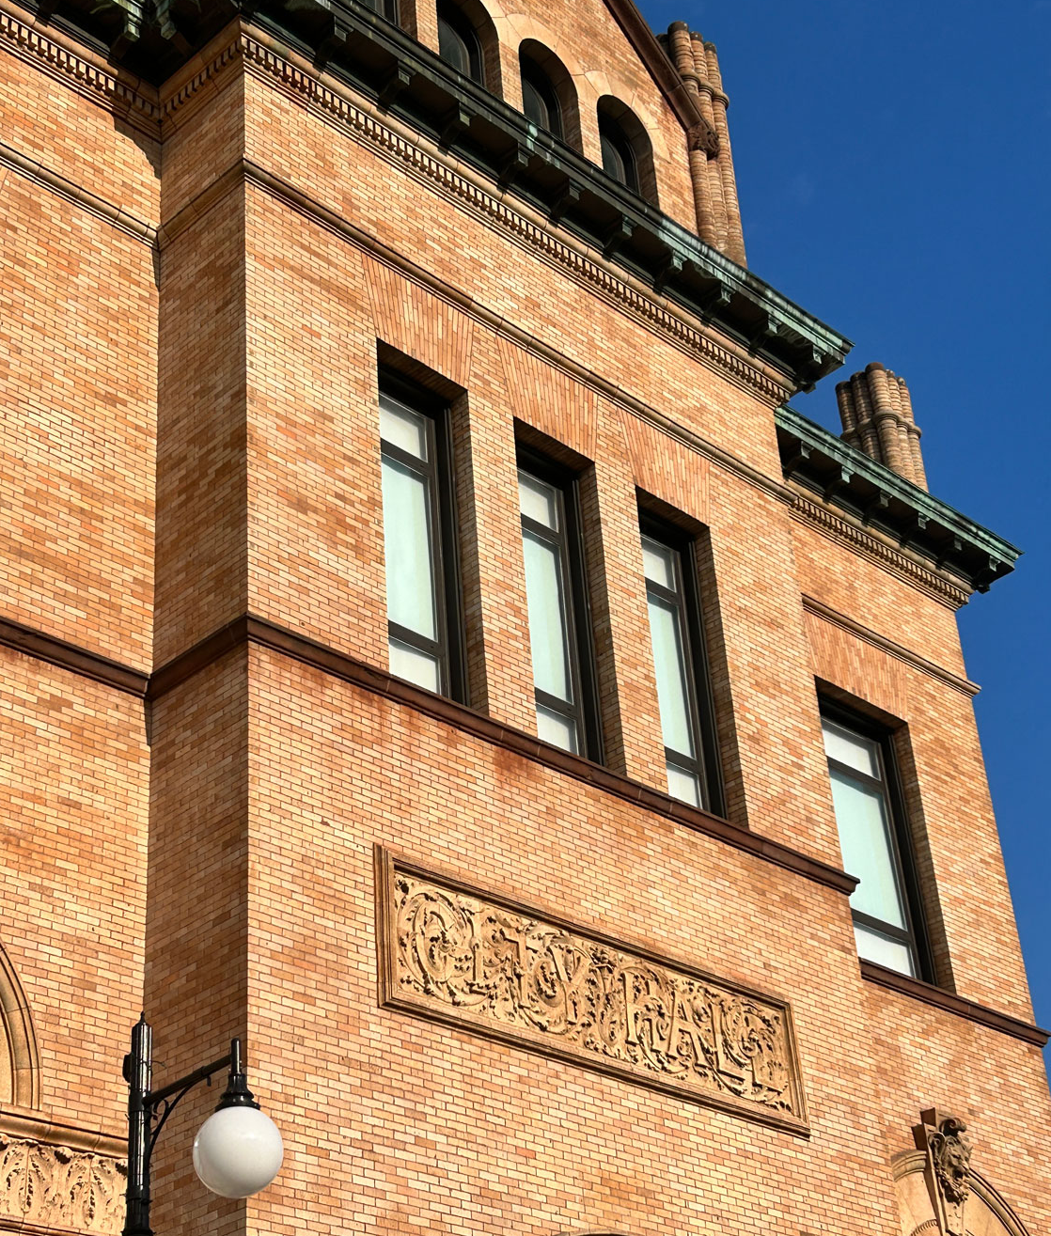
GROUND FLOOR Deputy Collector Finance Office Tax Office FIRST FLOOR City Solicitor’s Office Elections Commission Mayor’s Office SECOND FLOOR Auditing/Payroll City Council Chambers City Council Committee Room G.A.R. Room Procurement Treasurer’s Office | THIRD FLOOR * Assessor’s Office City Clerk DPW Engineering Department Human Resources Licensing Commission Parking Authority Weights and Measures SHAWS CENTER * Board of Health Building Department 39 MONTAUK ROAD * Public Works 50 SCHOOL STREET* Planning Department *New / temporary locations
Robert F. Sullivan, Mayor

Slide 6
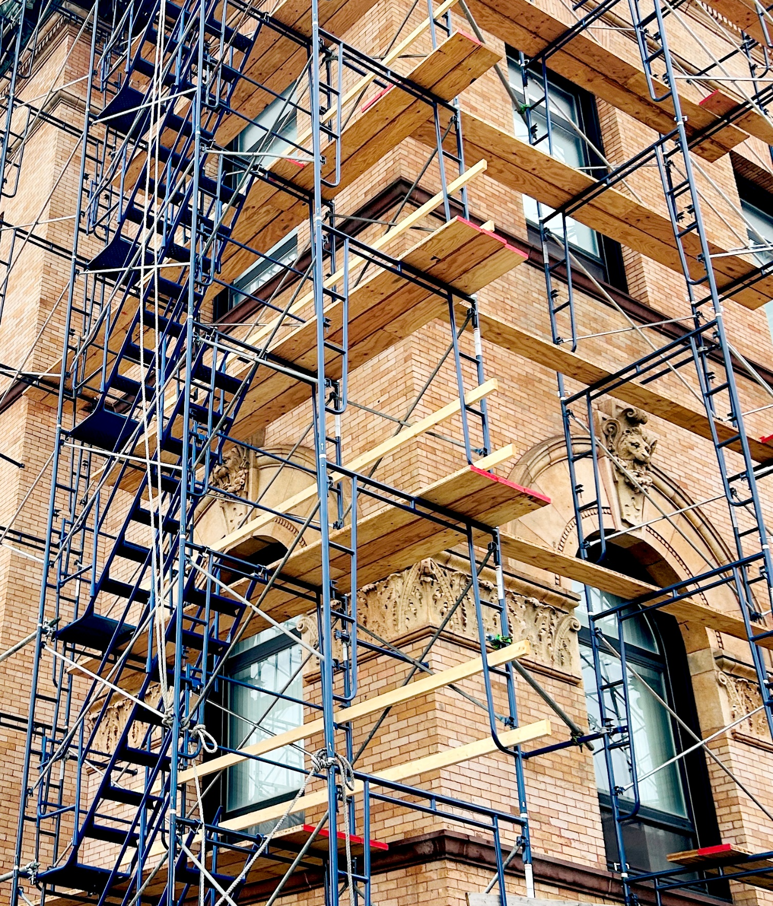
GROUND FLOOR Deputy Collector Finance Office Tax Office FIRST FLOOR City Solicitor’s Office Elections Commission Mayor’s Office SECOND FLOOR Auditing/Payroll City Council Chambers City Council Committee Room G.A.R. Room Procurement Treasurer’s Office | THIRD FLOOR * Assessor’s Office City Clerk DPW Engineering Department Human Resources Licensing Commission Parking Authority Weights and Measures SHAWS CENTER * Board of Health Building Department 39 MONTAUK ROAD * Public Works 50 SCHOOL STREET* Planning Department *New / temporary locations
Robert F. Sullivan, Mayor

Slide 7

GROUND FLOOR Deputy Collector Finance Office Tax Office FIRST FLOOR City Solicitor’s Office Elections Commission Mayor’s Office SECOND FLOOR Auditing/Payroll City Council Chambers City Council Committee Room G.A.R. Room Procurement Treasurer’s Office | THIRD FLOOR * Assessor’s Office City Clerk DPW Engineering Department Human Resources Licensing Commission Parking Authority Weights and Measures SHAWS CENTER * Board of Health Building Department 39 MONTAUK ROAD * Public Works 50 SCHOOL STREET* Planning Department *New / temporary locations
BROCKTON CITY HALL
45 School Street
Brockton, Massachusetts 02301
508-580-7123
brockton.ma.us
Robert F. Sullivan, Mayor

Slide 8
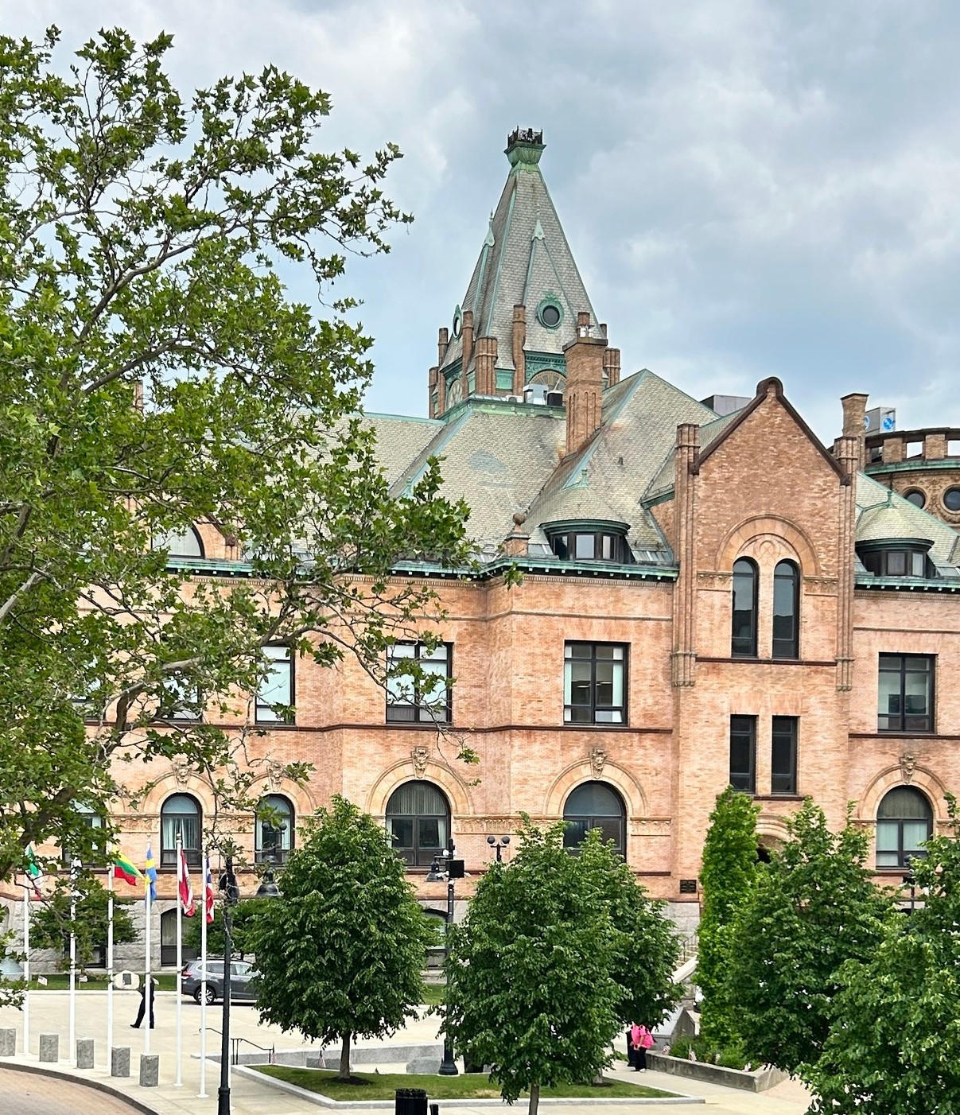
GROUND FLOOR Deputy Collector Finance Office Tax Office FIRST FLOOR City Solicitor’s Office Elections Commission Mayor’s Office SECOND FLOOR Auditing/Payroll City Council Chambers City Council Committee Room G.A.R. Room Procurement Treasurer’s Office | THIRD FLOOR * Assessor’s Office City Clerk DPW Engineering Department Human Resources Licensing Commission Parking Authority Weights and Measures SHAWS CENTER * Board of Health Building Department 39 MONTAUK ROAD * Public Works 50 SCHOOL STREET* Planning Department *New / temporary locations
Robert F. Sullivan, Mayor

Slide 9
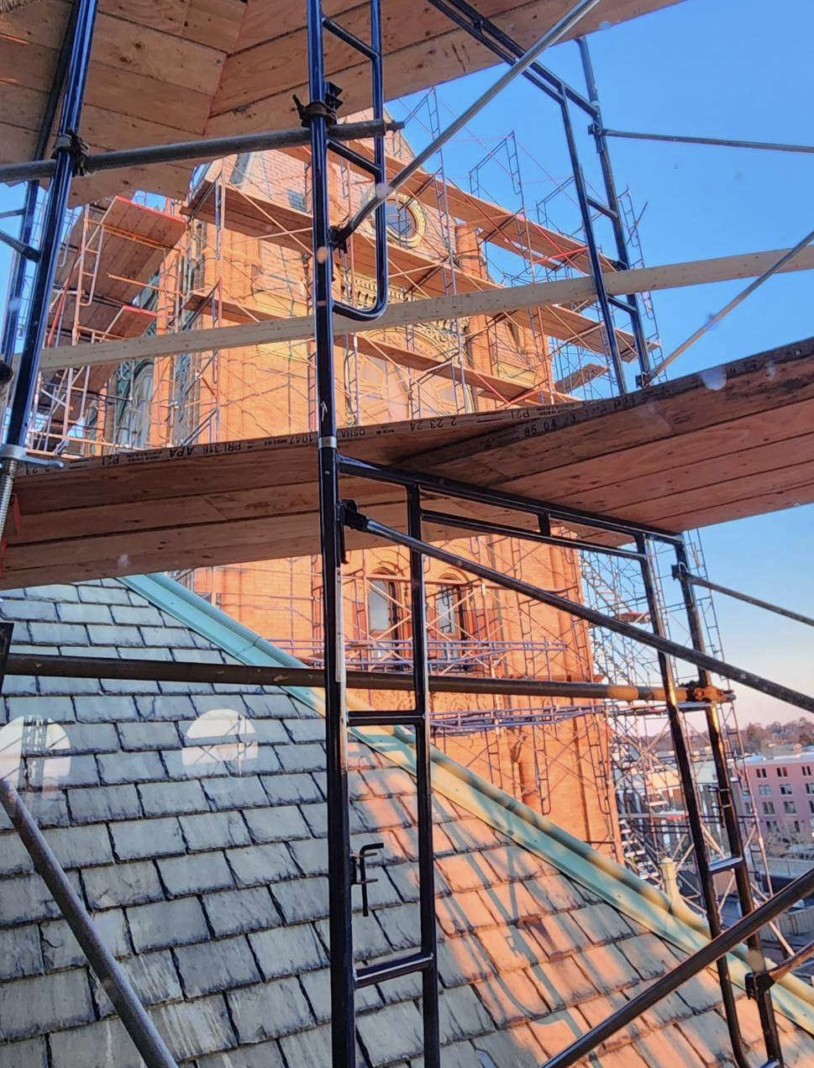
GROUND FLOOR Deputy Collector Finance Office Tax Office FIRST FLOOR City Solicitor’s Office Elections Commission Mayor’s Office SECOND FLOOR Auditing/Payroll City Council Chambers City Council Committee Room G.A.R. Room Procurement Treasurer’s Office | THIRD FLOOR * Assessor’s Office City Clerk DPW Engineering Department Human Resources Licensing Commission Parking Authority Weights and Measures SHAWS CENTER * Board of Health Building Department 39 MONTAUK ROAD * Public Works 50 SCHOOL STREET* Planning Department *New / temporary locations
Robert F. Sullivan, Mayor

Slide 10
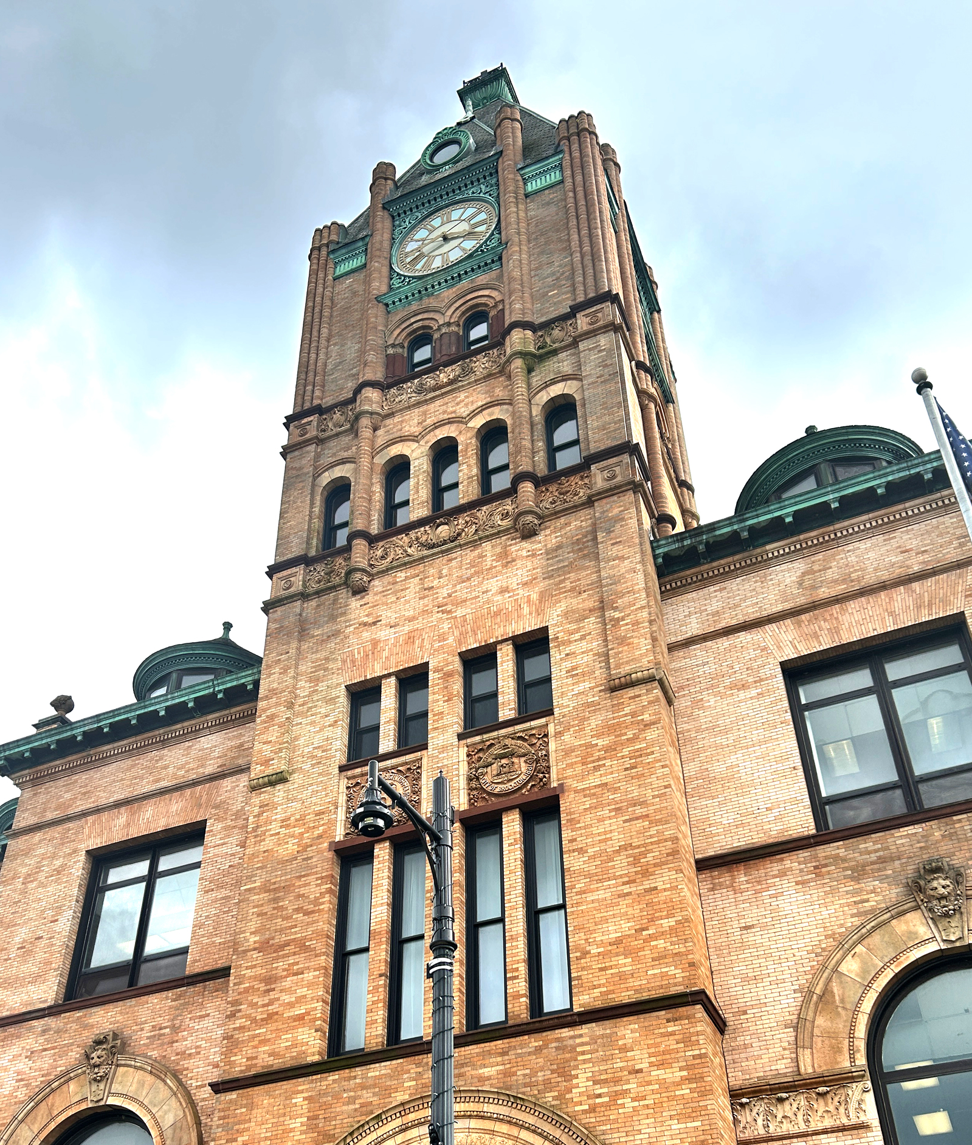
GROUND FLOOR Deputy Collector Finance Office Tax Office FIRST FLOOR City Solicitor’s Office Elections Commission Mayor’s Office SECOND FLOOR Auditing/Payroll City Council Chambers City Council Committee Room G.A.R. Room Procurement Treasurer’s Office | THIRD FLOOR * Assessor’s Office City Clerk DPW Engineering Department Human Resources Licensing Commission Parking Authority Weights and Measures SHAWS CENTER * Board of Health Building Department 39 MONTAUK ROAD * Public Works 50 SCHOOL STREET* Planning Department *New / temporary locations
Robert F. Sullivan, Mayor

Slide 11
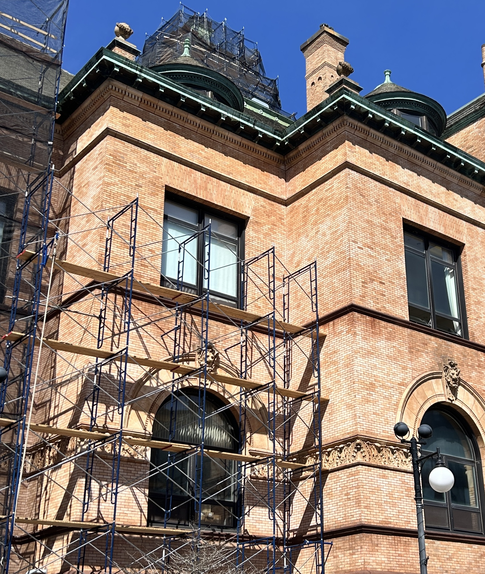
GROUND FLOOR Deputy Collector Finance Office Tax Office FIRST FLOOR City Solicitor’s Office Elections Commission Mayor’s Office SECOND FLOOR Auditing/Payroll City Council Chambers City Council Committee Room G.A.R. Room Procurement Treasurer’s Office | THIRD FLOOR * Assessor’s Office City Clerk DPW Engineering Department Human Resources Licensing Commission Parking Authority Weights and Measures SHAWS CENTER * Board of Health Building Department 39 MONTAUK ROAD * Public Works 50 SCHOOL STREET* Planning Department *New / temporary locations
Robert F. Sullivan, Mayor

