Slide 1
Mayor Robert Sullivan’s
Message of Progress

Slide 2
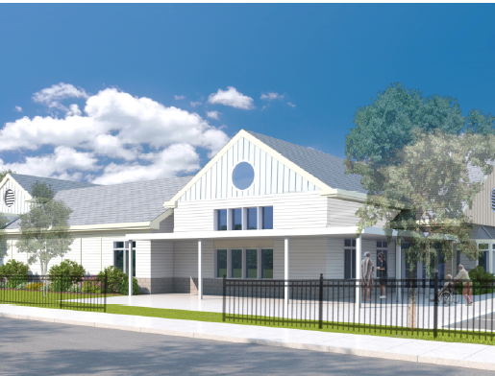
ARPA Construction Projects
Mary Cruise Kennedy Senior Center
Total: $7,669,400* ARPA funding
*Includes state earmark of $1 million

Slide 3
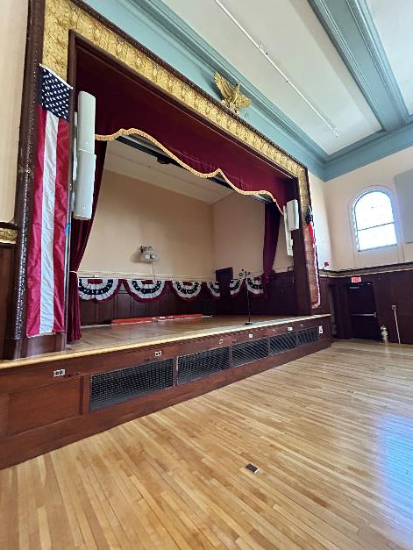
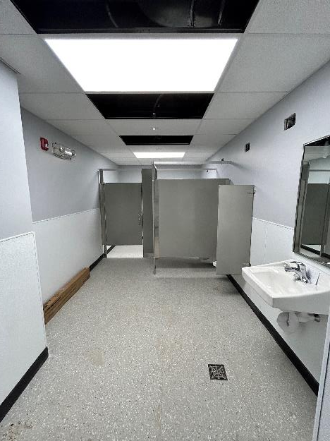
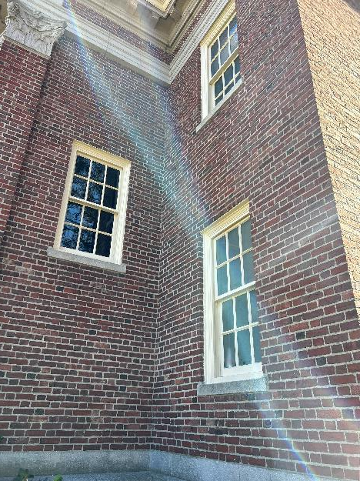
ARPA Construction Projects
War
Memorial Building
Total: $4,987,262
ARPA funding

Slide 4
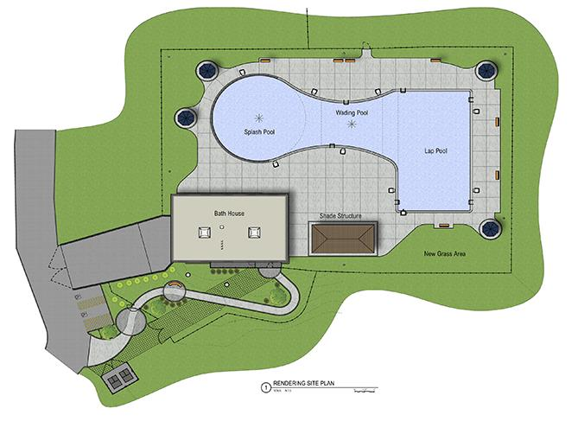
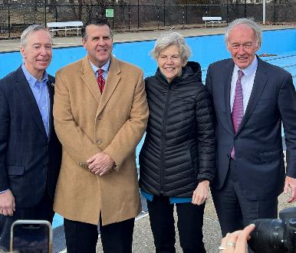
ARPA Construction Projects
Lawrence R. Cosgrove Memorial Pool
Total: $6,004,533*
ARPA funding
Includes Federal earmark of $3 million

Slide 5
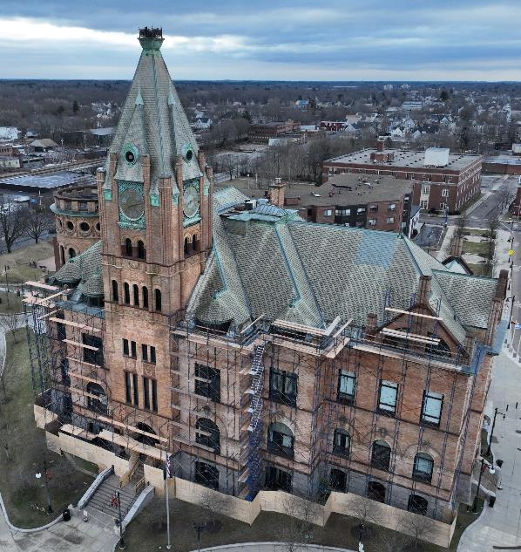
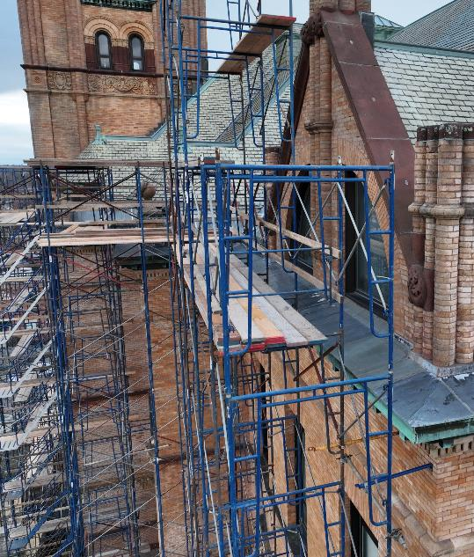
ARPA Construction Projects
Brockton City Hall
Total: $12,461,131
ARPA funding

Slide 6
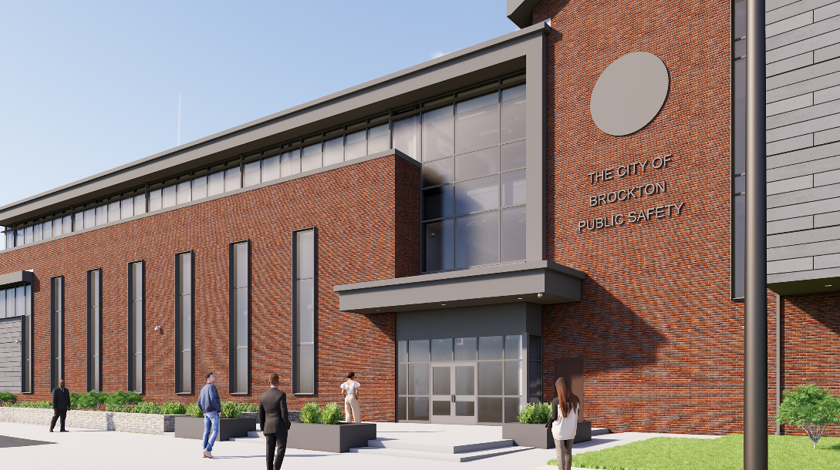
Brockton Public Safety Building
Total Bonded:
$98 million (to date)

Slide 7
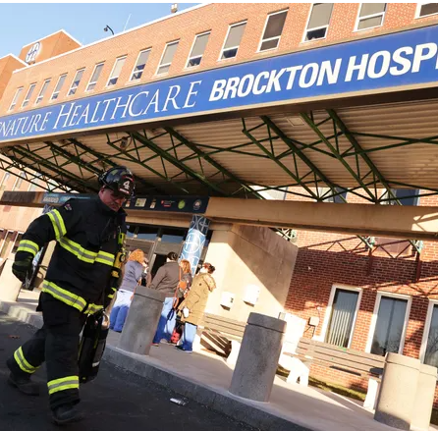
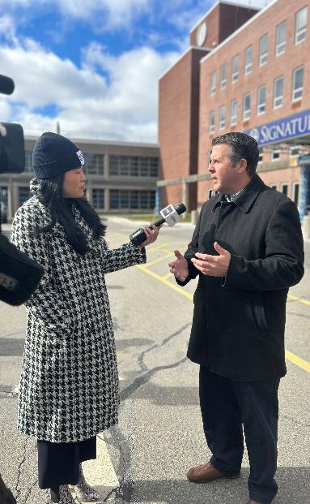
Brockton Hospital/Signature Healthcare
Expected reopening Summer of 2024

Slide 8
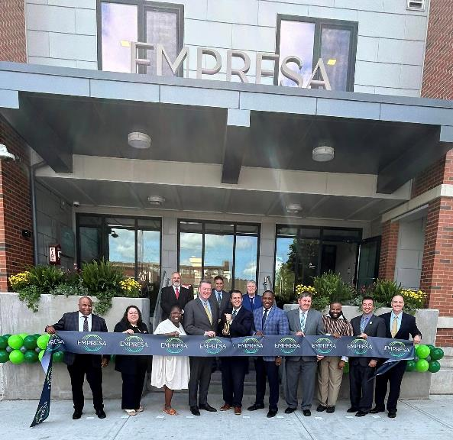
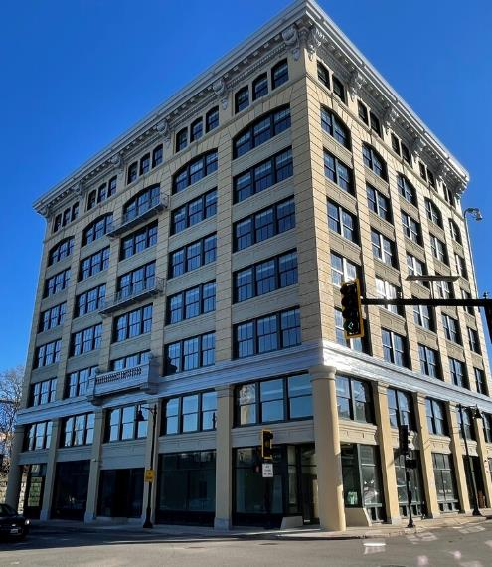
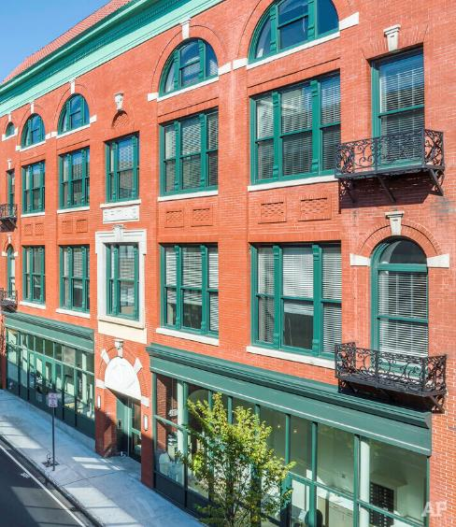
Residential Projects
Empresa
The Anglim
The Petronelli

Slide 9
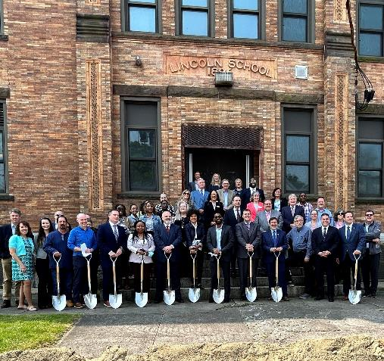
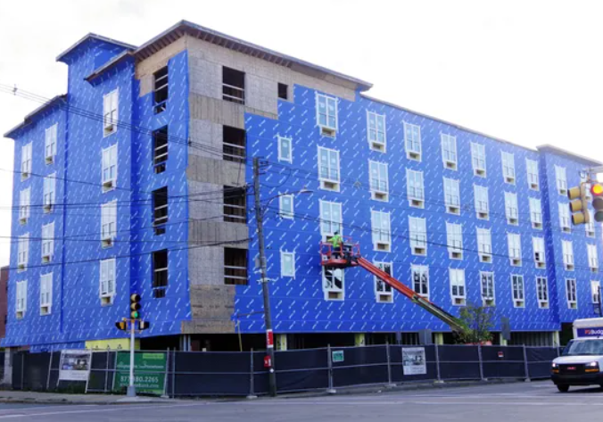
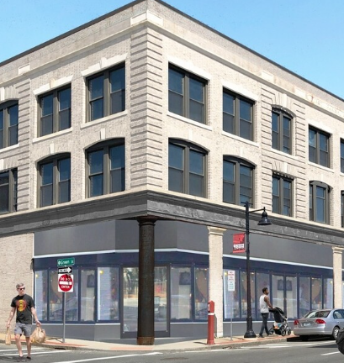
Residential Projects
Lincoln School Senior Housing
Centre Station
One Nine Residences

Slide 10
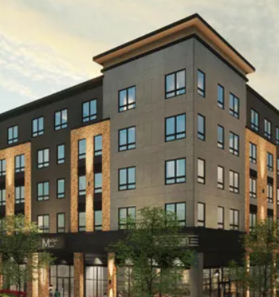
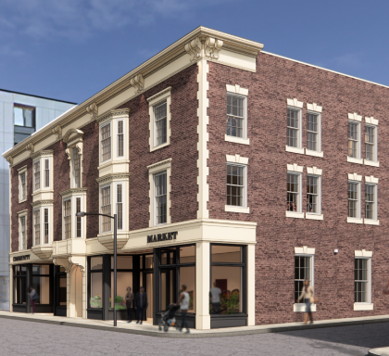
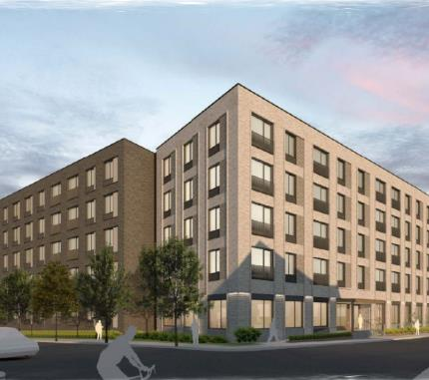
Residential Projects - Permitted
43-69 Montello Street
26 School Street
132 Main Street
46 Montello Street
Petronelli Way
69 North Montello Street
Merian on Main (rendering)
Hotel Grayson (rendering)
Brockton South
Transit-Oriented-Development
(rendering) 1200 Montello Street

Slide 11
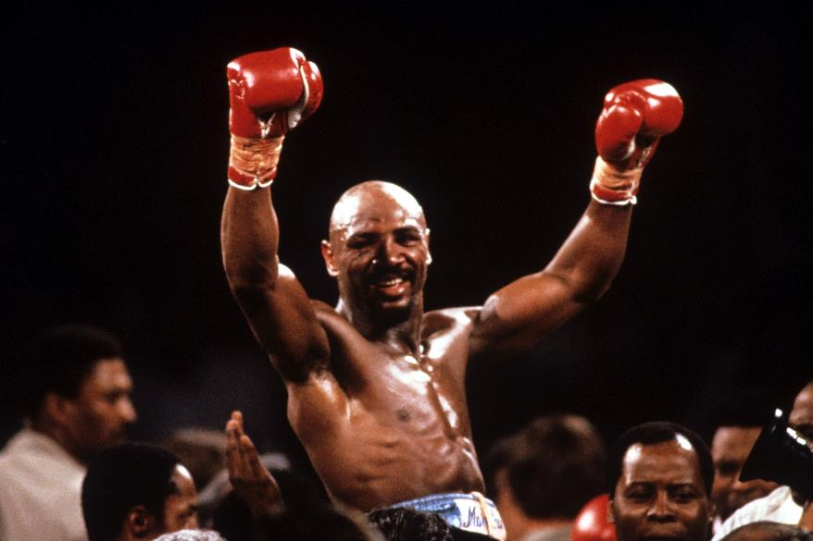
Marvelous Marvin Hagler Tribute
Marvelous Marvin Hagler Park
Marvelous Marvin Hagler Statue
Spring 2024

Slide 12
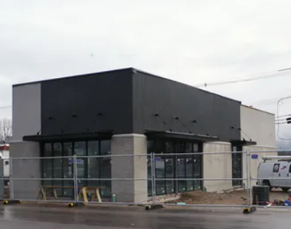


New Businesses
Starbuck’s
Belmont Street
Tru Hotel by Hilton
Westgate Drive
Air Energy Group, LLC
Industrial Blvd.

Slide 13
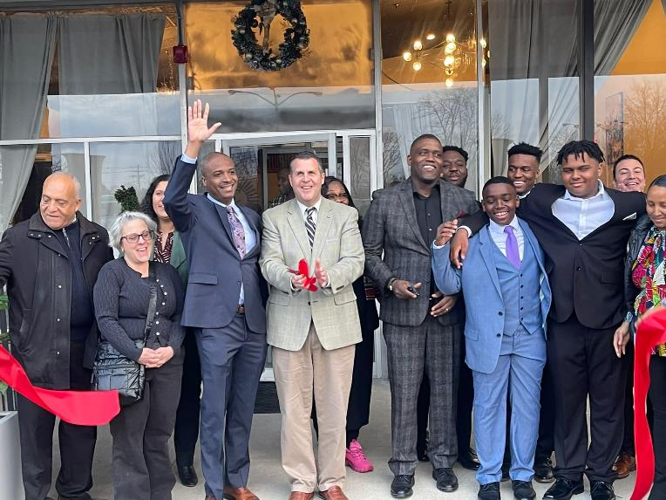
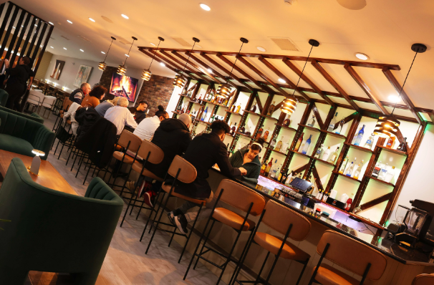
New Restaurants
Sunrise Steakhouse
Salo Bar and Grill

Slide 14
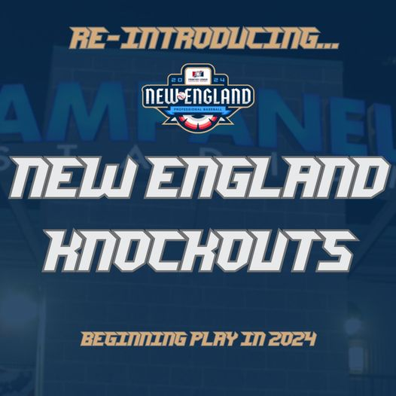

Baseball in Brockton
This summer: 80 home baseball games at Campanelli Stadium

Slide 15
Thank You

