Slide 1
http://www.uphelp.org/pubs/maximizing-business-insurance-benefits-after-fire

Slide 2

What is a Public Adjuster?
Advocates for YOU, the policy holder
Handles your claim from start to finish
Appraises and negotiates with the insurance company
Ensures the best possible settlement
Notes:
What Is A Public Adjuster? A public insurance adjuster is a licensed claims adjuster who advocates for you, the policyholder, in appraising and negotiating your insurance claim. The public adjuster’s expertise in handling insurance claims from start to finish will give you peace of mind, allow you to focus on the business of living your life, and ensure you get the best possible settlement from your insurance agency.

Slide 3
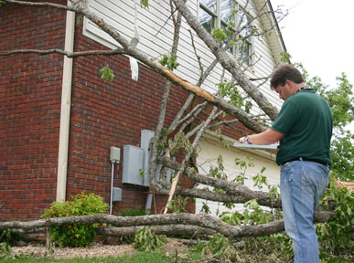
There are TWO kinds of adjusters
The insurance company adjuster
A public adjuster
Notes:
What is the difference between a public adjuster and an insurance company adjuster? The insurance company adjuster is working for the insurance company, not for you – he or she has the insurance company’s interests in mind. The public adjuster represents your interests. We will meet with the insurance company adjuster to make sure he/she sees every element of the loss and ensure the best outcome.

Slide 4
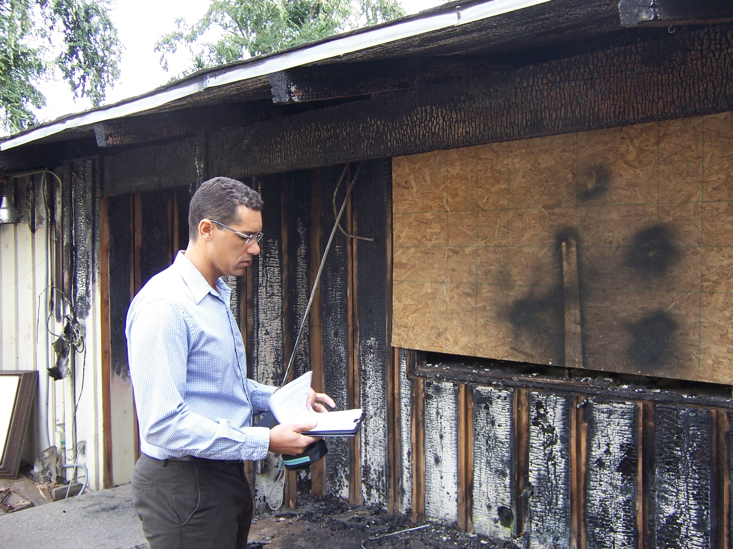
What is the process?
Inspect your damage and review your policy
Evaluate loss
Mitigation or remediation services
Contact your insurance company
Meet with the insurance company adjuster
Negotiate your best settlement
Notes:
What is our process? After you make the initial contact, we will come to your loss site, inspect the damage, and review your insurance policy. We will evaluate all dwelling, building, structural, business and personal property loss including any loss of business income, business interruption, and additional living expenses. Then we will contact your insurance company, report the claim, and make an appointment to meet their adjuster at the loss site, show him or her the damage and negotiate the best settlement for you. We can also help you find mitigation and remediation services to protect your property from further damage.

