Slide 1

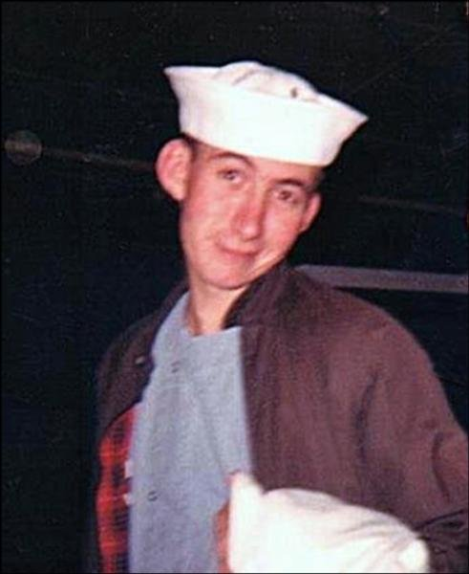
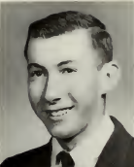
NAVY Hospital Corpsman
MILTON RICHARD ALLERBY
April 27, 1947–June 11, 1968
21 years old
Brockton High School
Class of 1965

Slide 2

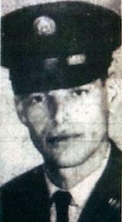
ARMY Specialist
DONALD DELMORE
TRIPP
May 28, 1943–August 20, 1969 26 years old

Slide 3
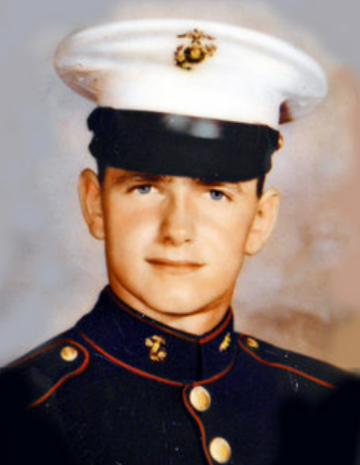

MARINE CORPS Corporal
WLADYSLAW “Scotty” STANISZEWSKI
June 22, 1947–July 7, 1967 20 years old

Slide 4
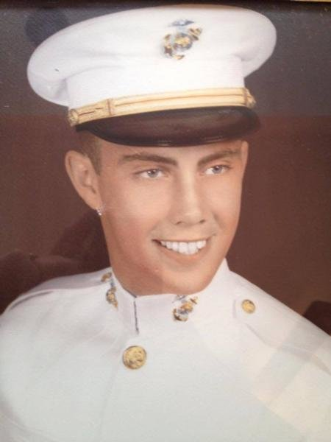
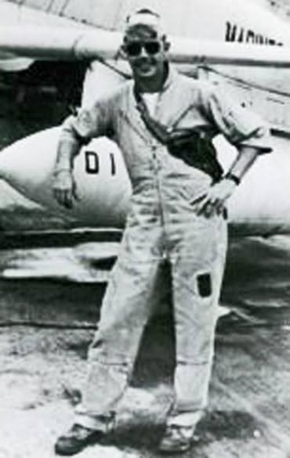
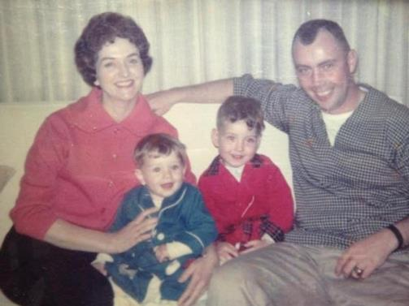
MARINE CORPS Major
WILLIAM FRANCIS
MULLEN
MIA
March 28, 1935–April 29, 1966 31 years old

Slide 5
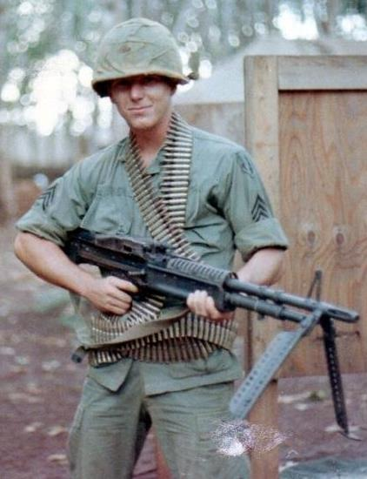
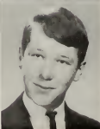
ARMY Sergeant
ROBERT
LAWRENCE
RODRICK
April 18, 1947–June 14, 1968 21 years old
Brockton High School
Class of 1965

Slide 6
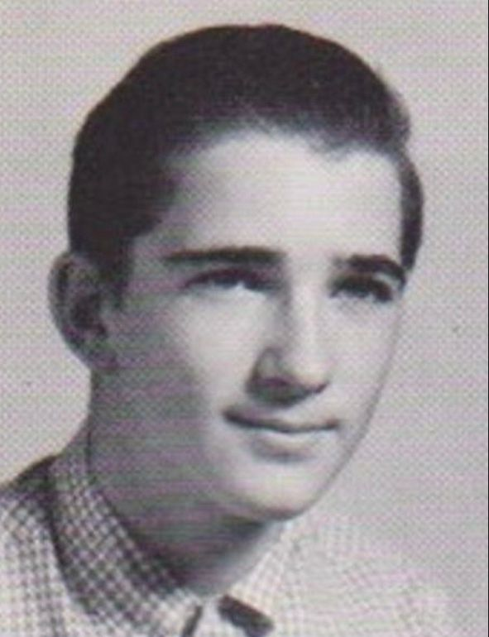
MARINE CORPS Private
BRUCE EDWARD
MARTIN
October 12, 1951–February 22, 1970 18 years old

Slide 7
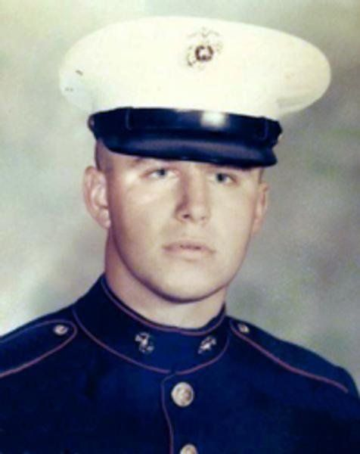
MARINE CORPS Private First Class
PAUL MICHAEL
KOLENDA
June 1, 1948–October 9, 1968 20 years old
Cardinal Spellman High School
Class of 1966

Slide 8
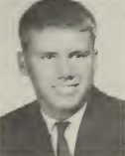
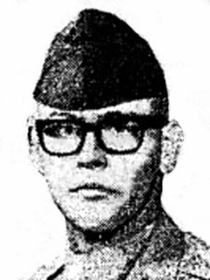
ARMY Corporal
THEODORE FRED JOHNSON
December 15, 1948–January 18, 1968 19 years old
Brockton High School
Class of 1966

Slide 9
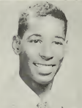
ARMY Specialist
HUGH RICHARD JOHNSON, JR.
April 20, 1947–February 10, 1968 20 years old
Brockton High School
Class of 1965

Slide 10
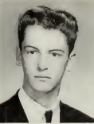
MARINE CORPS Corporal
JOHN RICHARD HOULIHAN
June 14, 1947–July 6, 1967 20 years old
Brockton High School
Class of 1965

Slide 11
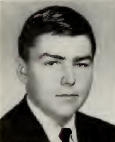
ARMY Specialist
TIMOTHY HOLSTER
August 10, 1947–November 1, 1966 19 years old
Brockton High School
Class of 1965

Slide 12
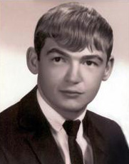
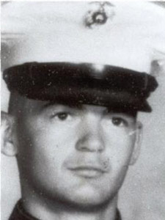
MARINE CORPS Lance Corporal
DANNY ERIC GOODWIN
April 28, 1947–August 24, 1967 20 years old
Brockton High School
Class of 1966

Slide 13

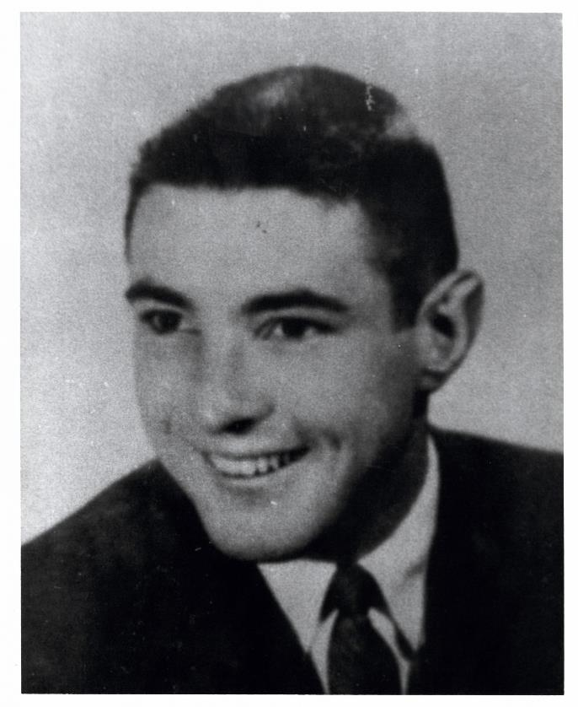
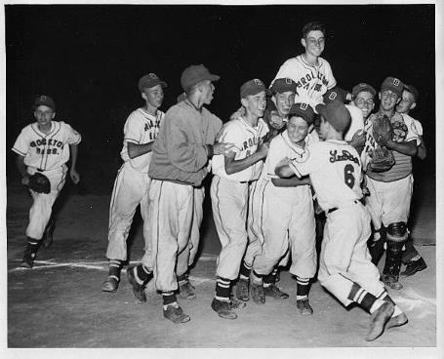
NAVY Lieutenant Commander
WILLIAM DAVID
FRAWLEY
MIA
November 14, 1938–March 1, 1966 27 years old
Brockton High School
Class of 1956

Slide 14
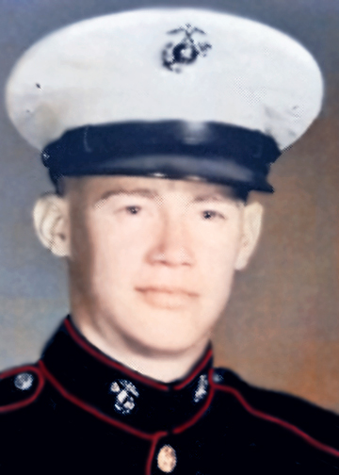
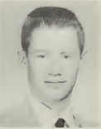
MARINE CORPS Sergeant
MICHAEL JOHN CADORETTE
July 17, 1947–December 7, 1968 21 years old
Brockton High School
Class of 1965

Slide 15
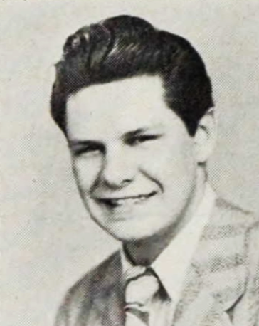
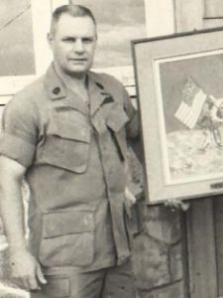
ARMY Sergeant Major
ROBERT ALFRED DONDERO
June 15, 1927–November 6, 1969 42 years old
Brockton High School
Class of 1945

Slide 16
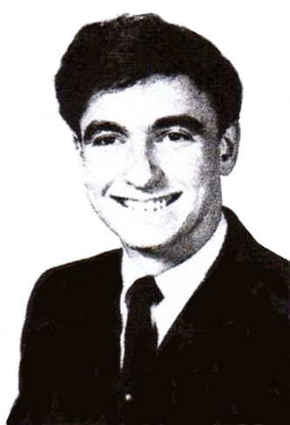
ARMY Specialist
JAMES FRANCIS CONNOR, JR.
April 11, 1949–February 11, 1971 21 years old
Brockton High School
Class of 1967

Slide 17
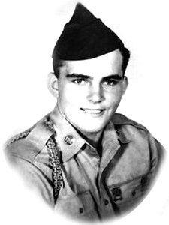
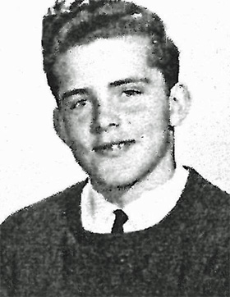
ARMY Private First Class
RONALD E BERRISFORD
March 13, 1948–February 11, 1967 18 years old
Brockton High School
Class of 1966

Slide 18
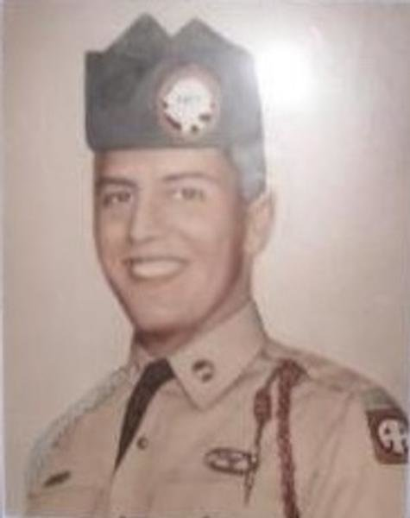
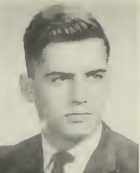
ARMY Specialist
ROBERT LEON “BUZZ” BOSS
May 28, 1945–May 6, 1966 20 years old
Brockton High School
Class of 1963

