Slide 2
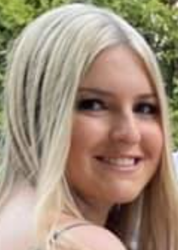
About Me
My name is Mia Sara and I am 17 years old. Throughout my life, my parents have stressed the importance of charity and giving back to the community. My family has always been involved in clothing drives, food drives, and many other charitable events, which is why I wanted to start my own charity. My mission is to find companies with overstocked items and connect them with charities that are in need.
My Goal
To seek out companies and people with unused items in their warehouses or homes and get them into the hands of people who need them. It is a win-win for all!

Slide 3
How We Help Businesses
MIA Exchange acts as the middleman, connecting businesses with overstock to charities in need. I have been Googling, emailing, and calling companies, convincing them to donate their unsold items for over a year. In return, they receive a tax-deductible form. I coordinate the donation, the paperwork, and the delivery of the items.
When Covid hit and charities would only accept new items, it was the perfect opportunity...I couldn’t sit and do nothing. I needed to help out as much as I could when people needed it the most”
Mia Sara

Slide 4
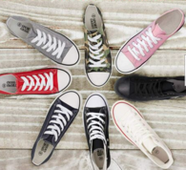
Companies MIA Exchange Activated to Donate
Trendy footwear 900
Charities
Inn at Hempstead
Long Island coalition for the homeless
The Salvation Army
Ke Di Leather
600 pairs of shoes
5,000 pairs of socks
5,000 T-Shirts
Donated 40 cartons
of athletic apparel
1,950 pairs of sandals
Trendy Footwear Wholesaler
20 cartons of women’s boots
2500 pounds of assorted women’s apparel
500+ pounds of apparel
900 pairs of footwear

Slide 5
How We Help Charities
MIA Exchange actively seeks out relationships with local charities and discovers what types of items they need. Then we connect them with a company, coordinate the delivery of items, and facilitate the company receiving a tax-deductible form for their donation.
“Wouldn’t it be nice for someone going to a charity and getting an item with a tag on it….To date MIA Exchange has donated 10,000 pounds of apparel to charities.” Mia Sara
We make a living by what we get, but we make a life by what we give - Winston Churchill

Slide 6
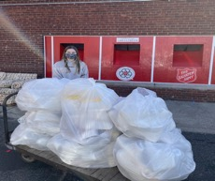
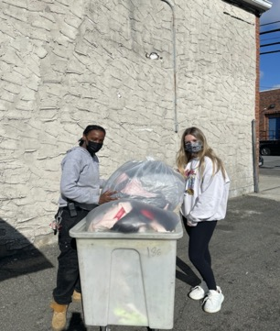
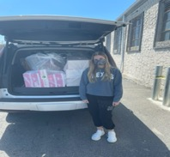
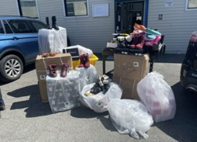
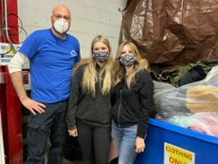
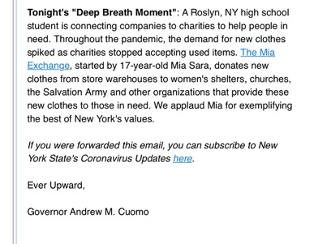
Mia in Action
Dropping off hundreds of pounds of new apparel to charities

Slide 7
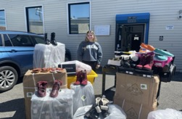
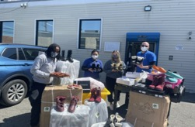
Dana Lopez, Director of Marketing & Communications for the Inn explains the positive impact of MIA Exchange on her organization

Slide 8
MIA Exchange In The News
Channel 12
October 7, 2021
“This piece I do is all about people making positive impacts in their community and Mia, you fit the bill !”
Erin Colton, American Emmy award-winning journalist, anchor, & reporter
While making a donation delivery, I received a call from Channel 12 News. Pulling over, I was interviewed about the great success of MIA Exchange.

Slide 9
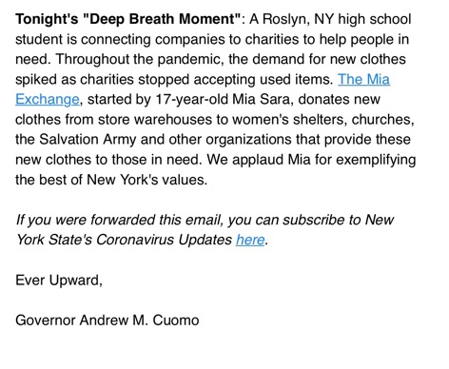
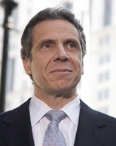
Governor Cuomo Gave MIA Exchange a Shout Out!

Slide 10
NY State Legislature Acknowledges Mia for
Extraordinary Leadership
“Your leadership and organizing skills not only helped the most disadvantaged members of our community but also inspired the rest of our community as well...Your extraordinary leadership qualities have been recognized…”
Nassau County Arnold Drucker, District 16

Slide 11
Be the Change You Wish to See in the World
Learn How You Can Be a Helping Hand
www.MiaExchange.com

