Slide 1
Chapter 1 Innovation and Intellectual Property
Bronwyn H. Hall & Christian Helmers

Slide 2
Introduction
Innovation widely seen as engine behind economic growth and improvements in standard of living.
Objectives:
Maximize benefits from innovative activity
Mitigate costs of innovative activity
Requires understanding of innovative process and how to manage it, both at the business and the economy-wide level

Slide 3
Introduction
Focus on innovations that have direct impact on economy, by increasing productivity or improving and expanding available goods and services
But why study innovation?
How innovation contributes to economic growth
How does innovation process work?
What motivates innovators?
Choose innovation strategies to increase profits / defend against competitors
Design institutions and government policy

Slide 4
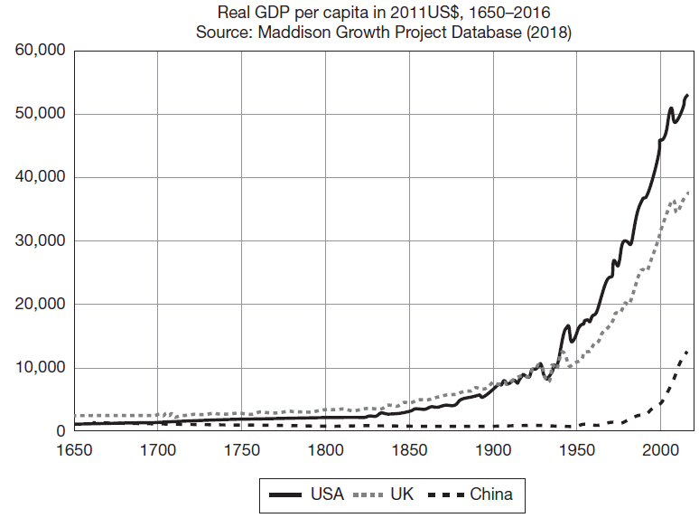
Innovation and economic growth
Only 1/2 to 2/3 of growth accounted for by increases in the physical capital stock and the education levels of workers.
Remainder due to technical change which means greater output is obtained from the same inputs.

Slide 5
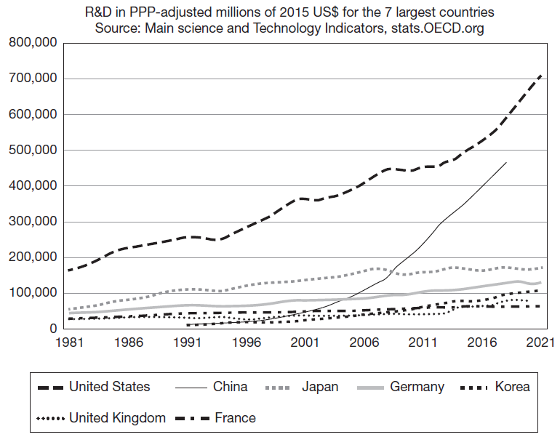
Increased importance of R&D investment

Slide 6
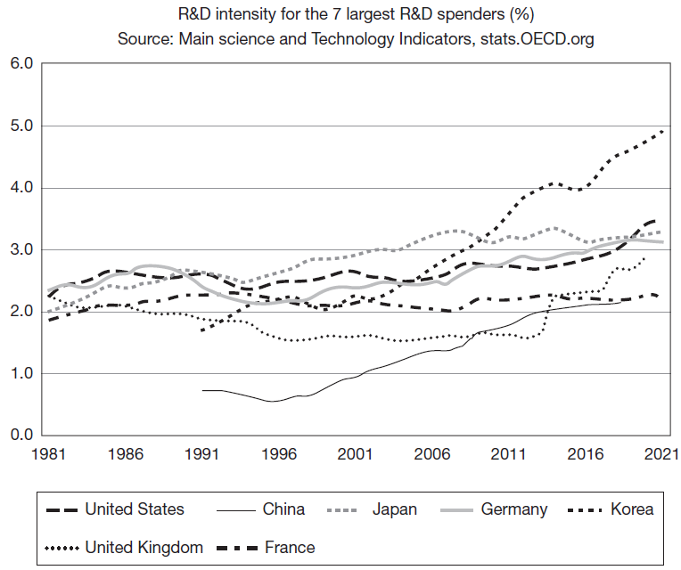
R&D intensity over time

Slide 7
Overview
Innovation as source of competitive advantage and growth
What affects incentives for innovation?
How do firms appropriate the returns to innovation?
How can innovation translate into competitive advantage?
Objective of this course: gain understanding of technical change and the innovative process, its determinants and consequences.
In particular:
Incentives for innovation
Source of strategic and competitive advantage for companies
Policy tools

