Slide 1
Chapter 12 Trademarks and Brands
Bronwyn H. Hall & Christian Helmers

Slide 2
Overview
Structure and purpose of the trademark system
Process and legal requirements to obtain a trademark
Characteristics and purpose of collective marks, certification marks, and geographical indications
Economics of the trademark system
Connection between trademarks, innovation, marketing, and economic performance
Use of trademarks in combination with other IP rights
Trademark squatting, non-use, cluttering, depletion and congestion
Link between trademarks and e-commerce (domain names)

Slide 3
Introduction
Trademarks everywhere in the modern economy.
Trademarks widely used throughout the world.
More than 10.8 million trademark filings worldwide in 2018 (compare to fewer than 3.3 million patent filings).
Trademark filings increased faster than patent filings over last decade.
Trademarks widely used in developing countries by developing country residents.
Trademarks much more widely used across entire economy than other IP rights.

Slide 4
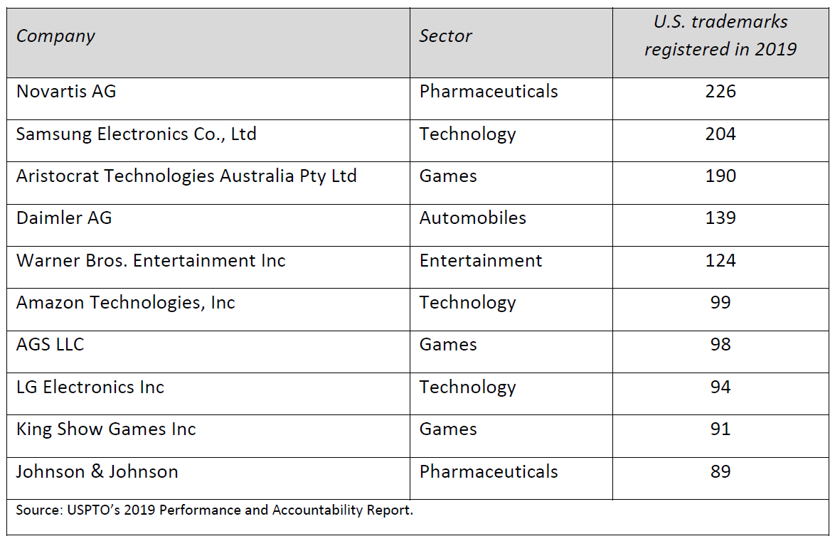
Top trademarking for-profit companies in the U.S. in 2019

Slide 5
Trademark system
A trademark is “(a)ny sign, or any combination of signs, capable of distinguishing the goods or services of one undertaking from those of other undertakings.” (TRIPS agreement)
A trademark is “any word, name, symbol, or device, or any combination thereof […] used by a person […] to identify and distinguish his or her goods […] from those manufactured or sold by others and to indicate the source of the goods.” (U.S. Lanham Act of 1946)
Purpose of a trademark:
Distinguish one product from another.
Identify the source of the product.
For a sign to achieve these objectives as a trademark, it has to be distinctive.

Slide 6
Trademark system
Conceptual distinction between:
Source distinctiveness:
A trademark must allow consumers to identify source or origin of trademarked product.
Defines trademarkable subject matter and distinguishes trademark from purely decorative or functional product feature.
Differential distinctiveness:
How “unique” is a trademark?
Often referred to as “trademark strength.”
Some marks are inherently more distinctive.
Acquired over time with use of trademark in commerce and investment in building reputation and goodwill.

Slide 7
Trademark system
Purposes of trademark protection:
Owners are entitled to advertise sign as (un)registered trademark (™) and signal to others that they have exclusive right to use trademark for protected products in commerce.
Prevent others from imitating trademarked words and signs and from free-riding on reputation and goodwill embodied by brand that trademark protects.
Trademarks can also be licensed for use by third parties or sold (but trademark as such usually cannot be licensed or sold separately from the product(s) it protects).

Slide 8
Trademark procedures - eligible subject matter
Broadly defined: any product or service can be protected by a trademark.
Available for “any combination of signs, capable of distinguishing the goods or services of one undertaking from those of other undertakings.”
Main subject matter exclusion: inherent lack of distinctiveness.

Slide 9
Trademark procedures - geographic scope
Trademarks are national rights: they can only be enforced within the jurisdiction in which they were granted.
Geographical scope of a trademark determines an applicant’s ability to register trademark: examination only verifies whether there exist any confusingly similar marks in geographic area for which trademark protection sought.
International priority right under Paris Convention that provides priority from a filing at another trademark office within six months of first filing.
Regional trademark systems:
European Union Intellectual Property Office (EUIPO): trademark protection in all EU member states.
African Regional Intellectual Property Organization (ARIPO): trademark protection in 10 African member states.
Madrid System administered by World Intellectual Property Organization (WIPO):
Streamlined system for obtaining trademark protection in member countries through single application in single language.
Simplifies fee payments and trademark renewals through single procedure.
But applications still have to be approved and registered by national offices designated by applicant and once registered, trademarks are subject to national law.
Several international agreements that facilitate obtaining international trademark protection (e.g. Singapore Treaty on the Law of Trademarks).

Slide 10
Trademark procedures - scope of protection
Trademarks are classified into 45 classes according to the Nice classification system.
34 product and 11 service classes.
Trademarks only provide legal protection for specific classes.
Implies that, in principle, different parties can register the same or similar marks in different classes or product/service categories.
Depending on the national trademark system, applicants can request protection only in a single or in multiple classes.

Slide 11
Trademark procedures - length of protection
Trademarks can be maintained in force indefinitely.
Renewal requires:
Payment of renewal fees in regular intervals.
In some jurisdictions proof of use in commerce.

Slide 12
Trademark procedures - registration
Trademarks are registered IP rights.
Trademark protection also available for unregistered marks.
Protection for unregistered trademarks granted when firms have established distinctiveness for a given mark by actively using it in commerce.
Importance of registration differs across jurisdiction:
Only registration provides legal protection.
Use in commerce results in legal protection, not registration (still, advantages to registering a trademark over relying on an unregistered right).

Slide 13
Trademark procedures - use requirements
Some jurisdictions require use in commerce for a trademark to benefit from legal protection.
Purpose of use requirement is to discourage rent seeking through:
Trademark squatting.
Strategically registering trademarks for potential future use while keeping competitors from using them.
Use requirements enforced in different ways:
EUIPO does not require proof of use at any stage of the registration process or afterwards. Proof of use only necessary if trademark subject to cancellation proceedings or enforced in litigation.
USPTO requires proof of use upon registration or declaration that trademark will be used within 6 months. Registration and remedies for infringement contingent on actual use and proof of use.

Slide 14
Trademark procedures - application and grant
Types of examination:
Formal examination: only assesses whether filing concerns trademarkable subject matter and satisfies formal requirements.
Substantive examination (relative grounds examination): assesses distinctiveness and verifies that no likelihood of confusion exists with existing marks.
Following examination, trademark published in gazette/trademark journal.
Publication may coincide with grant of the trademark.
If pre-grant opposition, third parties can oppose grant within certain time window (e.g. 30 days). Once window closed without a successful challenge, trademark registered.

Slide 15
Trademark procedures – types of trademarks
Word mark: single word or combination of words, letters, and numbers, which are registered in standard black font on a white background.
Figurative mark: figure without text.
Mixed mark: combination of word and figurative mark where word can have special fonts and be colored.
Non-traditional marks: 3-dimensional shapes, taste, sound, and scent marks. Have to be non-functional. Other non-traditional marks include holograms or moving image marks

Slide 16
Trademark procedures - distinctiveness
Inherently distinctive marks:
Fanciful mark: entirely new word that has no obvious connection with existing words (e.g. Kodak, Exxon). Any association with product result of investments and efforts made by owner.
Arbitrary mark: existing words, symbols etc. that have no obvious relation to the product that they protect (e.g. Apple, Adobe). Any association with product result of investments and efforts made by owner.
Inherently non-distinctive marks:
Descriptive mark: describe the product that they protect (e.g. Holiday Inn, Kentucky Fried Chicken), have naturally a closer link with the product. Can acquire secondary meaning.
Suggestive mark: implies characteristics of the goods that it is used to name, but does not describe it (e.g. Financial Times, WhatsApp). More narrow than descriptive marks but still inherently has a close, “suggestive” connection with the product that it protects.

Slide 17
Trademark procedures - opposition and cancellation
Opposition:
Adversarial administrative proceedings that take place within a certain time window, either before or after registration of a trademark.
Grounds for opposition: absolute (e.g. descriptive mark) and relative (e.g. likelihood of confusion).
Cancellation:
Adversarial administrative post-registration cancellation proceedings.
In some jurisdictions ability of third parties to invalidate a trademark time-limited (e.g. in U.S. after 5 years certain grounds are no longer admissible for cancellation).

Slide 18
Trademark procedures - fees
Trademark offices charge a range of fees:
Filing
Publication
Examination
Registration
Renewal
Fee structure varies across trademark offices
Fee per class or fixed fee for a given number of classes, etc.
Some offices award fee discounts to specific applicant groups, such as individuals or small and medium sized enterprises (SMEs).

Slide 19
Trademark procedures - re-assignment and licensing
Trademarks cannot be traded without product or service that is covered by trademark.
In U.S., sale or licensing of a trademark is prohibited unless accompanied by sale or licensing of right to produce protected good.
Restriction reflects basic function of trademark system: allowing trademarks to be detached would increase rather than decrease consumer confusion and search costs.
If company goes out of business, its trademarks cannot be transferred to a creditor unless creditor continues to use them in commerce.

Slide 20
Collective marks and certification marks
Collective marks:
Registered by collective groups or organizations that award them to their members.
Associate certain characteristics with product that are characteristic of a group or organization (e.g. geographical origin or method of manufacturing etc.).
Identifies products to belong to a group and sets them apart from products that do not belong to group.
Main distinction between collective and regular trademarks: collective marks used by multiple members of a group that are part of collective organization that owns mark.
Certification marks:
Certify that a product satisfies certain standard.
Example: certify that a good was produced with a certain method of manufacture or that the product consists of certain material (e.g. Woolmark which identifies goods that consist of 100% wool).
Entity that awards certification has to establish and verify rules that define standard that warrants certification.
Certifying entity itself cannot engage in production of goods that obtain certification.
Difference between certification and collective marks: collective marks reserved to members of association that owns mark whereas certification marks are available to anyone that satisfies requirements.

Slide 21
Geographical indications
Geographical indications (GI) are granted for products if their specific geographical origin accounts for their characteristic attributes or reputation (e.g. Champagne, Roquefort, Parmigiano Reggiano).
GIs serve similar functions as trademarks: identify source of a product which is associated with certain characteristics.
In some jurisdictions, GIs considered part of trademark system (e.g. the U.S.) and protected through collective or certification marks.
In other jurisdictions, sui generis protection granted in the form of a separate IP right (e.g. EU).
Depending on how GIs protected, differences in requirements for protection and scope of protection.
GIs useful in settings where production highly fragmented and individual producers too small to convey individually high quality of products.

Slide 22
Economics of trademarks
Markets generally characterized by asymmetric information (Akerlof 1970):
Buyers and sellers have different information about product they intend to buy or sell.
Quality to some degree unobservable to consumers before purchasing and consuming a product or service.
Trademarks help reduce asymmetric information (and consumer search costs) by allowing sellers to identify themselves and to signal that their products are of a certain, consistent quality.
Trademarks also provide some form of guarantee regarding the non-contractible elements of a product.
If a company does not provide expected quality or non-contractible features, trademark will suffer loss of goodwill.
Self-enforcing mechanism.

Slide 23
Economics of trademarks
Landes and Posner (1987)
If trademarks reduce asymmetric information, consumers are willing to pay a higher price because they incur lower search costs.
Assume full price faced by consumers for product x manufactured by a company is p, which consists of “money price” m paid by consumers to the company and their search costs s(t,z):
$p=m+s(t,z)$ (1)
Search costs depend on trademark t as well as a range of other factors z, such as advertisement etc.
Assume s decreases in t.

Slide 24
Economics of trademarks
Firm’s profit function:
$π=mx−cx−rt$ (2)
where π denotes firm profits, c are marginal costs of producing x, and r is the marginal cost of “producing” trademark protection t.
Substitute (1) into (2):
$π=\left[p−s\left(t,z\right)\right]x−cx−rt$ (3)
Assumed perfect competition.
First order conditions with respect to x and t are respectively:
$p−s\left(t,z\right)−c=m−c=0$ (4)
$−\frac{ds}{dt}x−r=0$ (5)

Slide 25
Economics of trademarks
FOC (4): “money price” is equal to marginal cost.
FOC (5): firm invests in t up to the point where it equates marginal cost of a little more trademark protection r to marginal return in the form of lowering search costs a little further (-ds/dt) which applies to all units of x sold in the market.
Model illustrates two features of trademark protection:
Firms invest optimally in trademark protection to the point where marginal benefits equal marginal costs.
Even in a perfectly competitive market, trademark protection allows companies to charge a higher price m.

Slide 26
Trademarks and innovation
Trademarks often associated with innovation.
However
Mark has to be distinctive and not lead to likely consumer confusion due to conflicts with existing trademarks.
No legal requirement that a trademark protect something new (an innovation).
Trademark system per se not tasked with promoting innovation and no reason to assume that trademarks reflect innovative activity.
In practice, new trademark registrations usually triggered by introduction of new products or changes to existing products
Ability to protect brand names of new products helps innovators appropriate returns to their innovation.

Slide 27
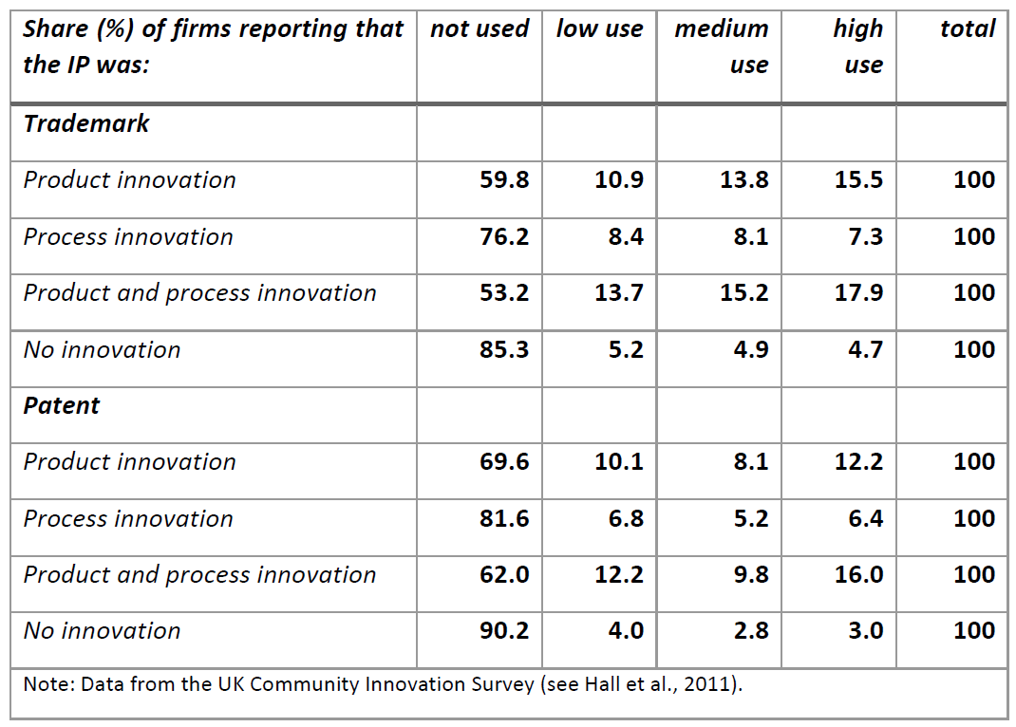
Use of trademarks and patents

Slide 28
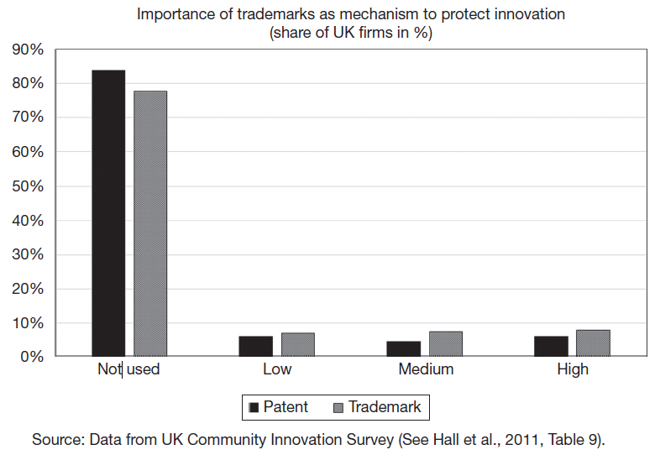
Trademarks and innovation

Slide 29
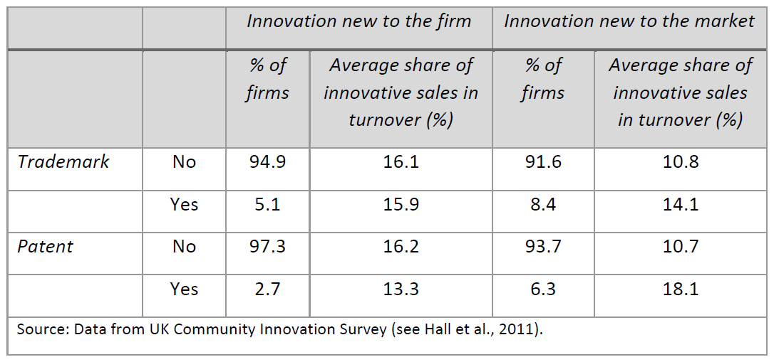
Use of trademarks and patents share of turnover due to innovation

Slide 30
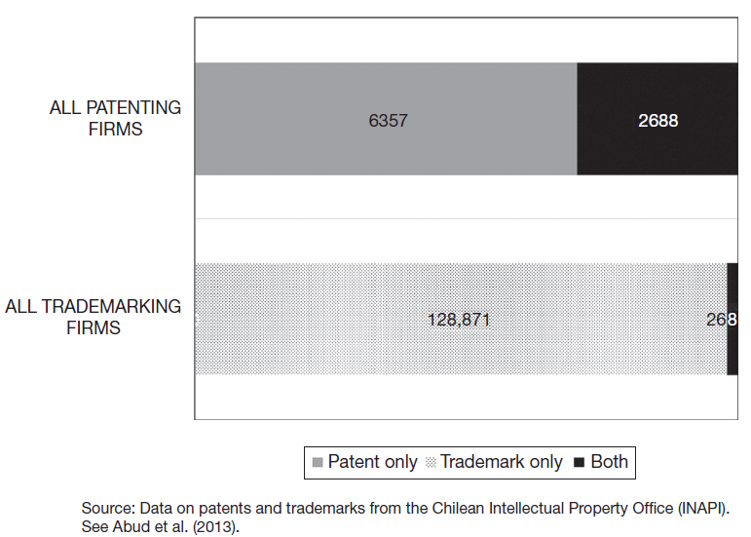
Patenting and trademarking activity
Small number of patenting firms are likely to use trademarks.
Most trademarking firms do not also patent.

Slide 31
Trademarks and marketing/branding
A brand embodies the perception by the public of a company’s characteristics, attributes and often its values.
Companies often invest heavily in creation and maintenance of brands as a way of securing a competitive advantage.
A brand is built on reputation and trademarks protect reputation embodied by a brand.
Terms “trademark” and “brand” often used interchangeably.
But a trademark is the legal instrument that protects the reputational value embodied by a brand.

Slide 32
Trademark value
Value of a trademark depends mainly on trademark strength.
Trademark strength is a measure of inherent distinctiveness or uniqueness of a trademark.
Determinants of trademark strength (Economides, 1998):
Consumer’s ability to recall the mark and its associated features.
Ability of others to use a confusingly similar mark.
Reluctance of trademark owner to change the variety and quality features of the trademarked product over time.
Trademark strength depends on trademark and brand characteristics:
Descriptive and suggestive marks are broader and potentially more effective in excluding competitors. They also provide information to consumers which partly substitutes for advertising.
Trademark strength also depends on brand awareness.
Determinants of trademark strength inherently intangible and therefore hard to measure.

Slide 33
Trademark value
Cost valuation:
Total cost of obtaining a trademark, includes registration and legal fees, marketing and advertising costs etc.
Accounting method relatively easy to implement, but likely to undervalue the trademark.
Expected income:
Present value of all expected earnings made with the trademark.
Project future returns associated with a trademark, which is associated with a lot of uncertainty and requires a number of strong assumptions.
Hypothetical royalty rates, how much they would have to pay in royalties if they had to license their trademark from a third party. But difficult to find comparables.
Market value:
Fair market value, how much would third parties pay for a trademark if it were sold or licensed.
Standard way to measure this is to rely on historic sales or licensing price data of comparable trademarks.
Challenging because market relatively thin and hence few transactions as reference points.
Can use the Griliches, Hall et al. Tobin’s q methodologies to measure the value of trademarks to a firm (Greenhalgh & Rogers 2006; Thoma 2021)

Slide 34
Trademarks and economic performance
Trademarks and economic performance:
Trademarks help companies sustain brand premium, which translates into positive mark-ups.
Less competition helps companies grow faster.
Incentivize companies to invest in branding, advertisement and innovation.
Trademarks can have negative welfare effects due to less competition and increased market concentration.
Empirical evidence suggests that trademarking is positively associated at the firm-level with market value, employment and revenue growth as well as productivity.

Slide 35
Trademark use combined with other IP rights
Other IP rights, design rights, patents and copyright, used in combination with trademarks to protect an innovation.
Espresso machine maker Ariete filed patent on new techno-logy to expel pre-packaged capsules for espresso machines.
Shortly thereafter filed for a EU trademark for product line “Capricci”, espresso capsules for use in machines that have patented technology.
Finally, also filed for a design right that protects design of espresso machine that would shortly thereafter be sold in the market.

Slide 36
Trademark use combined with other IP rights
Use of copyright and design rights in combination with trademarks may avoid companies seeking trademarks with overly broad boundaries.
For example, products often have attributes that have aesthetic features, e.g. specific color. Color has no function, but if color inherently associated with a product, it could effectively exclude other companies from using that aesthetic feature in their products.
Use of copyright and design rights in combination with trademarks may provide excessive protection:
Because copyright expires while trademark protection does not (provided a trademark is renewed), combined use of a trademark and copyright can provide substantial additional protection.
Cartoon character Mickey Mouse protected by both trademark and copyright.
Combined trademark and copyright protection of cartoon characters widespread.
Product shapes can be protected by both trademarks and design rights.
Trademarks do not require novelty and non-obviousness, but design rights do; it is possible that applicants obtain first a design right and then extend protection through trademark.

Slide 37
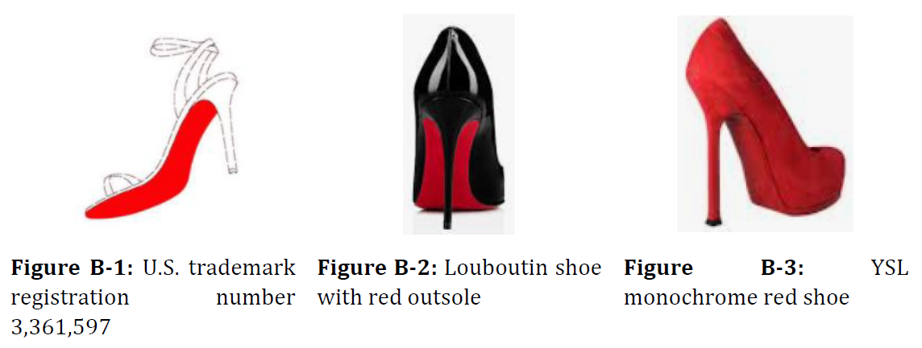
Trademarks and competition
Christian Louboutin’s shoes typically feature a lacquer red outsole.
Louboutin successfully registered the red sole as a trademark in U.S.
Louboutin filed a lawsuit alleging trademark infringement against Yves Saint Laurent (YSL) after YSL launched an all red shoe.
Court found that Louboutin’s trademark was in fact valid as it had acquired secondary meaning but limited it to shoes where the red sole contrasts with the upper part of the shoe.

Slide 38
Trademarks and competition
Trademark monopoly power limited because:
Trademark protection does not prevent imitation of product except for its trademarked characteristics.
Generic terms and decorative or functional features excluded from trademark protection.
Trademarks only protect products that have acquired goodwill.
Only if a trademark is recognized by the relevant part of the public, consumer confusion can arise if a competitor were to offer a product under the same/similar name.
But trademarks still have potential for anti-competitive use, in particular to prevent entry of new competing products:
Trademark system may grant protection in areas other than where the product has acquired goodwill.
Results in broad exclusivity despite statutory limitations on trademark protection.
Descriptive marks may provide control over parts of the name space that are particularly powerful in associating brand names with product characteristics.
Example: “ActivTrak” for a fitness tracker, which makes it difficult for competing fitness products to use the words active and tracker (Buccafusco et al., 2023).

Slide 39
Trademarks and competition
In practice, trademark protection has to strike balance between providing effective exclusivity while not unduly restricting competition by granting overly broad exclusivity.
Main practical challenge: determine whether exclusion of competing products or services represents a legitimate use of the negative right conferred by a trademark or anti-competitive behavior.
No direct empirical evidence on the anti-competitive effect of trademarks.
Anecdotal evidence suggests that trademark protection of pharmaceuticals creates inertia and delays consumer switching once market exclusivity due to patent protection expires.
Brand owner invests resources to create a perception of high quality among consumers by for example generating a public image through extensive marketing campaigns.
Producers able to charge higher prices despite existence of cheaper therapeutically equivalent drugs, may result in deadweight loss.

Slide 40
Trademark squatting
Squatting: someone that has not created the trademark and invested in building associated goodwill registers the mark with the trademark office.
In most cases intention of squatters is to extract rents from the actual brand owners.
Examples of squatting:
Starbucks in Russia;
Tesla in China;
Pfizer in China.
Available evidence for Chile suggests that trademark squatting is a relatively rare, albeit systematic occurrence (Fink et al., 2018).
Squatters – which are both individuals and companies -- target most valuable, mostly foreign brands, overwhelmingly related to the fashion industry.
Brand owners react to squatting by filing trademarks pre-emptively, including in classes not directly related to the product marketed by the companies.

Slide 41
Trademark squatting
Despite risk of having one’s trademark squatted, it may be rational for firms to forgo trademark protection.
Most likely scenario in which firms decide to forgo trademark protection concerns protection in new markets.
When companies launch new product, they will routinely obtain trademark protection for that product in their home and other core markets.
Often, firms eventually sell product also in other countries.
Because it is hard to predict at the time the product was launched, companies may not obtain early trademark protection in all of the countries in which they eventually sell their products.
Leaves room for squatters.
Ability to successfully squat a trademark also depends on a number of institutional factors (e.g. use requirement).

Slide 42
Combining trademark protection and secrecy
Trade-off between legal protection and required disclosure of information.
Trademark owner has to disclose trademark, often a brand name, as well as classes in which protection is sought (in U.S., more detailed information on specific goods and services required).
Disclosure occurs in most jurisdictions almost immediately upon filing of a trademark via online register.
Trademark-based market intelligence helps competitors adjust their own product development and product positioning:
Competitors learn about new product announcements.
New brand names may convey additional information (e.g. entry into new product markets).
Even when brand name already known, new trademark filings in additional classes may indicate brand extensions and entry into new product categories.
Information also exploited by trademark squatters.
Challenge for companies’ trademark filing strategies:
Delay trademark filing until the official announcement or even launch of a new product.
Legal risk, third party might file same or a potentially confusingly similar trademark in the meantime.

Slide 43
Combining trademark protection and secrecy
Creative filing strategy to evade trade-off: submarine trademarks (Fink et al., 2022).
File trademark first in a remote jurisdiction without online register (e.g. Trinidad and Tobago, Tonga, Saint Lucia).
Under Paris Convention, applicants have 6 months to file same trademark in U.S. where they claim original filing date in foreign jurisdiction as U.S. filing date.
Since trademark was not published in foreign jurisdiction during 6-month period, trademark filing remained secret while still securing legal trademark protection in U.S.
Examples: iPhone, iPad, Kindle Fire, Amazon Echo, and Google Chrome.
Alternative filing strategy: set up shell companies whose only purpose is to file a trademark.

Slide 44
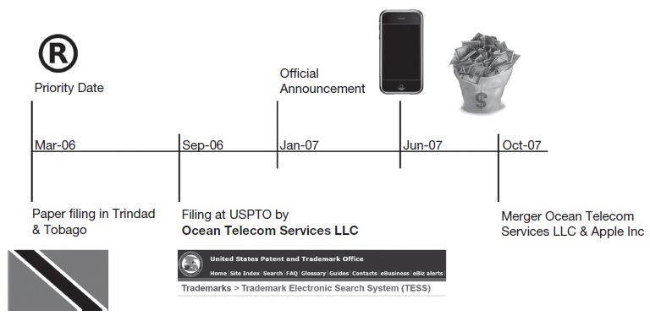
Combining trademark protection and secrecy
iPhone trademark was filed by shell company Ocean Telecom Services LLC instead of Apple in Trinidad & Tobago and about 18 months after filing Ocean Telecom Services was absorbed by Apple.

Slide 45
Trademark non-use, cluttering, depletion and congestion
Cluttering: existence of trademarks on the register that are not used by their owners.
Negative use: entity holds trademark mainly to keep others from using it.
Clutter increases costs for firms to search register and register new and sufficiently distinctive trademarks.
Depletion: because supply of “competitively effective” trademarks is limited, number of unclaimed trademarks is shrinking.
Congestion: registered trademark is increasingly also claimed by others to cover other goods and services.
Word mark “ACE” (Beebe and Fromer, 2018): Trademark first registered in U.S. to cover adhesive bandages, later registered for hardware goods and hardware store services, now total of 130 different registered trademarks for ACE across different classes, owned by 95 different trademark owners.
Empirical evidence shows that:
Firms incur large costs in searching trademark registers and in ensuring there are no potentially conflicting existing marks (von Graevenitz, 2013; von Graevenitz et al., 2015).
Existence of depletion and congestion (Beebe and Fromer, 2018).

Slide 46
Trademarks and domain names
Domain names are “web addresses” that link to websites.
Domain name and trademark of a company name usually the same.
Domain name system is administered by the Internet Corporation for Assigned Names and Numbers (ICANN).
The domain names themselves can be purchased from domain name registrars (e.g. GoDaddy).
Anyone can buy domain names even if domain name is a registered trademark owned by a third party (first come, first served).
ICANN offers several mechanisms to address trademark conflict:
Uniform Dispute Resolution Policy (UDRP) deals with domain name disputes including domain name squatting (cybersquatting).
Uniform Rapid Suspension (URS) offers streamlined and faster UDRP procedure that leads to the suspension of domains.
Trademark clearinghouse notifies trademark owners when new domain name registries become available or domain that corresponds to a registered trademark is registered.

Slide 47
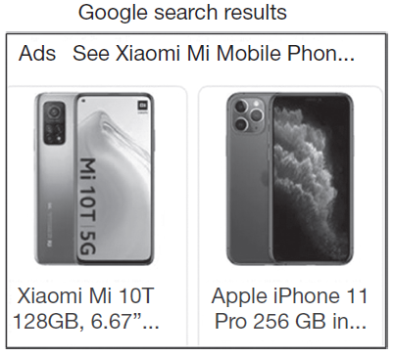
Trademarks and online search
Search engines such as Google allow companies to bid for search terms so their ads are displayed in addition to search results.
Keyword-based advertisement includes registered trademarks.
Google also displays product placement ads (PLA).
A Google search for “xiaomi mi” where both “xiaomi” and “mi” are registered trademarks by Xiaomi Communications, returns results that include the Apple iPhone.

Slide 48
Trademarks and online search
Trademark owners argue that advertiser and search engine liable for trademark infringement: display of products other than the product protected by trademark that a consumer searched for results in consumer confusion.
Does search engine’s display of competing product in addition to the trademarked product increase competition or only cause consumer confusion?
Pro-competitive effects might outweigh any negative effects on trademark owners.
Empirical evidence based on Internet user browsing behavior suggests both effects at play (Bechthold and Tucker, 2014):
Consumers that look specifically for trademarked product when using trademark in their keyword-based search less likely to go to trademark owner’s website.
Consumers that use the trademarked keyword for a more general search are more likely to visit the trademark owner’s website.

Slide 49
Trademarks and online search
Problem more acute on online marketplaces such as Amazon since their own search engines have goal of selling products to consumers.
Amazon relies on its own proprietary search engine that allows consumers to search for items on its site.
In U.S. in 2013, Multi Time Machine (MTM) sued Amazon for trademark infringement:
MTM does not sell its watches on Amazon, nor does it allow authorized retailers to sell them on Amazon.
When a consumer entered MTM’s trademark “MTM special ops” into the Amazon search bar, Amazon offered a list of search results, displaying watches by MTM’s competitors that sell on Amazon.
Amazon argued that it offered consumers new information on other products within the same product category.
Court decided in Amazon’s favor: consumers are not confused about the search results since Amazon clearly identified the brand names of the competing products it displayed.
In Germany in 2019, Ortlieb sued Amazon for trademark infringement:
Ortlieb sued Amazon because Google displayed Amazon ads when users searched for “ortlieb fahrradtasche” (“ortlieb bicycle bag”).
Amazon ads were displayed by Google as a result of keyword advertisement linked directly to the Amazon website.
German Federal Court of Justice decided in Ortlieb’s favor: Amazon misled consumers because ads that appeared on Google suggested that it would only lead to a display of Ortlieb products.

Slide 50
Summary
Trademarks by far most widely used IP right.
Close link between trademarks, brands, and marketing.
Trademarks are a critical tool used by companies to create and protect brand recognition and appropriate returns to marketing.
Link between trademarks and innovation more complex.
New products and services often protected by trademarks and trigger new trademark filings.
Trademarks help companies appropriate returns on innovation.
But no legal requirement that trademarks protect anything new.
Purpose of trademark system is not to encourage innovation but to reduce asymmetric information in the marketplace.

