Slide 1
Chapter 13 Copyright
Bronwyn H. Hall & Christian Helmers

Slide 2
Overview
Structure and purpose of the copyright system
Process and legal requirements to obtain copyright protection
Economics of copyright
Copyright, software, and artificial intelligence
Copyright and digitization

Slide 3
Introduction
Public libraries closed during COVID lockdown.
Lending of physical books ground to a sudden halt.
In response, Internet Archive created “National Emergency Library.”
Internet Archive had been operating “Open Library” prior to COVID.
Open Library offered scanned books for users to borrow online – “controlled digital lending” (CDL).
Internet Archive only allowed one user at a time to digitally check out a book.
Internet Archive mimicked traditional offline lending of physical books, which is permissible under copyright law.
Internet Archive’s National Emergency Library lifted the “one at a time” restriction and allowed different users to check out same book at the same time.

Slide 4
Introduction
In June, 2020, a group of publishers, including Hachette Book Group, Harper Collins, Penguin Random House, and John Wiley & Sons sued Internet Archive for copyright infringement of 127 of their books that were available on the National Emergency Library.
Internet Archive lost lawsuit in the first instance.
District court ruled that CDL and emergency library infringe publishers’ copyright: Internet Archive’s “fair use defense rests on the notion that lawfully acquiring a copyrighted print book entitles the recipient to make an unauthorized copy and distribute it in place of the print book, so long as it does not simultaneously lend the print book. But no case or legal principle supports that notion.”

Slide 5
Introduction
Case has broader implications because libraries across the U.S. had started CDL.
Library scans book that library already owns and lends out in physical form.
It then makes the scanned version available online for check out.
Only a single user is allowed to check out the scanned version at a time and while the digital copy is on loan, the physical copy is unavailable to readers.
Lending model much more economical for libraries than the lending of e-books.

Slide 6
Introduction
Case illustrates trade-off inherent in copyright protection:
Reproduction of a book once it has been written is cheap, in digital format marginal costs are close to zero.
If an author or publisher sets price equal to marginal cost, we get socially optimal amount of consumption.
However, author or publisher cannot recover their fixed investment in the creation of the book.
Because author understands this, they would never have written the book in the first place.
Copyright law faces challenge of balancing interests of creators in requiring positive profits and those of public in obtaining access to creative works.

Slide 7
Introduction
Copyright is closely associated with innovation and technological change:
Copyright protects scientific output (e.g. database) and computer software.
Copyright interacts with creation of new technologies as they often change the way copyrighted works can be created, copied and distributed.
Copyright emerged in response to innovation: the printing press in the mid 15th century.
Technological change and copyright continued to co-evolve over time.
Invention of Xerox photocopier in 1959, audio compact cassette in 1963, spread of videocassette recorders for home use in late 1970s and early 1980s.
All of these technologies had a major impact on consumers’ ability to access and copy copyrighted works.
In response to technological change, copyright law had to adapt over time.
For example in U.S., Audio Home Recording Act of 1992 amended U.S. Copyright Act to allow release of recordable digital audio tapes while at the same time mandating for the first time copy-protection and anti-circumvention measures.

Slide 8
Introduction
Rapid development of Internet and digital technologies created challenges for copyright system.
Digitization dramatically reduced cost of copying, transforming, storing, and distributing copyrighted works.
Affected new works and existing works that could be transformed into digital format.
Changed how people consume copyrighted works (e.g. music streaming).
Changed creation of copyrighted works as the lines between creators and consumers blur.
Creation of new business models that are directly or indirectly based on some form of copying of copyrighted works (e.g. music and video streaming services, such as Spotify or Netflix, platforms that offer access to digital content, such as YouTube, and eBooks, such as Amazon’s Kindle Books).
Transaction costs due to copyright have become relatively more important and enforcement more difficult.
Advent of powerful AI tools that facilitate and even automate potentially the entire production process of creative output poses new challenges for the copyright system.
Copyright system affects technological development.
To what extent certain are new technologies compatible with copyright protection?

Slide 9
Legal aspects of copyright
Copyright Act of 1709, Statute of Anne, established the first statutory copyright in Great Britain.
Limited to book authors and granted right to control copying of books for 14 years (renewable for another 14 years).
In 1790, U.S. Congress passed the U.S. Copyright Act.
Copyright protection in U.S. modeled closely after the British Copyright Act and granted copyright only to books.
In 1909, copyright protection extended to all works of authorship including music.
Currently, in the U.S., copyright protects “original works of authorship fixed in a tangible medium of expression”, which includes literary, dramatic, artistic, musical, and other works including software.

Slide 10
Legal aspects of copyright
Bar to obtaining copyright low compared to other IP rights: works must be original to acquire copyright.
Original not the same as novelty in patent law.
Work does not need to be an expression of a novel or inventive idea.
Specific requirements for originality differ across jurisdictions.
Copyright is automatically acquired through creation of work and “fixing it” in a tangible medium.
Copyrightable subject matter: certain types of work that contain no original authorship such as a standard calendar cannot acquire copyright protection.
No registration or examination required to obtain copyright.
No publication requirement for copyright protection since copyright protects both published and unpublished works.
In some jurisdictions such as the U.S., registration with Copyright Office encouraged and confers certain advantages (e.g., establishes ownership, enforcement).

Slide 11
Legal aspects of copyright
Scope of copyright protection relatively easily defined: copyright protects literal expression of an idea, not idea itself.
In 1859, Charles Selden wrote a short book titled Selden's Condensed Ledger, or Bookkeeping Simplified that contained a simplified book-keeping system.
Book consisted “of an introductory essay explaining the system of book-keeping referred to, to which are annexed certain forms or banks, consisting of ruled lines, and headings, illustrating the system and showing how it is to be used and carried out in practice.”
In 1867, W.C.M. Baker produced a book that contained a similar book-keeping system.
Selden’s wife (Selden himself had died in 1871), sued Baker for copyright infringement.
U.S. Supreme Court held in 1879 that “the mere copyright of Selden's book did not confer upon him the exclusive right to make and use account books, ruled and arranged as designated by him and described and illustrated in said book”.
Specific way in which Selden’s book-keeping system was described in his book was protected by copyright but not book-keeping system itself.

Slide 12
Legal aspects of copyright
Copyright does not protect the idea of the work; it only protects its expression.
Expression can take different forms and copyright can protect different expressions of the same idea:
For example, an artist of a 2-dimensional artwork can prevent another artist from making a 3-dimensional sculpture of the 2-dimensional work.
Author of a novel may prevent someone else from turning the book into a movie without permission.
No copyright infringement usually occurs if copying only concerns an insubstantial part of copyrighted works.

Slide 13
Legal aspects of copyright
Indirect liability (secondary infringement): someone is not directly infringing copyrighted works but instead offers, for example, a peer-to-peer file sharing service specifically designed to enable the exchange of copyrighted music and movies.
Indirect liability helps prevent diffusion of infringing copies, especially in situations where it is difficult to take action against individual unauthorized copiers.
In the U.S., indirect liability rests on the common law doctrines of contributory infringement and vicarious liability:
Contributory infringement means a party knowingly induces infringement by another party.
Vicarious liability means that one party has control over the actions of another party, and obtains some financial benefit from that party’s actions.
Indirect liability also affects the development of new technology:
When videocassette recorders (VCR) for home use emerged in the late 1970s and early 1980s, TV program producers and movie studios argued that VCR manufacturers should be liable for copyright infringement: devices enabled consumers to engage in illegal copying of TV shows and movies.
The argument was that manufacturers were in a better position to prevent copyright infringement than if copyright owners had to monitor and pursue individual consumers.
In Sony v. Universal, U.S. Supreme Court rejected both contributory infringement and vicarious liability.

Slide 14
Copyright and criminal law
In response to technological changes due to Internet, various efforts over the last two decades to strengthen copyright protection and enforcement, especially online.
In the U.S., several draft bills, e.g. Stop Online Piracy Act (SOPA) and PROTECT IP Act (PIPA), would have imposed significant criminal penalties for copyright infringement.
Criminal penalties already exist for copyright infringement
Also for infringement of other IP rights, notably designs and trademarks.
Copyright stands out in the severity and frequency with which criminal penalties have been applied to infringers.
Over-enforcement through criminal sanctions could stifle technology development and adoption.
What are the economic arguments in favor of criminal penalties for copyright infringement?

Slide 15
Copyright and criminal law
Property vs. liability rules:
Property right confers to its owner the exclusive right to dispose of the right.
Liability rule, owner cannot refuse access because third party can compensate owner for unauthorized use.
Property rules enable market transactions that result in bargaining surplus.
Liability rules allow third party to engage in unauthorized use if value access sufficiently to pay compensatory damages to right holder.
Criminal sanctions serve as penalty (in addition to compensatory damages) to deter parties from converting property into liability rules when it is not economically efficient.
Arguments against criminal sanctions for copyright infringement:
If transactions costs are high, property rules may be inefficient.
Criminal penalties impose costs on public, including cost of detection, prosecution, incarceration, probation etc.
Extent of harm caused limited; potential net impact on rightsholder of unauthorized access or copying not always negative.

Slide 16
Economic and moral rights
Copyright law distinguishes between economic and moral rights:
Economic rights:
Focus on role of copyright in incentivizing creation of original works.
Transferable rights that concern commercial exploitation of copyrighted works such as reproduction or distribution rights.
Moral rights:
Focus on personality rights of individual creator and therefore not transferrable.
Ensure an author’s moral right of attribution, i.e. to be identified as creator of original works, right to have integrity of works preserved, right to withdraw works from public.
Common law jurisdictions, such as U.S. do not usually recognize moral rights.
Moral rights more common in civil law jurisdictions.
Economic rights matter for an artist’s incentives to create new work. Moral rights can achieve same objective by granting status and recognition to the artist.

Slide 17
Droit de suite, blockchain, and NFTs
Droit de suite created in France in 1920 and exists in the European Union and number of other countries around the world.
Establishes resale right for an artist.
Ad valorem levy payable to original artist for resale of a painting above a certain price in public sale on secondary market.
In Europe non-transferable right designed to allow artists to benefit from any increased value of their work in the future.
Paintings often increase substantially in value over time and achieve much higher prices in the secondary market than when they are first sold by the artist:
Contemporary artist Robert Rauschenberg’s painting Thaw created in 1958 and sold it to an art collector for $900.
Resold at Sotheby’s art auction in the U.S. 15 years later in 1973 for $85,000.
Because U.S. does not recognize droit de suite, Rauschenberg did not receive any money from the increased value of his painting.

Slide 18
Droit de suite, blockchain, and NFTs
Blockchain technology offers alternative: functions as public ledger that keeps track of all transactions over time in a de-centralized way.
A non- fungible token (NFT) is a numerical certificate that uniquely identifies a given work and can therefore be used to authenticate original work.
Transfers of an NFT are recorded on the blockchain, each subsequent transfer triggers a payment to artist that created work through a smart contract, which is a program that is built into the blockchain.
New technology does away with the need for a statutory right and replaces it with a decentralized solution that requires no enforcement or third-party intermediary.

Slide 19
Term of protection
Copyright protection lasts for a specific amount of time.
Statutory copyright term expanded considerably over time:
U.S. Copyright Act of 1790 set term at 14 years from first publication.
Term extended to 28 years in 1831.
Option to renew copyright protection for another 28 years was added in 1909.
In 1976, term was extended to life of author plus another 50 years after author’s death (or 75 years for work for hire).
1998 Sonny Bono Copyright Term Extension Act extended this further to life of author plus 70 years (for work for hire 95 years from date of publication or 120 years from date of creation).
Economic benefits of extensions contested:
Longer copyright term allows creators or their successors to make more money including from new opportunities that may arise due to changing technology and new markets.
Should encourage investment in creation of work.
Magnitude of marginal impact on incentives disputed.
Akerlof et al. (2002) suggest that additional 20 years added by the Sonny Bono Copyright Term Extension Act had minimal, impact on present value of work.
Retroactive extension, benefits almost exclusively owners of copyrighted works that are about to expire.

Slide 20
Ownership
Initial ownership of copyright pertains to creator.
Copyright can be transferred, including beyond creator’s life.
If work is created in course of an author’s employment ( “work made for hire”), copyright is owned by employer.
For commissioned works, creator is owner of copyright unless parties establish an agreement to the contrary.
Joint authorship results in common ownership, all authors own copyright.
Distinction between joint authorship and co-authorship:
Co-authorship: contributions of different authors are separate from each other. For example in case of a song, one person might write the lyrics, another the music. Each author gains a separate copyright for their part of the work.

Slide 21
International dimension
Copyright is a territorial right, subject to national laws and only enforceable in a given jurisdiction.
Various aspects of copyright protection harmonized early on by Berne Convention in 1886:
Berne Convention is an international treaty that sets minimum standards for copyright protection.
Requires signatory states to grant protection for literary, scientific and artistic works.
Requires national treatment for foreigners, that protection is available without a registration requirement, and that minimum copyright term is author’s life plus 50 years.
U.S. did not sign Berne Convention until 1990:
U.S. copyright system did not recognize national treatment until 1891.
Even after 1891, U.S. granted copyright protection to foreigners only if their work was typeset in U.S. (provision was abandoned in Copyright Act of 1976).
Until 1891, U.S. copyright system discriminated against foreign authors who did not enjoy copyright protection.
TRIPS agreement also contains several provisions related to copyright:
Required signing of Berne Convention and required signatories to offer copyright protection for computer programs and databases.
Despite far-reaching international harmonization, there are still substantial differences in copyright protection across jurisdictions.

Slide 22
Copyright limitations and exceptions
Copyright law recognizes limitations on copyright protection to account for situations in which public’s interest in obtaining access to copyrighted works outweighs copyright owner’s interest.
Limitations include closed list of exceptions from copyright liability.
In U.S., limitations include exceptions such as fair use and compulsory licensing.
In practice, most important exception is fair use doctrine.
Uses of copyrighted material covered by fair use: criticism, comment, news reporting, teaching, scholarship, or research.
In U.S., courts apply 4-factor test to assess whether fair use applies:
Purpose and character of use, including whether such use is of a commercial nature or is for nonprofit educational purposes;
Nature of the copyrighted work;
Amount and substantiality of portion used in relation to copyrighted work as a whole;
Effect of use upon potential market for or value of copyrighted work.
Another important limitation is exhaustion (first-sale doctrine): once copyrighted work has been legally purchased, copyright owner can no longer control the distribution of work.

Slide 23
Copyright and exhaustion
Kirtsaeng v. John Wiley & Sons, Inc.
Supap Kirtsaeng imported foreign edition academic textbooks from Thailand where books had been purchased legally.
Supap took advantage of international price discrimination practiced by academic book publishers.
Publisher John Wiley & Sons sued Supap for copyright infringement arguing that the importation of copyrighted works without the authorization of the U.S. copyright owner was prohibited.
U.S. Supreme Court held that sale of copies lawfully made abroad was covered by the first-sale doctrine, i.e., copyright exhaustion applies internationally.

Slide 24
Copyright on software and AI
Copyright protection for software relatively new:
In U.S., software obtained statutory copyright protection as “literary works” through 1980 amendment of 1976 Copyright Act and subsequent case law.
Challenge for copyright in software context is distinction between software’s underlying idea and function and its expression in the form of code.
If only literal expression of specific code was protected, it would be easy for others to copy the essence of the code without infringing its copyright.
If copyright protects against non-literal copying of software, it would offer broader protection but risks protecting underlying idea rather than just its expression.
Could result in protection similar to patents, but without examination and with a much longer statutory term of protection.

Slide 25
Copyright on software and AI
Copyright infringement lawsuit litigated in the early 1990s by software developer Lotus against competitor Borland.
Lotus 1-2-3 was a popular spreadsheet program created by Lotus in early 1980s.
Borland released competing software, Quattro Pro, in late 1980s.
District court found copyright infringement because Borland had copied Lotus 1-2-3 menu commands and structure, even though Borland “did not copy any of Lotus's underlying computer code”.
U.S. Court of Appeals for the First Circuit found that Lotus 1-2-3 menu structure, which Borland had copied, was a method of operation and as such not protected by copyright.

Slide 26
Copyright on software and AI
Can works generated by AI can acquire copyright protection and if so, who should be the author?
Generative AI capable of producing new work without direct human intervention that in principle could benefit from copyright protection, e.g. images (Midjourney or OpenAI’s DALL-E 3) or music (Amper Music or AIVA).
Does AI satisfy the originality requirement?
In U.S., originality requirement mandates some level of creativity and that work be an independent creation by its author.
Stephen Thaler tried to register a copyright for a piece of visual art called “A Recent Entrance to Paradise” autonomously generated by AI system called “Creativity Machine.”
Thaler claimed ownership of copyright, Creativity Machine was listed as author.
U.S. Copyright Office refused registration on the basis that the work lacked human authorship.
On appeal, court affirmed copyright office’s decision and clarified that question of who owns the copyright to “A Recent Entrance to Paradise” does not even arise because “the work at issue was never subject to copyright protection” due to its lack of human authorship.
Court’s decision still allows for copyright protection of creative works involving AI provided there is human input.

Slide 27
Copyright on software and AI
Is use of copyrighted works for training of AI covered by existing copyright exceptions?
Copyrighted works play an important role in training of AI algorithms.
In U.S. Several lawsuits have been filed recently in the U.S. and Europe against AI companies alleging copyright infringement.
Getty Images sued Stability AI both in the U.S. and UK claiming that Stability AI had copied millions of images from Getty’s database without authorization.
Authors Guild and 17 prominent writers, including John Grisham and George R.R. Martin, filed a class-action suit in the U.S. against Open AI alleging infringement of copyrighted works of fiction used as input for training ChatGPT.
Outcome of debate has potential economic implications as availability of copyright protection for AI generated works will shape incentives for development and application of AI technology.

Slide 28
The economics of copyright
Fixed costs of creating new work high.
Marginal cost of reproduction low.
If artist set price equal to marginal cost, artist unable to cover fixed costs incurred in the creation of the work, leads to “underproduction”.
Copyright allows artist to price above marginal cost.
Artist makes positive profit, which covers fixed costs.
But at higher price, fewer consumers are able to afford the work, leads to “underutilization”.
Trade-off between avoiding underutilization and underproduction.
Similar to trade-off in context of patent system.
But copyright different because:
Imitation (reproduction) very cheap.
Unauthorized copying common.
New works often rely in some form or fashion on existing works.

Slide 29
The economics of copyright
Landes and Posner (1989)
Simple model to show trade-off between providing incentives for creation of new works by granting copyright and cost that copyright generates for the use of existing works in the production of new works.
Artist that produces original work.
Copycat that makes unauthorized, identical copies of artist’s work.
Quantity supplied by artist is x.
Quantity supplied by copycat is y(p,z), where z≥0 denotes the overall level of copyright protection (z = 0 means no copyright).
Assume consumers cannot distinguish between original and unauthorized copies so price of the work or its copies is p.

Slide 30
The economics of copyright
Total quantity of artworks supplied in market q = x+y.
Artist incurs constant marginal cost c to make a copy and costs e(z) to create their new artwork.
Assume supply of copies by copycat increases in price $\frac{∂y(p,z)}{∂p}>0$ and decreases in copyright protection $\frac{∂y(p,z)}{∂z}<0$.
Assume cost of creating new original work e increases in overall level of copyright protection $\frac{∂e(z)}{∂z}>0$.

Slide 31
The economics of copyright
Artist’s profits π:
$π=\left(p−c\right)x−e(z)$ (1)
Replace quantity x supplied by artist using x = q-y:
$π=\left(p−c\right)[q−y\left(p,z\right)]−e(z)$ (2)
Take first derivative of artist’s profits with respect to z:
$\frac{∂π}{∂z}=\underset{\begin{aligned}Revenue effect \\ +\end{aligned}}{\underbrace{−[\left(p−c\right)\frac{∂y\left(p,z\right)}{∂z}]}}\underset{\begin{aligned}Cost effect \\ −\end{aligned}}{\underbrace{−\frac{∂e\left(z\right)}{∂z}}}$ (3)
Strengthening of copyright protection has two opposing effects on artist’s profits:
Revenue effect: positive effect on artist’s profits due to its negative effect on supply of art by copycat.
Cost effect: negative effect on the artist’s profits due increase in artist’s cost e(z).

Slide 32
Existing works as input
Existing works often serve as input for creation of new works.
If strong copyright protection, cost of creating new works increases because creators infringe copyright on some of elements used when creating new works.
Photo (“Puppies”) taken by professional photographer Art Rogers and sold as a postcard.
Contemporary artist Jeff Koons created the sculpture and freely admitted that the sculpture was based on the photo printed on a postcard.
Koons showed the sculpture at an exhibition and sold three copies for a total of US$367,000 in 1988 (about US$925,000 in 2022).
Rogers sued Koons in 1989 for copyright infringement.
Koons argued that fair use should apply because he had transformed the original black-white 2-D work into a colorful 3-D sculpture.
Court rejected Koons’ defense and found that Koons had infringed Rogers’ copyright.

Slide 33
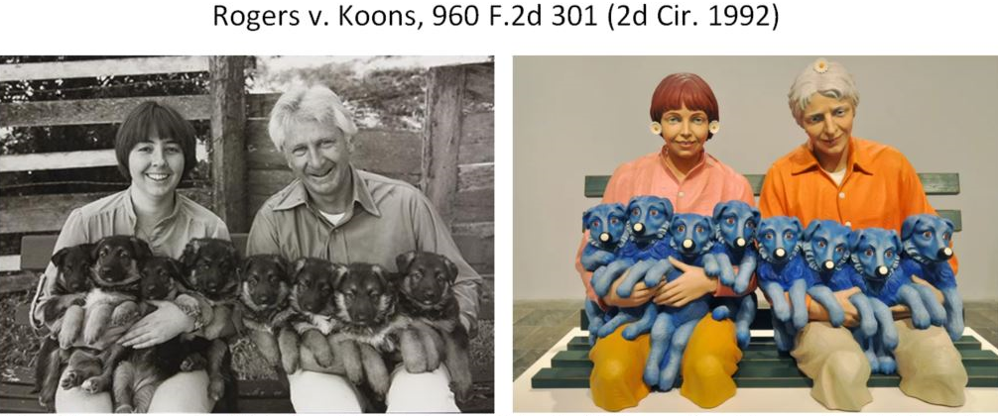
Existing works as input

Slide 34
Existing works as input
Rogers v. Koons case illustrates how prior works serve as input for the creation of new works.
Often not easy to determine whether existing works serve only as input or whether subsequent works are a slightly altered copy of prior original works.
Photographer Andrea Blanch sued Koons for copyright infringement of a photo called “Silk Sandals by Gucci” that had appeared in a fashion magazine.
Koons took the photo and placed it in a collage painting that contained several other elements.
No dispute about the fact that photo copyright protected and that Koons had copied the photo without authorization and incorporated it directly into his art piece.
Court found in Koons’s favor, fair use applied because “Koons used Blanch's work in a transformative manner”, it had no negative economic effect on Blanch’s work, and “the amount and substantiality of Koons's copying was reasonable in relation to the purpose of the copying".

Slide 35
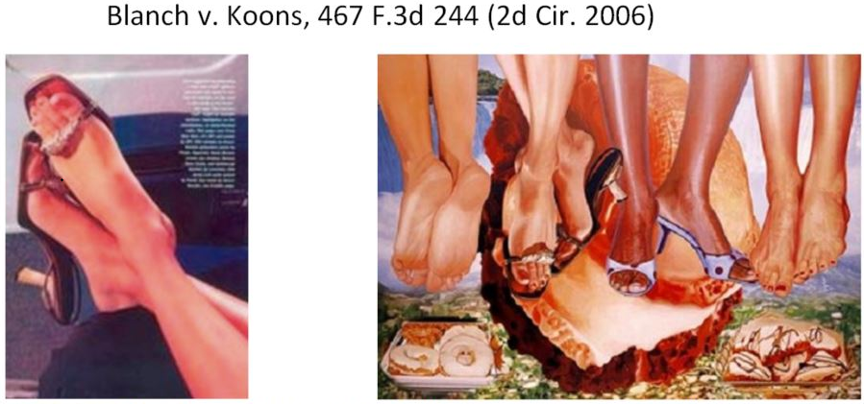
Existing works as input

Slide 36
Sampling
“Metall auf Metall” Kraftwerk v. Pelham
German electronic music pioneer Kraftwerk sued German music producer Moses Pelham in 1999 for use of a 2-second sample of Kraftwerk’s song “Metall auf Metall” from 1977 for a new song produced by Pelham.
Kraftwerk alleged that by using a 2-second sample of their song without authorization, Pelham infringed their copyright.
Pelham countered that the German copyright act allowed the free use of a sample for the creation of new and independent work.
German Federal Court of Justice ruled in 2012 against Pelham and found that even a 2-second sample infringed on Kraftwerk’s phonogram.
Pelham filed constitutional complaint because decision would have effectively ruled out unauthorized use of a sample, which would have affected in particular hip-hop as an entire music genre.
In 2019, Court of Justice of the European Union ruled that samples amounted to unauthorized reproduction under EU law but that sampling is allowed provided the sample is unrecognizable to the ear of the average listener once it has been incorporated in the new work.
Decision illustrates delicate balance copyright law attempts to strike between protecting original works and not obstructing creation of new works.

Slide 37
Revenue effect
How responsive are creators to the revenue effect?
Artists potentially have fairly inelastic supply with respect to financial compensation.
In practice, royalty income distribution highly skewed.
Empirical evidence on impact of copyright suggests large effects on prices (Li et al., 2018; Reimers, 2019).
Copyright affects supply and quality of creative works (Giorcelli and Moser 2020):
Introduction of copyright in Italy in early 19th century significantly increased creation and quality of new operas.
Composers benefitted from copyright because it gave them right to obtain royalties from repeat performances.

Slide 38
Copying
Unauthorized copying common.
E.g. illegal streaming or downloading of music or movies on now defunct platforms such as The Pirate Bay or Megaupload.
Availability of relatively easily accessible pirated copies common occurrence in markets for copyrighted works.
Several reasons:
Copying and distribution often cheap, especially of digital works.
Copyright enforcement costly and time consuming while economic damage caused by individual copy low.
Enforcement difficult, especially if those that produce and distribute unauthorized copies abroad.

Slide 39
Copying
Presence of copies creates de facto competition.
Even if assume unauthorized copies not perfect substitutes of original works, resulting market structure looks more like monopolistic competition.
Despite exclusivity granted by copyright, in practice, copyright owners have limited market power.
Limits revenue and ability to price discriminate.
But competitive pressure from copying may have an “escape competition effect”.
Some degree of copying profitable for artist in the presence of network externalities

Slide 40
Copying
Copyright owner can rely on price discrimination in the presence of unauthorized copying: indirect appropriation (Liebowitz, 1985).
If artist knows who will use their legally purchased version for unauthorized copying, artist charges user more.
Artist price discriminates among buyers as a function of number of copies that will be made with each original work.
Indirect appropriation can also occur through complementary products:
For example, artists can increase profits through live concerts.
If copying of an album increases demand for concert tickets, resulting increase in prices of concert tickets can mitigate decreased revenue due to copying.

Slide 41
Copying
Data for concert prices in the U.S. shows steep increase starting in the late 1990s when Napster appeared.
Pattern also explained by artists setting higher prices because concerts had less impact on record sales due to piracy (Krueger, 2005).
But in particular lesser known bands saw their revenue from live concerts increase in the post-Napster period (Mortimer et al., 2012).
Effect consistent with file sharing allowing consumers to listen and discover more diverse set of music.
Evidence from songs that entered public domain in the UK after their recording copyright expired suggests that the relationship between concerts and copyright is more complex.
Number of reissues increased, although the songs were performed less live in concert because artists preferred to promote their copyrighted works (Watson et al., 2022).

Slide 42
Private copy protection
Statutory copyright protection avoids over-investment in private copy protection.
Private copy protection describes measures that creators take to impede unauthorized copying and access of copyrighted material (e.g. DRM including encryption, digital watermarks, or authentication protocols).
Private copy protection is a substitute to legal copyright protection.
Number of drawbacks to copy protection:
Requires private investment in access and copy control which increases cost of producing and distributing original works.
Provides copyright owners with the ability to limit non-infringing uses.
Potential for private copy protection to be used anti-competitively.

Slide 43
Private copy protection
Nintendo vs. PC Box:
PC Box sold mod chip that allowed users to circumvent restrictions Nintendo built into its game consoles.
Nintendo claimed that restriction was necessary to prevent copyright infringement of its video games.
Restriction meant that Nintendo was able to prevent any third party content from being played on its consoles.
PC Box argued that its circumvention device enabled additional legal uses of Nintendo’s console for purposes such as playing MP3 files or movies.
Court of Justice of the European Union ruled with respect to technological protection measures such as those used by Nintendo that national courts have to weigh their impact on “preventing or restricting not only acts which require the rightholder’s authorisation […] but also acts which do not require such authorization”.
With respect to circumvention devices such as PC Box’s mod chip, the court ruled that national courts must to take into consideration the extent to which these devices “can be used for legitimate purposes other than allowing acts which require the rightholder’s authorisation”.

Slide 44
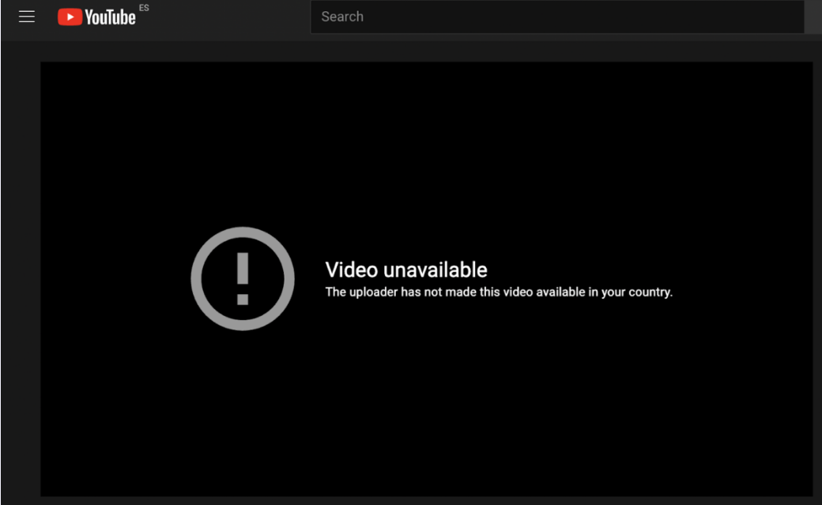
Geo-blocking and price discrimination
Geo-blocking allows content providers to block access to digital content, such as movies, music, or e-books, based on a user’s geographical location.
Technology also allows content providers to tailor content to users depending on their location.
Technology also used to price discriminate against users across locations.
Geo-blocking allows content providers to avoid copyright infringement and instead benefit from geographically differentiated licensing.
For example, Netflix can stream a given TV show in only a subset of countries where its streaming service is available to avoid paying for a global license.
Geo-blocking can also be used to prevent access for users in a certain country for other legal reasons, such as laws prohibiting online gambling.
Geo-blocking relatively easily circumvented through use of virtual private networks (VPN) or anonymous proxy servers.

Slide 45
Copyright and digitization
Copyright has played central role in shaping development of new, digital technologies and online market places.
Copyright law has been challenged by digitization and had to adapt to accommodate changes in which copyrightable work is created, distributed, and consumed.
Digitization has had a large impact on media industries that heavily rely on copyright, including music, film, and books.
Digitization reduced marginal costs of copying and distribution to close to zero.

Slide 46
Copyright and digitization
Resulting widespread piracy eroded the music industry’s profits starting in 1999 (although the exact magnitude of the effect of piracy on sales is contested).
Free access to copyrighted works allowed consumers to sample and thereby increase demand (Peitz and Waelbroeck, 2006).
Working out the net effect is difficult:
Positive correlation between legal sales of a song and how often it is shared illegally on file-sharing websites.
Positive correlation does not imply that illegal sharing causally drives up demand.
Positive correlation does not imply that everyone that obtained an illicit copy would have otherwise legally purchased a copy.

Slide 47
Copyright and digitization
Data from a European consumer mail survey in 2001 suggest that regular users of file sharing sites and those downloading MP3 files from the Internet were 32% less likely to legally purchase music (Zentner, 2006).
Strengthening of copyright enforcement online lead to less internet traffic, which is an indicator of reduced peer-to-peer file sharing activity, and an increase in legal music sales (Adermon and Liang, 2014).
Evidence indicates that piracy and legal sales are indeed substitutes, albeit certainly not perfect ones.
Finding does not necessarily carry over to other types of creative works.
Free availability of books in digital format on Google Books increased sales of their physical counterparts because it facilitated consumer search and discovery (Nagaraj and Reimers, 2023).
Effect is likely to dominate substitution of paid-for physical books for free online versions because consumers do not consider them perfect substitutes and their improved ability to search online expands demand sufficiently.

Slide 48
Copyright and digitization
Digitization gave content creators direct access to consumers, which facilitated entry into the market.
Cheaper to create new content, store and offer content to consumers.
Cheaper to rely on content as input because storage of content has become drastically cheaper and a number of platforms have emerged that allow creators to shop for input (e.g. Beatstars).
Owners of copyrighted works deal with the challenges posed by digitization in various ways:
Lower prices to discourage use of unauthorized copies of lower quality.
Engage in bundling through subscriptions (e.g. Amazon Prime).
Sell personalized access (e.g. playlists on Spotify).
Make it harder to copy or gain unauthorized access by using DRM.
Sell physical or service complements (e.g. software companies can provide customer service or regular free updates).

Slide 49
Summary
Copyright protects expression of an idea, not idea itself.
Acquired by creation of original works that fall within the definition of copyrightable subject matter.
No examination or requirement of registration to benefit from copyright protection.
Copyright protection has been substantially harmonized internationally, but important differences remain across jurisdictions.
Economics of copyright center on trade-off between granting exclusivity to allow authors to recoup their fixed investment in the creation of original works and ensuring the widest possible access to the work.
Trade-off complicated by fact that unauthorized copying is common and that the creation of original works almost invariably relies on existing copyrighted works as input.
Copyright affects creator’s incentives to engage in private copy protection.
Digitization and AI pose unique challenges for the copyright system.

