Slide 1
Chapter 16 Patents and pharmaceuticals
Bronwyn H. Hall & Christian Helmers

Slide 2
Overview
Basic characteristics of the R&D and drug development process in the pharmaceutical industry.
The patent system in the pharmaceutical industry.
Effects of patent protection on drug development, diffusion, and pricing.
Strategic patenting and secondary patents.
Patent litigation and collusive agreements to delay generic entry.

Slide 3
Introduction
Pharmaceutical industry different from other industries in many dimensions:
Diverse market participants: research institutions, drug developers/manufacturers, wholesalers, physicians, patients, insurance providers.
Subject to far-reaching regulatory intervention that promotes variety of goals.
Innovation has dramatic consequences for people’s well-being and life expectancy.
Innovation requires large upfront investments.
Very R&D intensive.
Development of new drugs and their regulatory approval process takes many years before commercialization.
End consumer does not usually pay. Instead payment made by insurance company or government, and product choice made by medical professional.
Successful drugs extremely profitable.

Slide 4
Introduction
Pharmaceutical industry important from an aggregate economic perspective:
Total health spending in U.S. nearly 17% of GDP in 2015, in Germany and Switzerland slightly more than 11%.
Substantial differences between industrialized and developing countries in terms of health spending and access to drugs:
U.S. accounts for largest share of global sales in market for prescription drugs, followed by European Union (EU).
Developing countries account only for small share of global sales despite being home to much larger share of the world’s population.

Slide 5
Introduction
Two types of companies:
Originators
Generics
Originators introduce new drugs.
Generic companies offer “copies” at much lower prices.
Substantial drop in price following generic entry puts pressure on originators to continue to innovate to benefit from exclusivity for new drugs.
Creates incentives for originators to use patent system strategically to extend exclusivity.
Competition occurs mostly between originators and generic companies, but originators also compete against each other.

Slide 6
Introduction
Originators:
Rely heavily on patent protection.
Vertically integrated companies.
Examples: Johnson & Johnson, Pfizer, Roche, Novartis, and Merck
Drug development very expensive and highly uncertain.
Patent system plays crucial role in development and commercialization.
Usually rely on few top-selling prescription drugs (blockbusters).
Carefully guard their exclusivity and employ range of (patent) strategies to extend exclusivity in scope and over time.
Capitalize on brand recognition and customer loyalty built during the period of patent exclusivity to soften competition even after generic entry occurs.

Slide 7
Introduction
Generics:
Make therapeutically equivalent drug to the originator product as soon as the originator loses exclusivity.
Loss of exclusivity generally occurs when a patent expires, or because a generic company successfully invalidates relevant patents or avoids infringement.
Generic companies enter market without incurring large R&D investment incurred by originator companies since they replicate existing drugs.
Generic companies rely on safety and efficacy data generated by the originator in its pre-clinical and clinical trials.
Saves most of the R&D investment associated with drug development and speeds up market entry.
May also engage in innovation, mostly extensions of existing drugs to differentiate products.
Use patents to protect new products or processes, but patent protection generally far less important.

Slide 8
Introduction
Long-standing and highly contentious policy debate about the role of patents in pharmaceutical industry.
New drugs can have enormous therapeutic value.
Example: Gilead’s Sovaldi
Sovaldi has made it possible to cure hepatitis C.
Enormous value of Sovaldi to people affected by hepatitis C.
But Gilead heavily criticized for charging $1,000 per pill or approximately $84,000 for a 12-week treatment necessary to cure virus.
Despite high price tag, people in developed countries may have access to the drug through health insurance.
Sovaldi too expensive for almost everyone in developing world.
Gilead can only charge such high prices because it benefits from regulatory and patent exclusivity.

Slide 9
Pharmaceuticals: A primer
Two classes of drugs:
Non-biologic drugs: consist of synthetic active ingredients.
Biologic drugs: synthetized from living organisms.
Important differences between non-biologic and biologic drugs that affect their development and manufacturing process as well as regulation by health authorities.
Many blockbuster drugs are biologics, but majority of drugs still non-biologics.
Focus on non-biologics.

Slide 10
Pharmaceuticals: A primer
Drugs consist of active and inactive ingredients.
Active ingredient (compound) produces therapeutic effect.
Drugs can contain one or several active ingredients.
Inactive ingredients have no therapeutic effect but can still affect a drug’s effectiveness.
Originators conduct basic R&D to find new active ingredients that lead to novel pharmaceutical products.
Originators conduct incremental innovation where they improve existing drugs, for example through new formulations or delivery methods.
R&D and regulatory approval of new active ingredients costs on average $800 million-$1 billion and takes 10-12 years between early stage research and market authorization (EUCOM, 2009).

Slide 11
Pharmaceuticals: A primer
Drug innovation process starts with basic research to discover large number of candidate active ingredients to treat particular disease.
Most promising candidate molecules reach the pre-clinical stage where they are tested for safety and efficacy in the laboratory and using animals.
Only 1 out of 5,000 candidate active ingredients that enter pre-clinical phase will be successful and eventually approved for therapeutic use (EUCOM, 2009).
Assess safety and efficacy in humans in clinical trials.

Slide 12
Pharmaceuticals: A primer
Clinical trials proceed in 4 phases:
Phase 1: Drug administered to humans. Only healthy individuals receive drug; test safety and efficacy. Takes on average 1-3 years, only 1 out of 3 active ingredients survives.
Phase 2: Drug is administered to individuals who have condition designed to treat, in order to test its efficacy. Often leads to changes in formulations and dosages. Takes 2-5 years, only 1 out of 3 drugs survives.
Phase 3: Large-scale randomized control trials involving individuals with and without relevant condition. Most expensive stage in drug-development. Often leads to changes to drug and way it is administered. Takes on average 2-4 years, on average 2 out of 3 drugs survive.
Phase 4: Begins only after drug has been approved by health regulators and is actively in use. Monitor and improve safety and efficacy by analyzing interactions with other drugs and collecting more data on potential adverse reactions, (long-term) side effects, and efficacy. Leads to further improvements of drug and its administration.
If a drug successfully completes Phase 3, it has to obtain market approval by regulators before it can be sold and administered to patients.
Once approved by national regulators, World Health Organization (WHO) issues international non-proprietary name (INN).

Slide 13
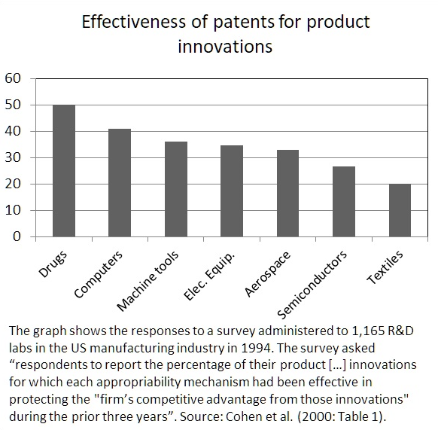
Pharmaceuticals and the patent system
Patents play important role in the pharmaceutical industry.
Patents in combination with regulatory exclusivity are main tools to achieve exclusivity during limited period of time that enables originators to recover their investments.

Slide 14
Patents and a drug’s lifecycle
Patents play an important role throughout a drug’s lifecycle.
During early stages of drug development process, originators file patents on candidate compounds:
Patents cover the chemical compounds.
Ensure freedom to operate for development of the compound.
Typically patents with broad claims early on in the development process.
As drug development process progresses, originators routinely file more patents on different related aspects, such as process or method patents.
Clinical trials often reveal new information that leads to improvements in formulations or dosages.
Due to often long lag between basic research and market authorization of new drug, patents on original candidate compounds usually filed many years before drug reaches market:
Period of effective patent exclusivity often much shorter than the 20 year patent term.
Patent term extensions to partially compensate for time lost due to long drug development and regulatory approval process.

Slide 15
Patent types
Broad distinction between product and process patents:
Product patents cover compounds.
Process patents cover a range of subject matter including production methods, formulations, dosages, etc.
Specific to pharmaceuticals, distinction between primary and secondary patents:
Primary patents cover active ingredients:
Commonly filed during early stages of drug development process and during pre-clinical trial phase.
Originators file large number of primary patents on all candidate compounds to ensure freedom to operate and block potential competitors.
Secondary patents comprise product and process patents:
Secondary process patents typically cover production processes and methods, formulations, dosages, and treatment methods.
Secondary product patents cover alternative forms (such as salts or isomers) of existing compounds.
Typically filed after primary patents and throughout a drug’s entire lifecycle.

Slide 16
Patent types
Among secondary patents that protect drugs approved by FDA between 1991 and 2005 (Kapczynski et al., 2012):
56% are formulation patents;
24% of patents cover salts, crystalline forms etc.;
63% of patents cover methods of use.
Combination of primary and secondary patents means that a given drug is usually protected by more than a single patent.
Patents that protect a given drug filed at different stages of product development and a drug’s lifecycle:
Most secondary patents filed after FDA approval (Kapczynski et al., 2012).
In Chile, nearly half of secondary patents filed after drug approval by Chilean health regulator (Abud et al., 2015).

Slide 17
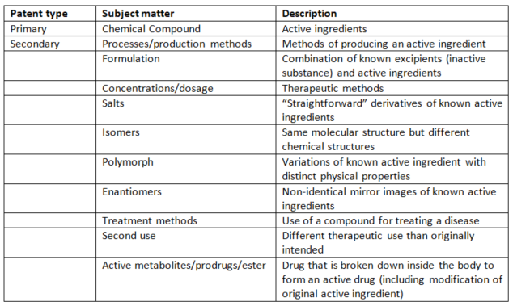
Patent types

Slide 18
Patents and generic entry
Generic companies benefit from abbreviated drug approval process.
Generic companies do not need to submit pre-clinical and clinical trial data to prove safety and efficacy.
Only need to demonstrate “bioequivalence”, i.e. generic drug has same therapeutic effect as originator drug.
Avoids duplication of clinical trials, substantially speeds up approval process, and saves generic company significant expenses required by pre-clinical and clinical testing.
In some jurisdictions, market approval contingent on status of patent protection for a given drug (patent linkage).
In U.S., Hatch-Waxman Act of 1984 created different paths for approval for generic drugs:
Not protected by any patents listed in the Orange Book (Paragraph I certification);
Relevant patents have already expired (Paragraph II certification);
Will expire at later date (Paragraph III certification);
Generic entrant demonstrates either non-infringement of patents listed in the Orange Book or successfully invalidates them in court or through administrative proceedings (Paragraph IV certification).
In exchange for successful Paragraph IV challenge, generic entrant obtains 180 days of marketing exclusivity.

Slide 19
Data exclusivity
New drugs benefit from regulatory exclusivity, which is distinct from patent exclusivity.
Regulatory exclusivity results from restrictions imposed by regulators on approval of competing (generic) drugs.
Regulatory exclusivity exists independently from patent protection.
Data exclusivity restricts generic company’s ability to rely on existing clinical efficacy and safety data to obtain market authorization.
Data exclusivity does not prevent generic company from conducting own tests and submitting own test results. But not profitable to do so.
Data exclusivity exists in large number of countries around the world, including developing countries but not harmonized internationally and substantial differences exist in terms of length and scope of protection afforded by data exclusivity.

Slide 20
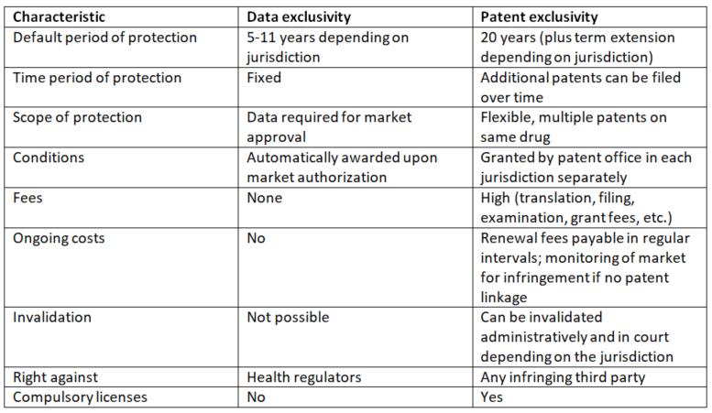
Data exclusivity

Slide 21
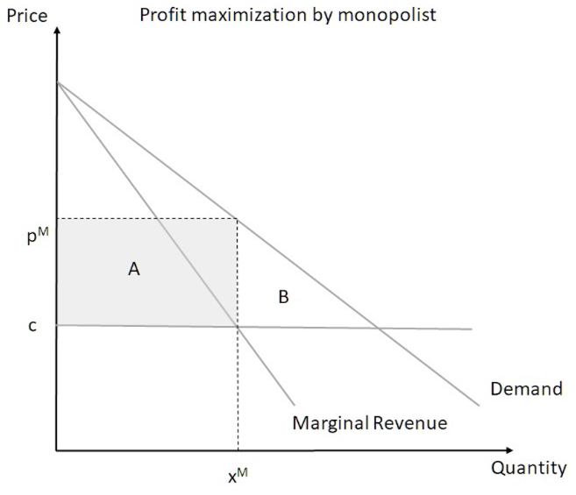
Patents, drug development, and diffusion
New drug development very expensive and highly uncertain.
Originators use patents in combination with regulatory exclusivity to exclude competitors, both other originators and generics.
Trade-off:
Patent allows originator to make positive profits off new drugs which creates incentives for investment in the development of new drugs.
Patents restrict access to new drugs by allowing originators to choose in which markets drugs will be available and at which price.
Monopolist sets price p^{M}, monopolist obtains producer surplus (area A).
Leads to deadweight loss (area B).
Producer surplus allows the monopolist to recover its investment in R&D but deadweight loss means that a fraction of consumers are unable to obtain access to the drugs sold by the monopolist.

Slide 22
Patents, drug development, and diffusion
Launch of first HIV/AIDS medication azidothymidine (AZT) in 1987, sold under brand name Retrovir by British originator Wellcome.
Available on U.S. market for annual cost of US$ 8,000 (approximately US$18,000 today).
In U.S., cost was covered by private medical insurance and publicly funded programs.
Not affordable to the vast majority of people infected with HIV in the developing world.
Patents prevented the production or importation of generic HIV medication in developing countries.

Slide 23
Patents, drug development, and diffusion
In 1997, combination of different anti-retroviral (ARV) medications, highly active antiretroviral therapy (HAART), became available and dramatically reduced mortality of people infected with HIV.
The impact of patents on access to ARVs was significantly affected by TRIPS agreement which came into effect in 1995.
India was an exception as the country did not grant product patents until 2005.
Indian generic companies were able to produce low-cost ARV medication, including the highly effective HAART combinations of different active ingredients.
Indian generic company Cipla offered a triple-combination ARV for US$350 a year in 2001.
Originator companies argued that they required high drug prices to recover their investment in R&D and to finance continued efforts to improve HIV/AIDS therapies.
But lack of access caused the death of millions of people in the developing world.

Slide 24
Patents, drug development, and diffusion
Available empirical evidence on impact of pharmaceutical patents on incentives for R&D mixed.
No evidence that stronger patent protection of pharmaceuticals leads to an increase in domestic innovative activity in the pharmaceutical industry except in high income countries (Qian, 2007).
Stronger patent rights in developing countries did not lead to more investment in research on diseases relatively more prevalent in these countries (Kyle and McGahan, 2012).
More detailed evidence on the impact of TRIPS on innovative activities of local pharmaceutical companies in India:
Indian pharmaceutical industry experienced increase in R&D spending, driven mainly by large players, Ranbaxy and Dr. Reddy’s.
Indian generics producers developed new generic drugs and novel drug delivery systems since adoption of TRIPS agreement.
Strengthened position in global contract research and manufacturing markets and engaged more in collaborations and alliances with foreign originator companies.
Despite increased R&D spending and domestic patenting activities by Indian generics producers, so far little success with development of genuinely new drugs (Athreye et al., 2009).

Slide 25
Patents, drug development, and diffusion
Evidence on impact of patent protection on prices less ambiguous.
Generic entry leads to large price drops but only if competition among generic producers occurs.
How do prices change when originators lose exclusivity and generic entry occurs?
Prices drop on average by 25% within one year and decline further over time (EUCOM, 2009).
Effect of patents on prices is heterogeneous across drugs, patents increase prices the most in lucrative therapeutic areas.
First generics company that enters the market for a given drug able to charge significant mark-ups over cost (20-30%). Mark-ups persist even when there are multiple entrants and only go to zero when there are 10 or more competitors (Reiffen and Ward, 2006).
Larger therapeutic markets attract more entrants and generics enter market faster.
Originators often maintain high prices by targeting less price sensitive market segment (Regan, 2008).
Lack of price sensitivity result of brand recognition and customer loyalty built during exclusivity period.
Originators still experience a significant decrease in market share and revenue following generic entry.

Slide 26
Patents, drug development, and diffusion
What happens to drug prices when patent protection is introduced?
Introduction of product patents in India to comply with TRIPS led only to modest price increases (Duggan et al., 2016).
Relatively minor effects of product patents to some extent explained by
Specific TRIPS provisions (threat of mandatory licensing, price regulation, generic producers that were manufacturing a drug before 2005 in India could continue to do so even if a patent was later granted).
Potential difficulties with patent enforcement.
India’s TRIPS implementation excluded compound patents with priority dates prior to 1995, which effectively limited available patent protection for a significant number of drugs (Sampat and Shadlen, 2015).

Slide 27
Patents, drug development, and diffusion
Does patent protection accelerate or hinder access to new drugs?
How fast do new drugs approved by the U.S. FDA become available in the U.S., Germany, and India (Berndt and Cockburn, 2014)?
93% of drugs were launched in the U.S. within 3 years of market approval and 77% in Germany within the same period. In India, only 30% were launched within 3 years.
Median launch lag in the U.S. less than 2 months, about a year in Germany, around 5 years in India.
Market potential is main factor, but patent protection also affects launch decisions by originators.
Drugs introduced in India quickly faced generic competition while there is no evidence for similarly fast generic entry in U.S. and Germany.
New drugs are significantly less likely to be launched in countries that afford weaker patent protection to pharmaceuticals (Berndt et al., 2011).
Availability of product patents for pharmaceuticals increases accessibility of new drugs (Cockburn et al., 2016).

Slide 28
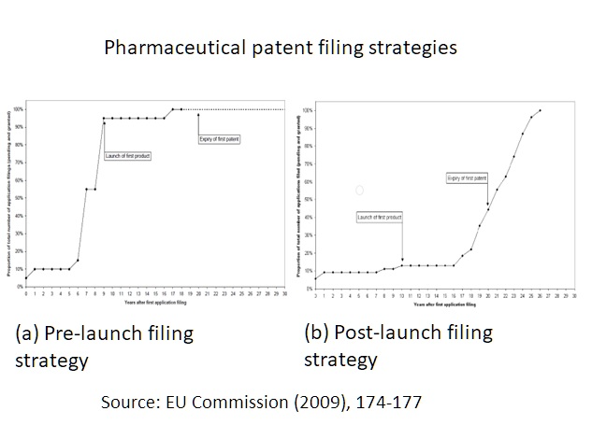
Strategic patenting
Originators use set of strategies to extend period of exclusivity and scope of protection to limit competition beyond that granted by primary patents and regulatory exclusivity.
Strategic patenting aimed at generic entry and competition by other originators.
Multiple goals:
Secure freedom to operate.
Preserve market exclusivity.
Facilitate bargaining in IP disputes.
Pre-launch filing strategy: majority of patents filed prior to launch.
Post-launch filing strategy: majority of patents filed after launch.

Slide 29
Strategic patenting
Continuous filing of patents over entire lifecycle of a drug expected because companies continue to do research on a drug far beyond the initial R&D phase, throughout clinical trials and even after drug successful in market.
Creates challenge for regulators and policy makers to distinguish between patents on complements or follow-on innovation and purely strategic behavior to extend patent protection in length or breadth
Second generation products (“evergreening”):
Second generation drugs usually have same therapeutic effect as first generation drug.
Second generation drug will also be patented and launched shortly before first generation product loses patent exclusivity.
Originator may withdraw first generation drug from market and invest heavily in marketing while still benefiting from market exclusivity to switch users from first to second generation drug.
Originators avoid significant price drops for second generation drug if it won’t be perceived as a perfect substitute for first generation drug.
Patent protection of modified active ingredient, combinations of active ingredients, dosages or formulations involved in such second generation products play a crucial role in this strategy.
Presence of a second generation product can make entry less attractive.

Slide 30
Strategic patenting
Secondary patents play an important role in patenting strategies employed by originators.
Secondary patents used to:
Extend the overall length of patent protection.
Increase the scope of patent protection.
Effect of secondary patents on length of patent exclusivity substantial:
Secondary patents extend exclusivity by 4-5 years in U.S. (Kapczynski et al., 2012).
Secondary patents extended patent life of two originator HIV drugs, Abbott’s Kaletra (lopinavir/ritonavir) and Norvir (ritonavir) by at least 12 years (Amin and Kesselheim, 2012).
But in practice effective extension of patent protection achieved by secondary patents limited because generic companies more likely to successfully challenge these patents through Paragraph IV entry (Hemphill and Sampat. 2012).

Slide 31
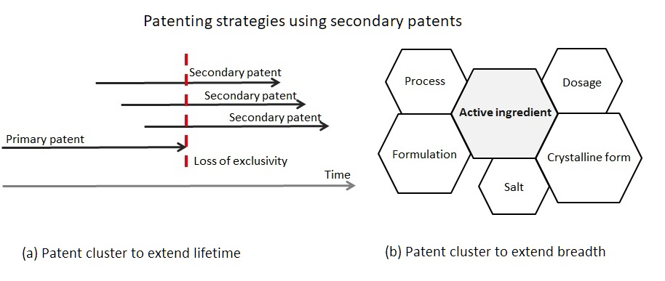
Strategic patenting

Slide 32
Strategic patenting
Strategic objectives are achieved through specific patenting strategy or combination of different patent strategies including:
Blanketing/Flooding: originator company protects a drug in unsystematic ways by filing a large number on a wide range of aspects related to a given drug.
Fencing/Surrounding: originator files patents on different technological solutions for similar functional outcomes, effectively surrounding patents that protect the basic active ingredient with other patents.
Networking/clustering: the originator creates an overlapping patent portfolio, akin to a web of patents, which makes it harder for generic competitors to enter with a generic version in form of for example a salt or crystalline form of the active ingredient.
Secondary patents are generally perceived as “weaker” than primary patents.
Ratio of primary to secondary patents is 1:13 for pending patents but only 1:5 for issued patents (EUCOM, 2009).
Strategic patenting more prevalent the higher branded drug’s sales (Kapczynski et al., 2012).
Generic companies more likely to target these drugs due to lucrative market opportunity and legal vulnerability of secondary patents (Hemphill and Sampat, 2012).

Slide 33
Secondary patents: India's Glivec decision
Glivec highly effective drug to treat chronic myeloid leukemia.
Active ingredient in Glivec new form (beta crystalline form) of known active ingredient (imatinib mesylate).
Annual cost of Glivec in U.S. in 2013 around US$60,000.
In April 2013, Indian Supreme Court confirmed Indian Patent Office’s rejection of Novartis's patent application for Glivec.
Patent Office’s rejection based on Section 3d of India's Patent Act:
“the mere discovery of a new form of a known substance which does not result in the enhancement of the known efficacy of that substance or the mere discovery of any new property or new use for a known substance or of the mere use of a known process, machine or apparatus unless such known process results in a new product or employs at least one new reactant” is not an invention and hence does not meet the requirements for patentability.
Section 3d effectively limits the patentability of secondary patents.
Ruling allowed generic companies to manufacture Glivec in India.

Slide 34
Litigation and settlement
Patent exclusivity involves uncertainty regarding patent infringement and validity.
Considerable uncertainty for originators, especially once the primary patents have expired and patent exclusivity relies on secondary patents.
Originators use the settlement of litigation to delay entry by generics: pay-for-delay or reverse payment.
Originators pay generic companies to settle patent litigation.
Parties agree on delayed market entry date for generic.
In 2013, U.S. Supreme Court held in FTC v. Actavis that such pay-for-delay settlements violate U.S. antitrust law if purpose of settlement to avoid competition:
Generic manufacturer Actavis had applied for Paragraph IV certification to market a generic version of originator Solvay’s AndroGel.
Solvay sued Actavis for patent infringement.
Parties settled in 2006 and agreed that Actavis would not enter market until 2015 while Solvay’s patent on AndroGel was set to expire in 2021.
Actavis received an annual payment of between US$19 and 30 million from Solvay.
Settlement would have delayed generic entry by up to 9 years at substantial cost to consumers.

Slide 35
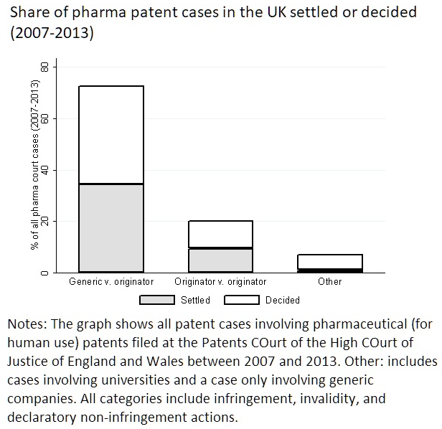
Litigation and settlement
Only a quarter of settlements involve any agreements to delay generic entry and a payment from originator to generic company (European Commission, 2009).
UK litigation data suggest that settlements occur in about half of all cases where originators litigate against other originators or generics.
Settlements are equally likely in litigation between originators and litigation between originators and generic companies.
Pay-for-delay settlements unlikely to dominate outcome of patent litigation between originators and generics.
But direct connection between pay-for-delay settlements and secondary patenting (Hemphill and Sampat, 2013): Pay-for-delay settlements more likely to occur when secondary patents barrier to generic entry.

Slide 36
Summary
Patents play crucial role in pharmaceutical industry.
Fundamental trade-off inherent in patent system particularly apparent in pharmaceutical industry:
Temporary exclusivity allows originators to recoup investments in development of new drugs.
Exclusivity restricts access to drugs.
Strategic patenting common in pharmaceutical industry.
Originators rely on different patenting strategies to secure own freedom to operate and prevent competition from other originators and generics.
Secondary patents are main tool used by originators to extend patent exclusivity both in length and scope.
Anti-competitive use of settlements between originators and generic companies.
Originators and generic companies can effectively collude because the originator’s monopoly position hinges on patent exclusivity.

