Slide 1
Chapter 17 Software, business and financial methods, open source, and artificial intelligence
Bronwyn H. Hall & Christian Helmers

Slide 2
Overview
R&D and product development process in the software industry.
Legal and policy debate over patent protection of software, business and financial methods.
Effects of software, business and financial method patents on innovation.
Open source software and its relation to proprietary software.
Current debate on interaction between artificial intelligence (AI) and the patent system.

Slide 3
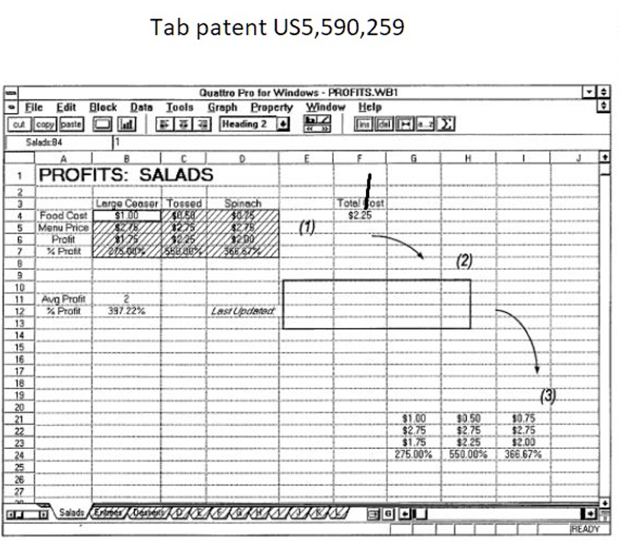
Introduction
In September 2014, Data Engine Technologies sued Google alleging that Google Sheets infringed six patents, known as “Tab Patents.”
Patents “claim a method of implementing a notebook-tabbed interface, which allows users to easily navigate through three-dimensional electronic spreadsheets.”

Slide 4
Introduction
What is the invention covered by Tab Patents?
Claim 12 of patent US 5,590,259:
In an electronic spreadsheet system for storing and manipulating information, a computer-implemented method of representing a three-dimensional spreadsheet on a screen display, the method comprising:
displaying on said screen display a first spreadsheet page from a plurality of spreadsheet pages, each of said spreadsheet pages comprising an array of information cells arranged in row and column format, at least some of said information cells storing user-supplied information and formulas operative on said user-supplied information, each of said information cells being uniquely identified by a spreadsheet page identifier, a column identifier, and a row identifier; […]

Slide 5
Introduction
District court found patents invalid because claims were directed to an abstract idea.
CAFC reversed district court’s decision stating that claim 12 is
“directed to more than a generic or abstract idea as it claims a particular manner of navigating three-dimensional spreadsheets, implementing an improvement in electronic spreadsheet functionality”
District court then found patents not to be infringed by Google because Google Sheets at the time lacked 3-dimensionality (3-dimensionality means a “multipage” spreadsheet).
Patents asserted against Google cover a software invention (“computer implemented invention”).

Slide 6
Introduction
Software patents have been highly controversial since they started to emerge in the U.S. in the early 1970s.
Mainly two reasons:
Is software merely an abstract (mathematical) concept? If so, should patents be available at all to protect software?
Software as a technology is fundamentally different from other technologies and may be incompatible with patent system.

Slide 7
Introduction
Open source software offers alternative to proprietary software.
Open source developers make source code freely available.
Enables free sharing of software.
In practice, open source and proprietary software often used as complements not as substitutes.

Slide 8
Introduction
Closely related debate about business method patents (including financial method patents)
Patent that protect ways of conducting business, mostly online.
Critics:
Overwhelmingly protect obvious and often trivial ways of conducting business.
Many patents protect obvious idea of moving existing and already widespread business practices online.
Patent owners acquire extremely broad exclusivity over ideas that do not merit exclusivity through patent protection.
Proponents:
Generate enormous returns for companies and their implementation usually requires a technical solution and investment.

Slide 9
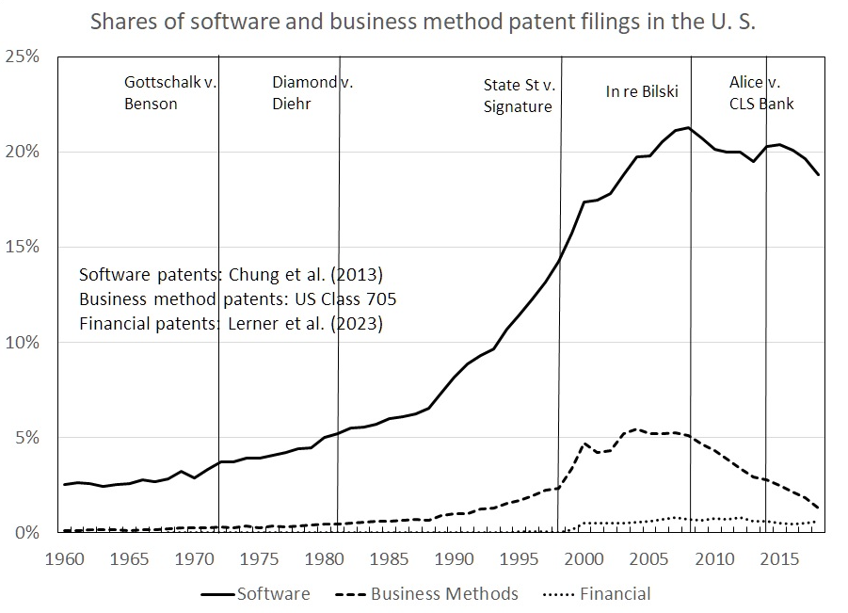
Introduction

Slide 10
Introduction
Debates on software and business method patents have been largely taking place in the U.S. and Europe.
But increased attention in larger developing countries, especially India.
Debates have been going on for several decades, but far from settled.
Renewed interest due to fast-increasing importance of AI across entire economy.
Economics literature has relatively little empirical evidence to offer.

Slide 11
Background
“[t]he basic algorithmic ideas that people are now rushing to patent are so fundamental, the result threatens to be like what would happen if we allowed authors to have patents on individual words or concepts. […] Algorithms are exactly as basic to software as words are to writers, because they are the fundamental building blocks needed to make interesting products”.
“[w]hen I think of the computer programs I require daily to get my work done, I cannot help but realize that none of them would exist today if software patents had been prevalent in the 1960s and 1970s. Changing the rules now will have the effect of freezing progress at essentially its current level”.
Donald Knuth (1994)

Slide 12
Definition of software patents
What is a “software patent”?
Conceptually obvious: a patent that claims an invention implemented through software.
In practice more difficult:
“Pure” software patents are relatively rare.
Generally difficult to draw clear line between software as a technology and everything else.
Also note that patents protect inventions and not code itself. Copyright protects code but not underlying idea.

Slide 13
Definition of software patents
Different approaches in the literature:
Patent classes to filter software patents.
Relevant classes identified by looking at patenting activity of largest software companies in the industry, such as Microsoft, Oracle etc. (Graham and Mowery, 2003; Hall and MacGarvie, 2010).
Use of patent classes may result in the inclusion of both software and hardware patents even when classes are narrowly defined.
Keyword searches (Bessen and Hunt, 2007)
Manual review of individual patent claims and descriptions (Allison and Lemley, 2000; Allison and Tiller, 2003).
Combination of different approaches (Hall and MacGarvie, 2010).

Slide 14
Legal background
Is software per se excluded from patent eligible subject matter?
Certain inventions are exempt from patentable subject matter.
Mathematical algorithms are generally not patent eligible because they are considered an abstract idea.
But applications of abstract ideas are patent eligible.
Is software merely an abstract idea or is it a patent eligible “process, machine, manufacture, or composition of matter”?
Courts in the U.S. created long line of precedents:
Courts’ opinion on the question of whether software claims are directed to patent eligible subject matter has changed significantly over time.
Supreme Court decision in Alice v. CLS Bank in 2014 does not categorically exclude software from patentability but imposes stringent test on the determination of whether software is merely directed to an abstract idea.
In Europe, software is excluded from patentability because EPO requires inventions to have “technical character” and to produce a “technical effect.” But de facto open to interpretation, and as a result, EPO grants thousands of software patents every year.

Slide 15
U.S. case law
1972 Gottschalk v. Benson, (409 U.S. 63 (1972)): Software should be considered abstract ideas that are not patentable.
1978 Parker v. Flook (437 U.S. 584 (1978)): An algorithm itself was not patentable unless the corresponding claims also covered patentable hardware.
1981 Diamond v. Diehr (450 U.S. 175 (1981)): Software was patentable as long as it was implemented through a mechanical or physical process.
1994 In re Alappat (33 F.3d 1526 (Fed. Cir. 1994)): Lowered threshold of patentability by considering transformation of data as a sufficient transformation to turn an abstract idea into a patentable claim.
1998 State Street Bank & Trust Co. v. Signature Financial Group (149 F.3d 1368 (Fed. Cir. 1998)): Lowered threshold for patentability further by holding a “pure” software claim patentable as long as software produces “a useful, concrete, and tangible result.” Decision opened the door for patenting of software and business method claims.

Slide 16
U.S. case law
2008 In re Bilski (545 F.3d 943 (Fed. Cir. 2008)): Software has to be “tied to a specific machine or apparatus” or “transforms a particular article into a different state or thing” in order to meet the patentability threshold (so-called “machine-or-transformation test”).
2010 Bilski v. Kappos (130 S. Ct. 3218 (2010)): Patentability of software could not be determined solely on the basis of machine-or-transformation test. Software protecting merely an abstract idea was not patentable. Business method patents are not categorically excluded from patentability.
2012 Mayo Collaborative Services v. Prometheus Laboratories Inc (132 S. Ct. 1289 (2012)): Case was not about software patents, it had direct relevance for software patenting because it effectively raised patentability bar for software.
2014 Alice Corp. Pty. Ltd. v. CLS Bank Int. (134 S. Ct. 2347 (2014)): Machine transformation (“apply it with a computer”) not sufficient to render an abstract idea patentable. Established 2-step test. In first step, court has to determine whether a claim is directed to an abstract idea. Provided answer in first step is “yes,” in second step, court has to determine whether claim contains “enough” to transform patent ineligible subject matter into patent eligible subject matter, where “enough” means an “element or combination of elements that is sufficient to ensure that patent in practice amounts to significantly more than a patent upon the ineligible concept itself”.

Slide 17
Software and the patent system
Software as a technology differs from other technologies
R&D process more complex. To create and execute software, many different elements have to work together and communicate with each other.
Presence of network externalities since software made by one firm usually has to be compatible with software produced by other firms.
Software development is cumulative, developers routinely build and improve on existing code.
Software development also moves much faster than most other technologies.
Software is not confined to a specific industry or economic activity. Instead, software is used in many different ways throughout economy.
Software development involves relatively large fixed costs, but usually relatively low marginal costs.

Slide 18
Software and the patent system
Patent system functions relatively poorly in practice for software inventions.
Two types of challenges for protection of software by patents:
“Patent quality”
Characteristics of software as a technology.
Economic consequences:
Uncertainty over scope and validity of software patents.
Overly broad claims more likely to result in patent thickets and claims more likely invalid.
Despite quick innovation cycle, due to fuzzy boundaries and ability to claim broad software inventions, even patents that cover obsolete software still read on newer technology and therefore have exclusionary power.
Software patents often asserted to obtain “past damages based on infringements that no longer occur or […] to apply […] [them] to new product generations” (Burk and Lemley, 2009: 57).

Slide 19
Patent quality
Claim boundaries:
Legal boundaries of a patent are defined by its claims (in combination with other information provided by patent specification).
Patentees have incentives to define broad claims in order to obtain broad coverage (functional claiming).
Broader claims more likely to ensure freedom to operate and create strategic value since competitors more likely to “trespass”.
But broad claims increase chances that patent found invalid and make it more difficult to discern what exactly is claimed as invention.
“The patentee owns […] what they claim, not what they actually built or described.” (Burk and Lemley, 2009: 12)

Slide 20
Patent quality
Disclosure:
Fuzzy claim boundaries affect disclosure.
No requirement for software patents to disclose code that executes patented invention
Limited disclosure results in lack of notice and fewer knowledge spillovers.
Prior art:
Patent examiners more likely to miss relevant prior art that would have prevented grant or narrowed claims.
Software as a field less likely to be disclosed in sources conventionally considered prior art (e.g. academic publications).
In early days of software patenting, lack of expertise at the USPTO (and other patent offices around the world).
Classification of patents also makes prior art search difficult.
During certain periods, applicants had incentives to characterize software as hardware.

Slide 21
Software as a technology
Complexity/cumulative:
Software complex and cumulative technology.
Patents on specific aspects of technology increase transaction costs for software developers.
Block or slow incremental innovation.
Disproportionate effect on new companies.
Innovation cycle:
Very short innovation cycles and rapid technological obsolescence.
Long grant lags and once granted, patent valid for up to 20 years.
Jeffrey Bezos: “[t]his isn't like drug companies, which need long patent windows because of clinical testing, or like complicated physical processes, where you might have to tool up and build factories. Especially in the age of the Internet, a good software innovation can catch a lot of wind in 3 or 5 years”.
Mismatch between innovation cycle and property rights granted by patents.

Slide 22
Empirical evidence on the impact of software patents
Empirical evidence on the impact of software patents on companies and innovation sparse.
Difficult to isolate effect of patents on software development from other major changes that software and internet revolution has brought about.
Much of empirical evidence relies on changes observed in response to changes in U.S. case law relevant to software patenting.
Available evidence does not offer clear results on the impact of software patents.

Slide 23
Empirical evidence on the impact of software patents
Noel and Schankerman (2013):
Large patent premium in the stock market valuation for software firms over the period 1980-1999.
Software patents create value to firms by enhancing ability to appropriate the returns.
Lerner and Zhu (2007):
Software firms, more affected by 1996 U.S. Supreme Court decision that reduced the scope of copyright protection of software, filed more patents.
Growth in software patenting associated with increased sales and expansion of firms’ product lines.
Hall and MacGarvie (2010):
Stock market value of software companies dropped as a result of an expansion of software patentability in the U.S. over period 1975-2002.
Software patents as such contributed little to a firm’s market value.
Cockburn and MacGarvie (2009, 2011):
Increase in software patenting triggered by the expansion of patentability reduced entry of new software start-up firms.
More patenting reduced likelihood that start-ups received outside investment.
Lin and Rai (2023):
Narrowing of scope of software patents as a consequence of Alice v. CLS Bank led to fewer software patent filings by companies in software industry.
Software firms expanded open source activities.
Increase in sales because Supreme Court decision reduced the risk of software patent litigation.

Slide 24
Business method patents
Amazon’s 1-click patent:
In 1997, Amazon introduced a business method for customers to shorten their purchase transaction on Amazon’s online platform.
Method allows customers to enter their payment information once and then retain this information such that customers do not have to re-enter the information for every purchase.
Amazon patented this “Method and System for Placing a Purchase Order via Communications Network” (US 5,960,411).
priceline.com’s auction patent:
priceline.com patented a “Method, apparatus, and program for pricing, selling, and exercising options to purchase airline tickets”
Patent essentially covers a sealed-bid (Dutch) auction for purchasing airline tickets online.

Slide 25
Business method patents
Business method patents cover business method inventions.
Business method inventions are discoveries that describe methods of doing business, e.g. new way of executing a business transaction.
Business method patents cover range of applications including finance, business data processing, insurance, and marketing methods.
Lines between business method and software-enabled invention blurry because business method patents often protect implementation of a business method using software on Internet.
Claimed invention is commercial rather than technological.
Business method inventions have become much more central to many businesses because of explosion of e-commerce and importance of online transactions more generally.

Slide 26
Business method patents
Should commercial inventions be awarded same protection as inventions that constitute a technical solution to a technical problem?
Legal debate focused on whether business methods are merely an abstract idea:
In 1998, CAFC issued an opinion in State Street Bank and Trust v. Signature Financial Corporation that is widely seen as the door opener to increase in business method patent.
In Europe, business methods are not patentable. But business methods can be patentable provided they solve a technical problem.

Slide 27
Business method patents
Proponents of business method patents claim:
Business methods are “commercial discoveries” that build on scientific and technological discoveries.
Implementation drives “commercial innovation” that can help commercialization of scientific and technological discoveries.
Increase the market value of scientific and technological discoveries.
Provide incentives for further innovation and investment in order to implement them.
Critics of business method patents:
Opportunity to monopolize broad, abstract ideas.
Abstract idea – a way of conducting business -- not an actual technical solution to a technical problem.
Some business methods are trivial.
Prior art search is even more difficult for business method than software patents.

Slide 28
Financial method patents
Financial method patents typically cover formulas or methods of making financial transactions.
Early financial patents (e.g. Black-Scholes option pricing formula) cited little academic literature (Lerner, 2002).
Patent examiners seemed unaware of much of the non-patent prior art in this area, leading patents to be issued on methods that had long been in the literature.
During first decade following State Street, financial patents litigated 27 to 39 times as often as other patents. Typically large corporations and financial institutions targeted.
Patent landscape has evolved as many financial transactions have moved online (Lerner et al., 2023):
During the decade 2000-2010, patented innovation in finance has shifted toward information technology and non-financial firms, and to California from New York.
Patents based less on the academic finance literature and more likely to concern payment methods and transaction security.
Productivity in this sector has hardly risen, in spite of the growth in (patented) innovation activity.

Slide 29
Open source software
Open source software widely used on different types of hardware:
Operating system Linux.
Mobile operating system Android.
Mozilla’s Firefox browser
Programming language Python.
Source code is made publicly and freely available.
Allows other developers to modify and improve code.
Most widely used license for open source software is GNU General Public License (GPL).
Allows modification of the code, but requires that any modified source code also be made available under the General Public License.
Restrictive clause ensures that open source code does not turn into proprietary software (if parts of modified code are protected by patents, patents must be available royalty-free to all users).

Slide 30
Open source software
Avoids problems associated with (temporary) exclusivity granted by the IP system.
Returns come from alternative sources, mostly complementary sales and service revenues .
For-profit companies play an important role in the creation and diffusion of open-source software.
Many companies engage in development and use of both types of software.
Microsoft generates bulk of revenue through licensing of proprietary software such as Windows or Office.
Microsoft offers own open source Linux distribution Azure Sphere for its Azure cloud computing services.
Survey of 2,000 firms across 15 countries (Lerner and Schankerman, 2009: Table 4.2):
40% of surveyed software companies engage in development of open source software.
Majority of companies that develop proprietary software also develop same type of software as open source.
But bulk of revenue (around 80%) comes from proprietary software.
Complementarities between open source and proprietary software:
Synergies in the development and marketing of the two types of software.
Heterogeneity among software users, which creates demand for both types of software.
Users often combine the use of open source and proprietary software.
Open source unlikely to act as a substitute for proprietary code and render software patents redundant.

Slide 31
Artificial intelligence
Field of AI evolving extremely fast and relationship of AI with the patent system evolving.
AI different from traditional software through its ability to execute cognitive functions without human interference.
AI and the patent system:
Are inventions related to the development of AI algorithms or their use patentable?
Can an AI algorithm produce a patentable invention?

Slide 32
Artificial intelligence
Are inventions related to the development of AI algorithms or their use patentable?
If AI is subfield of software, AI does not require specific considerations as it is subject to the same patent rules and regulations as software.
Can an AI algorithm produce a patentable invention?
Starting in 2018, Stephen Thaler filed two patent applications titled “Food container” and “Devices and methods for attracting enhanced attention” at various patent offices around the world that named an AI system called DABUS as inventor.
EPO, national patent offices in Australia, Germany, Israel, Korea, New Zealand, the UK and U.S. rejected the patents on the grounds that an AI system cannot be an inventor (or be named as the inventor).
Question far from settled. DABUS patents still pending in many other jurisdictions, including China and Japan, and possible appeals to decisions.
Decisions over the patentability of AI-generated inventions may impact incentives for investment in AI-driven innovation.

Slide 33
Summary
Software patents:
From legal perspective: is software an abstract idea and therefore excluded from patentability?
Answer not clear despite extensive case law.
Regardless, patent system might not be well suited for the protection of software.
Patent system might increase transaction costs for companies and on balance these costs might outweigh benefits from patent protection.
Conclusions largely based on theoretical arguments rather than clear empirical evidence.
Business method patents:
Debate about business method patents mirrors that of software patents.
Do business methods reflect broad abstract ideas rather than technological inventions?

Slide 34
Summary
Open source software:
Thriving, widespread alternative to proprietary software.
In practice, open source and proprietary software co-exist and are often used in combination.
Open source rather complement than substitute to proprietary software.
Artificial intelligence:
So far AI does not create any major new challenges to the patent system.
Question of patentability of AI same as software.
Can AI be an inventor of a patent?

