Slide 1
Chapter 19
Patent litigation and enforcement
Bronwyn H. Hall & Christian Helmers

Slide 2
Overview
Introduction: Patent enforcement system and dispute resolution
Basic structure of patent litigation
Economic theory of litigation
Economic theory of patent litigation
Design choices of litigation systems
Main features of the most important patent litigation systems around the world

Slide 3
Introduction
In December 2013, iLife Technologies Inc. filed a complaint against Nintendo Inc. at a U.S. district court alleging infringement of six patents.
  iLife alleged that technology incorporated in Nintendo’s Wii game console to enable motion-controlled play infringed on iLife’s patents.
  Nintendo countered by challenging validity of asserted patents.
In parallel administrative validity challenges at USPTO’s Patent Trial and Appeal Board (PTAB), Nintendo successfully invalidated five of six patents.
In August 2017, jury in the court case found that Nintendo had infringed claim 1 of iLife’s one remaining patent US 6,864,796 titled “Systems within a communication device for evaluating movement of a body and methods of operating the same”.
  The jury upheld claim’s validity and awarded iLife a lump-sum royalty payment of US$ 10.1 million.
Nintendo then successfully filed a post-trial motion to set aside the jury verdict.
  Judge found that iLife’s patent was invalid because it covered patent-ineligible subject matter and decided the case in favor of Nintendo.

Slide 4
Introduction
Case illustrates core characteristics of patent litigation:
  Patent owner alleges infringement of all or a subset of claims of one or several patents by a single or multiple defendants.
  As a defense, defendant routinely challenges patents’ validity.
  Patent litigation considered one of the most complex forms of civil litigation.
  High costs of litigation, long duration of the proceedings, and often high stakes.
Recent focus on patent litigation:
  Global smartphone patent wars.
  Proliferation of non-practicing entities (NPEs).
  Patent litigation involving standard essential patents (SEPs).
Long-standing interest in the economic literature in the analysis of litigation from a theoretical as well as empirical perspective.

Slide 5
Introduction
Patent litigation important from a policy perspective:
  Enforceability of patent rights is crucial for the functioning of the patent system.
  In-court litigation has direct effects on the patent system as a whole.
  Ability to enforce intangible property right if it is infringed upon that confers value to it.
  “The only relevant patents are those that are licensed or litigated […] not the whole universe of patents.” (Burk and Lemley, 2009: 85).
Litigation matters because it can have implications for innovation that reach far beyond the courtroom.

Slide 6
Introduction
Design of litigation system:
  Patent owners can enforce a patent if it is infringed.
  Allow alleged infringers to defend themselves in court if necessary, including by challenging a patent’s validity.
  Discourage strategic behavior: plaintiffs seeking overly broad injunctions, excessive damages, or engaging in nuisance lawsuits and defendants driving up enforcement costs to deter assertion or force settlements.
  Courts have to strike a delicate balance between allowing patent owners to enforce their rights and to obtain appropriate remedies while avoiding incentives for excessive litigation.

Slide 7
Structure of patent litigation
Main objective of patent litigation is to allow patent owners to enforce their patent claims against potential infringers.
Other patent related claims asserted in court:
  Disputes with regard to inventorship or ownership of a patent.
  Patent licensing agreements.
  Declaratory actions where a party seeks confirmation from a court that a patent is invalid, not infringed, or unenforceable.
In practice, these types of claims account for only a small share of all patent cases compared to infringement actions.

Slide 8
Structure of patent litigation
Starting point of patent litigation is usually allegation of patent infringement.
  Objective of patent owner is to get relief in the form of a preliminary or permanent injunction against future infringement, and monetary damages compensating for past infringement.
  Patent owner sends a demand letter, although this step is often skipped.
  In most cases, dispute either resolved through an exchange of letters or dropped by patent owner in case no response from the alleged infringer is received.
If no response or if direct communication does not lead to resolution, patent owner can file a complaint with first-instance civil court asserting patent infringement.
  Once complaint has been filed, legal process of litigation in court begins.
  Objective of plaintiff - demonstrate that claims of one or more patents infringed.
Defendant counters that there is no infringement.
  In some jurisdictions, defendant can also rely on an invalidity defense in court.
  In other jurisdictions, patent validity can only be challenged in separate court or administrative proceedings.

Slide 9
Structure of patent litigation
Structure of litigation:
  Case management conference
  Pre-trial discovery
  Pre-trial hearings
  Motions for a preliminary injunction, a stay, or summary judgment, etc.
Precise structure of the proceedings depends on the jurisdiction.
Parties have ample opportunity to settle dispute before it goes to trial and during trial.
Only if no settlement is reached, do judges (or a jury) decide a case on the merits.
Once the court has decided a case, may be additional steps:
  Decide the amount of damages to be paid.
  Allocate the litigation costs.
Decisions can be appealed before a court of second instance and in some, albeit rare cases, another appeal before the highest court of the jurisdiction is possible.

Slide 10
The economics of (patent) litigation
In most basic models of litigation, single plaintiff P and single defendant D, both risk-neutral
P decides whether to file a claim with the court.
  Provided the suit is filed, plaintiff and defendant have the option to settle their dispute.
If they do not settle, case proceeds to trial and judge decides.
  P expects to obtain a gross pay-off from litigation x.
  Pay-off equals the expected judgment of the trial (i.e. the probability of winning times the expected amount won).
Both P and D incur positive litigation costs c_{P} and c_{D}, respectively.
  Assume that the parties bear their own costs regardless of the outcome of the case (American cost allocation rule).

Slide 11
The economics of (patent) litigation
P decides whether to file a complaint at the court.
  P will sue if its expected pay-off from doing so exceeds cost: x > c_{P}.
Conditional on P having filed suit, parties enter settlement negotiations before trial takes place.
  Assume settlement involves payment from D to P in exchange for P dropping the case.
  Assume that P makes a take-it-or-leave-it settlement offer that D can accept or reject.
If no settlement, parties move to trial and judge decides.

Slide 12
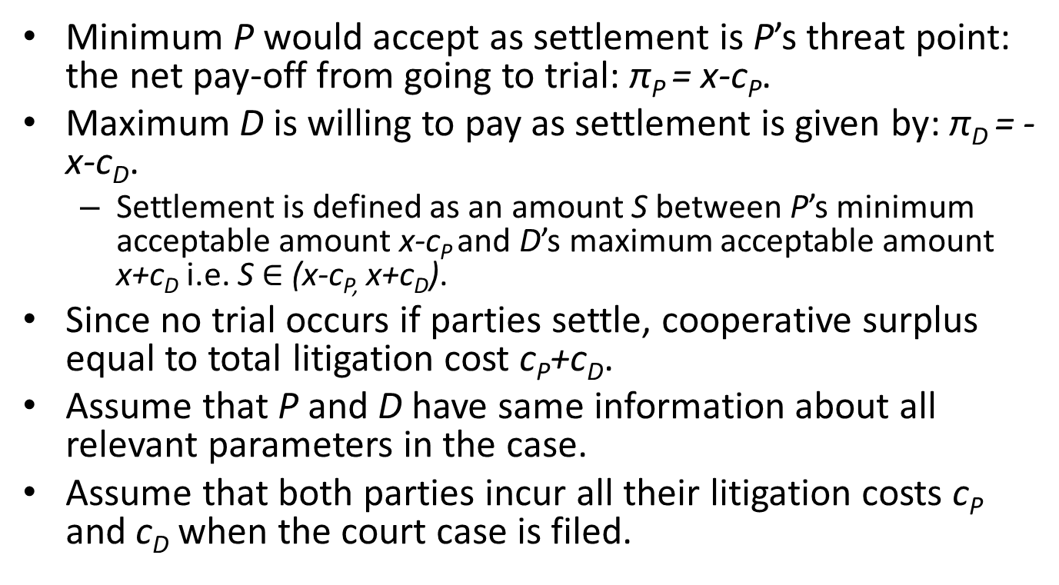
The economics of (patent) litigation
Minimum P would accept as settlement is P’s threat point: the net pay-off from going to trial: π_{P} = x-c_{P}.
Maximum D is willing to pay as settlement is given by: π_{D} = -x-c_{D}.
  Settlement is defined as an amount S between P’s minimum acceptable amount x-c_{P} and D’s maximum acceptable amount x+c_{D} i.e. S $∈$ (x-c_{P,} x+c_{D}).
Since no trial occurs if parties settle, cooperative surplus equal to total litigation cost c_{P}+c_{D}.
Assume that P and D have same information about all relevant parameters in the case.
Assume that both parties incur all their litigation costs c_{P} and c_{D} when the court case is filed.

Slide 13
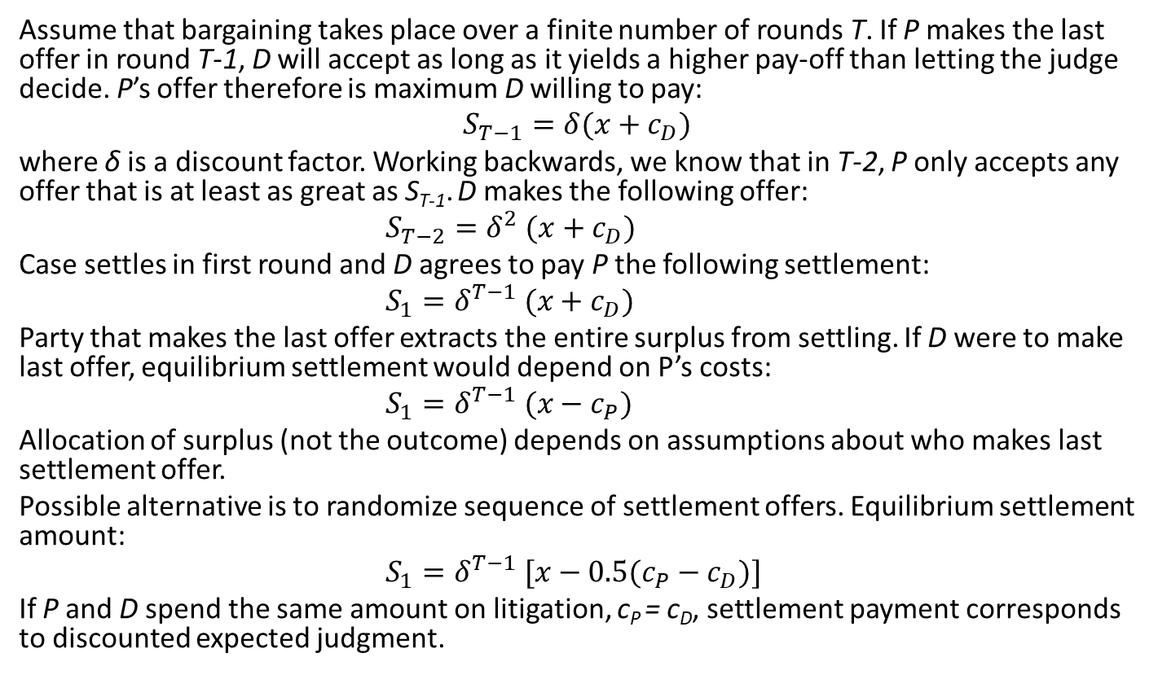
The economics of (patent) litigation
Assume that bargaining takes place over a finite number of rounds T. If P makes the last offer in round T-1, D will accept as long as it yields a higher pay-off than letting the judge decide. P’s offer therefore is maximum D willing to pay:
$$S_{T−1}=δ(x+c_{D})$$
where δ is a discount factor. Working backwards, we know that in T-2, P only accepts any offer that is at least as great as S_{T-1}. D makes the following offer:
$S_{T−2}=δ^{2} (x+c_{D})$
Case settles in first round and D agrees to pay P the following settlement:
$S_{1}=δ^{T−1} (x+c_{D})$
Party that makes the last offer extracts the entire surplus from settling. If D were to make last offer, equilibrium settlement would depend on P’s costs:
$S_{1}=δ^{T−1} (x−c_{P})$
Allocation of surplus (not the outcome) depends on assumptions about who makes last settlement offer.
Possible alternative is to randomize sequence of settlement offers. Equilibrium settlement amount:
$S_{1}=δ^{T−1} [x−{0.5(c}_{P}−c_{D})]$
If P and D spend the same amount on litigation, c_{P} = c_{D}, settlement payment corresponds to discounted expected judgment.

Slide 14
The economics of (patent) litigation
Model predicts certain settlement (settlement produces a cooperative surplus).
  In practice, parties do not always settle.
How can we account for this reality in the model?
  Reason that settlement can fail is simple: D not willing to pay amount S demanded by P to drop the case.
But why would D disagree with P over the settlement payment?
Two explanations for why settlement fails:
  Divergent expectations theory: parties have different, exogenously determined expectations about the outcome of the case (Priest and Klein, 1984).
  Asymmetric information; one party has private information relevant for the outcome of the case (Bebchuk, 1984).

Slide 15
Divergent expectations
P and D differ in their beliefs about the expected judgement x = ρ·j where ρ denotes probability that P wins and j is amount of damages awarded to P by court.
Both parties hold beliefs about case quality q:
  P believes case quality is q_{P} = q+ε_{P}
  D believes it is q_{D} = q+ε_{D}
  where ε_{i} (i=P,D) are normally distributed random variables.
Threshold quality q* where if q>q* plaintiff wins and if q<q* defendant wins.
Parties’ beliefs about the probability that the plaintiff wins:
where Φ is the standard normal cumulative distribution and σ is the standard deviation of ε_{i}.
Settlement fails if difference in P and D’s expected judgements exceeds total litigation costs x_{P}-x_{D} > c_{P}+c_{D}, where x_{P} = ρ_{P}·j and x_{D} = ρ_{D}·j.
Settlement fails if P is sufficiently more optimistic than D about the outcome of the case.

Slide 16
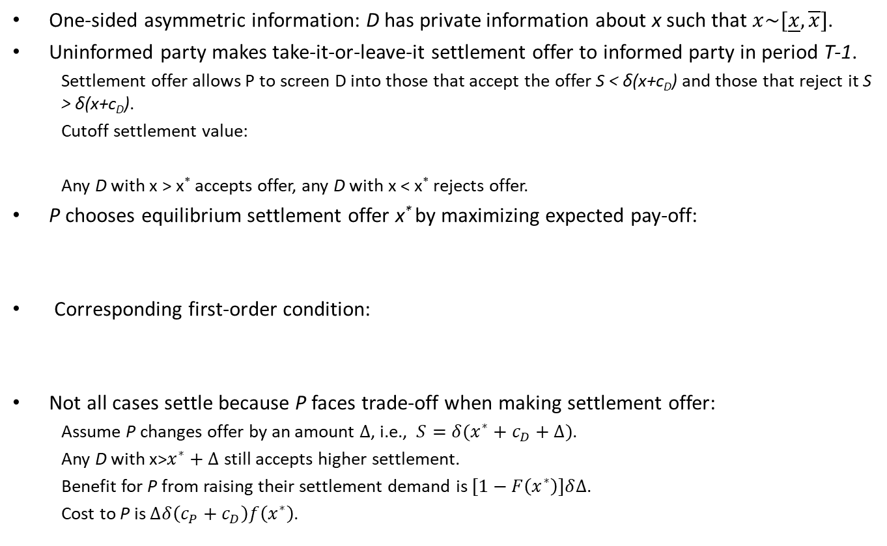
Asymmetric information
One-sided asymmetric information: D has private information about x such that $x\sim [\underline{x},\overline{x}]$.
Uninformed party makes take-it-or-leave-it settlement offer to informed party in period T-1.
  Settlement offer allows P to screen D into those that accept the offer S < δ(x+c_{D}) and those that reject it S > δ(x+c_{D}).
  Cutoff settlement value:
  Any D with x > x* accepts offer, any D with x < x* rejects offer.
P chooses equilibrium settlement offer x* by maximizing expected pay-off:
Corresponding first-order condition:
Not all cases settle because P faces trade-off when making settlement offer:
  Assume P changes offer by an amount $∆$, i.e., $S=δ(x^{∗}+c_{D}+∆)$.
  Any D with x>$x^{∗}+∆$ still accepts higher settlement.
  Benefit for P from raising their settlement demand is $[1−F\left(x^{∗}\right)]δ∆$.
  Cost to P is $∆δ\left(c_{P}+c_{D}\right)f\left(x^{∗}\right)$.

Slide 17
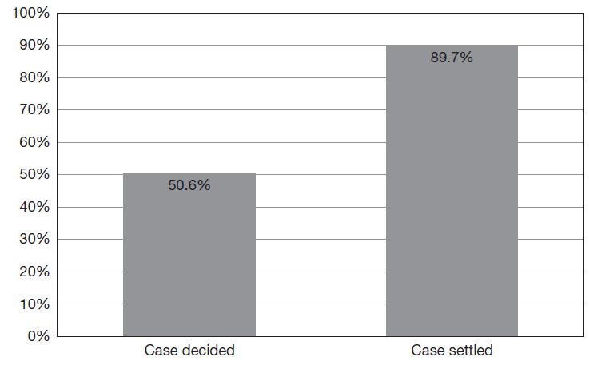
Selection
Priest-Klein Hypothesis: plaintiff win rate for cases decided by the judge predicted by the model is around 50%.
Asymmetric information: cases that settle on average have a higher expected judgement x than those that go to trial.

Slide 18
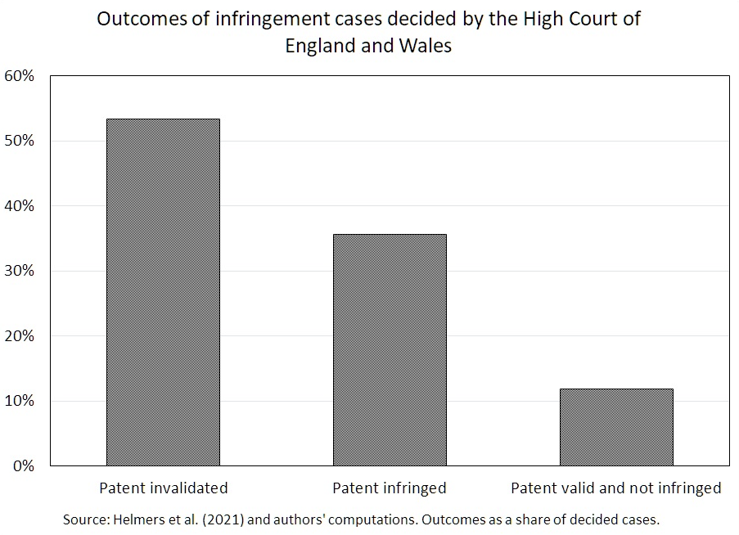
A model of patent litigation
Patent litigation different from other types of litigation because it deals not only with infringement but also validity.
Empirically, question of validity important.

Slide 19
A model of patent litigation
Ability to challenge validity in litigation has several implications:
  Litigation even in absence of divergent expectations or asymmetric information.
  Challenging patent validity in court creates externalities.
Focus on question of how validity affects litigation (Meurer, 1989).
Assume patent infringed with certainty, only open question is validity.
Assume patent invalid with probability α, which is known to both parties.
Litigation costs are c_{P} and c_{D} , impose symmetry c_{P} = c_{D} = c.
P can refuse to license patent or make a take-it-or-leave-it settlement offer to D in form of a licensing agreement before any litigation occurs.
Under the agreement, D agrees not to challenge the validity of patent and pays lump-sum royalties to P in exchange for using patented technology.

Slide 20
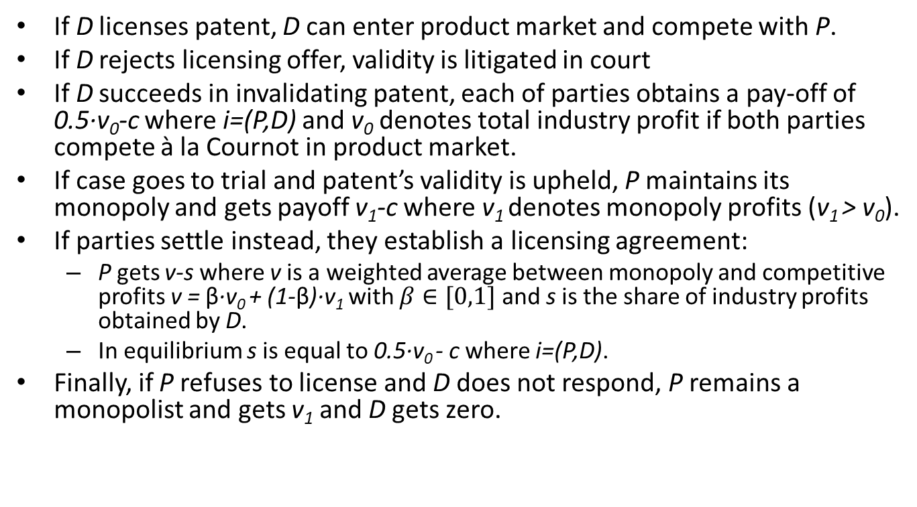
A model of patent litigation
If D licenses patent, D can enter product market and compete with P.
If D rejects licensing offer, validity is litigated in court
If D succeeds in invalidating patent, each of parties obtains a pay-off of 0.5·v₀-c where i=(P,D) and v₀ denotes total industry profit if both parties compete à la Cournot in product market.
If case goes to trial and patent’s validity is upheld, P maintains its monopoly and gets payoff v₁-c where v₁ denotes monopoly profits (v₁ > v₀).
If parties settle instead, they establish a licensing agreement:
  P gets v-s where v is a weighted average between monopoly and competitive profits v = β·v₀ + (1-β)·v₁ with $β∈[0,1]$ and s is the share of industry profits obtained by D.
  In equilibrium s is equal to 0.5·v₀ - c where i=(P,D).
Finally, if P refuses to license and D does not respond, P remains a monopolist and gets v₁ and D gets zero.

Slide 21
A model of patent litigation
D’s threat to take P to court is credible only if their expected pay-off from challenging the patent in court is non-negative:
(1)
If Equation (1) does not hold, P refuses to license patent to D.
If Equation (1) holds, P will either refuse to license which will lead to D challenging patent’s validity in court, or make a settlement offer that D accepts.
P’s decision to litigate or settle is determined by:
(2)
Substituting the equilibrium settlement s = 0.5·v₀-c into (2) and simplifying yields
(3)
If (1) and (3) hold, litigation occurs. If (1) holds but (3) does not, parties settle.

Slide 22
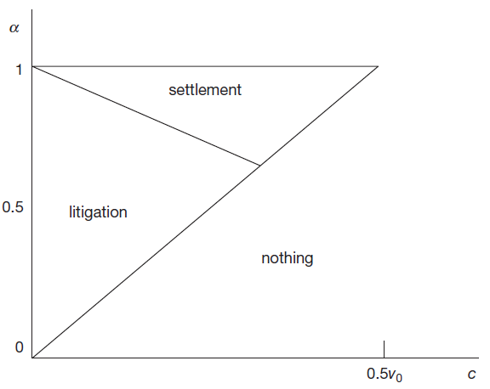
A model of patent litigation
v realized by patentee depends on settlement reached and outcome of litigation.
Value of a plot of land would be unaffected by a settlement or outcome of litigation since property title would not be invalidated (v=v₁=v₀).
If parties have common information and same litigation costs, dispute over a plot of land would always settle, while litigation over patent validity can still occur.

Slide 23
Features of patent litigation systems
Economic theory of litigation highly stylized and abstracts from much of complexity of patent litigation systems across jurisdictions.
Basic structure of patent proceedings similar across jurisdictions, but important differences along all dimensions that characterize a litigation system.
Differences result from differences in:
  Law (including case law)
  Procedures
  Institutions
  Professional practice
  and evolve constantly over time.

Slide 24
Unified vs bifurcated litigation systems
In unified system:
  Infringement and invalidity are dealt with within the same proceedings.
  Invalidity usually raised as a defense.
  Court assesses both claims.
  If patent invalid, it cannot be infringed.
In a bifurcated system:
  Separate proceedings in different venues to establish infringement and invalidity.
  Invalidity not an admissible defense to an infringement claim.
  Challenge validity in parallel at the competent venue.
Courts can stay infringement proceedings until validity has been decided.
If no stay:
  Injunction gap: judgement on infringement is fully enforceable despite a pending invalidity challenge.
  Patent found infringed that is eventually invalidated.

Slide 25
Number of courts and specialization
Number of courts competent to hear patent cases differs significantly across jurisdictions:
  U.S. - 94 federal district courts.
  Germany - 12 regional courts .
  France/Netherlands - single court competent to hear patent cases.
  UK - two courts: one court (Intellectual Property Enterprise Court) hears less complex cases of lower value than the other court (Patents Court).
  Japan - two courts, the Tokyo District Court and Osaka District Court
Specialist courts, divisions, or judges:
  UK Patents Court specialist court in Chancery Division of the High Court.
  Germany some regional courts have specialist chambers.
  Japan – specialist IP High Court
  U.S. court of appeal (CAFC)
Availability of different courts provides opportunity to engage in forum and judge shopping.
  Individual courts and judges have discretion regarding procedural choices.
  Can result in concentration of caseloads in certain venues.
  For example, Eastern District of Texas and Western District of Texas.

Slide 26
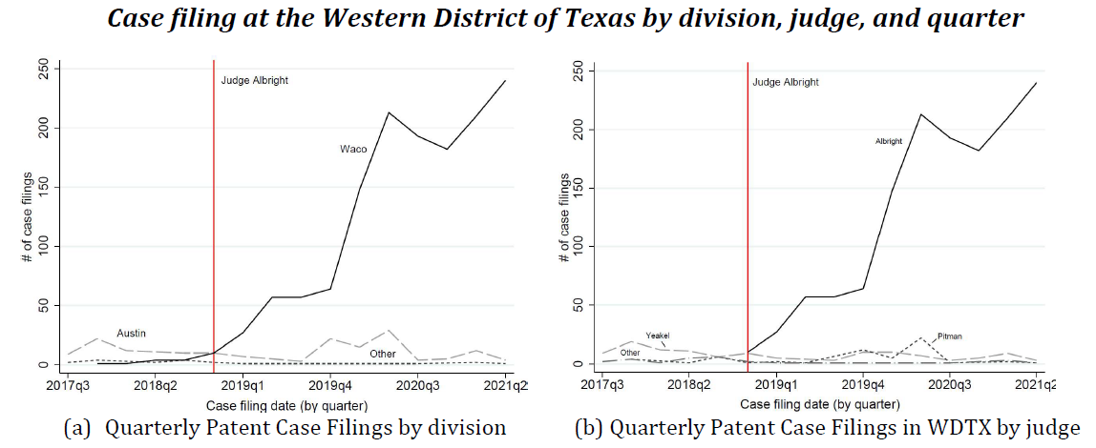
Judge shopping in the Western District of Texas
On September 18, 2018 Alan Albright became newest member of the U.S. District Court for the Western District of Texas.
Apart from being very vocal publicly about wanting to attract patent cases to his Waco court, he adopted a number of local practices that tend to favor patent enforcers, such as an aggressive default patent case schedule.

Slide 27
Duration of proceedings
Proceedings differ in speed across and within jurisdictions.
Infringement actions took on average around (Cremers et al., 2016a):
  14 months to a first decision in Germany.
  30 months in France.
Many factors explain differences:
  Bifurcation
  Case management
  Pre-trial discovery
  Expert testimony
  etc.
Duration of proceedings has direct economic effects:
  Litigation expenses
  Uncertainty
Creates incentives for parties to influence case duration strategically to get the other party to settle or drop the case.

Slide 28
Costs and cost allocation
Costs associated for each party vary significantly across jurisdictions:
  Germany US$ 90,000-250,00
  France US$ 60,000-250,000
  UK or U.S. well above US$ 1 million.
Differences explained by a number of factors:
  Extent of pre-trial discovery.
  Role of expert witnesses.
  Length and complexity of trial.

Slide 29
Costs and cost allocation
Differences in cost allocation:
  American rule, each party pays its own litigation costs regardless of the case outcome;
  English rule, losing party covers its own as well as the cost of the winning party.
But highly stylized depiction of reality.
  In English system, costs are allocated on a per-item basis, actual share of costs shifted closer to one half to two thirds.
  In the U.S., in exceptional cases courts shift fees from losing to winning party.
  Costs also shifted in other jurisdictions, e.g. Germany, but only affects fraction of total costs due to cost scales applied by courts.
Theory suggests allocation of litigation costs has important effects on litigation behavior.
Empirically, limiting a court’s ability to award fees to winner results in more cases being filed.

Slide 30
Examples of patent litigation systems

Slide 31
United States
Common law jurisdiction.
Unified litigation system:
  Patent cases heard by 94 federal district courts.
  District courts do not have divisions/judges specialized in patent matters.
  Appeals are heard by CAFC which has exclusive jurisdiction in patent matters since 1982.
  Supreme Court hears appeals from the CAFC at its discretion.
Significant disclosure requirements during pre-trial discovery phase of a case, which force parties to incur substantial expenses relatively early in a case.
Pre-trial claim construction (“Markman”) hearing.
Expert testimony in court plays important role.
In patent cases that involve monetary damages, parties have right to jury trial.
Parties can file infringement complaint with International Trade Commission (ITC).
Challenge patent validity administratively at patent office:
  Ex parte re-examination.
  Inter Partes Review.
  Covered Business Method (CBM) review (no longer available).

Slide 32
China
Patents can be enforced through civil court system and patent office.
  Civil court system limited to handling infringement actions.
    Supreme People’s Court, the Higher People’s Court, the Intermediate People’s Court, and the Lower People’s Court.
  Since 2014, 3 specialist IP courts; 20 IP tribunals in several provinces with exclusive jurisdiction over IP.
  In 2019, the Supreme Court created specialized IP Court to hear civil and administrative IP appeal cases.
Civil courts do not issue declarations of non-infringement.
  Only very limited discovery
  Proceedings are relatively fast
  Litigation costs and damages are relatively low
Patent validity sole responsibility of Chinese Patent Office’s (CNIPA) Patent Review and Adjudication Board (PRAB).
  No opposition proceedings,
  Since 2021, CNIPA can also hear patent infringement cases provided they have “significant influence throughout the country”.
  CNIPA can order the accused party to cease infringement and mediate financial compensation.

Slide 33
Europe
Since June 2023, patent enforcement occurs at the national and pan-European level.
  National courts are competent to hear cases involving national patents
  Unified Patent Court (UPC) is competent to hear cases involving patents granted by the European Patent Office (EPO)
    “classic” non-unitary European patents
    Unitary European patents

Slide 34
Europe
Germany
  12 regional courts competent to hear patent infringement cases.
  Appeals are heard by higher regional courts and in final instance at Federal Court of Justice.
  Invalidity cannot be challenged in court proceedings.
    2 ways to challenge validity in Germany: administratively through opposition procedures or court proceedings before Federal Patent Court.
    If (9 month) opposition window is open, invalidity only challenged administratively.
UK (England & Wales)
  Two courts are competent to hear patent cases:
    Intellectual Property Enterprise Court hears less complex claims of lower value.
    Patents Court, specialist court of the Chancery Division of the High Court of Justice.
    Courts hear both infringement and invalidity claims.
    Appeals heard by the Court of Appeals. Decisions by the Court of Appeals can be challenged before the Supreme Court.
  Patents granted by the EPO and validated in the UK can be challenged in opposition proceedings during the 9-months opposition window.

Slide 35
Europe
Unified Patent Court
  Pan-European court with unitary effect for currently 18 EU member states
  Began operations in June 2023.
  Exclusive jurisdiction with respect to litigation of unitary patents as well as European patents (seven-year opt-out period for European patents).
  The court of first instance has decentralized structure, central, regional, and local divisions
  In the first instance judge panel consists of both legally and technically trained judges.
  Aggressive timelines.
European Patent Office
  Administrative post-grant procedure to challenge validity of unitary and non-unitary patents through opposition, within 9 months after patent grant.
  If opposition successful, patent invalidated and cannot enter into effect.

Slide 36
Summary
Courts play central role in functioning of patent system.
Courts offer opportunities to use patents for strategic purposes and rent-seeking.
Debate in U.S. on patent system over last two decades reflects ambivalent role of patent litigation in enabling patent system and ultimately in providing incentives for innovation.
In Europe, patent litigation largely perceived as uncontroversial, except in situations where national courts came up with divergent decisions on the same patent granted by the EPO.
Recent debates about NPEs, SEPs, and especially the design and functioning of the UPC may indicate a significant change in attitudes.
China experienced steep increase in patent filings over last two decades, patent enforcement system is gaining importance and as a result is receiving increased amount of attention from public and policy makers.
Design and functioning of patent enforcement systems has large effects on the patent system and innovation more broadly.

