Slide 1
Chapter 22 Patent trolls
Bronwyn H. Hall & Christian Helmers

Slide 2
Overview
Definition and business model of patent trolls, also referred to as non-practicing entities (NPEs) or patent assertion entities (PAEs)
Classification of NPE types
Economics of NPEs
NPE enforcement strategies
Empirical evidence on the impact of NPEs
Defensive aggregators, litigation insurance, and “invalidation entities”

Slide 3
Introduction
In 2000, Research in Motion (RIM) introduced RIM 957, its first mobile phone with push email capability.
In 2001, patent holding company NTP sued RIM for patent infringement in a U.S. district court.
Court awarded NTP $53.7 million in damages and a permanent injunction.
RIM unsuccessfully appealed the case.
RIM challenged validity of patents administratively before USPTO, but proceedings took too long to affect the litigation in court.
RIM settled with NTP to avoid permanent injunction and paid NTP $612.5 million lump-sum royalty.

Slide 4
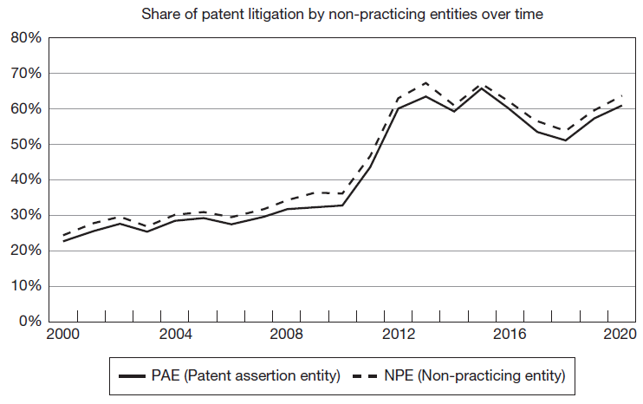
Introduction
NTP is a patent troll, also referred to as non-practicing entity (NPEs) or patent assertion entity (PAEs).
NPEs are entities that do not make any products and instead make money from licensing patents to companies that do.
Since NTP v. RIM case, share of infringement cases filed by NPEs among all U.S. patent infringement cases increased considerably.
Since 2012, NPE cases accounted for majority of patent cases in U.S.

Slide 5
Introduction
Patent trolls have received enormous amount of attention by practitioners, academics, policy makers, and even general public and popular media outlets.
In U.S., all major reforms of patent system over last two decades have been motivated at least in part by concerns over litigation by patent trolls.
Topic remains highly controversial.
Ongoing dispute over:
Who qualifies as a patent troll.
Effects of patent trolls on innovation and welfare.

Slide 6
Introduction
NPEs specialize in enforcement of patents.
Positive impact on innovation:
NPEs are specialized market intermediaries that help connect upstream inventors with downstream producers.
Promote technology transfer and increase returns for innovators.
Help small companies and individual inventors monetize inventions since they are better positioned to make credible enforcement threats vis-à-vis larger companies.
Negative impact on innovation:
Neither generate new ideas nor transform existing inventions into commercially viable products.
Enforce patents against inadvertent infringers and patents often invalid or have little or nothing to do with the allegedly infringing technology.
Opportunistic conduct using threat of enforcement to pressure companies into paying royalties.
Little or no technology transfer associated with NPE licensing.

Slide 7
NPE Definition
Different definitions of patent trolls.
Troll moniker controversial.
Lowest common denominator across different definitions is that NPEs are entities that derive all or close to all of their revenue from patent licensing.
Defining NPEs complex because business models often overlap and change over time.

Slide 8
NPE Definition
Entity-level definition (Hagiu and Yoffie, 2013):
Acquire patents solely for the purpose of payments from alleged infringers.
Do not undertake any research, develop technology or products related to their patents.
Behave opportunistically by waiting until industry participants have made irreversible investments in technology before demanding licensing payment.

Slide 9
NPE Definition
Patent-level definition (Chiang, 2009):
Patent owned by someone that does not practice the invention.
Patent infringed by, and asserted against, non-copiers exclusively or almost exclusively.
Patent has no licensees practicing the particular patented invention except for defendants in b) who took licenses as settlement.
Patent asserted against large industry that is, based on b), and composed of non-copiers.
Note: term “non-copiers” refers to companies that did not knowingly or inadvertently replicate the patented technology.

Slide 10
Classification of NPE types

Slide 11
Classification of NPE types
Category 1 (PAE):
Acquire patents that are monetized.
Do not conduct any R&D (never have conducted any R&D).
Do not practice the patents they acquire.
Includes very large NPEs (portfolio NPEs/mass aggregators).
Account for large majority of NPE patent assertions.
Examples: Acacia Research Corporation, IP Edge, Dominion Harbor.

Slide 12
Classification of NPE types
Category 2 (PAE):
Founded by and usually still owned by inventor of asserted patents.
Registered companies provide corporate shell.
Accounts for second largest number of NPE patent assertions.
Examples: Lemelson Medical, Education and Research Foundation, Ronald A. Katz Technology Licensing LLC.
Includes individuals that hold patents in their own name and assert them themselves rather than through a limited liability company.
Example: Leon Stambler.
“Non-practicing individuals” relatively rare (not all cases by individuals are NPE cases).

Slide 13
Classification of NPE types
Category 3 (PAE):
At some point vertically integrated companies but shifted business model to focus predominantly or exclusively on licensing.
Examples: Conversant Intellectual Property Management, Unwired Planet.
Category 4:
Consortium, association formed by different independent companies.
Example: Rockstar Bidco.
Category 5:
Universities and spin-off companies (spin-off do not make or commercialize products).
Controversial since universities engage in research and as per their mandate focus on education and research, not commercialization of research. University licensing often also involves major technology transfer.
Examples: Eolas (University of California, San Francisco spin-off), Wisconsin Alumni Research Foundation (University of Wisconsin-Madison affiliated technology transfer company).

Slide 14
The economics of NPEs
From a theoretical perspective, impact of NPEs on innovation ambiguous.
Positive impact on innovation:
Efficient intermediaries, assisting inventors in monetizing their inventions in the marketplace.
Enable specialization, upstream inventors can focus on coming up with new ideas while downstream companies turn them into successful products.
Promote liquidity in secondary market for patents.
Increase returns to innovation, especially for smaller inventors, including individual inventors.
Negative impact on innovation:
Exploit weaknesses of patent system combined with threat of litigation to obtain licensing payments from inadvertent infringers of patents of dubious quality.
Engage in ex post licensing of patents without any associated technology transfer.
Extract licensing payments through opportunistic conduct from companies that did not rely on patented invention / patented invention has no actual relevance for infringing product.

Slide 15
The economics of NPEs
Model by Scott-Morton and Shapiro (2014) summarizes opposing theoretical arguments.
Two firms and NPE:
Firm P innovates and obtains patent.
Vertically integrated firm M conducts R&D and commercializes products.
NPE monetizes patent on P’s behalf.
P and M choose R&D investment levels x and y to maximize profits P(x) and V(x,y).
Assumes increase in investment x by P benefits M:
Assume consumers benefit from more investment x: where S(x,y) denotes consumer surplus.

Slide 16
The economics of NPEs
Assume P asserts patent against M. P extracts $θV(x,y)$ from M (with $θ∈[0,1,]$).
Fraction $α$ (with $α∈[0,1,]$) of $θV(x,y)$ absorbed by NPE as transaction costs associated with monetization.
Profit function for P and M:
Using first order conditions for profit maximization, shows that increasing $θ$will increase x and lower y.
Total welfare defined as sum of P and M’s profits and consumer surplus:
(1)

Slide 17
The economics of NPEs
Evaluate impact of NPE on welfare by totally differentiating Equation (1) with respect to $θ$:
Use the following
To rewrite (2):
Re-arranging terms yields:
(2)
(3)

Slide 18
The economics of NPEs
In order to interpret equation (3), a few more modifications are helpful. Define shares of M’s profits received by P and M as:
Use these definitions to write:
And hence:

Slide 19
The economics of NPEs
Substituting these terms into equation (3) yields:
A1 captures positive effect of an increase in patentee’s investment level x on both manufacturer M and consumers.
A2, which is $(1−α)$, represents share of money paid by manufacturer to patentee.
B1 represents direct costs of NPE enforcement.
B2 captures impact of a reduction in M’s investment level y due to costs imposed by NPE.

Slide 20
The economics of NPEs
Net impact of NPEs on welfare depends on:
Extent to which NPEs pass on any payments from licensees to inventors.
Degree to which income from licensing generated by NPEs increases incentives by inventors to invest in R&D and promote innovation.
Extent to which the costs of NPE enforcement reduce incentives to invest in R&D and innovation by companies targeted by NPE assertions.

Slide 21
NPE enforcement strategies
NPEs extract licensing payments from successful innovators by pursuing different patent enforcement strategies.
Goal of NPE enforcement strategies differs from those of practicing entities:
Main goal of practicing entities is to either outright prevent competitors from obtaining market access, secure freedom to operate, or to raise rivals’ cost while obtaining licensing revenue.
Neither of these motivations apply to NPEs since they do not participate in the downstream product market.

Slide 22
NPE enforcement strategies
Nuisance value litigation
Assert patents without much if any prospect of winning a court case.
Exploit high litigation cost and uncertainty to get alleged infringer to settle.
Patents asserted under this strategy likely at least partially invalid or not infringed if they were litigated.
Strategy particularly useful against smaller companies.
Example: Innovative Wireless Solutions filed 281 lawsuits for infringement of WiFi/Ethernet patents against end users including hotels, coffee and sandwich shops.

Slide 23
NPE enforcement strategies
Litigation
Target big, successful companies, ready to litigate case to a decision to obtain multi-million-dollar payout (jury award or a permanent injunction that is transformed into a lucrative settlement).
Prepared to establish that patents are valid and infringed.
Careful selection of the patents, sufficiently broad to read on commercially successful technology commercialized by several big players in the market while still likely valid if challenged.

Slide 24
NPE enforcement strategies
Timing of enforcement
Ex post licensing often relies on hold-up.
Wait until companies have successfully developed and commercialized a technology before asserting their patents.
Allows NPEs to exploit sunk investment.
Approach more likely to succeed if target companies are unaware of threat.
In the past, patent ambush through “submarine patents”.
Example: Jerome Lemelson used submarine patent filing strategy to collect over $1.5 billion in royalty payments before his core patents were invalidated.

Slide 25
NPE enforcement strategies
NPE ownership structure
Hide patent ownership through opaque corporate ownership structure.
Larger NPEs use extensive networks of shell (limited liability) companies, to acquire, hold, and assert patents.
Make it more difficult for potential licensees to assess their licensing needs.
NPEs may evade potential penalties in litigation, notably fee shifting.
Example: IP Edge tried to conceal that it was behind a number of shell companies that filed a large number of lawsuits. IP Edge recruited random individuals without any ties to IP Edge as owners of these companies (the owner of one these NPEs runs a food truck) in exchange for small percentage of settlement proceeds. All relevant litigation-related decisions made by IP Edge via another shell company.

Slide 26
NPE enforcement strategies
Portfolio NPEs
Usually investor-backed NPEs that amass thousands of patents and pursue multiple monetization strategies.
Pressure operating companies into accepting portfolio licenses under the threat of litigation.
Sheer size of the aggregator’s patent portfolio makes it difficult for operating companies to defend themselves since challenging the entire portfolio is not feasible.
Aggregator pressures companies into accepting a licensing agreement without any actual litigation.
Example: Intellectual Ventures with more than 11,000 patents in 2020.

Slide 27
NPE enforcement strategies
Patent privateering
NPEs used by practicing entities.
Companies monetize their patents without negatively affecting business relationships with other companies.
Strategic tool to harm competitors by raising their costs without running the risk of a countersuit.
Undermine the diffusion of new technologies brought to market by competitors by inducing NPEs to sue their competitors’ downstream customers.
Example: Ericsson transferred several thousand patents to Unwired Planet, which asserted them against Ericsson’s competitors. Unwired Planet and Ericsson agreed on sharing licensing revenue, with Ericsson obtaining between 20 and 70% of royalty revenue.

Slide 28
Empirical evidence on NPEs: Opportunistic litigation behavior
“Opportunistic” means:
NPEs enforce patents that are likely to be at least partially invalid.
NPEs enforce patents against successful companies that did not copy patented technology and in most cases technology protected by asserted patent bears no relevance to technology developed by alleged infringer and played no role in technology’s commercial success.
NPEs assert their patents by exploiting fuzzy boundaries that characterize in particular software patents.

Slide 29
Empirical evidence on NPEs: Opportunistic litigation behavior
NPEs overwhelmingly enforce software patents with relatively broad scope:
Allison et al. (2017): 66% of NPE assertions litigated to judgment involved software patents compared to 23% by regular companies.
NPEs often enforce their software patents against large companies across different industries:
Meurer et al. (2012): NPEs assert same patents against multiple defendants across industries, including end-users, including large retailers such as Walmart or Target.
NPE cases terminate faster:
Miller (2018): NPEs terminate much faster because a much larger share of NPE lawsuits ends with settlement.
FTC (2016): NPEs often settle for US$ 300,000 or less, which is amount a defendant would have to spend on initial stages of litigation.

Slide 30
Empirical evidence on NPEs: Opportunistic litigation behavior
NPEs are much more likely to lose than practicing companies when the case is litigated to a decision on the merits:
Allison et al. (2017): NPEs prevail in 14% of decided cases while practicing companies do so in 31% of cases.
Risch (2012): even when NPE cases reach a decision and their patents are not invalidated, findings of infringement are exceedingly rare.
NPEs behave opportunistically in litigation:
Cohen at al. (2019): NPEs pick their targets strategically by pursuing cash-rich companies and engage in forum shopping.
NPEs use corporate ownership strategically to obfuscate their patent dealings:
Ewing and Feldman (2012): Intellectual Ventures used more than 1,200 shell companies to acquire and hold its patent portfolio.
Helmers et al. (2022): other large NPEs also distribute their patent holdings across large networks of shell companies, such as publicly traded NPE Acacia with almost 200 subsidiaries.

Slide 31
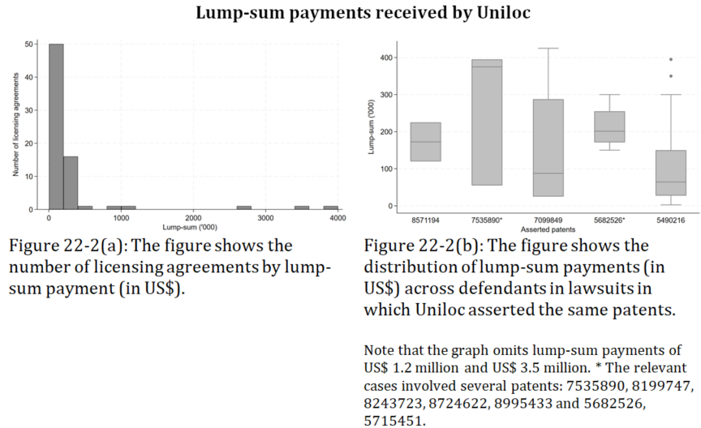
Evidence on NPE licensing

Slide 32
Empirical evidence on NPEs: NPEs as intermediaries
Risch (2012):
Most patents asserted by NPEs originate from practicing companies that did not go out of business.
NPEs promote active trading of patents.
Feldman and Lemley (2015):
Small sample of 181 respondents to a survey of U.S. companies.
Very few licensing agreements entail an actual transfer of technology and only tiny fraction leads to development of new products or features.
Actual technology transfer essentially absent in licensing agreements with NPEs.
Companies only agree to license patents held by NPEs in order to avoid lawsuits or to settle them.
Licensing requests by NPEs were more likely to come only after the NPE had initiated a lawsuit.
Love (2013):
NPEs enforce patents much later during a patent’s life than practicing entities.
Indicates that NPEs wait until technologies have become commercially successful before they assert their patents.
By then, the technology originally covered by their patents most likely already largely obsolete.
Bessen and Meurer (2014):
NPEs pass through only very small share of the proceeds from patent licensing to inventors.
Only around 5% of the direct costs to defendants is used to reward independent inventors.

Slide 33
Empirical evidence on NPEs: Impact on innovation
Chien (2014):
Survey of small technology companies and start-ups sued by NPEs.
40% of respondents reported that NPE assertion had significant impact on their operations, including shutdown of business lines or even the entire business.
Effect was larger the smaller the company.
Meurer et al. (2012):
Stock market reactions to NPE lawsuits.
Targeted companies experience large losses in market capitalization, on average more than $120 million.
Losses dwarf direct costs of litigation in the form of legal expenses.
Cohen et al. (2019):
Companies reduce R&D investment significantly after either losing in court or settling with NPEs.

Slide 34
Empirical evidence on NPEs: Impact on innovation
Appel et al. (2019):
Adoption of “anti-troll” laws in U.S. at state-level led to an average increase of 4.4% in employment in high-tech start-ups.
Companies substantially increased their patenting activities in response to law change.
Effect is concentrated in information technology firms and driven mainly by improved access to external finance.
Tucker (2014):
Effect of NPE Acacia’s assertion of software patents against medical imaging technology companies.
Sales of companies’ medical imaging technology dropped by about a third relative to other products made by same firms.
Result holds when sales by firms sued by Acacia were compared to firms that were not sued by Acacia.
Companies sued by Acacia halted any innovative activity of the technologies affected by the NPE lawsuit.

Slide 35
Defensive aggregators, litigation insurance, and “invalidation entities”
Practicing companies understand threat posed by NPEs.
Effective response is hampered by several factors:
Practicing companies are main source of patents asserted by NPEs.
Practicing companies face a positive externality in the invalidation of patents (Farrell and Merges, 2004).
For practicing companies, the value of acquiring a patent portfolio may be less than for an NPE.

Slide 36
Defensive aggregators, litigation insurance, and “invalidation entities”
Several market-based solutions to these problems have appeared over the last decade.
Defensive aggregator
Ability to spread cost of patent acquisition across members.
Internalize part of positive externalities from acquiring and invalidating NPE patents.
Address free-rider problem through “catch-and-release” strategy.
RPX, Allied Security Trust (AST).
License on Transfer (LOT)
If member of LOT network sells patent to an NPE or becomes an NPE, all other members of network automatically obtain a license to affected patents.
Reduces the supply of patents to NPEs and reduces value of patents to NPEs.
“Invalidation entities”
Focus on invalidation of NPE patents through administrative invalidity proceedings.
Unified Patents, publicly committed to not to pay NPEs in exchange for licenses or purchase patents from NPEs.
(Defensive) litigation insurance
Policy reimburses defendants for a share of their litigation expenses.
Credible commitment to litigate can deter NPE assertion.
Aon, IPISC, RPX, and Unified Patents.

Slide 37
Summary
NPEs have attracted an enormous amount of controversy for more than two decades.
Compelling theoretical arguments in favor of and against patent assertions by NPEs:
NPEs may act as market intermediaries, promoting technology transfer and generally create liquidity in secondary patent markets. They may also help small and individual inventors monetize their patented inventions.
NPEs may opportunistically exploit problems in the patent granting practice, especially in the context of software. Allows NPEs to extract licensing payments from innovators without facilitating any type of actual technology transfer.
Existing empirical evidence clear:
Opportunistic patent enforcement imposes direct and indirect costs on companies.
NPE assertions substantially harm companies’ innovative activities.
Not obvious how to address NPE assertions:
NPEs merely a reflection of a broader underlying problem with the patent system.
Number of private organizations have emerged without policy intervention with the goal of curbing NPE activity.

