Slide 1
Chapter 3 Supply and demand for innovation
Bronwyn H. Hall & Christian Helmers

Slide 2
Overview
Intro – examples
Supply factors:
Technological opportunity
Appropriability
Absorptive capacity
Financing
Demand factors
Market size
Consumer taste and willingness-to-pay
Regulatory mandates
War
Direction of innovation
Simultaneous innovation

Slide 3
Introduction
Begin with two examples of important innovation with very different timelines:
Covid vaccines
Human flight

Slide 4
Introduction – covid vaccines
U.S. government: Operation Warp Speed (OWS)
Goal: accelerate development, manufacturing, and distribution of COVID-19 vaccines, therapeutics, and diagnostic tests.
OWS public-private partnership between various government departments and private firms.
OWS strategies:
Simultaneous FDA review of clinical trials for multiple vaccines.
Manufacture candidate vaccines while pre-approved.
Use of Department of Defense to coordinate supply, production, and deployment.
Results:
8 companies funded in August 2020 to pursue vaccine candidates.
3 companies produced successful vaccines by end of 2020 (Johnson and Johnson, Astra-Zeneca, and Moderna).
4th project, Pfizer-BioNTech, not funded by OWS but benefited from advance purchase agreement with U.S. government (and received 375 million euro funding from German government).
Illustrates Importance of a clearly identified need sending strong demand signal that innovation would have a market as well as the role of a focused government effort.

Slide 5
Introduction – human flight
Quest for human flight goes back to ancient Greece and kite flying in China.
Extensive design and drawings by Leonardo da Vinci during the 15th century.
1783 - first really successful flight by Montgolfier brothers, using hot air balloon.
1903-1908 - modern human flight begins with Wright brothers and Alberto Santos-Dumont.
Why was human flight achieved in the early 1900s and not earlier?
The driving forces appear to have been:
desire to be first,
supply of the basic components,
understanding of mechanics from previous failures,
potential for profit.

Slide 6
Determinants of invention and innovation
Innovative outcomes determined by:
Supply of inputs.
Demand for innovative output.
Our examples:
Driving force behind Covid vaccines was immediate and pressing demand.
Driving force behind heavier-than-air flight was long-felt human desire for flight together with supply of relevant inputs to the innovation.
Demand was not enough, without supply.

Slide 7
Supply of innovation
The most important supply factor for innovation: availability of innovators, which depends on capabilities and incentives:
Capabilities/ability of individuals:
Nutrition
Income level
Education and level of science and technology
Incentives for innovation:
Ability to finance and secure returns to innovation
Life expectancy
Willingness to bear risks
Religion
Values

Slide 8
Technological opportunity
An important supply factor – the science and technology knowledge to which inventors have access.
Technological opportunity refers to availability of relevant knowledge for making inventions in a particular area.
Rapid covid vaccine development depended in part on science learned as a result of earlier SARS viruses.
Human flight had to wait until the science and technology of materials and engines was sufficiently developed.
Not all individuals and firms have easy access to relevant S&T:
Lack appropriate education (“missing Einsteins”).
Lack absorptive capacity.

Slide 9
Missing Einsteins and Marie Curies?
Invention, innovation, and entrepreneurship unequally distributed across the population with respect to gender, race, and family background.
Suggests “missing’ inventors
Exposure to innovative activity during childhood is a critical factor in determining whether an adult becomes an inventor (Bell et al. 2019)
Gender-linked - female invention linked to childhood exposure to female invention; not to male invention.
Parental background (STEM education and inventorship) predict entry into inventing - effects much larger for males than females (Hoisl et al. 2021).

Slide 10
Absorptive Capacity
Absorptive capacity: ability to recognize the value of new information, assimilate it, and apply it to commercial ends (Cohen and Levinthal 1989).
Model of R&D competition in an industry with n number of symmetric firms, equilibrium R&D investment as a function of level of spillovers from competitors' R&D and absorptive capacity of the firm.
Assume static model with two firms i and j, solve for Nash equilibrium in R&D investment where each firm’s profits $Π$ depends positively on its own stock of knowledge K and negatively on its rival’s stock of knowledge:
$Π_{i}=g(K_{i},K_{j})$ $\frac{∂g}{∂K_{i}}>0;\frac{∂g}{∂K_{j}}<0$
A firm’s stock of knowledge is a function of its own R&D R, spillovers from its rival’s R&D, and general knowledge level of economy T:
$K_{i}=R_{i}+γ_{i}(θR_{j}+T)$ $0≤θ≤1$
$θ$measures the spillovers of rival’s R&D.
$γ$ is an increasing function of the firm’s R&D and parameter $β>0$that indexes the ease of learning for a given level of R&D. $β$is assumed to increase the marginal effect of R&D on absorptive capacity but to reduce the level of absorptive capacity

Slide 11
Absorptive Capacity
Return to a firm’s R&D is given by the derivative of profit with respect to R&D:
$$\frac{∂Π_{i}}{∂R_{i}}≡ρ=\frac{∂g}{∂K_{i}}\left(1+\frac{∂γ_{i}}{∂R_{i}}\left(θR_{i}+T\right)\right)+\frac{∂g}{∂K_{i}}θγ_{i}(R_{i},β)$$
First term: positive impact of firm’s knowledge stock on its profits, which includes a spillover term mediated by the impact of firm’s own R&D on its absorptive capacity.
Second term: negative because rivalry effects imply a negative impact of the other firm’s knowledge stock on profits, one that is larger in absolute value if either spillovers or absorptive capacity are larger.
Equilibrium: set the return $ρ$ equal to the cost of R&D, which is assumed to be one. Solve for Rs (too complex for analytical solution).

Slide 12
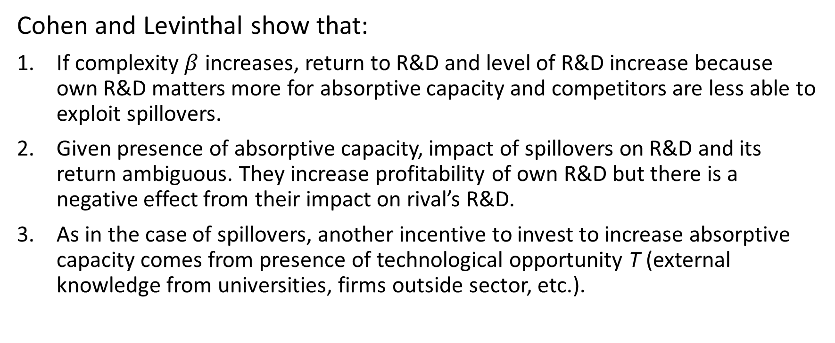
Absorptive Capacity
Cohen and Levinthal show that:
If complexity $β$ increases, return to R&D and level of R&D increase because own R&D matters more for absorptive capacity and competitors are less able to exploit spillovers.
Given presence of absorptive capacity, impact of spillovers on R&D and its return ambiguous. They increase profitability of own R&D but there is a negative effect from their impact on rival’s R&D.
As in the case of spillovers, another incentive to invest to increase absorptive capacity comes from presence of technological opportunity T (external knowledge from universities, firms outside sector, etc.).

Slide 13
Absorptive Capacity
Decreases in ease of learning → increases in R&D investment by the firm.
If firms can affect absorptive capacity via investment in R&D, increases in spillovers can → increased incentives for R&D.
Contrary to the earlier work which assumed implicitly that spillovers reduce R&D incentives by making imitation lower cost than invention.
Implication: firms may invest in basic research in order to increase their absorptive capacity, in spite of the fact that such research also has broader spillovers.
Broader implications: countries may also vary in their ability to absorb and use frontier science and technology; this fact is highly relevant for the failure or success of development strategies

Slide 14
Financing innovation
Key element of innovation cost: cost of financing the resources needed to develop an invention and bring it to market.
Financing innovation challenging because cost of external finance higher than required return:
Asymmetric information
Moral hazard
Lack of securable assets
Result:
some projects not being undertaken;
some individuals may have better access to funds than others, another source of missing Einsteins.

Slide 15
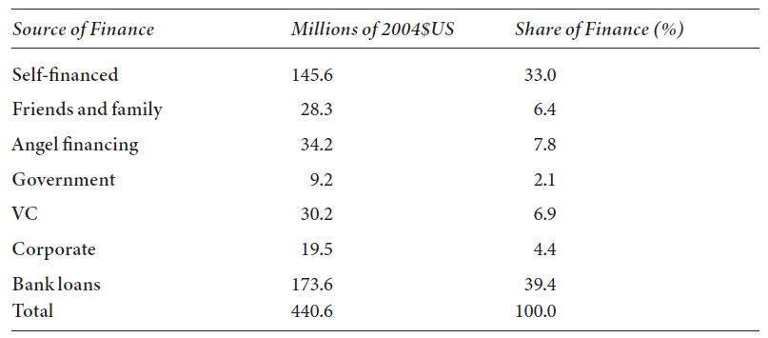
Financing innovation
Overall, the main sources of finance for innovative startups are self and bank loans

Slide 16
Demand for innovation
Where does demand for innovation come from?
3 types of actors:
Consumers:
Consumer demand less important for radical innovations.
Focus on incremental innovations to familiar technologies.
Firms:
Demand depends on expected profit from investments and innovation choices.
Signals from customers/consumers.
Governments (via public procurement):
Policy goals (e.g. environmental mandates leading to new technologies).
Defense/geo-political considerations.

Slide 17
War and demand for innovation
War the impetus behind many important innovations.
e.g., boring machine for cannon used in steam engine development.
Importance of science and technology during World War II:
Atom bomb, radar, microwaves, and medical treatment improvements in blood transfusion, skin grafts, and trauma (Gross and Sampat 2023).
Creation of national science policy and National Science Foundation (NSF), and U.S. Atomic Energy Commission (AEC).
More recent – improvements in drone technology.

Slide 18
Direction of innovation
Direction of innovation: (infinitely) many paths in different directions that might be pursued at a given point in time. Limited resources to invest, need to choose path
Choice determined by same factors that determine the overall level of innovation: the science base, expected innovation cost, expected profit from the innovation, risk and uncertainty, etc.
Innovation studies classify paths in different ways:
By broad science/technology field
Process-oriented vs. product-oriented
Incremental vs. radical
Influence of supply:
Current state of scientific or technological knowledge (tech opportunity)
Composition of potential innovators
Influence of demand:
Technological bottleneck or imperative need for improvement
Relative factor prices/interruption of supply

Slide 19
Simultaneous invention
Invention often nearly simultaneous
Two or more individuals that may or may not be in contact with each other come up with the same or very similar ideas at almost the same time
Examples:
Calculus (Newton, 1671 and Leibniz, 1676)
Theory of natural selection (Darwin and Wallace, 1858)
Principle of least squares (Legendre, 1806 and Gauss, 1809)
Telephone (Bell and Gray, 1876)
Flying machines (Wright, 1895-1901, Langley, 1893-1897)
Photography (Daguerre-Niepe and Talbot, 1839)
Telegraph (Henry, 1831, Morse, 1837, Cooke-Wheatstone, 1837, and Steinheil, 1837)

Slide 20
Simultaneous invention
Why is simultaneous invention common?
Supply and demand factors often apply to economy or society rather than to individuals.
Therefore it is:
Likely that more than one individual will perceive the opportunity to make a scientific discovery.
Likely that more than one individual will perceive the opportunity to make a technological invention that satisfies consumer needs and where cost of invention recoverable via potential profit.

Slide 21
Summary
Level and direction of innovation determined by interaction of supply with demand.
Non-economic factors and chance also matter, but are less subject to policy targeting or conscious strategy by individuals and firms.
Supply factors:
Current science and technology base
Individuals and institutions with the relevant knowledge
Availability of finance
Cultural attitudes (toward risk, newness, and societal values)
Demand factors:
Consumer needs and willingness to pay
Market size
Shocks to relative input costs
Regulatory mandates
Perceived benefit of potential innovation
Many inventions and scientific discoveries are made simultaneously by two or more individuals.

