Slide 1
Chapter 4 Appropriation mechanisms
Bronwyn H. Hall & Christian Helmers

Slide 2
Overview
Basics of intellectual property (IP) rights.
Main features and laws associated with each type if IP right:
patents including utility models, design rights, and plant patents
copyright
geographical indications
trademarks
sui generis IP rights
trade secrecy
Comparing and combining the different IP rights.

Slide 3
Introduction
Innovation is a quasi-public good.
Incentives for innovation depend on methods by which innovators secure returns to innovative efforts.
Appropriation methods to secure returns:
Informal: based on actions undertaken by innovator without recourse to legal protection.
Formal: defined by the legal system, often requiring some kind of registration.

Slide 4
Intellectual property
Focus on formal appropriation mechanism: intellectual property.
Also discuss informal appropriation mechanism: secrecy.
The term “intellectual property” is commonly understood to refer to the intangible products of human creativity such as:
Knowledge of how to make or do something
Creative works such as books, movies, musical recordings, photographs, etc.
New designs for commercial use
Original product markings and trade names
New plant varieties
Often non-rival and non-excludable.
Not really property in traditional sense.
Legal protection necessary to exclude others from use.

Slide 5
Intellectual property
Patents
Copyright
Trademarks
Design rights
Plant patents
Geographical designations
Sui generis protection, e.g. semiconductor masks
[Trade secrets]

Slide 6
Intellectual property
IP addresses problem created by non-excludability.
Other arguments for the creation of IP:
Moral rights to the creator in the case of artistic creations, granting the creator the right to control their work.
Consumer protection from confusion and potential fraud.
Coverage of IP right generally restricted to the country or region that grants them.
Some international cooperation.

Slide 7
Patent
A patent confers the right to exclude others during a limited period from the use of an invention in a given jurisdiction.
Grants broad legal protection because protects against any use of the patented invention.
Patent can be sold, licensed, or used as a security.
But uncertainty associated with validity and scope of patent.

Slide 8
Patent
Patents granted only to patent eligible inventions:
any product or process invention in any field of technology, with some exception.
No obligation to use patented invention.
Patents are national rights.
Several regional patent systems, e.g. European Unitary Patent.
Requirements to obtain patent protection largely harmonized internationally (following TRIPS):
Novelty: new to the world.
Non-obviousness: not an obvious extension of existing invention.
Useful: can be used in practice.
Patent term 20 years from the date of filing the patent application.
Patents published 18 months after filing, disclose technical information in a standardized format.

Slide 9
Patent
Economic justification for patent system:
Invention motivation: the right to exclude others from using the invention creates an incentive to invent.
Invention dissemination: patents disclose an invention and therefore facilitate knowledge diffusion.
Induce commercialization: patents also provide incentives to develop and commercialize an invention by excluding others from this activity for a time.
Exploration control (prospect theory): ownership of a broad patent on an initial breakthrough allows for exploration and development or in a number of directions without the wasteful effort that would occur if anyone could enter the area.
Market for technology: patents enable a more efficient market for technology and its development.
In practice, patents often used by firms as part of a complex strategy to secure returns to their innovations.

Slide 10
Utility models
Some countries grant utility models:
Also known as petty patents or utility patents (not to be confused with US patents).
Weaker form of patent with less stringent patentability requirements.
Utility models generally cheaper to obtain and maintain.
Shorter grant lag.
Shorter protection (generally 6 to 15 years).
Lower patentability requirements.
In some countries, no substantive examination required.
Useful for protecting inventions that make small improvements to, and adaptations of existing products or that have a short commercial life.
Often used by local inventors in developing countries.

Slide 11
Plant patents
Protection for new plant varieties relatively recent (in U.S. in 1930).
Effort to increase incentives for innovation in agriculture sector.
Allows for protection of new varieties created via cuttings and roots rather than seeds.
In 1961, International Union for the Protection of New Varieties of Plants (UPOV) created.
UPOV Convention created sui generis plant breeder's rights for a new plant variety:
New plant must be novel, which means that it must not have been previously marketed in the country where rights are applied for.
New plant must be distinct from other available varieties.
Plants must display homogeneity.
Trait or traits unique to the new variety must be stable.

Slide 12
Plant patents
In U.S., 3 types of IP protection available for plants:
Plant variety protection (PVP) – seeds, tubers, and asexually reproduced plants (issued by the Plant Variety Protection Office of the Department of Agriculture). Term is 20 years (25 for trees and vines). This IP right is subject to a research exemption for the purpose of breeding new varieties as well as a farmer’s exception to allow for the saving of seed to replant. The novelty requirement is much weaker than that for plant patents or utility patents.
Plant patents – asexually reproduced plants (issued by the US Patent and Trademark Office). Term is 20 years from filing date. Enforcement of a plant patent requires proof that the copy is the progeny of the patented plant.
Utility (invention) patents – for genes, traits, methods, plant parts, or varieties (issued by the USPTO). Term is 20 years from filing date.

Slide 13
Design rights
Design rights (patents) protect ornamental aspect of an article.
Design dictated by function or purpose of a product not protected.
Cover shape, pattern, color, etc. of an article.
Grant owner of registered industrial design or design patent the right to prevent third parties from making, selling or importing articles bearing or embodying a design which is a copy, or substantially a copy, of the protected design.
In some countries, no examination/registration required.
Shorter protection term.
Scope not based on verbal description but solely on graphical depiction of design.

Slide 14
Geographical indications (GI)
Geographical indication (GI) is a designation that a particular product is produced in a specific region, excluding similar products produced elsewhere from claiming they come from the region.
Examples: Champagne, Roquefort, Parmigiano Reggiano.
GIs identify the source of a product associated with certain characteristics.
GIs similar to trademarks, but more restrictive as they must be connected to a specific place.
GIs protected through collective or certification marks or sui generis rights.

Slide 15
Copyright
Copyright covers original works of authorship that are fixed in tangible form, such as books, artworks, prints, photographs, films, recordings, but also software.
Copyright grants creator exclusive control over their creation: the rights to reproduce the work, produce derivative work including audiovisual adaptation, to perform or record the work, or to display the work.
Copyright only protects the literal expression of an idea, not the idea itself.
Limitations and exceptions (e.g. fair use).
Registration generally not required but possible.
Copyright term life of the creator plus 70 years.

Slide 16
Trademark
Trademark: “any word, name, symbol, or device, or any combination thereof [...] used by a person ...] to identify and distinguish his or her goods [...] from those manufactured or sold by others and to indicate the source of the goods.”
Purpose: distinguish one product from another and to identify the source of the product.
A trademark is a right to exclude other from using the mark or one that is substantially similar, unless it is licensed to them by the owner of the trademark.
Requirement: trademark has to be distinctive.
Protection available in form of registered and unregistered trademarks.
Trademark term 10 years, renewable indefinitely.

Slide 17
Semiconductor mask protection
Sui generis IP for semiconductor masks.
Introduced in the U.S. by Semiconductor Chip Protection Act (SCPA) of 1984.
Semiconductor mask is “a series of related images, however fixed or encoded - (A) having or representing the predetermined, three-dimensional pattern of metallic, insulating, or semiconductor material present or removed from the layers of a semiconductor chip product; and (B) in which series the relation of the images to one another is that each image has the pattern of the surface of one form of the semiconductor chip product.”
In U.S., registration required during the first two years of commercial exploitation and length of term is 10 years.
Protection not renewable and can be licensed or transferred to another entity.
Mask design must be somewhat original but no substantive examination before registration.
In practice, relatively little take-up of semiconductor mask protection, due to technical changes in the industry (miniaturization).

Slide 18
Trade secret
Trade secret: information kept within the firm, where firm has made an effort not to reveal it to public, and where information is not already generally known.
Not registered, has indefinite term, only offers protection from misappropriation.
Imitation without misappropriation is allowed.
Trade secrets include customer lists, formulas, pharmaceutical test data, methods of production, advertising strategies and marketing plans, etc.
Legal provisions granting trade secret protection vary considerably across jurisdictions.

Slide 19
IP use by the top 2000 R&D performers 2010-2012
Many more firms make use of trademarks than patents.
About half of patenting firms also use trademarks.

Slide 20
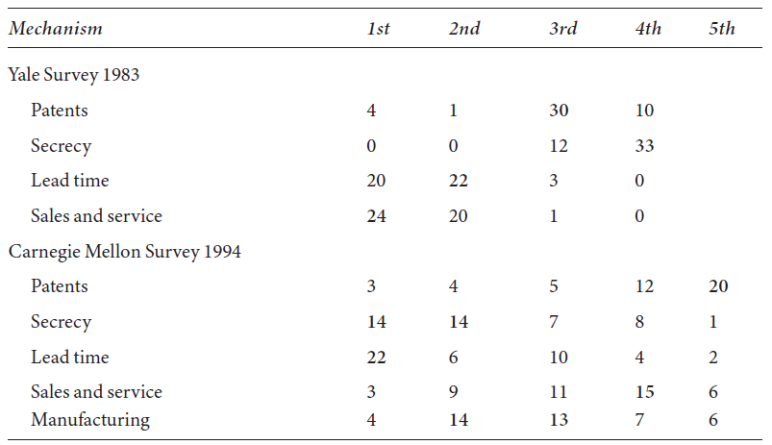
Effectiveness of appropriability mechanisms for product innovations
Informal mechanisms for securing returns to product innovations (lead time, sales and service) generally more important than formal methods:

Slide 21
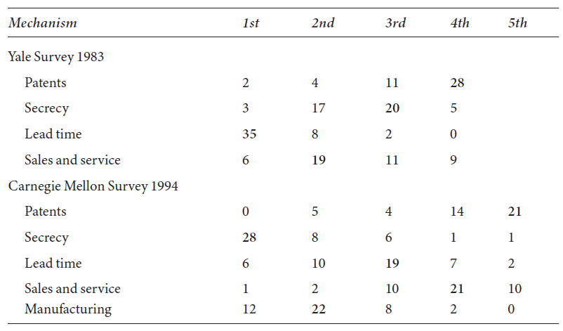
Effectiveness of appropriability mechanisms for process innovations
For process innovations, secrecy now the most important mechanism for securing returns:

Slide 22
Summary
Creators of ideas and intangible products motivated by ability to capture some returns from their innovative activities.
IP:
Ensures development of future prospects from an invention;
Provides disclosure of technical information that might otherwise be kept secret;
Enables trade in technology;
Ensures “moral rights” for creators even if they make no effort to claim ownership;
Provides protection via geographical indications to those whose traditional inventions do not rise to patentability or other IP protection due to their historical development.
IP comes at a cost which creates trade-off in designing and using IP system.

