Slide 1
Chapter 5 Innovation and Competition in Firms
Bronwyn H. Hall & Christian Helmers

Slide 2
Overview
Basic landscape of R&D and innovative activity across industries and firm sizes
Modeling the relationship between market structure and innovation
Empirical evidence on market structure and innovation
“Patent races” and the timing of innovation
Innovation and the evolution of industries and their structure

Slide 3
Introduction
Interaction between innovative firms (established and startup) in the market.
Innovation has potential to change market structure.
As result of innovation, industries develop, evolve, and even disappear.
What market structure is most conducive to innovation?
Has innovation an effect on market structure?
What type of firm innovates under which circumstances?
Important policy implications.

Slide 4
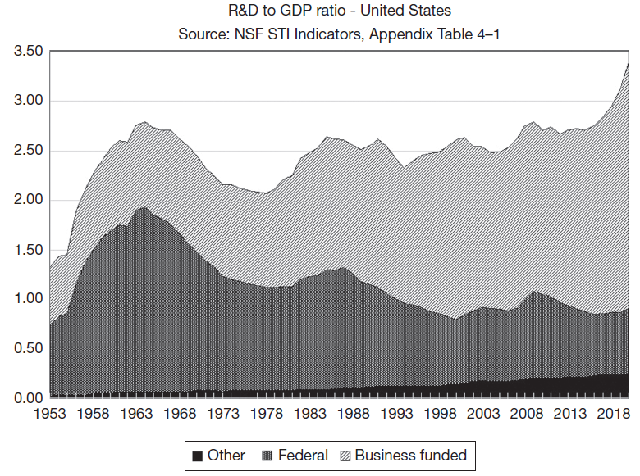
R&D funding in the U.S.
Growth of business funded R&D in the US during the past six decades, and corresponding fall in R&D funded by the federal government.
As a share of GDP, total R&D today is at roughly the same level as in 1962.

Slide 5
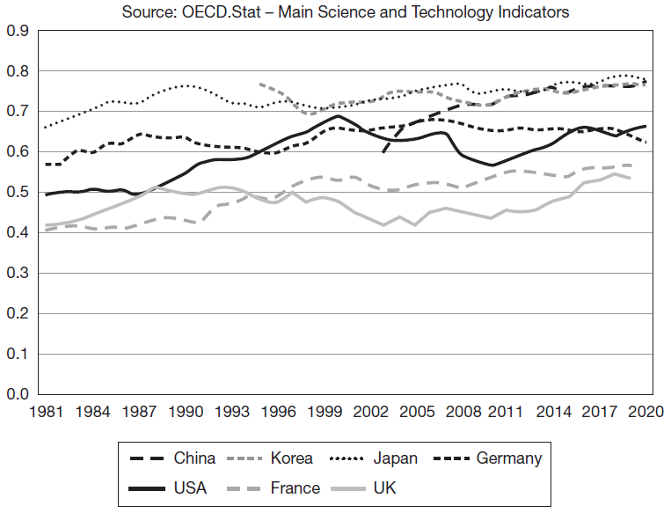
Business-financed R&D share of total R&D
Growth in business R&D also visible in the other major R&D-doing countries.

Slide 6
Introduction
Industry R&D spending has increased during the past 50 years.
Main reasons:
Increases in technological opportunity.
Increases in market demand for new products (also increases in market size due to globalization).
But increase has not led to as much increased productivity and economic growth.
“Red Queen Effect”: running faster to stay in place.

Slide 7
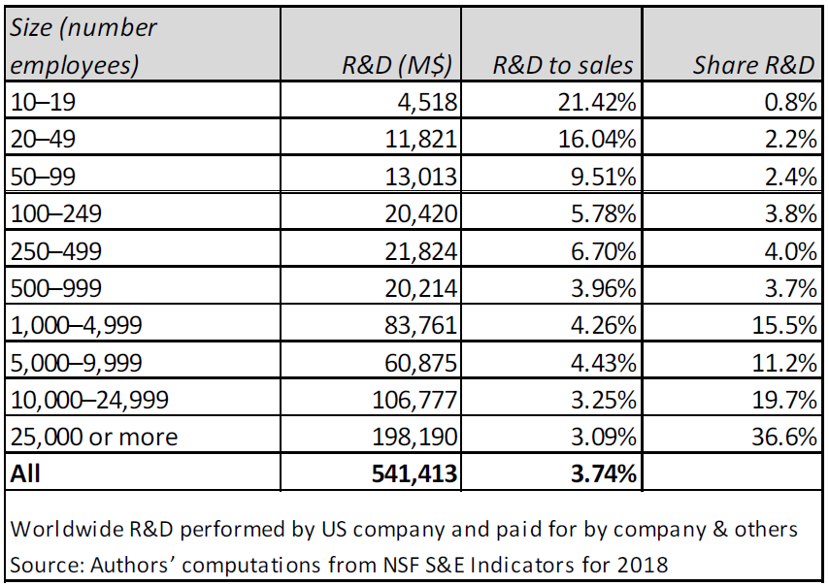
Stylized facts
R&D investment varies considerably across industries.
Industry (regardless of firm size) most important predictor of investment in R&D.
Majority of R&D performed by large firms with >1,000 employees.
When small and medium sized firms perform R&D, their intensity is much higher.

Slide 8
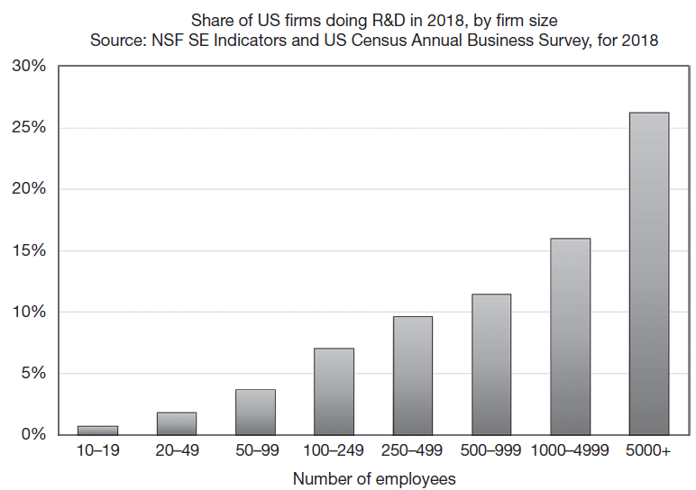
Stylized facts
The larger the firm, the more likely it is to have formal R&D spending that is tracked separately.

Slide 9
Stylized facts
Share of Firms with Different Types of Innovation (among innovators).

Slide 10
Market structure and innovation (Schumpeter, 1942)
“The atomistic firm in a competitive market is the suitable vehicle for static resource allocation, but the large firm operating in a concentrated market is the most powerful engine of progress and … long run expansion of output … perfect competition … has no title to being set up as a model of ideal efficiency.”
“...the problem that is usually being visualized is how capitalism administers existing structures, whereas the relevant problem is how it creates and destroys them.”

Slide 11
Market structure and innovation
Advantages of monopoly and large firm size for innovation come primarily from economies of scale and scope:
Because R&D is a fixed cost, spreading over more units is cost efficient.
Because R&D in one area often generates spillovers to another area, a multi-product firm more efficiently internalizes these spillovers.
Less redundant research and fewer wasteful patent races.
Monopolists may also face greater incentives to innovate because they will lose market power if they fail to innovate (in contrast to Arrow 1962 below).
Easier to finance innovation for monopolist, because of existing profits and lower costs in capital market.

Slide 12
Static theory of optimal R&D supply
First best solution:
Cover fixed cost of an invention and its development with lump sum tax and let competition bring the price of the product down to marginal cost.
Not feasible due to uncertainty and incomplete information.
Patent protection: grant inventor short-term monopoly, resulting profits cover fixed costs of R&D, but there will be deadweight loss due to monopoly pricing.
If no patent protection available but innovator can protect invention briefly via first mover advantage, there will be imitation. As successive imitators enter, consumer surplus grows, and profits and deadweight loss shrink.
Implications:
Other things equal, there will be more innovation with patents, at the cost of deadweight loss, because there will be higher profits to cover costs.
With no patent protection, number of firms in the market depends on the relative costs of imitation (appropriability conditions). If imitation costs large, few additional firms will enter, if they are small, many firms will enter. If there is no first mover advantage (imitation is instant), in equilibrium no one will enter if innovation cost is greater than imitation cost.

Slide 13
Drastic vs non-drastic innovation (Arrow, 1962)
Single cost-saving innovation that cannot be imitated by other firms.
Innovation only affects cost of production (no change in demand).
Important distinction between drastic (major) and non-drastic (minor) innovations.

Slide 14
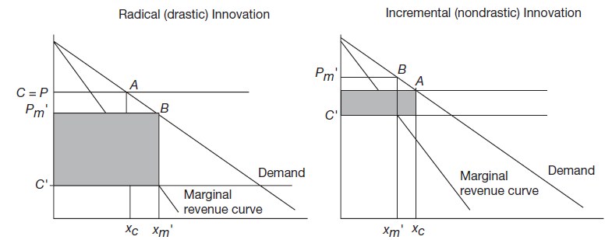
Drastic vs non-drastic innovation
D(x) denotes the demand curve as a function of quantity and R(x) the monopolist’s marginal revenue curve:
Minor (non-drastic): $p_{M}^{′}>c$ post-innovation monopoly price is above pre-innovation unit cost (limits market power of innovator to point A).
Major (drastic): $p_{M}^{′}<c$ post-innovation monopoly price is below pre-innovation unit cost (innovator drives everyone else out of market at point B).

Slide 15
Drastic vs non-drastic innovation
Incentives for innovation under: perfect competition and monopoly.
Perfect competition: price before innovation is c, quantity is $x_{c}$, profits are zero. If one firm innovates:
Drastic innovation: firm becomes a monopolist, so price and quantity are $p_{m}^{′}$ and $x_{m}^{′}$. Profits are $Π_{m}^{′}$.
Non-drastic innovation: firm cannot price higher than c due to competition from old technology. Quantity is still $x_{c}$, but costs have fallen to c’ and profits are $x_{c}(c−c^{′})$.
Monopolist:
Before the innovation, price $p_{M}$determined by marginal revenue curve (${R(x}_{m})=c$), quantity $x_{m},$ profits $Π_{m}=x_{m}(p_{m}−c)$.
After the innovation, price $p_{m}^{′}<p_{M}$determined by marginal revenue curve ($R(x_{m}^{′})=c^{′}$), quantity $x_{m}^{′}{>x}_{m},$ profits $Π_{m}^{′}=x_{m}^{′}(p_{m}^{′}−c^{′})$.

Slide 16
Drastic vs non-drastic innovation
Drastic innovation: monopolist has less incentive than a competitive firm (“replacement effect”).
Non-drastic innovation: competition generates more innovation than monopoly.
Monopolist has less incentive to innovate in general because already has some profit and the cost reduction benefit is spread over smaller output than under competition.
Monopolist has relatively more incentive for minor than for major innovations.

Slide 17
Non-drastic innovation
Compare monopolist’s profits:
$$Π_{m}^{′}−Π_{m}<x_{c}\left(c−c^{′}\right)$$
$$⟺∆revenue−∆costs<x_{c}\left(c−c^{′}\right)$$
$⟺\int_{x_{m}}^{x_{m}^{′}}{R\left(x\right)dx−(c^{′}x_{m}^{′}−cx_{m}}$)<$x_{c}\left(c−c^{′}\right)$
Since monopolist’s marginal revenue curve downward sloping and below pre-innovation marginal cost when quantity is greater than $x_{m}$:
$$\int_{x_{m}}^{x_{m}^{′}}{R\left(x\right)dx<\int_{x_{m}}^{x_{m}^{′}}{cdx=c(x_{m}^{′}−x_{m})}}$$
Therefore, profits from innovation greater for the competitive firm than for monopolist:
$$⟹\int_{x_{m}}^{x_{m}^{′}}{R\left(x\right)dx−\left(c^{′}x_{m}^{′}−cx_{m}\right)<c\left(x_{m}^{′}−x_{m}\right)−\left(c^{′}x_{m}^{′}−cx_{m}\right)}$$
$$=x_{m}^{′}\left(c−c^{′}\right)<x_{c}(c−c^{′})$$

Slide 18
Dasgupta-Stiglitz (1980)
Model allows supply and demand conditions to vary.
Model allows for imperfect patent protection.
Results in an equilibrium between market structure and R&D intensity, given particular supply and demand conditions.
Suitable for describing variations across industries in innovative behavior at a point in time.
Causality flows two ways, from innovation to market structure and from market structure to innovation.

Slide 19
Dasgupta-Stiglitz Model
Elasticity of demand $ε$
Market size $σ$
Innovation elasticity – the productivity of R&D in reducing unit cost $α$
Scale between R&D and its cost $β$
Demand function and cost functions have constant elasticity form:
$$P\left(Q\right)=σQ^{−1/ε}$$
$$c\left(x\right)=βx^{−α}$$
where P is market price, Q is total quantity produced, c is unit cost of production, x is a fixed cost (R&D) that shifts the constant marginal cost downward.

Slide 20
Dasgupta-Stiglitz Model
Firms make Cournot conjectures about both the output and the R&D of other firms.
In free entry zero profit equilibrium, all firms will make the same choices and can be treated as identical.
Due to fixed cost (R&D), market only supports finite number of firms with markups above marginal cost.
Solution strategy:
Derive the equilibrium output given demand parameters, number of firms n, assuming no entry and constant unit (variable) cost.
Assume that each firm pays a fixed cost x to enter and compute the equilibrium number of firms as a function of demand and cost.
Assume that only fixed cost is R&D (x) and that firms can choose x to reduce their production cost. Compute new equilibrium that gives number of firms, output, and level of R&D as a function of the model’s demand and supply parameters.

Slide 21
Dasgupta-Stiglitz Model
First step:
$$markup=\frac{P−c}{P}=\frac{1}{nε}$$
Given n firms, Cournot equilibrium determines price P given marginal cost c and the demand elasticity ε. Lower markups are associated both with a higher number of firms n and higher demand elasticity.
Second step:
$$profits π=variable profits −fixed costs=0$$
$$π=\left(P\left(Q\right)−c\right)q−x$$
$$⟹n=\frac{\left(P\left(Q\right)−c\right)q}{x}=\frac{\left(σQ^{−\frac{1}{ε}}−c\right)q}{x}$$
Note that Q denotes aggregate output and q denotes output of an individual firm.
Equilibrium number of firms in market is number for which variable profits can cover their fixed costs. Larger market σ increases equilibrium number of firms n, while higher fixed costs reduce n for a given markup and increase the markup holding n constant.

Slide 22
Dasgupta-Stiglitz Model
Third step:
$$π=\left[P\left(Q\right)−c\left(x\right)\right]q−x$$
Solution obtained using 3 equations that give values for n, Q, and x:
Zero profit: $\left[P\left(Q\right)−c\left(x\right)\right]q−x=0$
FOC for output: $\frac{P\left(Q\right)−c}{P(Q)}=\frac{1}{nε}$
FOC for R&D: $x=\frac{αcQ}{n}$
Using these equations, one can show the following:
$$n=\frac{(1+α)}{αε}$$
Industry R&D intensity: $\frac{nx}{PQ}=\frac{α}{1+α}$
Equilibrium number of firms depends on demand elasticity ε and technological opportunity α.
Conclusion: In equilibrium, comparing across industries, those with high technological opportunity will have higher R&D intensities, fewer firms, and high markups.

Slide 23
Aghion et al. (2005)
Model derives implications of the dynamism inherent in innovative competition for the relationship between innovation and market structure.
Relationship between the firm markup and innovation has inverted U shape, as a firm’s market power increases, it first becomes more innovative and after a certain point, its innovative activity declines.
Model assume R&D competition exists between firms: either “neck-in-neck” or leader-follower.
Propositions:
Research intensity of neck-in-neck firms increases if there is more competition (escape competition effect), and the research intensity of the laggard firm declines with more competition (Schumpeterian effect).
As long as imitation probability of success is high enough, aggregate innovation rate follows an inverted-U pattern, first increasing with increases in competition and then decreasing.
Technological gap between leader and follower increases as product market competition increases.
Peak of the inverted U is larger and occurs at a higher level of the competition index in industries where competition is more neck-in-neck.

Slide 24
Bounds theory (Sutton, 1998)
Central problem in empirically examining the concentration/innovation relationship: range of activities encompassed by an “industry”, not all of which will be directly in competition with each other.
e.g., motor vehicles, which also includes auto parts.
Firms pursue strategies designed to differentiate them from others to allow them to price above marginal cost and generate economic rents.
Assumptions:
Firms do not pursue loss-making strategies.
If a profitable opportunity emerges, some firm will take it.
All potential entrants to a new submarket are equally advantaged.
Model delivers lower bounds to concentration in R&D intensive industries:
Concentration will be high if submarkets in an industry produce close substitutes.
Concentration can be quite low if submarkets do not produce close substitutes.

Slide 25
Timing of innovation and patent races
Firms will generally not choose the socially optimal date of an innovation.
Only price-discriminating monopolist chooses optimal date because firm gets all the surplus (consumer and producer), thus internalizes process.
Monopolies that do not get all the surplus from their innovation tend to be too slow, while competition can be either too fast or too slow.
Theoretical work on racing for an invention (or patent) shows that innovation can be too fast and involve duplicative effort if patent protection is strong (Reinganum 1982).
If there are spillovers, duplicative effort may be reduced but innovation still sped up.

Slide 26
Empirical evidence: Firm size and innovation
Relationship between R&D and firm size cannot confirm or deny the Schumpeterian hypothesis that large firms are “better” at innovation (Fisher and Temin, 1973).
Assume a firm is composed of two types of workers: R&D workers R and production workers N, with firm size S=R+N.
Two functions that describe performance of an R&D firm:
Value added per worker from R&D workers R = F(R,N)
Total R&D output of the firm = RF(R,N)
where F is defined as dollar value generated by an R&D worker above and beyond the value generated by a firm without R&D workers.

Slide 27
Empirical evidence: Firm size and innovation
Tests of the Schumpeterian hypothesis in the literature is based on the following elasticity:
$$η=\frac{S}{R}\frac{∂R}{∂S}>1$$
True test of this hypothesis is test of whether the total R&D output of the firm rises more than proportionately with increases in R&D:
$$ε≡\frac{S}{RF}\frac{∂\left(RF\right)}{∂S}=η+\frac{S}{F}\frac{∂F}{∂S}>1$$
Finding that $η$ is greater than or less than unity has no particular implications for the magnitude of $ε$.
Intuition: relevant test is a test for total impact of R&D on firm size, which combines two effects: impact of firm size on R&D productivity together with impact of size of the R&D program on total firm size.

Slide 28
Empirical evidence: Concentration and innovation
Causality in the relationship between concentration and innovation unclear: not clear whether innovation causes successful firms to grow and an industry to become concentrated or whether an industry with several large firms does more innovation because it is optimally concentrated.
Need to hold constant “exogenous” determinants of innovation:
Potential size of the market
Technological opportunity
Appropriability conditions
Concentration measures at the industry level do not quite capture the relevant competitive environment (industry definition not same as market definition).

Slide 29
Empirical evidence: Structural models of competition and innovation
In evaluating competition-innovation relationship, important to know whether level of innovation too low or too high from a consumer welfare perspective, but determining optimal level requires knowledge of consumer demand and willingness to pay.
Requires dynamic game theoretic model of the competition-innovation interaction among firms that incorporates demand:
Allows for counterfactual simulation in order to estimate welfare and examine the tradeoff between concentration leading to higher prices versus concentration leading to more innovation.
Sequential interaction of firms that both compete in a sector and also innovate to improve their competitive position.
Estimation of the demand function and marginal cost functions at each point in time as well as the quality evolution (innovation) over time.
Analysis usually restricted to specific technology sector such as airframes, hard drive production, or semiconductors, to assume some homogeneity of product being considered.
Examples: Benkard (2004), Goettler and Gordon (2011), Igami (2017), and Igami and Uetake(2020).

Slide 30
Innovation and industry evolution (Klepper, 2016)
Major innovations can create entire new industries.
New industries exhibit common pattern as they develop:
When technology is new and continuously evolving, the industry experiences high entry rates and growth in the number of firms.
“Shakeout”: After technological convergence, exit from the industry increases and entry declines along with the number of firms. Successful firms have larger market shares, hence greater incentive to innovate, thus becoming even larger, a self-reinforcing process.
After shakeout, only a few firms survive and industry becomes concentrated and innovation stagnates. Ultimately, possibly after considerable time, the industry is ripe for disruption as the world around it changes.
Instead of (3), also possible that firms continue to enter, opening up new submarkets with new products in the broad industry (vertical disintegration).

Slide 31
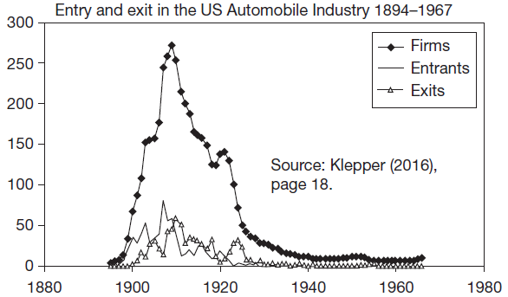
Innovation and industry evolution (Klepper, 2016)
At first, more entry than exit, then more exit than entry and a decline to fewer than 10 firms.

Slide 32
Summary
Relation between market structure and innovation depends on many factors.
No theory robust to all these different elements - rather different models for different contexts.
Therefore no clear empirical results.
But:
Evidence for some association between firm size and innovation.
Evidence for U-shaped relation between competition and innovation.
Progress in modeling and estimating fully structural dynamic models of innovation, competition, and demand.

