Slide 1
Chapter 6 Returns to R&D and Innovation
Bronwyn H. Hall & Christian Helmers

Slide 2
Overview
Theory supporting the measurement of returns to R&D investment
Estimation of returns to R&D and other innovation measures
Using production functions
Using a rate of return formulation
Using firm market value
Challenges in the econometric estimation of returns to R&D
Implications of the choice of output price deflator for measured returns
Returns to other innovation measures

Slide 3
Introduction
R&D and innovative activity has the characteristics of an investment:
Spend today to achieve returns in the future.
Need a measure of the returns from the investment.
Ex ante: evaluate expected return from the investment.
Ex post: measure the realized return on the investment.

Slide 4
Introduction
R&D a type of investment, but
Differs from investment in tangible capital:
Generates spillovers
Enormous uncertainty
Intangible nature compounds capital market imperfections
Sunk costs
Large share of capital created is human capital

Slide 5
Introduction
R&D and innovation differ from other types of investment: they generate spillovers.
Knowledge spillovers
Example: pharmaceutical firm that undertakes an R&D project to generate new drug ignores knowledge spillovers to other firms from their success or failure. But spillovers important: failed HIV vaccine research contributed to the creation of SARS-Cov-2 vaccines.
Pecuniary spillovers (lower prices or improved products)
Spillovers ignored in measurement of private returns:
Private returns based on average profits above costs made by individual firms that invest in R&D.
Given optimizing calculus of the firm, returns close to cost of capital needed to undertake the investment.

Slide 6
Introduction
Social returns are benefit achieved by R&D investment at the economy/industry-wide level relative to its cost.
Social returns are ordinarily higher than private returns (but not necessarily).
Social returns and gap between private and social returns serve as guides to government policy makers designing or targeting R&D subsidies.

Slide 7
Introduction
Literature on innovation returns focuses on returns to R&D investment.
Partly for historical and data availability reasons
Other complementary innovation investments undertaken by firms:
Purchase of external knowledge and IP (patents, trademarks, knowhow, etc.).
Purchase, installation, and use of new (technologically advanced) equipment.
Training of employees in new processes, or in supporting new products.
Marketing new goods and services.
Compared to R&D, less uncertainty once undertaken, and faster pay off.
But any R&D-driven innovation project includes these other costs if it is successful.

Slide 8
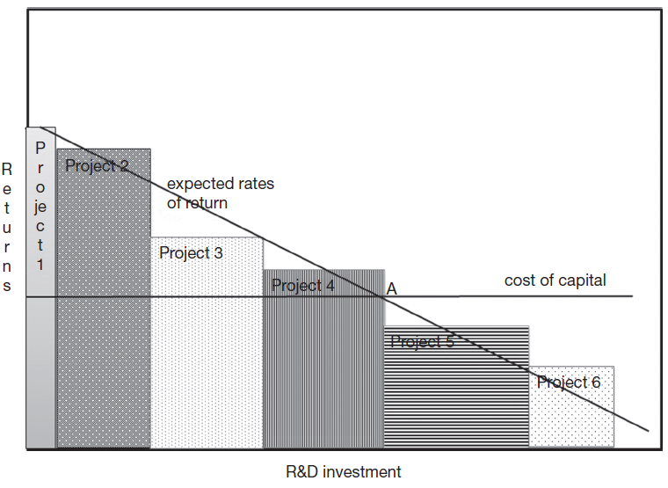
Theory
A firm deciding to undertake an investment project compares its expected returns of the project to the cost of the capital needed to finance it.

Slide 9
Theory
According to standard investment theory, point A characterized by:
$$c=r+δ−\frac{\dot{p}}{p}$$
Where c is cost of capital, r is net return from R&D investment, δ its depreciation,$\frac{\dot{p}}{p}$ is the change in price of such investment over time.
Cost or rental price of investment composed of three terms:
Return it can earn each period in use.
Cost of depreciation this period that renders capital less useful in future.
Capital gain or loss on its price during period, which reduces or increases the investment cost today relative to the future.
All of this highly uncertain at the time of investment choice, so realized returns may be quite different.

Slide 10
Theory
Implications from standard theory for interpretation of measurement of returns to R&D:
Depends on depreciation of knowledge and innovation produced by R&D investment.
Depreciation takes place when “asset” becomes less productive.
Often depends on changes in the competitive environment (e.g. introduction of Apple's iPod in 2001, R&D of previous manufacturers of portable MP3 players became suddenly less valuable)
If firm chooses inputs and R&D to maximize present discounted value of profits, on average, the marginal after tax gross return to R&D will be equal to cost of capital (plus risk premium).
Private rates of return disciplined by financial markets towards a particular level.
Social rates of return not constrained in this way.

Slide 11
Econometric method
Expenditure on R&D creates intangible capital within the firm (knowledge capital).
Knowledge capital depreciates at rate δ over time.
Knowledge capital K at firm level often measured by perpetual inventory formula:
$$K_{t}=\left(1−δ\right)K_{t−1}+R_{t}$$
where R denotes R&D investment.
Assuming knowledge accumulation process has gone on a long time and R&D spending is constant over that period, K≈ R/δ.
Assuming R&D has grown at constant rate g over time, K≈R/(δ+g).
Important difference from ordinary tangible investment:
Depreciation of knowledge asset affects private returns, but knowledge itself still useful to others, therefore social rate of depreciation may be lower.

Slide 12
Econometric method
Measure private firm returns to R&D in the current period using the (revenue) production function:
S = F(C,L,K)
where S denotes sales as a function of inputs C capital, L labor, and R&D capital K.
Derivative of S with respect to K is amount of additional output per one unit of K, holding capital and labor fixed.
Using data on firms, measure this derivative using a regression.

Slide 13
Econometric method (implementation)
Conventional Cobb-Douglas production function:
$$S_{it}=A_{t}C_{it}^{α}{L_{it}^{β}K}_{it}^{γ}e_{it}^{ε}$$
Subscript i indicates the firm, t indicates the time period, $ε$ denotes an error term, $A_{t}$ is a trend in productivity change over time not accounted for by changes in level of inputs.
In logs:
$s_{it}=a_{t}+αc_{it}+βl_{it}+γk_{it}+ε_{it}$
$γ$ measures elasticity of output with respect to knowledge capital:
$$\hat{γ}=\frac{∂s}{∂k}=\frac{K}{S}\frac{∂S}{∂K}$$
Returns to R&D capital given by increase in sales from an increase in knowledge stock:
$$\frac{∂S}{∂K}=\hat{γ}\frac{S}{K}=\hat{γ}{\left(\frac{K}{S}\right)}^{−1}$$

Slide 14
Estimates of the production function with R&D
Sample | French manufacturing | US manufacturing
# firms and years | 197 firms; 1980-1987 | 1073 firms; 1981-1989
Dependent variable | Log (value added/employee) | Log (sales/employee)
Log (capital/employee) | 0.199 (0.013) | 0.289 (0.008)
Log (R&D capital/employee) | 0.252 (0.008) | 0.035 (0.005)
Log (employees) | -0.035 (0.007) | 0.010 (0.010)
R-squared (standard error) | 0.966 (0.344) | 0.936 (0.360)
Source | Hall and Mairesse (1995), Table 3 | Hall and Mairesse (1996), Table 3*
*The estimates in the table are transformed from the original, to show the scale coefficient as the coefficient of labor.

Slide 15
$γ$ not a constant parameter
Assumption that $γ$ is a constant parameter, invariant across firms in different industries.
Under some simple assumptions about returns to scale and imperfect competition, elasticity of output with respect to an input is equal to the share of the input in the costs of production.
$γ$ will be higher in sectors with greater R&D intensity:

Slide 16
$γ$ not a constant parameter
Theory predicts that estimated R&D elasticity varies with R&D intensity if returns to R&D are roughly constant across firms and industries.
Firms invest in R&D up to the point where the returns are equal to the cost of R&D capital.
Assumption of equalized rates of return across sectors is a better benchmark than equalized elasticities.

Slide 17
Estimation using the rate of return formulation
Based on theory (rates of return should be equalized across industries), assume rate of return to R&D is a constant parameter.
Use differenced version of production function:
$$Δs_{it}=αΔc_{it}+βΔl_{it}+γΔk_{it}+Δe_{it}$$
Transform $γΔk_{it}$ so that it is written in terms of the rate of return $ρ$:
$$γΔk=γ\frac{ΔK}{K_{−1}}=γ\frac{ΔK}{K_{−1}}\frac{S_{−1}}{S_{−1}}=\left(γ\frac{S_{−1}}{K_{−1}}\right)\frac{ΔK}{S_{−1}}=ρ\frac{ΔK}{S_{−1}}$$
This can be estimated as:
$$Δs_{it}=αΔc_{it}+βΔl_{it}+ρ\frac{ΔK_{it}}{S_{it−1}}+Δe_{it}$$

Slide 18
Estimated rate of return to R&D
To estimate, either compute $\frac{ΔK_{it}}{S_{it−1}}$ with suitable assumption on $δ$ (since $ΔK=R−δK_{−1}$), or assume that depreciation is zero and simply include R&D intensity $\frac{R}{S}$in the equation.

Slide 19
Challenges in estimating rate of return to R&D
Choice of depreciation rate.
Double counting of R&D inputs.
Implications of omitting others' R&D in estimation.
Definition and scope of output.
Output measurement for services.
Price measurement - to get real output, nominal output needs to be deflated by its price - some R&D raises quality (and therefore lowers the price of a constant quality good, presumably increasing demand).

Slide 20
Depreciation rate
Construction of a “stock” of R&D knowledge requires choosing a depreciation rate.
When rate of return to R&D is computed from elasticity, choice of depreciation rate matters because estimated return is the product of the elasticity with output-R&D capital ratio, and R&D capital estimate depends inversely on depreciation.
But estimates of elasticity using relatively short panels of large manufacturing firms are not sensitive to choice of depreciation rate.
Recall that for firms with a roughly constant depreciation rate and growth rate of R&D:
K ≈ R/(δ+g)
Incorporate this into production function:
$$q_{it}=a+αc_{it}+βl_{it}+γr_{it}+γ\log\left(δ_{i}+g_{i}\right)+e_{it}$$
$\log\left(δ_{i}+g_{i}\right)$ term will be subsumed by fixed firm effect included in the estimation.
Estimate of $γ$ will be approximately equal to estimated coefficient of current R&D, no matter what depreciation rate is chosen.

Slide 21
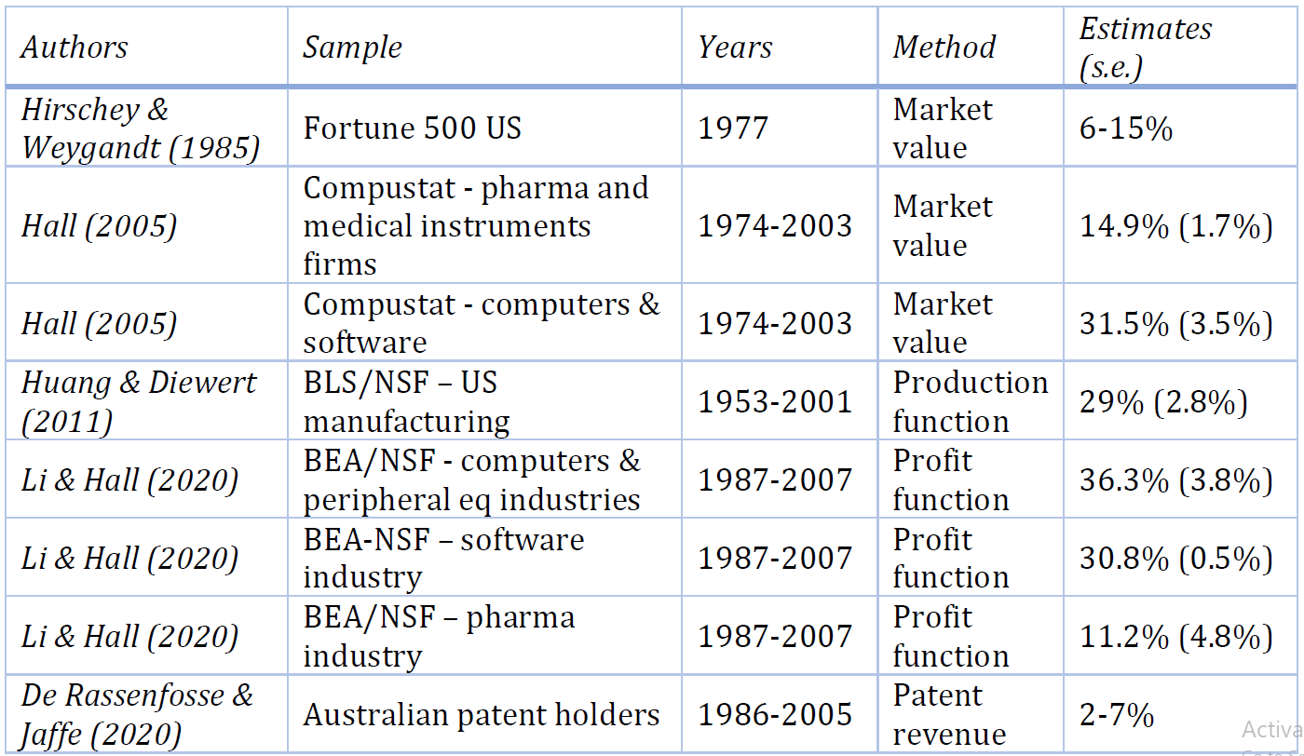
Depreciation rate estimates

Slide 22
Double counting of R&D
Double counting of R&D inputs occurs because labor and capital expense in R&D expenditure is also included in labor and capital itself.
Share of R&D spending on tangible capital is small (≈10%), capital generally expensed directly and not included in capital stock.
Main problem is labor, because majority of R&D spending labor-related (R&D employees usually well-paid compared to the rest of the firm).
Double counting leads to downward bias in estimated R&D coefficient of 25%-85% (Schankerman 1981).

Slide 23
Omitting others' R&D in estimation
If there are R&D spillovers from one firm to another, a productivity regression that includes only a firm's own R&D will overestimate the returns to R&D.
Need to account for spillovers in the estimation of returns to R&D, but spillovers (in principle) unobservable.
Correction requires some more explicit model of how spillovers contribute to firm's own R&D.

Slide 24
Price deflation
Output is often sales, possibly deflated by a single deflator that does not incorporate much quality change.
Define Y as quantity of real output and P as the price of each unit. Sales S is the product of price and quantity S = PY.
Rewrite production function:
$$s_{i}=y_{i}+p_{i}=a+αc_{i}+βl_{i}+γk_{i}+ε_{i}$$
Estimated $γ$ is sum of two effects:
$$\hat{γ}=\frac{∂s_{i}}{∂k_{i}}=\frac{∂y_{i}}{∂k_{i}}+\frac{∂p_{i}}{∂k_{i}}$$
$\frac{∂p_{i}}{∂k_{i}}<0$: R&D may lower price of a constant quality output (demand increases).
$\frac{∂y_{i}}{∂k_{i}}<0$: R&D increases the quantity produced holding capital and labor constant (efficiency gain)
Revenue elasticity with respect to R&D captures both effects: increase in demand due to quality improvement and fall in cost due to efficiency gains.

Slide 25
Price deflation
If quality-adjusted prices, interpretation of response of sales to R&D:
$\frac{∂s}{∂k}$= sales impact = return to the firm
$\frac{∂y}{∂k}$ = real output impact = partial “social” return
$\frac{∂p}{∂k}$ = price impact = benefit to consumers
This breakdown at the firm level does not measure true social returns, because it ignores knowledge spillovers.

Slide 26
Hedonic prices and welfare
Hedonic prices: prices of characteristics that customers care about when they purchase a good or service.
Each characteristic has a market price that is the result of a market equilibrium between demand by heterogeneous customers and the cost of supplying each characteristic.
Hedonic prices are measured using econometric regression: prices of goods are regressed on their characteristics.
Estimated coefficients from such a regression are the implicit price of the characteristic in the market.
Estimated coefficients allow predicting the price of a newly introduced good using its characteristics.

Slide 27
Hedonic prices and welfare
Hedonic price index based on change in prices of the same characteristics from period to period and aggregating them using weights that reflect the shares of the individual goods in the market.
Popular application: (residential) real estate, where each residence has a fairly unique combination of characteristics such as number of rooms, square footage, bathrooms etc.
Another application: market valuation of firms as a function of their assets.

Slide 28
Hedonic prices and welfare
Example: hedonic measure of quality change.
A conventional light and heating price index is a weighted average of the prices of various inputs, with weights w that add up to one:
$$p\left(t\right)=p_{1}\left(t\right)w_{1}\left(t\right)+p_{2}\left(t\right)w_{2}\left(t\right)+…+p_{n}(t)w_{n}(t)$$
n prices p are things such as:
per gallon fuel price;
an electricity Kwh price;
the price of a 60 watt light bulb;
A hedonic (quality-adjusted) light and heating index has the same form, with weights s:
$$q\left(t\right)=q_{1}\left(t\right)s_{1}\left(t\right)+q_{2}\left(t\right)s_{2}\left(t\right)+…+q_{m}(t)s_{m}(t)$$
m prices q are the prices of things such as:
raising the temperature in the house one degree;
1000 lumen-hours of light;
operating a TV or other viewing device 2 hours a day;
The qs are the prices of the characteristics that consumers actually care about, and whose quality is constant over time.

Slide 29
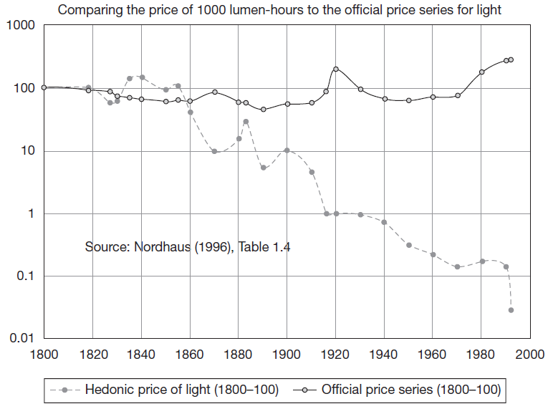
Price index of 1000 lumen-hours of light (Nordhaus, 1996)
If lighting was 1% of household budget over the 192 years, real wage and output growth have been underestimated by 0.036% per year, approx. 9% of real wage (note log scale).

Slide 30
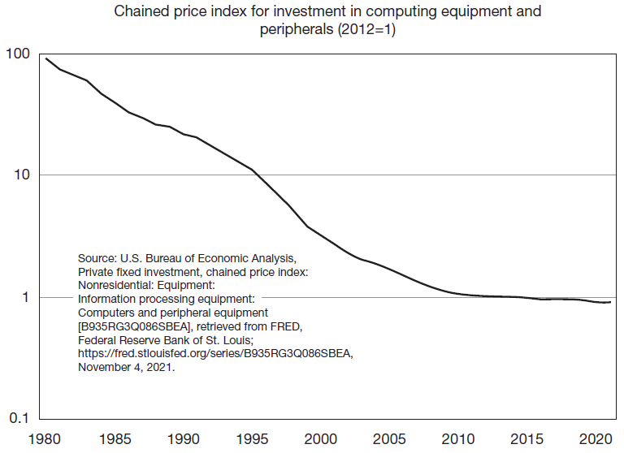
U.S. price index for computers
Illustration of the extent to which quality-adjusted computer prices fell between 1980 and about 2012 – a factor of 100!
A manifestation of Moore’s Law, which has now slowed down.

Slide 31
Using market value to value R&D
Measuring returns to R&D difficult because uncertain and in the future.
Rely on financial market theory to construct a valuation method based on the stock market value of the firms that invest in R&D (Griliches 1981).
Financial economic theory says that the price at which a firm trades is the market's estimate of the present discounted value of the dividends that will be generated by its current assets, both tangible and intangible, assuming optimal investment paths in the future in an expected value sense.
If one knows the quantity of these assets held by the firm, one can infer the marginal value (shadow price) placed on each of the asset types using a hedonic regression of stock market value as a function of the quantity of the various assets held by a set of firms.

Slide 32
Using market value to value R&D
Tobin (1969): shadow price q for physical capital is a signal for investment:
When q is greater than unity, the value of assets is higher than their cost, and firms should invest to bring q towards unity.
When q is less than unity, the value of assets is lower than their cost, and firms should disinvest.
Griliches and others used this approach to estimate the marginal value of innovation assets such as R&D capital and the stock of patents:
$$V=q{(A+γK)}^{σ}$$
where V denotes market value, A physical capital, K R&D, $σ$ is a scale coefficient near unity, $γ$ premium or discount applied to knowledge assets.

Slide 33
Using market value to value R&D
Taking logarithms of both sides and adding a disturbance to accommodate any errors in the relationship:
$$logV_{i} =logq+σ\log\left(A_{i}+γK_{i}\right)+ε_{i}$$
$$=logq+σlogA_{i}+σ\log\left(1+γK_{i}/A_{i}\right)+ε_{i}$$
$$≅logq+σlogA_{i}+σγK_{i}/A_{i}+ε_{i}$$
Test assumption of constant proportionality between market value and size measured by capital:
$$logQ_{i}=\log\left(\frac{V_{i}}{A_{i}}\right)≅logq+\left(σ−1\right)logA_{i}+σγ\frac{K_{i}}{A_{i}}+ε_{i}$$
The coefficient of $logA_{i}$ will be zero if V and A vary proportionally across firms.
Q is measured as the empirical ratio of the total market value of the firm V to the estimated replacement value of its tangible assets A.

Slide 34
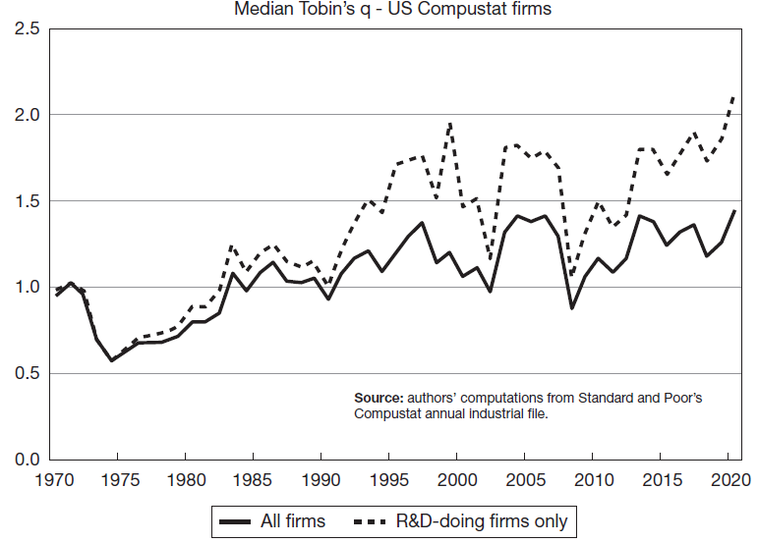
Evolution of Median Tobin's q - U.S. publicly traded firms

Slide 35
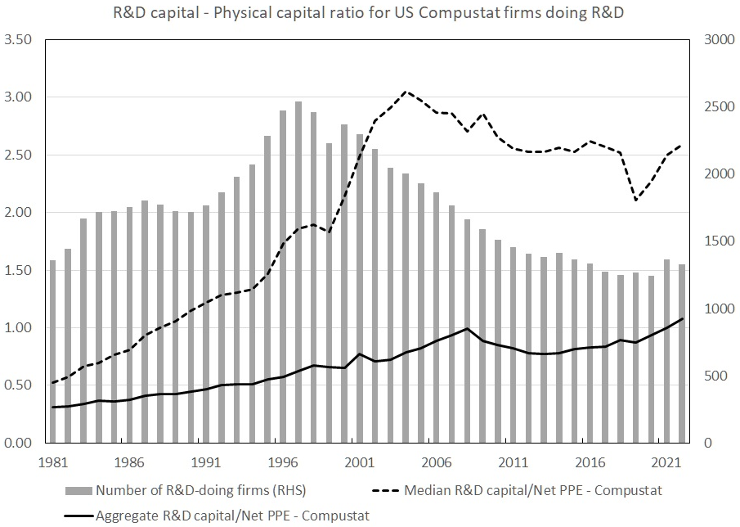
R&D capital to Net physical capital ratio for US public firms

Slide 36
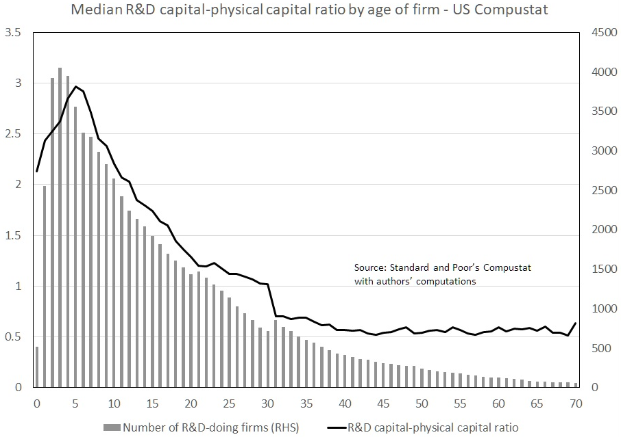
R&D capital to Net capital ratio by age of firm
Illustrating that younger firms are more R&D-intensive than older firms.

Slide 37
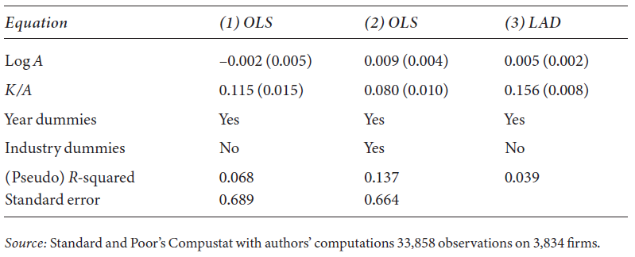
Estimates of a market value equation for U.S. firms 2000-2020
Assumption of constant returns to tangible capital ($σ=1$) accepted.
R&D capital enters significantly and has a coefficient equal to 0.11-0.15, less if we control for the industry of the firm.
Robust (LAD) estimate is significantly higher than the OLS estimate, suggesting the presence of outliers in the sample.

Slide 38
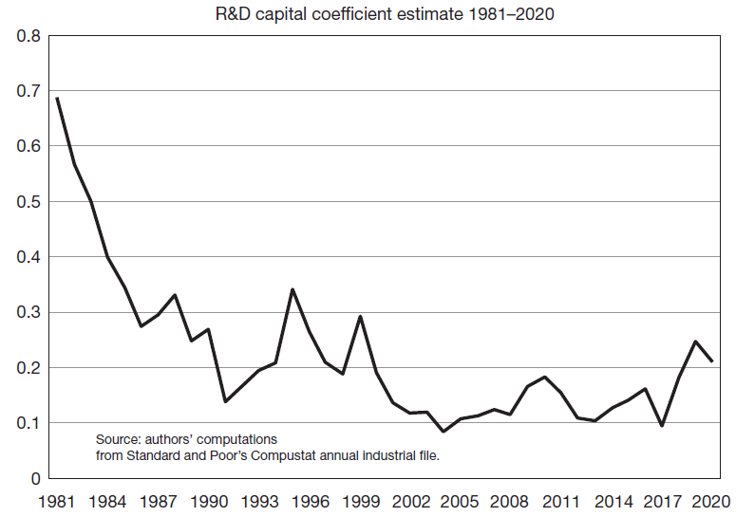
Historical evolution of the R&D capital value in the U.S.
In the early 1980s, market was signaling that doing and reporting R&D was valuable.
As a consequence, many firms entered and drove the coefficient down to a level closer to or below the share of R&D capital in firm value.

Slide 39
Summary
Measuring returns to R&D and innovation is challenging.
Analogy to ordinary physical investment imperfect, R&D generates a knowledge capital that benefits others besides those who own it.
Some of the knowledge generated is tacit and held by the more highly educated employees of the firm, which may allow them to capture some of the returns in the form of higher wages.
Lack of robust secondary markets for the output of R&D investment means that measuring depreciation is very challenging.
Important differences between social and private rates of return.
Private returns are subject to the discipline of financial markets and the cost of capital, the same is not true of social rates of return.

