Slide 1
Chapter 7 Diffusion
Bronwyn H. Hall & Christian Helmers

Slide 2
Overview
Models of innovation diffusion – the S-curve
Factors affecting the diffusion of innovation
Diffusion of network goods and GPTs
Network externalities in diffusion
Empirical evidence on diffusion

Slide 3
Introduction
Why do innovations spread? Or not?
How fast do innovations spread?
What factors explain the different rates at which innovations spread?
What factors explain the rates at which different firms adopt innovations at different times?
What factors determine the speed with which a firm substitutes new for old techniques?
Important for policy, innovation management, marketing etc.

Slide 4
Introduction
Adoption necessary for an innovation to have impact on economic growth and welfare.
Process by which adoption takes place: diffusion.
Most important step in the path from an idea to realization of its full benefits.
Diffusion typically follows s-curve when the cumulative share of adopters is plotted versus time.
Diffusion of network technologies particularly challenging due to increasing returns from adoption.

Slide 5
Introduction
Diffusion: the spread of an innovation throughout the economy or the relevant set of potential users.
Technology adoption: the choice to acquire and use a new invention or innovation.

Slide 6
The s-curve for diffusion
S-curve: displays the rate of diffusion of a particular technology in a population of potential adopters.
Resembles a cumulative logistic distribution.
Shows share of population of potential adopters that have adopted a new technology versus the time since the introduction of the technology.
Typical pattern: trending upward slowly, gradually becoming steeper as the technology spreads rapidly, and eventually flattening out because there are fewer and fewer potential users that have not already adopted the new technology.
Often diffusion is less than complete, s-curve reaches its limit somewhere below 100% adoption.

Slide 7
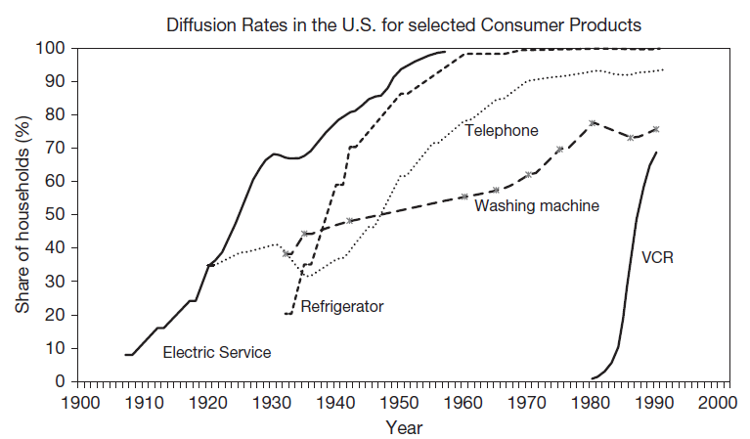
Diffusion of major consumer inventions in the U.S.

Slide 8
Models of the s-curve
Two models can generate the simple s-curve:
Benefits of the new technology vary across potential adopters and cost of adoption falling over time.
Based on an epidemic model of information spread among potential adopters, who may be identical in their tastes.

Slide 9
Heterogeneous consumer tastes
Benefits B of adoption have a normal distribution (could be generalized).
Costs of adoption decline monotonically at rate b over time and are the same for all potential adopters: C(t) = a – bt
Consumers will adopt when their benefit is greater than the cost of adoption.
At any time t, share of those that have already adopted are those with B > a – bt
Because a-bt is a monotone decreasing function of t, we can write the share of adopters at time t* as $Φ(t^{∗})$, where $Φ(∙)$ denotes the cumulative normal distribution function.
t* is equal to (a - B*)/b.
Normally distributed benefits and declining costs imply an s-curve that has the shape of the cumulative normal distribution.

Slide 10
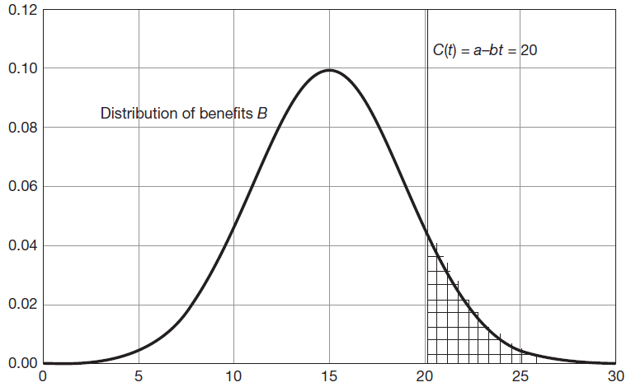
Benefits and cost of technology adoption

Slide 11
Heterogeneous consumer tastes
For the model to be relevant, support of benefit and cost distributions must overlap.
If benefit distribution lies below minimum cost, no one will adopt.
If benefit distribution lies entirely above the maximum cost, everyone will adopt instantaneously.
Truncated results also possible, if benefit for some consumers never exceeds even the lowest cost, no full adoption, s-curve will asymptote at a value <1.
If technology introduced at a cost below benefits for a share of consumers, s-curve will start above zero, assuming adoption by such consumers is nearly instantaneous.

Slide 12
Epidemic model
No heterogeneous consumer tastes or willingness to pay.
Assumes adoption spreads throughout the population as consumers encounter those who have already adopted and learn of the advantages of the new technology.
Initiated by small number of consumers who adopt early and then encounter the remainder randomly.
All (or a share) of those contacted adopt.
Eventually enough people have adopted so that few of those contacted randomly have not already adopted, and the process ends.

Slide 13
Epidemic model
N potential users of new technology.
At time t, $n_{t}$users have already adopted the technology.
${N−n}_{t}$ that have not yet adopted encounter the users and learn about the technology with a probability equal to a constant $β$ times the share of users that have already adopted $n_{t}/N$.
Rate of change of adoption:
$$dn_{t}=β\left(\frac{n_{t}}{N}\right)\left(N−n_{t}\right)dt$$
$$\frac{dn_{t}}{N}=β\left(\frac{n_{t}}{N}\right)\frac{\left(N−n_{t}\right)}{N}dt$$
which is a differential equation with the solution:
$$\frac{n_{t}}{N}=\frac{1}{1+exp\left(−\left(α+βt\right)\right)}$$

Slide 14
Epidemic model
Cumulative share of adopters at time t on the left hand side and version of the cumulative logistic function on the right hand side.
$α$ is a constant of integration (initial number of users).
Setting t to zero:
$$α=log\left(\frac{n_{0}}{N−n_{0}}\right)$$
Compute the mean and variance of t, the time of adoption, using the known characteristics of the logistic:
Mean(t)$=−α/β$
Var(t)$=π^{2}/3β^{2}$
$β$ describes the dispersion of the time of adoption.
Mean is proportional to $α$, scaled by dispersion parameter $β$.

Slide 15
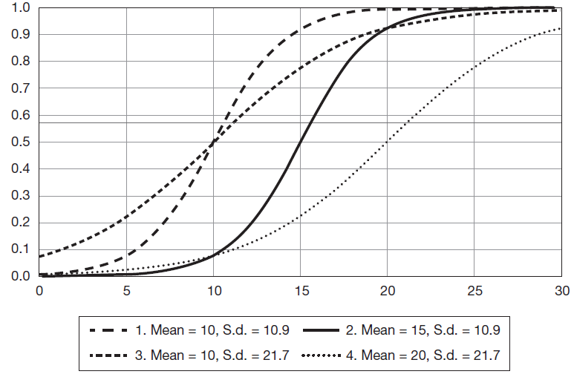
Epidemic model
Illustration of some s-curves for adoption with various means and standard deviations of the adoption time.
Note that for the logistic or for any symmetric distribution, the mean and median coincide, so at the mean, half the population has adopted.

Slide 16
Adoption as investment under uncertainty
Decision to adopt involves uncertainty.
Potential adopter compares upfront cost with an uncertain stream of future benefits.
Upfront costs are sunk, and decision cannot be reversed without additional cost.
Decision not “adopt or do not adopt” but instead “adopt now or wait to decide whether to adopt later.”
Model adoption decision as real options model (similar to Dixit and Pindyck (1994) for investment under uncertainty).

Slide 17
Adoption as investment under uncertainty
A financial option is a contract which grants its owner the right, to buy or sell an underlying asset at a specified strike price on or before a specified date.
There is no requirement that the owner exercise this right.
Real options are those where the asset is real (tangible investment).
In adoption setting, no contract, only option to adopt a new technology at any point in time at an uncertain price and whose payoff is uncertain.
Real options are often evaluated using a decision tree with two choices at every branch (adopt or not) and a value of each branch computed by looking forward down the tree.

Slide 18
Factors affecting diffusion
Diffusion of innovation has same broad determinants as innovation itself:
Demand for the new technology
Cost of adopting new technology
Level of uncertainty, availability of information (not only on how well technology works but also its use/applications)
Network externalities
Market structure
Cultural and social determinants
Regulatory and institutional environment
Competition from old technologies
Invention during diffusion process in the form of tweaking and adaptation.

Slide 19
Factors affecting diffusion
Benefits of adoption of a new technology depend on:
Perceived improvements it offers in consumption or industrial use.
Closeness of potential substitute technologies, either new or those in prior use.
Extent to which new technology supported by a network (about which more in a moment).
Availability of complementary goods (e.g. tools, worker skills), maintenance services.

Slide 20
Factors affecting diffusion
Costs of adoption of a new technology depend on:
Price of new technology.
Cost of financing the necessary investment.
Switching costs from the previous technology.
Because technology adoption largely fixed cost, scale of potential use affects adoption.

Slide 21
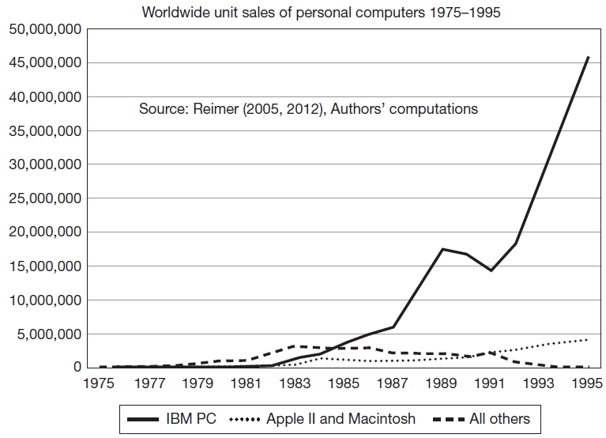
Worldwide sales of PCs
Illustrates the importance of a large sponsoring firm in the early PC industry for the adoption choice.

Slide 22
Network goods and standards
Network goods: technology whose value to one user depends on use by others.
Generate network externalities that lead to increasing returns.
Often require standards and coordination.
Two types:
Direct networks: Communications networks such as telephone, fax, email, messaging systems - the value to a user depends on with whom they can communicate.
Indirect networks: Virtual networks created by “hardware/software” systems - the value depends on the number of other users because the existence of more users means more software available due to economies of scale in providing such “software’”.

Slide 23
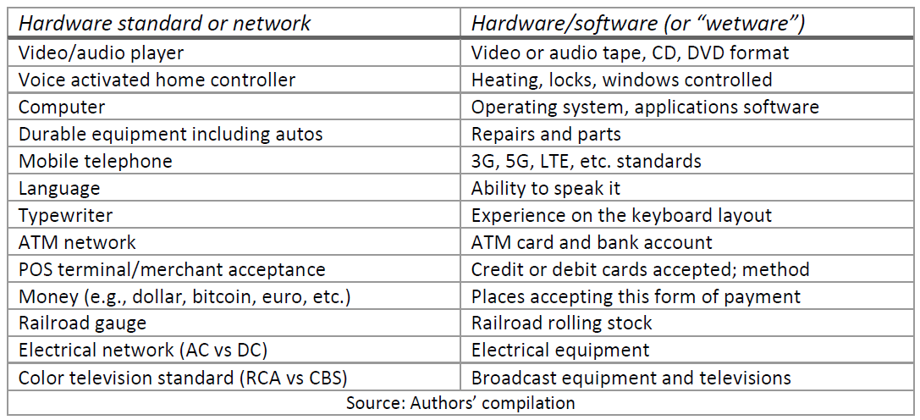
Hardware/software/wetware networks

Slide 24
General purpose technologies and standards
Use of electricity in homes needed even further investments:
Construction of a network to deliver the electricity.
Education of the consumer, given the apparent new danger of electrocution when misused.

Slide 25
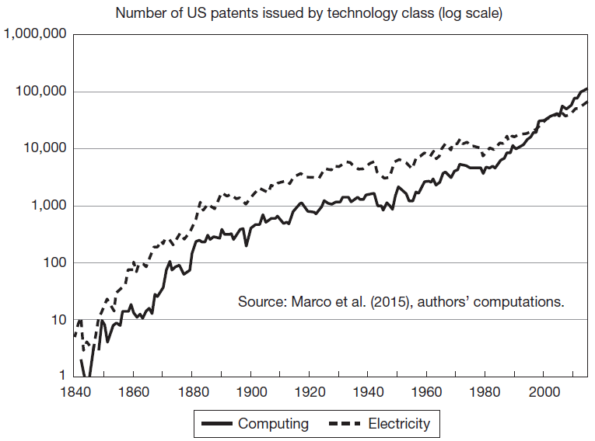
Trends in electrical and computing patenting 1840-2014
Illustrates the similarity of technology development in electrical and computing technology over time.
Both are GPTs that take a long time to fully develop and be widely adopted.

Slide 26
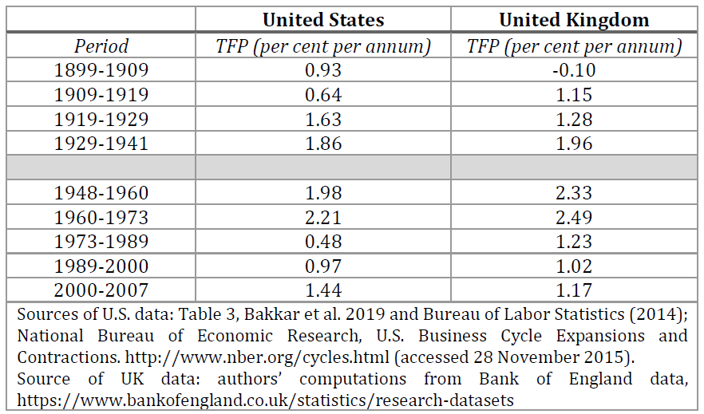
Slow diffusion and productivity slowdown
Slow diffusion of new general purpose technologies results in slow rate of productivity growth.
Some changes not reflected in conventional productivity statistics.

Slide 27
Network externalities and diffusion
Adoption rates for Pareto-improving standards (technologies) can be too slow (excess inertia):
One technology has a large installed base and early adopters of the other bear too large a share of the switching costs.
A new technology is unattractive with few users.
A new technology’s advantage is positive, but relatively small.
Adoption rates might be too fast (excess momentum):
If users are heterogeneous, the first adopters are those who like the new technology and ignore their negative effects on the users of the old technology.
The network advantage is not that large so both technologies survive.
The older technology has a small installed base, so switching costs are low.

Slide 28
Network externalities and diffusion
Better technology may not win network competition.
Small historical accidents at the outset can tip adopters to choose a standard that later users perceive as non-optimal (examples: QWERTY keyboard, VHS vs Betamax, DVD vs Blu-ray).
Path dependence: the dependence of economic outcomes on the path of previous outcomes, rather than simply on current conditions, leading to situations where “history matters.”
Lock-in: form of economic path dependence whereby the market selects a technological standard and because of network effects the market gets stuck with that standard even though market participants may have been better off with an alternative.

Slide 29
Modelling competing networks
Assume two technologies A and B and two groups of potential adopters R and S.
R-agents prefer A and S-agents prefer B.
Agents care about the number of prior adopters of a technology when they make their choice.
Choices are made in sequence, one at a time.

Slide 30
Modelling competing networks
Assume that R and S agents arrive in a random sequence with a probability that the next agent will be an R equal to 50%.
An R-agent chooses A if $a_{R}−b_{R}+r\left(n_{A}−n_{B}\right)>0$
$a_{R}−b_{R}$ positive by assumption
Decision depends on $r\left(n_{A}−n_{B}\right)$
Similar argument applies for S-agents
If r = s = 0 (constant returns; users do not value relative size of network), R always chooses A and S always chooses B.
Given a choice order probability of 0.5, in the long run, both A and B technologies survive with 50% market share each.
If both r and s are positive, implies increasing returns to network size.
Define ${n=n}_{A}+n_{B}$ to be the number of choices already made and $d_{n}=n_{A}−n_{B}$ to be the difference between A and B choice given n.

Slide 31
Modelling competing networks
Newly arrived R-agent chooses B even though they prefer A if:
$$d_{n}<\frac{b_{R}−a_{R}}{r}<0$$
Newly arrived S-agent chooses A even though they prefer B if:
$$d_{n}>\frac{b_{S}−a_{S}}{s}>0$$
With increasing returns to adoption, tipping point reached after which everyone will choose one of the two technology alternatives.
Not possible in general to predict which technology will prevail and outcome will depend on the random arrival rates of agents with different preferences.

Slide 32
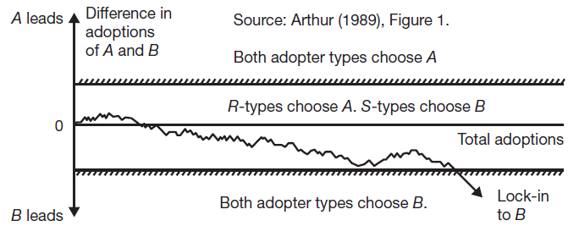
Modelling competing networks
Bounds are given by expressions involving the technology advantage and the value placed on the network size:
upper bound (A preferred): $\left(b_{s}−a_{s}\right)/s$
lower bound (B preferred): $\left(b_{R}−a_{R}\right)/r$
The higher the value placed on network size by the potential adopters, the tighter are the bounds and the sooner tipping into lock-in will happen.

Slide 33
Empirical estimation
Natural model for estimating the determinants of adoption is a failure time or hazard rate model, which describes the probability at a point in time that an agent will adopt the new technology, given that they have not yet adopted:
$$h\left(t\right)=\frac{f(t)}{(1−F\left(t\right))}=\frac{\# adopt at t}{\# not yet adopted}=hazard rate$$
where f is a density function of t and F is the corresponding cumulative function.
The most widely used version of the model is the Weibull, which allows for an increasing (α>1), constant (α=1), or decreasing (α<1) hazard rate:
$$F\left(t\right)=1−exp⁡(−γt^{α})$$
$$h\left(t\right)=γαt^{α−1}$$
A typical estimation approach is to parametrize γ as a regression function of the determinants of adoption or diffusion.

Slide 34
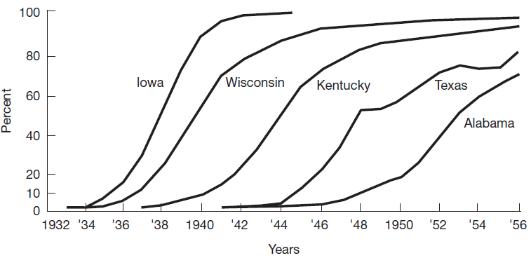
Diffusion of hybrid corn technology in the U.S. (Griliches, 1957)
First empirical diffusion paper used potential market size, the cost of adapting the technology to the geography, expected profitability to explain the differences in these curves.

Slide 35
Summary
Diffusion is the way the benefits of new technology reach society.
Diffusion can be slow due to a number of factors:
Uncertainty over the benefits and costs.
Need for complementary investments by the adopter.
Need for standards to make it useful if there are network effects.

Slide 36
Summary
Empirical work studying the factors affecting diffusion has confirmed that profitability and other financial factors, firm concentration and size, complexity, customer relationships, worker skill and education, uncertainty, and the network nature of the technology all affect its diffusion.
Technological standards are specifications of functions and the way they must be performed, or of the input/output parameters.
Network goods are goods whose value to one user depends on use by others.
Network externalities are the benefit or cost conferred on others when an individual chooses to purchase a network good.

