Slide 1
Chapter 8 Innovation Strategy
Bronwyn H. Hall & Christian Helmers

Slide 2
Overview
How firms create and capture value from innovation
Strategic goals for value creation and appropriation
Characteristics of different research strategies
Open innovation
Make or buy? …or collaborate?
Network effects and innovation strategy
Strategies for network competition

Slide 3
Introduction
Innovation strategies help to create value for the firm.
What is the “best” innovation strategy for firms and individuals?
How should an innovative firm structure its R&D efforts?
Broadly speaking, differences between established firms and start-ups imply different types of innovation:
Established firms: incremental (builds closely on prior technology).
Start-ups: radical (entirely new combinations of knowledge).
Increased importance of platform technologies creates new challenges for innovation strategy.

Slide 4
Value creation and strategic goals
Objective of innovative activity: value creation.
Describes act of innovating a product/service that provides benefits to customers large enough that they are willing to pay more for the innovative good than it costs to make.

Slide 5
Value creation and strategic goals: established firms
Innovation determined by threats and opportunities in firm’s environment:
Threats: new entrants, existing competitor, technological paradigm shift.
Opportunities: technological trajectory.
Sources of sustainable competitive advantage (sources of rent) help determine direction of innovation:
Brand recognition, distribution network, customer list, loyalty programs.
Example: Amazon’s successful innovation in delivery of books, suggested expansion into delivery of other products using their existing shipping system.
Incremental innovation reinforces existing core competencies.

Slide 6
Value creation and strategic goals: start-ups
Main asset: idea.
Usually in search for competitive advantage.
Goal to create new industry, new niche in existing industry, or replace existing firms with better technology.
More likely to succeed if
innovation radical,
upsets existing business models,
architectural innovation - “reconfiguration of an existing system to link components in a new way” - that can make an entire system obsolete.

Slide 7
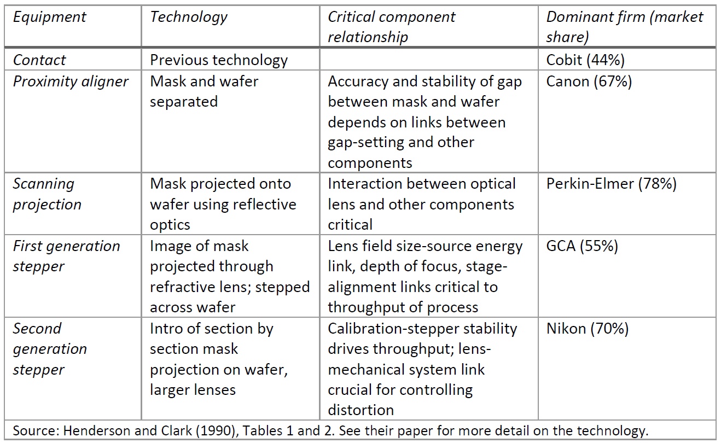
Architectural innovation in Photolithographic Alignment Technology in the 1980s

Slide 8
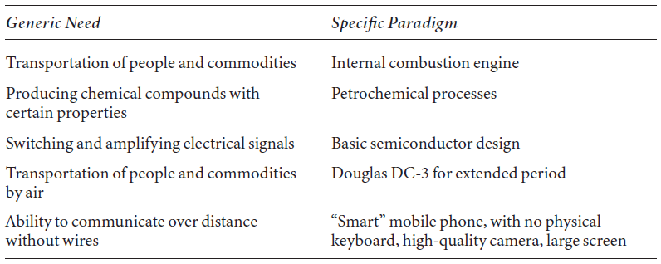
Value creation and strategic goals: Lessons from industry evolution
Transformation of a generic need for innovation to a specific paradigm.
Lots of experimentation (mainly by start-ups) following radical innovation, ultimately dominant design or paradigm emerges and incremental innovation takes off because technological trajectory has become clearer.

Slide 9
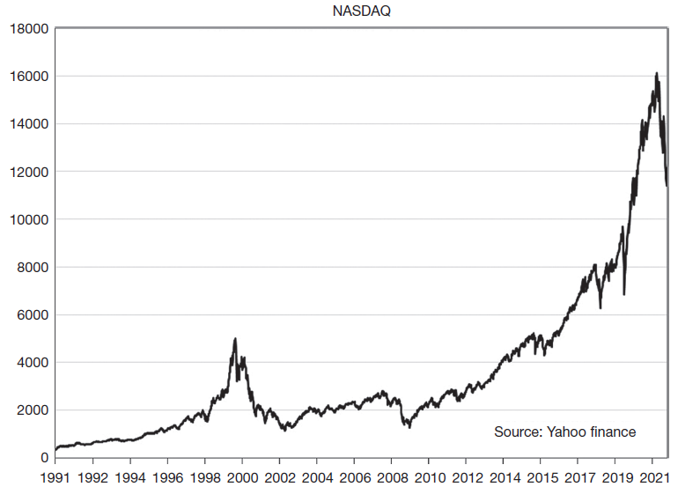
NASDAQ and the development of the internet
Illustrates the value creation associated with the diffusion of the internet and the development of complementary innovations.
Note that the 2000 dotcom boom is just a blip on this graph.

Slide 10
Value capture
Value created by innovation needs to be captured as profits.
Value capture: ability of firm to obtain some of benefits of innovation via pricing above cost.
Also referred to as appropriability.
Value capture through formal and informal appropriation methods:
Formal: intellectual property.
Informal: secrecy, first-mover advantage, better sales and service etc.

Slide 11
Value capture: complementary assets
In areas with weak appropriability, possession of specialized assets necessary for exploiting innovation enables subsequent entrants to capture value of innovation (Teece, 1986).
Complementary assets: assets whose value when combined with an innovation is greater than their stand-alone value.
Example: for social media firms, database of user information useful in adding value via advertising (also hard for entrants to replicate).
Most innovations require other investments to be commercialized: manufacturing, marketing and distribution, after-sales service etc.

Slide 12
Value capture: complementary assets
Types of complementary assets:
Generic (e.g. manufacturing establishment for running shoes)
Specialized (e.g. drug distribution system)
Co-specialized (e.g. containerized shipping)
In weak appropriability contexts with dominant design:
Generic asset investments reversible and easily imitated, generate no rents.
Specialized assets necessary for exploitation of innovation, generate rents.
Examples: commercialization of university inventions and independent inventors.

Slide 13
Research strategy
How much (basic) research should a firm undertake?
Especially relevant for research with wide and uncertain application:
Associated spillovers
Uncertain appropriation
Long-term pay-off
Basic research conducted by large, established, diversified multi-product firms with market power (IBM, AT&T before divestiture, DuPont, Dow Chemical, Eastman Kodak, Alphabet, Microsoft, etc.):
More likely to benefit from long-term pay-off
First-mover advantage
Basic research can solve applied problems
Biotechnology sector is an exception, discoveries closer to commercialization and patents very effective protection, so less need for size.

Slide 14
Open innovation
Shift towards use of knowledge external to the firm.
Open innovation strategy: “a paradigm that assumes that firms can and should use external ideas as well as internal ideas, and internal and external paths to market, as the firms look to advance their technology” (Chesbrough, 2006).
Empirical evidence suggests that innovation from external sources is important for innovating firms.
But assimilating ideas and inventions requires effort and management.
Open innovation often managed via use of proprietary systems, e.g. patents.

Slide 15
Make or buy?
Make or buy new technology needed to pursue particular strategic choices?
Purchase of new technology often in form of purchase of firm that owns it.
Acquisitions can be difficult to assimilate within existing firm; risk loss of human capital from acquired firm via exit of key employees.
Factors influencing decision:
Importance of speed if technology exists externally but would have to be developed in-house.
How closely linked it is to the firm’s own core competencies.
IP rights associated with technology
Large firms tend to combine external and internal knowledge acquisition strategies, small firms tended to specialize in one or the other (Cassiman and Veugelers, 1999).

Slide 16
Transaction cost theory (Williamson 1979)
Transaction cost theory: costs surrounding a transaction determine whether it takes place within firm or is transacted in market.
Assumptions:
Contracts incomplete, need for renegotiation over time.
Uncertainty surrounding the transaction process and outcome.
Need for one of the parties to make sunk investment in transaction-specific assets.
Creates incentives for opportunistic conduct.
Insight: transaction that is more at risk of opportunistic conduct is more likely to move inside the firm to align interests of both parties.
Application to innovation: most R&D conducted in-house.

Slide 17
Or collaborate?
Alternative option: collaboration via
Strategic alliance
Joint venture
Technology licensing
Collective research organization
Advantages:
Increased flexibility
Speed
Risk sharing
Knowledge exchange
Create new knowledge that would have been difficult to create solo
Disadvantages:
Value capture challenging
Firms potentially reluctant to reveal the most valuable part of their knowledge to collaborator, reducing effectiveness of collaboration

Slide 18
Goods with network effects Static analysis
In static analysis of market with network effects, network effects do not create network externality.
Example: many non-integrated firms competitively supplying hardware and software.
If customers myopic (do not evaluate future supply of software for their hardware choice), one consumer’s purchase decision has no effect on another consumer’s welfare.
No network externality, normal market with complementary goods.

Slide 19
Goods with network effects Dynamic analysis
Technology adoption decision depends on expectations about other people's future decisions.
Creates network externality where one person’s demand increases if another person purchases the technology.
Consumers’ expectations of network size matter.
Consumer has multi-period purchase decision (with varying quantity across consumers).
Example hardware and software:
Consumers choose hardware in first period and are then “locked-in” via sunk costs.
Quantity of hardware sold in first period signals future price of software (larger hardware base implies lower marginal cost, lower price, and greater variety of software).
Linkage increases elasticity of demand for hardware and results in indirect network externality.
Network externalities in systems competition can lead to underutilization and delayed adoption if consumers fear lock-in and wait for winning hardware.
Ex post markets subject to consumer lock-in (e.g. Fortran in mission-critical applications).

Slide 20
Goods with network effects Competition among systems
When standards are important to consumers, competing systems with different standards behave like network goods.
When market share of a competing system gets large, increased consumer demand leads to increasing returns effect.
Results in intense competition among systems manufacturers.
Success of any system strongly influenced by consumers' adoption decisions, which depend on their expectations of which system will win.
But consumer heterogeneity and inertia will limit standardization.

Slide 21
Goods with network effects Game theoretic analysis
Simple two player game between producers of a network good that requires standards.
2 forms of payoff matrix: one that leads to incompatibility and one that leads to compatibility.
Incompatibility can arise when consumer taste is sufficiently differentiated or lock-in is sufficiently strong.

Slide 22
Goods with network effects Game theoretic analysis
Incompatibility: no dominant strategy
If firm 1 chooses standard 2, firm 2’s best response is standard 1.
If firm 2 chooses standard 1, firm 1’s best response is standard 2.
2 Nash equilibria: (1,2) and (2,1).

Slide 23
Goods with network effects Game theoretic analysis
Compatibility: no dominant strategy
If firm 1 chooses standard 1, firm 2’s best response is standard 1.
If firm 2 chooses standard 2, firm 1’s best response is standard 2.
2 Nash equilibria: (1,1) and (2,2).

Slide 24
Goods with network effects Game theoretic analysis
Outcome of competition between two competing standards (systems) depends on whether firms prefer incompatibility or compatibility.
Incompatibility is more likely when:
Firms are similar in size and market share;
Standards battle does not delay adoption too much;
Product differentiation gives each one some market power.
Compatibility is more likely when:
Demand depends greatly on having a single standard;
Standards battle will dissipate too much in the way of profits.

Slide 25
Strategies for network competition: To induce adoption
Firms need to signal to consumers that they will not be stranded with a defunct network.
Example: if firm owns both hardware and software, network effects internalized and hardware price can be lowered to induce purchase (e.g. Nintendo, Sega, Atari).
Hardware only firm can use penetration pricing for hardware with discounts to early adopters, or rent hardware rather than selling.
Signal survival by means of reputation, advertising, sunk costs of investment in system (e.g. IBM’s entry in PC market).
Second sourcing (e.g. open source software in computer industry)

Slide 26
Strategies for network competition: To create or break lock-in
Induce lock-in of consumers through switching costs:
Contracts for service or parts
Costs of data conversion (proprietary data formats)
Loyalty and preferred customer programs
Break lock-in of consumers to encourage adoption:
Rebates to buyers turning in old equipment or competitive upgrades
Free training in the new standard
Provision of “gateway technology”

Slide 27
Summary
Goal of firm-level innovation is value creation and capture.
Strategy involves understanding where an industry is in its life cycle, and whether a firm is a startup, young, or established.
Established firms need to learn to adapt to radical and architectural inventions and to understand their implications for organization of own research.
Start-ups capture value from radical and architectural innovation through appropriation in the form of IP and complementary assets.
Different technologies may favor different make or buy or collaborate decisions.
Platform technologies require choosing level of compatibility with other platforms and ensuring platform survival.

