Slide 1
Insurance in Indian Country
Gregory S. Arnold, Esq., JD, LL.M (Insurance Law)
Tribal Association of Insurance Commissioners International, a corporation under tribal law
(509) 212-5311
GregArnold@TAIC.Online

Slide 2
“I…predict…insurance is next.”
Lance Morgan – CEO, Ho-Chunk, Inc. and co-founder of Big Fire Law & Policy Group, LLP
“Wiring The Rez” Native Business Conference, 02-01-2019, Chandler, AZ.

Slide 3
“I just do things to get then done, and I never, ever, give up!”
Chief Enoch Kelly Haney, The Gathering Business Summit 2019, Durant, OK.

Slide 4
Focus
FOR TRIBES
Economic Security.
Self-Determination.
Business opportunities tribally-owned, Indian-owned, and non-Indian-owned insurance companies.
Regulation to ensure consumer confidence and ward off state intrusion where it does not belong.
FOR INDIVIDUALS
Tax planning and benefits under the Internal Revenue Code
Greater control over premiums, risks, and claims

Slide 5
My Perspective
Tribal Association of Insurance Commissioners International, Inc. (“TAIC”), a voluntary membership regulator of insurance in
Indian Country www.TAIC.online
TAIC

Slide 6
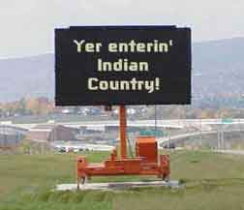

Slide 7
The Legalese:
18 U.S. Code § 1151.Indian country defined
Except as otherwise provided in sections 1154 and 1156 of this title, the term “Indian country”, as used
in this chapter, means (a) all land within the limits of any Indian reservation under the jurisdiction of the
United States Government, notwithstanding the issuance of any patent, and, including rights-of-way
running through the reservation, (b) all dependent Indian communities within the borders of the
United States whether within the original or subsequently acquired territory thereof, and whether within
or without the limits of a state, and (c) all Indian allotments, the Indian titles to which have not been
extinguished, including rights-of-way running through the same.
(June 25, 1948, ch. 645, 62 Stat. 757; May 24, 1949, ch. 139, § 25, 63 Stat. 94.)
https://www.law.cornell.edu/uscode/text/18/1151, last accessed 10-3-2019.

Slide 8
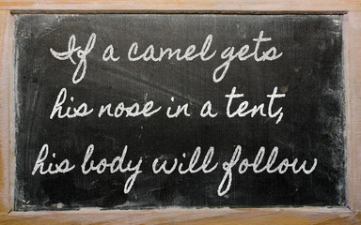
“What Day Is It?”

Slide 9
Beyond mere theory….
Working with the TAIC you can go beyond mere theory of what can be done in insurance in Indian Country. We help you to actually actively engage in the transaction of the business of insurance in Indian Country. This can be done with a humanitarian focus, leveraging the global presence of socially-conscious insurers.

Slide 10
Why is the focus Indian Country?
This is about (a) how to preserve sovereign immunity for tribally-owned insurance companies operating inside and outside of Indian Country, and about how to protect privately-owned insurance companies operating exclusively within Indian Country.
Tips on how to avoid inadvertent waiver of sovereign immunity when forming corporations and LLCs.

Slide 11
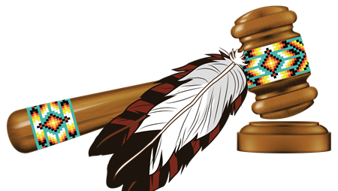
Case law….the Somerlott case.
Why tribally-owned corporations should not file corporations or LLCs under state law. Loss of sovereign immunity from suit.

Slide 12
“…no matter how broadly conceived, sovereign immunity has never extended to a for-profit business owned by one sovereign but formed under the laws of a second sovereign when the laws of the incorporating second sovereign expressly allow the business to be sued. And it doesn’t matter whether the sovereign owning the business is the federal government, a foreign sovereign, state – or tribe.”
Somerlott v. Cherokee Nation Distribs., Inc., 686 F.3d 1144 (10th Cir., 2012)

Slide 13

Wright v. Colville Tribal Enterprises Corp.
“[A] tribe may waive the immunity of a tribal enterprise by incorporating the enterprise under state law, rather than tribal law.” 147 P.3d 1275, 159 Wn.2d 108 (Wash. 2006).

Slide 14
Why is there interest in insurance companies focused on Indian communities?
Insurance that is not available elsewhere.
Examples:
1. Attorney malpractice insurance for attorneys practicing in Indian Tribal Courts
2. Title insurance for banks that issue mortgages to tribal members under HUD 184
3. Life/health/disability for tribal members in foreign countries.
Bail Bonds for defendants in Tribal Courts.
State-licensed carriers deny Indian Country claims
Benefits for tribes
Benefits for those working with tribes

Slide 15
Insurance that is too expensive elsewhere.
Workers’ Compensation insurance.
Cyber
Crime
Pandemic

Slide 16
Infrastructure of Private Insurance in Indian Country
Business Licenses; Transaction Privilege Tax License
Tribal Codes; Commercial, Corporations/LLCs; Insurance
Certificate of Authority to Transact the Business of Insurance
Insurance Commissioners or Insurance Registrars or similar titles
Dispute Resolution – Options
  Tribal Courts
  Insurance Court of Indian Country
  Other courts by agreement of the parties
Voluntary Regulators
  Tribal Association of Insurance Commissioners – www.TAIC.online

Slide 17
Types of Insurers
Primary including POICs
Reinsurer including PORCs
Captive including so-called micro-captives

Slide 18
Other Benefits of Working With a Tribal Domicile
For tribally-owned insurers, preservation of tribal sovereign immunity
More flexible and creative than state domicile’s
Companies Limited by Guarantee (“CLG”) – alternative to traditional capitalization
Some tribal domiciles have lower capitalization requirements than states
Fast turn around time
Alternative to offshore domiciles and no requirement to file forms or Section 953(d) elections with the IRS as a foreign entity
Less bureaucracy – direct line to Insurance Commissioners / Registrars
Tribally-owned insurers, for tribes with the right status, have tax, employment, and grant funding advantages. Tribal corporations create governmental revenues. Tribally-owned insurers also have socially responsible. Investing in a tribally-owned insurer has a cultural cashet.
Tribally-owned corporations in general, for tribes with the right status, have federal tax credits, such as investment tax credit (new market tax credits), Indian wages and insurance tax credits, and equipment and building accelerated depreciation.
Tribally-owned corporations in general, for tribes with the right status, have federal government contracting preferences, such as preferences on Bureau of Indian Affairs contracts (Buy Indian Act), tribal government owned corporations [8(a) Preferences], and Indian reservation-based businesses (HubZone Preferences).

Slide 19
Business Advantages of Federally-Recognized Tribes
Tribally-owned insurers, for tribes with the right status, have tax, employment, and grant funding advantages. Tribal corporations create governmental revenues. Tribally-owned insurers also have socially responsible. Investing in a tribally-owned insurer has a cultural cachet.
Tribally-owned corporations in general, for tribes with the right status, have federal tax credits, such as investment tax credit (new market tax credits), Indian wages and insurance tax credits, and equipment and building accelerated depreciation.
Tribally-owned corporations in general, for tribes with the right status, have federal government contracting preferences, such as preferences on Bureau of Indian Affairs contracts (Buy Indian Act), tribal government owned corporations [8(a) Preferences], and Indian reservation-based businesses (HubZone Preferences).
Tribally-owned corporations in general, for tribes with the right status, have subsidized financing advantages. These include incentives for foreign investors (Immigrant Investor/EB-5 Visas); tax exempt bonds (tribal economic development/TED bonds); USDA low interest loans for community facilities; USDA loan guarantee for rural businesses (Business & Industries); and BIA loan guarantees for Indian reservation projects..

Slide 20
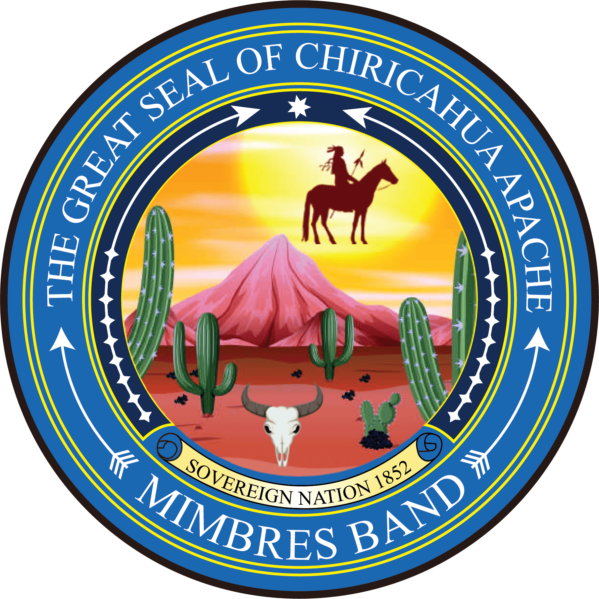
Companies Limited by Guarantee
“Corporation” or “Domestic Corporation” means a corporation for a profit subject to the provisions of this Act…”
“A corporation may be limited by capital, limited by guarantee, or a combination of both capital and guarantee.”
Chiricahua Apache Mimbres Band Nation, Corporations Act, Title 13, Section 2 (a).

Slide 21
Indian Communities With Insurance Companies Wholly-Owned by One or More Indian Communities

Slide 22
Wholly-Owned by Tribes:
Santa Ana Pueblo – AMERIND Risk
  Owned by three tribes; insureds are 400 tribal housing authorities
Mangas Insurance
  Owned by Chiricahua Apache Mimbres Band Nation
  Title insurance for mortgage loans involving trust properties
  Small auto for reservation-only vehicles
Tribal Re
  Tribal Re
  Owned by Chiricahua Apache Mimbres Ndé Nation

Slide 23
Indian Casino Insurance
Liability insurance to Indian casinos to cover injuries to casino invitees or patrons?
Tribal First
AMERIND Risk
Hudson Insurance Company
Travelers

Slide 24
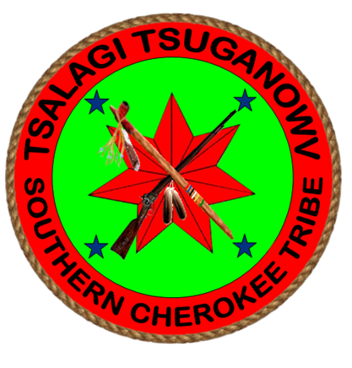
Indian Communities with Insurance Codes
Chiricahua Apache Mimbres Ndé Nation
The Southern Cherokee Indian Tribe
Others

Slide 25
Indian Communities With an Insurance Regulator
Chiricahua Apache Mimbres Band Nation
The Southern Cherokee Indian Tribe
Others.

Slide 26
More cases….
Williams v. Lee case
Warm Springs case
Treaties
Tribal Constitutions preserving sovereign immunity

Slide 27
Williams v. Lee case
“Implicit in these treaty terms…was the understanding that the internal affairs of the Indians remained exclusively within the jurisdiction of whatever tribal government existed.”
Williams v. Lee, 358 U.S. 217, 221 (1959)
Notice the lack of reference to “reservation” in this one quote.
“Essentially, absent governing Acts of Congress, the question has always been whether the state action infringed on the right of reservation Indians to make their own laws and be ruled by them.”
Williams v. Lee, 358 U.S. 217, 220 (1959)

Slide 28
Warm Springs case
“…the state has no regulatory control over the reservation…”.
Warm Springs Forest Products Industries v. Employee Benefits Ins. Co., 703 P.2d 1008, 1012 (1984)
“Because state regulation on a reservation must be expressly approved by Congress…defendant’s argument that the McCarran-Ferguson Act, 15 USC § 1012, which does not mention Indians, gave the states the jurisdiction over insurance matters involving reservation Indians is without merit.” Warm Springs, Id., at 1020.
“Because state regulatory power does not normally extend into the reservation, Oregon has no apparent interest in preserving the solvency of an insurer doing business outside of Oregon’s legislative jurisdiction.” Warm Springs, Id., at 1020-1021.

