Slide 1
Federal Fiscal Outlook
October 2019
Notes:
Thank you so much for having me today. Its an honor to be here with you today. And truly a pleasure to get out of Washington these days any chance I can get. I am COS at a non partisan, non profit called the CRFB.
Co –Chaired by Leon Panetta, Mitch Daniels, and Minnesota’s own Tim Penny – who many of you may know, and represented Minnesota in congress for several years.
I help lead a staff of about 20 in Washington where we analyze the federal budget, issue reports and analysis. We also educate and engage in legislative outreach to try and advance fiscally responsible policymaking in Washington on Capitol Hill. And we conduct extensive public outreach to raise attention to the issues, including media outreach and public education events like these to build support for our cause.
That’s what I’m doing here today and during this trip to Minnesota. A swing of a few events over a few weeks to bring more attention locally to a national issue that unfortunately doesn’t get much attention.
My plan for today’s remarks is to simplify this a bit. I find that especially in today’s political environment issues are often lost in the noise. Especially complicated issues like the budget and the national debt. So what I want to do is simplify this a bit – what I’m going to do is focus on a set of 15 basic facts about our federal outlook. Things that don’t require being an economist to understand, with the hope something resonates with you and you take that information and get involved, and share with others. So lets get started…

Slide 2
In 2019…
Total Revenue
Total Spending
$3.5
$4.4
Trillion
Trillion
(That means We will borrow ABOUT $900 billion.)
Today the Gross National Debt Is more than $22 trillion
Notes:
Fact 1 – in this fiscal year that is about to end, federal government estimated to spent approximately 4.4 trillion dollars; estimated to take in about 3.5 trillion in all forms of revenue.
Basic point – we are spending much more than we take in, to the tune of about 900 billion this fiscal year.
We have consistently spent much more than we take in, with deficits, every year since the early 2000s when we last had a budget surplus

Slide 3
Permanent Trillion-Dollar (Plus) Deficits By 2020
Billions
Source: Congressional Budget Office August 2019 Baseline
Notes:
#2 ) The annual deficit is projected to exceed 1 trillion on an annual basis next year – in 2020.
You may recall that in the heights of the great recession, we had over 1 trillion annual deficits four yeas in a row. But they then came down.
Difference here is, these deficits are projected to remain, and grow – permanently – as far as the high can see.
We will exceed size of those record annual deficits within the next 10 years.

Slide 4
Trump Entered Office With High Debt
Percent of GDP
Truman
106%
Trump
77%
Projected
Obama
Eisenhower
JFK
Clinton
Bush
Reagan
Bush
Johnson
Nixon
Carter
Ford
Sources: Congressional Budget Office, Office of Management and Budget
Notes:
#3) President Trump assumed office at a time when our debt levels were the highest they have ever been since when President Truman was in office at the end of World War II.
When people think of national debt, they often think of the over 22 trillion debt #. Real number is a debt to GDP ratio.
Using that metric, the debt to GDP is now about 79 percent of the economy. Highest ever was after World War II at 106%, and it came down after war was over.
I point out this historical fact not to blame prior administration before Trump, but rather just to put it in context of this being a problem before current political context. Because that is important context for next point…

Slide 5
Debt Levels Will Nearly Double in 30 Years
Source: CRFB Calculations Based on CBO August 2019 Baseline data
Notes:
#4) our debt levels, while already high by historical standards, are projected to double over the next 30 years.
Today, our debt as a percent of economy is about 79 percent. It will rise to 95 percent in 10 years. Exceed the record level by 2035 timeframe.
BUT, that is based on current law projections. Meaning on statutes written into law.
If you do a projection based on what may happen if policymakers continue current policies (i.e. extend tax cuts instead of let expire) its much worse.
Exceed the record in about 10 years. 200 percent o f the economy by 2050.

Slide 6
Self Inflicted Harm
Billions
$535B
53%
$529B
51%
$556B
58%
Sources: Congressional Budget Office, CRFB calculations
Notes:
#5) well over half of the projected deficit for next year is due to self inflicted harm.
Since 2015, and mainly since 2017, lawmakers have enacted various pieces of legislation that has worsened our fiscal outlook.
For example, we estimate that 58% of the deficit for 2019 is due to legislation enacted in the last few years. 556 billion of the 960 billion projected deficit.
When you’re in a hole, the first step is to stop digging. Stop making it worse. We are doing the opposite.
This is due in large part to the tax cuts, passed unpaid for. Followed up by two bipartisan spending deals passed in 2018 and another passed just at the end of July.

Slide 7
Social Security, Health Care, and Interest
Explain 80% of Spending Growth
Medicare
21%
Medicaid/ACA/CHIP
12%
Other Mandatory
4%
Social Security
30%
Defense Discretionary
8%
Net Interest
17%
Non-Defense Discretionary
8%
2019-2029 Spending Growth
Source: CRFB calculations based on Congressional Budget Office August 2019 Baseline data
Numbers may not add due to rounding.
Notes:
#6 – While this years deficit largely due to irresponsible action. Medium longer term it’s a different story. Over the 10 years, projections show that 80 percent of the projected spending growth are the result of three areas – social security, health care, and interest on our national debt. 80% of the growth.
Here is the thing, we’ve known that’s been coming for a long time because of our next fact.

Slide 8
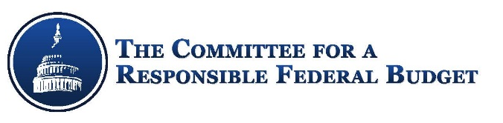
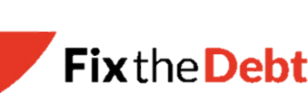
Where Does The Federal Government’s Money Come From?
Individual income and payroll taxes cover two-thirds of government spending.
In 2019, more than one-fifth of the government’s spending will be financed by deficits.
Payroll
$1,247
Individual
Income
$1,698
Corporate
Income
$228
Deficit
$960
Other
$278
Billions
Source: Congressional Budget Office, August 2019 budget projections.

Slide 9
Who Pays Federal Taxes?
The top 20% of households paid in 2016 almost 70% of the nation’s taxes. The top 1% paid one quarter.
Percentage of all federal taxes paid, by household income
Source: Congressional Budget Office, “The Distribution of Household Income, 2016”. Published 2019

Slide 10
Tax Expenditures: Another Kind of Spending
Tax Expenditures aren’t part of the budget that Congress passes every year, but are similar to government spending programs. Think about it: $1,000 given out in Pell grants and $1,000 given out through education tax credits will both give $1,000 to students.
If they were counted as a normal part of the budget, tax expenditures would be a quarter of spending.
Interest
6%
Other
9%
Tax
Expenditures
25%
Non-Defense
Discretionary 11%
Defense
Discretionary
11%
Social
Security
18%
Health Care
19%
Sources: Congressional Budget Office, August 2019 budget projections, Joint Committee on Taxation, “Estimates Of Federal Tax Expenditures For Fiscal Years 2018-2022”, 2018

Slide 11






Aging Demographics
1950
1960
2012
2035
(16:1)
(5:1)
(3:1)
(2:1)
CBO Current Law
Source: 2016 Social Security Trustees Report
Notes:
#7) We have an aging society. Advances in medicine and technology mean that people live much longer and more productive lives than they used to.
But the retirement of the baby boomers impacts our economy -government programs that support those in old age increasingly taking up a larger portion of the budget.
For example, in 1950 we had 16 workers for every one person collecting social security. In 2012 that ratio was 3 to 1. It is going to 2 to 1 by 2035
Former colleague used to joke and say it’s the new four letter word coming to Washington – MATH. We got programs that are growing due to the aging of the population, and rising health care costs, with revenue not adjusted to keep up. Leads to ever increasing debt, and interest costs.

Slide 12
Interest Spending is Fastest Growing Line Item
Billions
Source: CRFB calculations based on Congressional Budget Office August 2019 Baseline.
Notes:
#8) Interest Costs – Interest is the fastest growing line item in the federal budget. The cost to servicing our debt is the fastest growing line item (health is fastest program).
2019 spend 372 billion on interest. By end of next decade, over 800 billion a year just on interest on our debt.

Slide 13
Two-Fifths of Interest Goes Overseas
In 2019, we will spend $382 billion
on interest.
Roughly
$150 billion
Will be paid
To foreigners
Source: Congressional Budget Office, Treasury Department, January 2019.
Notes:
#9) About 40 percent of our interest spending goes overseas.
Of the 382 billion paid in interest, roughly 150 billion will be paid to foreigners.
Both China and Japan hold a bit less than a tenth of our debt – over $1 trillion each.

Slide 14
A Budget on Auto-pilot
Billions
Mandatory – 61%
Discretionary – 30%
Interest – 9%
$4.4
Trillion
Source: Congressional Budget Office August 2019 Baseline
Notes:
#10) A little over 60 percent of the budget is on “Auto pilot”. In other words, policymakers are not making decisions to increase it each year, its automatically happening.
This is the distinction between mandatory spending and discretionary spending in Washington. Mandatory spending programs are those of which have certain eligibility criteria and benefits, times the amount of people eligible, and then benefits are paid. Social security an example, Medicaid and Medicare are examples. They just grow and are paid automatically each year.
The rest, 9 percent interest, which is also automatic. The remaining 30 percent are discretionary programs for defense and non defense agencies and budgets. In other words, when you hear about the budget fights going on and whether to pass appropriations in Washington, they are often over only 30 percent of the budget. Cause the rest is growing automatically.
In other words, not only is our budget and debt problem growing – we have lost control of the budget as well.

Slide 15
U.S. Largest Projected Increase in Debt
Change in Debt-to-GDP 2019-2024
Source: International Monetary Fund World Economic Outlook, April 2019.
Notes:
11) When compared internationally, the U.S. national debt is projected to increase (debt to gdp) more than any other advanced economy over the next five years. According to the IMF.
Some say we have not had serious problems yet due to our debt cause u.s. looks good economically – we are a safe haven. Which is certainly true to a decent extent.
But point here is on only three other advanced economies will see their debt-to-gdp ratio increase over that same timeframe (japan, korea, Italy)

Slide 16
We Can’t Grow Our Way Out
Long-Term (Final Year) Annual Real GDP Change
Sources: CBO, OMB, Federal Reserve, Blue Chip, Goldman Sachs, Moody’s, IMF, and CRFB calculations..
Note: Long-term rate is either defined by estimating organization or the last year of the estimating organization’s projection period.
Notes:
12) Not easy answer – we can’t grow our way out of this debt problem.
Some say we just can have faster economic growth, that will bring in enough revenue to close the deficit. Certainly growth can help, and a pro growth economic agenda should be part of reducing the debt.
But relying on it alone is not going to work. Due to the aging of our population and demographics, all forecasters are expecting lower than historical average economic growth rates. It would take unprecedented sustained levels of economic growth to get us on track.

Slide 17
Rising Debt Will Reduce Income Per Person
Per-Person Income (Real GNP Per-Capita) in 2049 [Debt % of GDP]
Source: Congressional Budget Office June 2019 Long Term Budget Outlook
Notes:
13) This will have real consequences on people’s lives. According to the CBO, solving the debt could result in 9-10k more income per person relative to the worst projections. In other words, people will have more money in their pockets over the long run if we solved our debt problem due to the debts impact on the economy and thus on wages.

Slide 18
Some Consequences of Rising Debt
Economic Effects
  Less private sector investment
  Slower economic and wage growth
  Higher Interest Rates on loans for households and businesses
Budget Effects
  Higher government interest payments displace other priorities
Harder to Respond to a Crisis
  If we borrow more now, there will be less room to borrow in a war, recession, or national emergency
Missed Opportunities
  Higher debt means less resources for education, infrastructure, supports for low-income families, or funding for basic research that can help grow the economy and improve our standard of living.
Generational Unfairness, asking our kids to pay for their parents
Eventual Fiscal Crisis if changes are not made
Notes:
BEFORE I CONTINUE WITH MY LAST FEW FACTS – build on this point for emphasis on why this issue actually matters. Several reasons.
Higher debt will slow economic growth and lower wages – Rising national debt can crowd out productive investments in people, machinery, technology, and new ventures, resulting in fewer job opportunities and lower wages.
Higher interest rates drive up the cost of borrowing – Rising debt results in increased interest rates, driving up the cost of mortgages, car loans, and credit card debt. In 30 years, interest rates will be about half a point higher than if debt was on a stable path (i.e. a family with a $300,000 mortgage can expect to pay roughly $45,000 more over the course of the mortgage).
Higher debt will squeeze out critical public investments – Higher debt will limit resources available for areas such as education, infrastructure, supports for low-income families, and funding for basic research that can help grow the economy and improve our standard of living. By 2031, 100 percent of the revenue we collect will go toward interest payments and mandatory spending, meaning everything else – from defense to education to research – must be deficit-financed.
Our ability to react to a crisis is constrained by our growing debt – Higher debt limits our ability to respond to disasters and economic downturns. For example, if the country were to experience another recession, we would enter it with the highest debt burden as a percent of the economy in nearly 70 years.
A fiscal crisis is more likely if we let our debt continue to grow – Failure to get our debt under control could eventually precipitate a crisis where investors are no longer willing to loan money

Slide 19
374 Debate Questions, No Debt
Debate Mini Study
15: The number of hours of Democratic debates.
15: The number of different debate moderators.
22: The number of candidates who have participated in at least one debate.
374: The total number of questions asked at the debates so far.
0: The number of questions asked about rising national debt, $1 trillion deficits, or saving Social Security.
$636,347,603: The amount the federal government has spent on interest to service the debt in the 15 hours that candidates have debated.
$1,643,835,616: The amount the national debt has increased in the 15 hours that candidates have debated.
Notes:
Here is my last fact to hit home where we are, now that hopefully I’ve gotten some of your attention.
15) In over 12 hours of primary debates, and nearly 300 questions asked by moderators (not a single one about our deficit and debt.
We did a little mini study at our office where we counted it up.
509, 078, 082 is about spent on interest on debt in those 12 hours.
Debt itself increased over 1.3 billion in those 12 hours.
That kind of summarized where we are now that I finished my facts….
These are the numbers. This is the reality. But no one is focusing on it in our political discourse. Because its hard, and difficult politically – doesn’t really sell in a campaign.

Slide 20
A Framework for Fixing the Debt
Lead a National Conversation on the Debt.
Pay for Your Agenda. New spending programs and policies should be offset with taxes or spending cuts to avoid adding to the debt.
Cut Wasteful and Low Priority Spending. Cutting programs that don’t work or don’t serve an important public purpose could help reduce debt.
Recommend Cutting Tax Loopholes and Preferences. We spend $1.5 trillion through the tax code, and hundreds of billions more through tax evasion, tax avoidance, and loopholes.
Reducing Health Care Costs. Improving how we pay for and deliver health care can reduce costs without reducing coverage or quality of care.
Identify New Revenue Sources. New ideas like taxing carbon, data, financial transactions, inheritance, or sugary drinks could help fund government.
Pledge to Save Social Security. New tax revenue, changes to future benefits, or both will be needed – and changes must begin soon so they can be phased in fairly.
Fixing the Broken Budget Process. After the most recent government shutdown, the public has woken up to the reality that the budget process is broken. Americans would welcome efforts to end the madness in Washington.
Notes:
Ultimately, many have looked at this in a bipartisan way and have come up with the big areas and focuses of policymakers wanting to focus attention on this.
So if you’re talking with policymakers, here are some areas they can look at.
READ THEM

Slide 21
Debt Symbolizes a Broken System
…avoids tough choices
…cannot achieve compromise
…Focuses on short term vs long term
…rewards partisanship over progress
Notes:
Now having said that, here is the thing – I’m not naïve. Trying to get focus no this issue in this environment is really hard.
But guess what, the sad truth is all these facts I just walked through, a strong majority of lawmakers know all those facts. They know them. But they can’t do anything about it.
Cause the truth is in many ways our debt has come to symbolize and serve as a symptom of a deeper more fundamental problem – that our political system itself may be broken.
It’s a system that seems set up and incentivized NOT to solve problems and to avoid touch choices. As system set up to avoid bipartisan compromise which will get you into trouble politically.
A system that is set up to focus on short term issues at the expense of long term challenges. And in many ways the system rewards hyper partisan behavior instead of making progress.
Explain FixUS

Slide 22

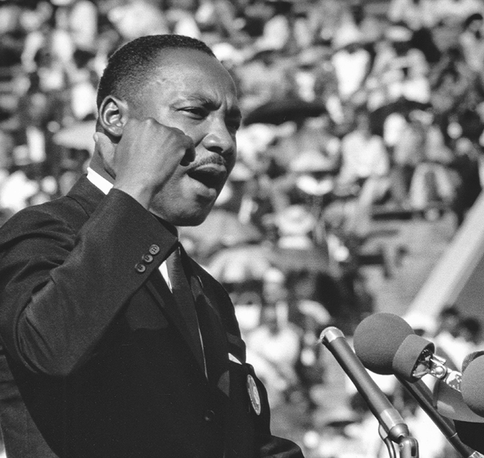
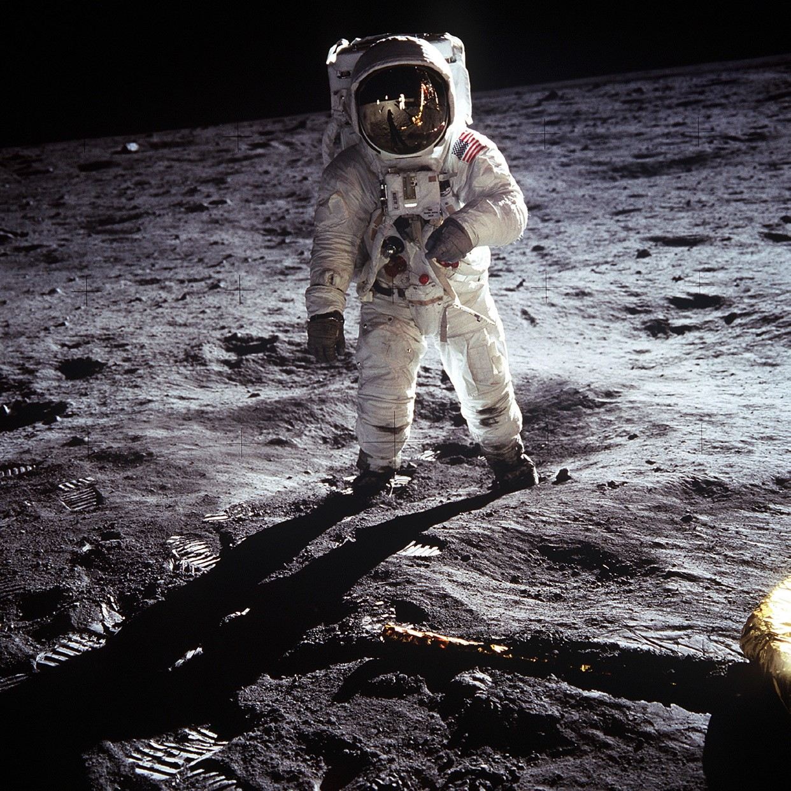
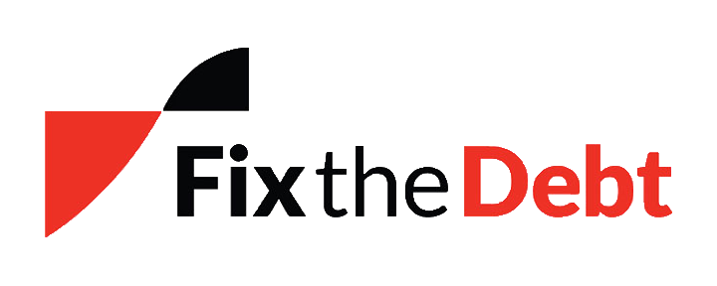
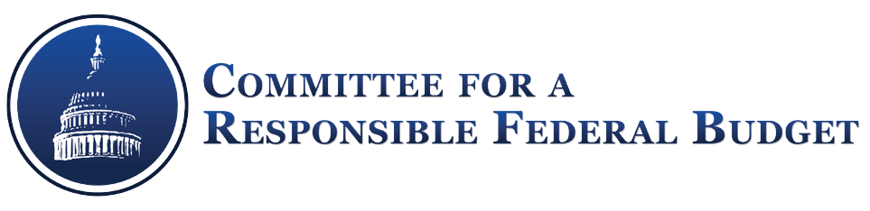
FixUS – Restoring America Now
FixUSNow.org

Slide 23
It's time for us to engage in a conversation about how to make healing our fractured nation a top national priority – FixUs at 33777

Slide 24
FixUS
OUR GOAL
Make healing our fractured nation and fixing our broken political system a top national priority that our leaders cannot ignore.
OUR CORE PRINCIPLES
Healing our divided nation is the defining challenge of our time
Extremism on both sides of the political divide have led America into a deepening crisis
A revitalized citizenry is the key to fixing our broken political system and preparing our nation to face the serious challenges ahead
We value compromise over conflict, discussion over divisiveness, and progress over partisanship
Americans share a common destiny; working together we can secure a future of freedom, justice and prosperity for future generations

Slide 25
THREAT FROM WITHIN
“
When I walked out of the Pentagon after 28 years in uniform, I never thought I’d say this, but what is going on politically in America today is a far graver threat than any our nation faced during my career, including the Soviet Union. And it’s because this threat is here and now, right at home, and it’s coming from within us. I guess the irony of being a great nation is the only power who can bring you down is yourself.
- Colonel Mark Mykleby, USMC (Retired)
(Source: The New York Times 10/2/18)

Slide 26

PRESIDENT GEORGE WASHINGTON
FOUR GREATEST THREATS
OUR NATION IS AT A CROSSROADS
Hyper-Partisanship
Foreign Intervention in Domestic Affairs
Fiscal Irresponsibility
Absence of Civic Education

Slide 27


LOSING FAITH IN INSTITUTIONS
AMERICA FACES DAUNTING CHALLENGES
78%
of Americans believe it's important that Republicans and Democrats work together
_{19%}
think they’re doing a good job of it
Trust in...
Essential to live in a democracy?
72% of those born in 1930s think so... compared to 30% of millennials (those born since 1980)
The Presidency
Congress is down 81%
is down 54%
(Sources: Pew & World Economic Forum)

Slide 28
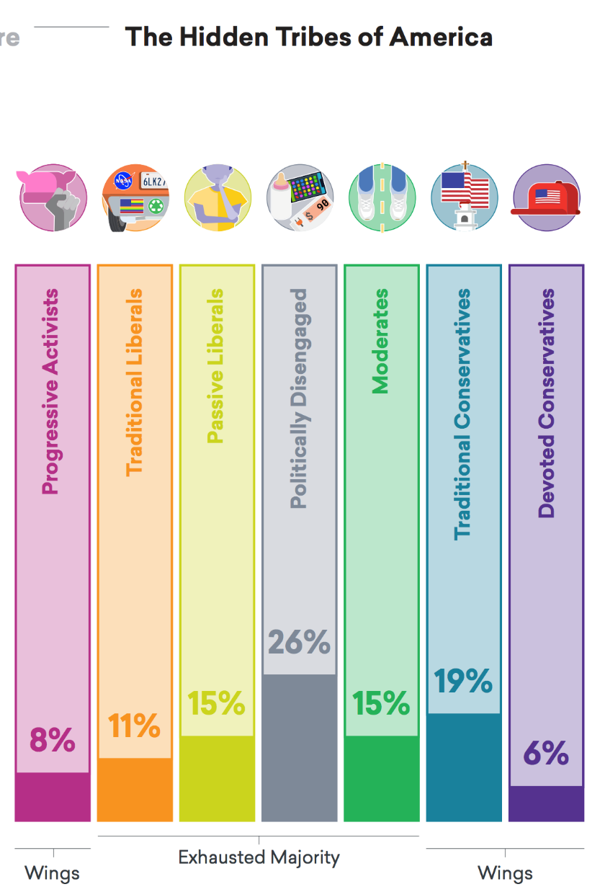
A STUDY OF AMERICA’S POLARIZED LANDSCAPE
EXHAUSTED MAJORITY
“
Members of the Exhausted Majority are considerably more ideologically flexible than members of other groups. While members of the “wing” groups (on both the left and the right) tend to hold strong and consistent views across a range of political issues, those in the Exhausted Majority tend to deviate significantly in their views from issue to issue.
- More in Common, 10/18
(Source: More in Common)

Slide 29
MORE IN COMMON SURVEY
A STUDY OF AMERICA’S POLARIZED LANDSCAPE
Progressive Activists
Traditional Liberals
Passive Liberals
Politically Disengaged
8%
11%
15%
26%
Younger, highly engaged, secular, cosmopolitan, angry
Older, retired, open to compromise, rational, cautious
Unhappy, insecure, distrustful, disillusioned
Young, low income, distrustful, detached, patriotic
Traditional Conservatives
Devoted Conservatives
Moderate
15%
19%
6%
Engaged, civic-minded, middle-of-the-road, pessimistic, Protestant
Religious, middle class, patriotic, moralistic
White, retired, highly engaged, uncompromising, patriotic
(Source: More in Common)

Slide 30
CONSEQUENCES OF THE
OUR NATION IS AT A CROSSROADS
CURRENT PATH
Paralysis in Washington on critical issues
Policy instability and uncertainty
Vulnerable to foreign influence
Rising public discord and unrest
Disenchantment with government and democracy

Slide 31
HOW DID WE GET HERE?
87% of Americans say political polarization is threatening our way of life
ECONOMIC
POLITICAL
SOCIAL & CULTURAL
Growing economic disparities
Politicians incented not to solve problems, due to gerrymandered districts, partisan primaries, etc.
Fragmented and polarized media and social media environment
Anxiety over rapid economic changes in technology, globalization, and the gig economy
Persistent racial, ethnic, and geographic divides
Increased money in politics skews the system
Rising social isolation and decline of religious and civic institutions
Frustration over lack of upward mobility
Congressional rules encourage partisanship
System viewed as “rigged” or “corrupt”
Ideological polarization of parties
Declining civility and civil discourse
(Source: AP/NORC)

Slide 32
A MOVEMENT IS BLOSSOMING
THE GOOD NEWS
Efforts devoted to:
Supporting candidates and elected officials who have committed to working in a bipartisan manner to solve problems
Reforming the incentives of our political system, including but not limited to:
Redistricting reform
Electoral and primary reform
Ballot access changes
Campaign finance reform
Advancing bipartisan economic policies to address the structural trends contributing to economic anxiety
Promoting cultural and societal changes, including:
More civility in political and public discourse
Enhanced civic engagement and education
New or improved media platforms to give voice to the ideologically homeless

Slide 33
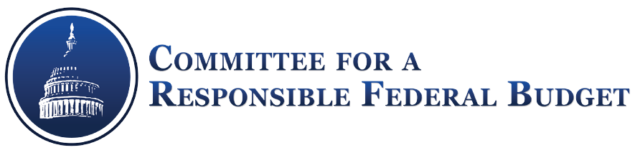



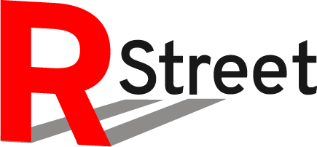






A GROUNDSWELL OF EFFORTS
Affinity partners:

Slide 34
ABRAHAM LINCOLN
“
It is not ‘can any of us imagine better?’ but, ‘can we all do better?’
- Annual Message to Congress, December 1, 1862

Slide 35
WHAT YOU CAN DO
JOIN FixUS
Sign up by texting FixUS to 33777 or going to www.FixUSNow.org and receive opportunities to:
Help identify and learn about our political problems & possible fixes
Join discussions about these issues with like-minded Americans (in person event, online, teleconferences)
Connect you with organizations and efforts trying to heal our divides
Engage your local community on these issues (via letters to the editor, hosting events, and recruiting others to join)

Slide 36

View this and other slide decks at
http://bit.ly/32sS2V5

