Slide 1
FixUS – Restoring America Now
FixUSNow.org

Slide 2
It's time for us to engage in a conversation about how to make healing our fractured nation a top national priority – FixUs at 33777

Slide 3
FixUS
OUR GOAL
Make healing our fractured nation and fixing our broken political system a top national priority that our leaders cannot ignore.
OUR CORE PRINCIPLES
Healing our divided nation is the defining challenge of our time
Extremism on both sides of the political divide have led America into a deepening crisis
A revitalized citizenry is the key to fixing our broken political system and preparing our nation to face the serious challenges ahead
We value compromise over conflict, discussion over divisiveness, and progress over partisanship
Americans share a common destiny; working together we can secure a future of freedom, justice and prosperity for future generations

Slide 4
THREAT FROM WITHIN
“
When I walked out of the Pentagon after 28 years in uniform, I never thought I’d say this, but what is going on politically in America today is a far graver threat than any our nation faced during my career, including the Soviet Union. And it’s because this threat is here and now, right at home, and it’s coming from within us. I guess the irony of being a great nation is the only power who can bring you down is yourself.
- Colonel Mark Mykleby, USMC (Retired)
(Source: The New York Times 10/2/18)

Slide 5
PRESIDENT GEORGE WASHINGTON FOUR GREATEST THREATS
OUR NATION IS AT A CROSSROADS
Hyper-Partisanship
Foreign Intervention in Domestic Affairs
Fiscal Irresponsibility
Absence of Civic Education

Slide 6
LOSING FAITH IN INSTITUTIONS
AMERICA FACES DAUNTING CHALLENGES
78%
of Americans believe it's important that Republicans and Democrats work together
_{19%}
think they’re doing a good job of it
Essential to live in a democracy?
72% of those born in 1930s think so... compared to 30% of millennials (those born since 1980)
Trust in...
The Presidency
Congress is down 81%
is down 54%
(Sources: Pew & World Economic Forum)

Slide 7
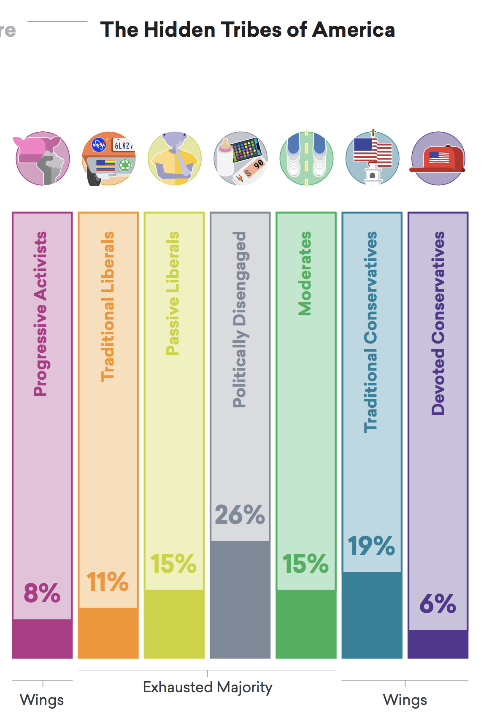
A STUDY OF AMERICA’S POLARIZED LANDSCAPE
EXHAUSTED MAJORITY
“
Members of the Exhausted Majority are considerably more ideologically flexible than members of other groups. While members of the “wing” groups (on both the left and the right) tend to hold strong and consistent views across a range of political issues, those in the Exhausted Majority tend to deviate significantly in their views from issue to issue.
- More in Common, 10/18
(Source: More in Common)

Slide 8
MORE IN COMMON SURVEY
A STUDY OF AMERICA’S POLARIZED LANDSCAPE
Progressive Activists
Traditional Liberals
Passive Liberals
Politically Disengaged
8%
11%
15%
26%
Younger, highly engaged, secular, cosmopolitan, angry
Older, retired, open to compromise, rational, cautious
Unhappy, insecure, distrustful, disillusioned
Young, low income, distrustful, detached, patriotic
Traditional Conservatives
Devoted Conservatives
Moderate
15%
19%
6%
Engaged, civic-minded, middle-of-the-road, pessimistic, Protestant
Religious, middle class, patriotic, moralistic
White, retired, highly engaged, uncompromising, patriotic
(Source: More in Common)

Slide 9
CONSEQUENCES OF THE
OUR NATION IS AT A CROSSROADS
CURRENT PATH
Paralysis in Washington on critical issues
Policy instability and uncertainty
Vulnerable to foreign influence
Rising public discord and unrest
Disenchantment with government and democracy

Slide 10
HOW DID WE GET HERE?
87% of Americans say political polarization is threatening our way of life
ECONOMIC
POLITICAL
SOCIAL & CULTURAL
Growing economic disparities
Politicians incented not to solve problems, due to gerrymandered districts, partisan primaries, etc.
Fragmented and polarized media and social media environment
Anxiety over rapid economic changes in technology, globalization, and the gig economy
Persistent racial, ethnic, and geographic divides
Increased money in politics skews the system
Rising social isolation and decline of religious and civic institutions
Frustration over lack of upward mobility
Congressional rules encourage partisanship
System viewed as “rigged” or “corrupt”
Ideological polarization of parties
Declining civility and civil discourse
(Source: AP/NORC)

Slide 11
A MOVEMENT IS BLOSSOMING
THE GOOD NEWS
Efforts devoted to:
Supporting candidates and elected officials who have committed to working in a bipartisan manner to solve problems
Reforming the incentives of our political system, including but not limited to:
Redistricting reform
Electoral and primary reform
Ballot access changes
Campaign finance reform
Advancing bipartisan economic policies to address the structural trends contributing to economic anxiety
Promoting cultural and societal changes, including:
More civility in political and public discourse
Enhanced civic engagement and education
New or improved media platforms to give voice to the ideologically homeless

Slide 12
A GROUNDSWELL OF EFFORTS
Affinity partners:

Slide 13
ABRAHAM LINCOLN
“
It is not ‘can any of us imagine better?’ but, ‘can we all do better?’
- Annual Message to Congress, December 1, 1862

Slide 14
WHAT YOU CAN DO
JOIN FixUS
Sign up by texting FixUS to 33777 or going to www.FixUSNow.org and receive opportunities to:
Help identify and learn about our political problems & possible fixes
Join discussions about these issues with like-minded Americans (in person event, online, teleconferences)
Connect you with organizations and efforts trying to heal our divides
Engage your local community on these issues (via letters to the editor, hosting events, and recruiting others to join)

