Slide 1
Documenting Current Events Through Poetry
A Workshop With:
Poet Laureate Dave Seter
Librarian Terra Emerson
March 21, 2026
Sebastopol Regional Library

Slide 2
Agenda for Today’s Workshop
2:00—2:15 INTRODUCTIONS
2:15—2:45 PRESENTATIONS ON TOPIC
2:45—3:10 WRITING EXERCISE
3:10—3:30 SHARING TIME AND WRAP-UP

Slide 3

Documentary Poetry: An Unofficial Definition
combines artistic talent with factual material from documents or witnesses
often refers to poetry of witness from multiple viewpoints, interpretations, and dialogues
often represents a case study of people, events, and places; usually a social/cultural issue
a poet is generally expected to transfer not only the witnesses’ perspectives but their own as well (which differentiates the poem from journalism)
Wazzan, Suzanne A. “The Genre of Documentary Poetry in Some Selected Samples of Contemporary Poetry: A Critical Approach.” Theory and Practice in Language Studies, Vol. 13, No. 6, pp. 1429-1437, June 2023

Slide 4
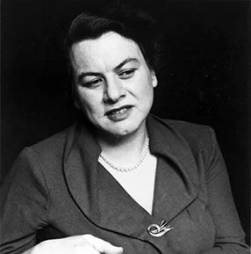

Muriel Rukeyser’s Book of the Dead
Written in response to the Hawk’s Nest Tunnel Disaster of the 1930s
Construction of the Hawk’s Nest Tunnel in West Virginia as part of a hydroelectric power project reportedly led to the death by silicosis of hundreds of workers, many of them African American.
The poem is written in sections. It includes poems to individual victims. It also includes sections titled “The Disease,” and “The Doctors,” which draw from medical texts, court transcripts, etc.
Muriel Rukeyser
Photo from Academy of American Poets website
credited to Rollie McKenna

Slide 5
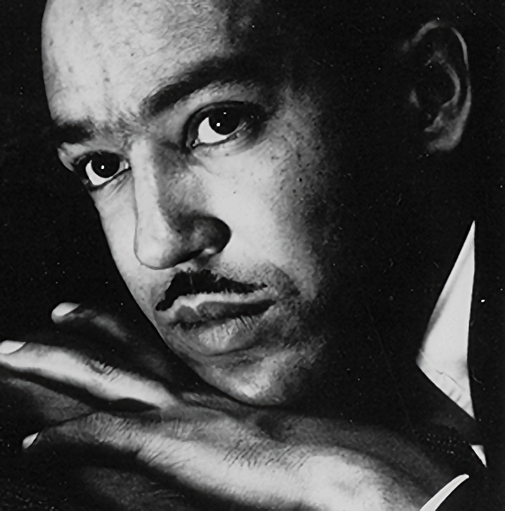
Langston Hughes’ Johannesburg Mines
Johannesburg Mines
In the Johannesburg mines There are 240,000 Native Africans working. What kind of poem Would you Make out of that? 240,000 natives Working in the Johannesburg mines.
Langston Hughes
Photo from Academy of American Poets website
uncredited photo

Slide 6
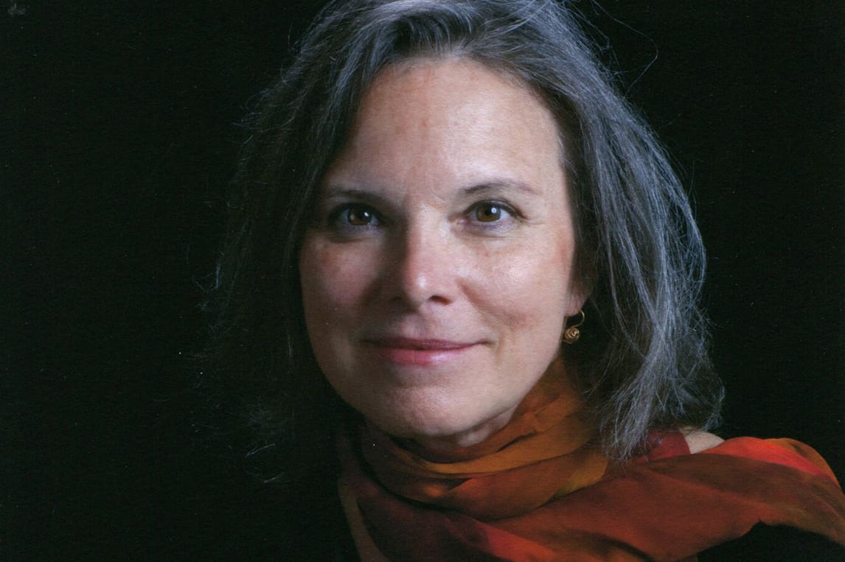
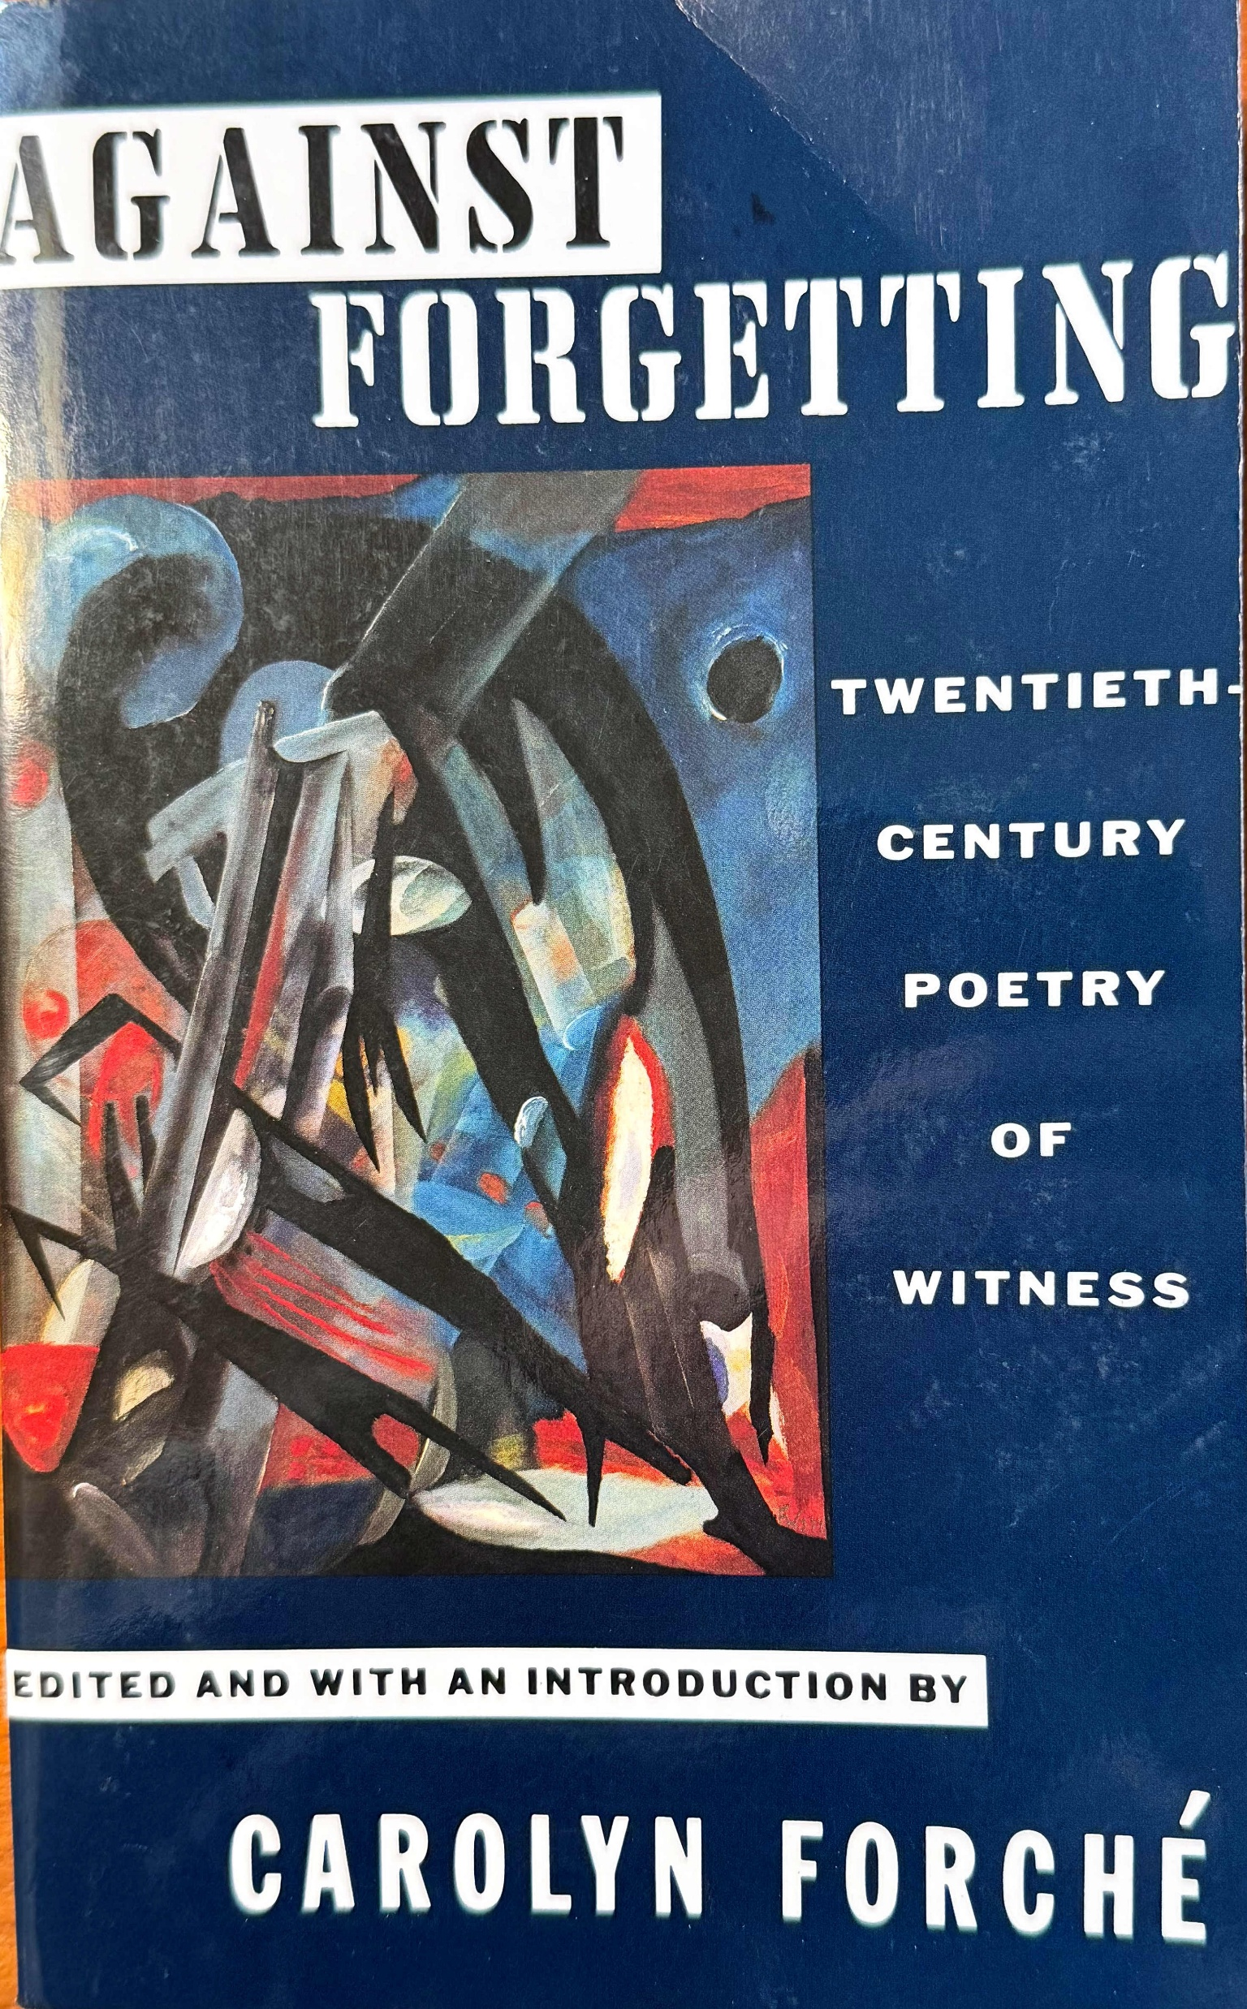
Carolyn Forché: Against Forgetting
If we give up the dimension of the personal, we risk relinquishing one of the most powerful sites of resistance.
The celebration of the personal, however, can indicate a myopia, an inability to see how larger structures of the economy and the state circumscribe… the fragile realm of individuality.
…perhaps we should not consider our social lives as merely the products of our choice: the social is a place of resistance and struggle where books are published, poems read, and protest disseminated.
Carolyn Forché
The Poetry Foundation website
Photo credited to Don J. Usner / Blue Flower Arts
Forché, Carolyn, Ed. “Introduction.” Against Forgetting: Twentieth Century Poetry of Witness. New York: W.W. Norton, 1993: 31.

Slide 7
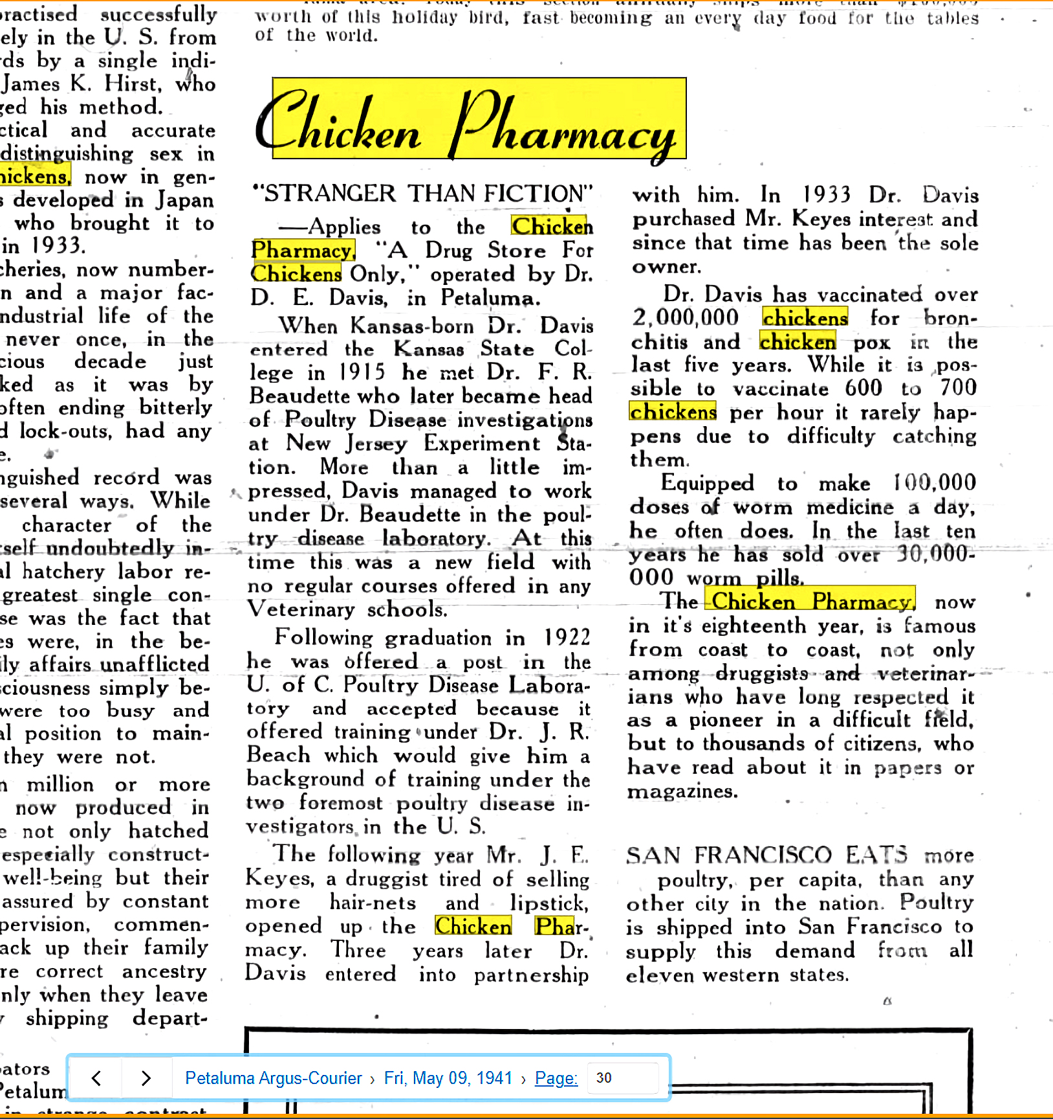
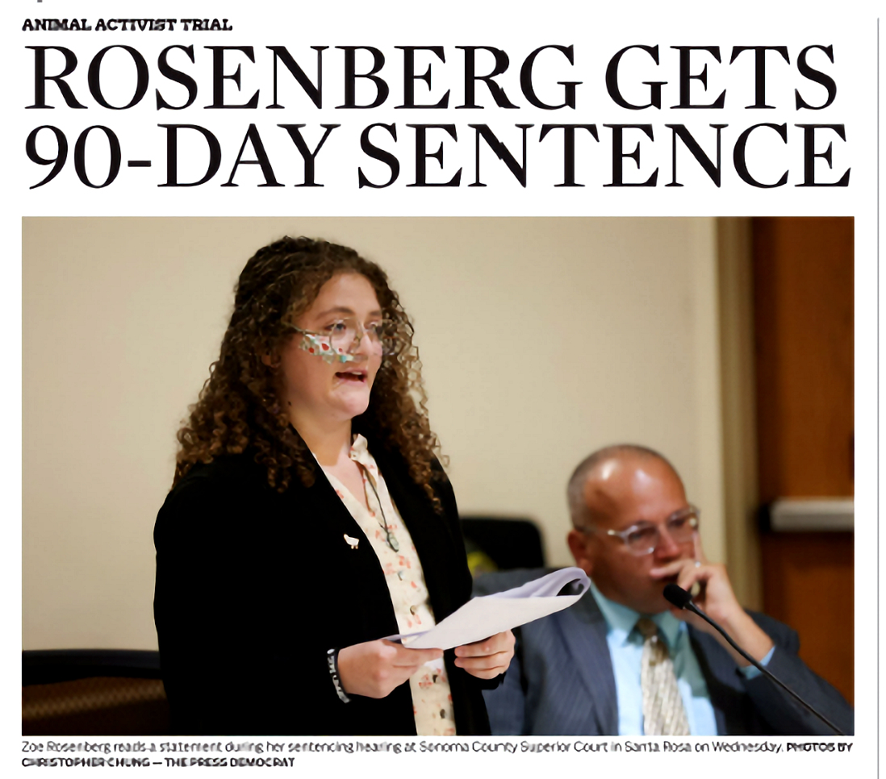
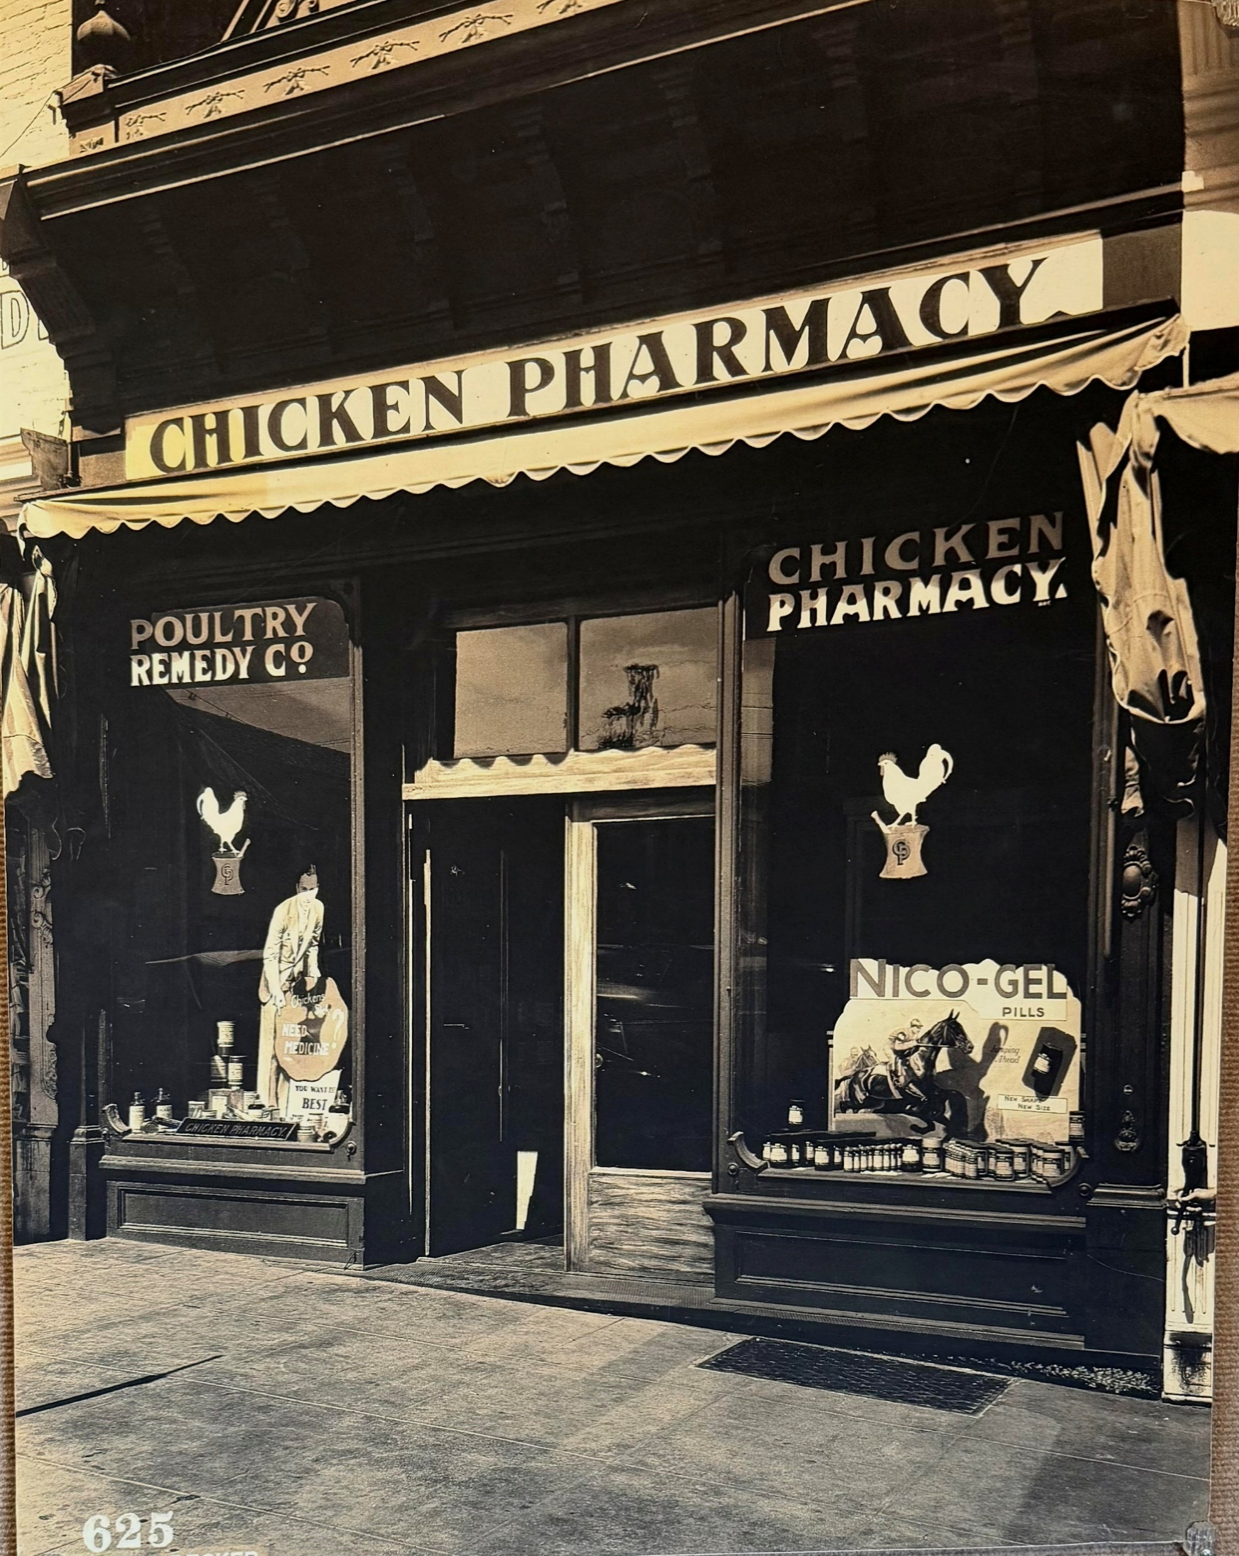
Using Library Resources to Help Write a Poem About Chickens
Santa Rosa Press Democrat
December 4, 2025
Petaluma Argus-Courier
May 9, 1941
Petaluma Historical Library and Museum

Slide 8


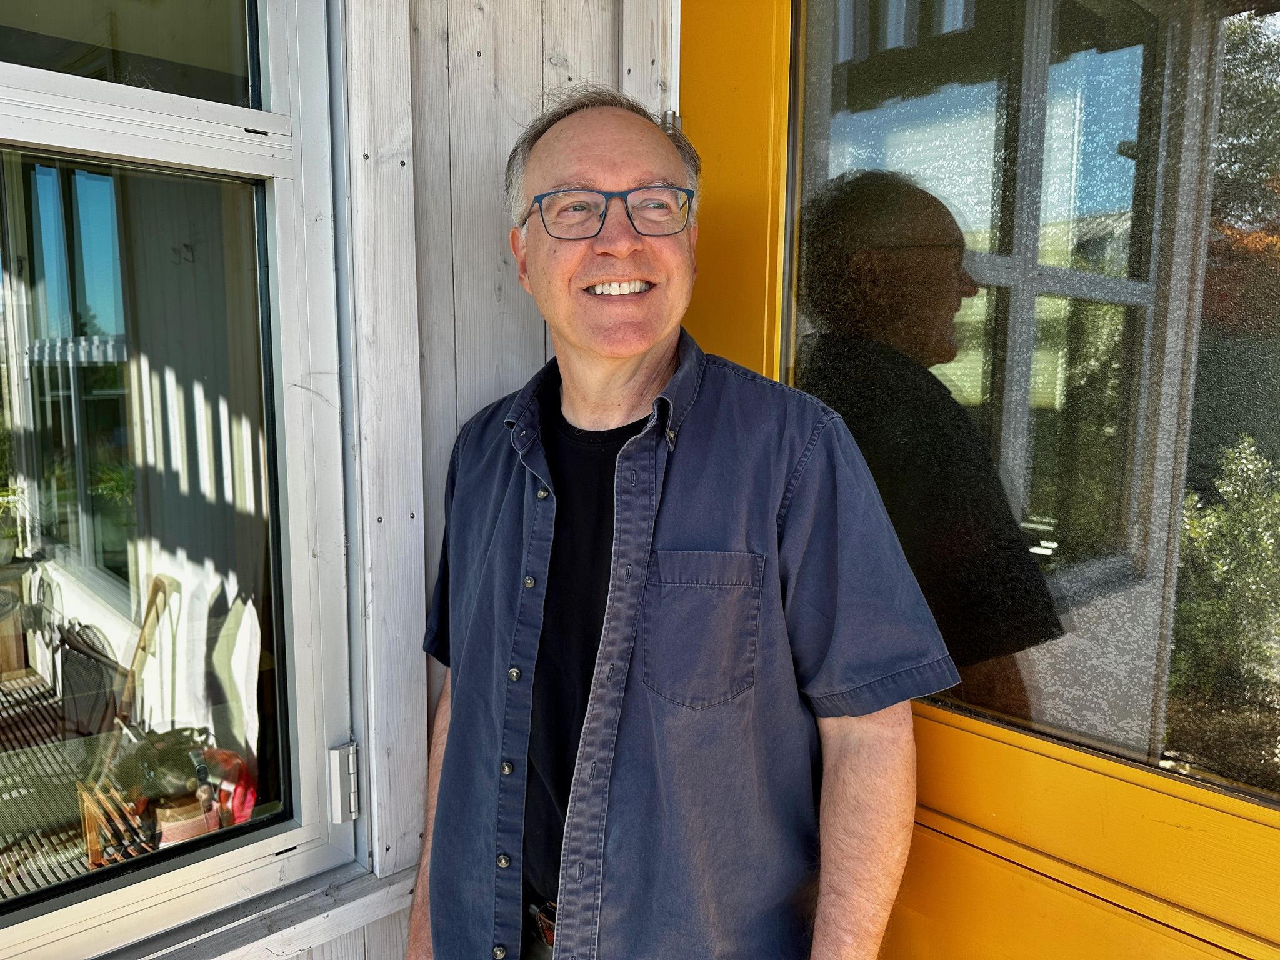
Thank You for Attending
Sonoma County Library: https://sonomalibrary.org/
Sonoma County Poet Laureate
Dave Seter: https://daveseter.com/

