Slide 1
THINKING LIKE A MOUNTAIN: A NATURE WRITING WORKSHOP
Rohnert Park / Cotati Regional Library
April 26, 2026
Dave Seter
Sonoma County Poet Laureate 2024-6

Slide 2
Today’s Agenda
1:30—1:40 Introductions
1:40—2:10 Presentation / Discussion
2:10—2:35 Writing Time
2:35—3:00 Sharing Time

Slide 3
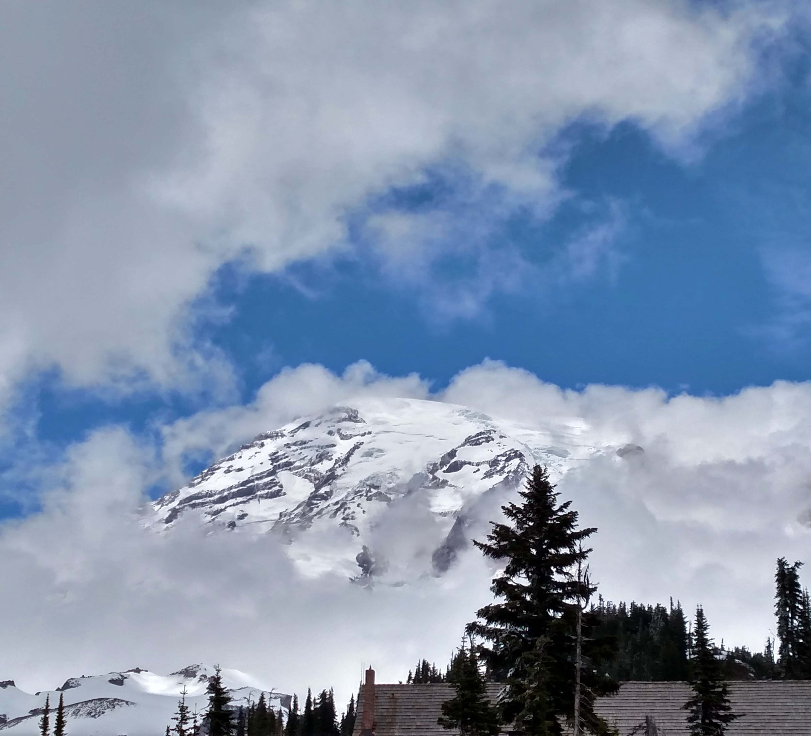
Putting Nature Back Into Nature Writing
One of the challenges in nature writing is to avoid anthropocentric treatment of the subject.
Anthropocentric: “Centering in humans; regarding humanity as the central fact of the universe.”
(Oxford English Dictionary)
One way to avoid anthropocentric thinking is by thinking like a mountain.
Mount Rainier
Photo by Dave Seter

Slide 4
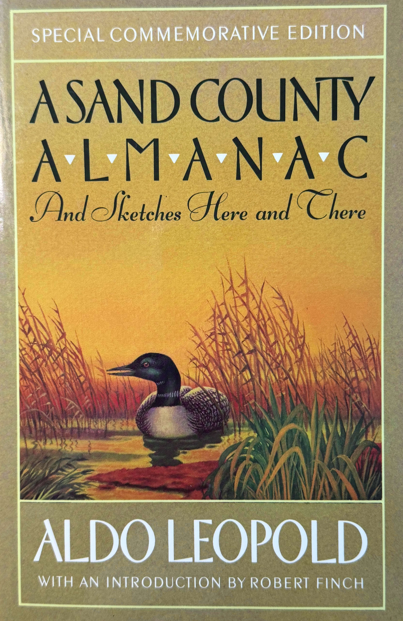
Aldo Leopold — Thinking Like a Mountain
Aldo Leopold’s “Thinking Like a Mountain” appears in his collection of essays A Sand County Almanac (1949)
Leopold’s essay reflects his changing views about the hunting of wolves.
I was young then and full of trigger-itch; I thought that because fewer wolves meant more deer, that no wolves would mean hunters’ paradise.
…we had never heard of passing up a chance to kill a wolf… When our rifles were empty, the old wolf was down…

Slide 5
Aldo Leopold — Thinking Like a Mountain
We reached the old wolf in time to watch a fierce green fire dying in her eyes… there was something new to me in those eyes—something known only to her and the mountain.
I have watched the face of many a newly wolfless mountain, and seen the south-facing slopes wrinkle with a maze of new deer trails.
I now suspect that just as a deer herd lives in mortal fear of its wolves, so does a mountain live in mortal fear of its deer.
Only the mountain has lived long enough to listen objectively to the howl of a wolf.

Slide 6
Thinking Like a Mountain: What Does it Mean?
The phrase thinking like a mountain is like a Zen Koan. It makes us ask ourselves: how can a huge, inanimate, object think? (John Tallmadge)
Koan: A riddle without a solution, used to demonstrate the inadequacy of logical reasoning and provoke enlightenment. (OED)
To think like a mountain means to take a holistic view of an environment. The phrase highlights the finite scope of human thought, its limitation to stretches of time that would seem miniscule to a mountain. (Timothy Clark)
Mount Rainier
Photo by Dave Seter

Slide 7
The Rights of Mountains (and Rivers)
In 2018, the New Zealand government granted Mount Taranaki, sacred to the Maori people, legal status as a person.
The Whanganui River in New Zealand became the first river to be recognized as a legal person in 2017.
Article 71 of the Constitution of Ecuador: Nature or Pachamama, where life is reproduced and exists, has the right to exist, persist, maintain and regenerate its vital cycles, structure, functions and its processes in evolution.
Mount Rainier
Photo by Dave Seter

Slide 8

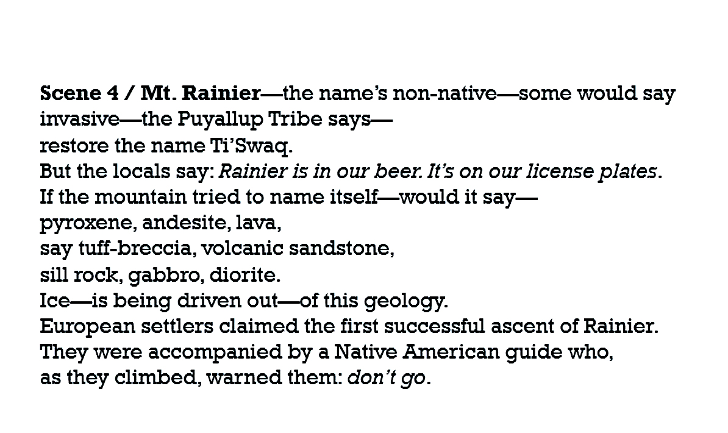

An Example in Poetry: Thinking Like Mt. Rainier
From “Godzilla Versus an Octopus of Ice” by Dave Seter

Slide 9
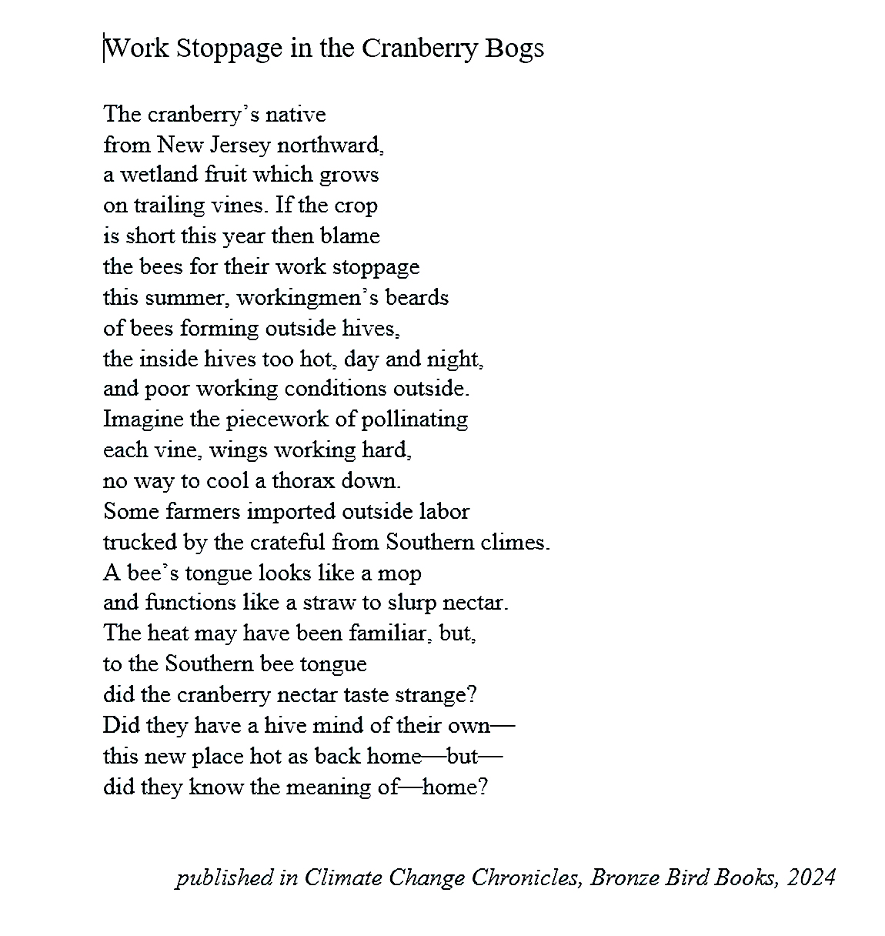
Thinking Smaller: Thinking Like a Bee
Poem by Dave Seter

Slide 10


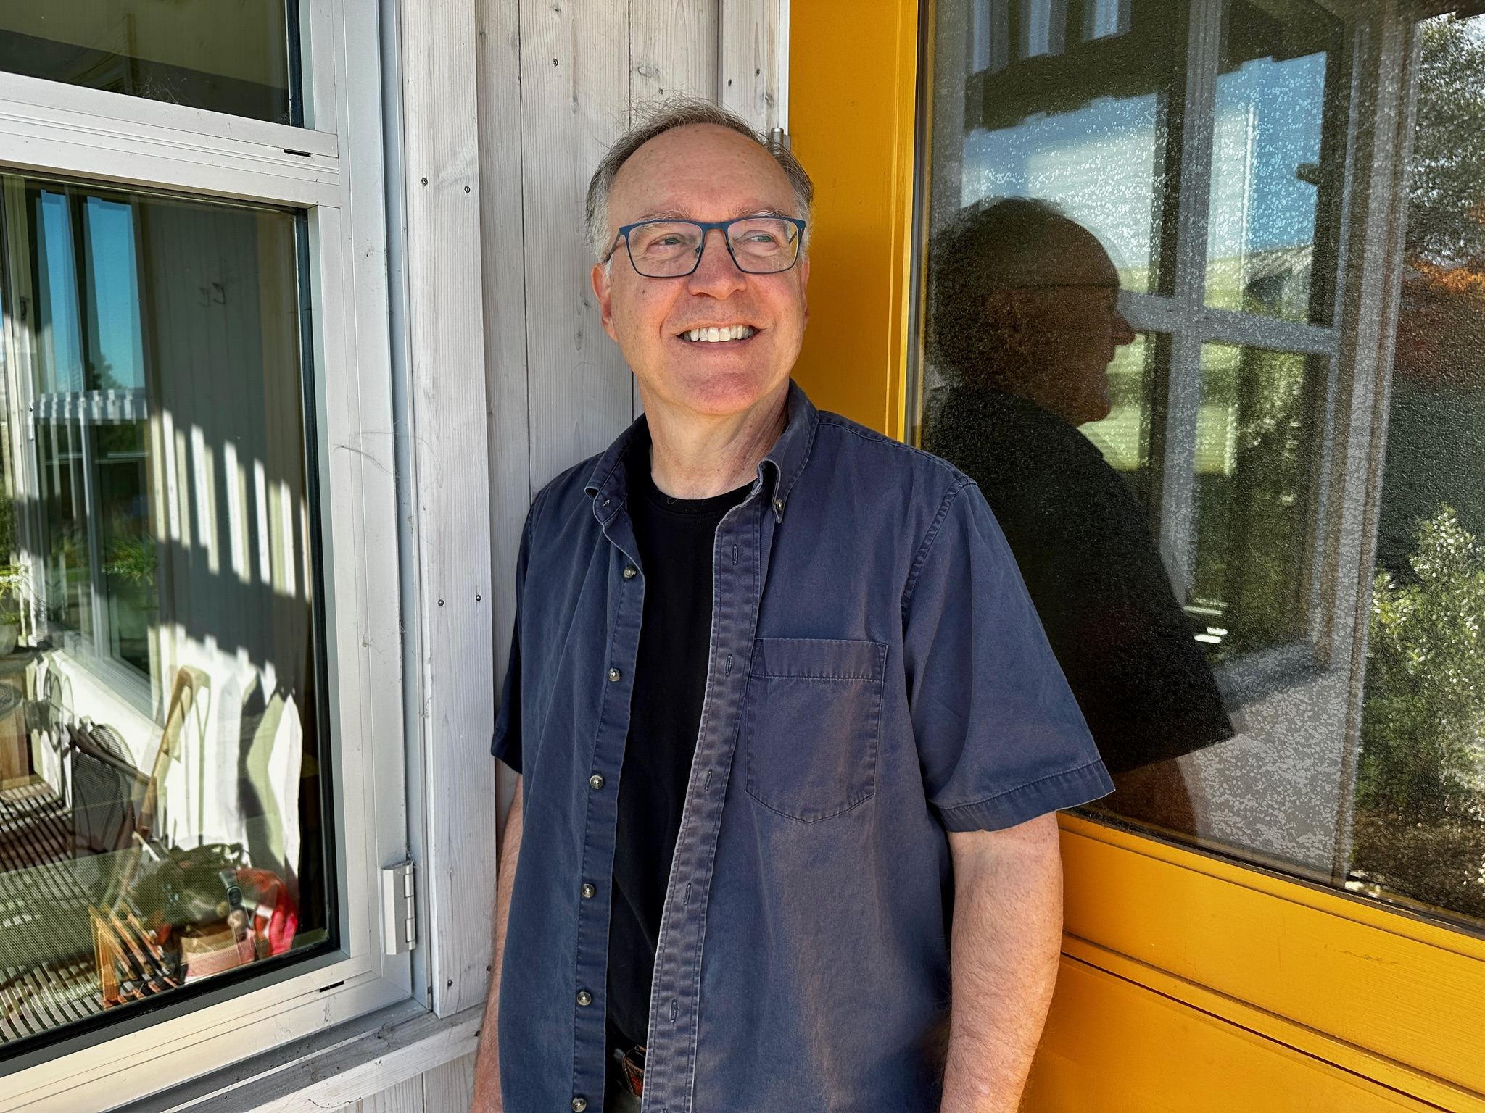
Thank You for Attending
Sonoma County Library: https://sonomalibrary.org/
Sonoma County Poet Laureate
Dave Seter: https://daveseter.com/

Slide 11
Thinking Like _______________: A Few Ideas
Choose a subject in nature that doesn’t “think” the way we do.
Choose large: mountain; ocean; forest; etc. Or choose small: hill; pond; plant; insect; etc.
Make your subject center of its universe.
Inhabit your subject.
What is passing time like for your subject?
Write / solve the Zen koan, or riddle, of how your subject “thinks”.
Mount Rainier
Photo by Dave Seter

Slide 12
Primary Works Cited
Clark, Timothy. “Thinking Like a Mountain?” The Cambridge Introduction to Literature and the Environment. New York: Cambridge U Press, 2011.
Leopold, Aldo. “Thinking Like a Mountain.” A Sand County Almanac. New York: Oxford U Press, 1989: 129-133.
The New Shorter Oxford English Dictionary, 1993 Edition.
Seter, Dave. “Godzilla Versus an Octopus of Ice.” First published in Don’t Sing to Me of Electric Fences (Cherry Grove, 2021).
Seter, Dave. “Work Stoppage in the Cranberry Bogs.” Climate Change Chronicles, Bronze Bird Books, 2024.
Tallmadge, John. “Anatomy of a Classic.” Companion to A Sand County Almanac. Ed. J. Baird Callicott. Madison: U Wisconsin Press, 1987: 128-153. Web. 28 February 2016.

