Slide 1
Poetry Challenge III
Interweaving (Found) Text
Dave Seter

Slide 2
Who Are We
Sebastopol Center for the Arts is committed to cultivating creativity and inspiring appreciation for the transformative power of art.
Dave Seter
Sonoma County Poet Laureate
2024-26
photo by Robin Mills
We produce, promote and present artists - local, national, international – through curated gallery exhibits, artists open studio events, arts lectures, poetry readings, concerts, adult and youth education, a state-of-the-art ceramics studio and an acclaimed documentary film festival.
We are dedicated to honoring diversity, encouraging creative excellence, and providing a welcoming gathering place for the community to: Experience Art, Make Art, Share Art and Celebrate Creative Thought.
Dave Seter is a poet, nature writer, and author of the poetry collection Don’t Sing to Me of Electric Fences, and the chapbooks Night Duty and Somewhere West of the Mississippi (forthcoming). His poems have won the KNOCK Ecolit Prize and received third place in the William Matthews competition. He earned his undergraduate degree in civil engineering from Princeton University and his graduate degree in humanities from Dominican University of California.

Slide 3
Found Text: General Concepts
Text may be found in everyday life: billboards; road signs; news copy; government documents (such as the U.S. Constitution); overheard conversation or political speeches; other poets’ poems; et cetera.
Text can also be “found” from a “random” process. Example: Dada poet Tristan Tzara wrote poems using random words pulled from a sack.
Text can also be “searched and found” if poet is seeking to augment their own words with the words of an expert; for example, if a poet is writing about earthquakes along the San Andreas Fault they may want to search and find geologic terminology to interweave with their own lines of poetry.

Slide 4
Some Benefits of Using Found Text
Using multiple “voices” de-emphasizes the “I” voice
Allows use of expertise from fields not the poet’s own
Can result in surprising combinations of phrases the poet would not ordinarily use
photo by Dave Seter

Slide 5
Definitions of the Found Poem
The literary equivalent of collage, found poetry is often made from newspaper articles, street signs, graffiti, speeches, letters, or even other poems.
A pure found poem consists exclusively of outside texts: the words of the poem remain as they were found, with few additions or omissions.
Examples of found poems can be seen in the work of Blaise Cendrars, David Antin, and Charles Reznikoff.
Portions of Ezra Pound’s Cantos are found poetry, culled from historical letters and government documents.
Charles Olson created his poem “There Was a Youth whose Name Was Thomas Granger” using a report from William Bradford’s History of Plymouth Plantation.
Special example: the Cento. From the Latin word for “patchwork,” the Cento is a poetic form composed entirely of lines from poems by other poets.
“Found Poem.” Glossary of Poetic Terms. Academy of American Poets. Digital file. Retrieved 12/9/24.
“Found Poem.” Glossary. The Poetry Foundation. Digital file. Retrieved 12/9/24.
“Cento.” Glossary. The Academy of American Poets. Digital file. Retrieved 01/14/25.

Slide 6
Master of Found Text: Marianne Moore (1887-1972)
Moore’s ability to place different types of language in dialogue with one another has become one of the most frequently noted features of her body of work.
Moore’s definition of culture encompassed a wide range of materials, including, but not limited to, scientific reports, descriptions of the natural world, conversational fragments, advertisements, and other literary texts, all of which appear, at some point, in her poems.
Darling, Kristina Marie. “Reclaiming the Intellectual Agency of Women: Marianne Moore & Jamesian Psychology.” Kenyon Review. First published March 20, 2019. Digital file.
Marianne Moore
Photo from Poetry Foundation website
Uncredited photo

Slide 7
Marianne Moore’s “An Octopus”
The title of the poem is deceptive: Moore’s poem is about Mount Rainier in Washington State. The poem is 227 lines long. The citations for sources of found text are given in the version of the poem appearing in The Norton Anthology of Modern and Contemporary Poetry, 3rd Ed.
Photo of Mount Rainier by Dave Seter

Slide 8
“Godzilla Versus an Octopus of Ice” (after Moore)
Sea-Tac to Mt. Rainier—on the drive—615 thousand cars per year will lose sight
of the mountain and may rely on the storytelling device
of National Park Service brochures to keep the mountain present—
so did the poet Marianne Moore—who adopted the octopus of ice in 1922.
Arms of glaciers dangle down the mountain’s talus slopes—alive themselves—
in fact, you night hear a ventriloquistic nasal eeeeenk—
then see a pika appear, thick-set, 5-6 inches, no tail, ears round. You might
think you see a rodent, but the posture is rabbit-like.
Only the mountain
has lived long enough to listen objectively to the call of the rabbit-like pika.
The octopus—with its pinkness in late-lying snowfields of living algae—is also alive,
but it has lost twenty-five percent of its grandeur and mass
since Marianne Moore slept here, at the foot of the mountain, in Paradise.
Photo by Dave Seter
Lines 19-31 of the 233-line poem “Godzilla Versus an Octopus of Ice”
From: Seter, David. “Introducing Godzilla to Marianne Moore’s Octopus of Ice at the Intersection of Global Warming, Environmental Philosophy, and Poetry.” Master’s Thesis, Dominican University of California.

Slide 9
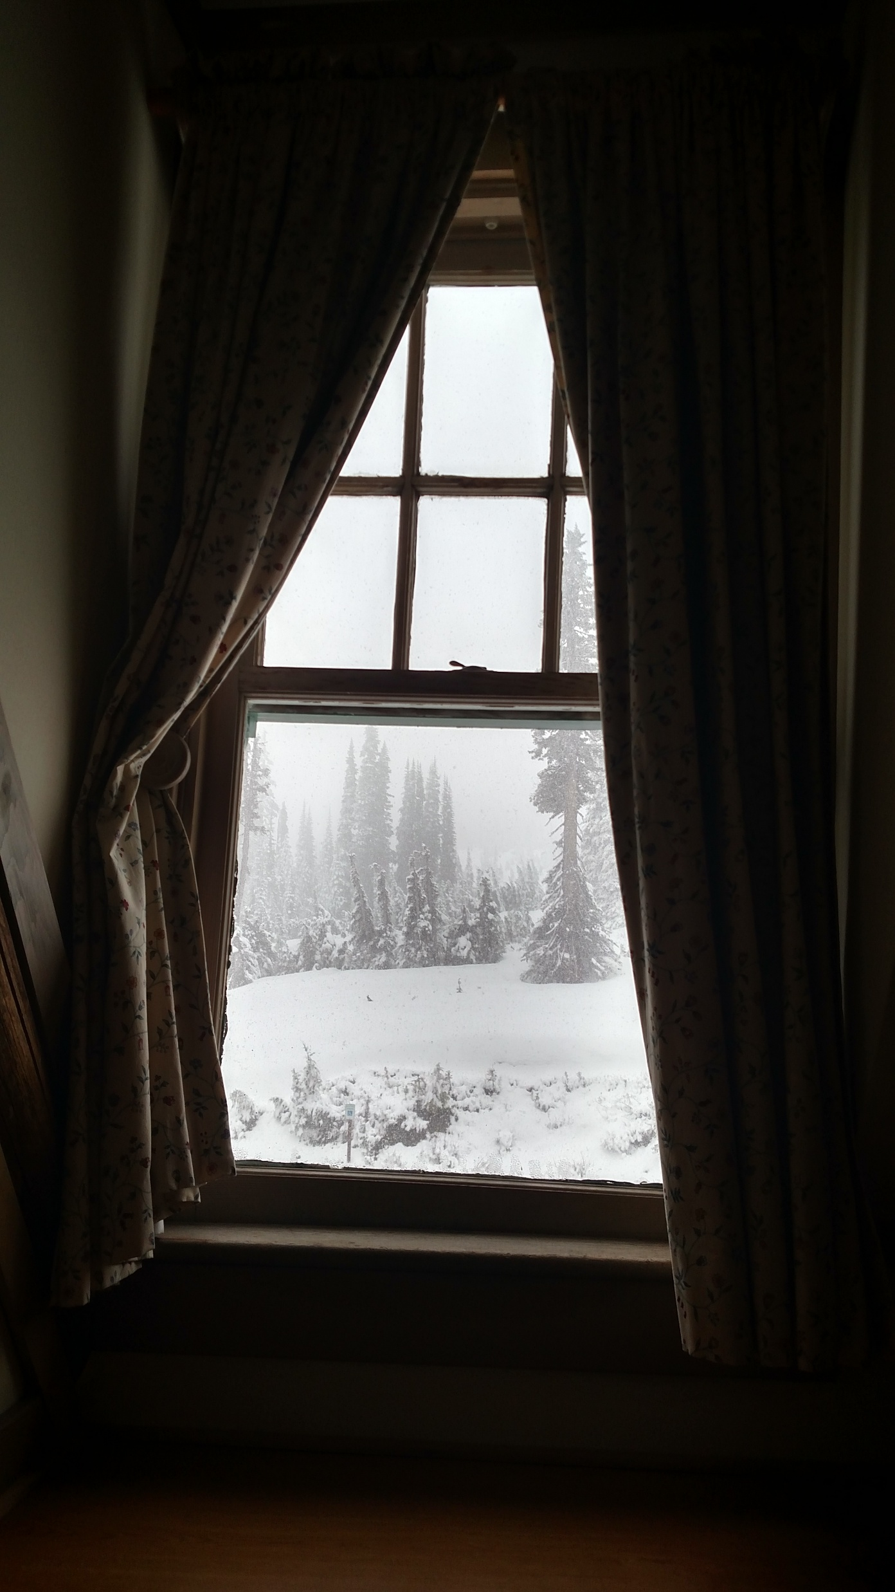
Sources: Lines 19-31 of “Godzilla Versus an Octopus of Ice”
Line 24 / a ventriloquistic nasal eeeeenk
Daniel Mathews’ Natural History of the Pacific Northwest
Line 27-28 / Only the mountain / has lived long enough to listen objectively
Aldo Leopold’s “Thinking Like a Mountain”
Line 29 / pinkness in late-lying snowfields of living algae
National Park Service Website for Mount Rainier
Photo by Dave Seter

Slide 10
The U.S. Constitution as a Source of Found Text

Slide 11
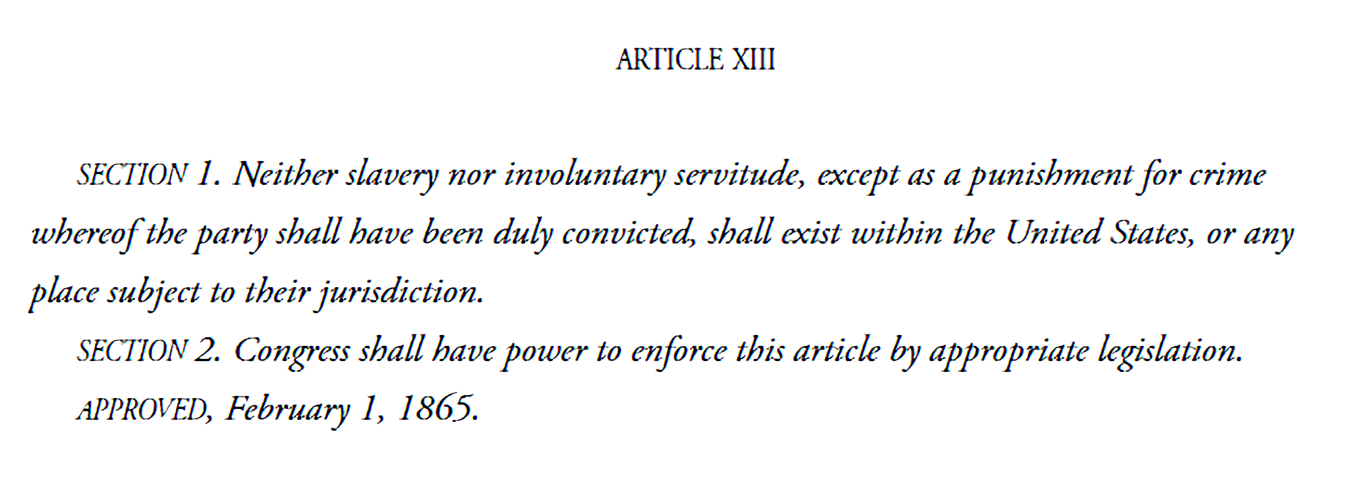
Donnell: Found Text from the U.S. Constitution (1st Stanza)
Keith Donnell, Jr.
Photo from Poetry Foundation website
uncredited photo

Slide 12
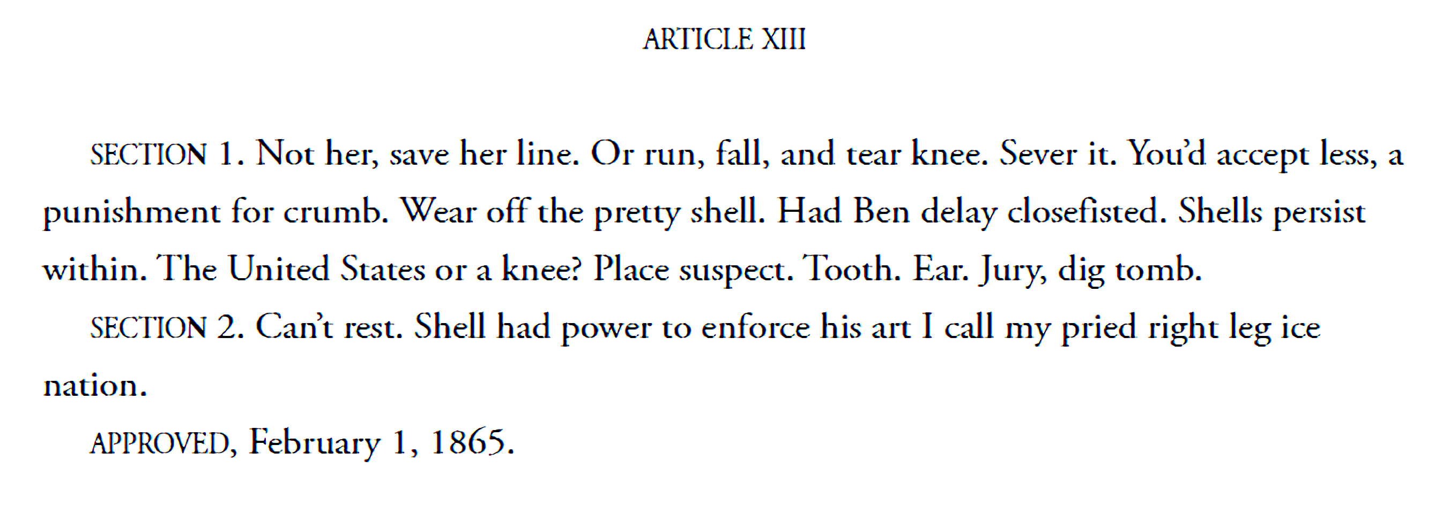
Donnell: Modified Text from the U.S. Constitution (2nd Stanza)
Keith Donnell, Jr.
Photo from Poetry Foundation website
uncredited photo

Slide 13
Writing Prompt One: Follow the Example of Keith Donnell, Jr.
Choose a topic of interest to you appearing in the Constitution
Review the text in the Constitution for the topic you have chosen
Do a “free write” responding to and/or modifying the language found in the Constitution
Use Donnell’s example, with the first stanza of your poem composed of text from the Constitution, and with the second stanza composed of text from your free write

Slide 14
Writing Prompt Two: Canada as 51st State
Read Article IV, Section 3, of the Constitution which specifies how States are admitted to the Union.
Do a “free write” exploring your thoughts on whether Canada should become the 51st State.
Bonus: add found text to your poem taken from Canada travel brochures.

Slide 15
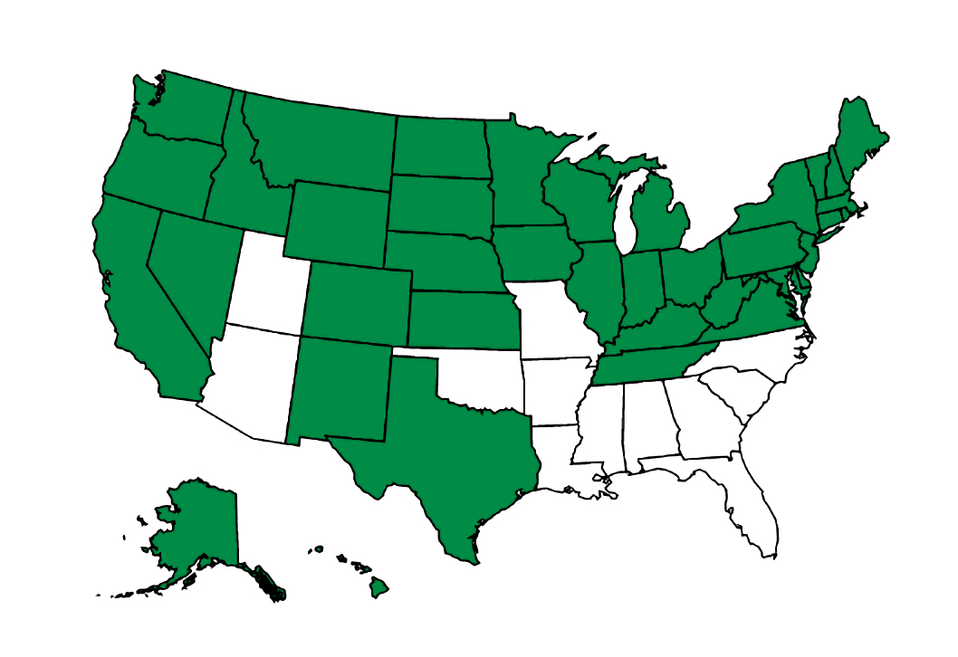
Writing Prompt Three: The Proposed Equal Rights Amendment
"ARTICLE —
"SECTION 1. Equality of rights under the law shall not be denied or abridged by the United States or by any State on account of sex.
"SEC. 2. The Congress shall have the power to enforce, by appropriate legislation, the provisions of this article.
"SEC. 3. This amendment shall take effect two years after the date of ratification.“
(Proposed Amendment to the Constitution, Ninety-Second Congress, 1972)
Do a “free write” exploring your thoughts on the Equal Rights Amendment. What does it say? What doesn’t it say?
Interweave the text of your free write with the text of the proposed Equal Rights Amendment to create your poem. Or use Donnell’s approach.

Slide 16
Writing Prompt Four: Found Text from SebArts Gallery
Walk the gallery and hallways, find and write down words or phrases that interest you or speak to each other.
Return to the writing space and interweave the found text into a poem. Feel free to intersperse your own words linking the found words and phrases together.

Slide 17
Sharing (Optional)
Share which prompt you chose
Read your draft poem (or a portion of the poem) to the group (if you feel comfortable doing so)
Give your overall reaction to the exercise:
Pros
Cons

Slide 18
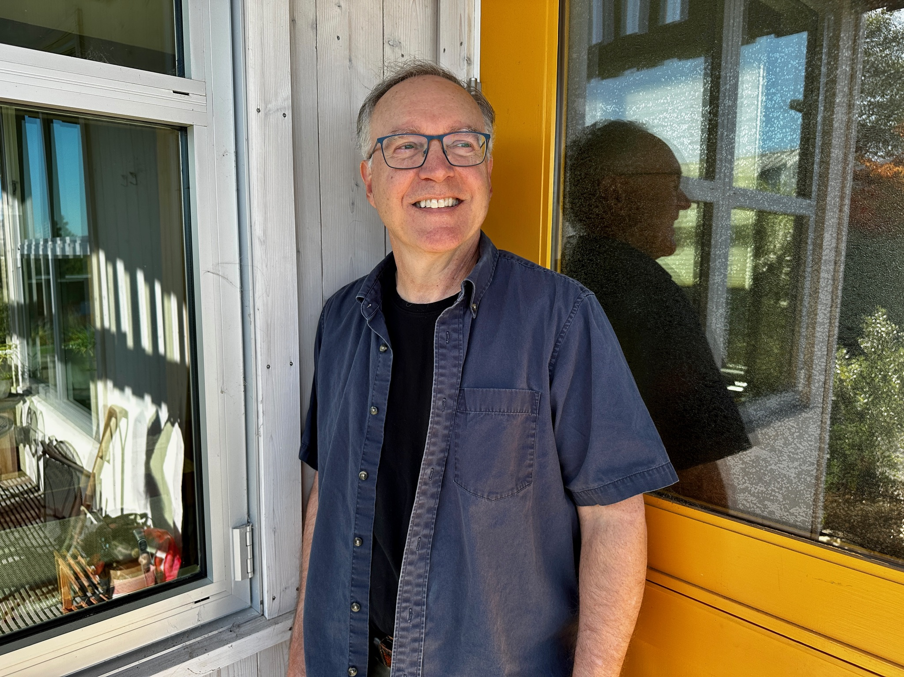
Thank You for Attending
Sebastopol Center for the Arts: https://www.sebarts.org/
Dave Seter: https://daveseter.com/

