Slide 1
Poetry Challenge I
Abstraction through Form
(The Questina Form)
Dave Seter

Slide 2
Who Are We
Sebastopol Center for the Arts is committed to cultivating creativity and inspiring appreciation for the transformative power of art.
Dave Seter
Sonoma County Poet Laureate
2024-26
photo by Robin Mills
We produce, promote and present artists - local, national, international – through curated gallery exhibits, artists open studio events, arts lectures, poetry readings, concerts, adult and youth education, a state-of-the-art ceramics studio and an acclaimed documentary film festival.
We are dedicated to honoring diversity, encouraging creative excellence, and providing a welcoming gathering place for the community to: Experience Art, Make Art, Share Art and Celebrate Creative Thought.
Dave Seter is a poet, nature writer, and author of the poetry collection Don’t Sing to Me of Electric Fences, and the chapbooks Night Duty and Somewhere West of the Mississippi (forthcoming). His poems have won the KNOCK Ecolit Prize and received third place in the William Matthews competition. He earned his undergraduate degree in civil engineering from Princeton University and his graduate degree in humanities from Dominican University of California.

Slide 3
Agenda for Today’s Workshop
1:00—1:15 INTRODUCTIONS
1:15—1:45 PRESENTATION ON TOPIC
1:45—2:15 WRITING EXERCISE
2:15—2:50 SHARING TIME
2:50—3:00 WRAP UP

Slide 4
Why Write in Form
When we think of mastery, we think of practice, and when we think of practice, we often think of repetition.
When we practice, we do two things: we isolate a technique for study, and we engage with difficulty.
In poetry, one of the best ways to practice technique is to write in (…) forms.
Hazleton, Rebecca. “Why Write in Form?” Poetryfoundation.org.
Originally Published: May 09, 2016

Slide 5
Abstraction
(3)(a) the act of considering something independently of its associations, attributes, or concrete accomplishments
(4) freedom from representational qualities in art
Imbolc by Holly Blake
The New Shorter Oxford English Dictionary (1993 Edition)

Slide 6
Dean Young
If the poet does not have the chutzpah to jeopardize habituated assumptions and practices, what will be produced will be sleep without dream, a copy of a copy.
The error is not to fall but to fall from no height.
The blood may be fake but the bleeding must be real.
Photo from The Poetry Foundation website
Young, Dean. The Art of Recklessness
Graywolf Press, 2010

Slide 7
An Incomplete List of Poetic Forms
OLD
Ballad
Ghazal
Pantoum
Sestina
Sonnet
Villanelle
Limerick
NEW
Golden Shovel (Terrance Hayes)
Tritina (Marie Ponsot)
Sonnetina
(Sonnetina Tre)
(Sonnetina Cinque)
and now… the Questina

Slide 8
The Sestina Form—Rules
The sestina is composed of seven stanzas: six sestets and one envoi of three lines.
End words of the sestets are repeated following a strict pattern:
1 2 3 4 5 6
6 1 5 2 4 3
3 6 4 1 2 5
5 3 2 6 1 4
4 5 1 3 6 2
2 4 6 5 3 1
The six end words must also appear in the envoi:
(6 2) (1 4) (5 3)

Slide 9
The Sestina Form—Examples
Examples:
“Sestina” by Elizabeth Bishop
“Farm Implements and Rutabagas in a Landscape” by John Ashbery
“Mantis” by Louis Zukofsky
“Paysage Moralise” by W. H. Auden
“Toward Autumn” by Marilyn Hacker

Slide 10
First Two Stanzas of “Sestina” by Elizabeth Bishop
September rain falls on the house. In the failing light, the old grandmother sits in the kitchen with the child beside the Little Marvel Stove, reading the jokes from the almanac, laughing and talking to hide her tears. She thinks that her equinoctial tears and the rain that beats on the roof of the house were both foretold by the almanac, but only known to a grandmother. The iron kettle sings on the stove. She cuts some bread and says to the child,
Photo from Academy of American Poets website

Slide 11
Qualities of the Sestina Form
A Sestina is like playing ping-pong with six balls and six other players.
The repetition of the end-words gives you a chance to mull over the themes that obsess you.
Guthrie, Camille. “Why Write Sestinas.” Poetryfoundation.org.
Originally Published: April 16, 2013

Slide 12
The Questina Form
Patterned after the Sestina but has four quatrains (instead of six sestets) and a two-line (instead of three-line) envoi.
Could be considered a short attention span Sestina
Quatrain + Sestina = Questina
Quest (n): (3) Any inquiry or investigation, the object of this
The New Shorter Oxford English Dictionary (1993 Edition)

Slide 13
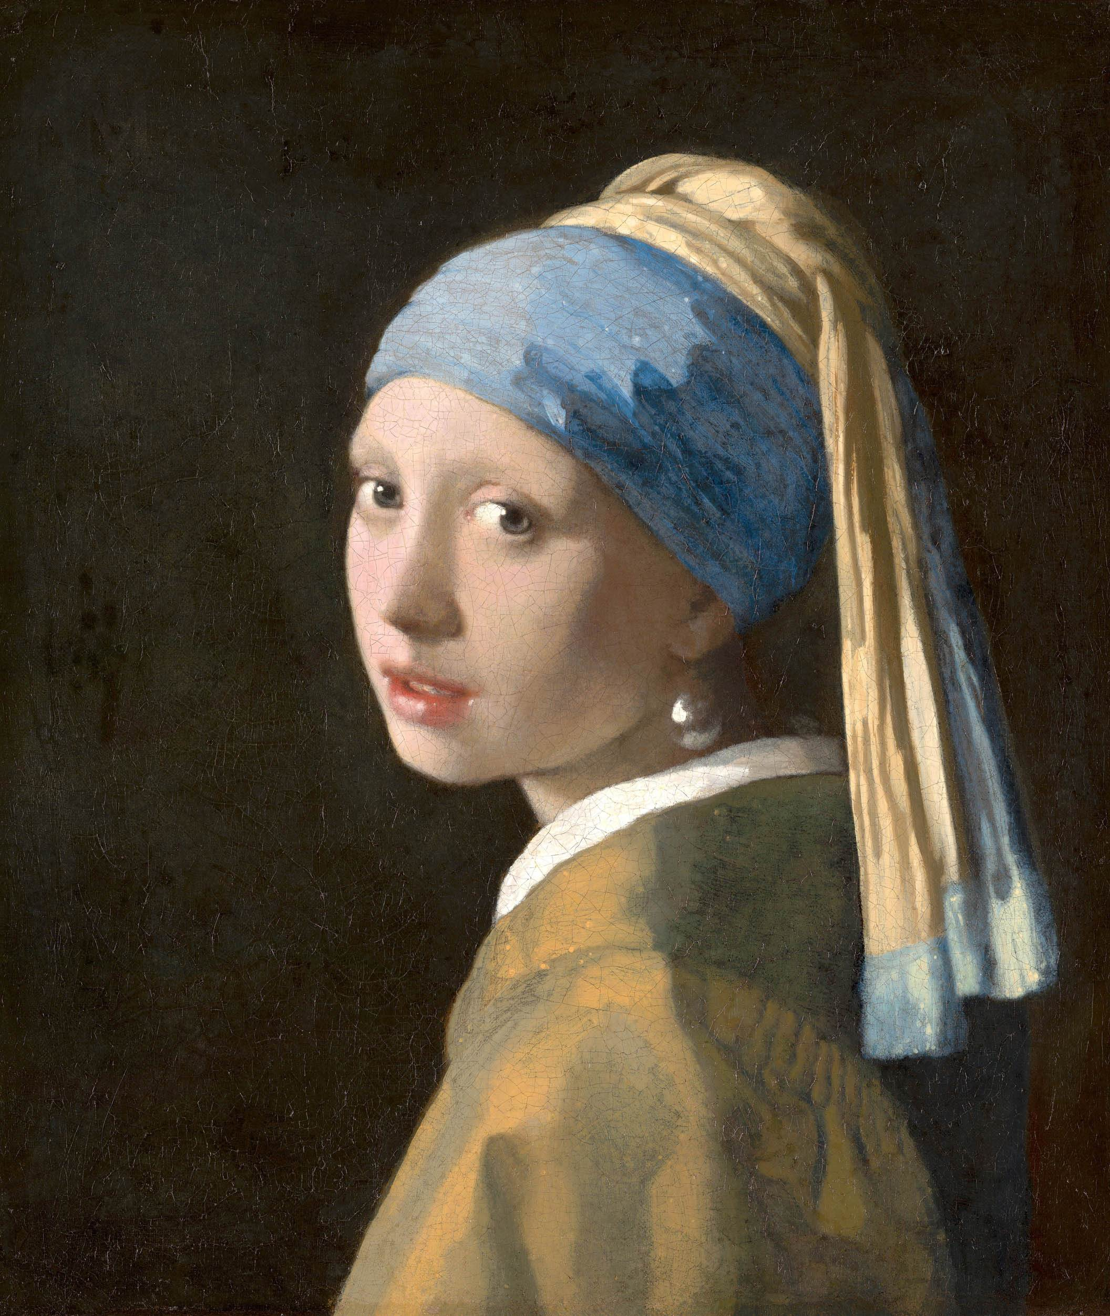
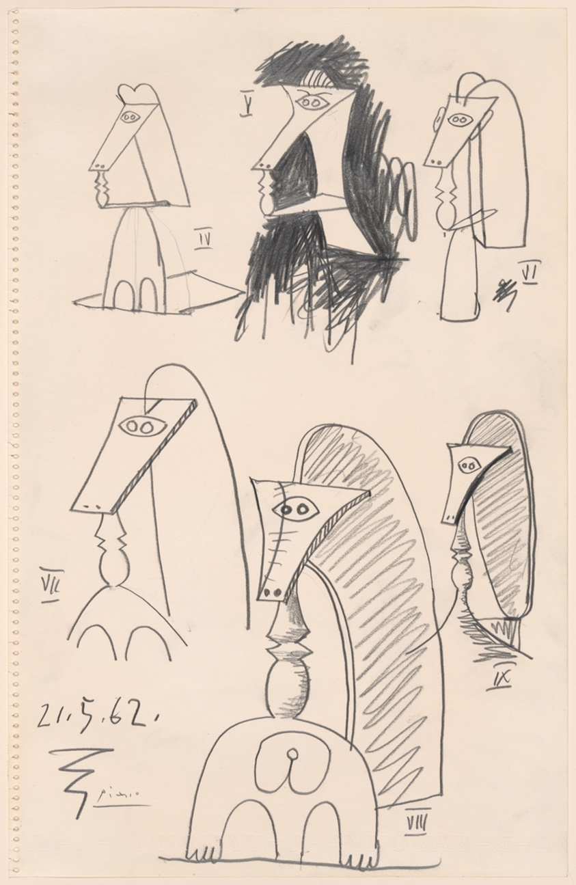
Sestina Versus Questina at a Glance
The Sestina has more layers
The Questina is more of a sketch
Vermeer’s Girl With a Golden Earring
Picasso’s Six Busts of Women

Slide 14
Rules of the Questina (Original Version)
USING THE END WORDS ABCD:
Stanza 1: ABCD
Stanza 2: DACB
Stanza 3: BDAC
Stanza 4: CDBA
Two-Line Envoi:
First Line: AB or BA (optional to end the line on one of these words)
Last Line: CD or DC (optional to end the line on one of these words)

Slide 15
Example Questina
WORD A = carbon
WORD B = mirror
WORD C = smoke
WORD D = song
*note: rhyming is NOT a requirement of either the Sestina or Questina

Slide 16
Example Questina: “Smoke and Mirrors”
Though both the human body and Kevlar contain carbon,
they can’t equally resist smoldering looks in mirrors.
From the first our machines spewed fire and smoke,
automobiles with back seats and radios tuned to love songs.
Overtaken by fire you can’t run but you can sing,
like the bird who returns when trees seem blackest carbon.
Is it truly wise, in the aftermath of blown smoke,
to rebuild a nest from memory, the mind’s mirror?
If a still body’s breathing you can see it in a mirror.
If you wait them out birds will betray themselves with song.
Common to all life: hydrogen, oxygen, nitrogen, carbon.
We are Big Bang remnants and there must have been smoke.
Birds mate, we mate, through wildfire, cigarette smoke.
Not all species need courage in whiskey and bar song,
slicking back their feathers in a barroom mirror.
Genetics change, our generation isn’t yours, a carbon-copy.
I will sing you a song about the science of fire, about carbon,
not lie like the broken jukebox blaring its smoke and mirrors.
Dave Seter
“Smoke and Mirrors”
Somewhere West of the Mississippi
Mammoth Publications (2025)

Slide 17
Questina: How to Choose End Words
Words that are in tension with one another, for example:
Love / Hate
War / Peace
Etc.
Words that have a relationship worth exploring, for example:
Dog / Cat
Chocolate / Vanilla
Etc.
Words that explore a personal obsession, quest or question.

Slide 18
Questina: A Few Possible Pairs of End Words
Love / Hate
War / Peace
Brother / Sister
Father / Mother
Black / White
Stop / Go
Winner / Loser
Day / Night
Winter / Summer
Fire / Rain
Bee / Insecticide
Drought / Flood
Birth / Death
Sun / Moon
Earth / Mars
UFO / Airplane
Rich / Poor
Plain / Checked
Chocolate / Vanilla
Housed / Unhoused
Truth / Lie
Ancient / Modern
Laugh / Cry
City / Country
Hawk / Dove
Sweet / Sour
Boy / Girl
Binary / Nonbinary

Slide 19
Where Does Abstraction Come In
The degree of abstraction depends to some extent on the choice of word pairs
The obsessive nature of word repetition stretches the brain to explore new territory
The “word game” nature of the form may lead to new insights on the meaning of words.

Slide 20
Writing Exercise
Choose four end words
Choose from the list provided or choose your own
Words that are in tension with one another
Words that have a relationship worth exploring
Words that explore a personal obsession, quest or question
Assign the words the letters A, B, C, D
Place the words in designated places in fill-in-the-blank form
Surround the words with your own text
Your choice: stream of consciousness or scientific method

Slide 21
Sharing
Share what four words you chose
Read your Questina to the group (if you feel comfortable doing so)
Overall reactions to the writing exercise:
Pros
Cons

Slide 22
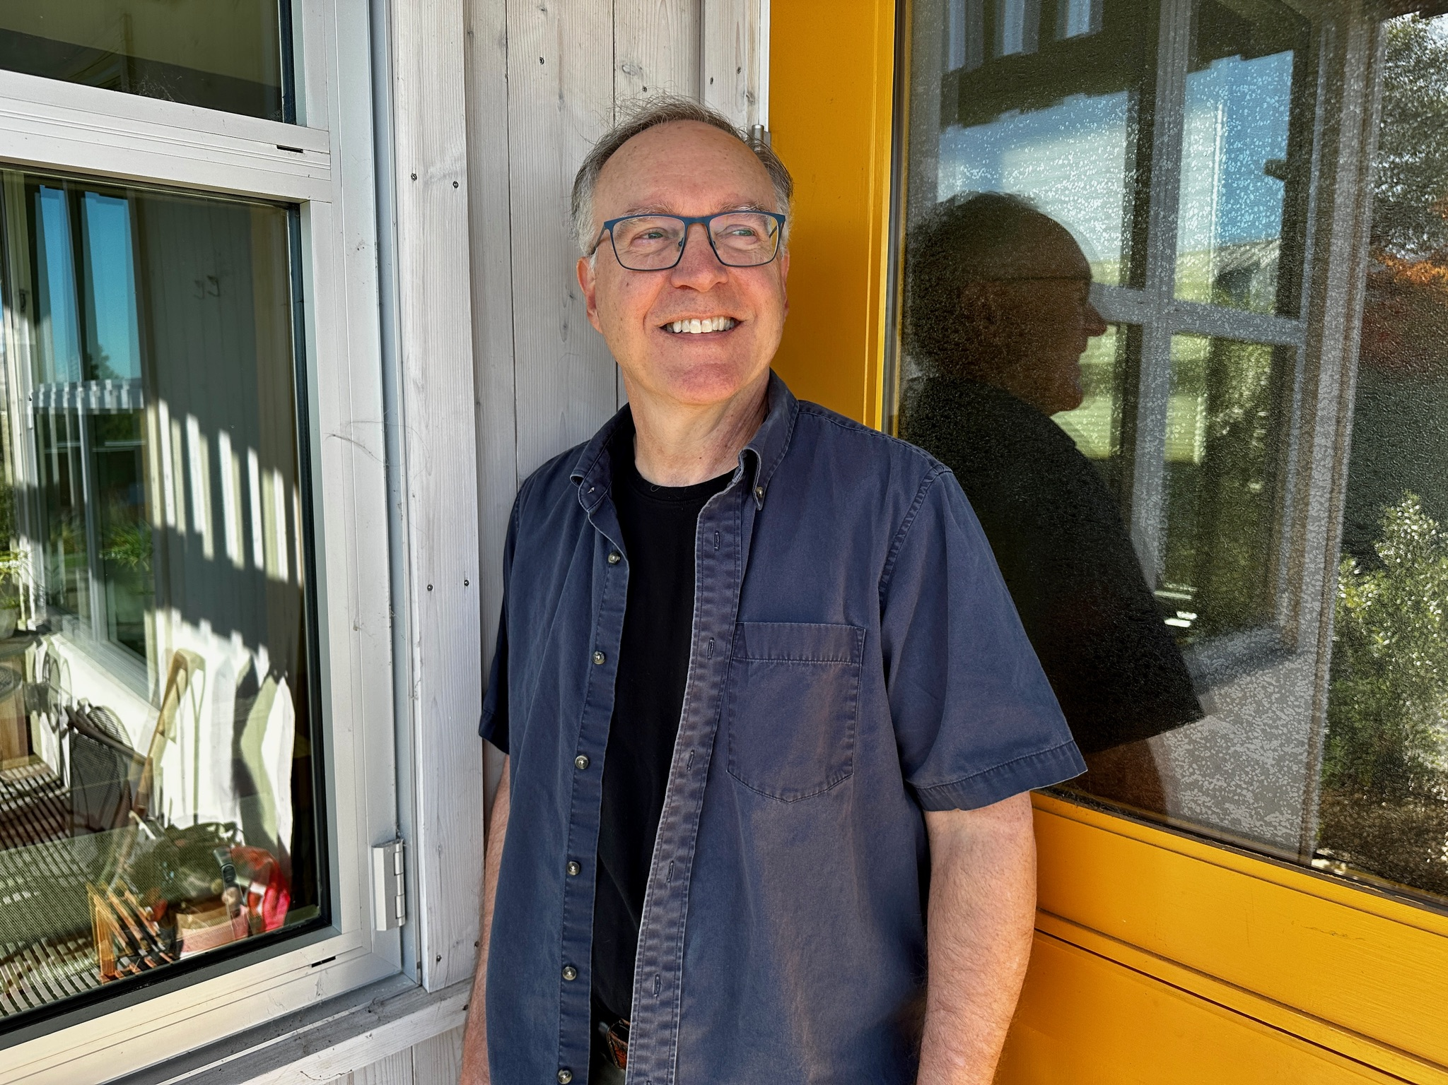
Thank You for Attending
Sebastopol Center for the Arts: https://www.sebarts.org/
Dave Seter: https://daveseter.com/

