Slide 1
Introducing Godzilla to Marianne Moore's octopus of ice
Presentation for Discussion
Vintage House
March 2026
Dave Seter
Sonoma County Poet Laureate 2024-6

Slide 2
Or: How to Write a Poem about Global Warming
Environmental Philosophy: Thinking Like a Mountain
Poetry: Marianne Moore’s “An Octopus”
Science: Global Warming and Mt. Rainier
Popular Culture: Godzilla

Slide 3
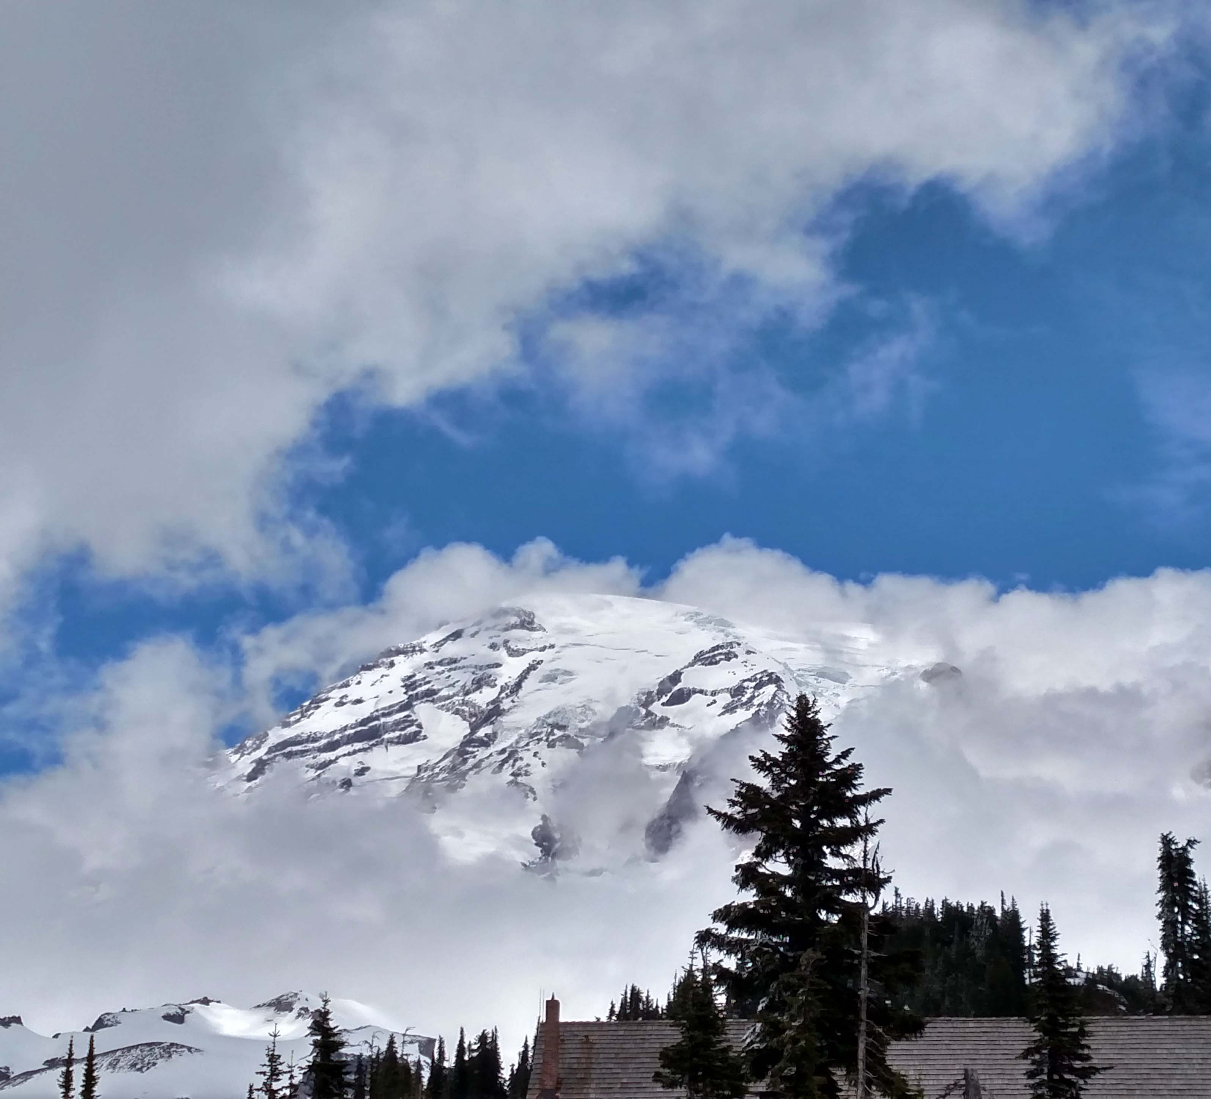
How to Write a Poem about Global Warming Part One – Think Like a Mountain
Aldo Leopold: “Thinking Like a Mountain.”
The phrase “thinking like a mountain” has been employed by ecologists to argue for a holistic view of nature that recognizes the interconnectedness of things.
Leopold: Only the mountain has lived long enough to listen objectively to the howl of a wolf (129).
If a mountain may think, or feel, it is through the transmission of life forces across its own being, from the dying wolf to the retreating glacier.

Slide 4
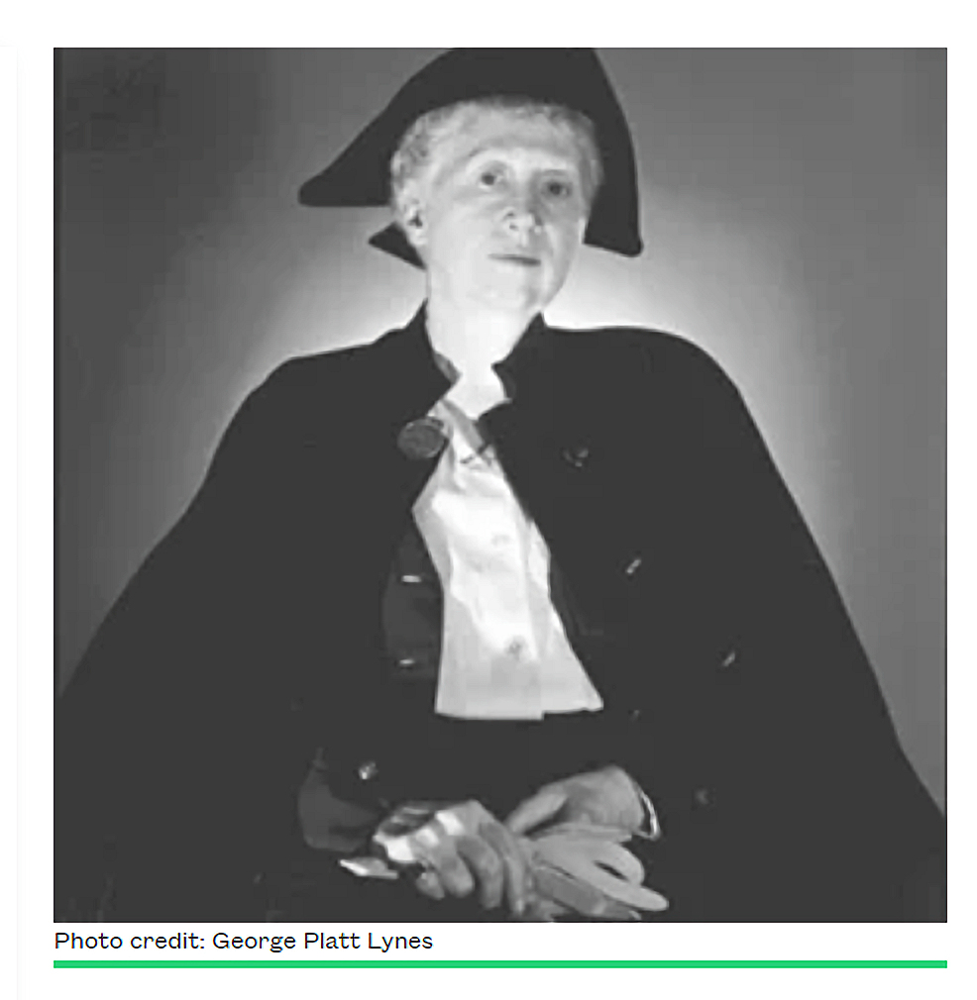
How to Write a Poem about Global Warming Part Two – Write Like Marianne Moore
Marianne Moore: “An Octopus”
About Mt. Rainier and the “octopus of ice” slung across its shoulders.
Published 1924.
Thinks like a mountain through a technique of collage / through transmission of life forces across the page.
In an age when such major poets as Eliot and Yeats have treated nature with an imperiousness that, at times, recalls their symbolist forebears, Miss Moore is ready to accord to objects and to animals a life of their own. (Tomlinson 1)
Marianne Moore
Poets.org website

Slide 5
How to Write a Poem about Global Warming Part Three – Describe the Retreating Octopus of Ice
The octopus contains 25% of all the ice in the lower 48 United States (Beason).
The octopus lost 25% of its volume between 1913 and 1994 (Portland State University).
Recent rate of loss is as much as 3% per year (Beason).
Species in retreat include: subalpine wildflowers; pika; and whitebark pine.
Mt. Rainier (photo by Dave Seter)

Slide 6
Problems in Communicating Global Warming: Morton
Timothy Morton: Global warming is a hyperobject and hyperobjects are inherently difficult to explain.
Definition of hyperobject (Morton 207):
Massively distributed in time and space.
Viscous—they have the strange quality of sticking to you the more you try to shake them off.
The more you know about them, the stranger and even more terrifying they become.
It’s only possible for humans to see pieces or aspects of them at any one time.

Slide 7
Problems in Communicating Global Warming: Marshall
George Marshall: our brains are wired to ignore climate change / global warming.
Confirmation bias: a person tends to fit information into his or her existing, already formed, belief system.
There are risks involved with holding views that are out of step with your social or peer group.

Slide 8
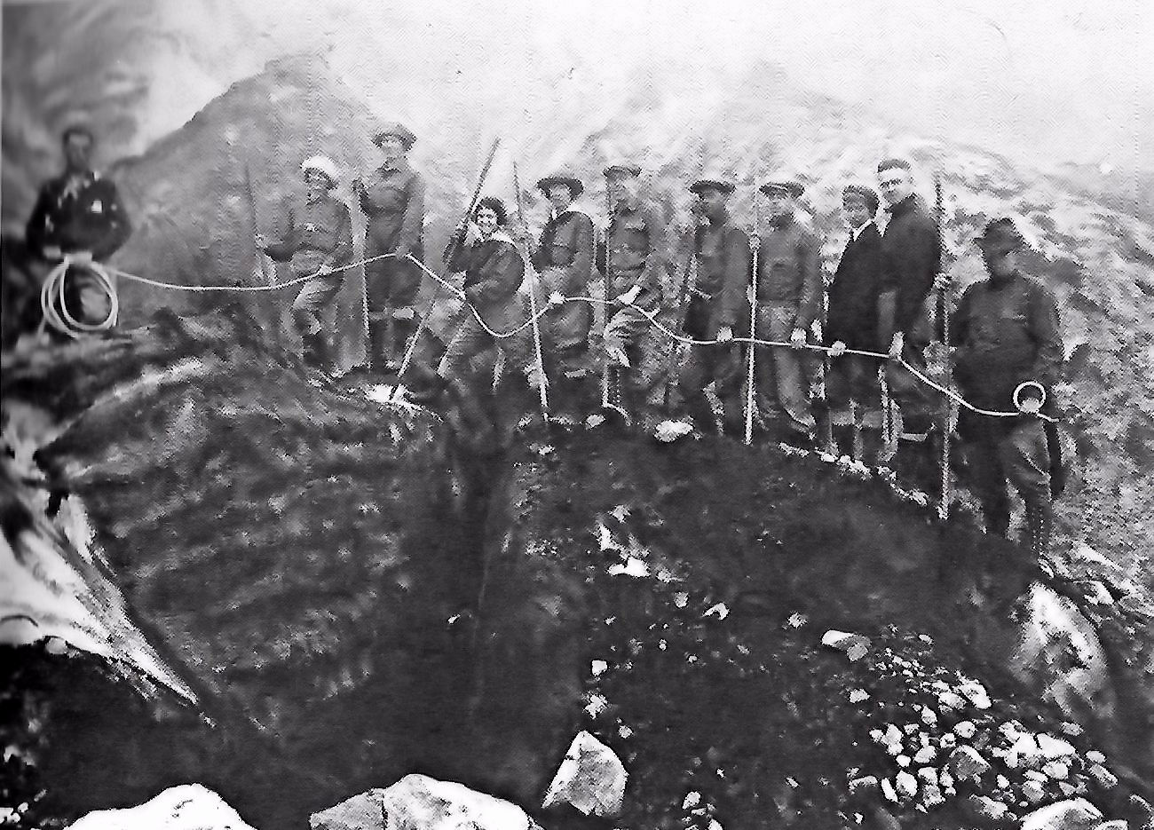
Addressing Morton’s Concerns
To the extent that global warming is a puzzle to be solved, the poet could hardly do better than to think like a forest, a mountain, or a glacier, in writing a poem that responds to the ecological condition of global warming. One way in which to think like a natural feature is to present the wealth of data the natural feature encounters, in the example of the mountain: fire, snow, creatures traversing and nesting in its terrain, the mountain climber, etc. Marianne Moore attempts to unravel the riddle of the octopus of ice, and its meaning, by assembling data from various sources much like a scientist. (Seter: 37)
Marianne Moore on Mt. Rainier
Photo from Rosenbach Museum

Slide 9

Addressing Marshall’s Concerns
And yet, in a world of denial, perhaps an agglomeration of detail isn’t enough in writing a contemporary, impactful, poem about global warming. To bridge the peer groups who hold differing opinions, pro and con, on global warming, perhaps a symbol of popular culture accepted by both peer groups is needed. Or better than a symbol, a gender-neutral spokesperson rooted in popular culture who may shake up our common understanding of global warming. A charismatic spokesperson to reach a larger audience than the less thrilling scientist quietly processing climate data: Godzilla, who was born in 1954 from nuclear weapons testing in the Pacific. (Seter: 37)
Movie Poster
Japanese Version
Original Movie: Godzilla

Slide 10
Q: How to Write a Poem about Global Warming? A: Introduce Godzilla to M. Moore’s Octopus of Ice

Slide 11
Primary Works Cited
Beason, S. R. “Change in Glacial Extent at Mount Rainier National Part from 1896 to 2015: Natural Resource Report NPS/MORA/NRR—2017/1472.” Fort Collins, Colorado: National Park Service, 2017.
Leopold, Aldo. “Thinking Like a Mountain.” A Sand County Almanac. New York: Oxford U Press, 1989: 129-133.
Marshall, George. Don’t Even Think About It: Why Our Brains Are Wired to Ignore Climate Change. New York: Bloomsbury, 2014.
Moore, Marianne. “An Octopus.” The Norton Anthology of Modern and Contemporary Poetry. Ramazani, Jahan, ed. New York: Norton, 2003: 441-446.
Morton, Timothy. “Sublime Objects.” Speculations Journal v 1.0 (2011): 207-227. Digital file.
Portland State University. “Glaciers and Glacier Change: Mount Rainier National Park.” Web content. Accessed July 7, 2017.
Seter, David. “Introducing Godzilla to Marianne Moore's Octopus of Ice at the Intersection of Global Warming, Environmental Philosophy, and Poetry.” MAH Thesis. Dominican University of California, 2018.
Tomlinson, Charles. “Introduction.” Marianne Moore: A Collection of Critical Essays, Tomlinson, Charles ed. Englewood Cliffs, New Jersey: Prentice Hall, 1969.

