Slide 1
Poetry Challenge II
Documentary Poetry
Dave Seter

Slide 2
Who Are We
Sebastopol Center for the Arts is committed to cultivating creativity and inspiring appreciation for the transformative power of art.
Dave Seter
Sonoma County Poet Laureate
2024-26
photo by Robin Mills
We produce, promote and present artists - local, national, international – through curated gallery exhibits, artists open studio events, arts lectures, poetry readings, concerts, adult and youth education, a state-of-the-art ceramics studio and an acclaimed documentary film festival.
We are dedicated to honoring diversity, encouraging creative excellence, and providing a welcoming gathering place for the community to: Experience Art, Make Art, Share Art and Celebrate Creative Thought.
Dave Seter is a poet, nature writer, and author of the poetry collection Don’t Sing to Me of Electric Fences, and the chapbooks Night Duty and Somewhere West of the Mississippi (forthcoming). His poems have won the KNOCK Ecolit Prize and received third place in the William Matthews competition. He earned his undergraduate degree in civil engineering from Princeton University and his graduate degree in humanities from Dominican University of California.

Slide 3
Agenda for Today’s Workshop
10:00—10:15 INTRODUCTIONS
10:15—10:45 PRESENTATION ON TOPIC
10:45—11:15 WRITING EXERCISE
11:15—11:50 SHARING TIME
11:50—NOON WRAP UP

Slide 4
Documentary Poetry: An Unofficial Definition
… combines artistic talent along with factual material from the real world or the documents of real witnesses.
… refers to the poetry of witness… from manifold viewpoints, witnesses’ interpretations, and dialogues.
… is a case study of people, events, and places; the poet can test a social and human case, through [their] artistic talent of writing.
… a poet is expected to transfer not only the witnesses’ perspectives but [their] own as well.
Wazzan, Suzanne A. “The Genre of Documentary Poetry in Some Selected Samples of Contemporary Poetry: A Critical Approach.” Theory and Practice in Language Studies, Vol. 13, No. 6, pp. 1429-1437, June 2023

Slide 5
Definition of the Word: Documentary
Adj.(4): factual, realistic, esp. (of a film, etc.) based on real events, places, or circumstances and usu. intended primarily to record or inform.
The New Shorter Oxford English Dictionary (1993 Edition)

Slide 6
Historical Case Study vs. Personal Poetry of Witness
Some of the examples we will cover today represent projects larger than one poem in scope. Generally, those projects are historical case studies which document forms of injustice.
The historical case study is essentially a research project.
However! The documentary poem need not necessarily address an injustice. A documentary poem may be prompted by any number of factors including an interest in family history. This is where genealogical research comes in.
However! Documentary poetry can also represent poetry of personal witness prompted by living history: events we witness during our everyday lives of bullying, racial discrimination, environmental harm, et cetera.
Events of personal witness may prompt the poet to delve further into the type event witnessed to place the event in a greater historical context. This is where research comes in.

Slide 7
Mark Nowak on Documentary Poetry
The movement has no founder or signature spokesperson
Has a Social-Democratic to Marxist political history
Grounded in WPA-era poems
Examples: Muriel Rukeyser’s “The Book of the Dead” and Langston Hughes’ “Johannesburg Mines”
Mark Nowak
Photo from Academy of American Poets website
Nowak, Mark. “Documentary Poetics.” Poetryfoundation.org.
Originally Published: April 17, 2010

Slide 8
Muriel Rukeyser’s Book of the Dead
Written in response to the Hawk’s Nest Tunnel Disaster of the 1930s
Construction of the Hawk’s Nest Tunnel in West Virginia as part of a hydroelectric power project reportedly led to the death by silicosis of hundreds of workers, many of them African American.
The poem is written in sections. It includes poems to individual victims. It also includes sections titled “The Disease,” and “The Doctors,” which draw from medical texts, court transcripts, etc.
Muriel Rukeyser
Photo from Academy of American Poets website
credited to Rollie McKenna

Slide 9
Excerpt from Rukeyser’s Book of the Dead
Almost as soon as work begun in the tunnel
men began to die among dry hills. No masks.
Most of them were not from this valley.
The freights brought many every day from States
all up and down the Atlantic seabord
and as far inland as Kentucky, Ohio.
After the work the camps were closed or burned.
The ambulance was going day and night (…)
Many of the shareholders at this meeting
Were nervous about the division of the profits;
How much has the Company spent on lawsuits?
West Virginia University Press, 2018

Slide 10
Langston Hughes’ Johannesburg Mines
Johannesburg Mines
In the Johannesburg mines There are 240,000 Native Africans working. What kind of poem Would you Make out of that? 240,000 natives Working in the Johannesburg mines.
Langston Hughes
Photo from Academy of American Poets website
uncredited photo

Slide 11
Documentary Poetry / Historical Events
“Bird Strikes Began with Wilbur Wright”
Dayton, Ohio—Wilbur Wright in flight, over cornfields—
later writes in his diary—
Four complete circles. Twice passed over fence into (…) cornfield.
Chased flocks of birds (…)
1 killed which fell on top of upper (…) fell off when swinging a sharp curve.
Wilbur Wright wasn’t just flying, but chasing a flock—
of what—crows—or redwing blackbirds?
The Wright Flyer 1905
Uncredited photo from Brittanica website
Dave Seter, excerpt from a draft poetry manuscript Dear Science

Slide 12
Documentary Poetry / Personal Witness
“Tribal Fishing Report”
(…) I’m here to help heal the land a century and a half after
the Bannock War ended badly and imprisoned warriors,
forced those off the land who tried to take back the land,
who lived close to the land, who left their blood on the land.
Scars take time to heal. Before men turned Mill Creek
the color of rust, the land would pull native redband trout
upstream on invisible lines of scent to the headwaters
where trout would spawn and fry would hatch.
What happened next is written across the earth.
A mining corporation filled the creek with speculation,
jumped the land’s claim to copper with bulldozers.
The exclamations of dynamite reverberated. (…)
Excavating Mine Tailings from Mill Creek
Photo by Dave Seter
Dave Seter, excerpt from Somewhere West of the Mississippi (Marathon Publications, 2025)

Slide 13
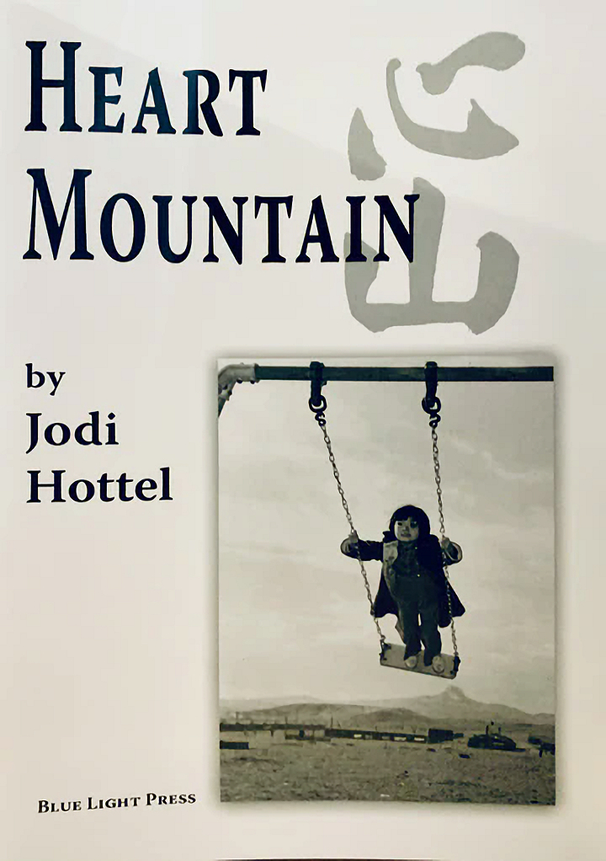
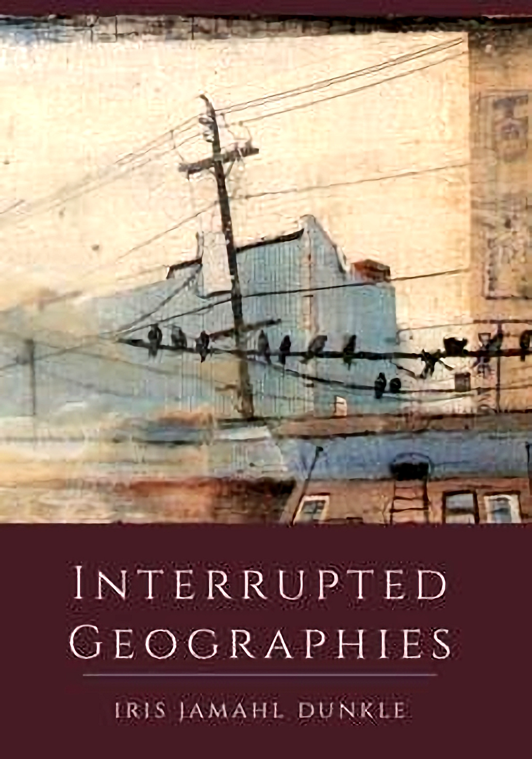
Documentary Poetry of Some Sonoma County Poets
Jodi Hottel. Heart Mountain (Blue Light Press, 2012).
Iris Dunkle. Interrupted Geographies (Trio House Press, 2017.)
The poems in this chapbook explore the relocation of Japanese Americans, including Hottel’s mother, to relocation camps including the one at Heart Mountain, Wyoming.
This collection includes a series of poems which document the sordid boom and bust history of the oil town known as Pithole, Pennsylvania, including a history of women forced into a life of prostitution.

Slide 14
Documentary Poetry of Some Sonoma County Poets
Denise Low. House of Blood House of Grace (University of Arizona Press, 2024).
The book responds to a rich archive: oral and written accounts, maps, dances, and archaeology about the Gnadenhutten, Ohio, massacre of Indigenous people by renegade Revolutionary soldiers. Benjamin Franklin commented on this tragedy as well as the Shawnee leader Tecumseh. The book’s arc follows a sequence of consequences, including deforestation, diaspora of Delawares, restoration, stereotyping, and continuance of traditions and spirituality.
Information retrieved from the poet’s website https://deniselow.net/

Slide 15
Documentary Research: Sonoma County Resources
Sonoma County Library Digital Collections: https://digital.sonomalibrary.org/local-history-culture/local-history-genealogy-notes
Sonoma County History and Genealogy Library: 725 3rd Street, Santa Rosa, CA 95404
Sonoma County Library e-Resources including: Ancestry; Heritage Quest; Heritage Hub; FIMO (Fire Insurance Maps Online): https://sonomalibrary.org/learn/localhistory

Slide 16
Writing Prompt I: Documenting Injustice
Make a list of injustices that matter to you, ones you think the world should know about.
Choose one of the injustices and do a “free write” about (1) what you know about the injustice; (2) how it makes you feel; (3) what you wish you knew and/or what you would like to find out.
To help you tease out what you might need to research, compare the information in your free write to the 5 W’s + H used in journalism.
The 5 W’s + H are: WHO / WHAT / WHEN / WHERE / WHY / HOW
Make a list of resources you might use to fill in the gaps in your poem.
Also remember to incorporate any direct personal experience (or act of witness) you may have related to the subject.
Adapted from: “Documentary Poetics (Grades 6-8)
Shedding light on injustice with found language.” The Poetry Foundation. Originally Published: March 31, 2022

Slide 17
Writing Prompt II: Family History
Do a “free write” on how you came to the Bay Area and /or Sonoma County in which you explore whether your roots here are deep or not so deep.
Once you’ve done the free write, expand the poem by considering one or more of the following questions:
Is there an interesting story about your ancestors that you would like to explore?
Have you taken a trip to the homeland of your ancestors? What did you learn?
Have your people ancestors been the subject of some form of injustice?
Is there a catalyzing event or series of events that would provide a “hook” to interest the reader?
If it helps to organize the poem, or series of poems, sketch out a timeline or other organizing principle such as a family tree.
Don’t forget to consider the WHO / WHAT / WHERE / WHEN ? WHY / HOW
Besides your own experience think about what resources can be accessed to add dimension to the narrative, such as:
Oral history or interviews
Written history

Slide 18
Sharing
Read your draft poem or describe your idea for a documentary project to the group (if you feel comfortable doing so)
Overall reactions to the writing exercise:
Pros
Cons

Slide 19
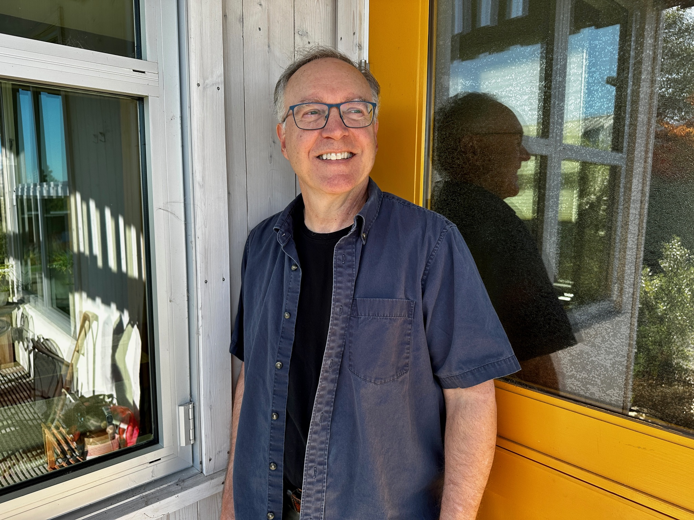
Thank You for Attending
Sebastopol Center for the Arts: https://www.sebarts.org/
Dave Seter: https://daveseter.com/

