Slide 1
Advancing the Diffusive Gradients in Thin-Films Passive Sampling Device for Monitoring PFAS in Drinking Water Systems
Samuel D. Hodges, M.S., E.I.T., Huong T. Pham, Ph.D., and Julian L. Fairey, Ph.D., P.E.
Department of Civil Engineering, University of Arkansas, Fayetteville, AR
David G. Wahman, Ph.D., P.E., and Levi Haupert, Ph.D.
Drinking Water Treatment & Distribution Branch, US Environmental Protection Agency, Cincinnati, OH
Notes:
Introduce yourself and lab group “the experimental work contributors” Dave and Levi contributed heavily to the modeling.

Slide 2
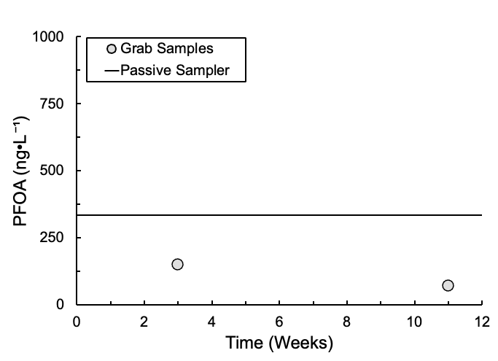
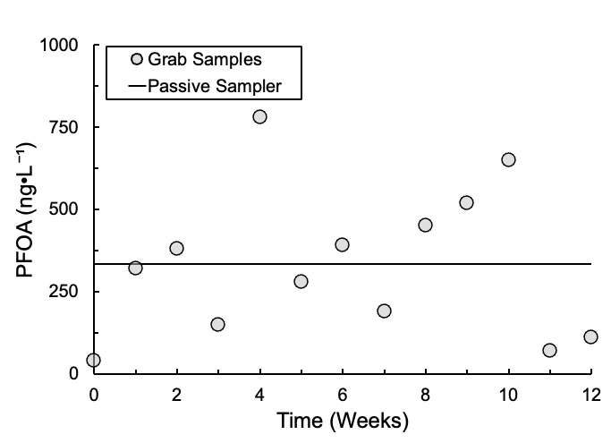
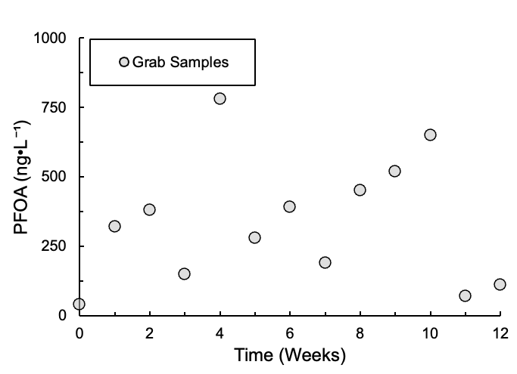
Grab vs. Passive Sampling
Grab sampling → snapshot in time, i.e., PFOA, weekly for 12 weeks
Passive sampling device (PSD) → time-weighted average
PSD does not capture extremes
Fewer PSDs vs. grab samples
Potential cost savings
PSD more representative of chronic exposures
Notes:
If you are targeting any measurement above a threshold, PSD may not be ideal
If you’re looking for chronic exposure could be excellent tool.

Slide 3
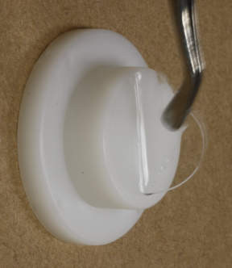
Diffusive Gradients in Thin-Films (DGT)
DGT-PSDs are kinetic samplers (as opposed to equilibrium samplers)
Longer deployment times → more analyte uptake and lower MDLs
Analyte mass transport restricted to diffusion through gel layer
Binding layer maintains maximal diffusive flux with bulk water
Binding
layer
Membrane filter (optional)
Diffusion Boundary Layer thickness (𝛿_{DBL}) in-situ
Diffusive gel
No PFAS sorption
PFAS diffusion coefficients (D_{Gel})
Rapid and complete PFAS uptake in binding layer
Housing
$δ$_{Gel}
C_{DGT}
Diffusive Gel
Bulk Water
C_{Bulk}
$δ$_{DBL}
DBL
DGT-PSD with gel layer uplifted by forceps
Conceptual profile of a DGT-PSD
Notes:
Summary=Where are we going
Longer deployment = more analyte uptake = lower MDL

Slide 4
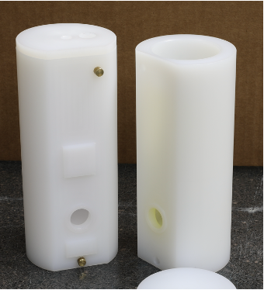
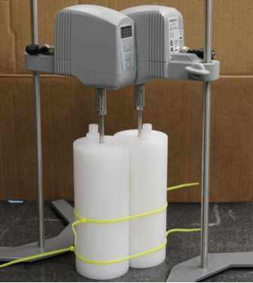
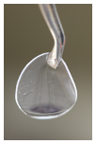
Analyte Diffusion Coefficients in Gel
D_{Gel} measured in polyethylene two-compartment diffusion cell
Diffusive Gels of four thicknesses, 𝛿_{Gel}
Source
Sink
0.08 cm
0.12 cm
0.16 cm
0.20 cm
C_{Source}
$δ$_{Gel}
$δ$_{DBL}
Used nitrate to determine 𝛿_{DBL} vs. Mixing Speed
50-, 100-, 200-, 300-, 400-, and 500 RPM experiments
Identified Mixing Speed for which 𝛿_{DBL} ≪ 𝛿_{Gel} → applied to PFAS D_{Gel} measurements
Diffusive Gel
DBL
Source
C_{Source}
Sink
C_{Sink}
$δ$_{DBL}
DBL
C_{Sink}
Notes:
Summary of the DCell DGel measurement goal
Used gel thickness to vary the expected mass uptake. Values should equate to same concentration, but may be off by a DBL thickness.

Slide 5
Finite Difference Model (FDM)
1-dimensional diffusion problem → D_{Gel} and 𝛿_{DBL}
Analyte diffusion from Source to Sink
Source
DBL
Diffusive Gel
DBL
Sink
$$Source Flux=J_{1}$$
$$Sink Flux=J_{2}$$
$$C_{(x=−δ_{DBL})}=C_{1}$$
$$C_{(x=0)}=C_{1}^{∗}$$
$$C_{(x=δ_{Gel}+δ_{DBL})}=C_{2}$$
$$C_{(x=δ_{Gel})}=C_{2}^{∗}$$
$δ$_{DBL}
$δ$_{Gel}
$δ$_{DBL}
C₁
J₁
q₁
J₂
Δ
x₁
x_{N}
C₂
−𝛿_{DBL}
0
L
L + 𝛿_{DBL}
x
Fick’s first law (conc. gradients) → flux through DBL
Fick’s second law (conc. gradients in time) → flux through gel
Initial value problem solved using deSolve package in R

Slide 6
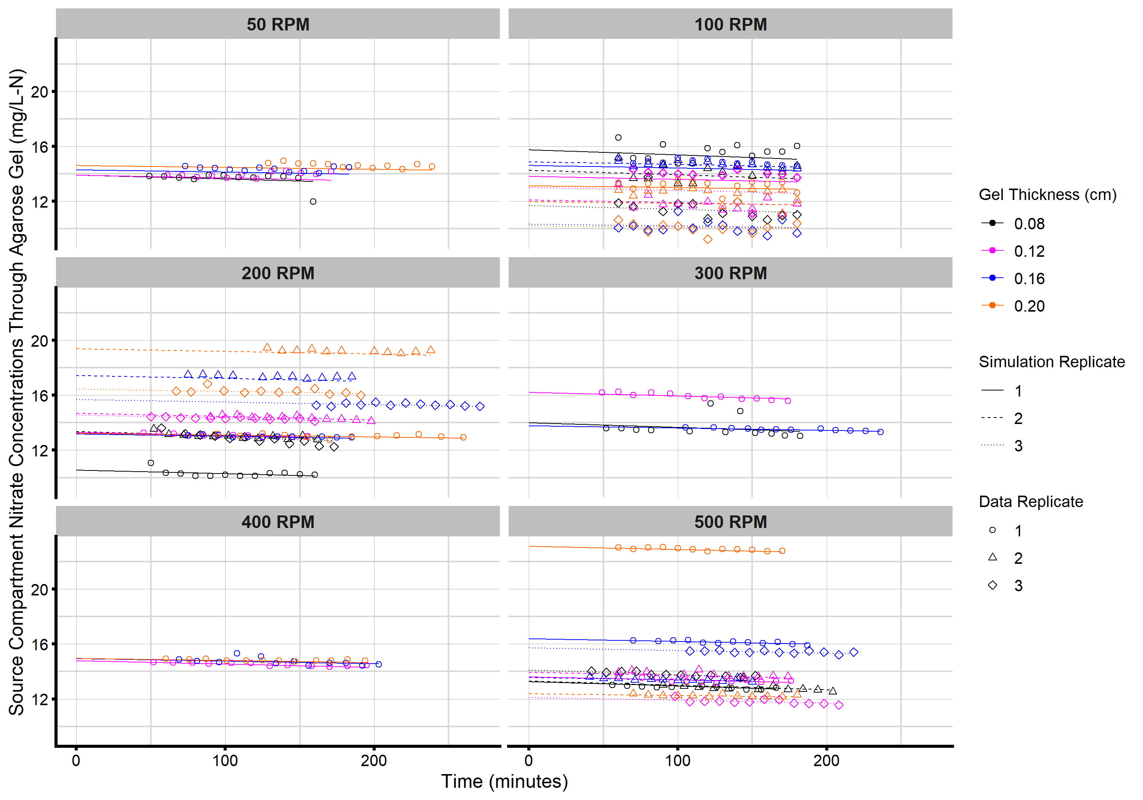
Source Compartment Nitrate Profiles
50 RPM
100 RPM
Six mixing speeds
50–500 RPM
Four gel thicknesses
0.08–0.20 cm
Replicate tests
Data replicate
Simulation replicate
Source Nitrate
t = 0 → 10–23 mg•L⁻¹-N
Decreased <10 % over 200-min test
200 RPM
300 RPM
500 RPM
400 RPM

Slide 7
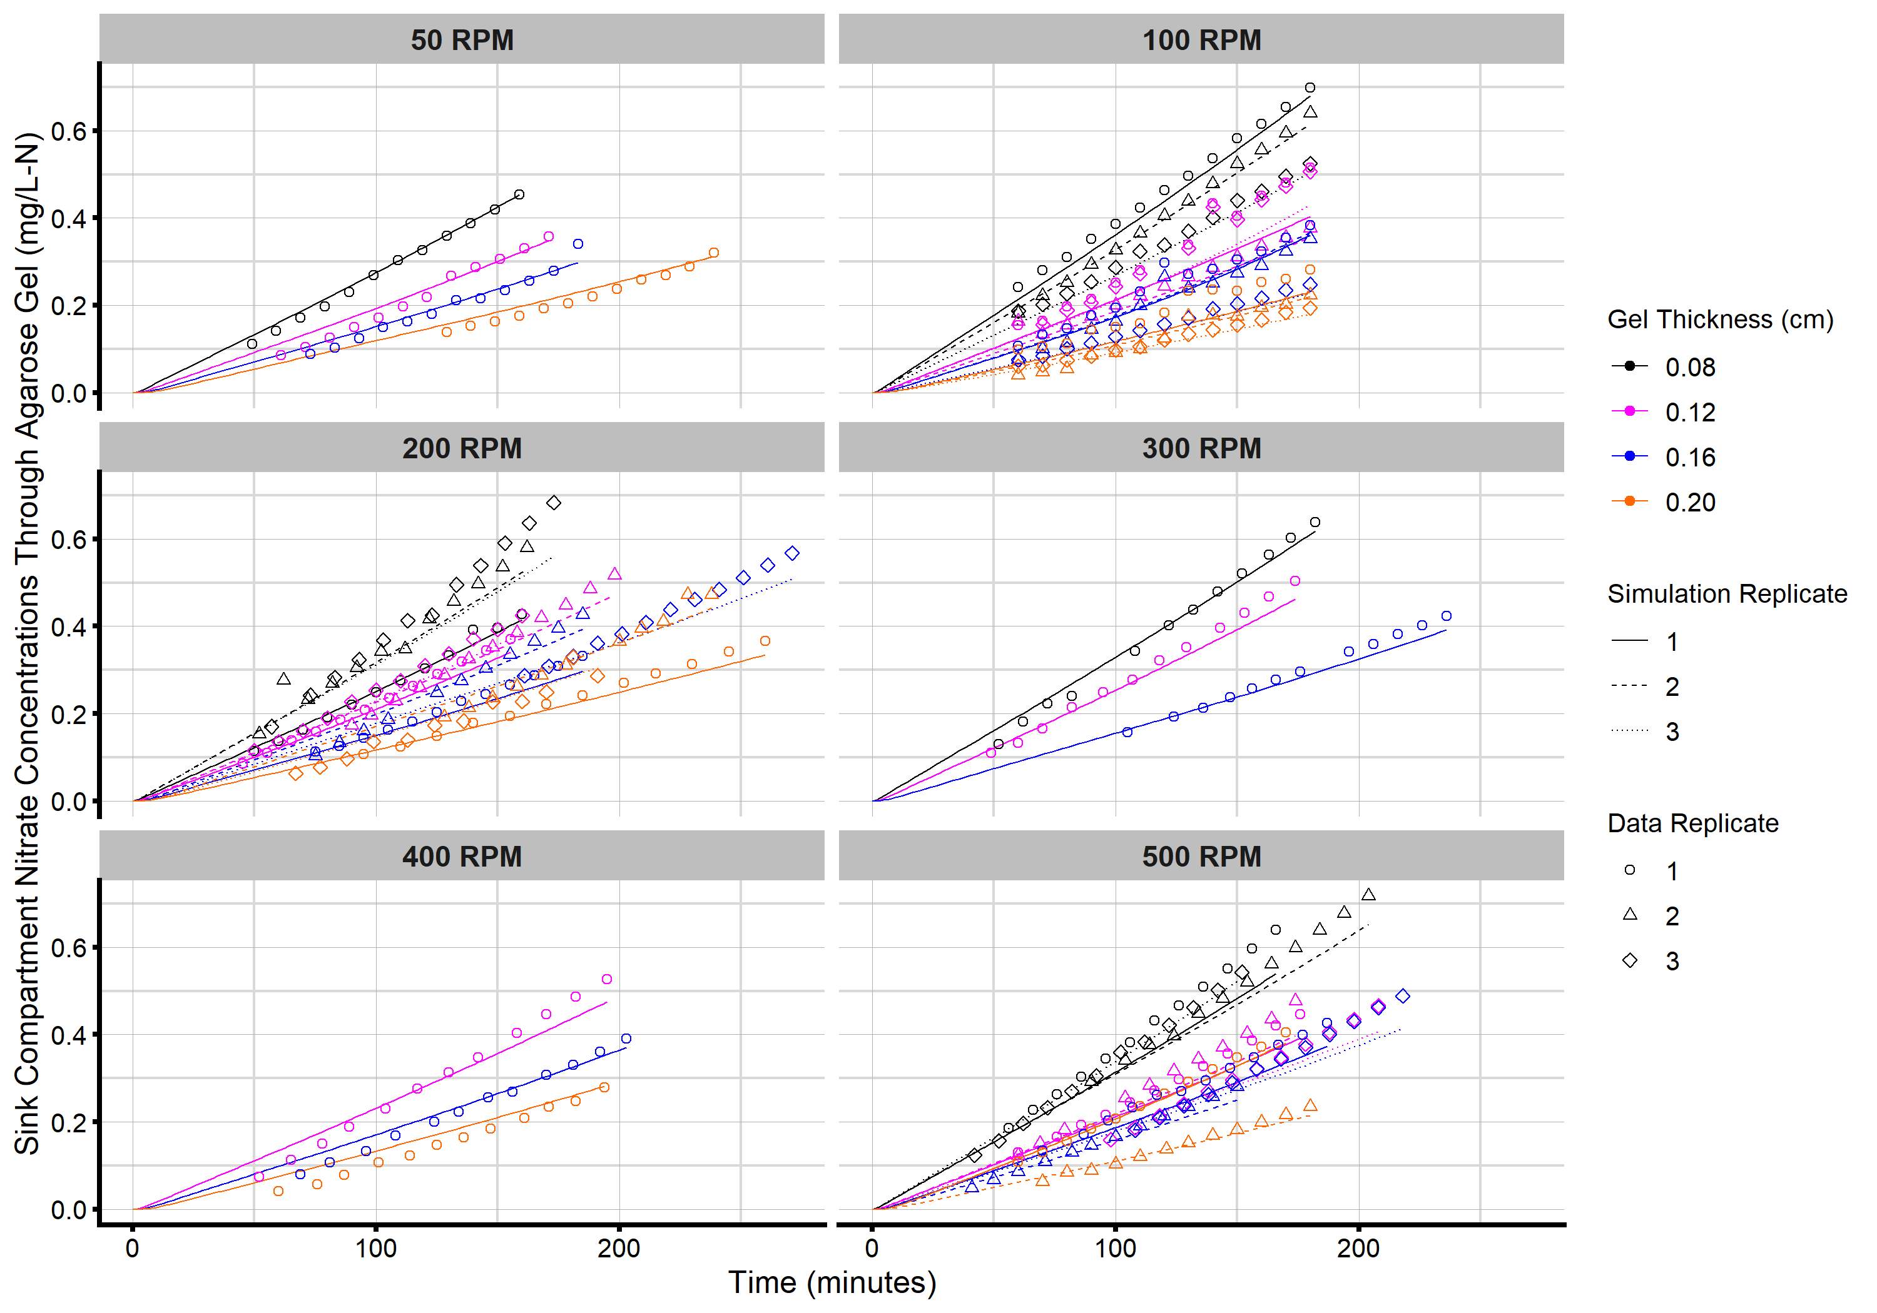
Sink Compartment Nitrate Profiles
50 RPM
100 RPM
No Initial Sink Nitrate
Final: 0.2–0.7 mg•L⁻¹-N
Increased diffusion with decreasing Gel Thickness
Greater slopes with thinner gels
FDM captures trends
Time
Gel thickness
Mixing speed
200 RPM
300 RPM
400 RPM
500 RPM

Slide 8
DBL Thickness vs. Mixing Speed
FDM fit of nitrate data → 𝛿_{DBL} vs. Compartment Mixing Speed
Diffusive Gel
Sink
At 50 RPM
𝛿_{DBL} = 111 μm
11–28 % of the total diffusive pathlength
At 500 RPM
𝛿_{DBL} = 1 μm
0.1–0.3 % of the total diffusive pathlength
Source
DBL
DBL
$δ$_{DBL}
$δ$_{Gel} = 0.08–0.20 cm
$δ$_{DBL}
C₁
J₁
q₁
J₂
Δ
x₁
x_{N}
C₂
−𝛿_{DBL}
0
L
L + 𝛿_{DBL}
x
Used 500 RPM mixing speed to measure PFAS diffusion coefficients
Made the DBL thickness insignificant in the FDM
Determined D_{Gel} for the target PFAS

Slide 9
PFAS Diffusion Coefficients in Gel
Two-compartment diffusion cell tests with PFAS mixtures
500 RPM Mixing Speed (insignificant DBL thickness)
Agarose Gel type
Spiked Source Compartment with 10,000 ng•L⁻¹ of each PFAS
C4–C14 PFCAs
C4–C10 PFSAs
4:2-, 6:2-, 8:2 FTSs; PFOSA; N-EtFOSAA and M-MeFOSAA
Water Chemistry
pH 5, 7, and 9 > pK_{a}’s of most PFAS → assess gel chemistry
Temperature:
5 and 22 °C

Slide 10
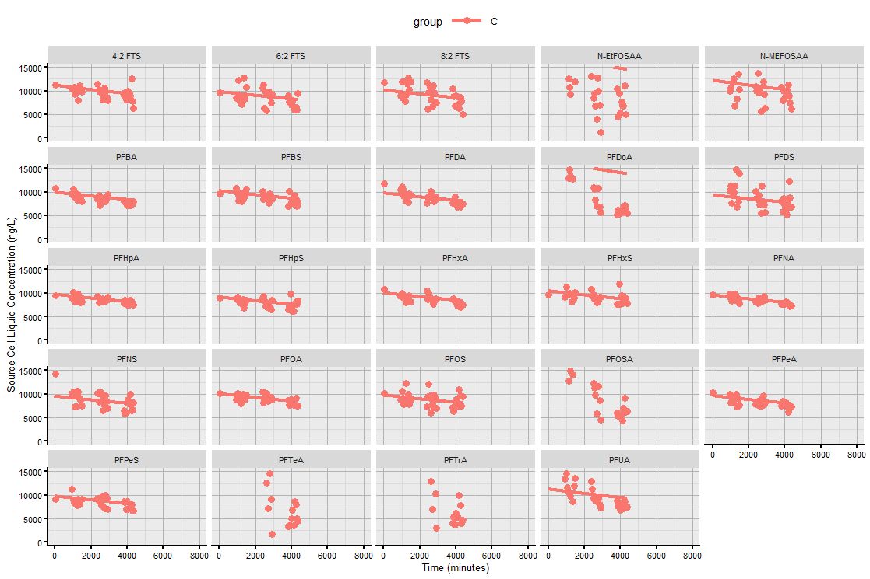
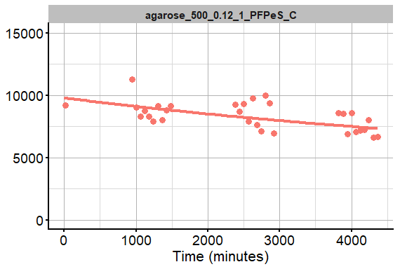
Source Compartment PFAS Profiles
Initial PFAS ~10,000 ng/L
Final PFAS ~7,500 ng/L
Captured well by FDM for 19 PFAS
Poor fits for five PFAS
PFPeS
Source Compartment PFAS Concentrations for Agarose Gel (ng/L)
Time (minutes)
Notes:
16-25 hrs
40-48 hrs
62-72 hrs

Slide 11
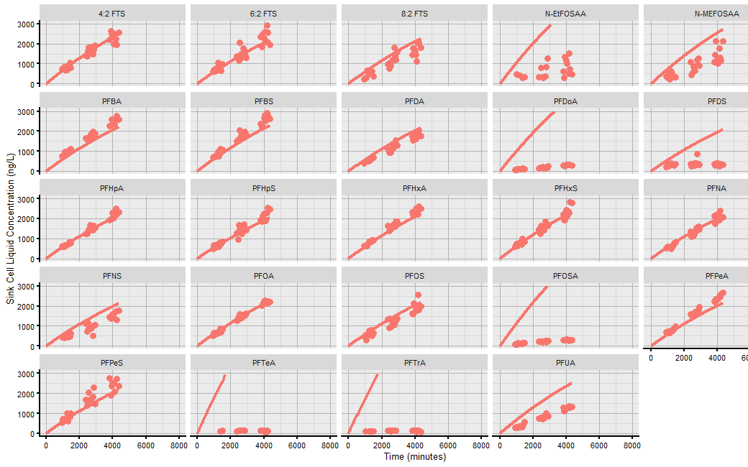
Sink Compartment PFAS Profiles
No initial PFAS
Final PFAS ~2,500 ng/L
About one-third of final source
Diffusive flux varies → FDM
Captured well by FDM for 16 of 24 PFAS
Source Compartment PFAS Concentrations for Agarose Gel (ng/L)
Time (minutes)

Slide 12
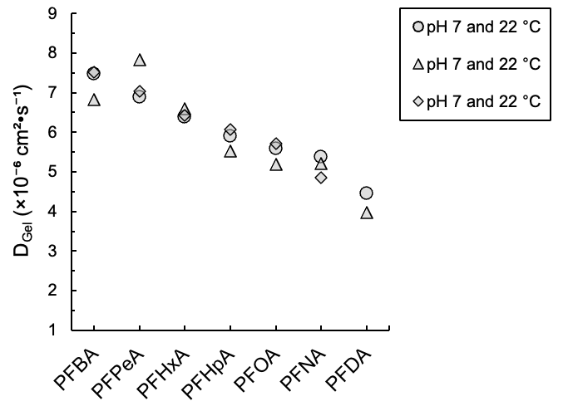
D_{Gel} for PFCAs at pH 7 and 22 °C
D_{Gel} decreased with increasing chain length
Expected trend
PFBA ≅ 7.2×10⁻⁶ cm²•s⁻¹
PFDA ≅ 4.2×10⁻⁶ cm²•s⁻¹
Reproducibility amongst triplicate tests
PFHxA ≅ 6.4–6.6×10⁻⁶ cm²•s⁻¹
PFPeA ≅ 6.9–7.8×10⁻⁶ cm²•s⁻¹
3–12% variation
Well within the 30% range commonly attributed to PFAS

Slide 13
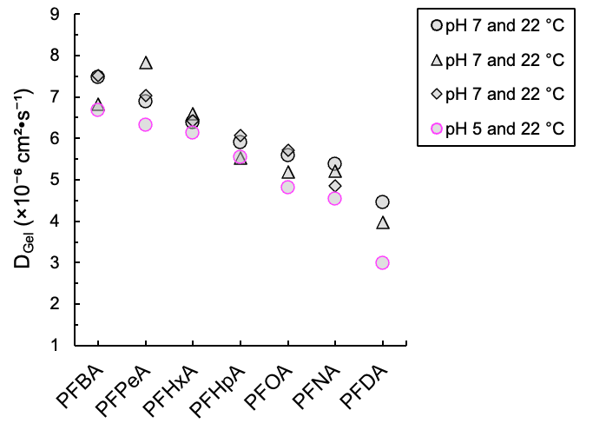
D_{Gel} for PFCAs: pH Impact
D_{Gel} at pH 7 ≅ D_{Gel} at pH 5
Notes:
pH drop

Slide 14
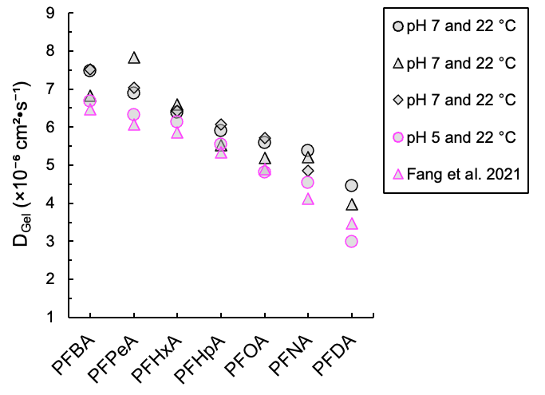
D_{Gel} for PFCAs: pH Impact
D_{Gel} at pH 7 ≅ D_{Gel} at pH 5
Fang et al. 2021 pH 5.6
Notes:
pH increase
Leads to restricted diffusion

Slide 15
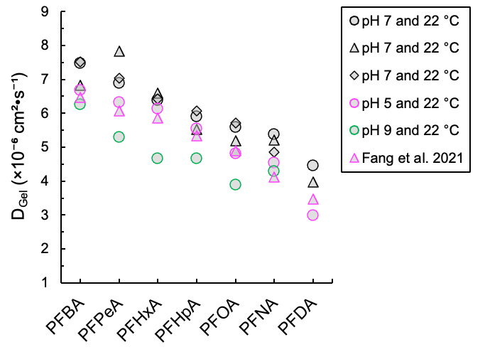
D_{Gel} for PFCAs: pH Impact
D_{Gel} at pH 7 ≅ D_{Gel} at pH 5
Fang et al. 2021 pH 5.6
D_{Gel} at pH 7 ≳ D_{Gel} at pH 9
Similar for PFBA and PFNA
~30 % lower for other PFCAs
D_{Gel} at pH 9 less than those at pH 5 and 7
Negative surface charge on agarose at pH 9 restricting diffusion of anionic PFAS?

Slide 16
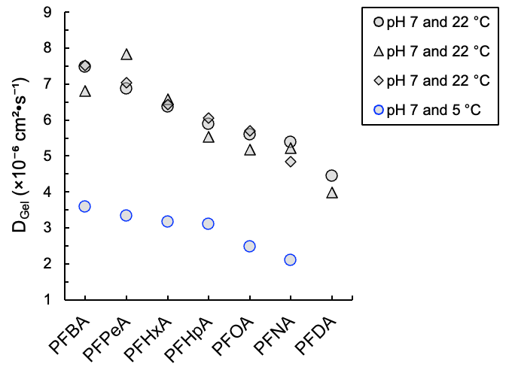
D_{Gel} for PFCAs: Temperature Impact
D_{Gel} at 22 ℃ > D_{Gel} at 5 ℃
Expected result
Lower at 5 ℃ by 2–3×

Slide 17
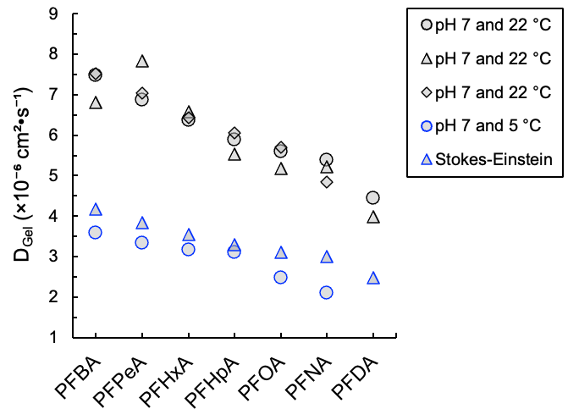
D_{Gel} for PFCAs: Temperature Impact
D_{Gel} at 22 ℃ < D_{Gel} at 5 ℃
Expected result
Lower at 5 ℃ by 2–3×
Stokes-Einstein Equation
${\left(\frac{D_{Gel}∙η}{T}\right)}_{T1}={\left(\frac{D_{Gel}∙η}{T}\right)}_{T2}$
Captures D_{Gel} at 5 ℃ based on values at 22 ℃
Need to deploy temperature logger with DGT-PSDs
Use Stokes-Einstein to adjust D_{Gel}
Notes:
Viscoscity

Slide 18
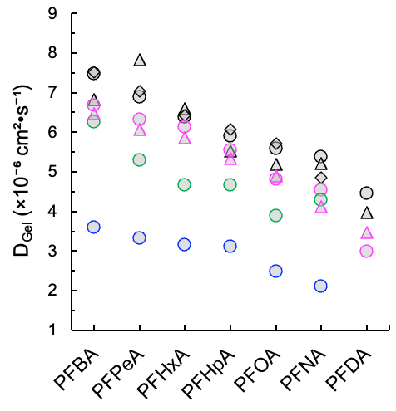
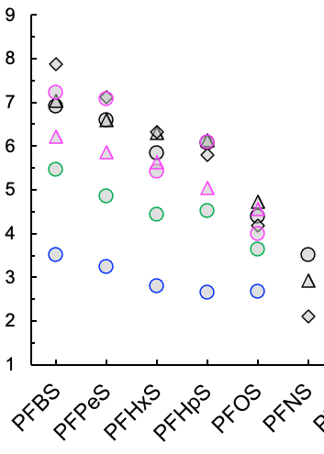
D_{Gel} for PFCAs and PFSAs
PFCAs
PFSAs
Similar D_{Gel} for PFCAs and PFSAs
PFAS chain length important
Functional group type less important

Slide 19
Binding Layer of DGT-PSDs
DGT-PSDs are kinetic samplers
Measured D_{Gel} for 13 PFAS as a function of pH and temperature
Need binding layer to maintain maximal diffusive flux with bulk water
Binding
layer
Membrane filter (optional)
Housing
$δ$_{Gel}
C_{DGT}
Diffusive Gel
Bulk Water
C_{Bulk}
$δ$_{DBL}
DBL
DGT-PSD with Gel Layer Uplifted by forceps
Conceptual Profile of a DGT-PSD
Assessed Weak Anion Exchange (WAX) and Strong Base Anion (SBA) resins
PFAS uptake and recovery
Used best-performing resin in DGT-PSDs
Notes:
Summary of the binding layer development

Slide 20
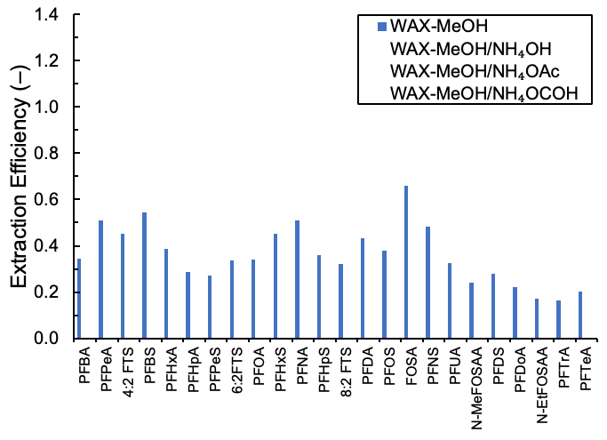
PFAS Extraction Efficiency from WAX
No PFAS with extraction efficiency ≳ 70 % using MeOH only

Slide 21
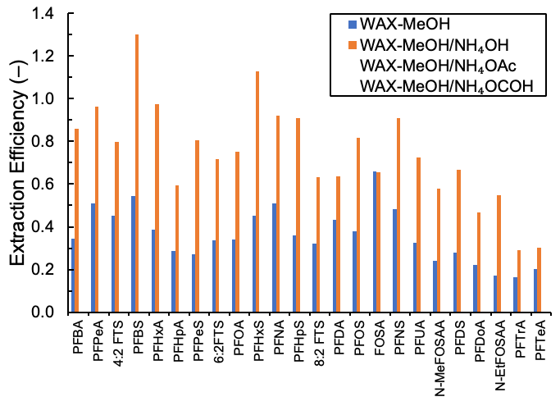
PFAS Extraction Efficiency from WAX
No PFAS with extraction efficiency ≳ 70 % using MeOH only
14 PFAS with extraction efficiency ≳ 70 % using MeOH and 50 μM NH₄OH
Notes:
Ammonium Hydroxide

Slide 22
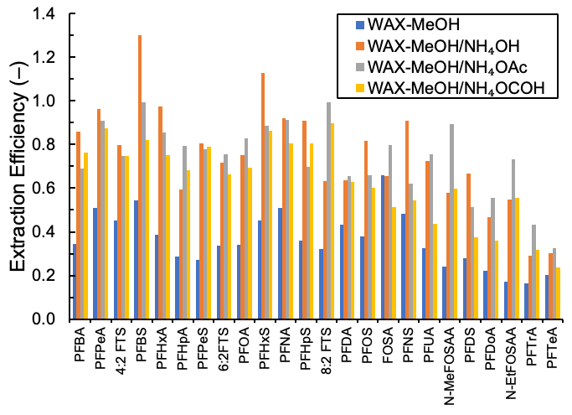
PFAS Extraction Efficiency from WAX
No PFAS with extraction efficiency ≳ 70 % using MeOH only
14 PFAS with extraction efficiency ≳ 70 % using MeOH and 50 μM NH₄OH
50 μM ammonium acetate and formate good as well
Notes:
Ammonium Hydroxide

Slide 23
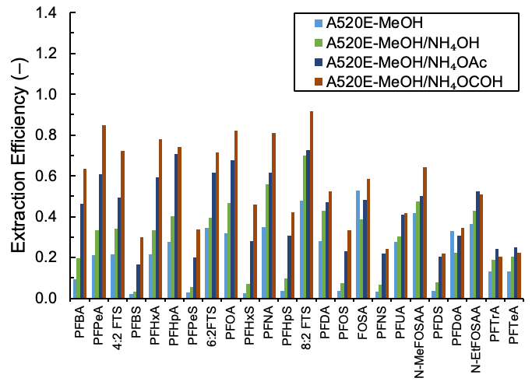
PFAS Extraction Efficiency from SBA
8 PFAS with extraction efficiencies ≳ 70 %
Selected WAX resin with MeOH/NH₄OH for PFAS extraction
Notes:
Ammonium Hydroxide

Slide 24
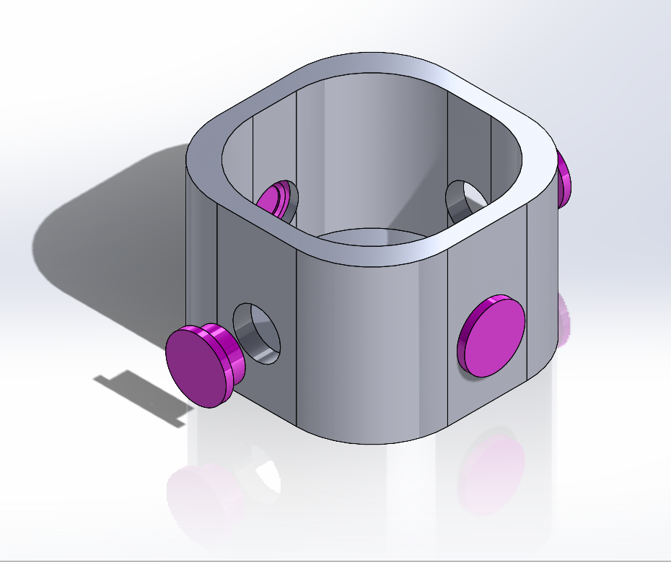
Box Tests with DGT-PSDs
pH 7 and 22 ℃
Spiked Box with the 24 target PFAS, each at ~5,300 ng•L⁻¹ into 750 mL water
Deployment times of 2-, 6-, and 11-days
Grab samples at start, middle, and end
Calculated TWA Grab sample for each PFAS
Extracted binding layer after deployment time
Used D_{Gel} values to back-calculate C_{DGT}
Averaged four DGT-PSDs
Compared PFAS TWA-Grab vs. DGT-PSDs
Goal of ± 40 %
3D-rendering of 1-L Box (grey) with DGT-PSDs (magenta) installed in each side-wall
Notes:
Summary of the box tests
High concentration for initial validation

Slide 25
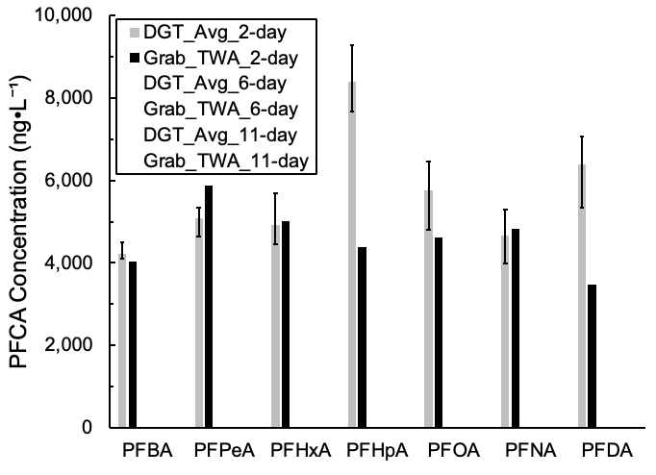
Box Tests with DGT-PSDs
2-day test
DGT-Average and TWA-Grab samples within 40 % for five of seven PFCAs
PFBA, PFPeA, PFHxA, PFOA, PFNA
DGT-PSDs over-estimated TWA-Grab samples for PFHpA and PFDA
Notes:
DON’T LIST THE COMPOUNDS

Slide 26
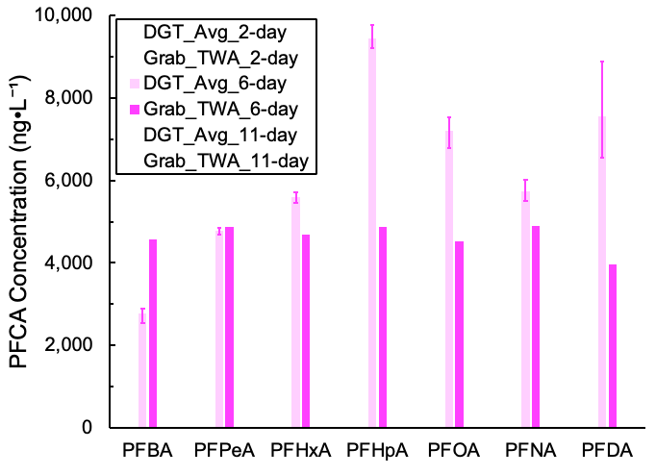
Box Tests with DGT-PSDs
6-day test
DGT-Average and TWA-Grab samples within 40 % for four of seven PFCAs
PFBA, PFPeA, PFHxA, PFNA
DGT-PSDs over-estimated TWA-Grab samples for PFHpA, PFOA, and PFDA

Slide 27
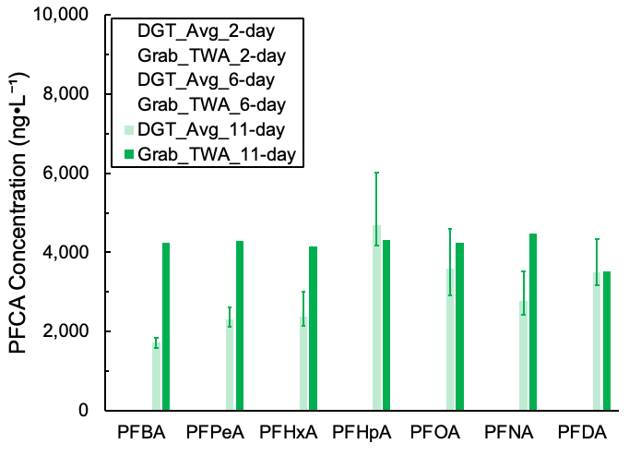
Box Tests with DGT-PSDs
11-day test
DGT-Average and TWA-Grab samples within 40 % for four of seven PFCAs
PFHpA, PFOA, PFNA, PFDA
DGT-PSDs under-estimated TWA-Grab samples for PFBA, PFPeA, and PFHxA
Resin at capacity?
More WAX resin?

Slide 28
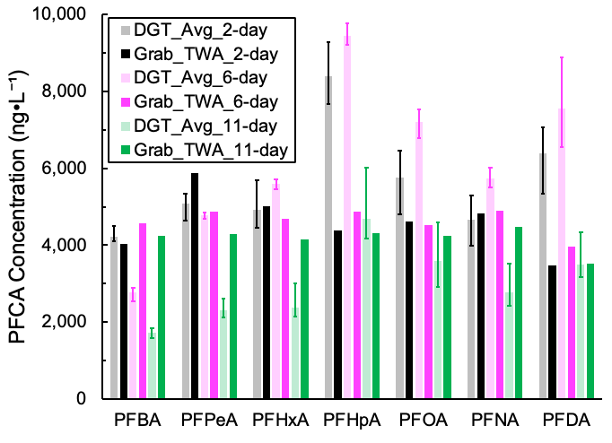
Box Tests with DGT-PSDs
2-, 6-, and 11-day tests
DGT-Average and TWA-Grab samples within 40 % for all seven PFCAs
13 of 21 PFCA–Deployment Time combinations

Slide 29
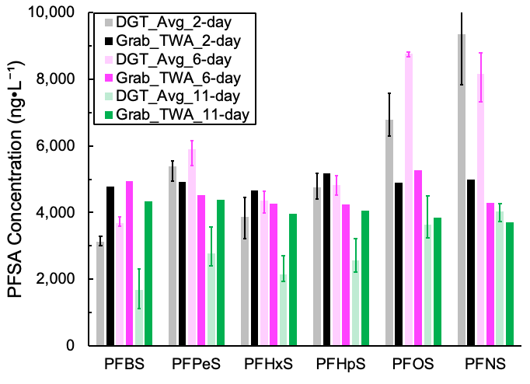
Box Tests with DGT-PSDs
2-, 6-, and 11-day tests
DGT-Average and TWA-Grab samples within 40 % for all six PFSAs
13 of 18 PFSA–Deployment Time combinations

Slide 30
Summary of Results to Date
DGT-PSDs are kinetic samplers
Mass transport to binding layer restricted to molecular diffusion through a thin gel layer
Measured D_{Gel} for C4–C10 PFCAs and C4–C9 PFSAs
Decreased with increasing carbon chain length
Similar at pH 5 and 7 but ~30 % lower at pH 9 → charge on agarose?
Decreased 2–3× at 5 ℃ compared to 22 ℃ → temperature logger
WAX binding layer
Maximized PFAS extraction efficiency using MeOH with 50 μM NH₄OH
Box experiments with DGT-PSDs
2-, 6-, and 11-days
± 40 % of TWA-Grab samples for majority of the PFAS
Notes:
Ammonium Hydroxide

Slide 31
Next Steps
D_{Gel} measurements as a function of conductivity
Box experiments with lower initial PFAS concentration
500 ng•L⁻¹ (previously 5,300 ng•L⁻¹)
Estimate number of binding sites in the DGT binding layer
Increase WAX dose in binding layer to overcome capacity limitations and competitive sorption effects

Slide 32
Acknowledgements and Disclaimer
Strategic Environmental Research and Develop Program (SERDP)
ER20-1363
Arkansas Water Resources Center (AWRC) student grant to SDH
Research was not performed or funded by EPA and was not subject to EPA’s quality system requirements. Views expressed are those of the authors and do not necessarily represent views or policies of EPA.

