Slide 1
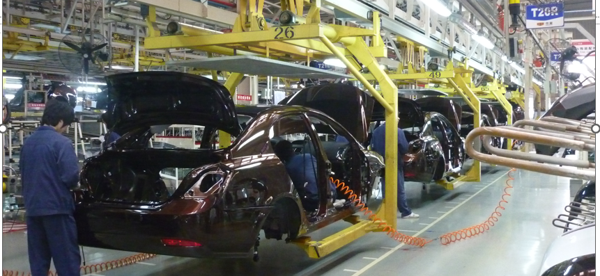
Integrating Real-World Competencies:
Aligning Sinclair College’s Digital Transformation Curriculum with the Ohio Manufacturing Competency Model
Peter Jensen, Program Developer – Lorain County Community College
Meredith Rodgers, Program Manager – Sinclair Community College
Notes:
This Photo by Unknown Author is licensed under CC BY-SA

Slide 2
The Ohio Manufacturing Competency Model
Notes:
Introduce self.
Here to talk about OH MFG CM, curriculum assessment, and resources.
May be short. Introducing CA, contextualizing in A&AM, and relating to SR – in which it is a key component.
Set up next slide:
Review of the A&AM Workforce Strategy background.

Slide 3
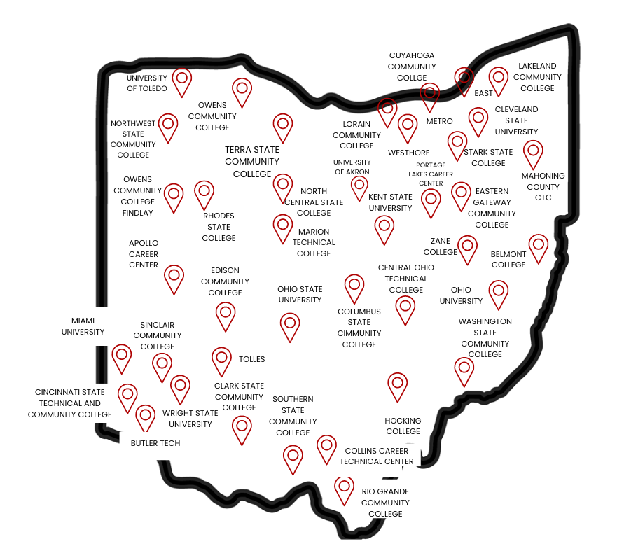
Vision:
The members of the Ohio Technical Skills Innovation Network, or Ohio TechNet, are nationally recognized for developing & implementing collaborative, innovative solutions that meet manufacturing and technical workforce needs.
Mission:
Ohio TechNet supports workforce development and academic professionals at Ohio educational institutions to incubate, develop and sustain innovative programming that accelerates growth of Ohio’s manufacturing & technical workforce.
Purpose:
Ohio TechNet partners benefit from peer-to-peer collaboration, technical assistance and access to resources, making program expansion and innovation at their institution more efficient, faster to implement and easier to sustain.
www.ohiotechnet.org
Notes:
The Ohio Technical Skills Innovation Network, or Ohio TechNet, is a statewide consortium of more than 40 educational institutions including community colleges, public universities, and technical centers working collaboratively to support workforce development and academic professionals in Ohio to innovate, develop, and sustain programming that accelerates the growth of the manufacturing & technical workforce.

Slide 4
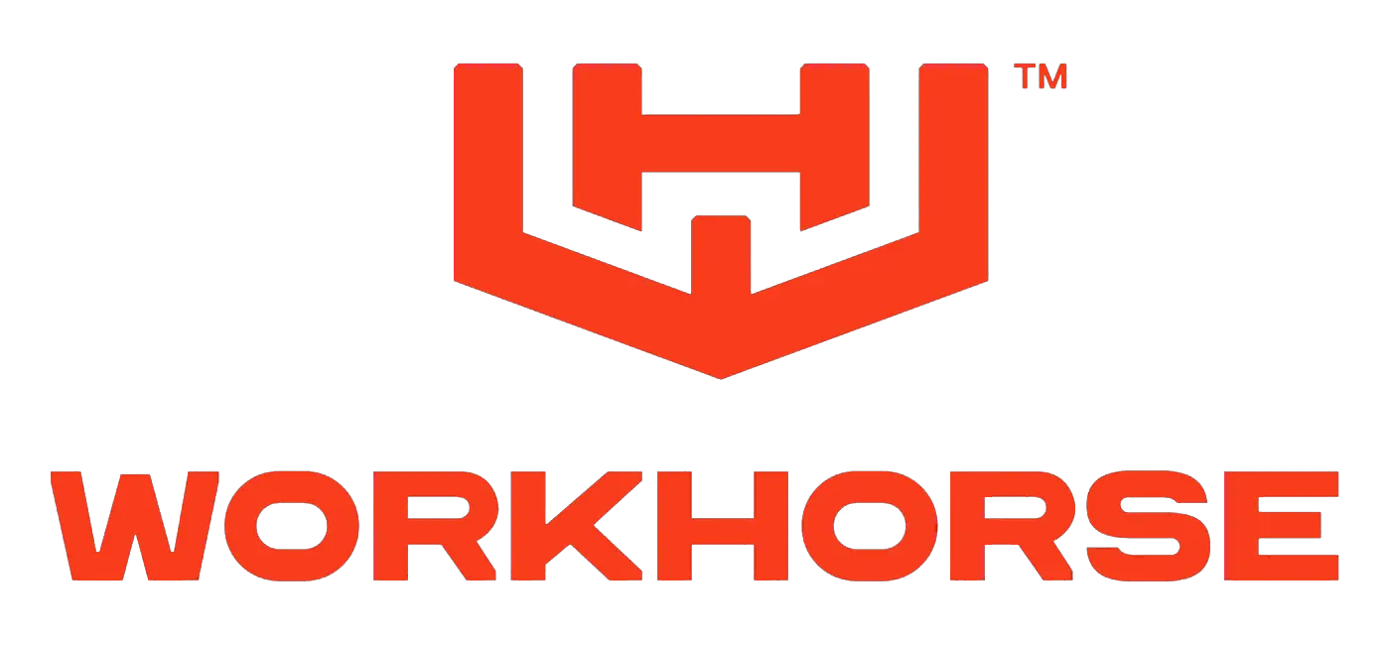
ADDRESSING THE TALENT IMPERATIVE THROUGH OHIO’S MANUFACTURING COMPETENCY BUILDING BLOCKS MODEL
Imperatives
Occupation or Employer-Specific
Electrification
Aerospace and Defense
Electrification
Electric Vehicle and Battery
Industry Specific Competencies
Ohio is growing across a number of manufacturing industries.
Industry Competencies
Industrial Products
Industry Related
Semiconductor
Etc.
Manufacturing
Individual industries have an opportunity to come together as a sector and serve as Ohio’s manufacturing force multipliers for talent and skill building, connecting the public and private sectors through a common model.
Education and workforce training providers are working across each industry to better meet their needs.
Workplace
Separate approaches to discussing in-demand, critical competencies and skills needs across each industry.
Foundational
Academic
Personal Effectiveness
Notes:
What is the CM? At a basic level, this pyramid. [REFER TO GRAPHIC]
Competencies: Foundational tiers; sector-wide tier; industry- and occupation-specific tiers.
We built a foundational model, sector-wide model, and three industry-specific models.
Demand-driven: Created by manufacturers. Describe workshops.
Describes operator and technician-level skills needs in terms of knowledge, skills, and abilities (KSAs).
Serves as a common language between employers and training institutions – aligning demand and supply.
One sector-wide manufacturing model.
Multiple industry-specific models: EV, Aero & Defense, semiconductor (recently completed)!
Set up next slide: There are several use cases for the CM.

Slide 5
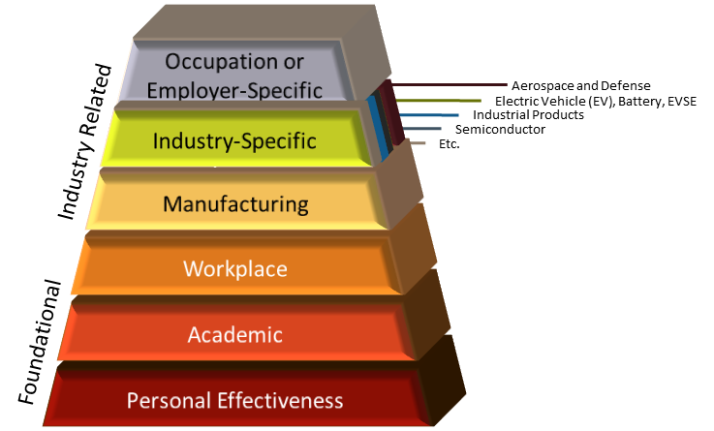
THE OHIO MANUFACTURING COMPETENCY MODEL DEVELOPMENT
Model development had an immense amount of support, participation, and feedback from stakeholders who have all played an invaluable role in creating a unique representation of Ohio’s Manufacturing Sector.
ISPs
Ohio Manufacturers
Education and Workforce Partners
Notes:
OMA served as the convener of manufacturers during the competency model build and development phase.
[DESCRIBE GRAPHIC].
OMA is the center-of-excellence for the competency model – providing toolkits to partners to implement use cases.
We aim to refine and routinely refresh this model to address critical manufacturing skill needs now and in the future.
We also connect educators and other partners to provide guidance on the curriculum assessment process – the use case I’ll be discussing today.
Ohio TechNet also served as a key partner in developing and implementing the Ohio Manufacturing Competency Model
Funded a portion of this work.
Helped coordinate with Ohio’s postsecondary manufacturing programs.
Aided in running CA pilots.
Now, they are offering CA Office Hours to help walk educators through the CA process – especially for A&AM SuperRAPIDS.
Set up for next slide: While developing the CM, we focused on specific in-demand occupations.

Slide 6
SHARED SKILLS ACROSS ENTRY- AND MID- LEVEL MANUFACTURING ROLES
The competency model aims to identify the core skills that are common across manufacturing operator, technician, and engineering roles. While no uniform definition exists for defining “technician” or “operator” since they can be included in a range of occupational areas, these representative occupations can help serve as guardrails or benchmarks for identifying commons skills shared among in-demand roles.
OPERATORS
TECHNICIANS
ENGINEERS
(Entry)
(Mid)
(Advanced)
CNC Operator*
Production Planner*
Production Manager*
Forklift Operator
Electrician
Electrical and Mechanical Engineers
Logistician*
Tool and Die
Maker*
PLC Technician
Processing Technician*
Machine Setters and Tenders for Metals and Plastic*
Computer Engineers
Maintenance Associate
Civil Engineers*
Health and Safety Technician
Electrical and Electronics Drafter*
Machine
Programmer
Process Engineer
Machine Operators*
Quality Control Inspector
Lean Technician
Health and Safety Engineers
Biomedical Engineers*
Assemblers and Fabricators
Welders Cutters Solders Brazers*
Chemical Technician*
Quality Engineers
Production Workers
Electro-Mechanical, Mechatronics Technician*
Robotic and Mechatronic Engineers
Industrial Engineers
Logistics Associate
Maintenance Technician
* = Identified as manufacturing priority occupations through Ohio Executive Order
= Specialty occupations that do not exclusively belong to a specific occupation level
Notes:
This is a categorized figure of manufacturing occupations considered while building the sector-wide model.
Are meant to contextualize skills by showing occupations where they are shared.
We then identified core skills that are shared across many of these occupations at the entry (operator) and middle (technician) levels.
Entry-level occupations are roles that require little to no previous experience.
Most closely associated to skills that a worker would hold at the operator level
Mid-level occupations are roles that require around two years of industry experience.
Most closely associated with technician level roles.
Advanced occupations are those that require the most manufacturing experience.
Mostly workers who have an undergrad degree or have spent a majority of their career in manufacturing.
These representative occupations serve as benchmarks for identifying common skills shared across in-demand manufacturing roles.
Compiling this list was an important part of the model development process.
Set up next slide: What did we find?

Slide 7
COMPARING CRITICALITY ACROSS THE SECTOR AND INDUSTRIES
While industry-specific competencies differentiate workforce needs, one of our key findings revealed that the most critical knowledge, skill, and abilities (KSAs) were found at the base manufacturing layer. This overlap in highly critical KSAs required across industries emphasizes the importance of base manufacturing competencies across Ohio.
Criticality:
Entry-Level Industry Specific
(238 KSAs)
Mid-Level Industry Specific
(294 KSAs)
High Medium Low
10% of entry-level KSA statements in the industry layers were deemed high criticality
26% were deemed medium criticality
64% were deemed low criticality
35% of mid-level KSA statements in the industry layers were deemed high criticality
56% were deemed medium criticality
9% were deemed low criticality
Industry-Specific
Manufacturing
Workplace
Entry-Level Manufacturing (Shared)
(172 KSAs)
Mid-Level Manufacturing
(Shared)
(140 KSAs)
48% of entry-level KSA statements in the base manufacturing layer were deemed high criticality
41% were deemed medium criticality
10% were deemed low criticality
33% of mid-level KSA statements in the base manufacturing layer were deemed high criticality
61% were deemed medium criticality
6% were deemed low criticality
Academic
Personal Effectiveness
A larger percentage of the most critical knowledge, skill, and ability statements fell
within the sector-wide manufacturing base layer as compared to the industry-layers
Notes:
The data from constructing the CM underscore the fact that several foundational manufacturing skills that are pertinent across many industries.
Note that the model calls “skills” KSAs – knowledge, skills, and abilities. I will discuss this later.
A few key points:
At the entry (operator) level, most critical competencies are found at the sector-wide level.
48% of skills in this layer are highly critical vs. 10% at the industry level.
Skills also show a high variance in criticality between entry- and mid-level positions
A higher percentage (35%) of industry-specific skills are highly critical at the mid-level.
As employees progress, the value on specialized skills increases.
Big takeaway: The sector-wide model shows a higher concentration of critical KSAs than the industry-specific layers.
A well-trained manufacturing workforce is versatile and can transition between industries.
It’s crucial for businesses and educators to invest in high-criticality, foundational manufacturing skills training.
Then tailor mid-level (technician) training to the specialized needs of the industry.
We need an all-of-manufacturing approach to emphasize sector-wide skills and build a future-proof workforce resilient to industry-specific fluctuations,
And the CM provides the framework for such an approach.
Set up next slide: Let’s look at some of the CM use cases.

Slide 8
THE COMPETENCY MODEL HIERARCHY
To help us organize and navigate our ever-growing competency model repositories, we have adopted a four-layer hierarchy structure.
Competency
Competencies are the broadest level of skill categorization. They represent a cluster of related skills or knowledge that collectively contribute to a specific area of expertise (e.g., operational quality, foundations of engineering).
Maintenance, Installation, and Repair
What
L1
Preventative and Predictive Maintenance
Sub-competency
Sub-competencies are the next level of skill categorization and break down broader competencies into more specific components. They reflect a cluster of skills specific to performing a particular aspect of a job.
Maintenance Planning
L2
Troubleshooting and Monitoring
Topics
Topics further narrow down the specific activities that fall under each sub-competency. They represent a broader level of skill identification.
Alarm and Event Analysis
Basic Equipment Troubleshooting
L3
Knowledge, Skills, and Abilities (KSAs)
KSAs are a concise method of identifying the different levels of proficiency that correspond to a specific topic.
Knowledge: The theoretical or factual understanding of concepts, information, and principles.
Skills: The practical, learned capabilities develop through training or hands-on experience. Skills are practical applications of theoretical knowledge.
Ability: A demonstrated cognitive or physical capability to successfully perform a task with a wide range of possible outcomes. It is often a collection of several underlying capacities that enable us to learn and perform.
Knowledge of equipment operation, system components, common failure modes and troubleshooting techniques.
How
Skill in diagnosing equipment issues, using technical manuals and diagrams, and conducting root cause analysis.
L4
Ability to quickly identify and resolve equipment problems to minimize downtime and maintain production efficiency.
Notes:
At the broadest level of skill categorization is a Competency.
A cluster of related skills or knowledge that collectively form a specific area of expertise – like “Production Operations.”
A Sub-Competency is the next level and breaks down a competency into more specific components.
For example, “Preventative and Predictive Maintenance,” “Maintenance Planning,” “Troubleshooting and Monitoring” are all sub-competencies that fall under the “Maintenance, Installation, and Repair” competency.
A Topic further describes narrow activities within the sub-competencies.
Finally, Knowledge, Skill, and Ability (KSA) statements are concise, plain-language statements to identify the levels of proficiency that correspond to a topic.
The competency, sub-competency, and topic layers describe the “what”.
KSA statements describe the “how.” The KSA statements describe the level of mastery or proficiency expected for common entry- and mid-level manufacturing occupations.
Knowledge: The theoretical or factual understanding of concepts, information, and principles. It is theoretical and not practical.
Skills: The practical, learned capabilities develop through training or hands-on experience. Skills are practical applications of theoretical knowledge.
Ability: A demonstrated cognitive or physical capability to successfully perform a task with a wide range of possible outcomes. It is often a collection of several underlying capacities that enable us to learn and perform. They are typically time-consuming to learn and have a component of innate or natural talents that a person brings to a task or situation.
Now, what does a repository look like?
[OPEN THE BASE REPOSITORY].
Explain the columns.
Next slide.

Slide 9
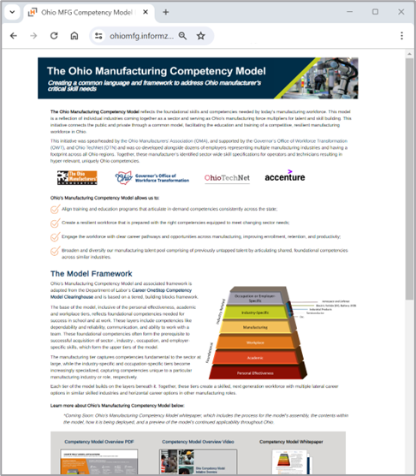
THE OHIO MANUFACTURING COMPETENCY MODEL LANDING PAGE
LANDING PAGE CONTENTS
Curriculum Assessment Training Recording (YouTube): Full session recording on how to run a
Five competency model repositories
Model Overview Video
Sub-competency one-pagers
Use Case Overviews
Competency Model Whitepaper
Use Case Toolkits
curriculum assessment and use templates
Curriculum Assessment Instructions and Results Template (PPT): Use case how-to guide and template report for presenting competency coverage and assessment findings.
Curriculum Assessment Template (XSL): Competency and curriculum coverage crosswalk document; includes charts for interpreting assessment results.
https://ohiomfg.informz.net/ohiomfg/pages/Ohio_MFG_Competency_Model_
*Five once the Industry-Specific Semi-Conductor Model is added.
Notes:
Four (five) sets of CM repositories – sortable Excel sheets that list the KSAs.
Model Overview Video, informational and promo materials, a whitepaper, and toolkits for use cases.
The OH MFG CM Landing Page has all of these tools – and places to submit CA and project proposals for A&AM SR 2024.
[OPEN WEBSITE].
Set up next slide: Let’s look at the CM in more detail.

Slide 10
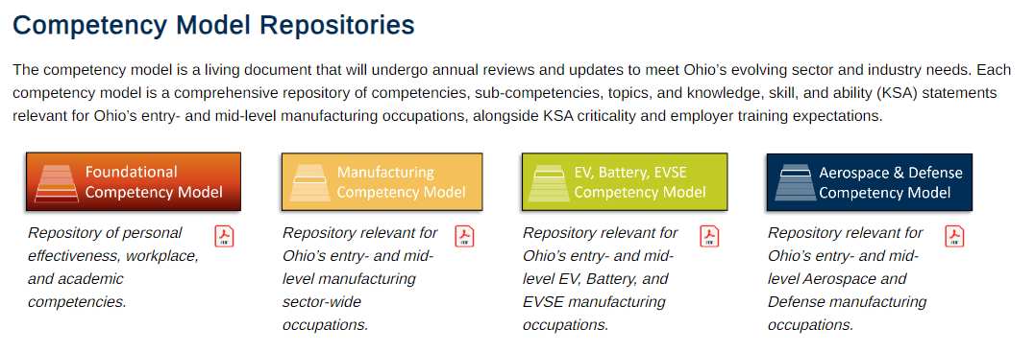
COMPETENCY MODEL REPOSITORIES
There are four competency model repositories – 1) personal effectiveness, workplace, and academic competencies, 2) manufacturing sector-wide competencies, 3) EV, Battery, and EVSE competencies, 4) Aerospace & Defense competencies, and 5) Semiconductor competencies.
Semiconductor Competency Model recently added!
5
1
2
3
4
Notes:
The site has four (soon five) OH MFG CM repositories (Excel sheets).
Associated with different layers of the OH MFG CM.
The foundational model includes the personal effectiveness, academic and workplace tiers – foundational skills needed for success in school and at work.
Like dependability and reliability, communication, and ability to work with a team.
Foundational competencies often form the prerequisite to successful acquisition of sector-, industry-, occupation, and employer-specific skills, which form the upper tiers of the model.
The manufacturing sector-wide model captures skills fundamental to the manufacturing sector at large and are needed across all industries.
The industry-specific models become increasingly specialized, capturing skills unique to a particular manufacturing industry (e.g., EV & Battery or A&D).
Set up next slide: Before we dive into a repository, we need to review some terminology related to skills classification.

Slide 11
OHIO MANUFACTURING COMPETENCY MODEL APPLICATIONS
Extension of the Competency Model’s value takes form in the many ways it can be applied or used across the state.
Competency Model Build
Building and customizing a competency model first involves collecting and synthesizing labor market information and then convening manufacturers to customize and validate.
Competency Model Applications
Various use cases can be pursued after a competency model has been established, such as…
Career
Pathways
Regional Training Mapping
Career
Pathways
Curriculum
Assessment
Employee Assessment
Identify advancement pathways within an organization or industry.
Reference tool to develop stackable credentials.
Identify advancement pathways within an organization or industry.
Reference tool to develop stackable credentials.
Align curriculum to employer and skilled labor needs.
Highlight curriculum gaps or redundancies.
Identify regional training strengths and gaps based on coverage of competencies.
Communicate role-specific competency mastery expectations to employees.
Gauge employee advancement readiness, succession planning.
Occupation or Employer-Specific
Aerospace + Defense
Industry Competencies
EV, Battery, EVSE
Industry Competencies
Electrification
Industrial Products
Electrification
Industry Specific Competencies
Industry-Specific
Semiconductor
Etc.
Manufacturing
Train-the-Trainer Program Enhancement
Train-the-Trainer Program Enhancement
Credential & Apprenticeship Development
Employer & Educator Mapping
Talent Pipeline Management
Workplace
Inform on-the-job training programs
Benchmark for supervisors to encourage continuous learning within teams.
Inform on-the-job training programs
Benchmark for supervisors to encourage continuous learning within teams.
Identify existing credentialling and apprenticeship program gaps.
Delineate educator and employer skill “responsibility”.
Identify target institutions based on high competency overlap.
Consistency in job posting language.
Source a broader pool of qualified candidates.
Academic
Personal Effectiveness
And many others (e.g., Credit for Prior Learning)…
The Competency Model Clearinghouse and associated framework is adapted from DOL’s CareerOneStop.
Notes:
These are the applications of the competency model.
CM is the database (literally a set of Excel sheets) of skills needed by OH manufacturers. Use cases are the specific applications of the model (toolkits built on the Excel sheets).
Let’s look at few of them.
Talent Pipeline Management – Use the CM to update job posting language in terms of skills.
Employee Assessment: Similar. Assess employees in terms of skills and gauge advancement readiness. Naturally, leads to:
Career Pathways: Define positions in terms of skills to identify advancement paths within an organization or industry.
Or use as a reference tool to develop stackable credentials.
Curriculum Assessment: Align curriculum to employer and skilled labor needs and highlight curriculum gaps or redundancies.
Regional Training Mapping: Based CA, assess regional program strengths or gaps based on competency coverage.
These two are key to the A&AM Super RAPIDS process.
Ser up next slide: OMA has developed a number of tools related to the CM.

Slide 12
Conducted by Educators
Utilized by Educators
Promoted by OMA and ISPs
WHAT ARE THE BENEFITS?
Promotes curricula across ISPs and employers.
Highlights clear path for educators to pinpoint curriculum areas to enhance.
Upskills students to be better prepared to enter the workforce.
WHAT QUESTIONS ARE ADDRESSED?
How can curricula more closely align with Ohio manufacturers’ designated competency needs?
How can ISPs promote curricula that address critical employer needs?
What additional content can supplement existing manufacturing curricula?
Manufacturing curriculum content can be cross-walked with and compared to content within the competency model at the Knowledge, Skill, and Ability (KSA) level. Programs can assess if they are thoroughly covering, providing exposure to, or not covering KSAs within the Competency Model to get hyper-detailed feedback on how curriculum aligns to the model. Based on the coverage category and criticality of KSA, an educator recommendation can be made to better align curriculum with Ohio’s manufacturing competency needs.
WHAT’S THE PROCESS?
01
Local education programs evaluated against competency model
02
Coverage level identified and classified
03
Recommendation and implementation of curriculum modifications/updates
Notes:
A curriculum assessment:
Compares the employer-defined KSAs in the CM with curriculum of training programs.
Can determine whether programs provide thorough coverage, exposure, or have a gap in necessary KSAs.
Based on criticality, the CA will produce strategic suggestions for demand-driven curriculum refinements.
Essentially, uses KSAs as a common language between employers and educators.
Many assessments are being completed as part of the A&AM Super RAPIDS process.

Slide 13
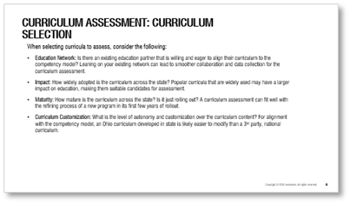
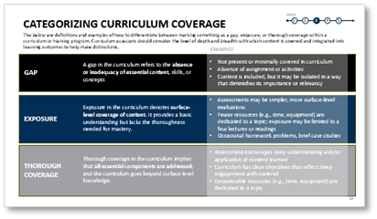
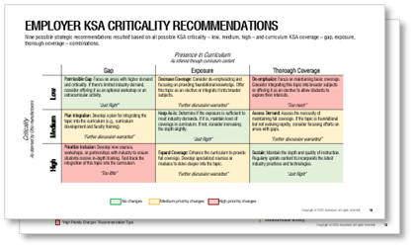
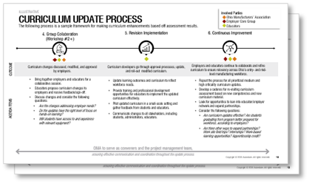
CURRICULUM ASSESSMENT PROCESS
The following process describes how to conduct a curriculum assessment and how to interpret findings.
1. Select Manufacturing Curriculum
2. Obtain Curriculum Content
3. Perform Curriculum-Competency Crosswalk
4. Review Recommended Actions
5. Implement
Action Plan
Select programs for educator self-assessment.
Collect learning outcomes, bodies of knowledge, lesson plans, curriculum modules, and study guides.
Compare curriculum content to manufacturing competencies at the knowledge, skill, and ability (KSA) level.
Discuss curriculum assessment outputs with ISPs and local manufacturers.
Create plan to enhance curriculum and work with manufacturers to help close gaps
Notes:
1. Select manufacturing curriculum – at the PROGRAM LEVEL. For credentials, at the credential level (which may be much smaller; credentials may bundle or customize).
CA can be used on any program – but is intended for those training entry and mid level manufacturing employees.
2. Collect curriculum content.
Bodies of knowledge, syllabi, lesson plans, homework and lab assignments, modules, readings, etc.
3. Perform curriculum-competency crosswalk.
Compare curriculum content to CM – assign specific content to each KSA to demonstrate presence.
Using the Curriculum Assessment Template on the OH MFG CM Landing Page.
4. Review recommended actions.
View the Entry-Level and Mid-Level Dashboards for recommendations.
Use results to populate the Results Template – for easier presenting.
5. Implement action plan.
Use the results to prioritize curriculum reforms and equipment investments.
Set up next slide: Let’s zoom into steps 2 and 3.

Slide 14
Steps
CATEGORIZING CURRICULUM COVERAGE
1
2
3
4
5
The below are definitions and examples of how to differentiate between marking something as a gap, exposure, or thorough coverage within a curriculum or training program. Curriculum assessors should consider the level of depth and breadth with which content is covered and integrated into learning outcomes to help make distinctions.
EXAMPLES
GAP
A gap in the curriculum refers to the absence or inadequacy of essential content, skills, or concepts.
Not present or minimally covered in curriculum
Absence of assignment or activities
Content is included, but it may be isolated in a way that diminishes its importance or relevancy
EXPOSURE
Assessments may be simpler, more surface-level evaluations
Fewer resources (e.g., time, equipment) are dedicated to a topic; exposure may be limited to a few lectures or readings
Occasional homework problems, brief case studies
Exposure in the curriculum denotes surface-level coverage of content. It provides a basic understanding but lacks the thoroughness needed for mastery.
THOROUGH
COVERAGE
Assessment encourages deep understanding and/or application of content learned
Curriculum has clear objectives that reflect deep engagement with material
Considerable resources (e.g., time, equipment) are dedicated to a topic
Thorough coverage in the curriculum implies that all essential components are addressed, and the curriculum goes beyond surface-level knowledge.
Notes:
As you review curriculum content, you will assign a category to each KSA to represent coverage in the curriculum:
Gap, exposure, and thorough coverage.
[READ THROUGH AND EXPLAIN].
Set up next slide: The template then provides strategic recommendations.

Slide 15
Steps
STRATEGIC UPDATE RECOMMENDATION FRAMEWORK
1
2
3
4
5
Strategic recommendations are derived once curriculum coverage is compared against criticality as deemed by Ohio employers.
Manual assessment of curriculum
Curriculum Assessment Output
Sample strategic decisions:
 | Criticality | Curriculum Coverage
Knowledge of calibration procedures, precision measurement tools, and equipment accuracy requirements. | High | Gap
Ability to ensure accurate designs that meet GD&T requirements. | High | Exposure
Knowledge of machine preparation activities such as lubrication, restocking of materials, understanding operation and safety. | High | Gap
Skill in reading and interpreting electrical schematics, including wiring diagrams, circuit layouts, and control panel drawings. | High | Thorough Coverage
Skill in identifying opportunities for improved ergonomic workstation layouts. | Low | Gap
Knowledge of GD&T principles and standards for parts manufacturing. | Medium | Thorough Coverage
Gap and High Criticality
Prioritize Inclusion
Based on employer input, critical need in industry; recommend bridging the gap and fast-track integration of KSA into curriculum.
Manufacturing KSAs
Thorough Coverage and High Criticality
Sustain
Maintain the depth and quality of instruction. Regularly update to incorporate newest industry trends.
Gap and Low Criticality
Permissible Gap
Assess the necessity of filling the gap. If there's limited industry demand, consider offering it as an optional workshop or an extracurricular activity.
“No Changes” Recommendation Type
“Moderate Changes” Recommendation Type
“High Priority Changes” Recommendation Type
Notes:
Strategic recommendations derived once curriculum coverage is compared against criticality as deemed by Ohio employers.
There are three recommendation “types”: No changes, possible/moderate changes, and high priority changes.
[READ THROUGH SAMPLE STRATEGIC DECISIONS].
Set up for next slide: Coverage vs. criticality provides a handy strategic recommendation matrix.
And the recommendation is generated by the Excel sheet.

Slide 16
Steps
INSIGHTS DRAWN FROM ASSESSING CURRICULUM
1
2
3
4
5
Nine possible strategic recommendations resulted based on all possible KSA criticality – low, medium, high – and curriculum KSA coverage – gap, exposure, thorough coverage – combinations.
Presence in Curriculum
As inferred through curriculum content
 | Gap | Exposure | Thorough Coverage
 | Permissible Gap: Focus on areas with higher demand and criticality. If there's limited industry demand, consider offering it as an optional workshop or an extracurricular activity. “Just Right” | Decrease Coverage: Consider de-emphasizing and focusing on providing foundational knowledge. Offer this topic as an elective or integrate it into broader subjects. “Further discussion warranted” | De-emphasize: Focus on maintaining basic coverage. Consider integrating this topic into broader subjects or offering it as an elective to allow students to explore their interests. “Too much”
 | Plan Integration: Develop a plan for integrating the topic into the curriculum (e.g., curriculum development and faculty training). “Further discussion warranted” | Keep As-is: Determine if the exposure is sufficient to meet industry demands. If it is, maintain level of coverage in curriculum. If not, consider increasing the depth slightly. “Just Right” | Assess Demand: Assess the necessity of maintaining full coverage. If the topic is foundational but not evolving rapidly, consider focusing efforts on areas with gaps. “Further discussion warranted”
 | Prioritize Inclusion: Develop new courses, workshops, or partnerships with industry to ensure students receive in-depth training. Fast-track the integration of this topic into the curriculum. “Too little” | Expand Coverage: Enhance the curriculum to provide full coverage. Develop specialized courses or modules to delve deeper into the topic. “Further discussion warranted” | Sustain: Maintain the depth and quality of instruction. Regularly update content to incorporate the latest industry practices and technologies. “Just Right”
Criticality
As deemed by Ohio manufacturers
High Medium Low
No changes Medium priority changes High priority changes
16
Notes:
There are nine possible coverage vs. criticality combinations.
[GO THROUGH HIGH PRIORITY]
[GO THROUGH POSSIBLE]
[GO THROUGH NO CHANGES]
Set up for next slide: The Dashboard tabs provide more easily interpretable graphics.

Slide 17
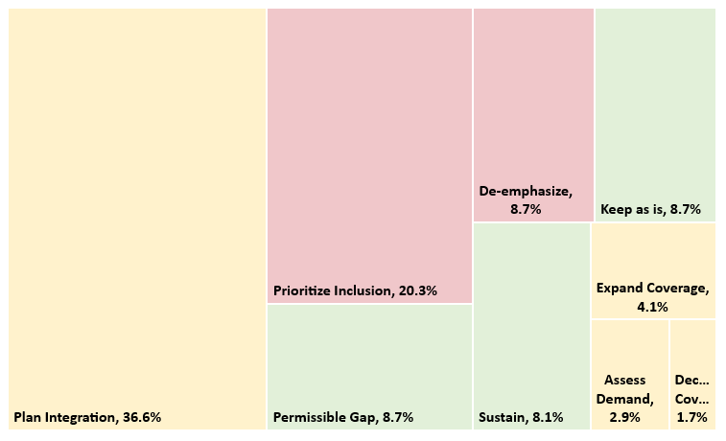
INTERPRETING CURRICULUM ASSESSMENT FINDINGS
The curriculum assessment excel dashboards consolidate individual KSA recommendations into at-a-glance charts summarizing assessment findings for a sample technician (mid-level) focused program.
SAMPLE ASSESSMENT OUTPUT
The most common recommendation category is represented as the largest box. The corresponding percentage indicates the percent of KSAs that fell within that recommendation type (note: size of the box does not equate to priority of the change)
Thorough: Low Criticality
Exposure: Medium Criticality
Recommendation types are shaded based on their priority. For example, KSAs falling within “Prioritize Inclusion” and “De-emphasize” should be addressed first within curriculum.
Exposure: High Criticality
Gap: High Criticality
The graph on the right indicates 36.6% of KSA statements, for example, fell within the “Plan Integration” recommendation type. In other words approx. 36% of mid-level KSAs within the model were medium criticality and missing from curriculum.
Thorough: High Criticality
Gap: Medium Criticality
Gap: Low Criticality
Plan Integration, 36.6%
“No Changes” Recommendation Type
“Moderate Changes” Recommendation Type
“High Priority Changes” Recommendation Type
Thorough: Medium Criticality
Exposure: Low Criticality
17
Notes:
Here is an example of the charts generated in the Excel templates.
[REVIEW THE BULLETS].
What does a curriculum assessment look like?
[SHOW CMFGA CA]
Set up next slide: Besides curriculum refinement, the CA has other uses.

Slide 18
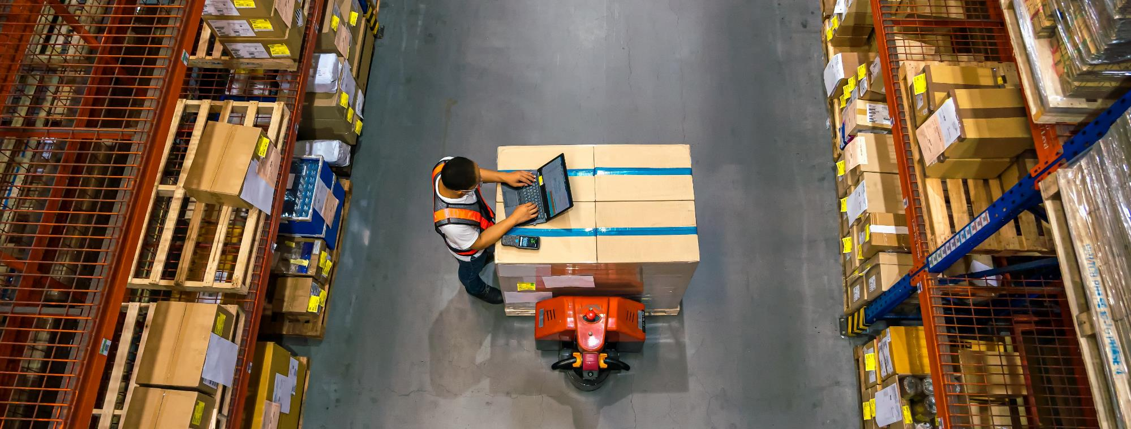
USING CURRICULUM ASSESSMENT RESULTS TO DRIVE ALIGNMENT WITH MANUFACTURERS
Assessment results and findings can be used to approach regional manufacturers and spotlight industry-ready talent.
When there’s high competency overlap, outputs can be used to:
Where there’s low competency overlap, outputs can be used to:
Promote your program to employers and regional industry-sector partnerships (ISPs) as graduating industry-ready talent
Approach manufacturers for agree-to-hire commitments to boost talent flow to manufacturers and drive course enrollment
Seek manufacturer partnership in developing work-based learning opportunities, field trips, facility tours, or internship / apprenticeship opportunities
Request co-development of new course modules or case studies with manufacturers
Seek manufacturer sponsorship for capstone projects
Notes:
[READ THROUGH THE POINTS]
And, of course, CAs can be used to justify funding requests – like A&AM Super RAPIDS.
Next slide.

Slide 19
COMPETENCY MODEL USE DECISION FRAMEWORK
Below provides directional guidance on knowing how and when to use each tier of the competency model when conducting curriculum assessments.
 | Assessing holistic manufacturing program Program emphasis on broad set of skills relevant to many industries | Assessing industry-specific manufacturing program When course aims to integrate industry-specific skills with broad manufacturing principles or when industry-specific program covers foundational , pre-requisite content before delving into industry-specific content | Assessing industry-focused module or niche component of program When module being assess is specialized or for continuing education or professional development courses focused on industry-specific skills only
Sector-Wide Manufacturing Competency Model
Industry-Specific Competency Model (e.g., EV, A&D, semiconductor)
Examples | OACC’s Intro to Manufacturing Program Tooling U-SME’s Certified Manufacturing Associate Program Introduction to Industrial Processes | Electric Vehicle Manufacturing Technology Aerospace and Defense Principles in Manufacturing | Battery Technology for Electric Vehicles Semiconductor Manufacturing Techniques
Notes:
Since there are multiple repositories, knowing when to use which is key.
When assessing a holistic manufacturing program (or credentials that bundle into one), use the sector-wide model.
When assessing industry-specific manufacturing programs, use BOTH the sector-wide and industry-specific models.
When assessing industry-specific modules, small credentials, or niche components of a program, use the industry-specific model.
See the included examples!
Set up next slide: Next we have some FAQs and tips for assessments.

Slide 20
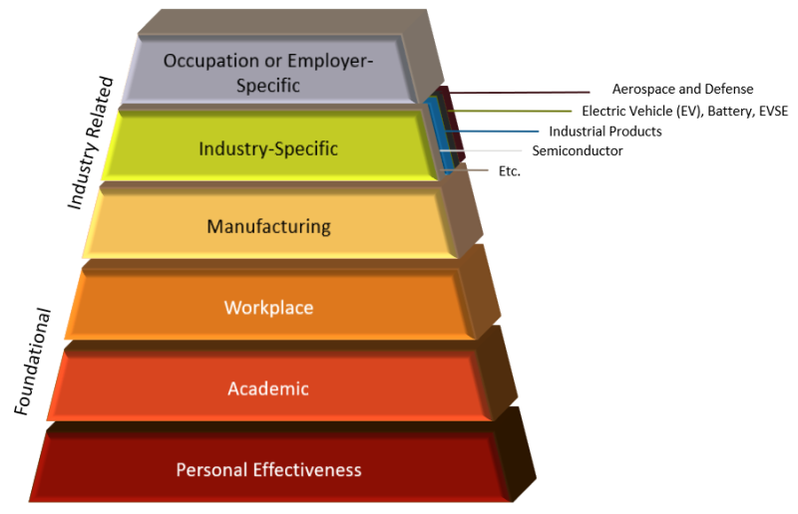
WHAT TYPES OF COURSES CAN BE ASSESSED
The Ohio Manufacturing Competency Model can be used to better align curriculum with Ohio manufacturer competency needs across all types of courses and programs.
Which programs are eligible for curriculum assessment?
Any operator- or technician-targeted course or program can be assessed.
Both entire programs (e.g., associate program) and individual courses in manufacturing can be assessed.
These assessments are not meant to be punitive, instead they are meant to highlight curriculum of manufacturer-defined competencies. Assessment results can be contextualized by course or program length and credit hours without direct comparison between different types of programs/courses
What are some examples of eligible courses?
The assessor should choose the combination of curriculum assessment materials that best suits the curriculum.
Available Curriculum Assessments
Industry-Specific
Additional industry-specific curriculum assessments coming soon…
Type of Program | Relevant Curriculum Assessment Materials
CNC Operator Course
Intro to Manufacturing Course
EV Technician Program
A&D Operator Program
Mechatronics Engineering (Bachelor’s degree) | Not eligible because doesn’t focus on operator and technician skillsets
Sector-Wide
Curriculum assessment materials can be found on the Ohio Manufacturing Competency Model Landing Page.
Notes:
Explains which programs can be assessed.

Slide 21
DOS AND DON’TS OF CURRICULUM ASSESSMENTS
Manufacturing curriculum can be mapped against the Ohio Manufacturing Competency Model to understand curriculum alignment to employer and skilled labor needs. For the excel assessment to be accurate, there are a few dos and don’t the assessor should be aware of.
What should you do?
Determine the level of coverage using the drop-down box to input gap, exposure, or thorough coverage.
Complete the “Source” column to document where in the curriculum you are finding coverage.
What shouldn’t you do?
Do not update any columns besides “Curriculum Coverage” and “Source” – everything will auto-populate without additional edits.
Do not use your own curriculum coverage nomenclature (e.g., “yes” “no” “partial”) – the dashboard and recommendations requires you to use gap, exposure, and thorough coverage.
Notes:
Provides tips for using the Excel templates for CA.

Slide 22
DIGITAL TRANSFORMATION
Digital Transformation is the process of adopting technology to improve products and business outcomes.
Digital thread enables Industry 4.0 technologies that drive Digital Transformation.
Notes:
Reintroduce self: Sinclair, Workforce Dev, Dig Transformation
Our team works on DTx and DT, Significance of DTx in today’s industries and DTx technologies are evolving, need for skilled workers that have backgrounds in DTx and DT. Broad – includes areas as seen in image as well as aspects of business including supply chain and logistics, also cybersecurity
https://www.stellardigital.in/blog/digital-transformation-the-benefits-and-challenges-adhered-to-it/

Slide 23
FOUNDATIONS IN DIGITAL TRANSFORMATION
Module | Topic
1 | What is Digital Transformation?
2 | Introduction to Product Lifecycle
3 | Problem Solving with Rapid Prototyping
4 | Data-Driven Manufacturing
5 | Digital Thread Supply Chain Logistics
6 | Data Acquisition and Management with Digital Thread
7 | Digital Thread and Quality Assurance
8 | Industrial Data Preparation and Management
9 | Data Analysis, Visualization, and Reporting for Industry 4.0
10 | Digital Twin Technology
11 | Cybersecurity with Digital Thread
12 | Artificial Intelligence and Industrial Applications
13 | Human Factors and Change Management with Digital Transformation
14 | Capstone Project - Introduction: Assembling the Digital Thread
15 | Capstone Project Presentations
Notes:
MODULAR curriculum, Each module is broken down into 3 lessons of content and altogether, if used as credit-based coursework, this could translate to a 3 credit, semester-long course if used in its entirety.
Filled gap between academic and workforce by building curriculum that can be used either credit based or workforce

Slide 24
Curriculum Content:
Each module
Lecture-style PowerPoint presentations
Case studies and industry spotlights
Career highlights
Activities for each module that are low to no cost to complete
Learning objectives and terms list
Instructor guides for each module
Glossary of terms
FOUNDATIONS IN DIGITAL TRANSFORMATION

Slide 25
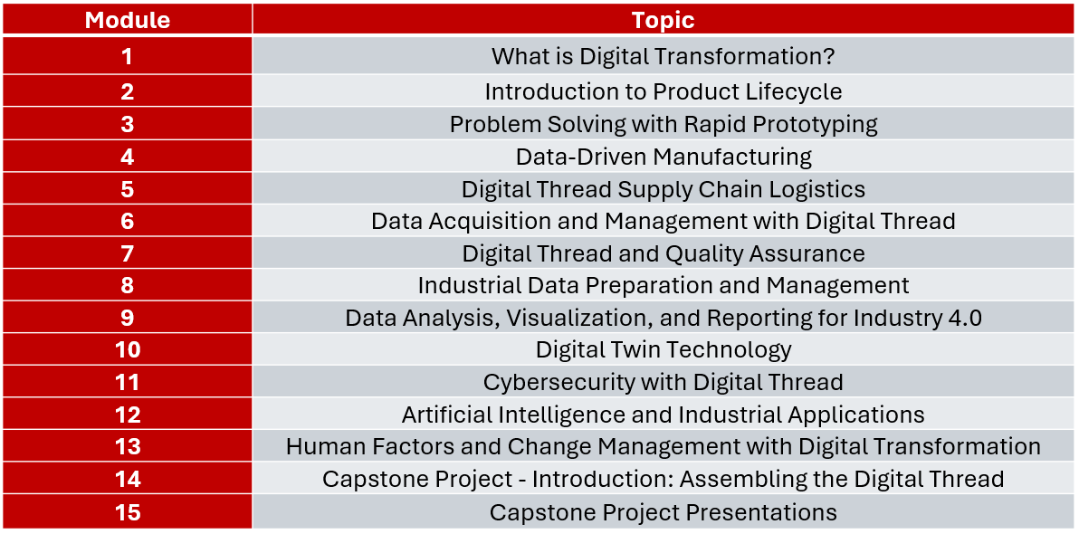
CURRICULUM APPLICATIONS
Credit-based coursework
New coursework development
Incorporation into existing coursework
Workforce Development Workshops
Train the Trainer models
Current Applications
Ohio University
Piqua High School/Upper Valley Career Center
Notes:
Note that the goal is to release open source and it’s available if anyone is interested. Current applications at OU and Piqua.
Why we built this curriculum as we did: Filled gap between academic and workforce by building curriculum that can be used either credit based or workforce
Take pieces to fill your needs

Slide 26
OHIO MANUFACTURING COMPETENCY MODEL
Notes:
Stress thorough coverage, exposure, or gap as the benchmarks used for the KSAs aligned in the curriculum, focused mainly on entry and mid level KSAs, also mainly knowledge and skill KSAs.
https://ohiomfg.informz.net/ohiomfg/pages/Ohio_MFG_Competency_Model_?_zs=iDVqT&_zmi=xSAL
Competency, sub-competency, topic, KSAs

Slide 27
ALIGNMENT WITH INDUSTRY
Relevance to Industry Needs
Ensure that learners acquire the KSAs that are in current demand.
Bridge the gap between education and the real-world needs of employers.
Validation of Curriculum
Industry-informed KSAs provide an external benchmark, validating that the curriculum is relevant and current with industry expectations.
Adaptability to Changing Trends
Industry-aligned KSAs reflect the evolving demands of the workforce, ensuring that educational content keeps pace with emerging technologies, practices, and trends.
Notes:
OMA competency model

Slide 28
FOUNDATIONS IN DIGITAL TRANSFORMATION
Module | Topic
1 | What is Digital Transformation?
2 | Introduction to Product Lifecycle
3 | Problem Solving with Rapid Prototyping
4 | Data-Driven Manufacturing
5 | Digital Thread Supply Chain Logistics
6 | Data Acquisition and Management with Digital Thread
7 | Digital Thread and Quality Assurance
8 | Industrial Data Preparation and Management
9 | Data Analysis, Visualization, and Reporting for Industry 4.0
10 | Digital Twin Technology
11 | Cybersecurity with Digital Thread
12 | Artificial Intelligence and Industrial Applications
13 | Human Factors and Change Management with Digital Transformation
14 | Capstone Project - Introduction: Assembling the Digital Thread
15 | Capstone Project Presentations
Notes:
MODULAR curriculum, Each module is broken down into 3 lessons of content and altogether, if used as credit-based coursework, this could translate to a 3 credit, semester-long course if used in its entirety.
Filled gap between academic and workforce by building curriculum that can be used either credit based or workforce

Slide 29
CURRICULUM ALIGNMENT
Module 5: Digital Thread Supply Chain Logistics | 1. Introduction to the Digital Supply Chain
 | 2. Enterprise Resource Planning
 | 3. A Walk through the Supply Chain
Notes:
M5 has 3 lessons….we aligned KSAs based on the content of each lesson.

Slide 30
CURRICULUM ALIGNMENT
7.1.2.1 K Knowledge of product flow within the manufacturing plant and rejection procedures.
7.2.2.1 K Knowledge of labeling standards, barcoding systems, and identification methods used for inventory items.
Notes:
First 2 KSAs, can see a subcompetency and topic here with the listed KSAs

Slide 31
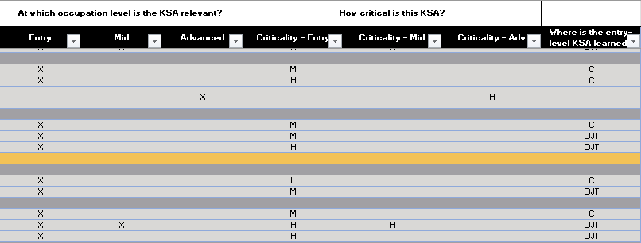
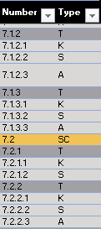
CURRICULUM ALIGNMENT
7.1.2.1 K Entry level KSA; Medium critically, Learned in curriculum.
7.2.2.1 K Entry level KSA; Medium critically, Learned in curriculum.
Notes:
As seen here, both are knowledge type KSAs, and all of the KSAs aligned to our curriculum were either knowledge or skill-based KSAs and either entry or mid level….

Slide 32
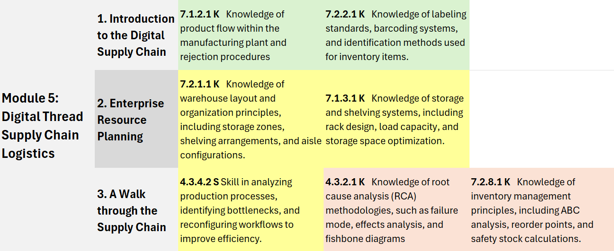
CURRICULUM ALIGNMENT
Thorough coverage
Exposure
Gap

Slide 33
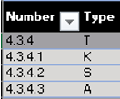
CURRICULUM ALIGNMENT
4.3.4.2 S Skill in analyzing production processes, identifying bottlenecks, and reconfiguring workflows to improve efficiency.
4.3.4.2 S Entry to mid level KSA; Low to mid level criticality, Learned in curriculum.

Slide 34
CURRICULUM ALIGNMENT
Thorough coverage
Exposure
Gap

Slide 35
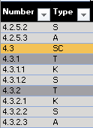
CURRICULUM ALIGNMENT
4.3.2.1 K Knowledge of root cause analysis (RCA) methodologies, such as failure mode, effects analysis, and fishbone diagrams.
4.3.2.1 K Entry level KSA, High criticality, Learned in curriculum.

Slide 36
CURRICULUM ALIGNMENT

Slide 37
CURRICULUM ALIGNMENT
Thorough coverage
Exposure
Gap

Slide 38
CURRICULUM ALIGNMENT
Thorough coverage
Exposure
Gap
Notes:
With this information, now what? Different rates of coverage – how align curriculum….do you need to fully cover all KSAs? Goals of curriculum, future development…. Make choices based on this knowledge as to how you want to address the gaps or depth you address the KSAs that industry has identified as valuable. What does industry value in this moment and how does my curriculum compare in covering those valued KSAs?

Slide 39
BEYOND THE COMPETENCY MODEL
OMCM provides a strong foundation.
Included knowledge and skills that extend beyond the current competency model including focusing on emerging technologies like AI, machine learning, and cybersecurity.
Goal: Future-proof the curriculum to ensure learners are not only equipped for today’s industry needs but also prepared for the emerging trends and challenges in Industry 4.0.
Notes:
Quality 4.0 – covered KSAs in quality but went beyond to where is it moving in I4.0

Slide 40
FUTURE CURRICULUM REALIGNMENT
Industry KSAs Are Not Static
Industry needs evolve with technology advancements and new business practices.
KSAs will need to be updated to meet these changes.
Ongoing Curriculum Evaluation
Regular review and adaptation of the curriculum is critical to ensure it remains relevant.
Future-Proofing Curriculum
Ensures learners are equipped not just for today's demands, but also for the future of Industry 4.0.
Notes:
Remove outdated KSAs, add newer updated KSAs, continue to future-proof our curriculum with new emerging technologies to ensure our learners are well prepared for employers in industry.
We’re going to be doing a revision of this curriculum and will be looking at how to do this

Slide 41
Scan QR code to
access the
Ohio Manufacturing
Competency Model

Slide 42
CONNECT WITH US
Sinclair College Workforce Development is building Digital Transformation Curriculum for Higher ED, K-12, and Workforce Development.
Looking for partners to explore Digital Transformation curriculum replication at no cost.
Peter Jensen
Program Developer pjensen@lorainccc.edu
Meredith Rodgers
Program Manager
meredith.rodgers@sinclair.edu
Ryan Nichols
Program Developer
ryan.nichols1@sinclair.edu
Elizabeth Generas
Lead Program Manager elizabeth.generas@sinclair.edu
Alex Lake
Program Coordinator
alexander.lake@sinclair.edu
Lorain County Community College, Ohio
Sinclair Community College, Ohio
Sinclair Community College, Ohio
Sinclair Community College, Ohio
Sinclair Community College, Ohio

