Slide 1
Unlocking ASEAN Low Carbon Market Opportunities Key Insights Summary
Dr Jim Hamill
jim.hamill@energise2-0.com
www.exportcentral.ai
www.linkedin.com/in/drjimhamill
December 4th 2025

Slide 2
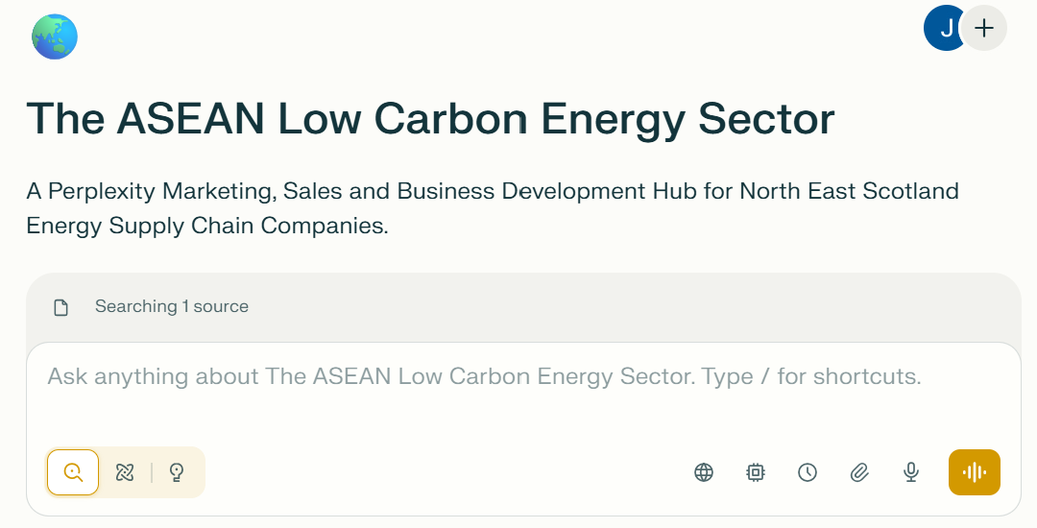
Perplexity AI
HOW we developed the Key Insights Summary is just as important as the insights themselves.
A detailed and comprehensive report is available.
From generic to company specific insights leveraging the power of AI.

Slide 3
Market Overview
Experiencing unprecedented growth, ASEAN is one of the most significant low carbon energy market opportunities globally with a combined project pipeline exceeding $120-220 billion USD.
Significant opportunities exist across all low carbon sectors including offshore wind, CCUS, green hydrogen, solar energy, wave and tidal, hydropower, clean energy and decommissioning.
The updated 2025 Nationally Determined Contributions (NDCs) demonstrate enhanced low carbon ambitions across most ASEAN countries, with notable improvements including shifts to absolute emissions targets, earlier peak emission commitments, and accelerated net-zero timelines.
With caveats, the region is open for business. Regulations, tariffs and local content requirements vary by country but are easing.

Slide 4
Key Project Analysis
Twenty major low carbon energy projects representing over $80 billion in total capital investment.
Spanning the complete development lifecycle from early-stage feasibility studies through front-end engineering design (FEED), engineering, procurement, and construction (EPC), and operational phases.
Distributed across offshore wind, solar with battery storage, geothermal, carbon capture and storage, hydrogen, grid infrastructure, and emerging marine energy technologies.
FEED or planning stages - 7
EPC or under construction - 3
Pre-FEED development - 3
Operational with expansion plans - 2
Tender stages - 2
Recently completed major milestones (auction awards, conditional approvals, or partnership agreements) - 3​

Slide 5



Key Project Analysis
By Technology
By Country
2025 - 2027
Offshore wind projects dominate the portfolio with 4 major developments representing approximately $25-30 billion in investment, followed by solar and battery storage systems ($15-20 billion), geothermal ($2.4 billion), carbon capture and storage ($4-5 billion), and grid infrastructure including subsea cables ($3-5 billion).​
Vietnam leads with 2 major offshore wind projects totaling 9.5 GW capacity and over $18 billion investment. The Philippines follows with the GEA-4 auction program delivering 10.2 GW across 123 projects valued at $15-20 billion. Malaysia hosts multiple projects including the ACWA Power partnership ($10 billion), Sarawak-Singapore cable ($2-3 billion), and CCS developments ($3-4 billion). Thailand's Gulf Energy solar-plus-storage portfolio represents $820 million in near-term investment. Indonesia features significant geothermal ($2.4 billion) and LNG-with-CCS projects ($20+ billion).​
​Tier 1: Imminent Contract Awards (Q4 2025 - Q2 2026)
Tier 2: Early-Stage Major Opportunities (2026-2027)
Tier 3: Strategic Multi-Billion Dollar Opportunities (2026-2028)

Slide 6
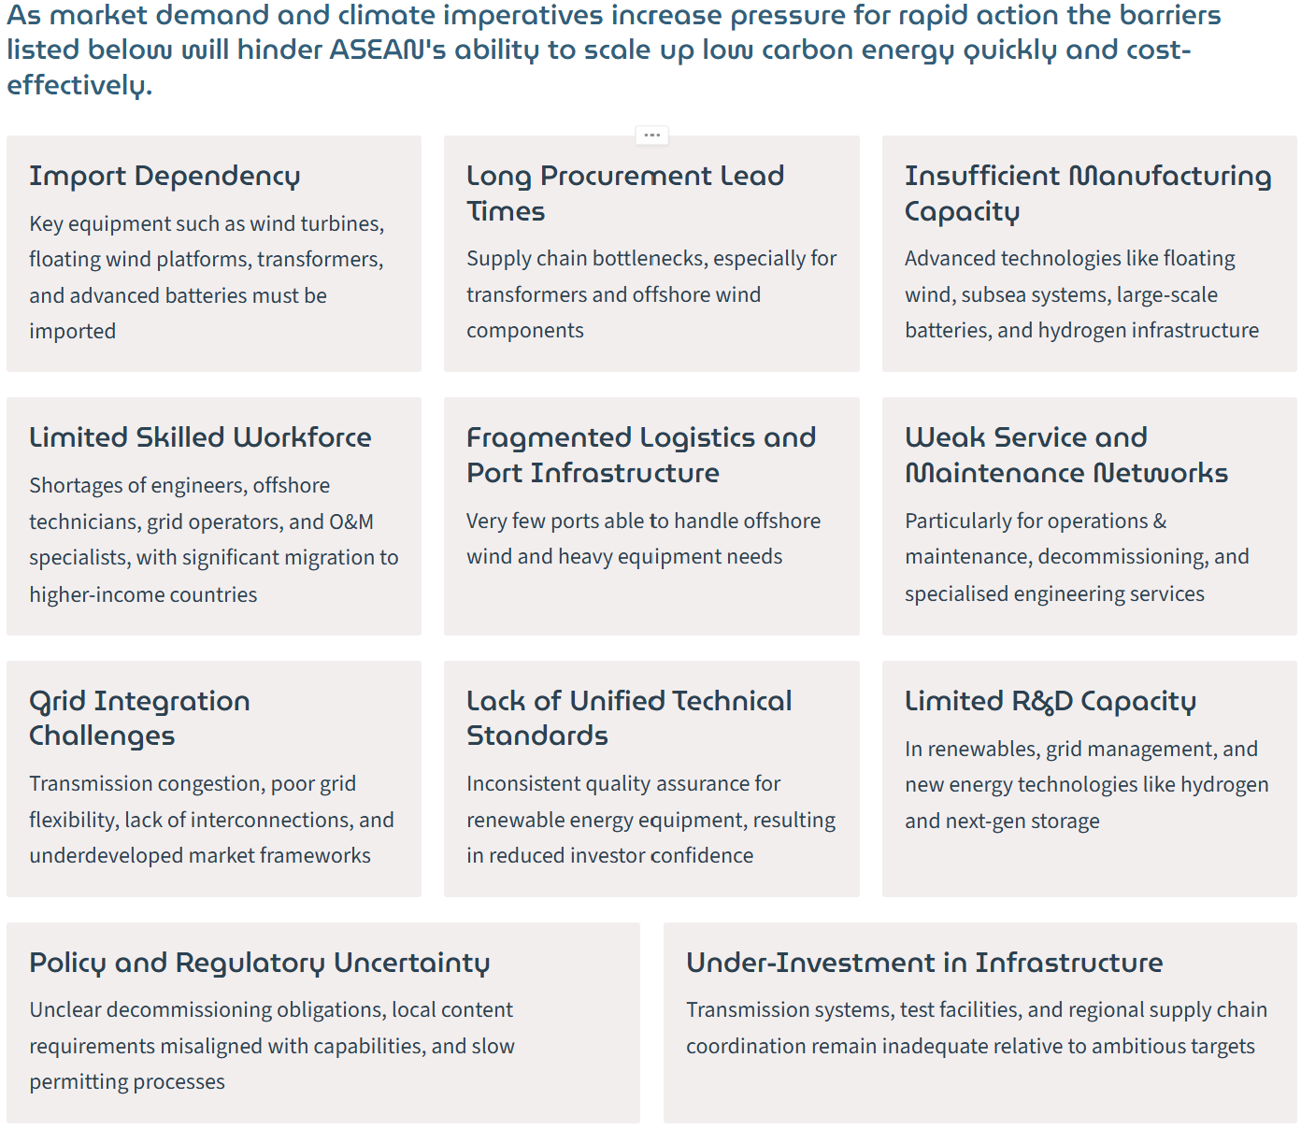
A Critical Juncture
A complex landscape where surging demand for clean energy encounters systematic infrastructure bottlenecks across manufacturing, equipment procurement, logistics, skilled labour availability, grid integration, capacity, technical services and specialised service provision.
Creating substantial opportunities for technology transfer and commercial partnerships with established energy hubs possessing world-leading capabilities in floating offshore wind, subsea engineering, and decommissioning expertise.

Slide 7
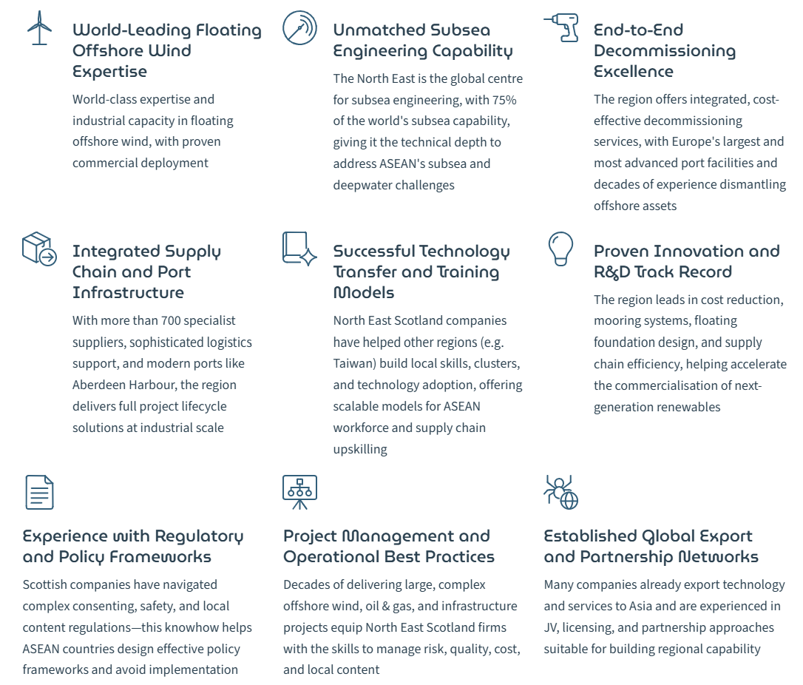
NE Scotland’s Unique Competitive Position
North East Scotland's energy supply chain companies are uniquely equipped to help accelerate ASEAN's low carbon transition.
Our world class blend of advanced technology, supply chain depth, global experience, and collaborative models are essential for rapidly closing ASEAN's renewable energy gap, building resilient clean energy systems for the future.

Slide 8

Competitor Analysis
China has established overwhelming dominance in ASEAN's renewable energy sector, representing the most formidable competitive threat.
But others very active too:
US
South Korea
Japan
Europe
UK
Regional and local champions
This Photo by Unknown Author is licensed under CC BY-SA

Slide 9
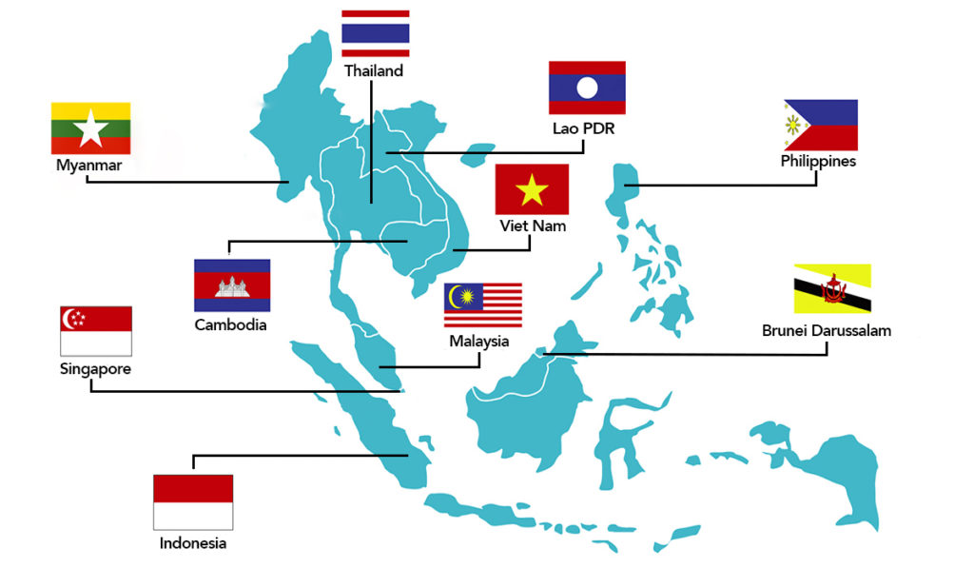
Conclusions
The region presents exceptional market opportunities for North East Scotland energy supply chain companies.
Massive Investment Scale
Technology Alignment
Competitive Opportunity
This Photo by Unknown Author is licensed under CC BY

Slide 10
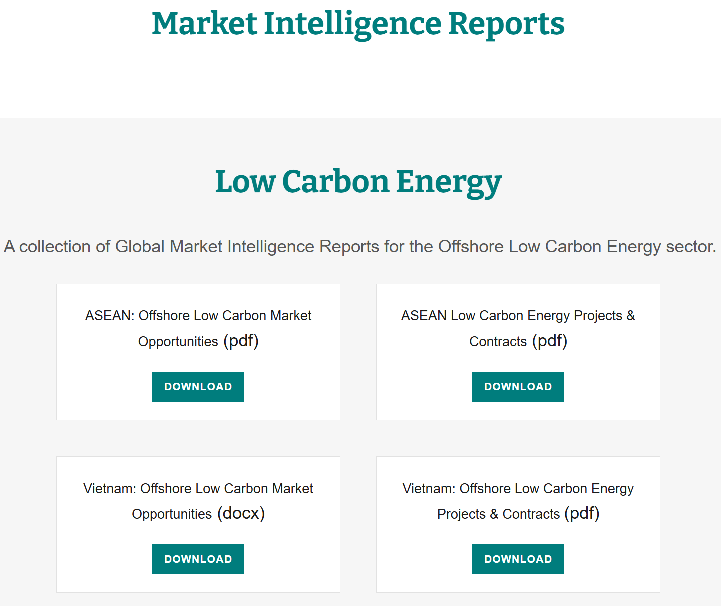
A Call to Action
The window of opportunity is 2025-2027.
Companies acting immediately and decisively will establish dominant market positions.
Late movers may face exclusion from premium opportunities.
Initiate market assessment, explore project and partnership opportunities, develop a market entry & development strategy, implement the strategy.
Download the reports – Export Central AI
https://exportcentral.ai/market-reports
Build you own AI-powered ASEAN Market Intelligence Hub using tools such as Perplexity AI.

Slide 11
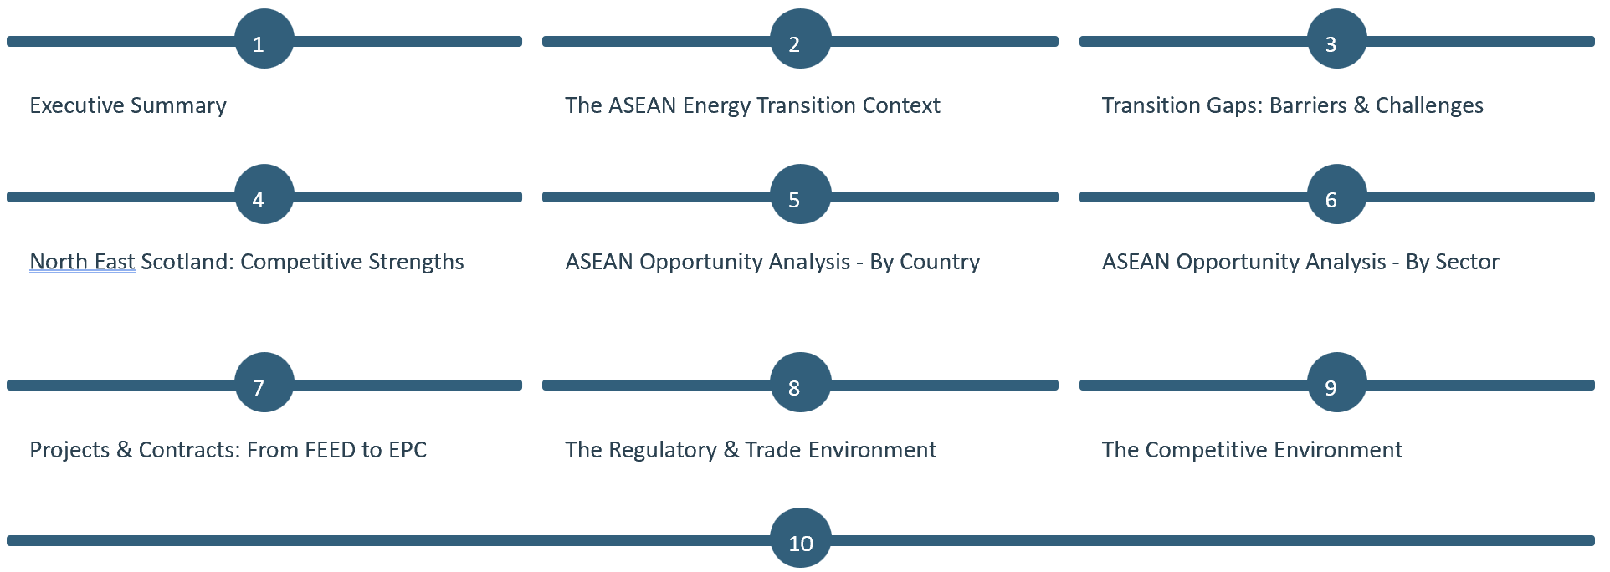
The Full Report

Slide 12
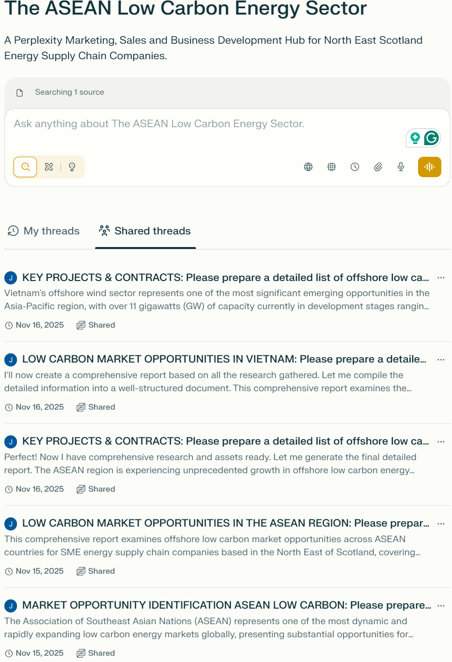
Customise the Report
Download the report
Create a Perplexity AI Pro account
Create a workspace called ASEAN Region
Provide context (about your company)
Upload the report
Prompt with company specific content requests
Set up Perplexity Tasks and real time updates
Develop actionable insights

