Slide 1

2023 Annual Meeting
of the
Twin Rivers HOA Members
Oviedo, FL
March 9, 2023
Virtual Meeting

Slide 2
Call to order - HOA President Bob White -- Welcome/Introduction/Thanks to Volunteers
Quorum?
Special Discussion Topics
  City Councilman Keith Britton – City of Oviedo
  John Painter – HOA Board Secretary/Treasurer – Fining System
  Topics Raised by HOA Members
Reports of Officers and Committees
  President’s Comments
  Reports of Secretary/Treasurer, Architectural Review Committee (ARC), Community Appearance Committee, and Neighborhood Committee
Composition of the Board of Directors (No election to be Held)
  Status
  Straw Poll
  Plan to make Appointments at April HOA Board Meeting
Old or New Business (None)
Notes:
This is a reflection on the city’s ability to provide goods and services. We are just now reaching the levels equivalent to the pre-recession levels..

Slide 3
Compelling Compliance
with
HOA Rules and Regulations
John Painter
Secretary/Treasurer
Twin Rivers HOA
Notes:
This is a reflection on the city’s ability to provide goods and services. We are just now reaching the levels equivalent to the pre-recession levels..

Slide 4
HOA Enforcement Issues
Less Compliance
Less Attractive Community
Lower Property Values
Priorities of HOA Members
Landlords
Difficult Owner/Residents
Adverse View of HOAs
Presented by: John Painter

Slide 5
Existing
HOA Enforcement Process
Education/
Notices/
Persuasion
Fines
Court Action
GAP
Effective with most owner/residents Relies on responsibility and good intentions, neighborliness Not as effective with Landlords | A Big Gap | Can be effective, when necessary, but also risky Very expensive and time consuming – for HOA Member and HOA Not desirable from a relationship perspective
Presented by: John Painter

Slide 6
Proposed Modified
HOA Enforcement Process
Education/
Notices/
Persuasion
Fines
Court Action
Very effective with most owner/residents Relies on responsibility and good intentions, neighborliness Not as effective with Landlords | Target violations that cause significant nuisance More effective with difficult owner/residents and landlords Shift much of the costs from HOA to bad actor | Can be effective, when necessary, but also risky Very expensive and time consuming – for HOA Member and HOA Not desirable from a relationship perspective
Presented by: John Painter

Slide 7
Focus of Rules Changes
Significant
Nuisance Issues
Landlord/
Renter Accountability
Achieving ARC Approvals
Fining Process
Presented by: John Painter

Slide 8
Fining Process
Complaint/Info Gathering
HOA Member can be Heard at a
Board Meeting
Where the Fine will be Considered
If Board votes to Fine,
Automatic Review by a Fining Committee
If Fining Committee approves, fine imposed
If Fining Committee does not approve, fine not levied
At least 14 Days’ Notice to the HOA Member of the Complaint and Consideration of Imposing a Fine
Pursuant to Section 720.3085, Florida Statutes, for any fine of at least $1,000 the Association may assert and record a lien against the Homeowner’s property.
Goal is to achieve rules compliance, not penalize HOA Members.
Presented by: John Painter

Slide 9
President’s Report
Bob White
President
Twin Rivers HOA
Notes:
This is a reflection on the city’s ability to provide goods and services. We are just now reaching the levels equivalent to the pre-recession levels..

Slide 10

What does your HOA Board do for you?
----- HOA is a not-for-profit organization ! -----
Administration
  Review and approve Sentry Management Inc. (SMI) contract
  Develop/maintain Goals and Objectives
  Develop Annual Budget
  Review and approve annual Insurance Policies
  Maintain the HOA Website
Maintain Residential Standards
  Maintain HOA Rules
  Review/approve improvement requests via the ARC
  Work with SMI on Inspections; emphasis on problem homes
Maintenance of Common Areas
  Oversea the Landscaper and Landscaping Contract
    Mowing and Edging
    Sprinkler System Maintenance and Repair
    Electrical System Maintenance and Repair
  Coordinate/oversee Repairs to walls and monuments on Lockwood
Christmas Decorations – Install, Tear-down and storage
Garage Sale – coordinate with city
Interfaces with City of Oviedo and Seminole County on your behalf

Slide 11


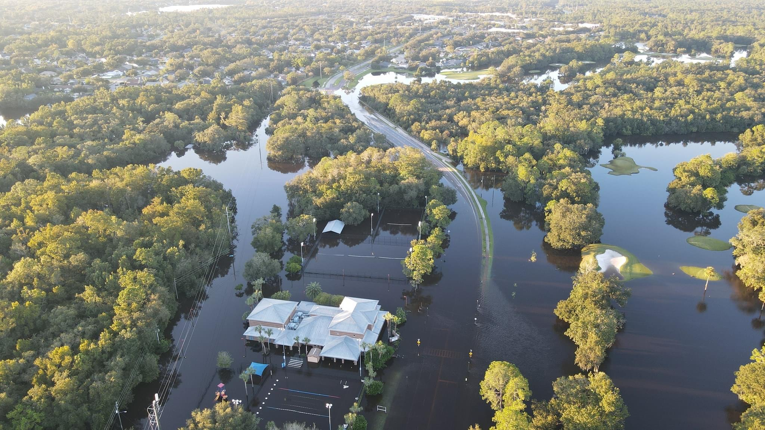
2022 Significant events
Landscaping Maintenance
Fired “Burnham LLC” .. after weeks of complaints
Hired “Exclusive Landscaping”
Hurricane Ian
Dozens of homes had serious flooding
Some of that flooding was directly tied to drainage infrastructure for which the city is responsible.
HOA is worked through the issues with the city and will track progress.

Slide 12

Twin Rivers
HOA Board of Directors
(as of 9 Feb 2023)
All board and committee members are volunteers
Status
Straw poll
Plan to appoint members at April Board mtg

Slide 13
Secretary and Treasurers’ Report
John Painter
Secretary Treasurer
Twin Rivers HOA
Notes:
This is a reflection on the city’s ability to provide goods and services. We are just now reaching the levels equivalent to the pre-recession levels..

Slide 14
Appointment of New Directors
Straw Poll
Several Volunteers
Straw Poll to Hear from HOA Members
Please Submit Ballot by End of March
Appointments at April 2023 Board Meeting
Notes:
This is a reflection on the city’s ability to provide goods and services. We are just now reaching the levels equivalent to the pre-recession levels..

Slide 15
As of February 2023
Per Sentry Management Records
ASSETS |  | LIABILITIES
Cash in Bank - Operating | $454,326 | Current Liabilities | $234,362
Cash in Bank – Reserve Acct | 213,104 | Equity – Reserved for Major Common Property Maintenance | 213,104
Maintenance Fees Receivable | 94,215 | Operating Equity | 316,179
Prepaid Insurance | 1,589
Deposits | 411
TOTAL ASSETS | $763,645 | TOTAL LIABILITIES | $763,645
Notes:
This is a reflection on the city’s ability to provide goods and services. We are just now reaching the levels equivalent to the pre-recession levels..

Slide 16
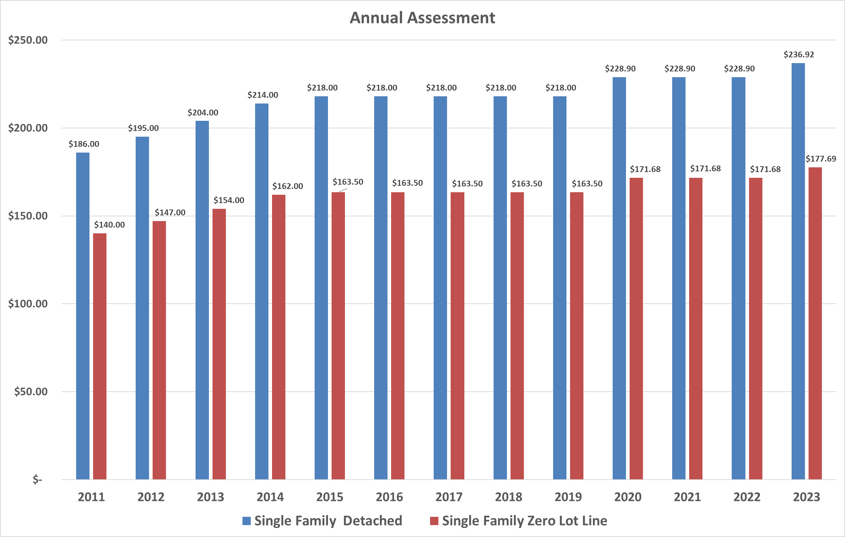
History of Assessment Levels
Notes:
This is a reflection on the city’s ability to provide goods and services. We are just now reaching the levels equivalent to the pre-recession levels..

Slide 17
Notes:
This is a reflection on the city’s ability to provide goods and services. We are just now reaching the levels equivalent to the pre-recession levels..

Slide 18
ARC Committee
and
Community Appearance Committee
Twin Rivers HOA
Cheryl Restagno
Chair and Community Standards Officer
Siri Goberdhan, Linda Dhennin, and Mike Franckewich

Slide 19
Color Book Overview
History
Goals
Selection
Process

Slide 20
History
Last update to Approved Color Book was the original Developers book back in the 1987-1990
Checking number of Homes who obtained ARC approval 8 years ago only 280+ homes were on file out of 1,173 homes.
Old process wasn’t working well for the homeowners in general
Based on various opinions, the Community Colors were dating the age of the homes in many cases.

Slide 21
Goals
Develop a color book that provides the homeowners increased value on their homes
Selection of the colors needed a broad assessment of the communities in the greater Oviedo Area
Ensure the process was homeowner friendly, increase the number of options, and the on-going upkeep of the book allowed the community to be competitive in the marketplace

Slide 22
Selection of Content
Review and rank all homes in Twin Rivers (scale 1-5 with 5 the highest)
Review existing color books of all surrounding communities and rank their available colors.
Review existing palettes from several paint companies (i.e. Behr, Sherwin Williams, PPG, Florida Paints, Benjamin Moore)
Review prior sales to determine based on size of home, the price a home sold for via sites that could provide us the information, i.e. Zillow
Determine Book format, develop book
Obtain Board Approval – completed August 2021

Slide 23
Process
  Color Book content
        Up to 50 pages each with
        Base Colors
        Up to 3 colors of Trim
        Up to 4 colors for Front Door per Base Color
1.
Homeowner Submits request to ARC
- to approve painting
2.
ARC
Responds
by Reviewing Process with Homeowner and Providing Color Book to Homeowner
3.
Homeowner reviews Color Book at home
and
obtains and considers paint samples
4.
ARC visits home, homeowner photos selected palette, ARC approves
“on-the-spot”
5.
ARC submits final paperwork to Association Manager, who emails a confirmation letter to homeowner

Slide 24
Neighborhood Committee
Plans for 2023
Vivian Guerra, Chair
Neighborhood Committee
Twin Rivers HOA

Slide 25


