Slide 1
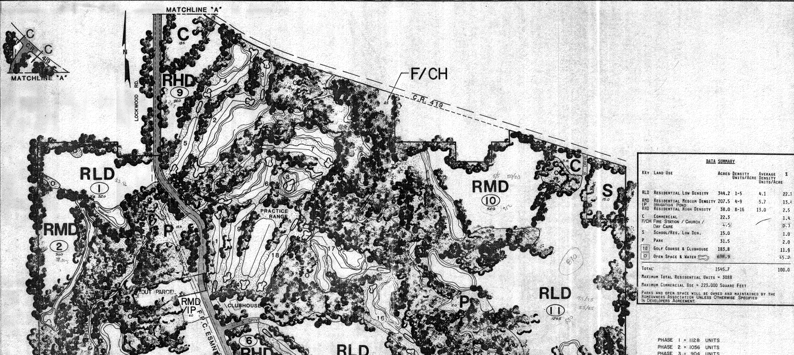
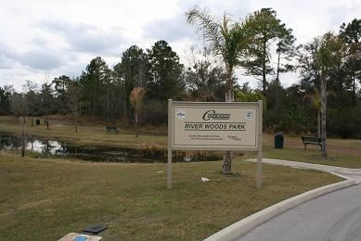

Original 12 Parcels in Twin Rivers PUD documents (1986)
River Woods Park

