Slide 1
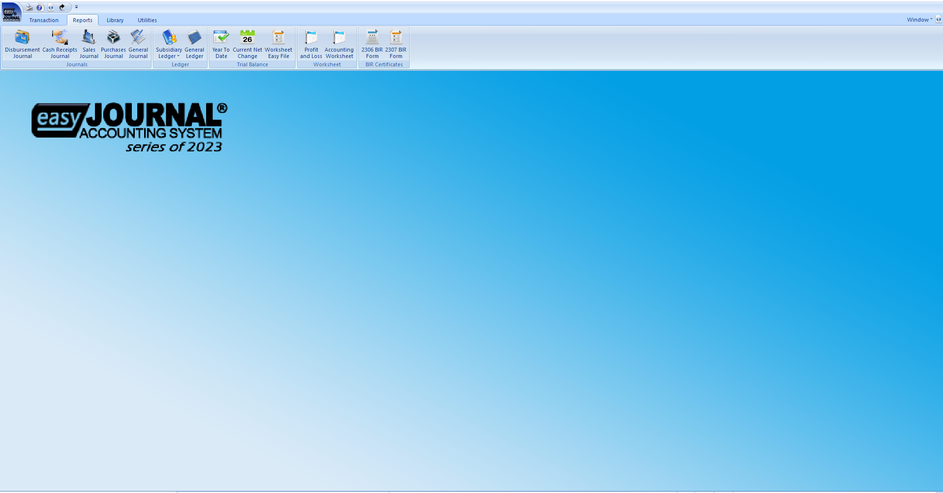
EASY JOURNAL ACCOUNTING SYSTEM
YOUR COMPUTERIZED ACCOUNTING SYSTEM

Slide 2
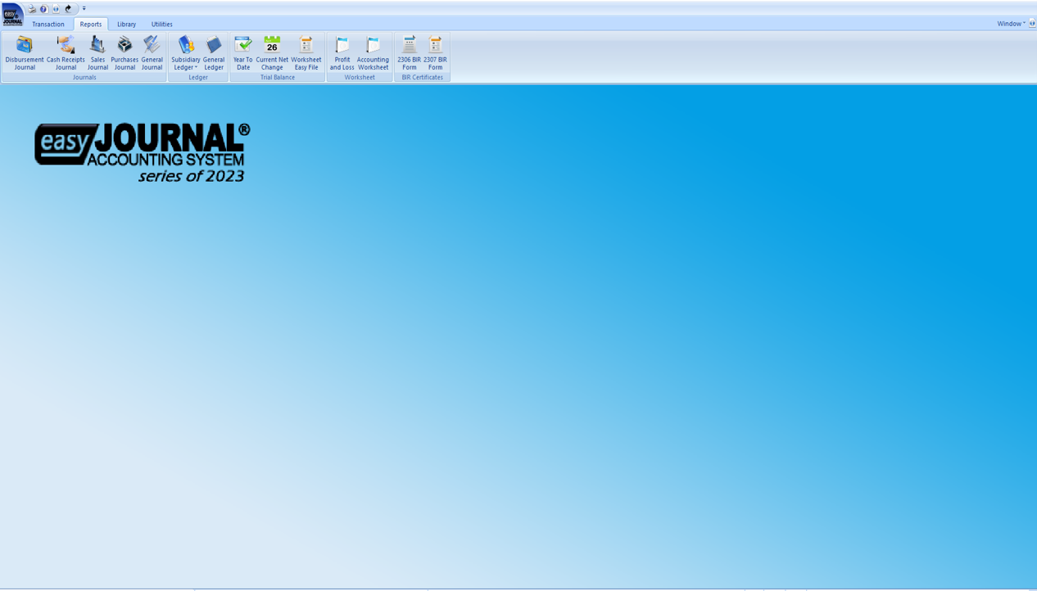
System overview

Slide 3
What is Easy journal accounting system
Easy Journal Accounting System is a computerized accounting system. Although, manual and computerized processes both apply the same accounting system they differ big on how data are processed and transformed.
Manual processes can be slower and more error-prone while computerized accounting can be faster and more accurate and can automatically make calculations and generates reports.

Slide 4
Easy journal accounting system modules
Accounting Module is where accounting transactions are recorded and financial reports are generated.
BIR Reports Module is where various BIR reports will be generated

Slide 5
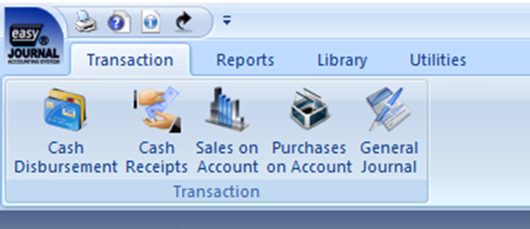
Accounting module
Transaction where you will record accounting transactions into its corresponding journals.

Slide 6
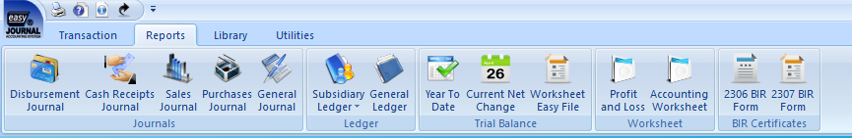
Accounting module
Reports where various financial reports are automatically generated.

Slide 7
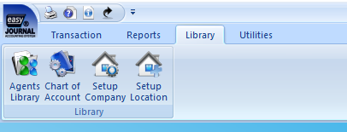
Accounting module
Library is where you will find the list of information that the system requires.

Slide 8
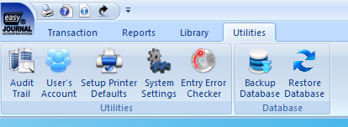
Accounting module
Utilities is where the other system’s necessary functions for its successful operation.

Slide 9
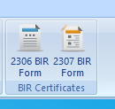
Bir reports module
Easy Journal Accounting System is capable of generating BIR reports.
BIR Forms
BIR Certificates
BIR Reports Summary
BIR DATA File

Slide 10
Bir reports module
BIR Forms
Monthly Value Added Tax Declaration, BIR Form 2550M
Quarterly Value Added Tax Return, BIR Form 2550Q
Monthly Percentage Tax Return, BIR Form 2551M
Monthly Remittance of Creditable Income Tax Withheld, BIR Form 1601E
Monthly Remittance Return of Final Income Tax Withheld, BIR Form 1601F
These forms are convertible to XML file compatible for eBIR printing.
BIR Certificates
Certificate of Creditable Tax Withheld at Source, BIR Certificate 2307
Certificate of Final Taxes Withheld, BIR Certificate 2306

Slide 11
Bir reports module
BIR Reports Summary
Summary List of Sales or SLS
Summary List of Purchases or SLP
Monthly Alphalist of Payees or MAP
Semestral List of Regular Suppliers or SRS
Summary of Alphalist of Withholding Tax Payers or SAWT

Slide 12
Getting started

Slide 13
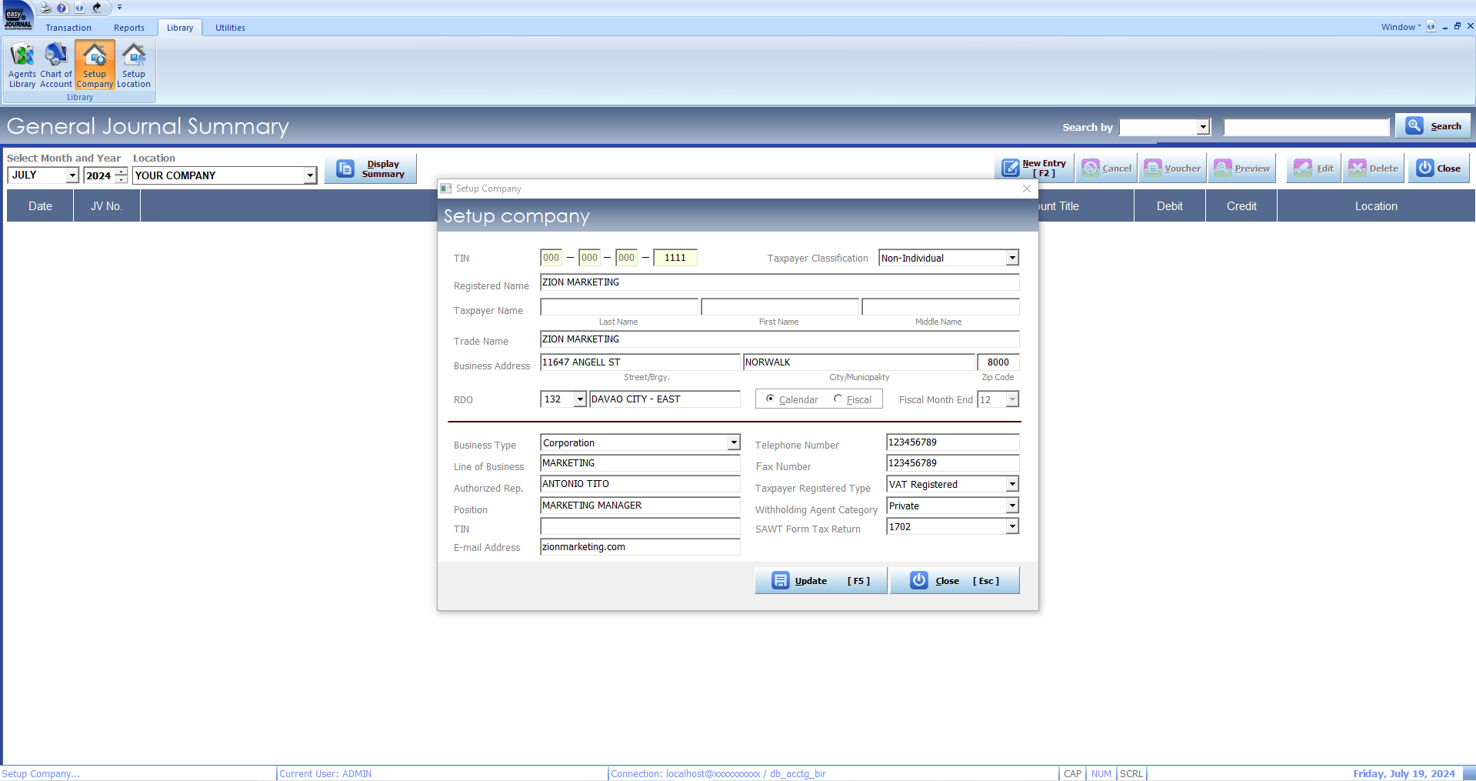
How to set up company information
Watch the video here
file:///C:/Help/mp4/company%20set%20up/company%20set%20up.html

Slide 14
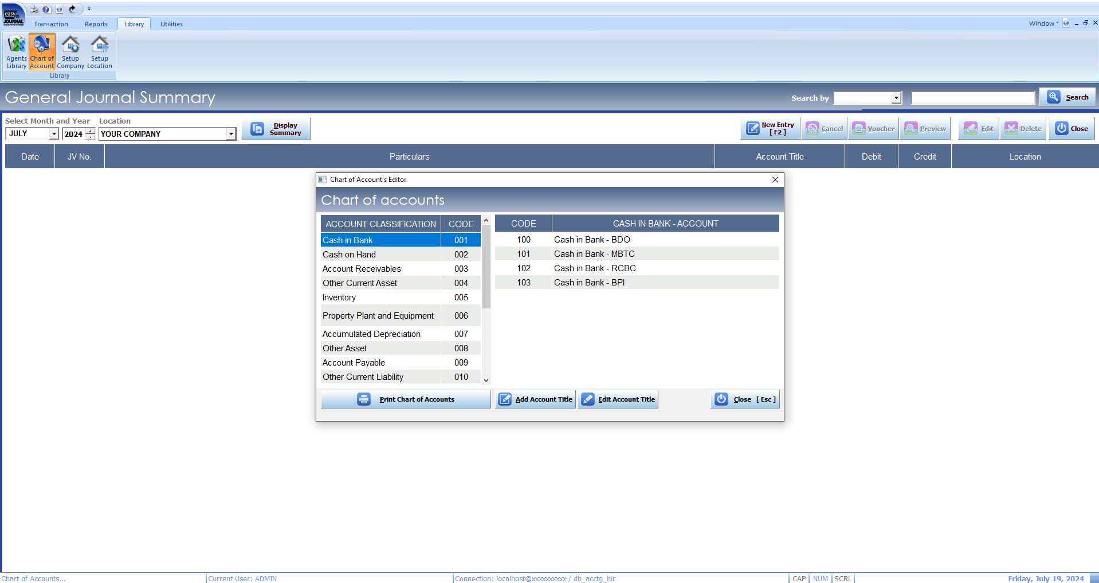
How to set up chart of account
Watch the video here
file:///C:/Help/mp4/chart%20of%20accounts/chart%20of%20accounts.html

Slide 15
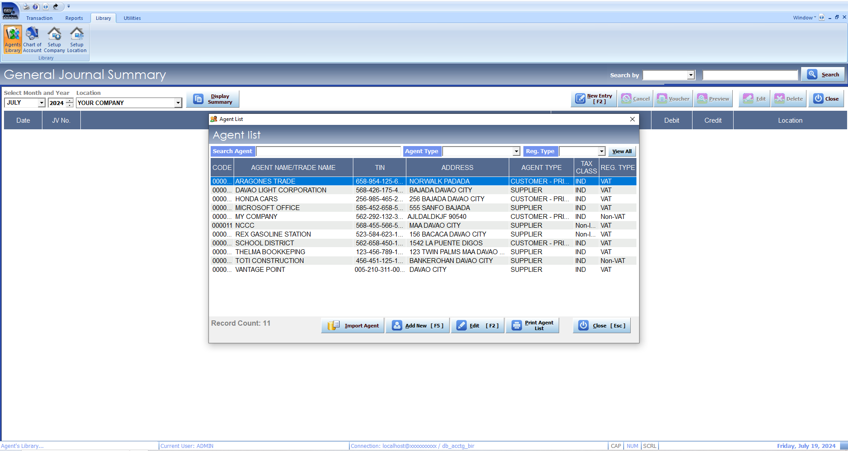
How to set up agent
Watch the video here
file:///C:/Help/mp4/set%20up%20agent/set%20up%20agent.html

Slide 16
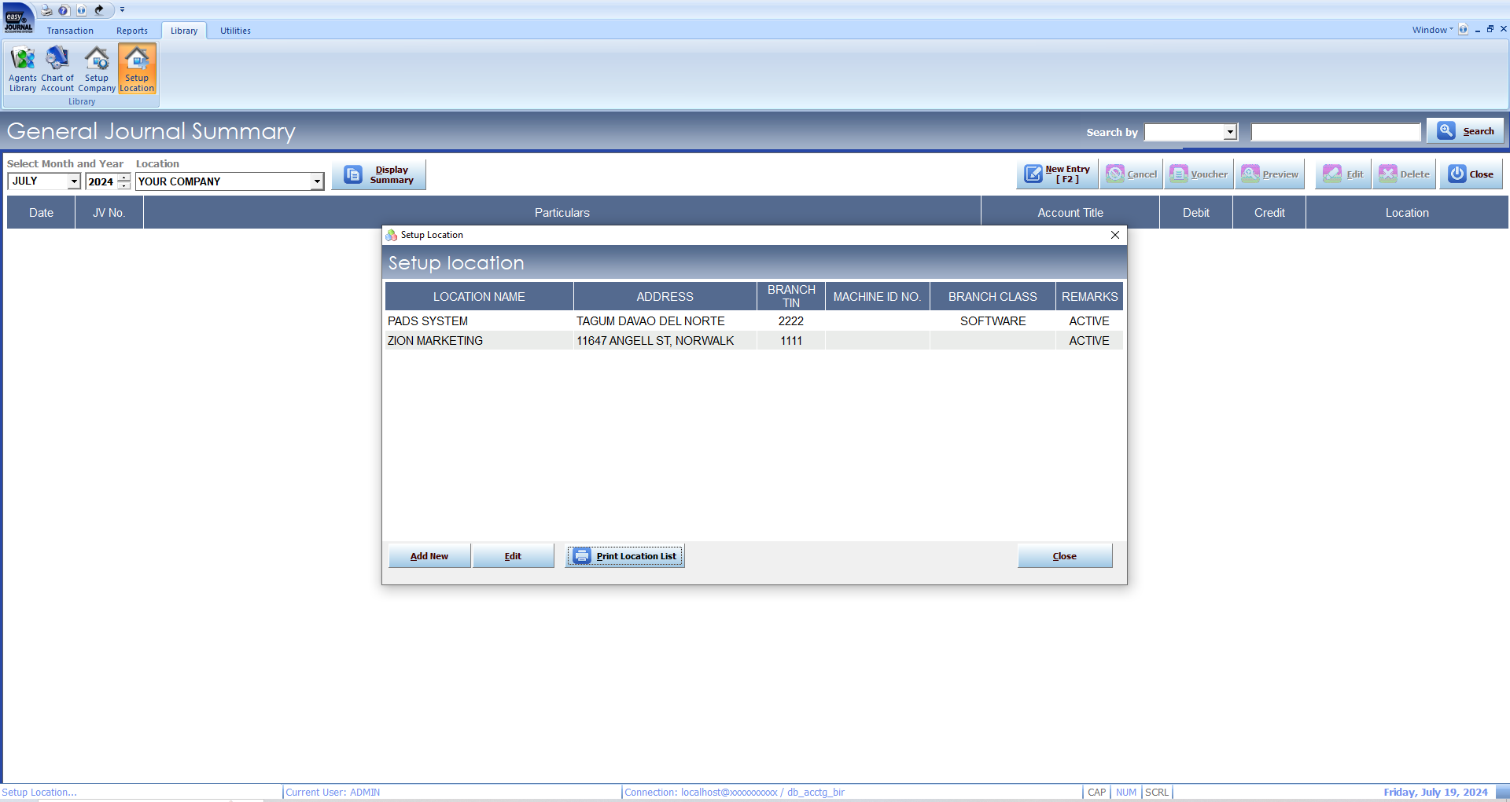
How to set up location
Watch the video here
file:///C:/Help/mp4/set%20up%20location/set%20up%20location.html

Slide 17
Recording transactions

Slide 18
Easy Journal Accounting System follows the same principles in recording transactions as with the traditional manual accounting. However, It primarily differs in processing data. Unlike manual accounting, EASY JOURNAL ACCOUNTING SYSTEM is programmed to post transactions to its corresponding ledger and reports can be automatically generated.
The two methods of accounting has two types of journals. These are General Journal and Special Journal which are called Books of Original Entry. Special Journal is developed to facilitate recording enormous transactions.

Slide 19
Special Journal
Special Journal is sub-divided into specialized books of accounts. Accordingly, transactions are grouped according to the nature of the transaction, and each will be recorded to its corresponding type of journal such as;
Cash Disbursement Journal
All transactions involving “Cash Payments” are to be recorded in Cash Disbursement Journal.
Cash Receipts Journal
All transactions involving “Receipts of Cash” are to be recorded in Cash Receipts Journal.
Sales Journal
All transactions involving “Sale of Merchandise on Account and Return” are to be recorded in Sales Journal.
Purchases Journal
All transactions involving “Purchase of Merchandise on Account, Expenses and Other Purchases and Return” are to be recorded in Purchase Journal.

Slide 20
General journal
All transactions that cannot be appropriately recorded to any type of Special Journal are to be recorded in General Journal. To begin recording transactions using EASY JOURNAL ACCOUNTING SYSTEM, you need to select the “Transaction” menu. Then select a particular journal you desire to enter. After you have selected a particular journal, the “Transaction Summary” will automatically appear
Transaction Summary “Transaction Summary” displays all the transactions that are posted in the system to different Journals. This serves as your books of accounts. Also, you need to open the Transaction Summary of a particular journal every time you post an entry in the system.

Slide 21
How to display transaction summary
Click on “Transaction” tab found on the upper left corner of your screen
Select what particular journal you desire to display
“Transaction Summary” screen will automatically appear
Select a particular month and year you desire to view and click on “Display Summary” tab. Your window will automatically show all the transactions that have been entered in the particular journal that you have selected
You may search any recorded transactions using the “Search Menu” found in the upper right corner of your screen. Learn More
You may ”Cancel”, “Edit” or “Delete” any of the transactions found in the summary by pointing at the particular transaction, then click “Cancel” “Edit” or “Delete”

Slide 22
How to open cash disbursement template
Click on “Transaction” tab found on the upper left corner of your screen.
Select “Cash Disbursement” icon.
Select “Cash Disbursement” icon.
“Transaction Summary” screen will automatically appear.
Select a particular month and year you desire to enter.
Click on “New Entry" to enter new transaction.
“Cash Disbursement” transaction template will appear.
Cash Disbursement transaction template is divided into two parts: the Header and the Transaction Details.

Slide 23
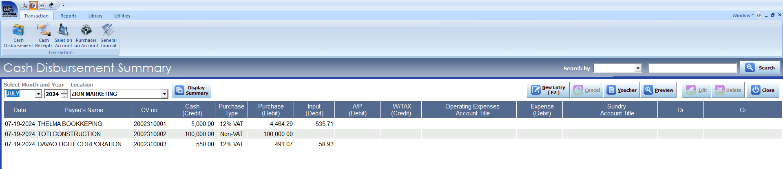
cash disbursement template
Header is found on the upper part of the template. You need to fill up the necessary information required in the Header like:
Date
Location
CV no.
Check No.
Payee's name
Address/TIN
Cash Account
Cash Amount
Particular
Watch the video here
file:///C:/Help/mp4/open%20cash%20disbursement%20template/open%20cash%20disbursement%20template.html

Slide 24
cash disbursement template
Transaction Details is found in the lower part of the template. In this section, you need to identify the type of Cash Disbursement transaction you desire to enter. Cash Disbursement transactions are categorized into following types:
Cash Purchase of Merchandise How to record Cash Purchase of Merchandise transactions
Open Cash Disbursement template
Fill up the information required on the Header part
On the Transaction Details, fill up Invoice No. found in the first column of the Transaction Details
Select Purchase Type under “Purchase Type” column then click “Enter” key. Learn More
“VAT Computation” menu will automatically appear. Fill up necessary information. Learn More
Click “OK” or press F5
Click Save & New or Save & Close button found on the bottom part to save the transaction
Watch the video here
file:///C:/Help/mp4/cd%20purchase%20of%20merchandise/cd%20purchase%20of%20merchandise.html

Slide 25
cash disbursement template
B. Payment of Accounts Payables
How to record Payment of Accounts Payables
Open Cash Disbursement template
Fill up the information required on the Header part
Under “A/P” column, fill up the amount to be credited to Accounts Payable. Learn More
Click Save & New or Save & Close button found on the bottom part to save the transaction
C. Payment of Expenses How to record Payment of Expenses
Open Cash Disbursement template
Fill up the information required on the Header part
Under “Expense Account Title”, select particular Expense Account Title you desire to enter. Learn More
Select “Vat Type”. Learn More
“VAT Computation” menu will automatically appear. Fill up the necessary information. Learn More
Click OK or press F5
Click Save & New or Save & Close button found on the bottom part to save the transaction
Watch the video here
file:///C:/Help/mp4/cd%20payment%20of%20accounts%20payable/cd%20payment%20of%20accounts%20payable.html

Slide 26
cash disbursement template
D. Other transactions involving Cash Payment
How to record Other transactions involving Cash Payment
Open Cash Disbursement template
Fill up information provided on the Header part
Other transactions involving Cash Payments shall be recorded in the “Sundry” column. Learn More
Select particular Account Title you desire to enter, then fill up amount either Debit or Credit
Click Save & New or Save & Close button found on the bottom part to save the transaction
Watch the video here
file:///C:/Help/mp4/cd%20other%20trans/cd%20other%20trans.html

Slide 27
How to open cash receipts template
Click on “Transaction” tab found on the upper left corner of your screen.
Select “Cash Receipts” icon.
“Transaction Summary” screen will automatically appear.
Select particular month and year you desire to enter.
Click on “New Entry" to enter new transaction.
“Cash Receipts” transaction template will appear.
Cash Receipts transaction template is divided into two parts: the Header and the Transaction Details. Header is found on the upper part of the template. You need to fill up the necessary information required in the Header like:
Date
Location
OR no.
Payor's name
Address/TIN
Cash Account
Cash Amount
Particular
Watch the video here
file:///C:/Help/mp4/open%20cash%20receipts%20template/open%20cash%20receipts%20template.html

Slide 28
cash receipts template
Transaction Details is found in the lower part of the template. In this section, you need to identify the type of Cash Receipts transaction you desire to enter. Cash Receipts transactions are categorized in the following types:
A. Merchandise Sold/Service Rendered for Cash How to record Merchandise Sold/Service Rendered for Cash transactions
Open Cash Receipt template
Fill up the information required on the Header part
On the Transaction Details, fill up Invoice No. found in the first column of the Transaction Details.
Select Sales Type under “Sales Type” column then press “Enter”. Learn More
“VAT Computation” menu will automatically appear. Fill up the necessary information. Learn More
Click OK or press F5
Click Save & New or Save & Close button found on the bottom part to save the transaction

Slide 29
cash receipts template
Watch the video here
B. Collection of Accounts Receivables How to record Collection of Accounts Receivable Open Cash Receipts template
Fill up the information required on the Header part
Under “A/R” column, fill up the amount to be credited to Accounts Receivable. Learn More
Click Save & New or Save & Close button found on the bottom part to save the transaction.
file:///C:/Help/mp4/cr%20collection%20of%20ar/cr%20collection%20of%20ar.html
C. Other transactions involving Cash Collection How to record Other transactions involving Cash Collection
Open Cash Receipt template
Fill up the information required on the Header part
Other transactions involving Cash Collection shall be recorded in the “Sundry” column. Learn More
Select particular Account Title you desire to enter, then fill up amount either Debit or Credit.
Click Save & New or Save & Close button found on the bottom part to save the transaction.
Watch the video here
file:///C:/Help/mp4/cr%20other%20trans/cr%20other%20trans.html

Slide 30
How to open sales on account template
Click on “Transaction” tab found on the upper left corner of your screen.
Select “Sales on Account” icon.
“Transaction Summary” screen will automatically appear.
Select a particular month and year you desire to enter.
Click on “New Entry" to enter new transaction.
“Sales on Account” transaction template will appear. Sales on Account transaction template is divided into two parts: the Header and the Transaction Details. Header is found on the upper part of the template. You need to fill up the necessary information required in the Header like:
Date
Location Learn More
Invoice no.
Customer's name Learn More
Address/TIN
Income Description Learn More
Watch the video here
file:///C:/Help/mp4/open%20sales%20on%20account/open%20sales%20on%20account.html

Slide 31
sales on account template
Transaction Details is found in the lower part of the template. In this section, you need to identify the type of Sales on Account transaction you desire to enter. Sales on Account transactions are categorized in the following types: A.Merchandise Sold/Services Rendered on Account How to record Merchandise Sold/Services Rendered on Account
Open Sales on Account template
Fill up the information required on the Header part
Select Sales Type under “Sales Type” column then click “Enter” key. Learn More
“VAT Computation” menu will automatically appear. Fill up the necessary information. Learn More
Click OK or press F5
Click Save & New or Save & Close button found on the bottom part to save the transaction.
Watch the video here
file:///C:/Help/mp4/soa%20merchandise/soa%20merchandise.html

Slide 32
sales on account template
B. Sales Return How to record Sales Return
Open Sales on Account template
Fill up the information required on the Header part
Click on Sales Return Button Learn More
Fill up CM No
Select Sales Type under “Sales Type” column then press “Enter”. Learn More
“VAT Computation” menu will automatically appear. Fill up the necessary information. Learn More
Click OK or press F5
Click Save & New or Save & Close button found on the bottom part to save the transaction.
Watch the video here
file:///C:/Help/mp4/soa%20sales%20return/soa%20sales%20return.html

Slide 33
How to open purchases on account template
Click on “Transaction” tab found on the upper left corner of your screen.
Select “Purchases on Account” icon.
“Transaction Summary” screen will automatically appear.
Select a particular month and year you desire to enter.
Click on “New Entry" to enter new transaction.
“Purchases on Account” transaction template will appear.
Purchases on Account transaction template is divided into two parts: the Header and the Transaction Details. Header is found on the upper part of the template. You need to fill up the necessary information required in the Header like:
Date
Location
PV no.
Supplier's name
Accounts Payable Account
A/P Amount
Particular
Watch the video here
file:///C:/Help/mp4/open%20purchase%20on%20account/open%20purchase%20on%20account.html

Slide 34
purchases on account template
Transaction Details is found in the lower part of the template. In this section, you need to identify the type Of Purchase of Account transaction you desire to enter. Purchase on Account transactions are categorized in the following types: A. Purchase of Merchandise on Account How to record Purchase of Merchandise on Account
Open Purchase on Account template
Fill up the information required on the Header part
Select Purchase Type under “Purchase Type” column then press “Enter”. Learn More
“VAT Computation” menu will automatically appear. Fill up the necessary information. Learn More
Click OK or press F5
Click Save & New or Save & Close button found on the bottom part to save the transaction.
Watch the video here
file:///C:/Help/mp4/poa%20merchandise/poa%20merchandise.html

Slide 35
purchases on account template
B. Expenses and Other Purchases on Account How to record Expenses and Other Purchases on Account
Open Purchase on Account template
Fill up the information required on the Header part
Under “Expense & Other Purchase Account”, select particular Account Title you desire to enter. Learn More
Select “Vat Type”. Learn More
“VAT Computation” menu will automatically appear. Fill up the necessary information. Learn More
Click OK or press F5
Click Save & New or Save & Close button found on the bottom part to save the transaction.
Watch the video here
file:///C:/Help/mp4/poa%20expenses/poa%20expenses.html

Slide 36
purchases on account template
C. Purchase Return How to record Purchase Return
Open Purchase on Account template
Fill up the information required on the Header part
Click on Sales Return Button Learn More
Fill up CM No.
If it is a Return/Adjustment of Merchandise Purchased, you need to select Purchase Type under “Purchase Type” column then press “Enter”. Learn More
“VAT Computation” menu will automatically appear. Fill up the necessary information. Learn More
Click OK or press F5
Click Save & New or Save & Close button found in the bottom part to save the transaction
If it is Return of Expenses and other Purchases, you need to select particular Account Title you desire to enter.
Select "VAT Type"
“VAT Computation” menu will automatically appear. Fill up the necessary information. Learn More
Click OK or press F5
Click Save & New or Save & Close button found in the bottom part to save the transaction
Watch the video here
file:///C:/Help/mp4/poa%20return/poa%20return.html

Slide 37
How to open general journal template
Click on “Transaction” tab found on the upper left corner of your screen.
Select “General Journal” icon.
“Transaction Summary” screen will automatically appear.
Select particular month and year you desire to enter.
Click on “New Entry" to enter new transaction.
“General Journal” transaction template will appear. General Journal template is divided into two parts: the Header and the Transaction Details. Header is found on the upper part of the template. You need to fill up the necessary information required in the Header like:
Date
Location Learn More
JV no.
Watch the video here
Transaction Details is found in the lower part of the template. This template basically contains Account Title and its corresponding Debit and Credit column.
file:///C:/Help/mp4/open%20gen%20journal/open%20gen%20journal.html

Slide 38
How to enter transaction in general journal
Open General Journal template
Fill up the information required on the Header part
Select a particular Account Title you desire to enter, then fill up amount either Debit or Credit. Learn More
Click Save & New or Save & Close button found on the bottom part to save the transaction.
Watch the video here
file:///C:/Help/mp4/gen%20journal/gen%20journal.html

Slide 39
Special type of transactions

Slide 40
Special type of transactions
There are certain transactions that require specific method when it is recorded in the system. Among these transactions are the following:
Purchase of Capital Goods with corresponding Input Tax
Importation with corresponding Input Tax
Closing of Input and Output Tax to VAT Payable Account
Government Sales with multiple Withholding tax
Expense transaction having partly 12% VAT and VAT exempt tax implication
How to enter Deferred Output tax on Services rendered on Account and recognize Output Tax upon collection.

Slide 41
How to record transaction involving Purchase of Capital Goods with corresponding Input Tax
There are two ways on how to record Purchase of Capital Goods with corresponding Input Tax. You may enter it in Cash Disbursement Journal or in General Journal. A. Under Cash Disbursement Journal
Open Cash Disbursement template
Provide the necessary information required in the header part
In Sundry Account column, select a particular Capital Asset Account that pertains to the transaction you desire to enter.
In the next row, select Input Tax Account
A prompt will appear asking “Would you like to include this transaction in VAT Computation?”
Click “Yes”
Provide seller's information
A menu will pop up. Select “Capital Goods” as Tax Source
Click Ok
Fill up “Input” amount
Save transaction

Slide 42
How to record transaction involving Purchase of Capital Goods with corresponding Input Tax
B. Under General Journal
Open General Journal template
Enter Capital Asset Account that pertains to the transaction you desire to enter
In the next row, select Input Tax Account
A prompt will appear asking “ Would you like to include this transaction in VAT Computation?”
Click “Yes”
A menu will pop up, provide seller's information
Select “Capital Goods” as Tax Source
Then Click Ok
Fill up “Input” amount
Save transaction
Watch the video here
file:///C:/Help/mp4/spl%20trans%20capital%20goods/spl%20trans%20capital%20goods.html

Slide 43
How to record transaction involving Importation with corresponding Input Tax
There are two ways on how to record Importation with corresponding Input Tax. You may enter it in Cash Disbursement Journal or in General Journal.
A. Under Cash Disbursement Journal
Open Cash Disbursement template
Provide the necessary information required in the header part
In Sundry Account column, enter Input Tax account
A prompt will appear asking “ Would you like to include this transaction in VAT Computation?”
Click “Yes”
A menu will pop up, select “Importation” as Tax Source
Fill up necessary information with regards to the particular Importation transaction
Click Ok
Save transaction
B. Under General Journal
Open General Journal template
Enter “Input Tax” account
A prompt will appear asking “Would you like to include this transaction in VAT Computation?”
Click “Yes”
A menu will pop up, select “Importation” as Tax Source
Click Ok
Fill up necessary information with regards to the particular Importation transaction
Then Click Ok
Save transaction

Slide 44
How to close Input Tax and Output Tax to VAT Payable Account
Open General Journal template
Enter Output Tax Account
A prompt will appear asking “Would you like to include this transaction in VAT Computation?”
Click “NO”
Fill up corresponding amount on Debit Side
In the next row, enter Input Tax Account
A prompt will appear asking “Would you like to include this transaction in VAT Computation?”
Click “NO”
Fill up corresponding amount on Credit Side
Enter VAT Payable and its corresponding amount on Credit side
Save transaction
Watch the video here
file:///C:/Help/mp4/spl%20vat%20payable/spl%20vat%20payable.html

Slide 45
How to Enter Government Sale with multiple Withholding Taxes
Watch the video here
There are two ways on how to record Government Sale with multiple Withholding Taxes. You may enter it in Cash Receipts Journal or in General Journal.
file:///C:/Help/mp4/spl%20govt%20sale/spl%20govt%20sale.html
A. Under Cash Receipts Journal
Open Cash Receipts template
Provide necessary information on the header part
On the Transaction Details, fill up Invoice No. found in the first column of the Transaction Details
Under Cash Sales Type column, select either 12% VAT, or VAT Exempt, then press "Enter"
“VAT Computation” menu will automatically appear. Fill up the necessary information
Select ATC, Withholding Tax amount will be automatically computed
Click OK
Observe that figures are automatically posted in their respective columns
Fill up the other Withholding Tax amount and its corresponding ATC below the first Withholding amount of the same column
Save transaction
B. Under Sales on Account
Open Sales on Account template
Provide the necessary information required in the header part
Under Cash Sales Type column, select either 12% VAT or VAT Exempt, then press "Enter"
“VAT Computation” menu will automatically appear. Fill up the necessary information Select ATC, Withholding Tax amount will be automatically computed
Click OK
Observe that figures are automatically posted in their respective columns
Fill up the other Withholding Tax amount and its corresponding ATC below the first Withholding amount of the same column
Save transaction

Slide 46
How to Enter Expense transaction having partly 12% VAT and VAT exempt tax implication.
There are two ways on how to record Expense transaction having party 12% VAT and VAT exempt tax implication. You may enter it in Cash Disbursement Journal or in Purchase on Account Journal.
A. Under Cash Disbursement Journal
Open Cash Disbursement template
Provide the necessary information required in the header part
Select particular Expense Account under Expense Account Title
On VAT Type column, select 12% VAT to record the portion under 12% VAT
“VAT Computation” menu will appear. Learn More
Click OK
On the second row, again select the same Expense account
On VAT Type column, select VAT Exempt to record the VAT Exempt potion
“VAT Computation” menu will appear
Fill up the corresponding amount
Save transaction
B. Under Purchase on Account Journal
Open Purchase on Account template
Provide the necessary information on the header part
Select particular Expense Account under Expense and other Purchases column
On VAT Type column, select 12% VAT to record the portion under 12% VAT
“VAT Computation” menu will appear. Learn more
Click OK
Then on the second row, again select the same Expense account
On VAT Type column, select VAT Exempt to record the VAT Exempt portion
“VAT Computation” menu will appear
Fill up corresponding amount
Save transaction
Watch the video here
file:///C:/Help/mp4/spl%20partial/spl%20partial.html

Slide 47
How to Enter Deferred Output tax on Services rendered on Account and recognize Output Tax upon collection
Deferred Output tax is recognized when a company rendered services to a customer or client but the payment for the said service is still collectible. Output Tax is recognized and to be offset against Deferred Output Tax when the amount has been collected. There are two processes involve in recording this type of transaction: First is to record the transaction in Sales on Account Journal to recognize Deferred Output Tax when service has rendered. Then recognize Output Tax in Cash Receipts Journal upon collection.

Slide 48
How to Enter Deferred Output tax on Services rendered on Account and recognize Output Tax upon collection
A. To record Deferred Output Tax in Sales on Account
Open Sales on Account template
Fill up the information provided on the Header part
Select Sales Type under “Sales Type” column then press “Enter”
“VAT Computation” menu will automatically appear. Fill up the necessary information
Click “Deferred Output Tax” check box
Click OK or press F5
Save transaction
B. To recognize Output Tax in Cash Receipts Journal
Open Cash Receipts template
Fill up the information required on the Header part
Under “A/R” column, fill up the amount to be credited to Accounts Receivable
In Sundry Account column, select Deferred Output Account Account
In the next row, select Output Tax Account
A prompt will appear asking “Would you like to include this transaction in VAT Computation?”
Click “Yes”
Select Agent Name
Fill up ATC (Industry Cover by VAT)
Click Ok or press “F5”
Fill up “Output VAT” amount
Save transaction
Watch the video here
file:///C:/Help/mp4/spl%20deferred%20output/spl%20deferred%20output.html

Slide 49
Generating financial reports

Slide 50
Generating financial reports
There are Four (4) types of Financial Reports that the system is capable of generating, namely:
A. Journals In this type of report, all of the transactions are generated in General Journal format. This means that Special Journal and General Journal can be viewed in traditional double entry form. There are five kinds of Journal report that the system is capable of generating:
Cash Disbursement Journal
Cash Receipts Journal
Sales Journal
Purchase Journal
General Journal
B. Ledger There are two kinds of Ledger report that the system is capable of generating:
Subsidiary Ledger
Creditors' Ledger
Debtors' Ledger
General Ledger

Slide 51
Generating financial reports
D. Worksheet Since the system is adapting Periodic Inventory System, the Worksheet will serve as the gateway of generating Balance Sheet and Income Statement.
C. Trial Balance There are two kinds of Trail Balance that the system is capable of generating:
Year to Date
Current Net Change

Slide 52
How to generate Journal Reports
Click on “Reports” icon found on upper middle of your screen
Select a particular Journal Report you want to generate
“Report Option” will automatically appear which will be found on the left side corner
Select Date Range
Click “Preview”
Watch the video here
file:///C:/Help/mp4/journal%20reports/journal%20reports.html

Slide 53
How to generate Ledger Reports
Click on “Reports” icon found on upper middle of your screen
Select a particular Ledger Report you want to generate
A. For Subsidiary Ledger Select either Creditors' Ledger or Debtors' Ledger
Select Date Range and other Report filter options like viewing reports pertaining only to a particular Debtor or Creditor
B. For General Ledger Select Date Range and other Report filter options like viewing reports pertaining only to a particular Account
Click Preview
Watch the video here
file:///C:/Help/mp4/ledger%20report/ledger%20report.html

Slide 54
How to generate Trial Balance Reports
Click on “Reports” icon found on upper middle of your screen
Select a particular Trial Balance Report you want to generate
For Year to Date Select As of Date
Click Preview
For Current Net Change Select Date Range
Click Preview
Watch the video here
file:///C:/Help/mp4/trial%20balance%20report/trial%20balance%20report.html

Slide 55
How to Generate Financial Statements
Click on “Reports” icon found on the upper middle of your screen
Select Worksheet
Select “Report Date”
Click “Preview Report“
Worksheet will automatically appear
Select “Income Statement” to view Income Statement.
Select “Balance Sheet” to view Balance Sheet
Watch the video here
file:///C:/Help/mp4/financial%20statement/financial%20statement.html

Slide 56
Using utilities

Slide 57
Using utilities
Items under Utilities Menu serve as tools that perform specific function which are useful in the system operation. These items are the following:
A. Audit Trail Audit Trail serve as a reference on every item entered or edited in the system. B. User's Account User's Account serves as User's data maintenance. The Admin User can set up control to every user's access in the system. C. Set Up Printer Defaults The User can select a default printer if there is more than one printer connected to network.

Slide 58
Using utilities
D. System Settings The User can set up default information involving VAT transactions. The User can assign Account Title for every VAT type on Sales and Purchases. E. Entry Error Checker Error may occur when recording transaction to the system. This is caused by partial saving of data due to network fluctuation or sudden system failure while saving the transaction. The double entry process will be affected, and this may create disparity on the data processed by the system. Entry Error Checker will prompt if there is an error and you need to correct it using this Utility. F. Back up Database For data security, you need to back up frequently the transactions encoded. You can save it through your drive D or C or you can use external storage device such as USB and the like.

Slide 59
How to view Audit Trail
Click on “Utilities” tab found on the upper middle of your screen.
Select on “Audit Trail”
“Audit Trail Summary” will automatically appear.
Select a particular month and year you desire to view and click on “Display Summary” tab. Your window will automatically display all the transactions that have been recorded showing the details about the Date/Time the transaction was recorded, the User, Computer Name/IP address and the Description.
You may search any recorded transactions using the “Search Menu” found in the upper right corner of your screen. First, you must select search category on “Search Menu” then type the information that pertains the record you want to search under particular search category you have selected. Click “Search”. The system will automatically display the transaction/s based on the information you have provided.

Slide 60
How to update User's Account
Click on “Utilities” tab found on the upper middle of your screen.
Select on “User's Account”
A. To Add New User Click Add New (F5) found in the bottom portion of your screen.
Fill up all necessary information like:
Employee Name
Username
Password
Administrator Learn More
User's Status Learn More
B. To Edit Record Click Edit Record (F2) found in the bottom portion of your screen.
Edit Information
Click Update Record (F5)
C. To assign User's Privilege Click User's Privilege (F2) found in the bottom portion of your screen.
Assign Privilege to a certain User
Click Update Record (F5)

Slide 61
How to Setup Printer Defaults
Click on “Utilities” tab found on the upper middle of your screen.
Select on “Setup Printer Defaults”
Select particular printer from the list
Click “Set as Default

Slide 62
How to update default Accounts for VAT transaction (System Settings)
Click on “Utilities” tab found on the upper middle of your screen.
Select on “System Settings”
Update default accounts
Click “Update Record”

Slide 63
How to correct entry using Entry Error Checker
Click on “Utilities” tab found on the upper middle of your screen.
Select on “Entry Error Checker”
The system will prompt any existing error
Correct the entry
Click “Update”

Slide 64
How to Backup Database
Click on “Utilities” tab found on the upper middle of your screen.
Select on “Backup Database”
Click “Backup Database” button. (Entries encoded on the Backup Setting will appear on the widow. However, should you want to change the backup location just click the “Search” button)
Click “Backup Database Now”
A new window will appear to show the backup is in progress. BACKUP SUCCESSFUL will prompt when it is finished. Then press any key to continue.

Slide 65
Generating bir reports

Slide 66
Generating bir reports
There are Four (4) types of BIR Reports that the system is cable of generating, namely:
A. BIR Forms There are Five (5) kinds of BIR Forms that the system is capable of generating:
Monthly Value Added Tax Declaration (BIR Form 2550M)
Quarterly Value Added Tax Return (BIR Form 2550Q)
Monthly Percentage Tax Return (BIR Form 2551M)
Monthly Remittance of Creditable Income Tax Withheld (BIR Form 1601E)
Monthly Remittance Return of Final Income Tax Withheld (BIR Form 1601F)
B. BIR Certificates There are Two (2) kinds of BIR Certificates that the system is capable of generating:
Certificate of Creditable Tax Withheld at Source (BIR Certificate 2307)
Certificate of Final Taxes Withheld (BIR Certificate 2306)

Slide 67
Generating bir reports
C. BIR Reports Summary There are Five (5) major kinds of BIR Reports Summary that the system is capable of generating:
Summary List of Sales (SLS)
Summary List of Purchases (SLP)
Monthly Alphalist of Payees (MAP)
Semestral List of Regular Suppliers (SRS)
Summary of Alphalist of Withholding Tax Payers (SAWT)
D. BIR Data File There are Five (5) major kinds of BIR Data File that the system is capable of generating:
Relief Sales Data File
Relief Purchases Data File
Importation Data File
MAP Data File
Annual Withholding Tax Data File

Slide 68
How to Generate BIR Forms
Go to BIR Reports Module
Click on BIR Form
A. For Monthly/Quarterly VAT Return or Monthly Percentage Tax Return (BIR Form 2550M/2550Q or 2551M) Select Monthly/Quarterly VAT Return or Monthly Percentage Tax Return (2550M/2550Q or 2551M)
Report Filter Option will appear
Select Monthly/Year you want to generate
Click “Preview”
Monthly/Quarterly VAT Return or Monthly Percentage Tax Return will automatically appear. Learn More
Print Return or Generate XML File for eBIR Form printing
B. For Monthly Remittance of Withholding Taxes (BIR Form 1601E/1601F) Select Withholding Tax Return (1601E/1601F)
Report Filter Option will appear
Select Monthly/Year you want to generate
Select Location Learn More
Click “Preview”
Monthly Withholding Tax Return will automatically appear. Learn More Note: Should you want to print the Monthly Alphalist of Payees to be attached in Monthly Withholding Tax Return, click the MAP button found on the upper left corner near the Preview button.
To print the MAP Report, click the Printer Icon found on the upper right corner of the Report
Print Return or Generate XML File for eBIR Form printing.

Slide 69
How to Generate BIR Certificates
Go to BIR Reports Module
Click on BIR Certificates
Select BIR particular Certificate
Report Filter Option will appear
Select Agent's Name and Report covered period Note: You may generate BIR Certificate per Quarter, Monthly or per Transaction. Just select your option in Report Filter Option menu.
Click “Preview”
BIR Certificate will automatically appear
Print Certificate

Slide 70
How to Generate BIR Reports Summary
Go to BIR Reports Module
Click on BIR Reports Summary
Select particular BIR Reports Summary
Report Filter Option will appear
Select a covered period you want to generate
Click “Preview”
BIR Report Summary will automatically appear
Print Report

Slide 71
How to Generate BIR Data File
Go to BIR Reports Module
Click on BIR Data Files
Select particular BIR Data File
Report Filter Option will appear
Select a covered period you want to generate
Click “Generate Data File”
Save Data File
Burn saved Data File in CD for submission or submit through eSubmission

