Slide 1
Municipal Plastic Bottle Ban
Barnstable County Commissioners
August 28, 2019

Slide 2
We are Sustainable Practices
We are Sustainable Practices! In 2019 we initiated a Municipal Plastic Bottle Ban campaign on Cape Cod. The goal of our effort is to prohibit town government purchase of single-use plastic bottles and the sale of beverages in single-use plastic containers on town property. So far, we have successfully championed and passed the Municipal Plastic Bottle Ban in 5 of the 15 towns that comprise Cape Cod. We have 10 more towns that we are actively pursuing this fall!

Slide 3
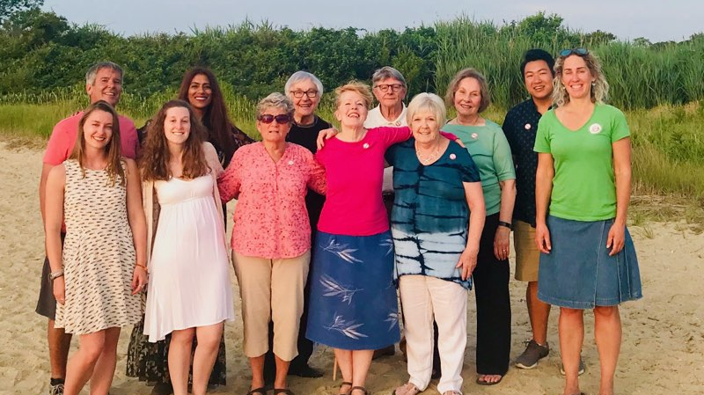

Slide 4
Single-use plastic bottle problem
Single-use plastic bottles are a by-product of the fossil fuel industry and have a significant greenhouse gas footprint; they do not biodegrade and can last forever. Their production emits toxic waste into the air, and chemicals from plastic can leach into our beverages. After plastics are discarded, they pollute the air via incineration, contaminate groundwater through landfills, as well as harm to our oceans, beaches, roadways, and wildlife. Recycling is of little help and does not eliminate or reduce our dependence on plastic. Further, recycled plastic is used in many products, increasing its presence in the environment. Fundamentally, recycling does not reduce the need for more plastic creation; recycled bottles are not made into new bottles.

Slide 6
Single-use plastic bottles, a U. S. issue
There are 50 billion plastic bottles consumed every year, about 30 billion of them in the U.S.
We consume roughly 60 percent of the world’s plastic bottles, even though we’re about 4.5 percent of the world population.
The majority of plastic bottles are from the sale and distribution of water! There are 1,500 single-use plastic water bottles consumed per SECOND in the U.S.

Slide 7
Plastic use is a health and well-being issue
Plastic has been found in rain, the air we breath and the water we drink; however, given that plastic was not created for human ingestion, there is not sufficient information to understand the consequences to human health from its ingestion and the leaching of its chemicals into consumables. Evidence does suggest that human ingestion of plastic may have adverse consequences. The hazardous effects of plastics are far more costly than indicated by price. They affect our immediate and long-term well-being.

Slide 8
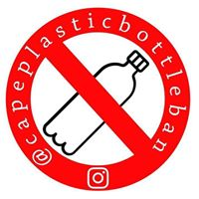
Municipal Plastic Bottle Ban

Slide 9
Focus
Our initiatives are focused on promoting municipal policy that addresses single-use plastic by eliminating purchase of single-use plastic bottled beverages by towns and prohibiting the sale of beverages in single-use plastic containers on town property. We are actively engaged with many towns to promote alternatives to plastic and are primarily focused on behavioral change in favor of reusable containers.

Slide 10
Rationale
The rationale for our Municipal Plastic Bottle Ban rests on the assumption that government is established to protect the welfare of the people it governs. Plastic bottles are made from non-renewable fuels, leach chemicals into consumables, and never biodegrade. Plastic bottles impact environmental health and the health and longevity of other species, who may ingest plastic as food. Ultimately, plastic re-enters the human food chain where the adverse consequences are both known and emerging.

Slide 11
Proposed by-law
ARTICLE: To see if the Town will vote to adopt the following as a general by-law and to insert it into the Code of the Town of _______, Massachusetts as Chapter___, §____:
The purchase by the Town of _____________ of either water or any other beverage in single-use plastic bottles of any size is prohibited and the sale of water or any beverage in single-use plastic containers is prohibited on town property.
Any Town department when engaged in public health and safety operations shall be exempt from this Bylaw.
Effective date: As soon as practicable but no later than September 1, 2020.
In the event of a declaration (by Emergency Management Director, or other duly-authorized Town, Commonwealth, or United States official) of an emergency affecting the availability and/or quality of drinking water for ________ residents the Town shall be exempt from this Bylaw until seven (7) calendar days after such declaration has ended.

Slide 12
Status
After successful passage of the Municipal Plastic Bottle Ban in five Cape Cod towns this spring: Provincetown, Wellfleet, Harwich, Chatham, and Orleans, Sustainable Practices will be filing and working in the remaining Barnstable County towns: Barnstable, Bourne, Brewster, Dennis, Eastham, Falmouth, Mashpee, Sandwich, Truro, and Yarmouth.

Slide 13
Municipal water infrastructure
We are working with merchants, municipalities and existing municipal water refill stations to map out access and availability of municipal drinking water across Cape Cod.
with

Slide 14
Opportunity
Cape Cod is a destination for many visitors because of our environment. We need to take active visible steps to protect and steward our natural resources for our livelihoods, health and welfare. However, our actions have the potential to be a significant example to our visitors as well.
The time for action is now and Cape Cod has an opportunity to set an example for others to follow elsewhere in our nation.

Slide 15
Questions
For more information on Sustainable Practices see:
Website: sustainablepracticesltd.org
Facebook: @sustainablepracticesltd
or send us a note:
Email: contactus@sustainablepracticesltd.org

