Slide 1
*DACA Renewal
and First-Time Applicants
* DACA- Deferred Action for Child Arrivals

Slide 2
Disclaimer:
This powerpoint does not provide legal advice, it provides recommendations. Following the step-by-step instructions does not guarantee acceptance of the DACA application. This information is to be used as a guide, along with the directions provided by the Department of Homeland Security, US Citizenship and Immigration Services.

Slide 3
Index by Slide:
4………..What forms do I need?
5-13…….Form I-821 D
14-18…...Form I-765
19-20……Form I-765WS
21-22……Form G1115
23………..Where to send? And fees.
24………..Att: Initial Request & Documents needed
25-26………..Self-prepping cover letter
27………..Renewal but First Time Self-Applicant
28………..How to check my case?
30………..Resources
Notes:
update numbers

Slide 4
What forms do I need?
The DACA application consists of four forms for both
RENEWALS or INITIAL applicants.
Form I-821 D
Form I-765
Form I-765 Worksheet
Form G-1145 (not required but recommended)
All forms are FREE of cost and available at:
https://www.uscis.gov/archive/renew-your-daca

Slide 5
Form I-821 D (Eight Parts)

Slide 6
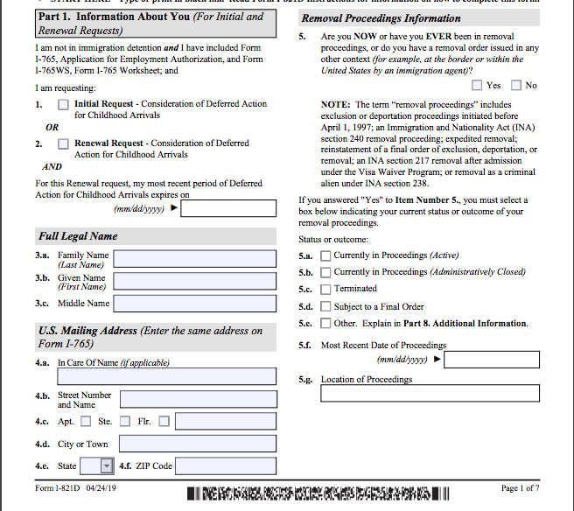
Form I-821D Part 1
Part 1:
Personal information
1.1 & 1.2
INITIAL or RENEWAL Request
Full Legal Name: Including any second
last names

Slide 7
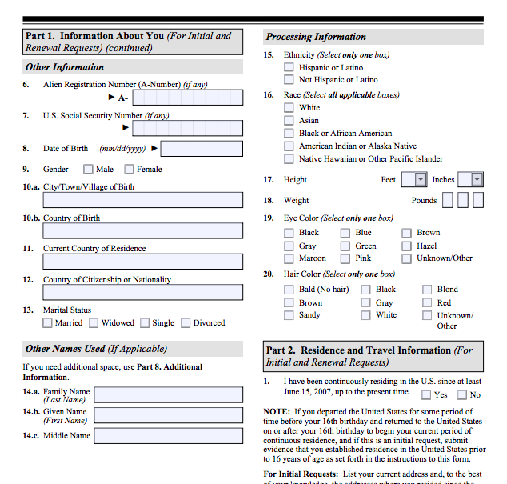
Form I-821D Part 1
1.6 and 1.7
Required for RENEWAL ONLY
Others name used: If you have legal papers that state your name with only one last name.
Use that name here.
Example:
My name is Daniel Martinez Gaytan
High School Diploma: Daniel Martinez

Slide 8
Form I-821D Part 2: Residence and Travel Information
All APPLICANTS must complete this part. Please be aware that INITIAL Requesters must provide more extensive information
than RENEWAL Requesters.
Address: Create a constant timeline of your residencies with no gaps in-between.
For RENEWAL Requests, make sure the information matches your previous applications. USCIS (United States Citizenship and Immigration Services) requires the address you have lived at since the last application submitted, but it is always good to list all addresses.
RENEWAL Travel Information: If you leave the country under advance parole make sure to attach copies of the advanced parole paperwork to the
application. Verify the dates you listed as being out the country
and check to see that it matches the documentation.

Slide 9
Form I-821D Part 3: For INITIAL Requests ONLY.
RENEWAL requests should skip this part.
Estimate your initial entrance to the USA. Keep this date consistent throughout the application.
Immigration status depends case by case, but if you do not have status make sure to choose:
“No Lawful Status.”
Education: Add name of high school.
Military Service: SKIP if you have never served.

Slide 10
Form I-821 D Part 4:
Criminal, National Security, and Public Safety Information.
Questions are very specific.
Read each carefully and pick between “NO” or “Yes.”
If you think one of the questions could potentially prevent you from getting approved, seek law assistance.

Slide 11
Form I-821 D
Part 5 and 6
Part 5:
Statement, Certification, Signature, and Contact Information of the REQUESTER.
All REQUESTERS must complete this part.
Part 6:
Contact Information, Certification, and Signature of the Interpreter.
Any REQUESTER using an interpreter must complete this part.
If an interpreter or any other person helped to fill out the application, they must fill out Part 6.
If you filled out this application by yourself, SKIP Part 6.

Slide 12
Form I-821D
Part 7
Contact Information, Declaration, and Signature of the Person Preparing this Request, if Other than the Requestor.
If someone else prepared your request, he or she must complete Part 7.

Slide 13
Form I-821-D
Part 8
If you need additional space for Parts 1-7, add the additional information in Part 8. Specify the additional part you are wanting to extend.

Slide 14
Form I-765

Slide 15
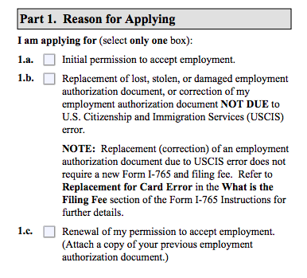
Form I-765
Part 1
Choose if you are: applying as a first-time applicant (INITIAL), RENEWAL, or REPLACEMENT of a card.

Slide 16
Form I-765
Part 2: Information about You
INITIAL applicants: SKIP THIS PART
USCIS # and social security number is not required.
INITIAL applicants: Check “NO” for 13.a to request a social security number.
Citizenship: If you have double citizenship, make sure to specify it here.
E.g. Mexico and El Salvador
Eligibility: (C) (33) = DACA
SKIP 28-31b
Passport: Attach a copy of your
native country’s passport along
with this application to support
this information.

Slide 17
Form I-765
Part 3: Applicant’s Statement, Contact Information, Declaration, Certification, and Signature.
If you use an interpreter make sure to complete Part 3.
DON’T FORGET TO SIGN!

Slide 18
Form I-765
Part 4 and 5
If you use a preparer or an interpreter, have them complete Parts 4 and 5.
Notes:
*****

Slide 19
Form I-765ws

Slide 20
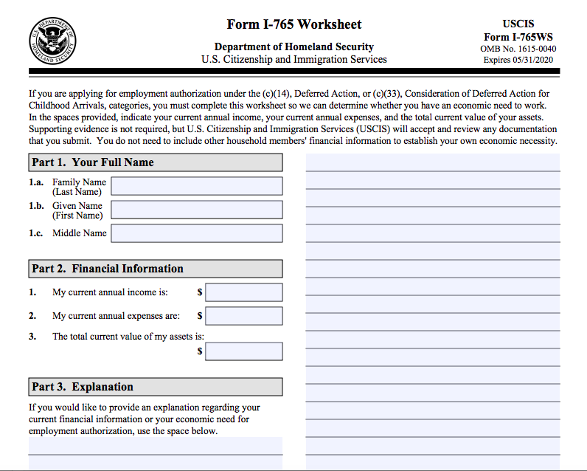
Form I-765ws
Estimate your annual income
Estimate your annual expenses
Estimate assets
Use this space to explain why you need Work Authorization.
Note: Often people share how having Work Authorization may lead to their dream career.

Slide 21
Form G-1145
(Optional but Recommended)
Notes:
*******

Slide 22
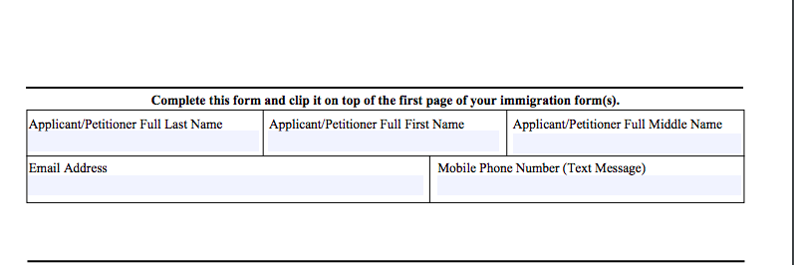
Form G-1145
Upon completion of this form, Homeland Security will send a notification once received.

Slide 23
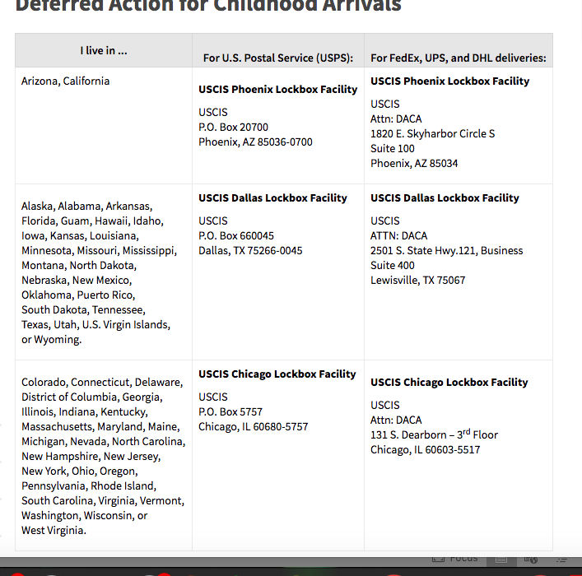
Form Fees
and
Mail-in Address
Along with completed forms, a cashiers check or money order of $495 needs to be mailed to the location listed.
Mail- in Address :
First address for U.S Postal Service and second address for FEDEX, UPS, and DHL.

Slide 24
INITIAL Applicants
Proof is required of residence within the US, since June 15, 2007, before the age of 16.
Copies Needed:
Passport
School records (from the very first grade attended in the US)
Birth Certificate (If in another language, it needs to be officially translated.)
Any school ID’s
Any documentation with photo that may be relevant
Hospital records (e.g immunization records)
Copy of utility bill, if proof of US residence
School diploma, certificates, or awards
Religious affiliation proof
Be sure to send in anything that might make your case stronger
e.g character reference letter !!

Slide 25
Organization of Paperwork
It is important to create an organized and professional look to the application and required paperwork. Create a cover letter to help the USCIS officer go through paperwork.
Example on the next slide.

Slide 26
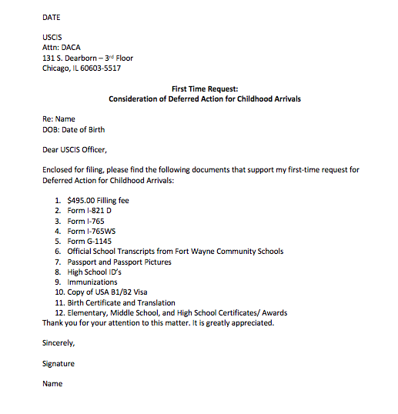

Slide 27
RENEWAL,
But First-Time Self-Applicant
If electing to self-apply for the first time, request a copy of the previous application from your lawyer. All previously submitted information should be provided for use as a template to use and follow throughout the renewal application.

Slide 28
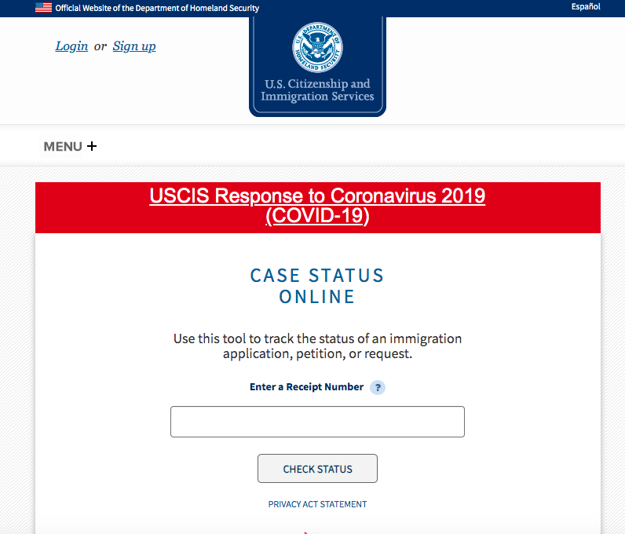
How to check my status?
Once you receive a text and/or confirmation letter with a receipt number, go to the website below to check your status.
https://egov.uscis.gov/casestatus/landing.do
Notes:
https://egov.uscis.gov/casestatus/landing.do add in

Slide 29
Before submitting the final application triple check all of the information.
Do not forget to sign the documents where signatures are required, (two signatures).
GOOD LUCK !!
For more questions Contact:
(260) 222-7099
hscholars1@gmail.com (general questions)
or hlcni06@aol.com (contact a board member)
Disclaimer: This powerpoint does not provide legal advice, it provides recommendations. Following the step-by-step instructions does not guarantee acceptance of the DACA application. This information is to be used as a guide, along with the directions provided by the Department of Homeland Security, US Citizenship and Immigration Services.

Slide 30
Additional Resources
USCIS Official DACA Website : https://www.uscis.gov/i-821d
Where to check my status : https://egov.uscis.gov/casestatus/landing.do
HLCNI: https://hlcnifw.org/
Disclaimer : This powerpoint does not provide legal advice, it provides recommendations. Following the step-by-step instructions does not guarantee acceptance of the DACA application. This information is to be used as a guide, along with the directions provided by the Department of Homeland Security, US Citizenship and Immigration Services.

