Slide 1

An Interesting case of a swollen arm
Phil Truskett

Slide 2
Background
60 year old man. Born in Vietnam
Married with 2 adult children
Wife is a house and wife does home duties
Came to Australia in 1985 and worked as a glazier at time of injury for 12 years
Attended with an interpreter who struggled with history taking

Slide 3
First injury to left arm 29 October 2011
Carry heavy pane of glass on left shoulder held by right hand
Glass shattered and shard lacerated dorsum of left index finger
Transported to Hospital by ambulance
20% laceration of extensor tendon in zone 1 and open DIPJ
Repaired by plastic surgeon
Tourniquet on arm. Repaired debrided K Wire

Slide 4
First injury to left arm 29 October 2011
Stated had no time off work
No physiotherapy
K wire eventually removed
Claimed weak grip

Slide 5
Second injury 28 March 2012
Loading glass onto a truck
Because of weakness of left grip fell 1.5 M to ground onto buttocks
May have injured left wrist but complained of pain from initial injury 2011
No time off work
Referred to specialist 22 March 2012 diagnosed subluxed radio-ulnar joint

Slide 6
progress
Prior CT 20 February 2012 confirmed posterior displacement of distal ulna and moderate subluxation of first carpometacarpal joint
28 June 2012, Arthroscopy and ulnar shortening osteotomy
A left arm tourniquet was used
Plaster and sling for 2 weeks
Stated Swelling of left arm commenced the day after surgery

Slide 7
Past history
30 March 2015 Sigmoid Colectomy for trauma, stoma closed April 2016
Previous hepatitis B
Depression

Slide 8
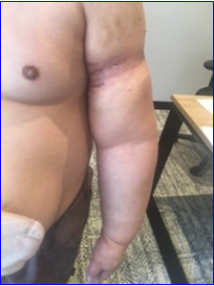
On examination

Slide 9
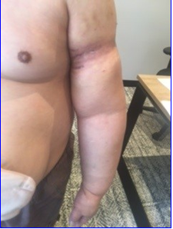
On examination
Normal affect
Left arm marked swelling ‘non-pitting’ Right arm normal
Right Left
Arm 28cm 35cm
Forearm 28cm 32cm
Normal Perfusion

Slide 10
Review of documentation Hand surgeon 5 Sept 2014
Described marked swelling “due to lymphatic obstruction, possibly due to misadventure associated with tourniquet use”

Slide 11
Review documentation vascular surgeon 18 Sept 2017
Was perplexed by appearance and described arm accurately. Made the diagnosis of:
“Lymphoedema tarda which can affect a single limb and appear late in life”

Slide 12
Review documentation plastic surgeon 18 Jan 2022
“Swollen left arm due to lymphoedema due to tourniquet injury”

Slide 13
Review documentation lmo
23 July 2012 brought in by wife threatening suicide he was holding knife
27 July 2012 hearing voices and paranoid about being watched on CCTV cameras at work
Arm swelling documented October 2012 (4 months after surgery)

Slide 14


Slide 16
EUR J PHYS REHABIL MED 2015;51:337-9

Slide 17

J Am Acad Orthop Surg 2012;20:
78-85
J Am Acad Orthop Surg 2012;20:
78-85

Slide 18


