Slide 1
Street Outreach & the Coordinated Outreach System
LOS ANGELES HOMELESS SERVICES AUTHORITY
Colleen Murphy, PGDip, Manager of Unsheltered Strategies, LAHSA
Patrick Siggins, SPA 4 Outreach Coordinator, PATH
September 2021

Slide 2
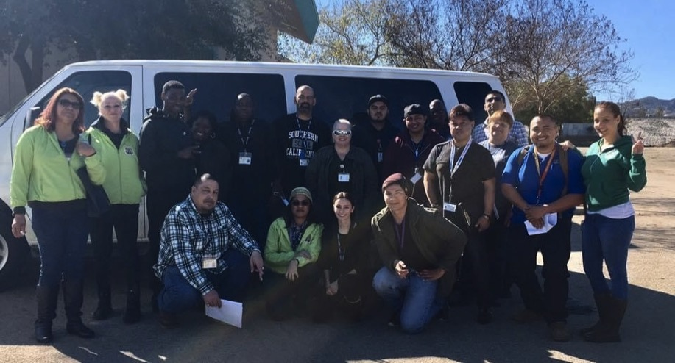
Los Angeles’ coordinated outreach strategy goals
Strategy created and co-led by LAHSA, DHS and DMH in 2016
Goal: Develop a coordinated outreach system to reduce duplication and increase efficiencies via:
Launch of DHS-funded Multidisciplinary Outreach Teams (MDT)
Increase in Generalist Outreach Workers
LAHSA Homeless Engagement Teams (HET)
CES Outreach
MDT Public Spaces Outreach Workers
Creation of CES Outreach Coordinators and infrastructure that facilitates collaboration, coverage
Develop a Centralized Outreach Request Portal (LA-HOP)
Strategy was independently evaluated by Resource Development Associates (RDA) in December 2019
https://homeless.lacounty.gov/wp-content/uploads/2020/02/rda.outreach011020.pdf
To read E6 and the other County Coordination Strategies:
http://homeless.lacounty.gov/wp-content/uploads/2017/01/Strategy-E-1.pdf
March 1, 2017, First Collaborative Outreach Effort under E.6 including HET, LAFH MDT, DMH, PATH SSVF, DPH, Sepulveda Basin

Slide 3
Los Angeles’ coordinated outreach strategy basics
Goal: To develop a coordinated outreach system to reduce duplication and increase efficiencies
Who?
Values
People who are sleeping on the streets or in cars / vehicles
Some teams focus on certain target populations
Whatever it takes
Housing focused while still addressing immediate needs
Client driven
Deeply embedded in our Coordinated Entry System
Collaborative and coordinated at all levels
Embrace low and high tech strategies to ensure efficiencies
Nimble yet strategic
Data-driven
High value on training and continuous learning
Where?
Streets, riverbeds, railroad tracks, underpasses, urban areas, remote areas, parks, libraries, encampments, beaches, etc.
When?
Usually during daylight hours due to safety and ability to connect to housing and services

Slide 4
Outreach model before E6
City/County Departments
Agency Outreach Team 2
LAHSA Outreach Teams
DMH
Teams
Law Enforcement/
First Responders
CES Regional
Leads
Concerned Citizens
Service
Providers
Elected
Officials
Agency Outreach Team 1
Other Specialty Outreach

Slide 5
Coordinated outreach model after E6 Strategy
Outreach system led and supported by LAHSA,DHS, DMH E6 Leadership Team
Countywide Web Portal for Outreach Requests (LA-HOP)
Connections to Supportive Services, Housing Resources via CES
All Stakeholders
SPA-Wide Outreach Coordinators
Create and support SPA-wide Outreach strategy to ensure well-functioning system
Lead coordination of encampment or regional outreach operations
Facilitate collaboration and coordination between outreach teams, key resources, and stakeholders
Deploy requests from LA-HOP to appropriate Outreach teams
Outreach To Do List
Proactively outreach to people experiencing homelessness
Respond to requests for outreach
Support participants with immediate needs (e.g., shelter, mental/physical health), connecting to permanent housing resources
Work with other outreach teams, first responders, other stakeholders to support participant’s care plans
LAHSA Homeless Engagement Teams
Multidisciplinary Outreach Teams
Other Outreach Teams
Funded via
Measure H and City of LA
Administered
via DHS
Funded primarily via Measure H
(e.g., DMH HOME,)
Funded by other municipalities, funders

Slide 6
LA’s outreach hub structure
LA’s coordinated outreach hub structure advantageous as homelessness is regional and fluid
People move across CDs, zipcodes, neighborhoods
Service duplication by teams is avoided as all teams use LAHSA’s Homeless Management Information System (HMIS) to enter client information
Teams serving in a Hub become close partners and leverage each other regardless of agency, funding source
Federation model valuable as
One agency can cover the geography and number of people in need
Creates
Redundancies
Regional “outreach HMO”
Force multiplier
Outreach coordinators help facilitate effective system

Slide 7
Types of outreach modalities
Proactive Outreach
Reactive Outreach
Provides regular, pre-emptive outreach services
A pre-determined pursuant to SPA outreach strategy or plan
Example: Teams conduct proactive outreach 5+ days a week in a pre-defined area, working with those who are experiencing homelessness in this area
Responds to requests from external requestors for outreach services
Example: A request is received and deployed via LA-HOP from a community stakeholder

Slide 8
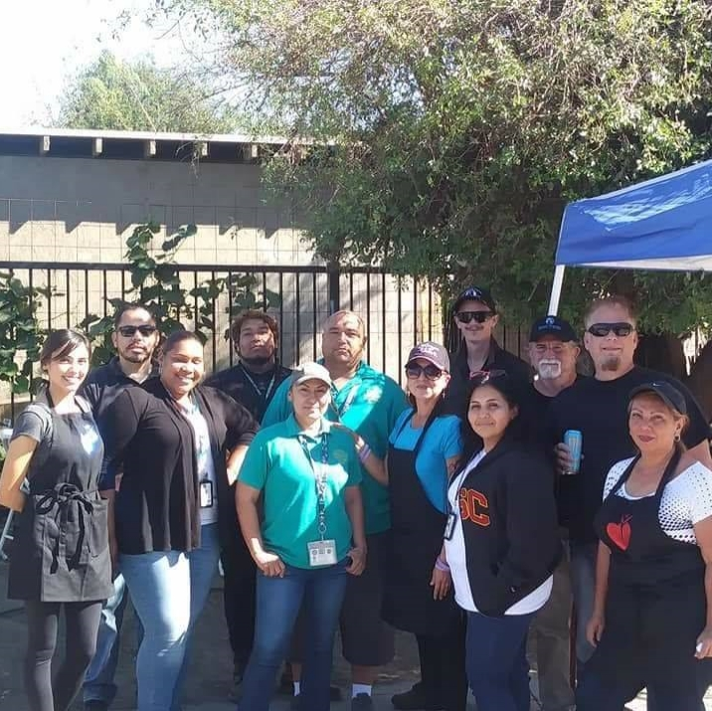
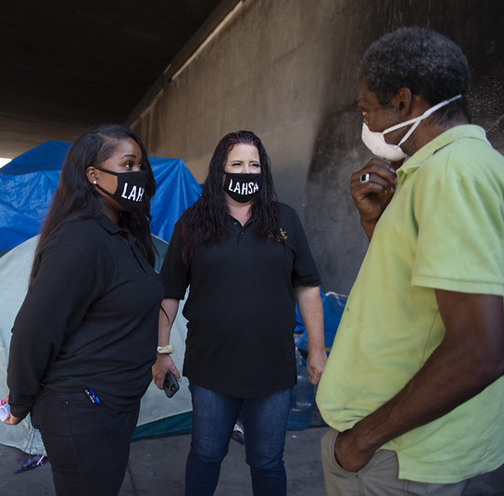
Types of outreach teams
LAHSA HOST
Federation of outreach teams working closely together to ensure coverage, reduce duplication, leverage strategic strengths/resources
LAHSA HET
SPA 1
LAHSA Homeless Engagement Teams (HET)
Teams of 2
Can tap into specialists from MDTs and Specialists
Funded via both City of LA and Measure H
LAHSA CARE, CARE+
Collaborative project integrating outreach in to the work into LASAN
Funded via City of LA
LAHSA Roadmap
Supports priority encampment outreach as determined by City of LA Council Districts
Funded via City of LA
LAHSA County Law
LAHSA HOST: Teams that with LASD to integrate services into their approach
LAHSA HOST Regional: Work with other PDs to integrate services into their approach
Funded via Measure H
DMH HOME
Focus on people who are gravely disabled/GD-adjacent
Funded via State MHSA and Federal PATH
Multi-Disciplinary Teams (MDT)
DHS administered
Teams with 5 members: health,
mental health, substance use,
case management, peer capacity
Funded primarily via Measure H
DMH HOME
SPA 2
SPA 3
HOPICS MDT
LAHSA CARE+
SPA 4
SPA 5
6
SPA 7
SPA 8
Other-Generalist Team
Community partner agency teams
Some have a special population focus
Funded via a variety of entities
Public Spaces MDT
DHS administered
Smaller teams of 2 added to serve Public Spaces
Funded via Measure H
Notes:
Talking through:
*Where we are: Streets, riverbeds, railroad tracks, underpasses, encampments, parks, libraries, remote areas, urban areas, beaches, etc.
*Coordination of services – weekly meetings; encampment strategies; strong partnerships with service providers to help talk through who can do the what, when, and how.
*Importance of the Coordinated Entry System and the coordination of resources

Slide 9
What services and referrals do outreach provide?
Outreach referrals, services are voluntary, client driven, employ a progressive engagement model, and driven by resource availability
Completing an initial assessment of needs and eligibility
Assist with obtaining documentation
Assist with obtaining benefits
Addressing physical and mental health needs
COVID-19 resources
Legal services
CES Survey / Next Step Tool
Birth Certificate (In State or Out of State
Public benefits
Urgent Care
Mental Health
Food Resources
COVID Tier 1 Assessments
Immigration
Primary Care Provider
Specialized Multidisciplinary Outreach Teams
Shower Sites
PRK Connection
Legal Clinics
ABH, Other roadmap IH assessments
California Identification Card
Medical Insurance
HIV Services
Clothing
COVID Testing
Expungement Resources
Substance Use Disorder Resources
COVID Vaccination
TB Tests
Ticket Forgiveness Programs
PPE
Vision / Dental
Shelter in Place Support
Benefits Advocacy
Connections to Interim and Permanent Housing
Hygiene Support
Family Reunification | Interim Housing | Rapid Rehousing | Permanent Supportive Housing | Higher Level of Care Housing
Notes:
Talking through:
*Where we are: Streets, riverbeds, railroad tracks, underpasses, encampments, parks, libraries, remote areas, urban areas, beaches, etc.
*Coordination of services – weekly meetings; encampment strategies; strong partnerships with service providers to help talk through who can do the what, when, and how.
*Importance of the Coordinated Entry System and the coordination of resources

Slide 10
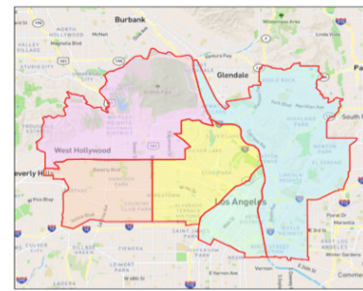
Outreach coordination
SPA 4 Outreach Zones
SPA-Based Outreach Coordinators are the glue
Coordinate strategies and teams
Outreach hubs created in each SPA
Teams assigned to hubs according to need (and in accordance with any contractual requirements) for proactive outreach
Weekly strategy, update care coordination meetings in each SPA
Team huddles to address specific projects, needs
ABH, Roadmap IH
LA-HOP requests deployed via teams assigned to these hubs and any other considerations (population, MH need, etc.)
Teams coordinate on-the-ground in their HUBs
HMIS ensures that teams know who is serving who
Downtown Hub – Metro LA
SEW Hub
NELA Hub
Mid Town Hub
Hollywood Hub
SPA Zones

Slide 11
What do Outreach Coordinators do?
Support enhanced collaboration among outreach teams
Facilitate care coordination among teams
Update teams on important things
Manage LA-HOP requests
Ensure complete and effective proactive and reactive outreach coverage for the SPA
Support coordinated outreach efforts in hot spots and in response to emergent needs (e.g., weather events)
Promote outreach best practices
Ensure strong connections to rest of the coordinated entry system
Provide stakeholder education on outreach, outreach system

Slide 12
Outreach coordination model
County Level Outreach Coordination
SPA Level Outreach Coordination
Zone/Hub Outreach Coordination
Care Coordination (Individual)
Teams coordinating on a County-wide level (e.g., COVID-19 emergency response with weekly strategy meetings, training on new posture, resources)
Teams coordinating a regional strategy (e.g., coordinating outreach around wildfire response with 3X daily huddles)
Teams coordinating on an encampment project (e.g. meeting weekly to develop and implement an outreach strategy on A Bridge Home catchment area)
Teams consulting together on a complex client case (e.g. bringing in DMH HOME team or MDT medical provider on higher need clients)

Slide 13
Los Angeles Homeless Outreach Portal (LA-HOP)
County-wide, web-based app designed by LAHSA, in collaboration with LA County Health Agency, LA County Homeless Initiative, and our broader outreach family to:
Ensure constituents can easily submit request for homeless outreach
Many different types of outreach teams and agencies performing outreach throughout LA County
Teams often have different skill sets, geographic coverage, and target population(s)
LA-HOP takes guesswork out of who should be contacted
Outreach Coordinator in the region acts as the “air traffic controller” for all requests.
Educate our community about what outreach teams can and can’t do
Support the unique needs of outreach teams to respond to these requests

Slide 14
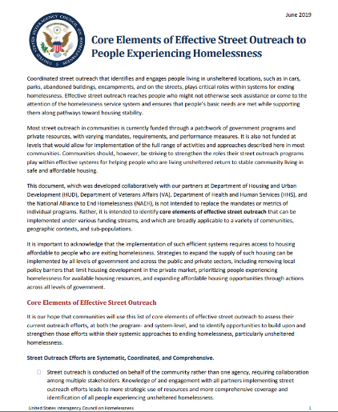
USICH’s 2019 Core Elements of Effective Street Outreach to People Experiencing Homelessness
How does LA’s System Match up to the Core Elements?
Street Outreach Efforts are Systematic, Coordinated, and Comprehensive
Street Outreach Efforts Are Housing Focused
Street Outreach Efforts Are Person-Centered, Trauma-Informed, and Culturally Responsive
Street Efforts Emphasize Safety and Reduce Harm
https://www.usich.gov/resources/uploads/asset_library/Core-Components-of-Outreach-2019.pdf

Slide 15
LAHSA’s Encampment Best Practices
Offers guidance for balancing need for location-specific work with the importance of regional, trauma-informed approach to unsheltered homelessness that places people experiencing homelessness on the path to a stable, permanent home.
https://www.lahsa.org/documents?id=5404-best-practices-for-addressing-street-encampments

Slide 16
LAHSA’s Encampment Best Practices, cont.
https://www.lahsa.org/documents?id=5404-best-practices-for-addressing-street-encampments

Slide 17
2019 RDA evaluation findings on outreach coordination
Finding 1
A high-functioning and collaborative leadership partnership between LAHSA, DHS, and DMH adopted a systems change approach to implementing new structures, processes, and dynamics in order to coordinate and direct the 200 teams delivering Strategy E6 homeless outreach services across the County.
Finding 2
The new regional coordination structure developed by E6 leadership forms the central backbone of E6, with SPA coordinators rapidly liaising outreach requests and effectively deploying teams. This structure efficiently matches available resources to the observed needs of outreach clients.
Finding 3
Implementing the E6 network of over 200 outreach teams to connect persons experiencing unsheltered homelessness with the Coordinated Entry System and field-based services made every location in LA County a possible entry point into the homeless service system.
Finding 4
The investment in collaborative planning strengthened outreach partnerships that enable the outreach system to flex to meet the services and care coordination needs of people experiencing unsheltered homelessness across LA County.
Finding 5
Measure H funds facilitate Strategy E6 coordination, enabling outreach teams across LA County –including teams that do not receive Measure H funds – to effectively coordinate as one organized system delivering street-based client services.

