Slide 1
1
Mission: The National Cemetery Administration honors Veterans and their families with final resting places in national shrines and lasting tributes that commemorate their service and sacrifice to our Nation.
NCA Overview
August 28, 2021
American Legion
Veterans Affairs and Rehabilitation Commission
National Cemetery Committee
Notes:
Introduce self as new USMA
Explain NCA’s mission

Slide 2
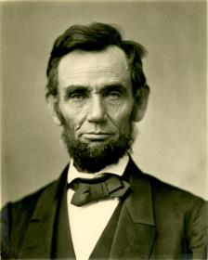
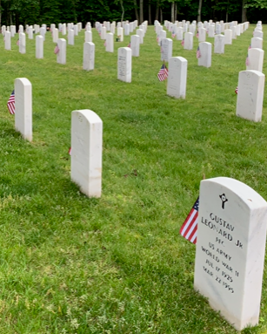
History, Mission, Priorities
History
The Omnibus bill of 1862, signed into law on July 17, authorized President Lincoln to purchase grounds for use as national cemeteries
Fourteen national cemeteries were established in 1862
Previously soldiers were buried where they fell
Today
155 national cemeteries
Perpetual care provided for 4.84 million Veterans service members, and family members
More than 3.82 million gravesites
9,245 developed acres
(As of June 2021)

Slide 3
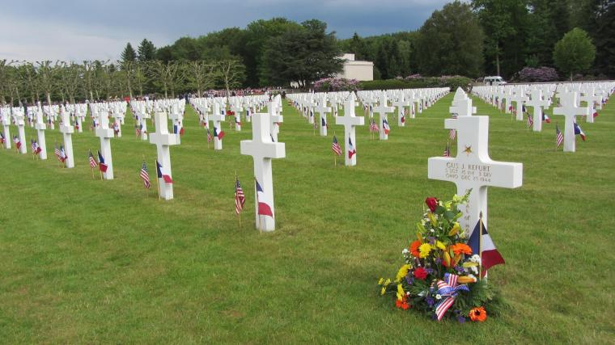
Partnering to Serve Veterans
Managing Military and Veterans Cemeteries
Army: 30 cemeteries
2 national cemeteries (Arlington NC, SAHNC)
28 post cemeteries and other sites
Interior: 14 national cemeteries
National Park Service historic sites such as Gettysburg, PA including one NC open to interment - Andersonville, GA
American Battle Monuments Commission: 26
Overseas cemeteries
NCA: 119 VA grant-funded cemeteries (State/territorial/tribal)
Epinal American Cemetery
France
Memorial Day 2014
(As of June 2021)

Slide 4
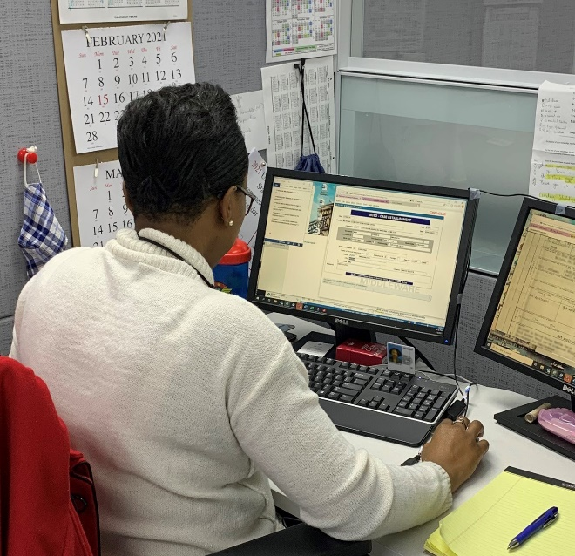
Eligibility Criteria and Scheduling
Any service member who dies on active duty or Veteran who was discharged under conditions other than dishonorable
National Guard members and Reservists who were called to Federal active duty or are entitled to retired pay
Spouses, dependent children and certain parents
The National Cemetery Scheduling Office serves all VA national cemeteries, seven days a week, 362 days a year
PRESS OPTION 1
https://www.cem.va.gov/burial_benefits/need.asp

Slide 5
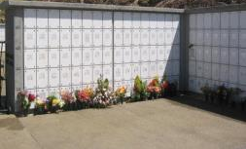
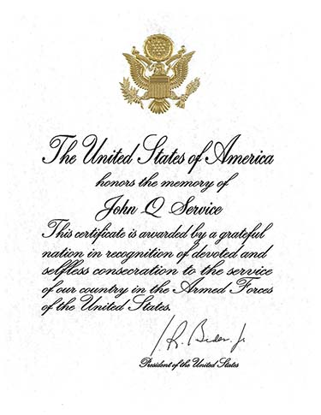
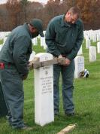
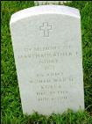
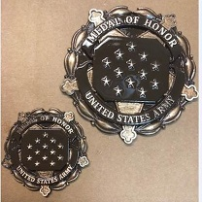
Burial and Memorial Benefits
Burial Flag
Niche Covers
Upright
Headstone
Presidential
Memorial
Certificate
Flat Marker
Medal of Honor Medallion
“In Memory
of…”
Bronze Medallion

Slide 6
Customer Satisfaction
In 2019, for the 7th consecutive time, NCA achieved the highest ranking of any participating organization public or private! *This is measured every three years*

Slide 7
NCA COVID Operations
• The most recent CDC guidance removed masking and physical distancing requirements for fully vaccinated individuals. Restrictions remain in place for unvaccinated individuals. NCA is abiding by this guidance at cemetery and office locations.
• NCA continues to encourage employees to be vaccinated.
• Telework continues at most office locations as “return to work” plans are finalized
COVID Related Impacts
Number of direct interments (March to June 2020) | 20,780 Casket: 13,774 Cremains: 7,006
Number of memorial services conducted post-direct interment | 2,391 through June 1, 2021
Number of COVID burials | 7,337 completed (117 scheduled)
(As of June 2021)

Slide 8
Increasing Access
In 2010, we covered 84.2% of the population.
By the end of FY 2021, we expect to cover 93.78% of the population.
NCA’s goal is to achieve 95%.
Access is defined as providing the Veteran population with reasonable access to a burial option within 75 miles of their homes.
(As of June 2021)

Slide 9
Providing Access and Choosing VA
New national cemetery
Urban Columbaria only
Rural national cemetery
Circle denotes open or dedicated national cemetery
(As of June 2021)

Slide 10
Providing Access and Choosing VA
 | Cemetery | Status | Total Veterans Served
1 | Tallahassee National Cemetery | Opened Oct 2015 | 63,571
2 | Cape Canaveral National Cemetery | Opened Jan 2016 | 311,826
3 | Omaha National Cemetery | Opened Sept 2016 | 103,602
4 | Pikes Peak National Cemetery | Opened Nov 2018 | 277,649
5 | Western New York National Cemetery | Opened Nov 2020 | 155,459
Urban Cemeteries
6 | Los Angeles National Cemetery | Opened Oct 2019 | 519,302
7 | St. Albans National Cemetery | Under Construction | 695,176
8 | Indianapolis National Cemetery | Under Construction | 218,765
9 | Alameda National Cemetery | Under Construction | 419,780
10 | Chicago National Cemetery | Land acquisition underway | 497,173
Rural Cemeteries
11 | Yellowstone National Cemetery | Opened May 2014 | 16,063
12 | Fargo National Cemetery | Opened Sept 2019 | 31,862
13 | Northwoods National Cemetery | Opened Aug 2020 | 37,071
14 | Snake River Canyon National Cemetery | Opened Mar 2020 | 15,809
15 | Cheyenne National Cemetery | Opened Oct 2020 | 55,855
16 | Acadia National Cemetery | Opened Aug 2020 | 19,327
17 | Cedar City National Cemetery | Under Construction | 14,426
18 | Elko National Cemetery | Land acquisition underway | 3,769
(As of June 2021)

Slide 11
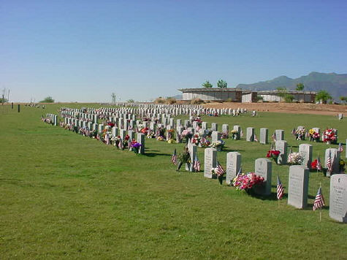
Veterans Cemetery Grants Program
2020 was the 42nd Anniversary of the Veterans
Cemetery Grants Program (VCGP)
Since 1978, VA has provided
more than $907 million in grants
119 state, tribal, and territory Veteran Cemeteries throughout the country
13 tribal Veteran cemeteries in operation
FY 2020, state, territory and tribal Veteran
Cemeteries conducted 37,268 interments
Arizona Southern
Veterans Memorial Cemetery
Arizona

Slide 12
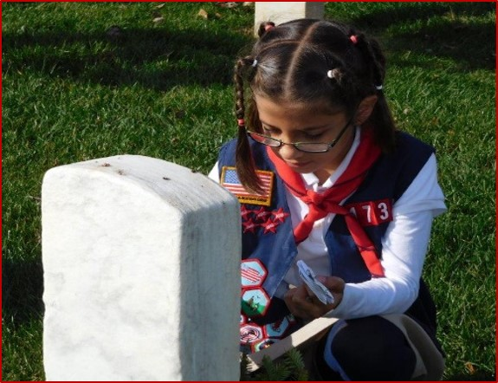
Veterans Legacy Program
Engaging students and communities with VA national cemeteries since 2016.
Launching new grant program in 2021.
Young Americans discovering the American Veteran tradition, at schools such as Texas A&M University, San Francisco State University, Black Hills State University, and others.

Slide 13
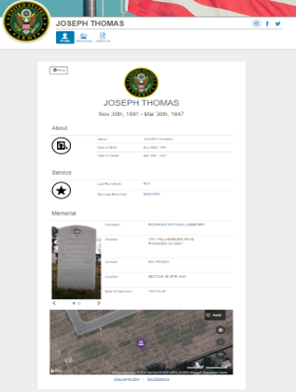
Veterans Legacy Memorial
Web App that honors Veterans in NCA cemeteries and extends the memorialization experience
More than 3.7 Million Veterans have a VLM profile page
Profile Pages Includes:
Birth/Death Dates
Military Service Details
Cemetery Information
Headstone/Marker photo(s)
GIS map and directions
www.va.gov/remember

Slide 14
1
Thank You

