Slide 1

Expertise That Sticks
Pharmosaic Consulting™ LLC Pitch Deck
Presented by Michael Quinn Doherty
Founder & Principal Consultant, Pharmosaic Consulting
Confidential | www.Pharmosaic.com

Slide 2

Formulation Expertise that Delivers.
Solving complex pharmaceutical challenges with precision.

Slide 3
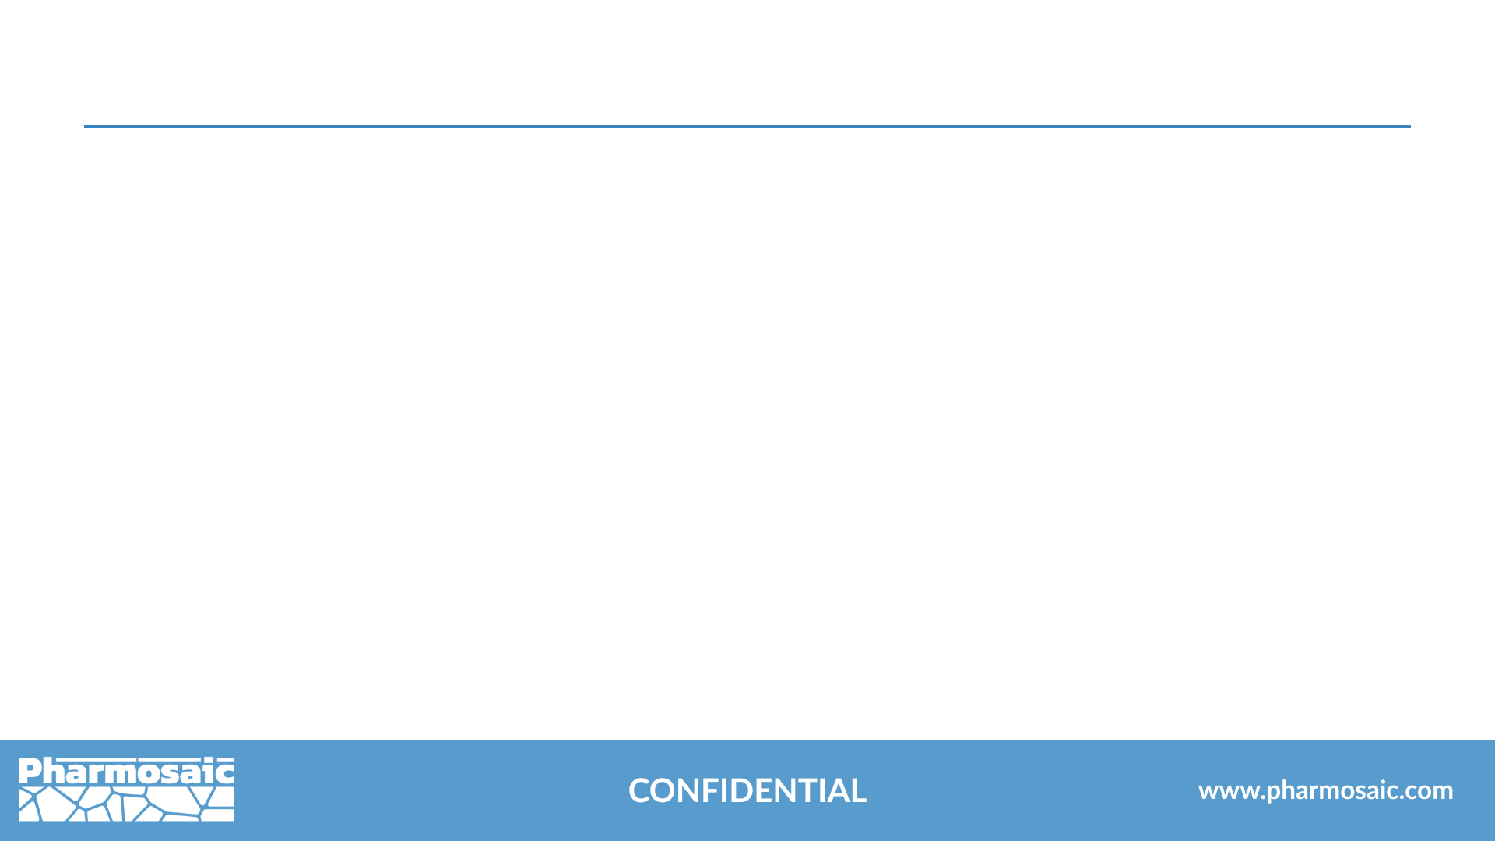
Pharmosaic Consulting
Services Offered
Drug Substance Developability
Formulation of Small Molecules, Biologics, & Polymeric Actives
Liquid & Semisolid Drug Product Development
Process Development & Scale-Up
Statistical Analysis & Design of Experiments (DoE)
CMC (Chemistry, Manufacturing, & Controls)
Quality by Design (QbD)
Innovation & Emerging Technologies
Fractional Leadership in Formulation & Pharmaceutical Development

Slide 4

Our Values: A Mosaic of What Matters Most
Vision-Driven
Shaped by Care
We prioritize patients and build partnerships grounded in empathy, transparency, and shared commitment.
Guided by Strategy
We embrace innovation to deliver future-ready solutions that advance development and improve patient outcomes.
Chemistry Core
We blend expertise with proactive risk management for flexible solutions.
Our science drives precise, data-led drug development.

Slide 5
Structure.
Function. Performance.
It all starts with chemistry.

Slide 6

Expert Consulting in Pharmaceutical Development
Active & Dosage Form Development & Integration
Understanding Diverse Actives
Small molecules
Polymers
Biologics
Expertise Across Various Formulations
Injectables
Transdermals
Topical, mucosal & localized delivery systems

Slide 7

Expert Consulting in Pharmaceutical Development
Lead Selection & Preformulation
Identifying the most developable assets to reduce risk and streamline development
Understanding the properties and behavior of the asset to develop control strategies
Investigating behavior in excipients that are appropriate for the intended dosage form, condition, patient population, region, etc

Slide 8
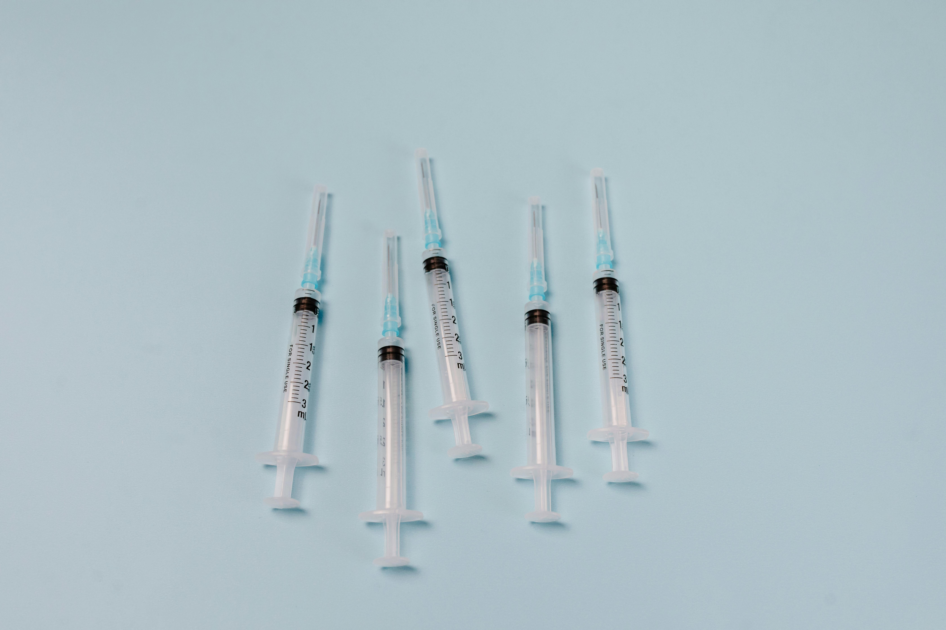
Expert Consulting in Pharmaceutical Development
Formulation Development & Scale-Up
Using preformulation studies to inform complex dosage form development and manufacturing
Determination of what is possible, building complexity as needed—simplicity first
In-depth technical knowledge of excipients and manufacturing requirements
Developing scalable processes at early stages
Informing later control and risk mitigation strategies

Slide 9

Expert Consulting in Pharmaceutical Development
Quality by Design (QbD) & Chemistry, Manufacturing, and Controls (CMC)
Defining the Target Product Profile
Developing risk mitigation and control strategies
Establishing specifications (CQAs) through CPP identification and performance testing (IVPT)
Exploring the design space using DoE
Authoring and reviewing critical documentation

Slide 10
Grounded in chemistry.
Guided by strategy.
Measured in outcomes.
We move your development program forward.

Slide 11

Expert Consulting in Pharmaceutical Development
Leadership & Program Support
Fractional leadership
Support for R&D challenges
Strategic oversight
Technical advising
Knowledge & experience

Slide 12

Expert Consulting in Pharmaceutical Development
Innovation & Technology
Solving unmet patient needs
Advancing disruptive drug delivery
Exploring novel therapeutic modalities
Designing innovative formulation strategies
Accelerating emerging technologies

Slide 13
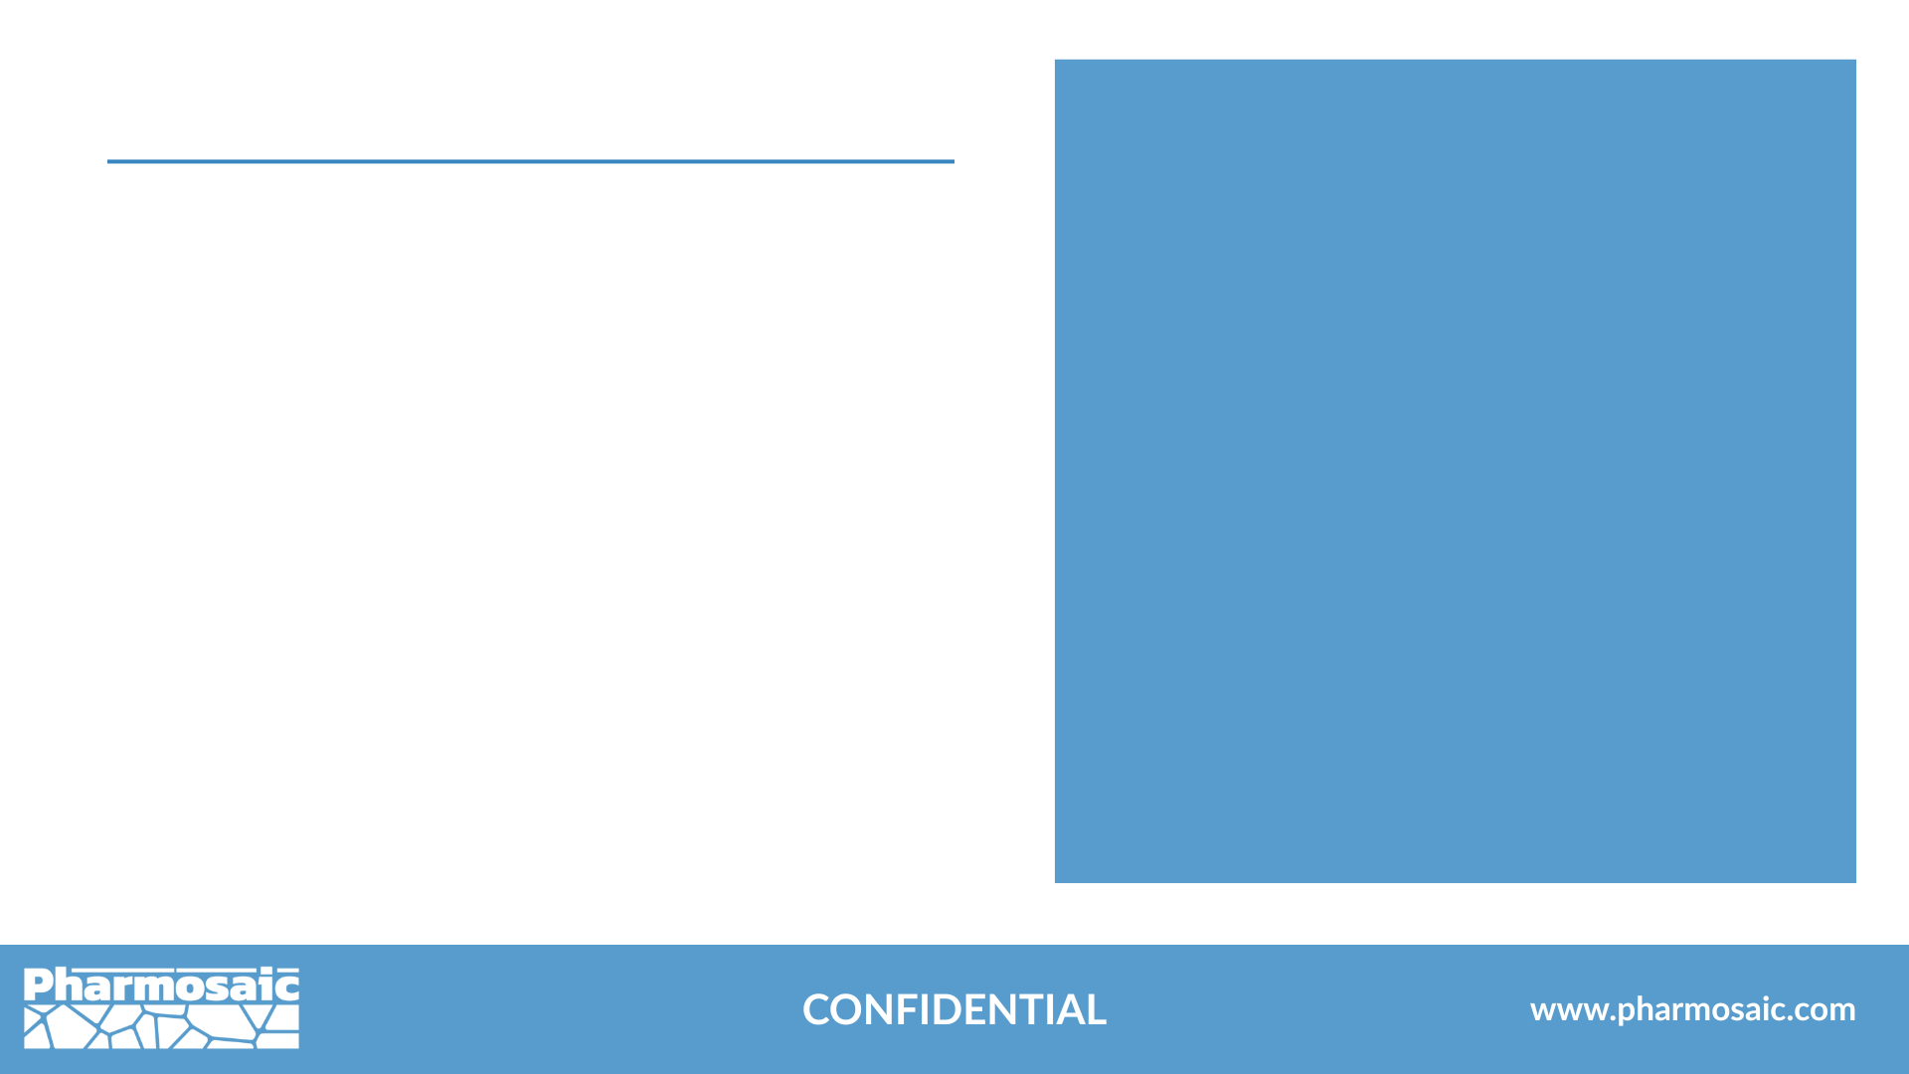
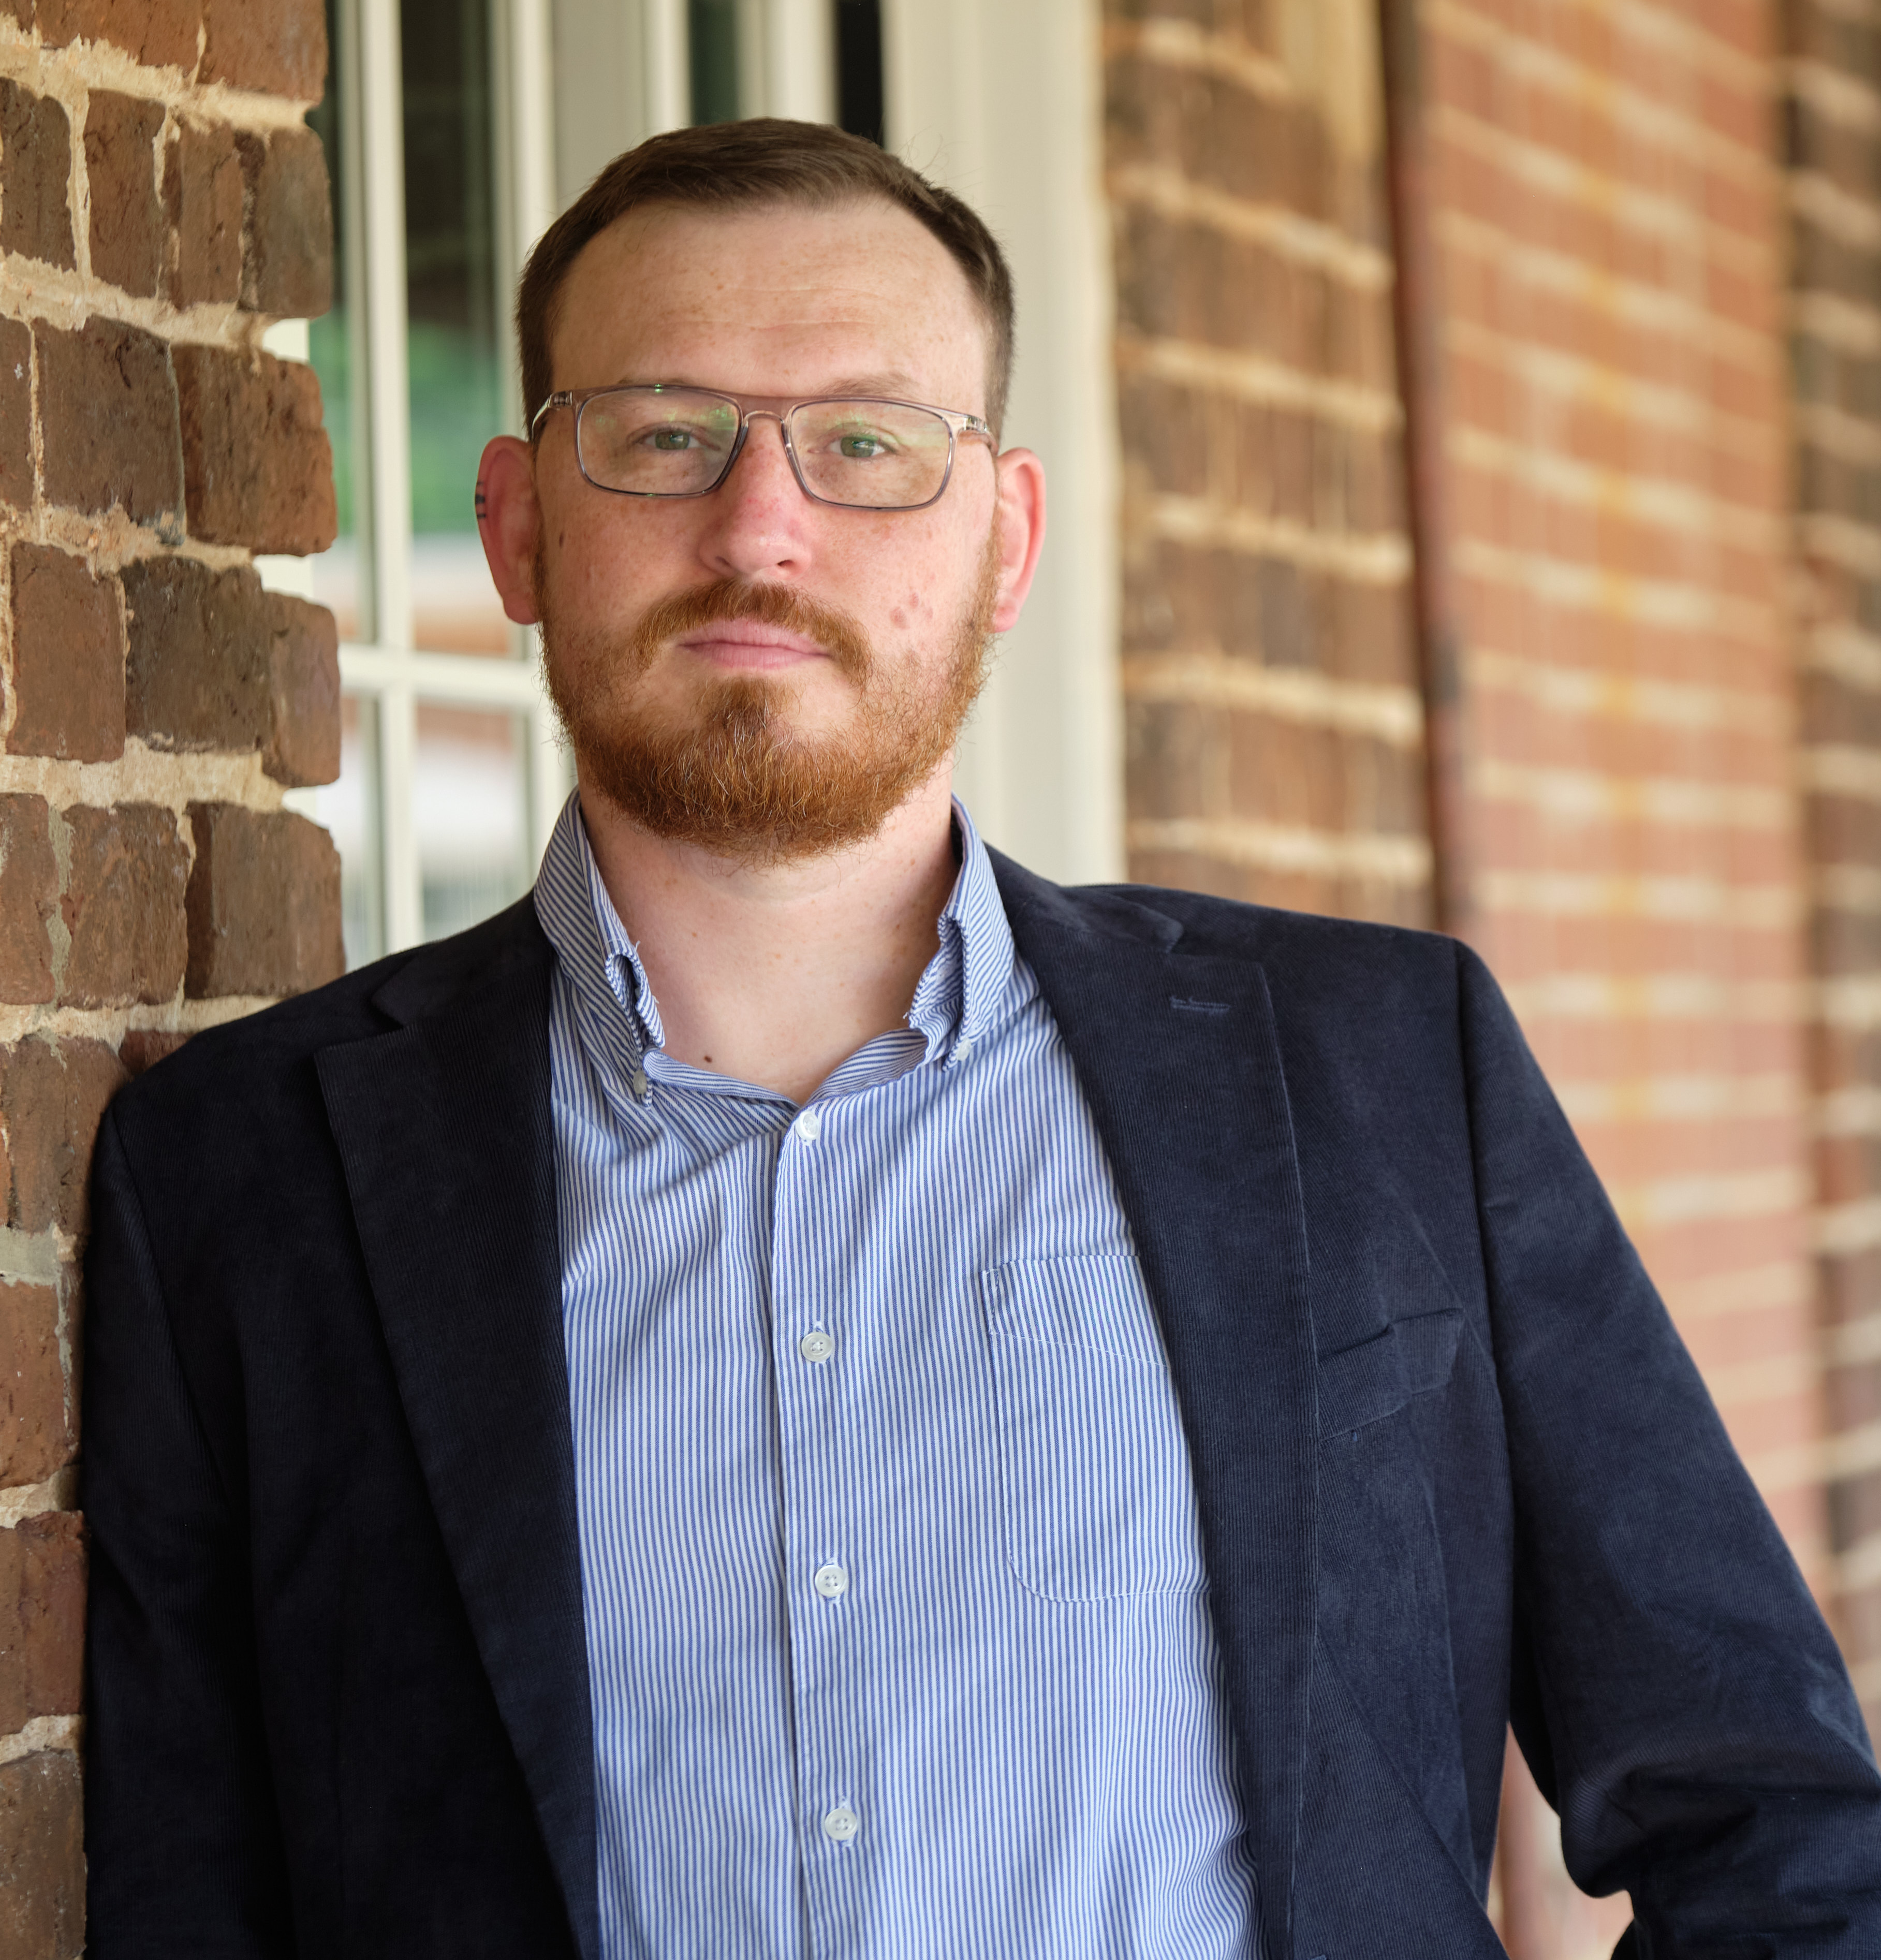


Michael Quinn Doherty
Founder & Principal Consultant
Pharmosaic Consulting™ LLC
20+ years in drug substance & product development
Leadership roles at CDMOs & pharma companies
Expertise in biologic and small molecule development
Strong foundation in chemistry
Commitment to scientific rigor
Innovator of topical, injectable and controlled-release delivery systems
Delivers evidence-based, data-driven solutions
mdoherty@pharmosaic.com ​
​
linkedin.com/in/michaelquinndoherty

Slide 14
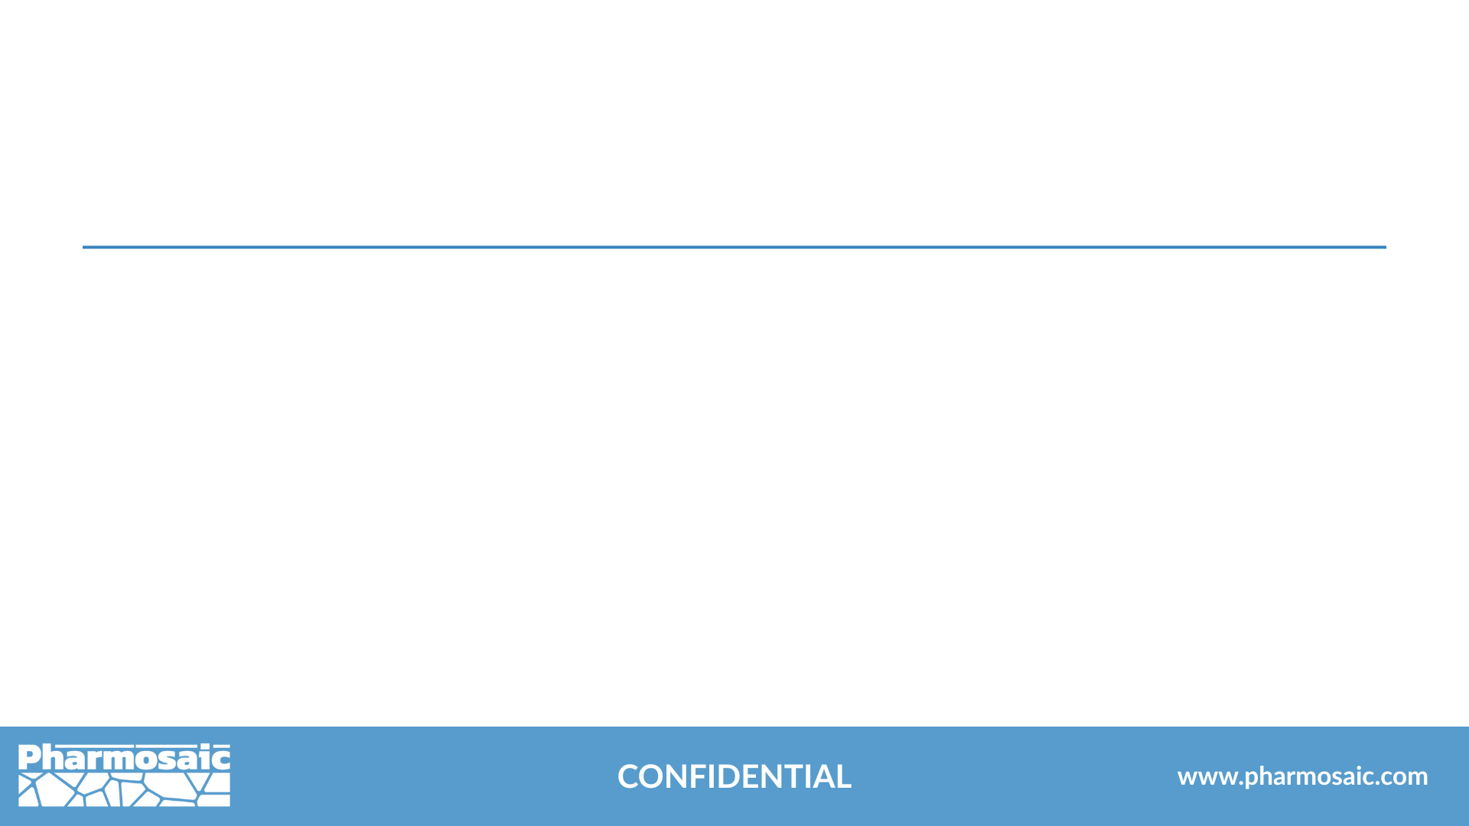

Connect With Pharmosaic
www.pharmosaic.com
linkedin.com/company/pharmosaic-consulting
mdoherty@pharmosaic.com
We take your development program further—with sharp strategy, efficient execution, and measurable impact.

Slide 15
Transforming Data into Clear Insight.
Advancing step by step, together.

Slide 16
Thank You
Presented by Michael Doherty
Founder & Principal Consultant, Pharmosaic Consulting™ LLC

Slide 17
Pharmosaic Consulting™ LLC
Services Offered
Drug Substance Developability
Formulation of Small Molecules, Biologics, & Polymeric Actives
Liquid & Semisolid Drug Product Development
Process Development & Scale-Up
Statistical Analysis & Design of Experiments (DoE)
CMC (Chemistry, Manufacturing, & Controls)
Quality by Design (QbD)
Innovation & Emerging Technologies
Fractional Leadership in Formulation & Pharmaceutical Development

Slide 18
Our Values: A Mosaic of What Matters Most
Vision-Driven
Shaped by Care
We prioritize patients and build partnerships grounded in empathy, transparency, and shared commitment.
Guided by Strategy
We embrace innovation to deliver future-ready solutions that advance development and improve patient outcomes.
Chemistry Core
We blend expertise with proactive risk management for flexible solutions.
Our science drives precise, data-led drug development.

