Slide 1

Expertise That Sticks
Pharmosaic Consulting™ LLC Email Deck
Presented by Michael Quinn Doherty
Founder & Principal Consultant, Pharmosaic Consulting
Confidential | www.Pharmosaic.com

Slide 2
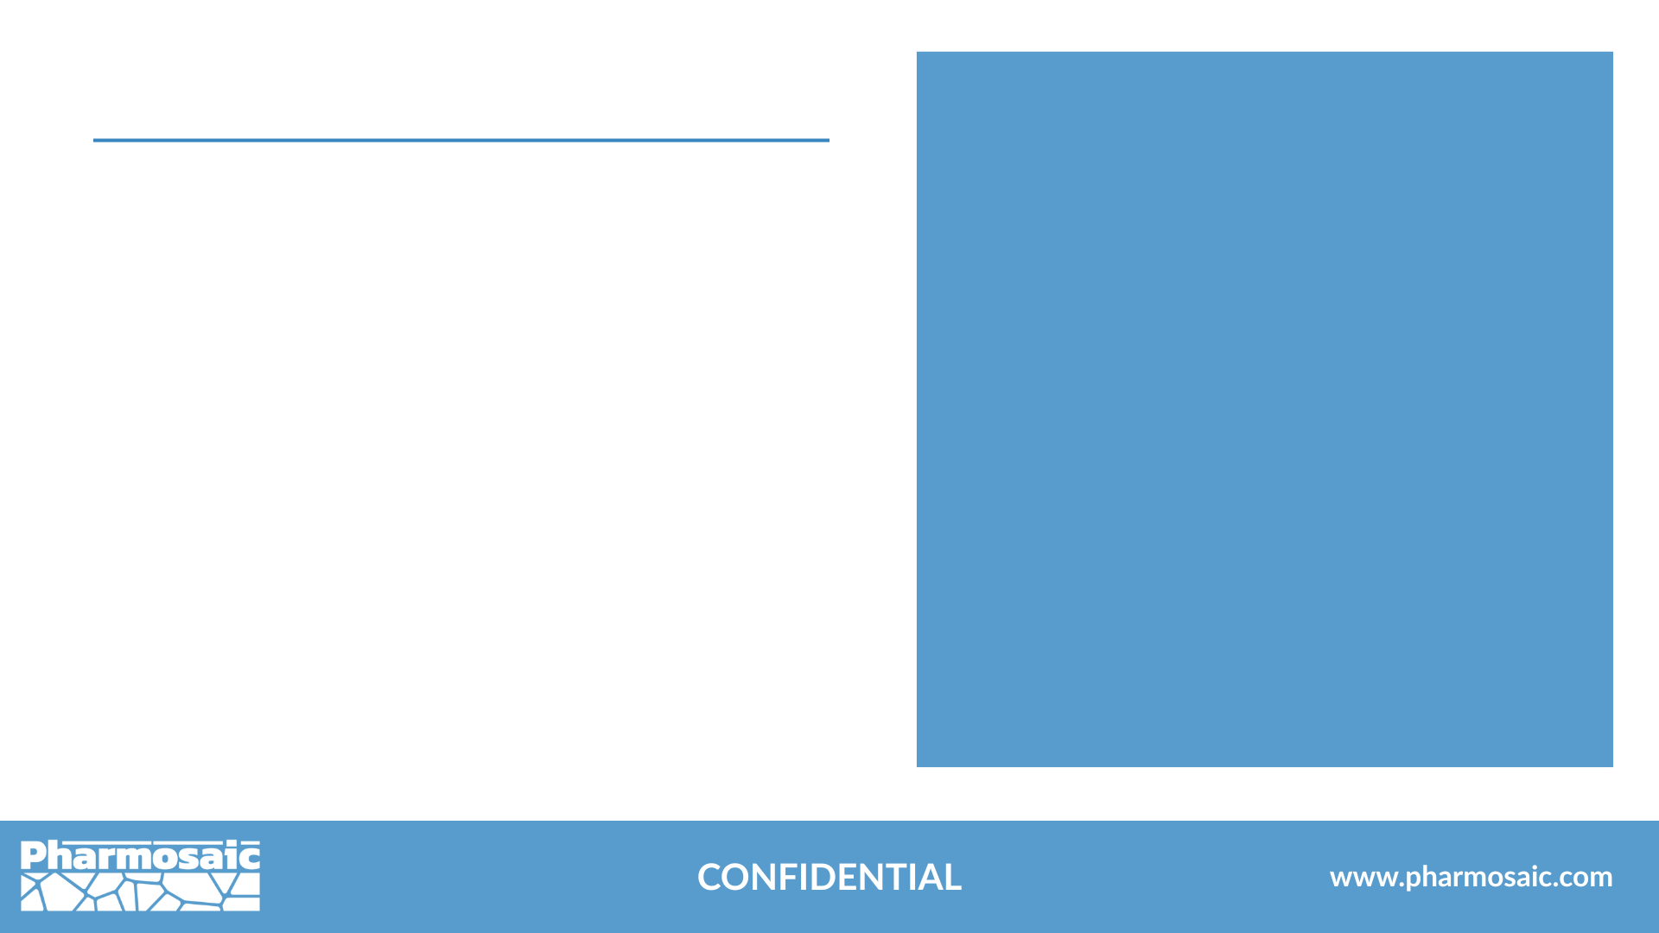

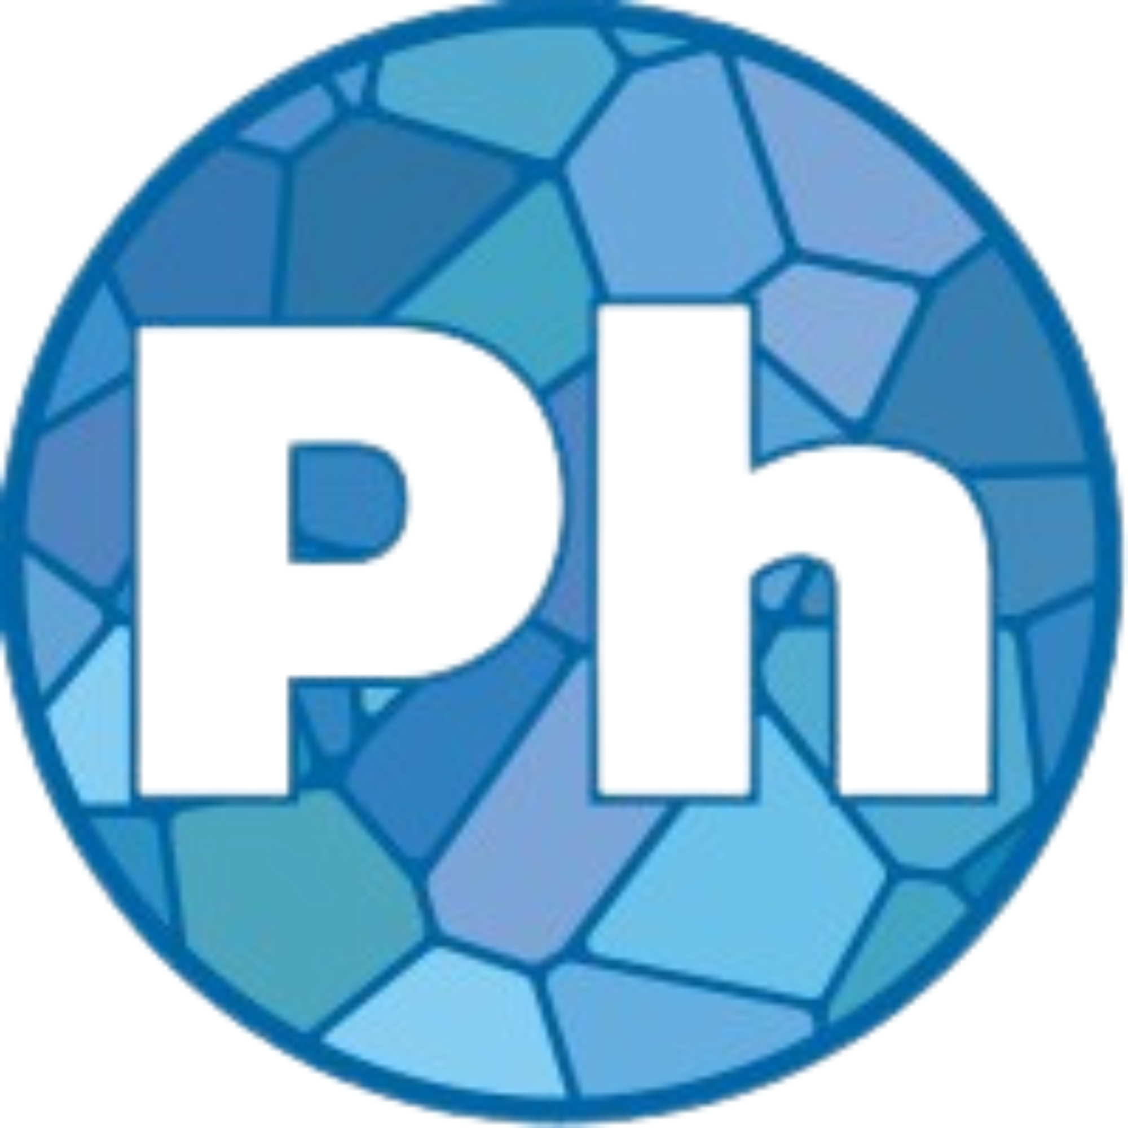

About Pharmosaic
Founded in 2024, Pharmosic Consulting was created to meet the rising need for specialized guidance in liquid and semisolid drug development.
Our work is rooted in the conviction that meaningful progress begins with a deep understanding of fundamental science and that quality can be built into these impactful therapies to minimize risk and meet patient demands.
By combining that foundation with robust statistical methodologies and decades of biopharmaceutical development experience, we help teams make insightful data-driven decisions that move developmental programs forward with confidence, clarity and speed.
www.Pharmosaic.com
​
linkedin.com/company/pharmosaic-consulting

Slide 3
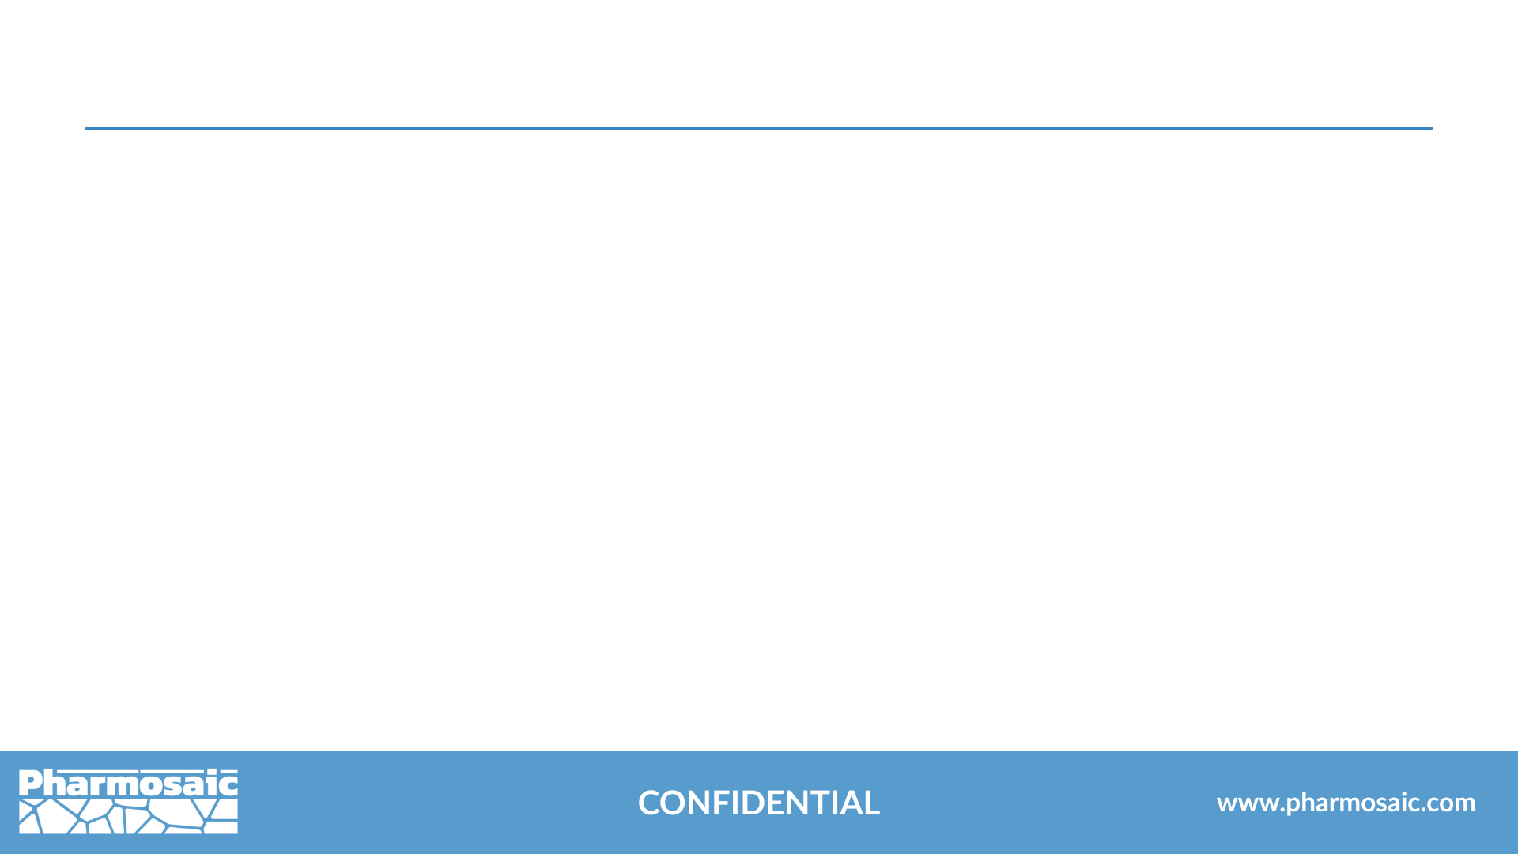

Our Values: A Mosaic of What Matters Most
Vision-Driven
Shaped by Care
We prioritize patients and build partnerships grounded in empathy, transparency, and shared commitment.
Guided by Strategy
We embrace innovation to deliver future-ready solutions that advance development and improve patient outcomes.
Chemistry Core
We blend expertise with proactive risk management for flexible solutions.
Our science drives precise, data-led drug development.

Slide 4

Grounded in chemistry.
Guided by strategy.
Measured in outcomes.
We move your development program forward.

Slide 5

Overview of Services
Drug Substance Developability
Liquid & Semisolid Drug Product Development
Formulation of Small Molecules, Biologics, & Polymeric Actives
Process Development & Scale-Up
Statistical Analysis & Design of Experiments (DoE)
CMC (Chemistry, Manufacturing, & Controls)
Quality by Design (QbD)
Innovation & Emerging Technologies
Fractional Leadership in Formulation & Pharmaceutical Development

Slide 6
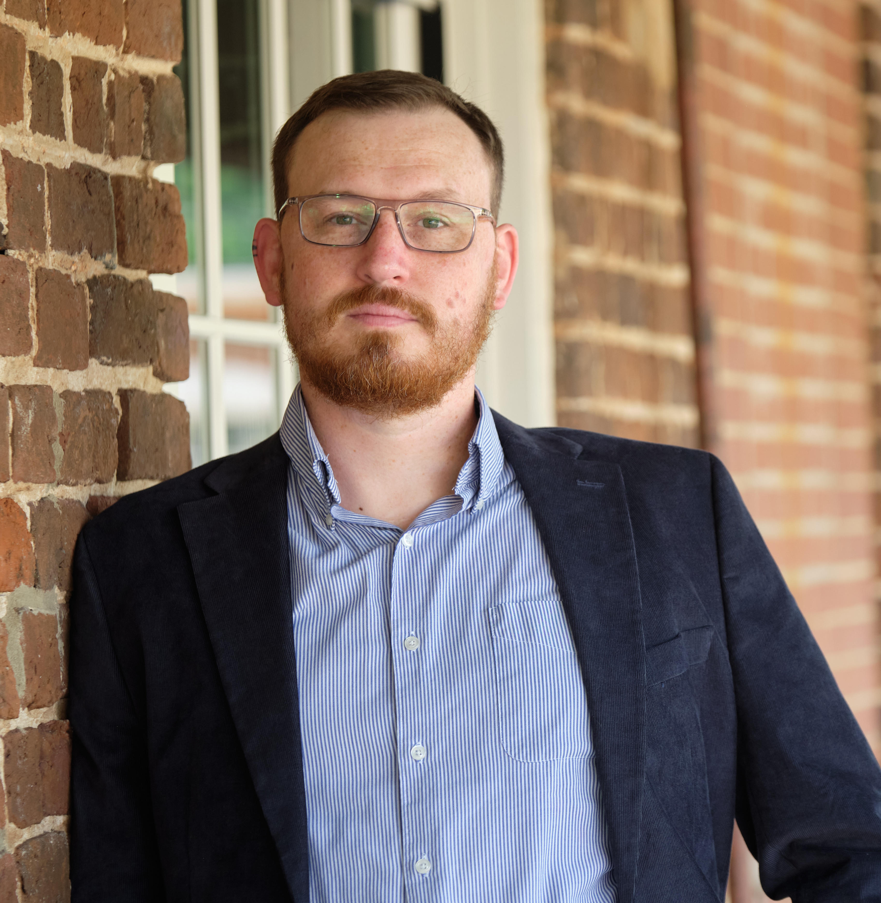

Michael Quinn Doherty
Founder & Principal Consultant
Pharmosaic Consulting™ LLC
With over 20 years of experience spanning drug substance, drug delivery, and product development, Michael brings deep expertise and sharp perspective to every project.
He has held leadership roles at both CDMOs and pharmaceutical companies, advancing high-concentration biologic delivery, pioneering topical formulas, and driving innovation in controlled-release technologies.
With a foundation in chemistry and a commitment to scientific rigor, he consistently delivers innovative, evidence-based solutions to the industry’s toughest pharmaceutical challenges.
mdoherty@pharmosaic.com ​
​
linkedin.com/in/michaelquinndoherty

Slide 7
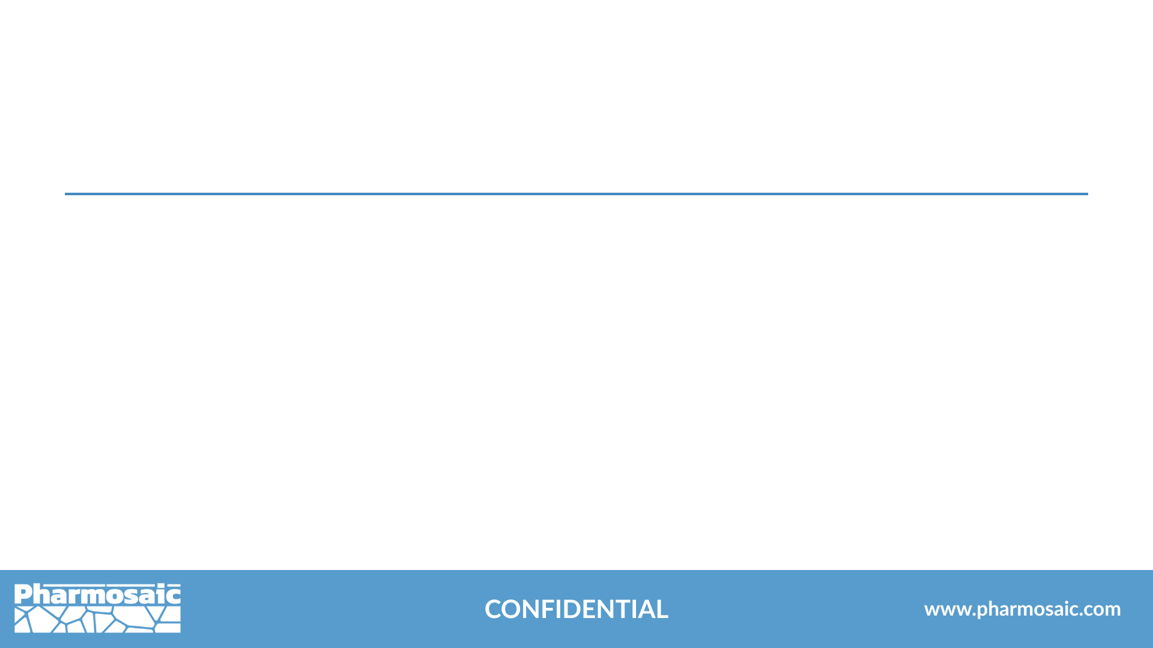
Connect With Pharmosaic
www.pharmosaic.com
linkedin.com/company/pharmosaic-consulting
mdoherty@pharmosaic.com
We take your development program further—with sharp strategy, efficient execution, and measurable impact.

Slide 8
Formulation Expertise that Delivers.
Solving complex pharmaceutical challenges with precision.

Slide 9

Thank You
Presented by Michael Doherty
Founder & Principal Consultant, Pharmosaic Consulting™ LLC

Slide 10
Our Values: A Mosaic of What Matters Most
Vision-Driven
Shaped by Care
We prioritize patients and build partnerships grounded in empathy, transparency, and shared commitment.
Guided by Strategy
We embrace innovation to deliver future-ready solutions that advance development and improve patient outcomes.
Chemistry Core
We blend expertise with proactive risk management for flexible solutions.
Our science drives precise, data-led drug development.

Slide 11
Rooted in Liquid and Semisolid Development
At Pharmosaic Consulting™, we deliver superior support throughout the pharmaceutical development process, including:
Lead selection of small molecules, biologics, and polymeric actives
Drug product development for liquid and semisolid dosage forms
Formulation Development, Process Development and Scale-Up
Statistical analysis and Design of Experiment (DoE)
Chemistry, Manufacturing, and Controls (CMC) strategy and Quality by Design (QbD)
Fractional leadership, strategic development and accelerating emerging technologies
From early-stage concepts and minimal viable products to late-phase troubleshooting, Pharmosaic brings deep, adaptable expertise to meet the evolving challenges of pharmaceutical R&D and manufacturing.

Slide 12

Expert Consulting in Pharmaceutical Development
Offering strategic and hands-on support across the development lifecycle, with expertise in:
Drug substance lead selection, preformulation, and formulation for liquid and semisolid dosage forms
Comprehensive drug product development for injectable and local delivery systems
Integration of small molecules and biologics into commercially viable dosage forms
Application of advanced technologies to accelerate and enhance drug development

